Slide 1
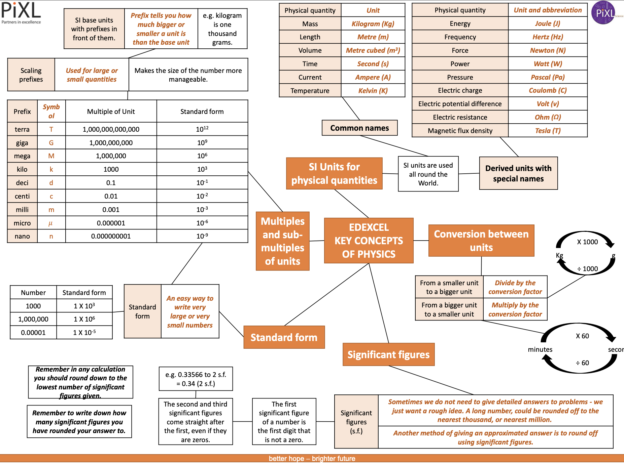
Half Term 1&2

Slide 2
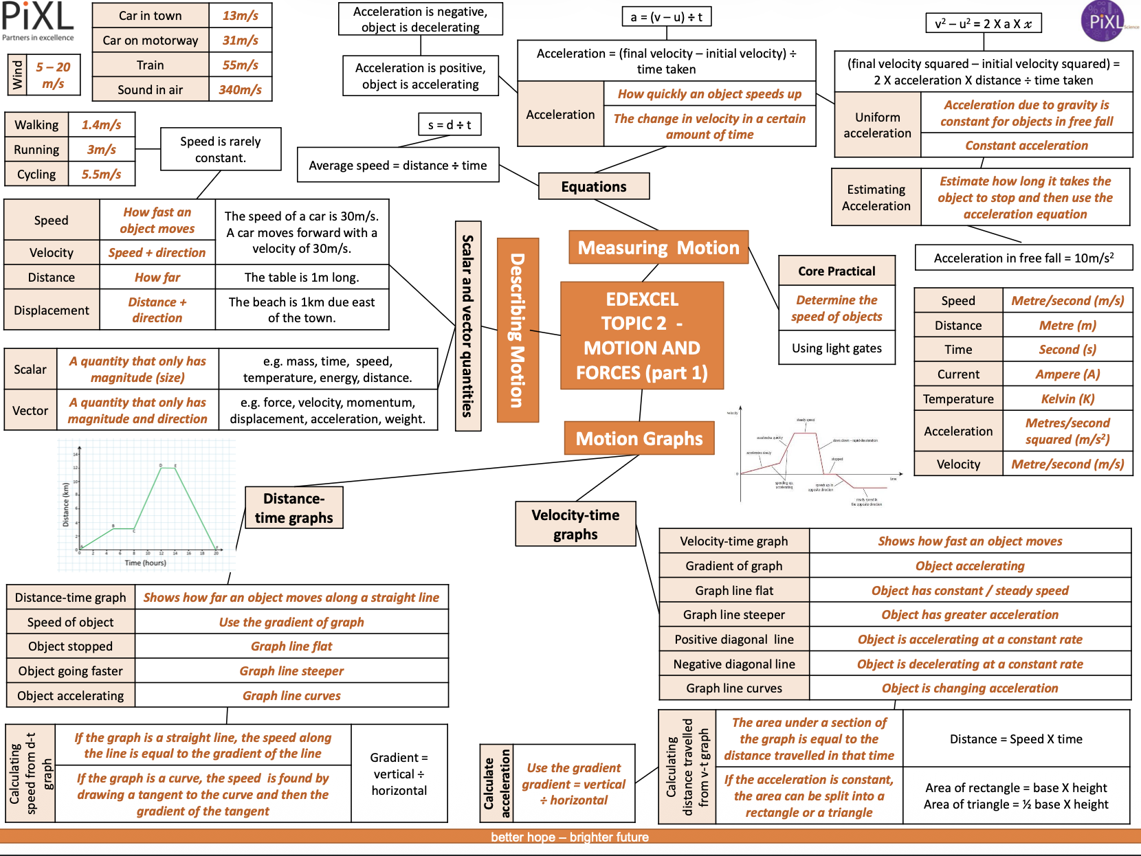
Half Term 1&2

Slide 3
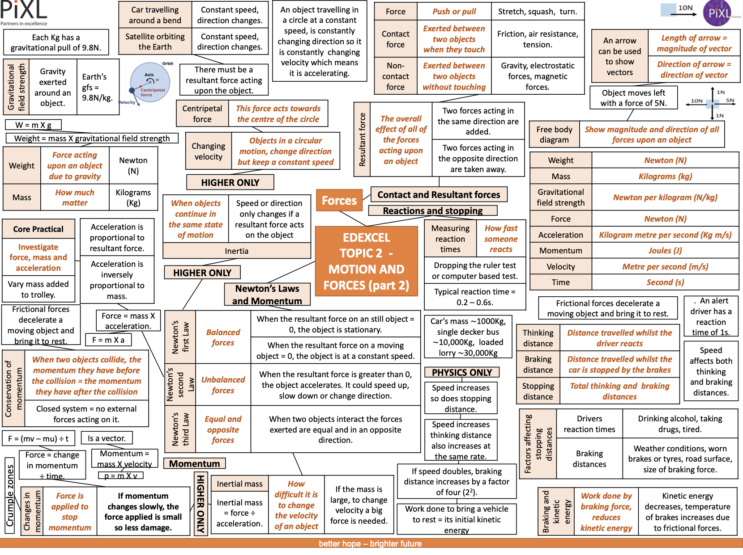
Half Term 1&2

Slide 4
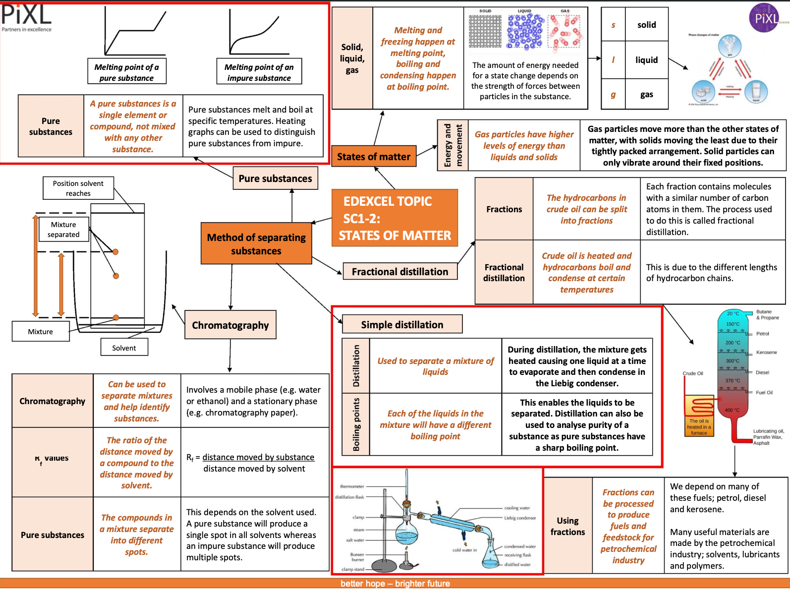
Half Term 1&2

Slide 5
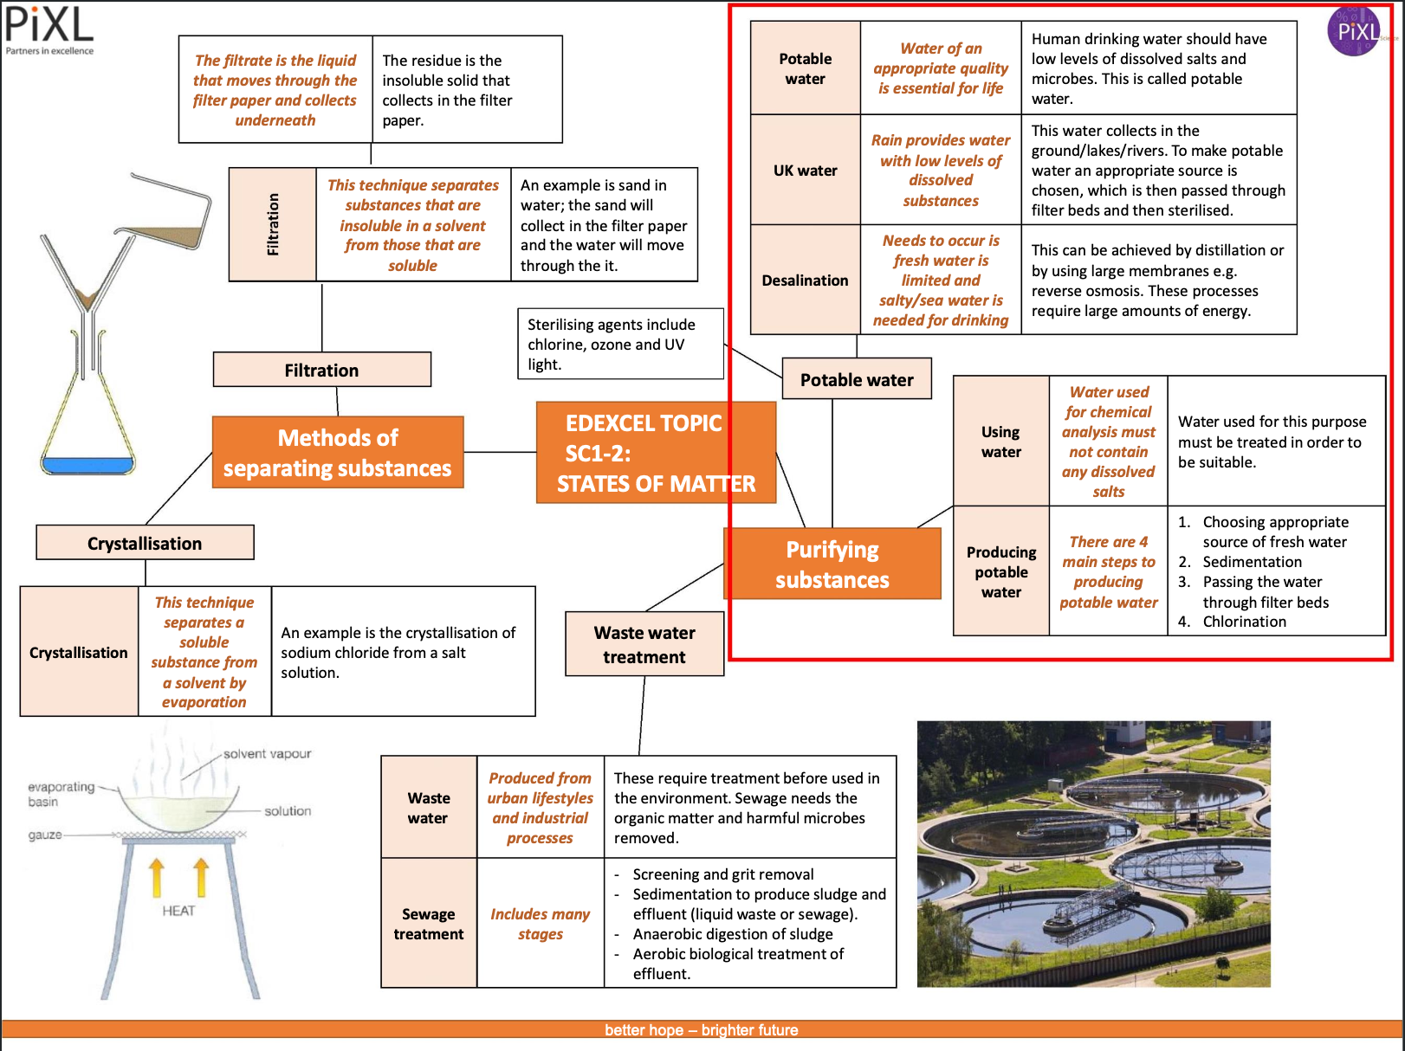
Half Term 1&2

Slide 6
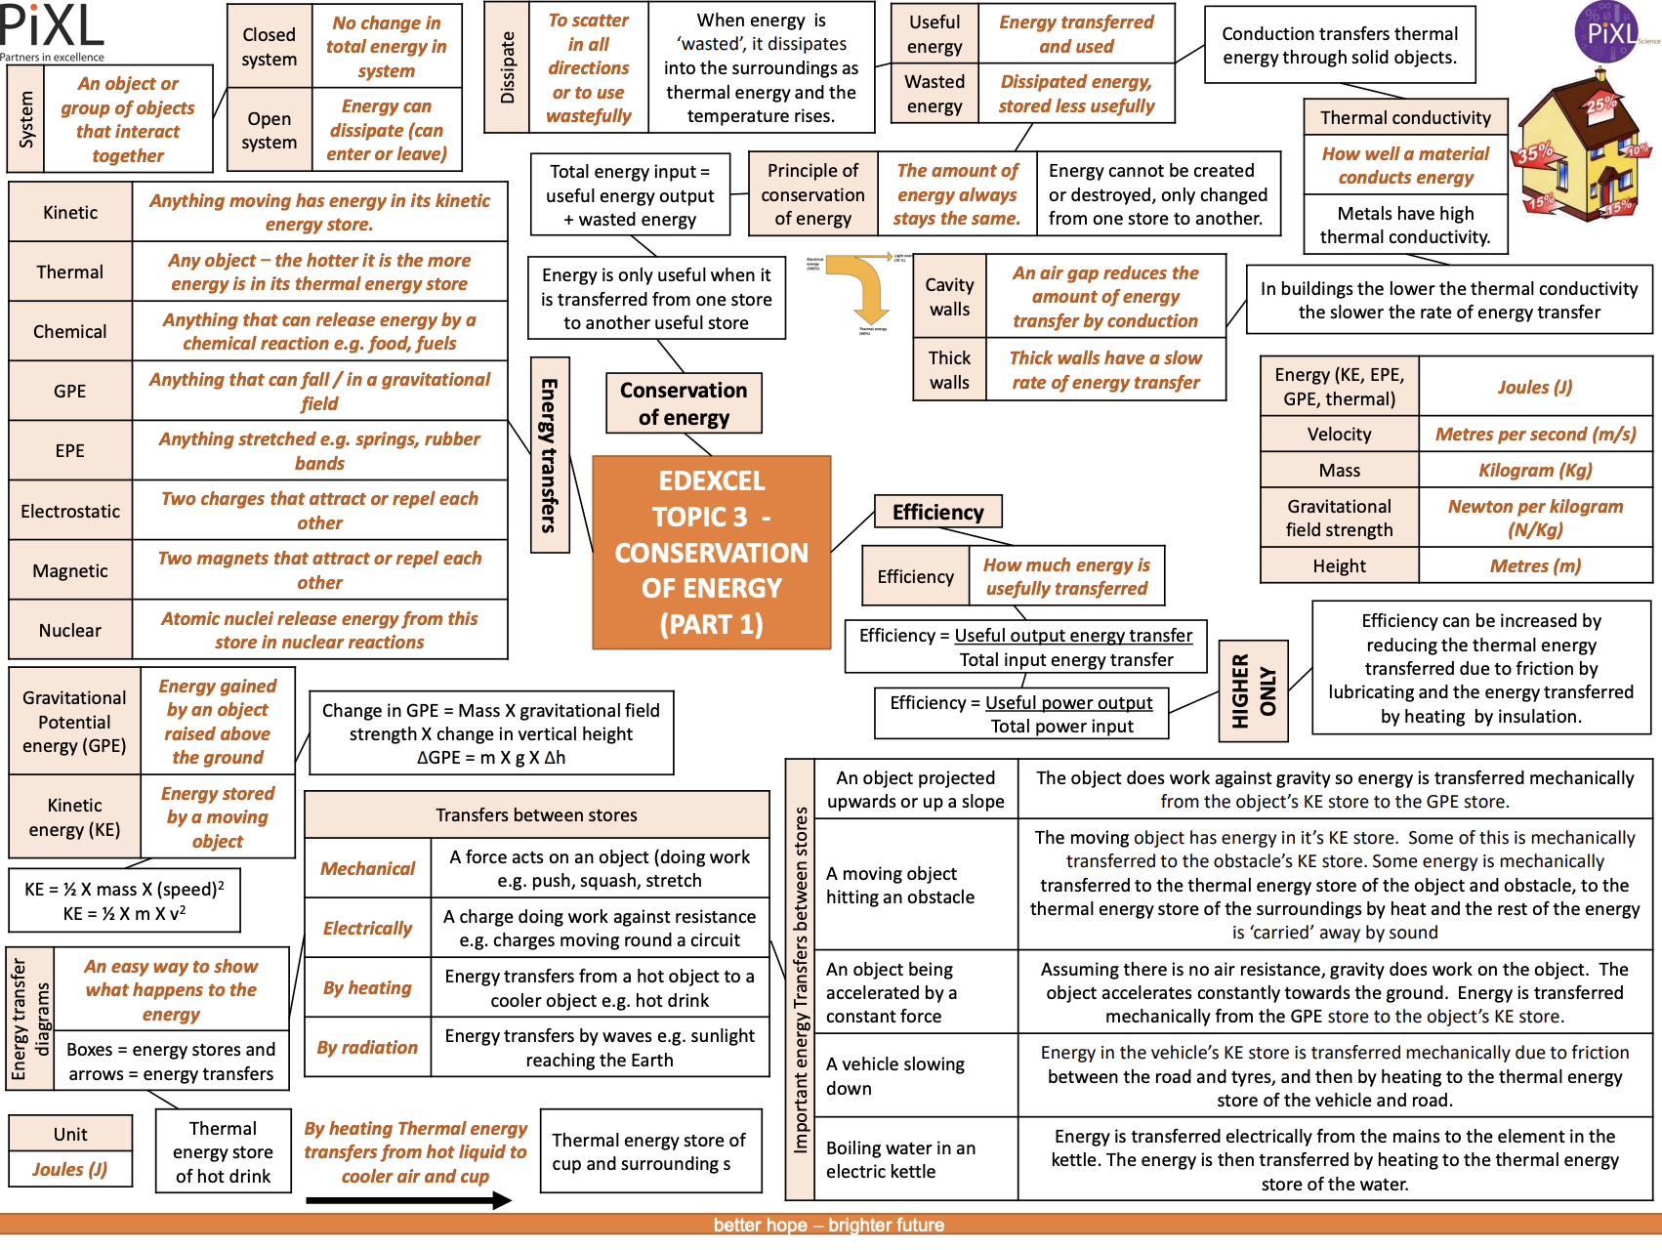
Half Term 3&4

Slide 7
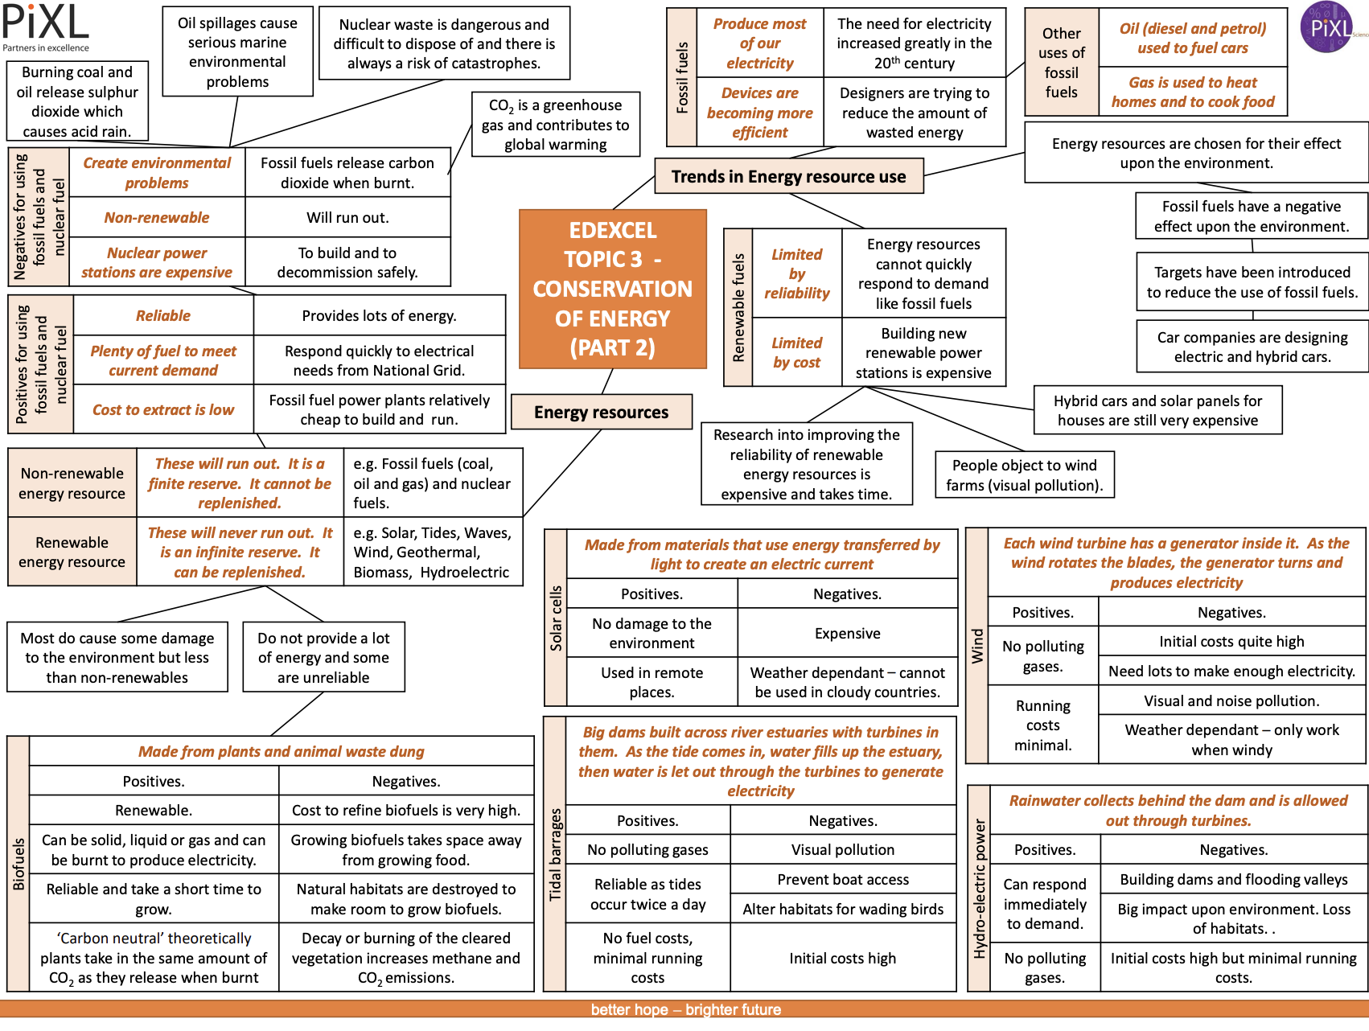
Half Term 3&4

Slide 8
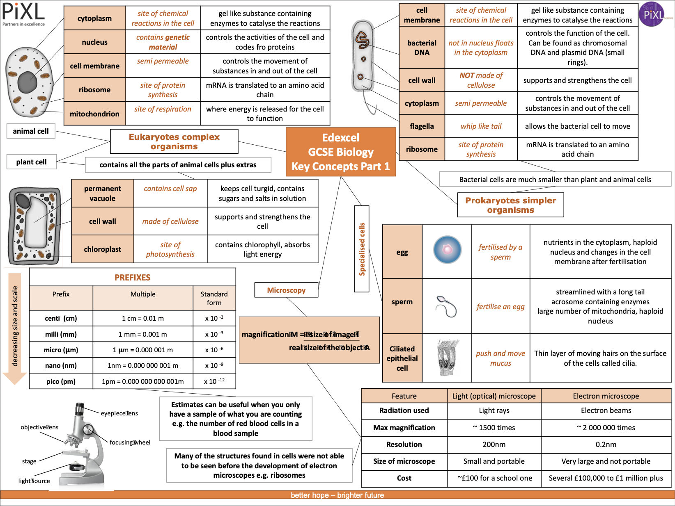
Half Term 3&4

Slide 9
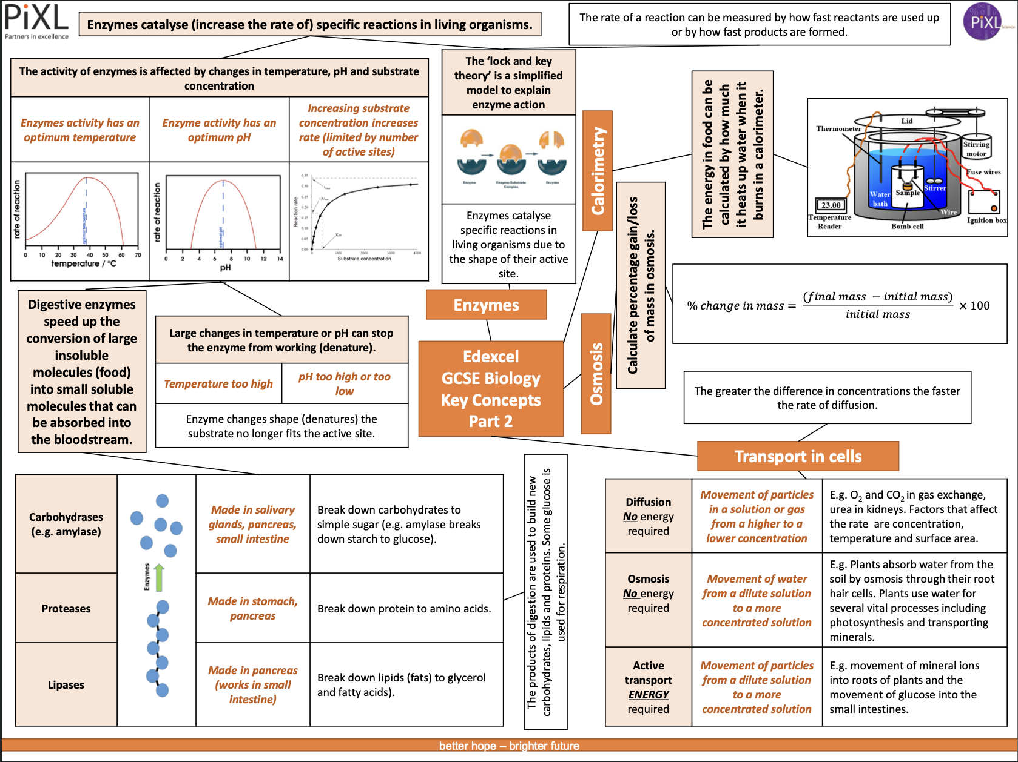
Half Term 3&4

Slide 10
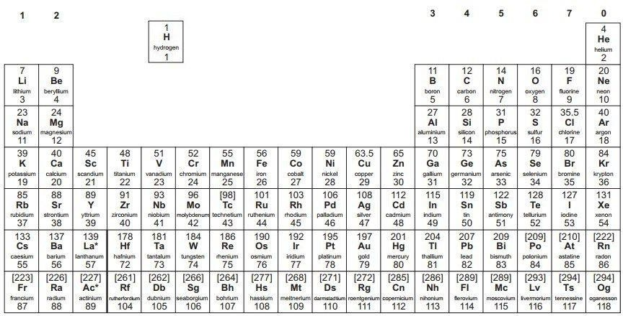
Half Term 5&6

Slide 11
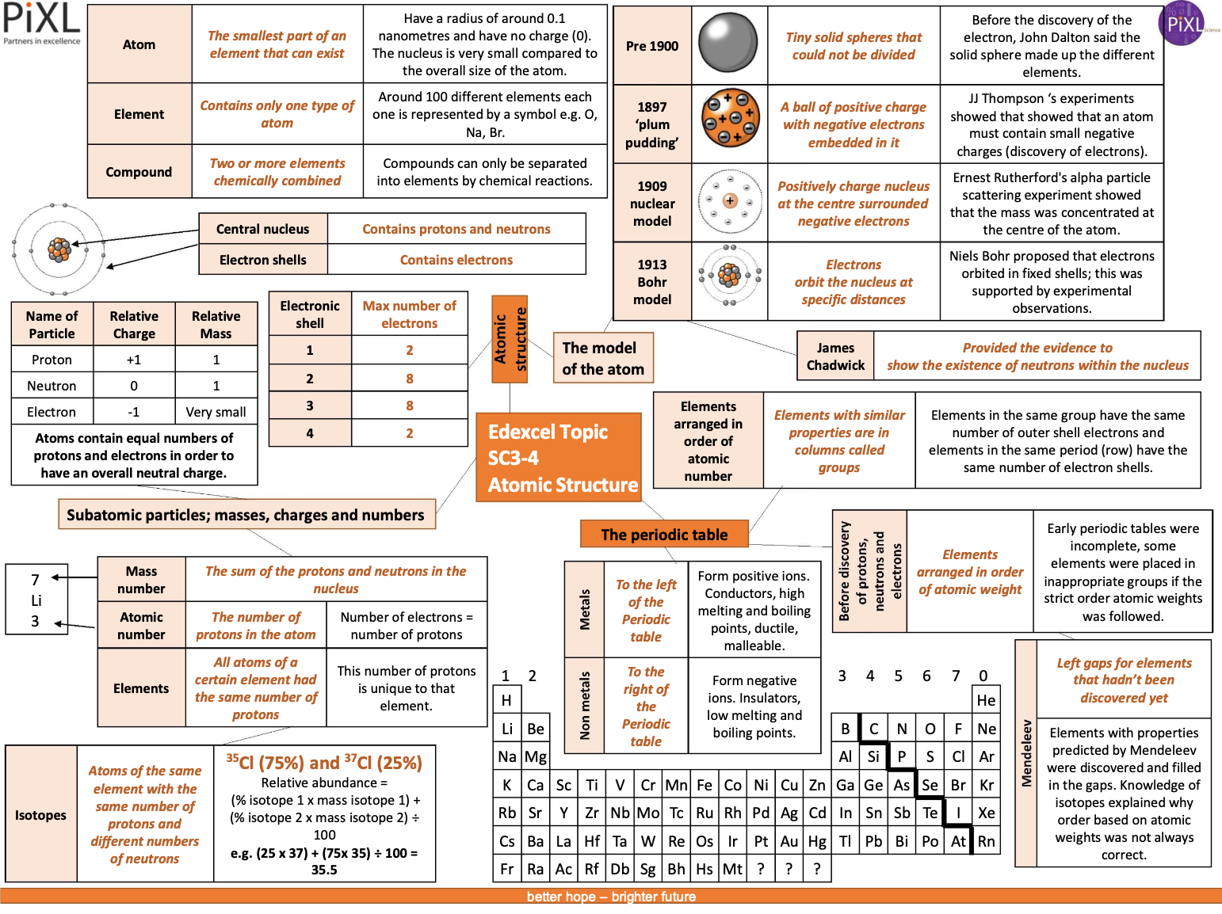
Half Term 5&6

Slide 12
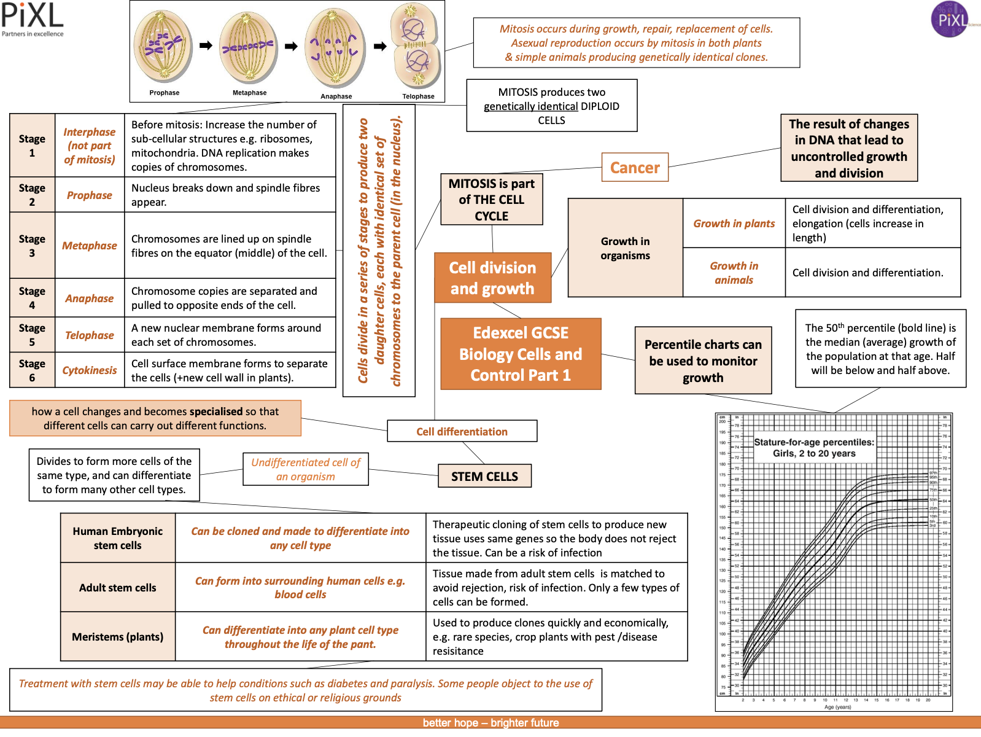
Half Term 5&6

Slide 13
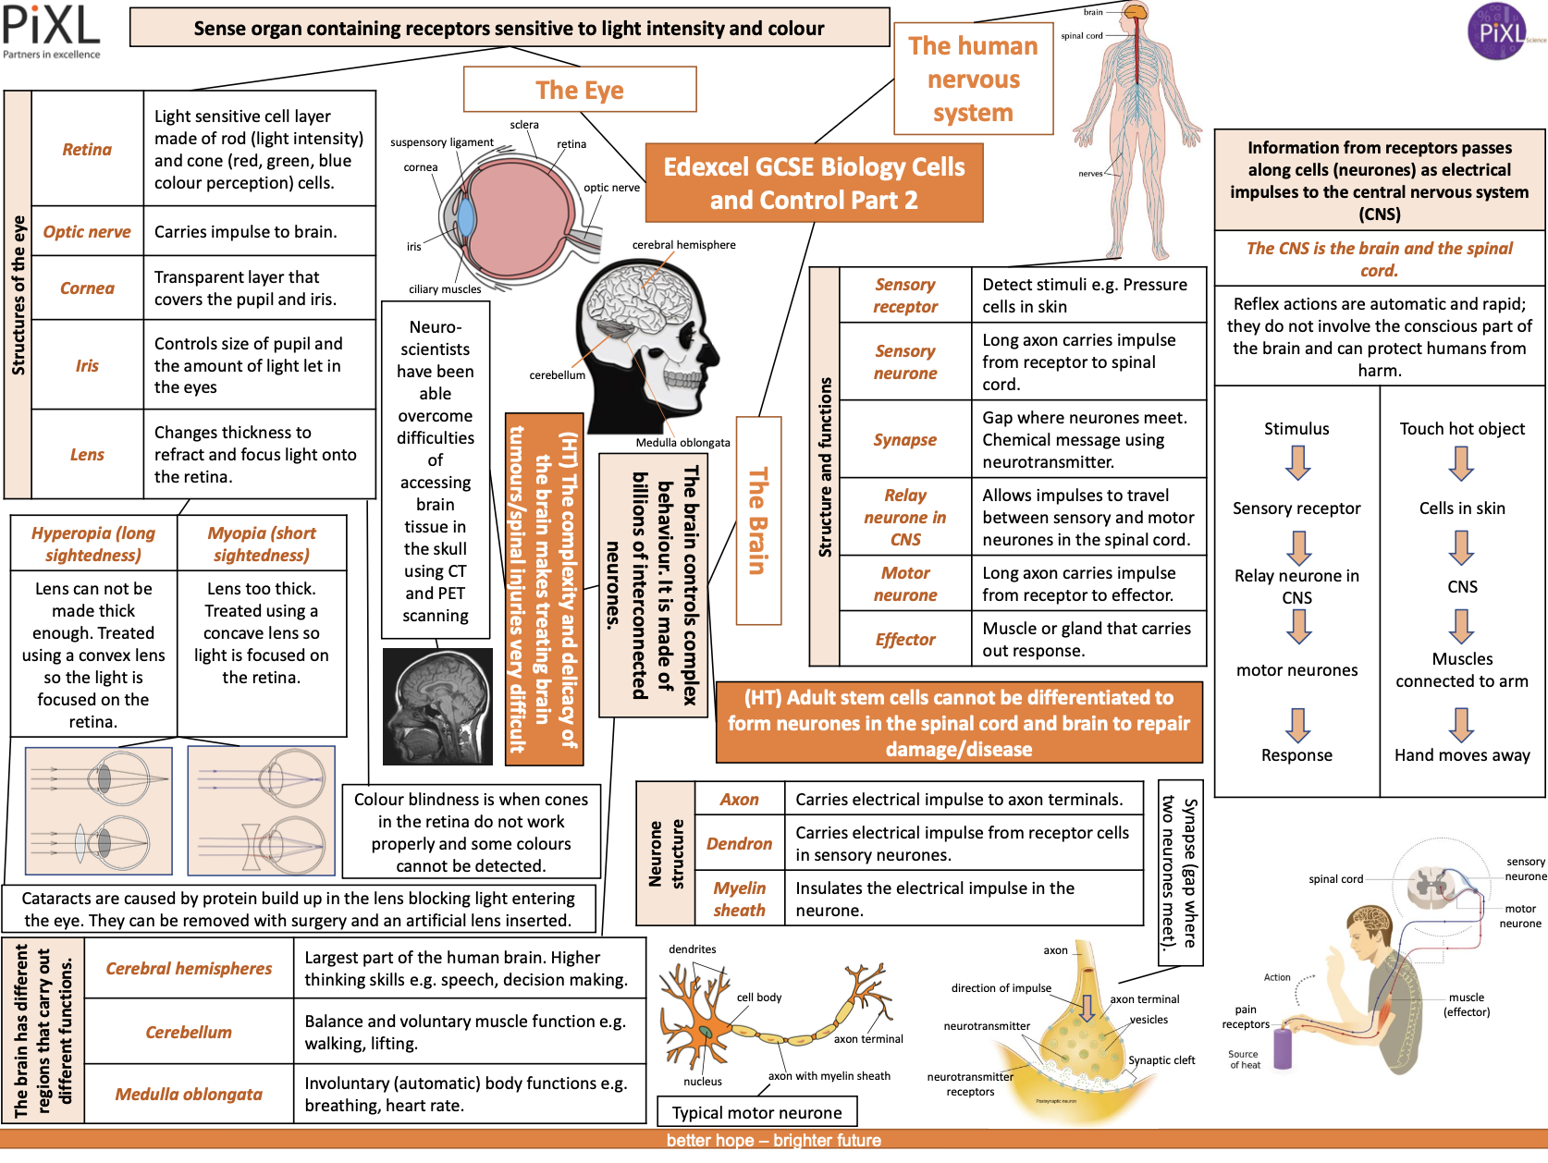
Half Term 5&6

