Slide 1
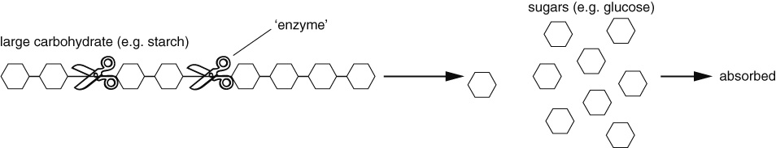
Summary Sheets
8A
HALF TERM 1
Food
We need to eat a wide variety of foods to get all the food substances that we need. When we do this, we are said to have a balanced diet. Carbohydrates, proteins, fats and oils (lipids), vitamins and minerals are nutrients, which means that they provide the raw materials for making other substances that the body needs.
Substance needed | Examples | Why it is needed | Good sources
carbohydrate | starch, sugars | for energy (in respiration) | pasta, bread, rice, potatoes
protein |  | for growth and repair (building new substances) | meat, fish, beans
vitamins | vitamin C | for health | fruits and vegetables (e.g. oranges contain lots of vitamin C)
minerals | calcium | for health | fruits, vegetables and dairy products (e.g. milk contains calcium)
fibre |  | for health (helps to stop constipation) | wholemeal bread, wholegrain rice, celery and other fibrous vegetables
water |  | for health (water dissolves substances and fills up cells)
We can do tests to find out which substances are in foods. For example, starch makes iodine solution go a blue-black colour.
Nutrition information labels on foods tell us what the food contains. The labels also tell us how much energy is stored in the substances that make up the food. The amount of energy is measured in kilojoules (kJ). The amount of energy a person needs in a day depends on:
levels of activity (more active people need more energy)
age (teenagers need more energy from food than adults do)
whether the person is a girl or a boy (boys need more energy than girls).
Food labels may also have health claims on them, which use persuasive language.
Eating too much or too little can cause problems. Too much fat may cause heart disease and can make people overweight. Very overweight people are obese.
People starve and become weak if they eat too little. Starvation and obesity are both forms of malnutrition. Other forms include deficiency diseases such as scurvy, which is due to a lack of vitamin C.
Digestion
Digestion turns large insoluble substances into small soluble ones. The organs of the digestive system help us digest food. Many of them produce enzymes (substances that are catalysts and help speed up food digestion).
We can use a model to make it easier to think about how enzymes work:
15
Page 1 of 2

Slide 2
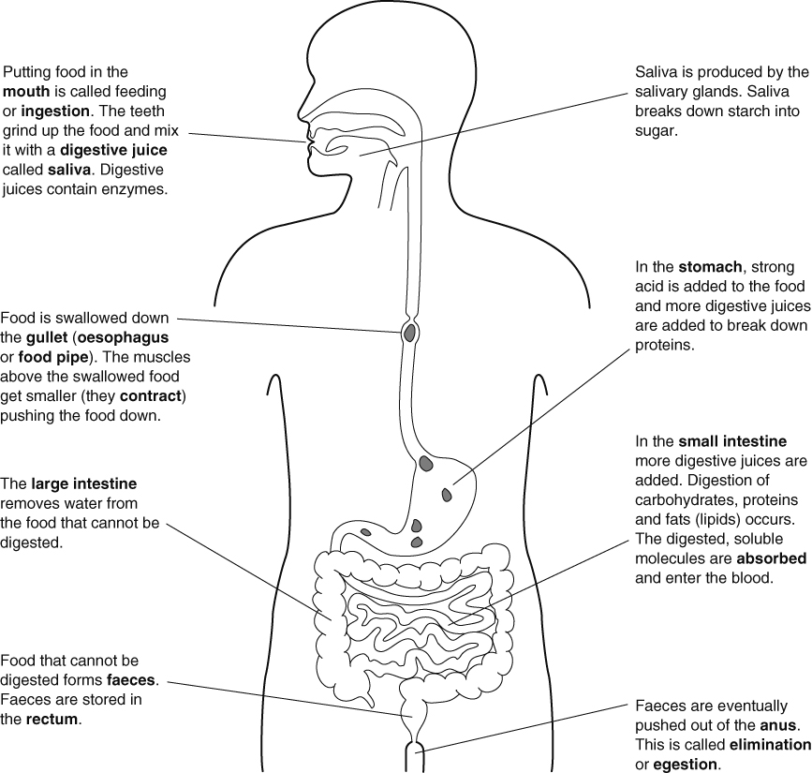
8A
HALF TERM 1
Summary Sheets
The gut
Food is digested in the gut.
To help absorb the digested food, the wall of the small intestine is folded and covered with villi. The cells have microvilli. These features all increase the surface area. The wall of the small intestine is also only one-cell thick, meaning that it is easy for small molecules to diffuse out of the small intestine and into the blood. The digested food molecules are carried in the blood plasma.
The surface area is the total area of the faces of a three-dimensional object.
16
Page 2 of 2

Slide 3
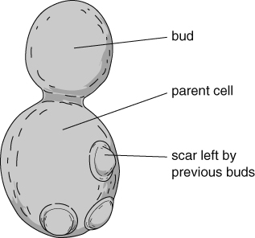
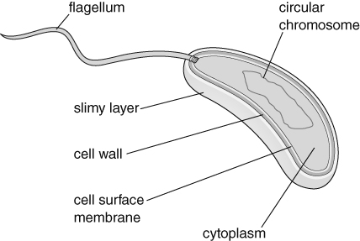
8D
HALF TERM 1
Summary Sheets
Kingdoms
Organisms are classified into five kingdoms. Viruses are not living and so are not in a kingdom.
Cell part | Kingdom
 | prokaryotes (all unicellular) | protoctists (mainly unicellular) | fungi (mainly multicellular) | plants (all multicellular) | animals (all multicellular)
cytoplasm | ✓ | ✓ | ✓ | ✓ | ✓
cell membrane | ✓ | ✓ | ✓ | ✓ | ✓
nucleus | ✗ | ✓ | ✓ | ✓ | ✓
mitochondria | ✗ | ✓ | ✓ | ✓ | ✓
cell wall | ✓ | ✗/✓ | ✓ | ✓ | ✗
chloroplasts | ✗ | ✗/✓ | ✗ | ✓ | ✗
Unicellular organisms can only grow to a certain size. If the organism is too big, it cannot get enough of the substances it needs throughout the cell because diffusion is too slow.
The tissues in multicellular organisms need to have raw materials transported to them because diffusion would be too slow.
Microscopic fungi
These include, for example, yeast. They:
reproduce asexually by budding
can use aerobic respiration, which is important in baking
can use anaerobic respiration (fermentation), which is important in alcoholic drink manufacture.
glucose → carbon dioxide + ethanol (alcohol)
Bacteria
Parts of a bacterium
Some bacteria are important in making yoghurt and cheese. These bacteria use a type of anaerobic respiration to ferment milk:
glucose → lactic acid
Feeding
Bacteria and fungi feed by releasing enzymes into their surroundings to digest large organic molecules. The digested molecules are then absorbed.
Page 1 of 2

Slide 4
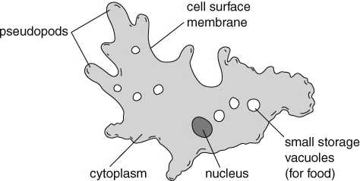
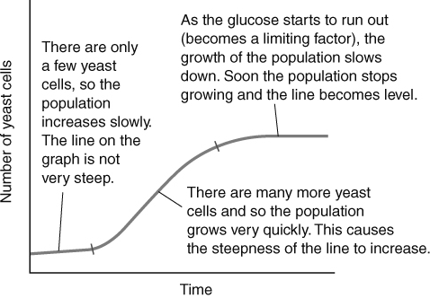
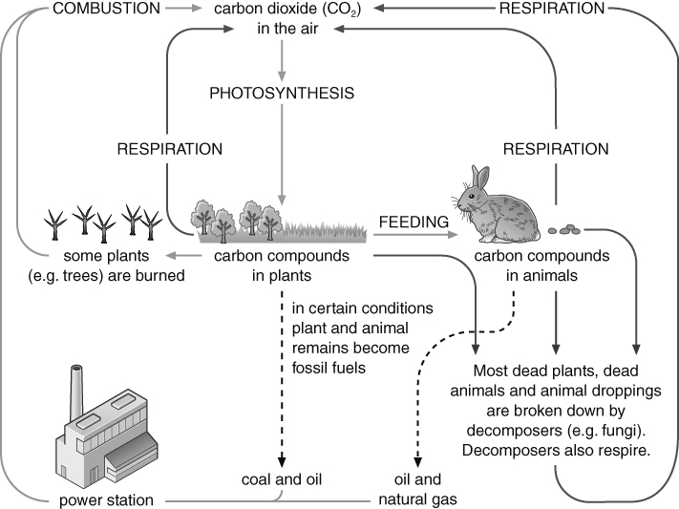
Summary Sheets
8D
HALF TERM 1
Protoctists
There are many different types of protoctist and some can photosynthesise:
carbon dioxide + water → glucose + oxygen Photosynthesising protoctists are therefore producers in a food chain, for example:
algae →
(producer)
pond snail → minnow → grey heron (consumer, herbivore) (consumers, carnivores, predators)
Some protoctists move using pseudopods, while others use cilia and others use flagella.
Parts of an Amoeba
Growth
All microorganisms need warmth, food and moisture to grow well. Some need light for photosynthesis. Some need oxygen for aerobic respiration. The increase in a population can be shown on a growth curve. Something that stops a population from increasing further is called a limiting factor.
The carbon cycle Many unicellular microorganisms are
decomposers and play an important part in the carbon cycle.
15
Page 2 of 2

Slide 5

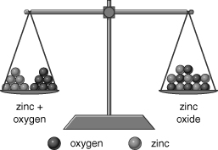
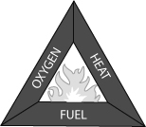



Summary Sheets
8E
Combustion and oxidation
HALF TERM 1
A hydrocarbon is made only of carbon and hydrogen. Many fuels are mainly hydrocarbons.
Hydrocarbon combustion:
hydrocarbon + oxygen → water + carbon dioxide Combustion is also an oxidation reaction because the substances react with oxygen. Carbon and hydrogen are non-metals but metals can also be oxidised:
metal + oxygen → metal oxide
This is a word equation.
Conservation of mass in reactions
In a reaction, the mass of the reactants is always the same as the mass of the products.
Metals can appear to gain mass when heated in air:
zinc + oxygen → zinc oxide
The difference in mass is the mass of oxygen that reacted.
When a hydrocarbon fuel combusts, it appears to lose mass because the products of the reaction (carbon dioxide, water vapour) are lost into the air.
Phlogiston
Before oxygen was discovered, scientists explained combustion by saying that, as a substance burnt, it gave out a substance called phlogiston to the air. For example:
wood → calx (ash) + phlogiston
However, the phlogiston theory could not explain why metals gained mass when they reacted with air.
The fire triangle and putting fires out
The fire triangle shows the three factors needed for a fire to burn. If any factor is removed, the fire will go out.
We use fire extinguishers to put out fires. Water extinguishers remove heat. Powder and carbon dioxide extinguishers exclude oxygen. Foam extinguishers can both remove heat and exclude oxygen.
Oil fires should not be treated with water because the water sinks through the oil, which heats up and causes the water to evaporate. This causes the oil to ‘spit’ and can spread the fire.
Hazard symbols
Hazard symbols explain why a substance must be handled carefully.
Page 1 of 2

Slide 6
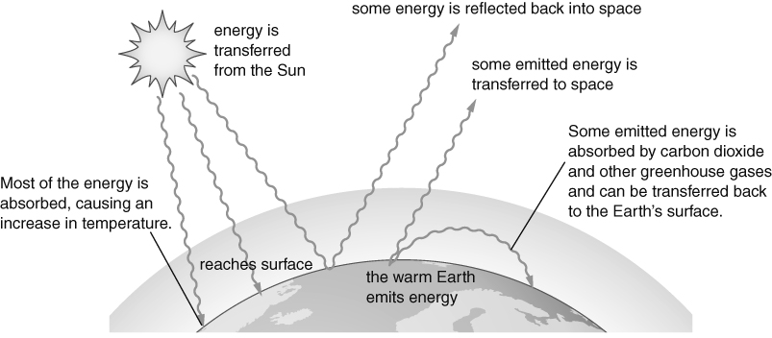
Summary Sheets
8E
HALF TERM 1
Air pollution from burning fossil fuels
Complete combustion – the fuel reacts completely with oxygen, e.g.:
hydrocarbon + oxygen → carbon dioxide + water
Incomplete combustion – the fuel only partly reacts with oxygen, e.g.:
hydrocarbon + oxygen → carbon dioxide + water + carbon monoxide + carbon (soot)
Impurities in fossil fuels, such as substances that contain sulfur, also react with oxygen when heated:
sulfur + oxygen → sulfur dioxide
At the very high temperatures in vehicle engines, nitrogen gas from the air reacts with oxygen:
nitrogen + oxygen → nitrogen oxides
Many products from burning fossil fuels are pollutants; they harm the habitats and their organisms.
Acid rain
Acid rain is rain water that is made more acidic by dissolved sulfur dioxide and nitrogen oxides. Some of these gases are removed from power station chimneys by neutralisation, and by using catalytic converters on vehicle exhausts. Catalytic converters also remove carbon monoxide (another pollutant).
Greenhouse effect and global warming
Greenhouse gases in the Earth’s atmosphere keep the Earth’s surface warm. This is the
greenhouse effect.
Carbon dioxide is a greenhouse gas. Most scientists think that the extra carbon dioxide released from burning fossil fuels has increased the temperature of the Earth’s surface (global warming).
Scientists predict that global warming will cause climate change. The best way to control global warming is probably to reduce the amount of carbon dioxide we release into the air.
15
Page 2 of 2

Slide 7
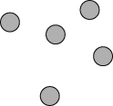
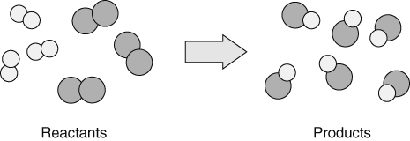
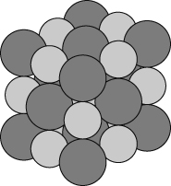
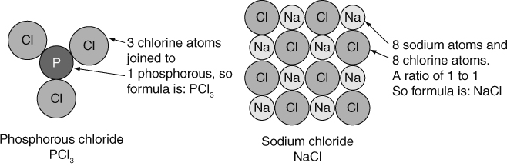
Summary Sheets
8F
Dalton’s atomic theory
Dalton’s theory stated that:
HALF TERM 1
All matter is made up of tiny particles called atoms.
Atoms are indestructible, and cannot be created, or destroyed.
The atoms in an element are all identical.
In compounds, each atom of an element is always joined to a fixed number of atoms of the other elements.
During chemical reactions, atoms rearrange, to make new substances. For example:
Atoms of an element.
No atoms are lost or gained so the mass of the reactants is equal to the mass of the products.
Atoms in a compound.
Word equations
The word equation for the above change is:
hydrogen + chlorine → hydrogen chloride
REACTANTS PRODUCTS
Some signs of a chemical reaction include:
colour change
gas produced
solid formed from solution
energy change.
Elements and their symbols
The symbols for the elements used today have been agreed by scientists in all countries. They are either a single or double letter. The first letter is always a capital letter.
Examples: nitrogen = N sulfur = S chlorine = Cl
lithium = Li copper = Cu iron = Fe
Formulae
The chemical formula of a substance tells you the number of atoms of each element that are joined in its molecules, or the ratio of atoms of each element in the compound.
Page 1 of 3

Slide 8
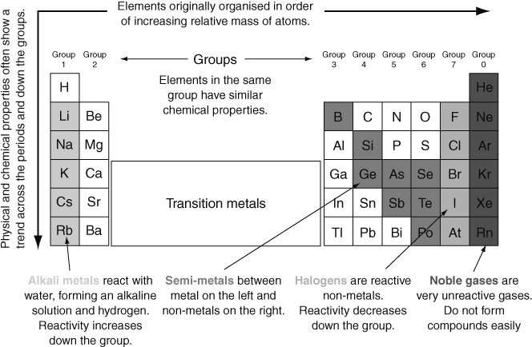
8F
HALF TERM 1
Summary Sheets
Metals and non-metals
The common properties of most metals are:
The common properties of most non-metals are:
high melting points
solids at room temperature
strong and flexible
malleable
shiny (when polished)
good conductors of heat and electricity.
low melting point
brittle(when solid)
not shiny
poor conductors of heat and electricity.
The properties of a substance are what it looks like or what it does. There are two types of properties:
chemical properties (e.g. flammability, pH, reaction with acid)
physical properties (e.g. melting point, boiling point, density).
The periodic table
The periodic table arranges the elements so that elements with similar properties are in the same vertical group. The periodic table also allows us to spot trends and patterns.
Page 2 of 3

Slide 9
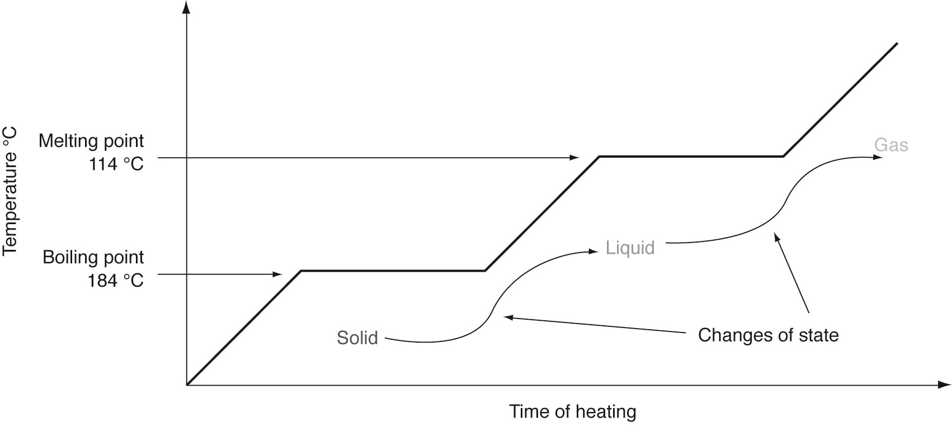
8F
HALF TERM 1
Summary Sheets
Metal and non-metal oxides
Many elements burn in air/oxygen to form oxides; e.g.:
calcium + oxygen → calcium oxide • carbon + oxygen → carbon dioxide
metal oxides tend to form alkaline solutions. • non-metal oxides tend to form acidic solutions.
Changes of state
17
Page 3 of 3

Slide 10
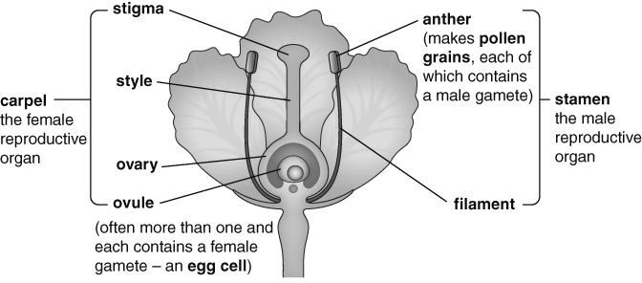
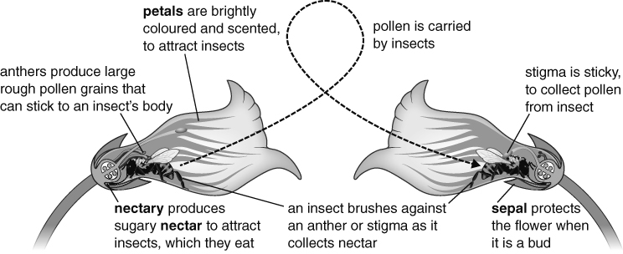
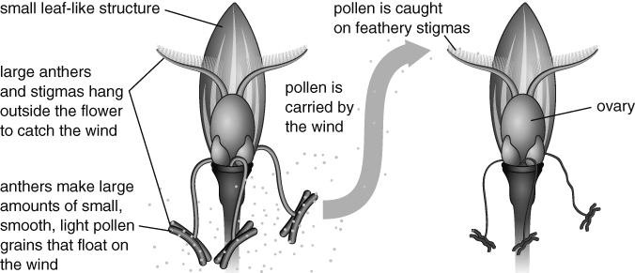
Summary Sheets
8B
HALF TERM 2
The plant kingdom
Organisms are classified into groups. The plant kingdom contains organisms that have green leaves, cell walls made of cellulose and can photosynthesise. Kingdoms are subdivided into smaller and smaller groups. The last two of these are the genus and the species. The names of these two groups are used to give each species a two-word scientific name.
Biodiversity
The range of species in an area is called biodiversity. We should preserve biodiversity because:
organisms depend on one another (they are interdependent)
we won’t be able to make use of organisms if they become extinct
more biodiverse areas recover better from natural disasters.
Sexual reproduction in plants
Reproduction produces new living things (offspring). Sexual reproduction needs two parents to produce sex cells or gametes. The gametes fuse to produce a fertilised egg cell or zygote. The zygote uses cell division to grow into an embryo, which can grow into an adult and become a parent (completing its life cycle).
The offspring from sexual reproduction contain characteristics from both parents. The differences in these characteristics is inherited variation.
Gametes are produced by
reproductive organs.
In plants, these are contained inside flowers.
The pollen grains made in the anther need to be carried to the stigma of another flower. They are usually carried by insects or the wind. The carrying of pollen from an anther to a stigma is called pollination.
15
Page 1 of 2

Slide 11
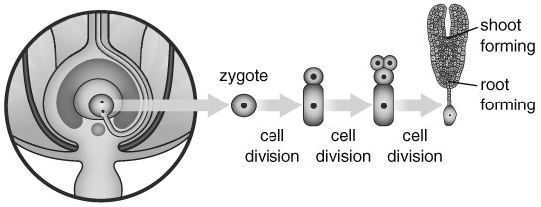
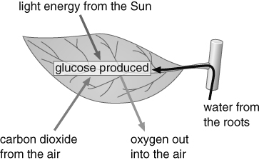
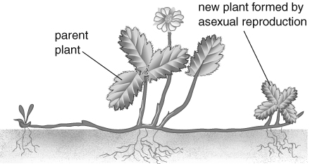
Summary Sheets
8B
Once on the stigma, a pollen grain grows a pollen tube, which enters the ovule containing an egg cell. The nucleus from the male gamete inside the pollen grain joins with the nucleus inside the egg cell to form a zygote. This is called fertilisation. The zygote grows into an embryo and the ovule becomes a seed, containing the embryo and a food store.
A part of the flower forms a fruit. This is used for seed dispersal, which stops the new plants competing with the parent plants for water, nutrients, light and space.
Some fruits are eaten by animals and the seeds come out in their faeces (e.g. apples).
Some fruits are carried on the fur of animals (e.g. burdock).
Some fruits are carried by the wind (e.g. dandelion).
Some fruits explode, scattering the seeds (e.g. lupins).
When conditions are right, seeds germinate. The resources needed are water, oxygen and warmth (WOW). Water allows chemical reactions to start, which break down the food store and allows cells in the embryo to swell up. Oxygen is needed for respiration, to release energy from the food store. Warmth is needed to speed up the chemical reactions.
The root grows first then the shoot. Finally new leaves open and photosynthesis can start in the
chloroplasts. The glucose from photosynthesis is turned into starch to be stored.
HALFTERM 2
A growing plant needs light, air, water, warmth and nutrients called mineral salts (LAWWN).
Asexual reproduction in plants
Some plants can reproduce using asexual reproduction. This is when one parent plant is able to produce offspring (e.g. by using runners in strawberries or tubers in potatoes).
Accuracy, estimates and sampling
We can take a small sample of a larger population and use it to estimate what the larger population is like. Plant populations in an area can be estimated by taking samples using a quadrat. The more samples we take the more accurate the estimate is likely to be but the longer it will take to do.
16
Page 2 of 2

Slide 12
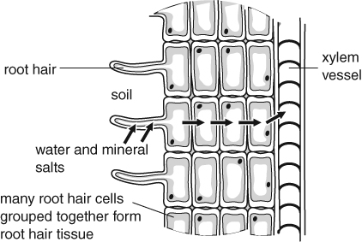
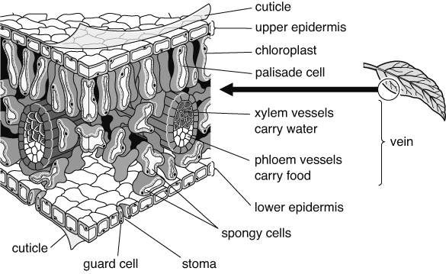
Summary Sheets
9B
HALF TERM 2
Photosynthesis
Photosynthesis is a series of chemical reactions that we can summarise using a word equation. Energy and chlorophyll are needed for it to happen. The energy is transferred by light (usually from the Sun) and becomes stored in glucose.
carbon dioxide + water → glucose + oxygen
Getting water
Water is taken out of the soil by the roots. Roots are adapted to their function by being branched and spread out to help them to absorb water from a large volume of soil. They also have root hair cells, which have a large surface area to help them absorb water quickly. The water flows up xylem vessels (made of hollow cells) to the leaf.
Water is also needed because mineral salts are dissolved in it. These keep plants healthy. For instance, plants need nitrates to make proteins. Water also stops plants wilting by filling up their cells, and it can keep their leaves cool.
Getting carbon dioxide
Air, containing carbon dioxide, diffuses into leaves through small holes called stomata.
Leaves are thin so that the carbon dioxide does not need to go very far before reaching the cells that need it. Increasing the amount of carbon dioxide around a plant can often speed up photosynthesis.
Getting light
Many leaves are wide so that they have a large surface area to trap as much light as possible. They are also arranged so that they do not shade one another.
Most photosynthesis happens in the palisade cells, which are found near the upper surface of leaves. Palisade cells are packed with chloroplasts. Chloroplasts contain chlorophyll, a green chemical that absorbs energy transferred by light and uses it to power photosynthesis. Increasing the amount of light can often speed up photosynthesis.
15
Page 1 of 2

Slide 13
9B
HALF TERM 2
Summary Sheets
Aerobic respiration
Plant cells release the energy stored in glucose using aerobic respiration (another series of chemical reactions):
glucose + oxygen → carbon dioxide + water
All living cells need energy and so all living cells respire. Aerobic respiration happens all the time, but photosynthesis can only happen when there is light.
Uses of glucose
Glucose is a type of sugar. It is used for three things:
respiration to release energy
making other substances that act as stores of energy (e.g. starch), which can be turned back into glucose for respiration when needed
making new materials for growth, e.g. cellulose (for cell walls), lipids (e.g. for cell membranes) and proteins (e.g. for enzymes). To make proteins, mineral salts called nitrates are needed.
New substances made by a plant are carried around the plant in phloem vessels.
Farming
Modern farming methods can cause environmental problems.
What is done | Why it is done | Problems this causes
land is cleared of hedges and trees | to create more land for crops and make it easier for machinery to move around | Destroys habitats. Lack of roots can cause soil erosion.
pesticides (e.g. herbicides, insecticides) are used | to kill pests that compete with or harm the crops | Can kill useful organisms as well as pests. Damages food webs.
fertilisers are used | they contain mineral salts that help plants to grow and increase the yield | Can wash into streams and rivers and cause pollution so that the organisms in the water die.
varieties | varieties of plants are chosen that produce the highest yield | The planting of huge areas of a single variety reduces biodiversity.
Breeding varieties
Farmers and plant breeders may choose or ‘select’ a plant with certain characteristics.
This organism is then used to breed from. The offspring that have the best of these characteristics are then bred from again. This is called selective breeding and is how many varieties are created.
Sometimes two different varieties are bred together to try to produce offspring with characteristics from both varieties. This is called cross-breeding.
16
Page 2 of 2

Slide 14
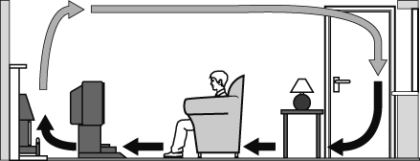
Summary Sheets
8K
HALF TERM 2
Energy transfers
Energy and temperature
When we know the temperature of something, we know how hot it is, not how much internal energy (thermal energy) is in it.
Temperature is measured in degrees Celsius (°C). Internal (thermal) energy is measured in joules (J).
The amount of thermal energy stored in something depends on:
how hot it is (its temperature)
the material it is made from
its mass.
When two objects are at different temperatures, energy will be transferred from the hotter one to the cooler one until they are at the same temperature.
Transferring energy by heating
Energy can be transferred by heating in different ways.
Evaporation can take place from a liquid at any temperature. When part of a liquid evaporates, it is the fastest-moving particles that escape to form a gas. The particles that are left are storing less energy as movement and so the temperature of the remaining liquid is lower.
Conduction takes place in solids and can also happen in liquids (although not very well).
The particles in a solid are held together tightly. When they gain energy they vibrate faster and further, and the vibrations are passed on. Metals are the best conductors. Most other solids are poor conductors.
Particles are not as close in a liquid, so conduction is not very good. Particles are a long way apart in gases, so gases hardly conduct heat at all. Something that does not conduct heat very well is a thermal insulator. Liquids, gases, and solids that contain a lot of trapped air are insulators.
Convection takes place in fluids (liquids and gases). When part of a fluid is heated, the particles spread further apart and the fluid becomes less dense. This makes it rise. As it rises it meets cooler fluid and passes the energy on. More cool fluid moves in to replace the rising fluid, setting up a convection current.
Infrared radiation can transfer energy through empty space and also through transparent materials. Radiation does not require the movement of particles. Any hot or warm object gives off or emits radiation. When something takes in energy from radiation, it is said to absorb it.
Infrared radiation is similar to light. It can be absorbed or reflected, and it can also be focused.
Dark, dull surfaces are good emitters and absorbers of radiation. Light, shiny surfaces are good at reflecting radiation. They are poor absorbers and emitters of radiation.
Power
Power is the rate at which energy is transferred. Power is measured in watts (W) or
kilowatts (kW). One watt is one joule of energy being transferred each second. 1000 W = 1 kW.
14
Page 1 of 2

Slide 15
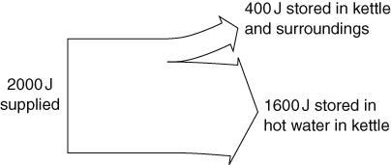
Summary Sheets
8K
HALF TERM 2
Efficiency
Not all energy is transferred usefully. Wasted energy is often transferred by heating. The percentage of useful energy produced by something is known as its efficiency.
_{efficiency =} useful energy transferred _{× 100%}
total energy supplied The Sankey diagram shows the energy transfers in
a kettle. The width of each arrow shows the amount of energy it represents. The energy stored in the kettle and the surroundings is wasted energy.
efficiency of kettle = ^{1600 J} × 100%
2000 J
= 80%
Paying for energy
We pay for the amount of energy we use in our homes. Electricity companies use units of kilowatt- hours on electricity bills. One kilowatt-hour is the amount of energy transferred when a one kW appliance is used for one hour.
We can reduce bills by insulating our homes and by using more efficient appliances.
The payback time of installing something that makes a home more energy efficient is the time taken for the cost of installation to be matched by the money saved. Sometimes buying a more efficient appliance may not save you energy overall because it costs more to buy than it will save.
payback time =
cost of change
savings per year
Accuracy and precision
A measurement is accurate if it is close to the true value of the thing being measured. Measuring devices that have small divisions can measure more accurately than instruments with larger divisions if they are set up correctly.
A measurement is precise if several measurements of the same thing give similar results. Precise measurements may not be accurate if the measuring instrument was not set up correctly.
15
Page 2 of 2

Slide 16
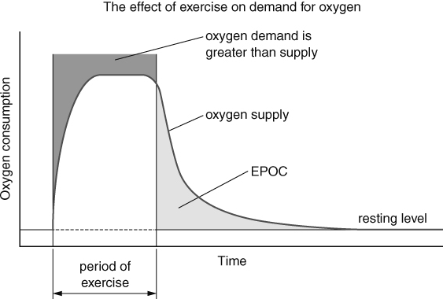
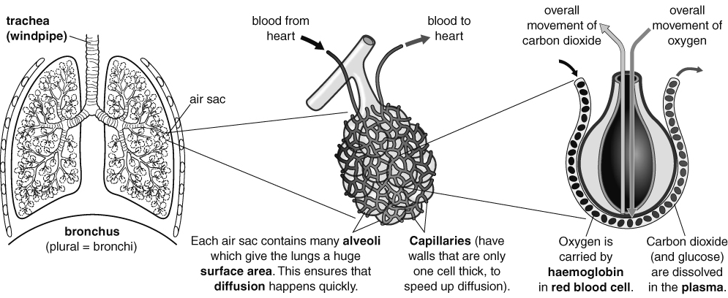
Summary Sheets
8C
HALF TERM 3
Types of respiration
All living cells respire to release energy. Organisms need energy for everything they do (for example, making new substances, moving).
Aerobic respiration is a series of chemical reactions that can be summarised as:
glucose + oxygen → carbon dioxide + water
Energy is released (but is not a chemical substance and so is not shown in the word equation). Carbon dioxide can be detected using:
limewater (which it turns cloudy)
an indicator (such as hydrogen carbonate) because it is acidic.
Anaerobic respiration does not require oxygen. In humans it is used to release energy from glucose when more energy is needed than can be supplied by aerobic respiration (for example, during strenuous exercise).
glucose → lactic acid
Anaerobic respiration causes muscles to tire quickly and so cannot be used for extended periods. A lot of the lactic acid travels from the muscles to the liver, where it is converted back to glucose. Anaerobic respiration releases less energy than aerobic respiration.
After strenuous exercise, the body needs extra oxygen. This excess post-exercise oxygen consumption (EPOC) (or ‘oxygen debt’) replaces oxygen lost from oxygen stores (in the blood and in muscles) and provides oxygen for increased levels of aerobic respiration (for example, to provide energy for removing lactic acid, for
faster breathing, for faster heart rate).
Gas exchange
Different organisms use different organs for gas exchange (swapping one gas for another):
gills (e.g. fish)
skin (e.g. frogs)
stomata in leaves (plants)
lungs.
Page 1 of 2

Slide 17
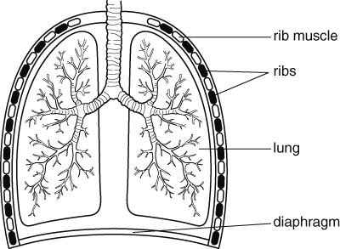
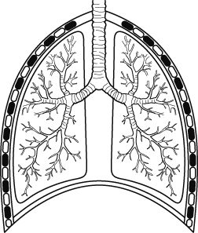
Summary Sheets
8C
HALF TERM 3
Ventilation and breathing
When you exercise, your breathing rate (number of breaths in one minute) and your pulse rate (number of times your heart beats in one minute) increase. This is because your cells need more oxygen and glucose for respiration.
Breathing is the movement of muscles in the diaphragm and attached to the ribs. These movements change the volume of the chest.
Breathing in (inhalation):
Breathing in (exhalation):
Diaphragm contracts and moves downwards.
Rib muscles contract and lift ribs up and outwards.
Volume of the chest increases.
Lungs expand.
Pressure in lungs is reduced.
Pressure outside is now higher than inside the lungs, so air flows into the lungs.
Diaphragm relaxes and moves upwards.
Rib muscles relax and move ribs down and inwards.
Volume of the chest decreases.
Lungs get smaller.
Pressure in lungs is increased.
Pressure inside the lungs is now higher than outside, so air flows out of the lungs.
Breathing ventilates the lungs. Ventilation is the movement of air into and out of the lungs.
Smoking
The chemicals in cigarette smoke are harmful.
Found in cigarette smoke: | Harm it causes:
nicotine | makes arteries narrower, causes heart disease
tar | can cause cancer, coats lungs reducing surface area, can cause alveoli to break apart (emphysema)
carbon monoxide | stops red blood cells carrying so much oxygen
high temperature of smoke | stops cilia working so lungs are not cleaned and mucus collects
Means, estimates and ranges
range = highest value – lowest value (with smaller ranges you can be more certain of your results) _{mean =} total of all values
number of values
Mean can be used to estimate a true value from repeated readings.
16
Page 2 of 2

Slide 18
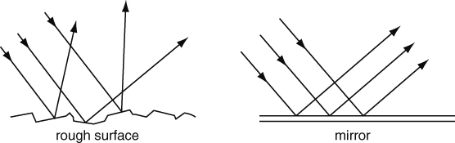
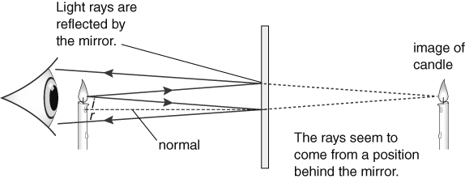
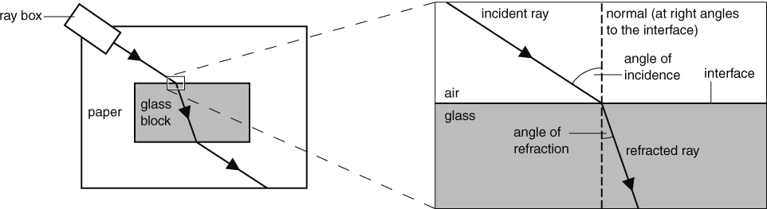
Summary Sheets
8J
HALF TERM 3
Light
Light travels in straight lines from a source. Light travels as transverse waves. It travels much faster than sound, and does not need a substance to travel through.
Light travels through transparent objects but not through opaque objects. Shadows are made when light is blocked by an object. Opaque objects block all light. Translucent objects allow some light to pass through, but it is scattered so you do not see a clear image.
Transmission and absorption
Transparent materials let light pass straight through. We say they transmit light. Opaque surfaces can absorb or reflect light. White surfaces reflect most of the light that hits them. Black surfaces absorb light very well and reflect very little. This is why they look so dark.
Reflection
Light rays are scattered by rough surfaces (diffuse reflection), which means that you cannot see an image in an object with a rough surface.
Mirrors and shiny materials such as polished metals reflect light evenly. This is called specular reflection. The angle of incidence (i) is equal to the angle of reflection (r) – this is known as the law of reflection. Angles are measured between the light rays and the normal (a line drawn at right angles to the reflecting surface).
You can see an image in a mirror because the reflected rays of light appear to come from a point behind the mirror.
The image in a plane mirror is the same size as the object, and the same distance away from the mirror. In the image, left becomes right and right becomes left.
Refraction
When light hits something transparent it changes speed and direction. This is called refraction. Refraction takes place at the interface between two substances. When light is transmitted through glass it slows down and changes direction towards the normal. When it travels back out it speeds up again and changes direction away from the normal.
15
Page 1 of 2

Slide 19
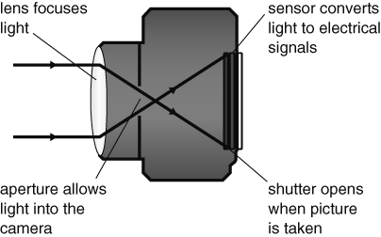
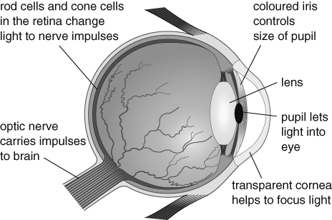
8J
HALF TERM 3
Summary Sheets
Lenses are curved pieces of glass or transparent plastic that are designed to refract light in particular ways. Converging lenses make rays of light come together. The focal point of a lens is the point where parallel rays of light are brought together by the lens, and the focal length is the distance of this point from the centre of the lens.
Lenses are used in cameras, microscopes and telescopes.
Cameras and eyes
Rod cells in our retinas detect faint light but not colours and cone cells detect the primary colours of red, blue and green. We see combinations of primary colours as secondary colours (magenta, cyan and yellow).
Colour
White light is a mixture of colours. White light can be split up using a prism to give a spectrum of seven colours (red, orange, yellow, green, blue, indigo, violet). The splitting of colour into a spectrum is called dispersion.
We are able to see colours because objects do not reflect all the colours in light. White objects reflect all the colours, but a red object only reflects red and all other colours are absorbed. This idea applies to all colours except black – black objects absorb all colours.
Filters are used to make coloured light. They transmit one of the colours in white light and let the other colours through. If you look at a coloured object in coloured light, its colour may appear to be different.
16
Page 2 of 2

Slide 20
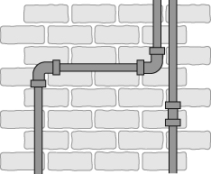
8G
The physical properties of metals
HALF TERM 4
Summary Sheets
Metals | Non-metals
good conductors of heat and electricity | poor conductors of heat and electricity
shiny | dull
solids with a high melting point (except for mercury) | most are low melting point solids or gases
flexible and malleable | brittle (break easily instead of bending)
The chemical properties of metals
The chemical properties of metals refers to their reactions with other substances. For example, metals can react with many non-metals:
e.g. calcium + chlorine → calcium chloride
(Note: When naming a compound the ending of the non-metal is changed to ide)
Metals can also react with air (oxygen), water and acids. Some metals react very quickly; they are
reactive. Calcium is a reactive metal. Other metals do not react quickly; they are unreactive. Gold is a very unreactive metal.
Uses of metals
Metals have many uses depending on their different properties. For example, copper is used in electrical wires as it is flexible and a good conductor of electricity. It is also used for roof sheets as it is malleable and doesn’t react quickly with water.
Metals as catalysts
Some metals act as catalysts. These are substances that speed up chemical reactions without being used up themselves. Catalysts have many uses, for example, platinum is used in catalytic converters in cars.
Corrosion and oxidation of metals
The reaction of metals with oxygen forms metal oxides:
metal + oxygen → metal oxide
e.g. word equation: calcium + oxygen → calcium oxide This is called an oxidation or corrosion reaction.
Some metals like sodium react quickly with water and oxidise immediately when scratched. Other metals do not react easily, for example silver changes colour very slowly as it reacts with oxygen.
Rusting
The corrosion of iron is called rusting. It destroys iron and steel structures because rust is weak and crumbly. Water and oxygen must be present for iron to rust.
iron + water + oxygen → iron hydroxide
Coating the iron with paint, plastic, etc. acts as a barrier to oxygen and water and stops iron rusting.
Page 1 of 2

Slide 21
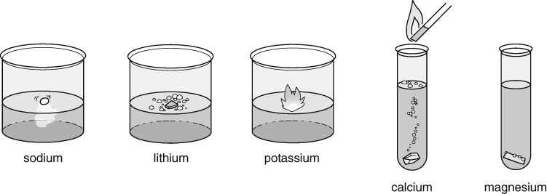
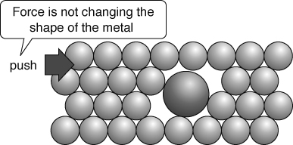
Summary Sheets
8G
HALF TERM 4
Metals and water
Some metals can react with cold water.
Reactivity series
The reactions of metals with oxygen, water and acids allows us to put the metals in order of reactivity:
Potassium
Sodium Lithium Calcium Magnesium Aluminium Zinc
Iron Tin Lead
Copper Mercury Silver Gold
D
e c
r e a s i n g
All the metals that react with water form a metal hydroxide (an alkaline solution) and hydrogen gas.
metal + water → metal hydroxide + hydrogen
The test for hydrogen gas is that it burns with a ‘squeaky pop’. Again, the equations can be written using words or symbols: sodium + water → sodium hydroxide + hydrogen
r e a c t i v i t y
2Na + 2H₂O → 2NaOH + H₂
Metals and acids
The metals that react with water react very quickly with acids. Some metals that don’t react with water do react with acids. When metals react with acids, they produce hydrogen and a salt.
metal + acid → salt + hydrogen
The name of the salt formed depends on the name of the acid:
The reactivity of metals can be linked to their uses.
For example, metals used for building need to have a low reactivity, otherwise they will corrode away.
hydrochloric acid → chlorides
sulfuric acid
nitric acid
→ sulfates
→ nitrates
Again, the equations can be written using words or symbols: magnesium + sulfuric acid → magnesium sulfate + hydrogen
Mg + H₂SO₄ → MgSO₄ + H₂
Alloys
Alloys are mixtures of metals with one or more other elements. Alloys have different properties from the pure metal and so can be more useful.
For example, steel, an alloy of iron, is stronger and does not rust as quickly.
Pure metals have a fixed, precise melting point where as alloys have a lower melting point and melt over a range of temperatures. Melting points can therefore be used to identify pure metals.
Alloys are usually also harder than pure metals because the different sized atoms disrupt the regular structure making it harder for the layers of atoms to slip over each other.
15
Page 2 of 2

Slide 22
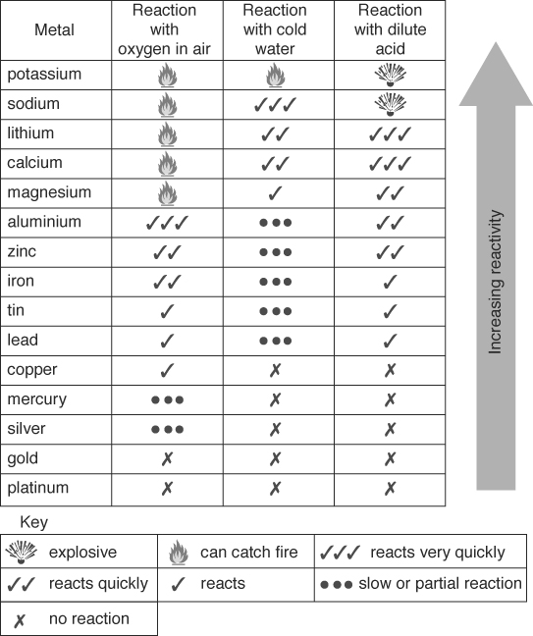
Summary Sheets
9F
Physical changes and chemical reactions
HALF TERM 4
Physical changes | Chemical reactions
Do not make new substances. | Always make one or more new substances.
Are often easy to reverse. | Are usually difficult to reverse.
The substances may change state or just be mixed together. | The new substances have different properties from the original substances.
Examples include: melting, boiling, condensing, freezing. | Examples include: combustion, neutralisation, thermal decomposition.
Gas pressure
Gas pressure is caused by the force of the particles hitting the walls of the container.
Change that increases pressure | Reason
increase the temperature | the particles move faster and so hit the walls of the container with more force and more often
increase the number of particles in the container | the particles are closer together and hit the walls of the container more often
decrease the volume of the container | the particles are closer together and hit the walls of the container more often
The reactivity series
This is a list of metals in order of reactivity, with the most reactive at the top.
The metals that react with water produce a metal hydroxide and hydrogen.
The metals that react with dilute acids produce a salt and hydrogen.
Most metals react with oxygen from the air to form metal oxides. This is an oxidation reaction.
Rusting of iron
Steel is an alloy containing iron mixed with small amounts of carbon and sometimes other metals. Iron and steel need air and water to rust. Salt makes them rust more quickly than usual.
Rusting can be prevented by:
a physical barrier to stop the air and water being in contact with the iron
sacrificial protection, in which blocks of a more reactive metal, such as zinc or magnesium, are attached to the iron. They then corrode instead of the iron.
Stainless steel is an alloy of iron containing chromium and it does not rust.
Page 1 of 2

Slide 23
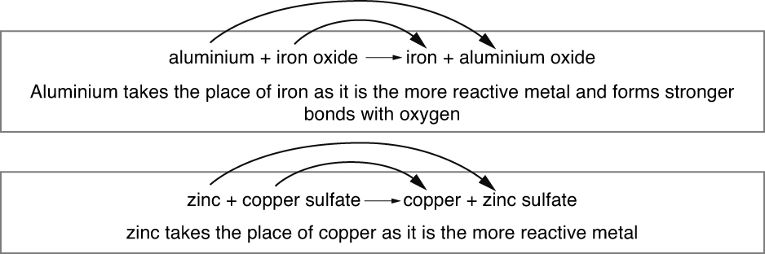
Summary Sheets
9F
HALF TERM 4
Hydrocarbons
These substances contain hydrogen and carbon only. They burn in a plentiful supply of air to form carbon dioxide and water:
hydrocarbon + oxygen → carbon dioxide + water The test for oxygen is that it relights a glowing splint.
An input of energy from a flame or spark is needed to start the combustion reaction by breaking some bonds in the reactants. Explosive mixtures contain an oxidising agent to provide extra oxygen for the reaction.
Energy changes
Exothermic reactions transfer energy from the reactants to the surroundings. The temperature of the surroundings increases.
Endothermic reactions use energy transferred from the surroundings to the reactants. The temperature of the surroundings decreases.
Displacement reactions
In a displacement reaction a more reactive metal takes the place of a less reactive metal in a compound.
Extracting metals
Most metals occur as compounds in ores in the Earth’s crust. Only a few, such as silver and gold, occur as the metallic element.
The metals high in the reactivity series are difficult to chemically extract from their ores and their isolation has happened relatively recently.
The metals lower in the reactivity series are easier to extract from their ores and they have been available to use as the pure elements for much longer.
Metals from zinc downwards in the reactivity series can be extracted from their ores by heating with carbon.
Metals above zinc in the reactivity series need electrolysis to extract them from their ores.
Oxidation is the gain of oxygen. Reduction is the loss of oxygen.
Percentage loss or gain
This is the
actual change
× 100
original amount
15
Page 2 of 2

Slide 24
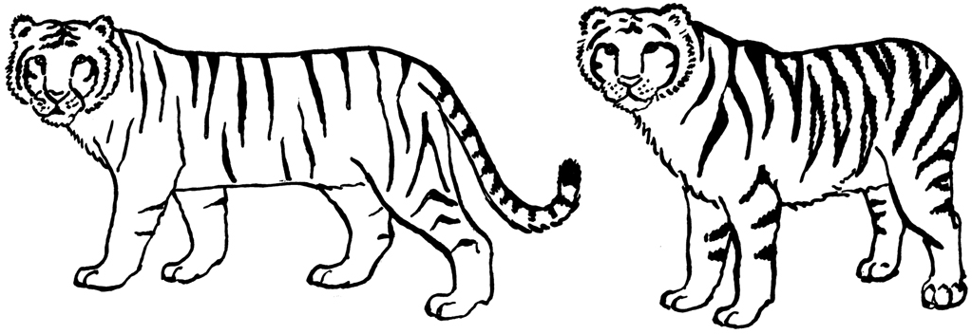
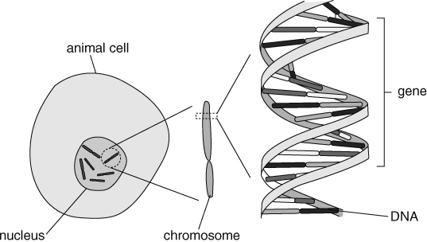
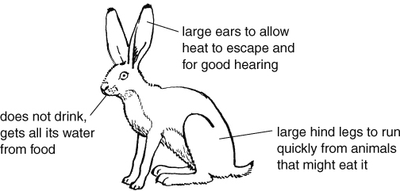
Summary Sheets
9A
A species is a group of organisms that are able to reproduce to give offspring that are also able to reproduce.
Members of the same species have
very similar characteristics (features). However, there is variation in these characteristics.
All tigers have stripes but there is variation in the stripes
between each tiger.
Environmental variation
Some characteristics vary due to environmental factors in an organism’s surroundings (its environment). There are living environmental factors (other organisms) and physical (non-living) environmental factors, such as the amount of sunlight. Variation caused by environmental factors is environmental variation.
All the organisms and physical environmental factors in an area form an ecosystem.
Inherited variation
Offspring inherit characteristics from their parents and these characteristics can vary (e.g. brown eyes and blue eyes). This is inherited variation.
Chromosomes, genes and DNA
An organism’s characteristics are controlled by genetic information contained in a code in DNA. James Watson and Francis Crick discovered the structure of DNA by making use of the data of other scientists, such as Rosalind Franklin and Maurice Wilkins.
Each chromosome contains a long molecule of DNA. Certain sections of that DNA molecule contain the genetic information and are called genes.
HALF TERM 4
In humans there are 23 different types of chromosome. Most cells have two copies of each type. Gametes, however, only have one copy of each type of chromosome. When two gametes fuse during fertilisation, they form a zygote that contains the chromosomes from both gametes.
For some characteristics, scientists can work out the probability that a child will inherit that characteristic. Probabilities are shown as percentages, decimals or fractions.
Adaptation
Animals and plants are adapted to where they live; they have characteristics that allow them to survive in that habitat.
Jack rabbits are adapted to living in a desert habitat.
Page 1 of 2

Slide 25
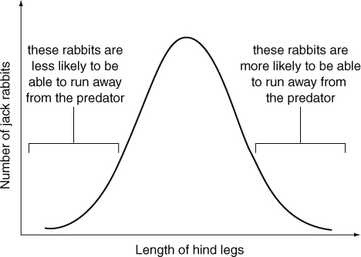
Summary Sheets
9A
HALF TERM 4
Natural selection
All characteristics vary slightly amongst the members of a species. We can often draw a bell curve (normal distribution) to show variation in a characteristic.
If conditions in a habitat change, then variation in a characteristic may help some members of a species to survive better than others. Imagine a new predator moves into the area in which jack rabbits live. By chance, some jack rabbits will have slightly longer hind legs that allow them to run faster. These are the jack rabbits that are more likely to survive and reproduce. So, the next generation of jack rabbits will have slightly more rabbits with longer hind legs.
This process is known as natural selection. Charles Darwin and Alfred Russel Wallace both came up with the idea that it is natural selection happening over and over again, over a long period of time, that causes evolution.
Endangerment and extinction
Changes in an ecosystem can cause species to become endangered or extinct. This is usually due to:
changes in physical environmental factors
competition from other organisms
disease
human activities (e.g. hunting, clearing habitats, using poisons).
We can try to stop this happening and preserve biodiversity (the number of species) by:
protecting areas and setting up nature reserves
setting up breeding programmes in zoos
banning the hunting of some animals or the collecting of wild plants
setting up gene banks (to store parts of organisms, such as seeds and gametes). We should preserve biodiversity because:
organisms depend on one another (they are interdependent)
we won’t be able to make use of organisms if they become extinct
more biodiverse areas recover better from natural disasters.
16
Page 2 of 2

Slide 26
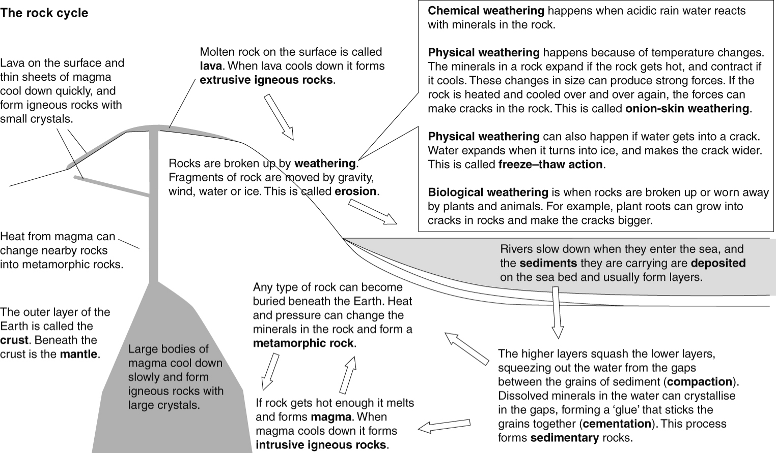
8H
HALF TERM 5
Summary Sheets
Rocks
© Pearson Education Ltd 2014. Copying permitted for purchasing institution only. This material is not copyright free.
15
Page 1 of 2

Slide 27
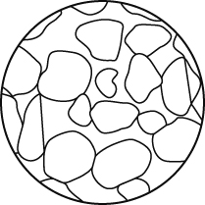
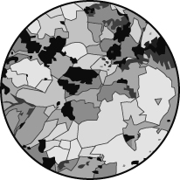
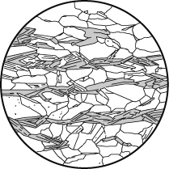
Summary Sheets
HALF TERM 5
8H
Rock textures
Rocks are made of grains. Each grain is made of a naturally occurring compound called a
mineral. The texture of a rock is a description of the size and shape of the grains.
Type of rock | Sedimentary | Igneous | Metamorphic
Examples | limestone, sandstone, mudstone, chalk | basalt, gabbro, granite | marble, quartzite, slate, schist, gneiss
Grains or crystals? | separate grains | interlocking crystals that are not lined up | interlocking crystals, often lined up in bands of different colours
Hard or soft? | often soft or crumbly | hard | hard
Porous? | often | not usually | not usually
Example of texture
Fossils
Fossils can form when dead plants or animals fall to the bottom of the sea. If their remains get covered by other sediments they do not rot. As the sediments turn into sedimentary rock, the shape of the organism is preserved in the rock. When a dead organism forms a fossil, its form can still be seen because its hard parts have been turned into stone.
Materials from the Earth
Many of the materials we use are obtained from the Earth. We use stone for building. Cement is made from limestone, and concrete is made by mixing cement, sand and gravel with water.
We also obtain metals from the Earth. Unreactive metals like gold and silver are found in their native states. Other metals are found as parts of minerals. An ore is a rock with enough of a particular mineral in it to make it worth mining. Pure metals are obtained from minerals using chemical reactions.
Mining for metals can destroy habitats and cause pollution. If we recycle metals we will:
make supplies of metals last longer
reduce amounts of mining (and so reduce the pollution and environmental damage this causes)
reduce pollution caused by putting metals in landfill sites.
© Pearson Education Ltd 2014. Copying permitted for purchasing institution only. This material is not copyright free.
16
Page 2 of 2

Slide 28
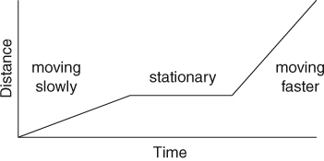
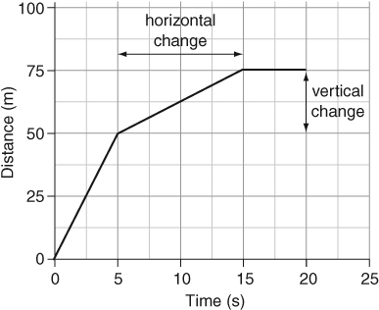

Summary Sheets
9I
HALF TERM 5
Moving things
Speed
To measure how fast something is travelling, you need to measure the distance it travels and the time taken. Units for speed are km/h or m/s or mph. The unit for speed depends on the units you have used to measure the distance and the time.
Speed is calculated using this formula:
_{speed =} distance
time
The mean (average) speed is the total distance travelled divided by the total time taken. Actual speeds during a journey can be faster or slower than the mean speed.
A car travelling at 50 km/h overtakes one travelling at 30 km/h. The relative speed of the faster car compared to the slower car is 20 km/h.
Distance–time graphs
A journey can be shown on a distance–time graph. This graph shows Kieron’s journey to school. The steeper the line on the graph, the faster the object or person is moving.
Gradients
The gradient of a line on a graph is a measure of how steep the line is. On a distance-time graph, the gradient of a line gives the speed that the object is moving.
Example
Calculate the speed of the object between 5 and 15 seconds.
_{gradient =} vertical change (distance moved) horizontal change (time taken)
₌ (75 m − 50 m)
(15 s − 5 s)
₌ 25 m
10 s
= 2.5 m/s
Levers and moments
Forces can be used to turn objects around pivots. A pivot is also known as a fulcrum.
Levers can be force multipliers, when they increase the force that is put in (the effort). They can be distance multipliers if they make the load move further than the effort. The amount the force or distance is multiplied depends on the distances between the load and the pivot, and the effort and the pivot.
A turning force is called a moment. Moments are measured in newton metres (N m).
The hammer is acting as a force multiplier.
moment (in N m) = force (in N) × perpendicular distance from the pivot (m).
Page 1 of 2

Slide 29




Summary Sheets
9I
HALF TERM 5
The longer the distance the greater the moment. This is why it is easier to turn a long spanner than a short one.
When an object is balanced, the anticlockwise moment is equal to the clockwise moment.
For the seesaw:
the anticlockwise moment = 300 N × 2 m
= 600 N m
the clockwise moment
= 400 N × 1.5 m
= 600 N m
The clockwise and anticlockwise moments are the same, so the seesaw is balanced, or in equilibrium.
Simple machines
A lever is an example of a simple machine. Ramps and pulleys are simple machines that act as force multipliers.
If a machine makes it possible to lift or move a load using a smaller force, the force has to move through a greater distance. The total amount of energy needed is the same.
The work done by moving a load is the same as the energy transferred. Work is done when a force moves through a distance. Work is measured in joules (J).
work = force × distance moved in the direction of the force.
The work done to lift the box 2 m is:
work = 1000 N × 2 m
= 2000 J
The ramp makes it possible to move the box using a force of only 500 N, but the box has to be moved 4 m.
work = 500 N × 4 m
= 2000 J.
The box stores the same amount of gravitational potential energy when it is in its final position whichever method is used to lift it. The law of conservation of energy means that only this amount of energy is used to lift it.
16
Page 2 of 2

Slide 30



Summary Sheets
9J
HALF TERM 5
Force fields and electromagnets
Static electricity
An atom consists of a central nucleus with small particles called electrons moving around it. An atom normally has no overall charge because it has the same number of positive and negative charges.
When you rub two materials together, electrons may be transferred from one material to the other. If the objects are insulating materials, the object that gains electrons has a negative charge of static electricity. The object that loses electrons has a positive charge.
A positively charged object will attract a negatively charged object. Two objects with the same charge (both positive or both negative) will repel each other.
The space around a charged object where it will attract or repel other charged objects is its electric field. The arrows on the diagram show the direction a positive charge would move.
Resistance
The resistance of a component is a way of saying how easy or difficult it is for an electric current to flow through it. The size of a current depends on the resistance of the circuit and on the voltage that is ‘pushing’ the current:
the higher the voltage, the higher the current (if the resistance stays the same)
the higher the resistance, the lower the current (if the voltage stays the same).
All metals conduct electricity, but some metals are better conductors than others. The resistance of a wire depends on:
the material from which it is made
its length (longer wires have higher resistances)
its thickness (thicker wires have lower resistances).
Calculating resistance
The units for measuring resistance are ohms, and the symbol is the Greek letter omega (Ω).
Voltage, resistance and current are related by this formula:
voltage = current × resistance
To calculate a resistance, you need to measure the current in amps and the voltage in volts.
resistance = ^{voltage}
current
Page 1 of 2

Slide 31


Summary Sheets
9J
HALF TERM 5
Electromagnets
A bar magnet is a permanent magnet, because it is always magnetic. A wire with electricity flowing through it has a magnetic field around it. An electromagnet is a coil of wire with an electric current flowing through it. It is only magnetic while the current is flowing. The shape of the magnetic field of an electromagnet is similar to the magnetic field of a bar magnet.
You can make an electromagnet stronger by:
increasing the number of coils of wire
increasing the size of the current (by increasing the voltage)
using an iron core.
Motors
If a wire carrying a current crosses a magnetic field, the wire will experience a force. This is the motor effect.
An electric motor consists of a coil of wire in a magnetic field. When there is a current in the coil, there is a force on each side of the coil that makes it turn.
The speed of the motor (or the force it provides) can be increased by:
increasing the size of the current
increasing the strength of the magnetic field
increasing the number of turns of wire on the coil.
15
Page 2 of 2

Slide 32




8I
HALF TERM 6
Summary Sheets
Fluids
Fluids are liquids or gases.
The particle model
The particle model can explain the properties of solids, liquids and gases.
 | Solids | Liquids | Gases
Properties | fixed volume fixed shape | fixed volume take shape of container | expand to fill container take shape of container
Particle diagram
Particles | are close together are held in fixed positions by strong forces | are close together are held by fairly strong forces can move around | are far apart are held by very weak forces can move around
Density
Density is the mass of a certain volume of something, and it can be calculated using this formula:
density =
mass
volume
The units for density are g/cm³ or kg/m³.
Changes of state
Substances can change state when they are heated or cooled. The three states of matter are solid, liquid and gas.
A liquid evaporates from its surface. When it is boiling, bubbles of gas form within the liquid.
Page 1 of 2

Slide 33

Summary Sheets
8I
HALF TERM 6
The melting point and the freezing point of a substance are the same temperature. The temperature of a substance does not change while it is melting, even if it is still being heated.
Changing density
Substances expand when they are heated. The particles in a solid vibrate more and take up more space. The particles in liquids and gases move around faster and take up more space. When a material expands its density decreases.
Substances contract when they cool down, as the particles have less energy and do not move as much. This reduces the volume and increases the density. When a liquid freezes and becomes a solid its density increases a lot.
Ice is unusual, because it is less dense than liquid water. This is why ice floats on water.
Pressure in fluids
Both gases and liquids are fluids. Fluids can flow. Pressure in fluids acts in all directions. The particles in fluids are moving all the time and hitting the walls of containers and other things they come into contact with. The force of the collisions causes pressure, which acts in all directions.
The pressure of gas in a container can be increased by:
putting more particles into the container (so there will be more collisions with the container walls each second).
heating the gas (so the particles move faster, hitting the walls harder and more often).
reducing the volume of the container (so the particles do not have as far to go between the walls and so collide with the walls more often).
As you go deeper into the sea, pressure increases because there is more water above you pressing down. If you climb a high mountain, the air pressure on you will get less, because there is less air above you pressing down.
Floating and sinking
You can decide if something will float by working out its density, and the density of the fluid. If the density of the object is less than the density of the fluid, it will float.
The density of water is 1 g/cm³, so objects with densities less than 1 g/cm³ will float in water.
Drag
Drag is another name for air resistance or water resistance. The amount of drag on something can be reduced by giving it a smooth surface and a streamlined shape. The drag increases as the speed increases, so cars use up more fuel per kilometre when they are travelling fast. Drag is caused by particles in the fluid hitting the moving object, and by the force needed for the object to push the fluid out of the way. The particles transfer energy to the object, which is why objects moving through air can get hot.
17
Page 2 of 2

Slide 34

9E
HALF TERM 6
Summary Sheets
Page 1 of 2

Slide 35

Summary Sheets
9E
HALF TERM 6
Problems with making and using materials
Burning fossil fuels provides the energy needed to make materials but is also linked to:
acid rain from production of sulfur dioxide
increase in carbon dioxide levels and the greenhouse effect
soot dirtying buildings and damaging health.
Toxic substances released in waste get into food chains.
As large animals eat lots of smaller animals, toxin levels increase (biomagnification) and can reach harmful levels in humans.
Non-biodegradable polymer waste causes pollution problems and dangers to animals for years.
Solutions to these problems include …
removal of sulfur from fuels
reduction in the use of fossil fuels and use of more renewable energy sources
control of hazardous waste from factories
use of biodegradable polymers, which break down in the soil, so they disappear more quickly.
Recycling materials to use again …
reduces our use of landfill sites
reduces the need to burn fossil fuels
reduces pollution from manufacturing process
saves our resources of raw materials, e.g. metal ores for metals and wood for paper.
Examples of materials that can be recycled
Metals – by separating and melting.
Glass – by separating colours and melting. Polymers – by using recycle labels.
Paper – by removing ink and adding water to make a pulp. Concrete – by crushing and grading.
Recycling saves the Earth’s resources.
Endothermic and exothermic reactions
Exothermic reactions transfer energy into the surroundings and so increase the temperature around them, e.g. combustion reactions. Endothermic reactions transfer energy from the surroundings and so decrease the temperature around them, e.g. decomposition reactions.
Peer review: how scientific discoveries are checked
Scientists carry out investigations and write a scientific paper on their findings. They send their paper to a scientific journal. An editor reads the paper. If it is interesting the editor sends it to scientists who work in same area for peer review. The scientists check that the paper has valid conclusions, that it is original and that the experiments work.
Depending on the review, the paper is recommended for publication, amendment or rejection.
17
Page 2 of 2

Slide 36




Summary Sheets
8L
HALF TERM 6
Earth and space
The Solar System
We live on a planet called the Earth. The Earth gets energy from the Sun. The Earth spins on its axis once every
24 hours. The side of the Earth facing the Sun has daylight,
and it is night on the side facing away from the Sun.
The Earth orbits around the Sun. It takes one year to go around once.
The Moon is a satellite of the Earth. We can see the Moon because it reflects light from the Sun. The Moon seems to change shape. The different shapes are called phases of the Moon. The phases happen because we cannot always see all of the part that is lit by the Sun.
There are eight planets in elliptical (oval-shaped) orbits around the Sun. Most of the planets have moons orbiting around them. The Sun, the planets and their moons make up the Solar System.
The eight planets are Mercury, Venus, Earth, Mars, Jupiter, Saturn, Uranus and Neptune.
Our current model of the Solar System
The Earth’s axis is tilted. When the northern hemisphere is tilted towards the Sun it is summer in the UK. Days are longer than nights, and the Sun is higher in the sky. The Sun’s rays are more concentrated, so it feels hotter.
Magnets and magnetic fields
Magnets attract magnetic materials. The two ends of a bar magnet are called the north-seeking pole and the south-seeking pole, or north pole and south pole for short. A north pole and a south pole attract each other. Two north poles or two south poles repel each other.
The space around a magnet where it has an effect is called its magnetic field. You can find the shape of the magnetic field using iron filings or using a plotting compass.
The Earth has a magnetic field. A compass is a small magnet that will point towards the Earth’s North Pole. But magnetic materials placed near a compass can change the direction that the compass
points towards.
This is the shape of the magnetic field of a bar magnet.
Page 1 of 2

Slide 37

Summary Sheets
8L
HALF TERM 6
Gravity and gravitational fields
The mass of something is the amount of substance or ‘matter’ it contains. It is measured in kilograms (kg). Weight is the force of gravity pulling on a mass. It is a force, so it is measured in newtons (N).
Gravity is the force of attraction between two masses. The force of gravity is stronger if:
the objects have large masses
the objects are close together.
On Earth, gravity pulls on every kilogram of mass with a force of about 10 N.
Gravity is not as strong on the Moon because the Moon has a much smaller mass than the Earth. If you went to the Moon your mass would not change, but your weight would be less than on Earth because the Moon’s gravity is weaker.
You can calculate the weight of an object using this formula:
weight (N) = mass (kg) × gravitational field strength (N/kg)
The Sun’s gravity keeps all the planets in our Solar System moving in elliptical orbits around it. If there was no gravity from the Sun, the planets would all fly off into space. The Earth’s gravity keeps the Moon in orbit around the Earth.
A satellite is anything that orbits around a planet. The Moon is the only natural satellite of the Earth. Artificial satellites are put into orbit around the Earth or other planets. They can be used for taking pictures or transmitting TV programmes.
Beyond the Solar System
Planets do not make their own light. We can sometimes see the planets because they reflect light from the Sun.
The Sun is a star. It is a ball of gas that gives out large amounts of energy. The Sun is like the stars you can see in the sky at night. The stars do not look very bright because they are a lot further away than the Sun. People often group stars into patterns called constellations.
The Sun is one of millions of stars in our galaxy, which is called the Milky Way. There are millions of galaxies in the Universe.
The stars are a very long way from Earth. Scientists measure distances to the stars using light years. A light year is the distance that light can travel in one year.
15
Page 2 of 2

