Slide 1
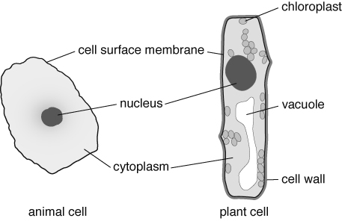
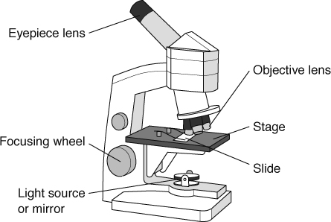
7A
HALF TERM 1
Summary Sheets
Cells, tissues, organs and organ systems
All organisms carry out seven life processes (movement, reproduction, sensitivity, growth, respiration, excretion, nutrition). All organisms are made from cells:
Cell part | Function
cell surface membrane | keeps cell together and controls what goes into and out of the cell
nucleus | controls the cell
cytoplasm | where activities happen, including respiration (which occurs in mitochondria)
chloroplast | contains chlorophyll to trap sunlight for photosynthesis
cell wall | made of cellulose and provides support
vacuole | storage space
A microscope is used to magnify tiny things such as cells.
total magnification = magnification of objective lens × magnification of eyepiece lens.
The object you look at is the specimen. It has to be thin to let light get through it. It is placed with a drop of water onto a slide. A coverslip is carefully lowered on top, to stop the specimen drying out, hold it flat and stop it moving. A stain can be used to help you see parts of the cell.
To use a microscope:
Place the smallest objective lens over the hole in the stage.
Turn the focusing wheel to move the objective lens close to the stage.
Place the slide on the stage.
Adjust the light source or mirror.
Look into the eyepiece lens.
Turn the focusing wheel until what you see is in focus.

Slide 2
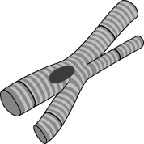
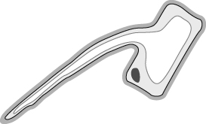
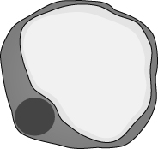
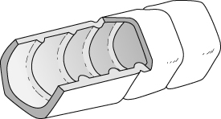
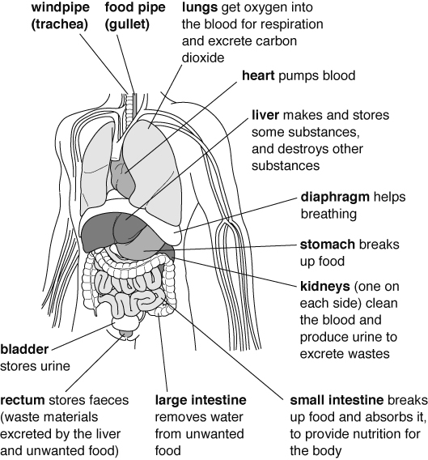
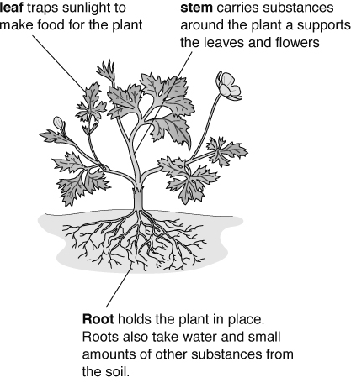
7A
Some cells are specialised and have special functions.
In animals In plants
HALF TERM 1
Summary Sheets
Muscle cells shape to move things.
Root hair cells take in water.
Fat cells in animals store fat. Xylem cells carry water.
A group of cells that are the same, all doing the same job, is called a tissue (e.g. muscle tissue).
A group of different tissues working together to do an important job is an organ. For example, the
heart is an organ and is made of muscle tissue and nerve tissue. Organs have important functions.
Organs often work together in organ systems.
Organ system | Organs | Job
breathing system | windpipe (trachea), lungs | takes air into the body and gets rid of waste gases
circulatory system | heart, blood vessels | carries oxygen and food around the body
digestive system | mouth, gullet, stomach, intestines | breaks down food
nervous system | brain, spinal cord, nerves | carries signals around the body
urinary system | bladder, kidneys | gets rid of waste
locomotor system | muscles, bones | allows movement
water transport system (plants) | roots, stem, leaves | carries water up a plant
Page 2 of 2
18

Slide 3
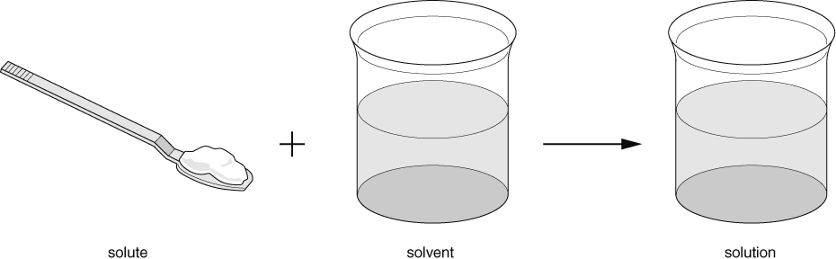
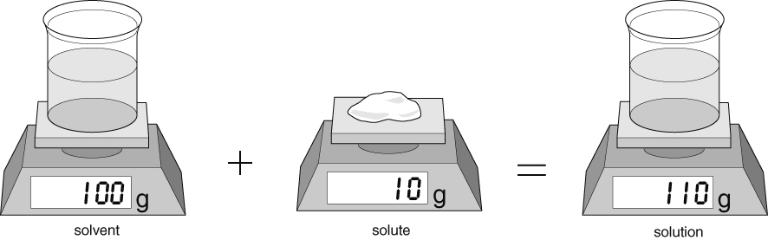
7E
HALF TERM 1
Summary Sheets
Mixtures
A mixture contains two or more substances jumbled together. There are different kinds of mixture:
suspension: the solids settle out of the mixture over time.
colloid: the solid pieces are smaller so they don't settle out, and the mixture looks cloudy or
opaque.
solution: the solids break up into such small pieces that they are not visible, and the mixture is
transparent.
Solutions
Some solids dissolve in water to make a solution. These solids are soluble. A solution is made from a solute (usually a solid) and a solvent (liquid). Some gases, such as oxygen and carbon dioxide, can also dissolve in water.
Substances that do not dissolve in a solvent are insoluble. When an insoluble substance is mixed with water, the mixture formed may be a suspension or a colloid.
The total mass of a solution equals the mass of solvent added to the mass of solute.
Water dissolves many different solutes. Other liquids (e.g. white spirit, ethanol) can also be used as solvents. Solutes that are insoluble in water may dissolve in other solvents.
If you keep adding solutes to a solvent, you will get to a point where no more will dissolve. The solution is saturated with solute. More solid may dissolve if you add more solvent (e.g. water) or increase the temperature.
The solubility of a solute is the amount that will dissolve in a fixed amount of solvent at a particular temperature.

Slide 4
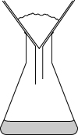
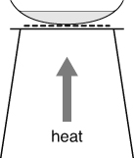
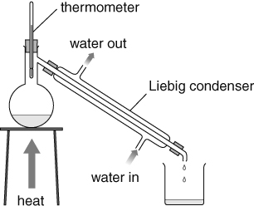
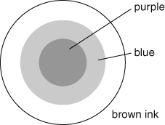

HALF TERM 1
Summary Sheets
Method | Used to separate | Apparatus used | Examples
filtering (filtration) | solids from a suspension (i.e. large pieces of solids that have not dissolved in a liquid) |  | sand from a mixture of sand and water
evaporation | solid substances from a solution or colloid |  | salt from a salt solution
distillation (evaporation followed by condensation) | liquid from a mixture |  | pure water from a salt solution
chromatography | individual solutes from a mixture of solutes in a solvent |  | colours found in ink
Interpreting a chromatogram
Chromatograms help to identify substances in a mixture.
This paper chromatogram shows that A, B, C and D are all single substances and that X is a mixture of C and D.

Slide 5
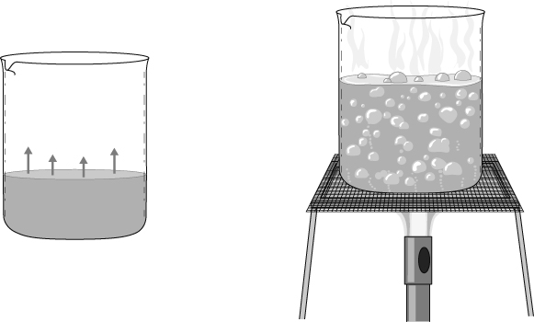
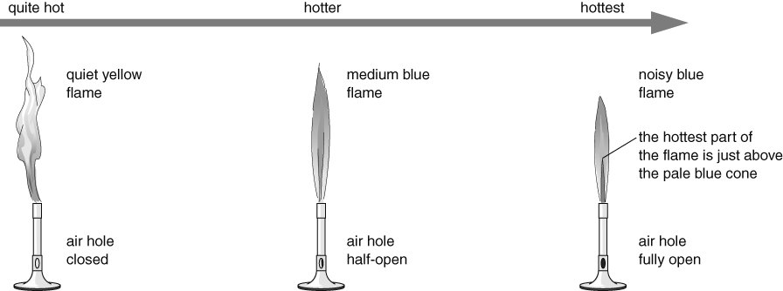
7E
Evaporation and boiling
HALF TERM 1
Summary Sheets
Evaporation is when a liquid turns to a gas at its surface.
It happens at any temperature.
It is faster when the temperature is higher.
When a liquid boils, all the liquid is trying to turn into a gas at the same time.
Boiling happens at the liquid's boiling point.
Gas formed inside the liquid makes bubbles that rise to the surface.
The boiling point of pure water is 100 °C.
Heating with a Bunsen burner
The air hole of a Bunsen burner can be adjusted to give different kinds of flame. Each kind is useful for different things.
Safety flame: should always be used when not heating.
This flame is used for gentle heating.
This flame is used for rapid heating.

Slide 6
Summary Sheets
7E
Hazards and risks
HALF TERM 1
A hazard is something that could cause harm.
A risk is how likely it is that the hazard will cause harm.
You should always plan to minimise risks in experiments.
Example of hazard | How to reduce the risk from the hazard
Burns or scalds from apparatus heated by a Bunsen burner. | Use heat-resistant gloves or tongs to touch apparatus.
Spitting liquid when heating to dryness. | Wear eye protection and make sure heat is turned off before the solution is completely dry.
Shaking of distillation flask by bubbling liquid. | Add anti-bumping granules to liquid to prevent large gas bubbles forming.
Writing a good method
Here is a method for lighting a Bunsen burner safely. The labels on the right show how to write a good method.
Method
The instructions are written as a set of steps in the correct order, or sequence, for carrying out the experiment.
Check the gas hose for breaks or holes and return the Bunsen burner and hose to your teacher if it is damaged.
Tie back loose hair and any loose clothing, such as a tie or scarf.
Remove everything except what is needed for the experiment from your working area.
Wear eye protection.
Place the burner on a heat-resistant mat 30–40 cm from the edge of the bench.
Make sure the air hole of the Bunsen burner is closed.
Hold a lit splint or a long-armed sparker or lighter about 2 cm above the top of the Bunsen burner.
Turn on the gas at the gas tap to light the burner.
Each step describes one action during the experiment.
Use imperative verbs (command words) to keep the sentence structure simple and the language clear.
Use the correct names for apparatus, and correct science terms where appropriate.
When you write up your method in your report at the end of the experiment, change the verbs to the past tense. For example:
I made sure the air hole of the Bunsen burner was closed.

Slide 7
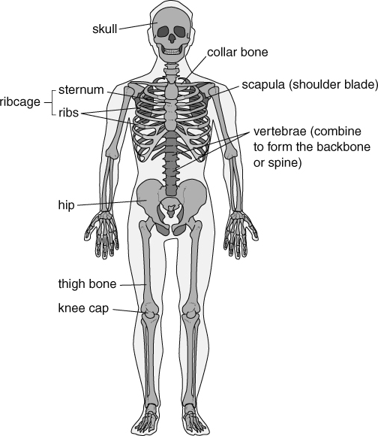
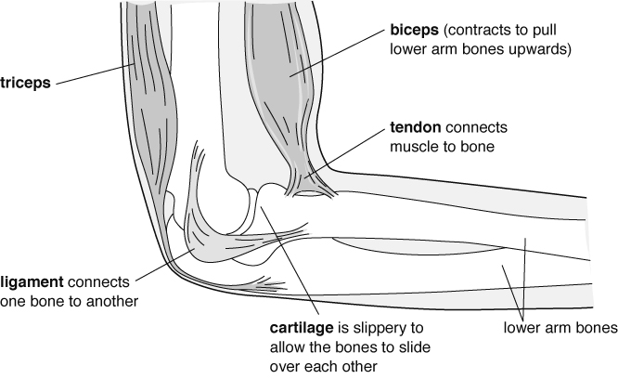
Summary Sheets
7C
Locomotor system
The locomotor system consists of bones and muscles and lets you move.
Bones are organs that form the skeleton, which:
protects some organs (e.g. the ribs and sternum protect the lungs; the skull protects the brain)
supports your body (e.g. the vertebrae in your ‘backbone’ hold you up straight)
allows you to move (using muscles at your
joints).
Bones are hard (to withstand knocks and pressure) and light (so they are easy to move). Many have a hollow centre containing bone marrow, where blood cells are made.
HALF TERM 2
The human skeleton.
Muscle action
Muscles cannot push and so bones need pairs of muscles (antagonistic pairs) to pull them in opposite directions. One muscle contracts (gets shorter and fatter) to pull a bone. At the same time, the other muscle in the pair relaxes.
The elbow joint is a flexible joint (whereas the bones in the skull meet at fixed joints).
Muscles are controlled by the nervous system. Impulses from the brain travel down the spinal cord and along nerves to muscles.
Muscle cells are adapted to their function by containing strands that can shorten to produce a pulling force. This requires energy from respiration.
The oxygen and nutrients (from food) required for respiration are carried to the muscles in the blood. Nutrients are carried in the plasma, while oxygen is carried on red blood cells. Blood also contains white blood cells, which attack micro-organisms.

Slide 8
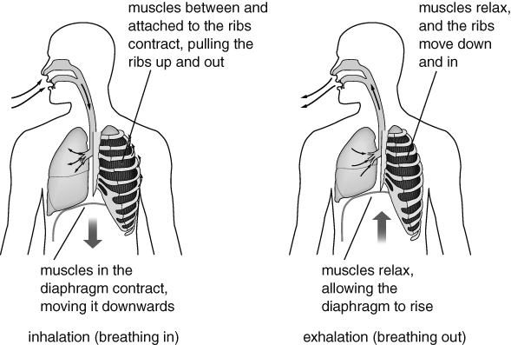
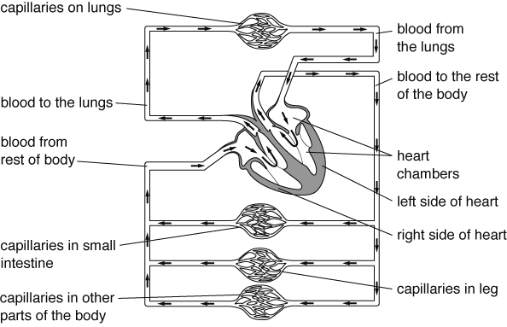
Summary Sheets
7C
HALF TERM 2
Breathing
The gas exchange or breathing system allows air to enter and leave the lungs, so that oxygen can get into the blood and carbon dioxide can leave the blood. Oxygen for respiration leaves the lungs and enters the blood. Carbon dioxide (a waste product from respiration) leaves the blood and enters the air in the lungs. Carbon dioxide is excreted when you exhale.
Breathing is the movement of the muscles in your diaphragm and between the ribs, which cause the changes in the volume of the lungs. Ventilation is the movement of air into and out of the lungs as breathing occurs.
Diagram showing breathing.
Circulation
Blood is carried to the heart by veins, where it enters the chambers of the heart. The blood is then forced back out when the heart muscle tissue contracts. The pumping of the heart can be felt in arteries as a pulse.
Arteries are connected to veins by capillaries, which are blood vessels with very thin walls that allow oxygen and nutrients to leave the blood to get to the cells in tissues. Carbon dioxide from the cells can easily get into the capillaries.
Some of the circulatory system.
Drugs
Drugs are chemicals that affect how the body works. Some can damage your organs (e.g. the liver), particularly if they are abused. Some drugs are addictive.
Medicines (e.g. antibiotics) are drugs that can help people who are suffering from diseases. Recreational drugs are drugs that people take because they like the effect that they have on their bodies (e.g. caffeine in coffee and alcohol, which are both legal drugs). Some are illegal drugs (e.g. heroin and ecstasy) because they have very harmful side-effects.
Drugs that slow down the nervous system are called depressants. Alcohol is a depressant.
It alters behaviour and slows reaction times. Drugs that speed up the nervous system are called
stimulants (e.g. caffeine).

Slide 9
Summary Sheets
7I
HALF TERM 2
Energy from food
Humans and other animals need energy to live. The energy resource for our bodies is the energy stored in food. We need to choose our food so that we get the right amount of energy.
The unit for measuring energy is the joule (J). There is a lot of energy stored in food, so we usually measure the energy in food using kilojoules (kJ). 1 kJ = 1000 J.
Energy transfers and stores
Energy can be transferred by:
heating
light
sound
electricity
forces.
Energy can also be stored in different ways.
Energy stored in… | Commonly called…
the chemicals in food, fuels and batteries | chemical energy
moving objects | kinetic energy
hot objects | thermal energy
objects that are stretched, squashed or twisted | strain energy or elastic potential energy
objects moved to high places | gravitational potential energy
inside the particles that everything is made up from | nuclear energy or atomic energy
Energy is not used up. It can be transferred and stored in different ways, but it cannot be created or destroyed. This is called the law of conservation of energy.
Fuels
Fuels store energy, and this energy is transferred when the fuels burn. Burning fuels are used to heat things.
Fossil fuels:
are made from plants and animals that were trapped in mud and rocks millions of years ago
include coal, oil and natural gas
are non-renewable (they take millions of years to form, and so our supplies will run out)
produce gases that cause pollution and global warming when burnt
are relatively cheap to obtain
originally got their energy from the Sun. The plants that became coal, oil and natural gas got their energy from the Sun, and the animals that became oil and natural gas got their energy from plants, which got their energy from the Sun.
Nuclear fuel is also non-renewable. Nuclear power stations produce dangerous waste materials.
Electricity is not a fuel. It has to be generated using other energy resources.

Slide 10
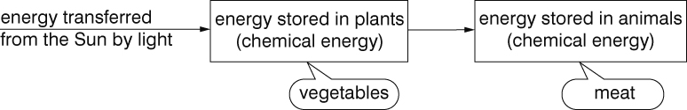
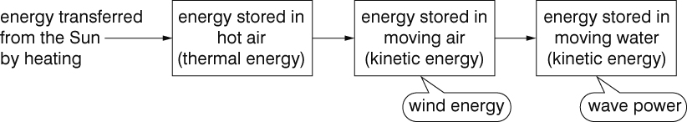
7I
HALF TERM 2
Summary Sheets
Making fossil fuels last longer
We can make fossil fuels last longer and help to reduce global warming by using less of them. We could walk or cycle whenever we can, or use a bus instead of using a car. Walking and cycling would make us fitter and healthier, and there would be less pollution if there were not as many cars on the roads. We could also save energy by keeping our houses cooler and putting on more clothes if we are cold instead of turning up the heating.
Renewable energy resources:
include solar, wind, tidal, wave, biofuels, geothermal and hydroelectricity
do not produce harmful gases or contribute to global warming
are often more expensive than using fossil fuels
will not run out
are not always available.
Hydroelectricity, geothermal energy and biofuels are available at any time. Tidal power is not available all the time, but we can predict when it will be available. Energy from solar, wind and waves is only available some of the time.
Energy from the Sun
Most of the energy resources we use store energy that originally came from the Sun.
Only geothermal power, nuclear power and tidal power do not depend on energy from the Sun.
How energy is transferred to our food:
How energy is stored in the wind and in waves:

Slide 11
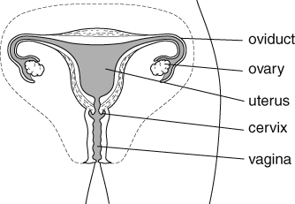
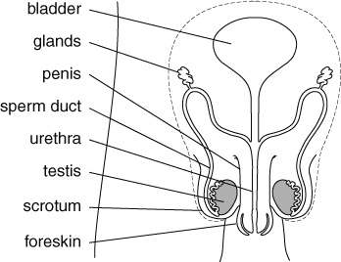
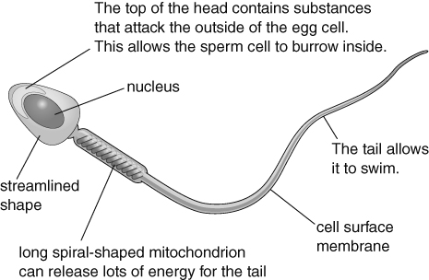
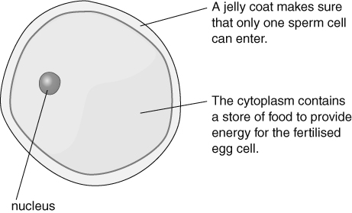
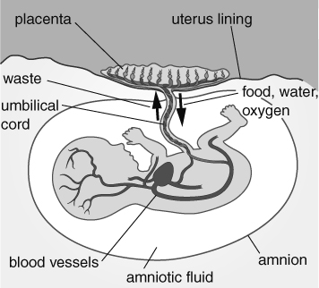
Summary Sheets
7B
HALF TERM 3
Reproduction
Reproduction produces new living things (offspring). Two parents are needed for sexual reproduction.
Males and females have reproductive systems, which contain reproductive organs to allow them to reproduce. The ovaries and testes produce gametes or sex cells.
Sexual intercourse in mammals
During sexual intercourse, semen (sperm cells mixed with special liquids from the glands) is forced out of the penis and into the top of the vagina. This is called ejaculation. The semen travels into the top of the uterus and the sperm cells then swim down the oviducts.
Sperm and egg cells are adapted to their functions. A sperm cell is much smaller than an egg cell.
The female reproductive system
The male reproductive system
Pregnancy in mammals
If an egg cell meets a sperm cell in an oviduct, fertilisation can occur (the nuclei from the two cells fuse). The fertilised egg cell divides to form a ball of cells (an embryo). The embryo travels to the uterus where it sinks into the uterus lining (implantation). The woman is now pregnant. Once the embryo has developed all its organs it is called a fetus. It takes about 40 weeks (9 months) for a human fertilised egg cell to grow into a baby ready to be born. This time is called the gestation period.

Slide 12
Summary Sheets
7B
HALF TERM 3
While inside the uterus, the fetus is supplied with oxygen and food by the placenta. The placenta also gets rid of waste (especially carbon dioxide) from the fetus. The umbilical cord connects the fetus to the placenta.
If a mother smokes, drinks too much alcohol or takes drugs while pregnant, she might damage the baby. The baby might be premature.
Birth in mammals
The uterus starts contractions and the woman goes into labour.
The muscles of the cervix relax.
The baby is pushed out head first through the cervix and the vagina.
The baby starts to breathe and the umbilical cord is cut. The scar left behind is the navel.
Then the placenta is pushed out of the uterus. This is the afterbirth.
The mother’s breasts contain mammary glands that produce milk to feed the baby. Breast milk contains all the nutrients that a baby needs and antibodies, which help destroy micro-organisms that might cause diseases.
Growing up
The stages through which an organism goes as it grows and develops are its lifecycle. In the human lifecycle, a baby grows into a child. Between the ages of 10 and 14 years, most children start to go through puberty. During puberty, sex hormones cause big physical changes to occur. Adolescence is the time when emotional as well as physical changes occur. It ends at about 18.
Changes in boys | Changes in girls
hair grows under arms, on face and on chest | hair grows under arms
pubic hair grows | pubic hair grows
shoulders get wider | hips get wider
body smell increases | body smell increases
testes start to make sperm cells | ovaries start to release egg cells
testes and penis get bigger | breasts develop
voice deepens (‘breaks’)
After puberty, animals are able to sexually reproduce. Men produce sperm cells for the rest of their lives. Women stop releasing egg cells at the age of 45–55 and this is called the menopause.
In all mammals fertilisation happens inside the female. This is called internal fertilisation. In some animals (e.g. frogs, fish) fertilisation happens outside the female (external fertilisation).
The fertilised egg cells of many animals also grow and develop outside their parents. This is called external development. Amphibians, birds and fish use external development. Humans use internal development and produce fewer offspring than animals using external development because the growing embryos are protected inside the mother.

Slide 13
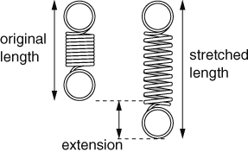
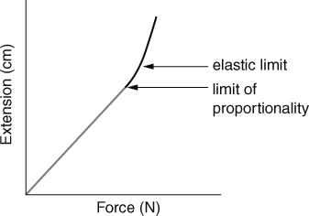
Summary Sheets
7K
HALF TERM 3
Forces
Forces are pushes or pulls. Forces can:
change the shape or size of an object
change the speed things are moving (make them move faster or slower)
change the direction of a moving object. The unit for measuring force is the newton (N).
Friction is a force caused by two things rubbing together. Air resistance and water resistance
are kinds of friction.
Solid things, like your chair, push up on you when you sit on them. Upwards forces from water or air are called upthrust. Things float in water because of upthrust.
Contact forces only act when two objects or materials are touching. Examples of contact forces are:
Some forces can have an effect without objects touching. They are called non-contact forces. There are three non-contact forces:
friction
air resistance
water resistance
upthrust.
magnetism
gravity
static electricity.
Weight and mass
Your mass is the amount of substance in your body. Your mass is measured in kilograms (kg). Your weight is a force caused by gravity pulling on your body. The newton (N) is the scientific unit used to measure forces, and so it is also used as the unit for weight.
Wherever you take an object, its mass will not change but its weight depends on the force of gravity. An object on the Moon would have a smaller weight than on Earth, because the Moon’s gravity is not as strong as Earth’s.
Measuring forces
Elastic materials will stretch with a force and then return to their original shape when the force is taken away.
Springs are elastic. The extension of a spring is the
difference between its original length and its stretched length.
The extension of a spring is proportional to the force on it. This is called Hooke's Law.
If the spring is stretched too far, the extension stops being proportional to the force. If it is stretched even further, it goes beyond its elastic limit. The spring will no longer return to its original length when the force is removed.
Force meters have springs inside them.
Materials like Plasticine® will stretch with a force but they will not return to their original shape afterwards.
Plasticine® is a plastic material.

Slide 14
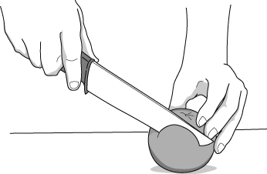
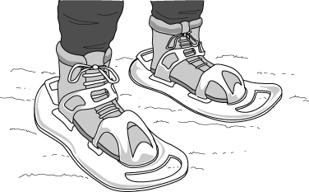
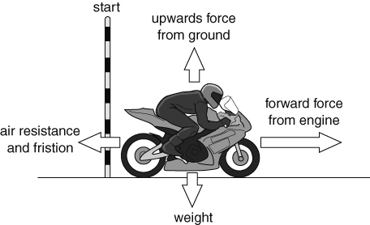
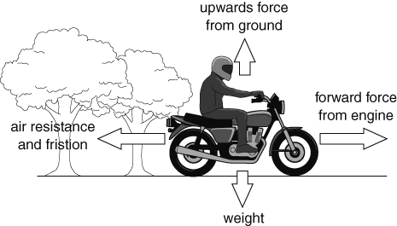
Summary Sheets
7K
HALF TERM 3
Friction
Friction is a contact force. Friction can:
slow things down
wear things away
produce heat
cause a noise.
Friction can be increased by using rough surfaces, or by using materials such as rubber that have a lot of friction.
Friction can be reduced by using smooth surfaces, or by lubrication. Oil and grease are examples of lubricants, and help things to move past each other easily.
Pressure
Pressure is the amount of force pushing on a certain area.
For a certain area, the bigger the force, the bigger the pressure. For a certain force, the bigger the area, the smaller the pressure.
Sharp knife – a small area giving a large pressure. Snow shoes – a large area giving a small pressure.
We can work out the pressure under an object using this formula:
pressure = force ÷ area
Balanced and unbalanced forces
Balanced forces are forces on an object that are the same size but work in opposite directions. If forces are balanced:
a stationary object stays stationary
a moving object continues to move at the same speed and in the same direction. If there are unbalanced forces on an object:
a stationary object will start to move
a moving object will change its speed or direction.
Unbalanced forces – the motorbike will speed up.
Balanced forces – the motorbike will continue to move at a steady speed.
A car or motorbike uses the energy stored in fuel to move at a steady speed because it needs a force from the engine to balance the forces of air resistance and friction.

Slide 15
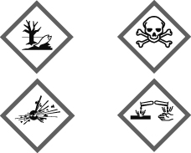
7F
HALF TERM 4
Summary Sheets
Hazards
A hazard is something that can cause harm.
Chemicals are labelled with hazard symbols to warn people of potential dangers.
Some common hazard symbols are:
Risk
WS
A risk is the chance that a hazard will actually cause harm.
Risks can be reduced by taking precautions. E.g. wearing eye protection to prevent chemicals splashing in your eyes or tying long hair back to prevent it catching fire in a Bunsen flame.
Acids
Common substances at home that contain acids include: citric acid, vinegar, fizzy drinks and car battery acid.
Acids have a sour taste.
Most concentrated acids are corrosive. If they are added to water they become more dilute. Dilute acids are less hazardous. Many dilute acids are irritant.
Alkalis
Common substances at home that contain alkalis include: toothpaste, drain cleaner, oven cleaner.
Many alkalis are metal hydroxide solutions.
An alkali can be described as a soluble base. A base is any substance, soluble or insoluble, that neutralises an acid forming a salt and water.
Indicators
Indicators change colour and can be used to detect acids, alkalis and neutral solutions.
Litmus is a common indicator.
Solution | Colour of litmus
acid | red
neutral | purple
alkali | blue

Slide 16
Summary Sheets
7F
HALF TERM 4
pH scale
A numbered scale from 1 to 14.
Acids have a pH less than 7. The lower the pH, the more acidic the substance is. The lower the pH, the more hazardous the acid is.
Neutral solutions have pH 7.
Alkalis have a pH more than 7. The higher the pH, the more alkaline the substance is. The higher the pH, the more hazardous the alkali is.
strong acid |  |  |  | we | ak | acid |  | neutral | weak alkali |  |  | strong |  |  | alkali
1 | 2 |  | 3 | 4 | 5 |  | 6 | 7 | 8 | 9 | 10 | 11 | 12 | 13 |  | 14
stomach acid |  | vinegar lemon juice |  | fizzy drinks |  |  | skin milk | pure water | indigestion powder toothpaste |  |  | washing powder |  | oven cleaner
Neutralisation
This is a reaction between an acid and an alkali.
acid + alkali → salt + water
It is also a reaction between an acid and a base.
acid + base → salt + water
Word equation
This summarises a reaction by writing the names of the substances you start with and the names of the new substances that are made.
Reactants are the substances you start with and are written on the left side of the word equation.
Products are the new substances that are made and are written on the right side of the word equation.
There is an arrow between the reactants and products. The arrow means ‘react to form’. Do not write an equals sign, =.
For example
hydrochloric acid + sodium hydroxide → sodium chloride + water Hydrochloric acid and sodium hydroxide are the reactants.
Sodium chloride and water are the products.
Notice the arrow between the reactants and the products.

Slide 17
7F
HALF TERM 4
Summary Sheets
Salts
Salts are made when an acid reacts with an alkali or a base.
Salts names are made of two words.
The first part of the name of the salt is the same as the metal in the alkali or base.
The second part of the name of the salt comes from the acid.
Acid | Second part of the name of the salt | Example
hydrochloric acid | chloride | Zinc chloride is made from zinc oxide and hydrochloric acid
nitric acid | nitrate | Magnesium nitrate is made from magnesium oxide and nitric acid
sulfuric acid | sulfate | Copper sulfate is made from copper oxide and sulfuric acid
Neutralisation in everyday life
Antacids are indigestion remedies. People take these medicines if they have indigestion caused by too much acid in the stomach. The antacid contains a base that neutralises the extra acid.
Soil can become too acidic for some crops to grow. Farmers spread lime (a base) on the soil to neutralise the acid.
Toothpaste contains a mild alkali to neutralise the acid in our mouths.
Alkalis are used to neutralise the acidic gases coming out of power stations.
Sulfuric acid reacts with iron oxide in rust and removes it from the surface of an object.
Page 3 of 3
16

Slide 18
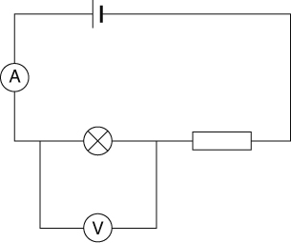
7J
HALF TERM 4
Summary Sheets
Electrical circuits
Electricity is a flow of charges. Electricity can flow through conductors but not through
insulators. Metals are good conductors of electricity. Plastics are good insulators.
For current to flow in a circuit, you need:
a complete circuit with no gaps
a cell or power supply.
We can use models to help us to think about electricity and circuits. One model for a circuit is a central heating system. The boiler and pump represent the cell, the pipes represent the wires, and the radiators represent bulbs.
Symbols
Component | Symbol | Component | Symbol | Component | Symbol
cell |  | bulb |  | ammeter
switch |  | resistor |  | voltmeter
Measuring electricity
Current is the amount of electricity flowing in the circuit.
It is measured using an ammeter connected in series.
The units for current are amps (A).
Voltage provides the ‘push’ and energy.
It is measured using a voltmeter connected in parallel.
The units are volts (V).
Resistance
The resistance of a circuit is a way of saying how easy or difficult it is for electricity to flow.
High resistance = hard for electricity to flow = small current.
Low resistance = easy for electricity to flow = large current.
Thin wires and resistors have high resistances. Thick wires have low resistances.

Slide 19
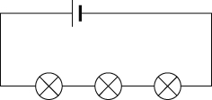

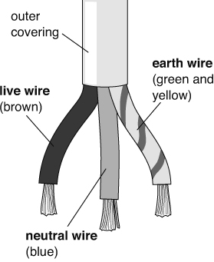
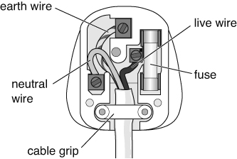
7J
Series and parallel circuits
Circuits can be series or parallel circuits.
HALF TERM 4
Summary Sheets
Series circuit | Parallel circuit
If one bulb breaks, all the others go off. The current is the same everywhere. If you put more bulbs in they will be dimmer, because it is harder for the electricity to get through. The resistance of the circuit is higher with more bulbs. | If one bulb breaks, the bulbs in the other branches stay on. The current splits up when it comes to a branch. The current in all the branches adds up to the current in the main part of a circuit. If you add more bulbs, they stay bright. It is easier for the current to flow with more branches, because there are more ways for the charges to go.
Safety
Electricity can be dangerous if it is not used properly. It can cause:
fires
burns
shocks that can stop your heart or lungs working. The wiring in houses is designed to be safe.
Fuses are used in plugs. They melt if the current gets too high. A fuse has a rating that shows what current it can carry without melting. It is important to use the correct fuse.
Circuit breakers also cut off the current if it gets too high. They protect the ring mains in buildings (loops of parallel circuits).
Cables have three colour-coded inner wires. The live and neutral wires are part of the circuit. The earth wire works with the fuse for safety.

Slide 20
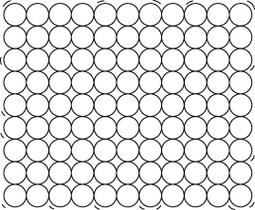
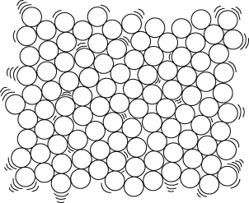

Summary Sheets
7G
HALF TERM 5
The particle theory
A scientific method describes how scientists try to explain the world around them. It usually starts with some observations, which generate a question. Scientists may then follow a series of unbiased steps to answer the questions. These steps could include the following:
thinking up an idea or using existing ideas that would explain the observations. These ideas are called hypotheses.
using the hypothesis to make a prediction about the hypothesis.
testing the prediction by experiment, and collecting data.
checking the data to see if it matches the prediction.
using the data as evidence to support the hypothesis (or prove it is wrong).
forming a theory if the hypotheses have been tested many times and shown, by the evidence, to be correct. The particle theory is an example.
The different properties of solids, liquids and gases can be explained by the particle theory
(or particle model). Solids, liquids and gases (the three states of matter) need to be handled and stored differently because of these different properties.
Solids
  Solids are made up of particles that are very close together. (Strong forces of attraction hold the particles together.)
  The particles in solids vibrate in fixed positions.
  The shape and volume of solids do not change.
  Solids cannot be squashed and do not flow.
Liquids
  Liquids are made up of particles that are fairly close together. (Quite strong forces of attraction hold the particles together.)
  The particles in liquids are able to move past each other.
  Liquids have a fixed volumes but their shape can change to fit the container as they flow easily.
  Liquids cannot be easily compressed (squashed).
Gases
  Gases are made up of particles that are well spread out. (There are only weak forces of attraction between the particles.)
  The particles in gases move about freely in all directions.
  The shape and the volume of gases can change as they flow very easily and spread out.
  Gases can be compressed (squashed) quite easily.

Slide 21

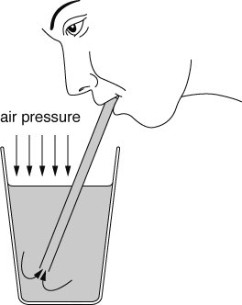
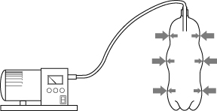
7G
HALF TERM 5
Summary Sheets
Brownian motion
When pollen grains in water are observed through a microscope they are seen to move jerkily in different directions. This is called Brownian motion. It is caused by water particles, which are moving all the time, hitting the pollen grains. The pollen grains are small enough so that when many water particles hit one side of the grain, the grain is moved in that direction.
Brownian motion provides evidence to support particle theory.
Diffusion
Diffusion is said to have occurred when chemicals mix together without anything moving them. Diffusion occurs because particles in a substance are always moving around. Diffusion is fastest in gases, and slower in liquids.
Dilution
When you add water to orange squash you dilute it. The colour becomes paler because the orange coloured squash particles are spread out more among the water particles.
Pressure in gases
Pressure is caused by particles hitting the walls of the container they are in. The pressure may increase because:
the container has been squashed, making the volume smaller so that the particles will be hitting the walls more often.
the number of particles has been increased, so that there are more particles moving around to hit the walls.
If the particles are in a flexible container, like a balloon, an increase in pressure inside the container can make the volume increase. If the pressure becomes too great, the balloon will burst.
Air pressure is the pressure caused by air particles around us. Air pressure lets us suck things up using a straw and also causes a container to collapse if the air is sucked out. If all the air is sucked out of a container, you get a vacuum – nothingness.

Slide 22
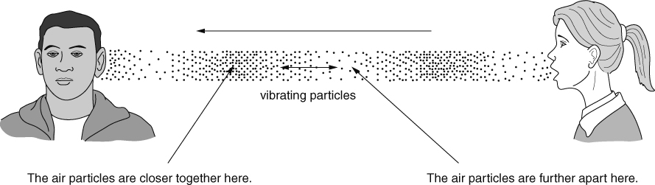
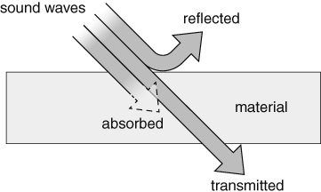
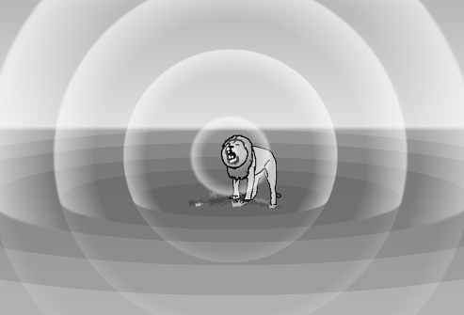
Summary Sheets
7L
HALF TERM 5
Sound vibrations and waves
Sound is a way of transferring energy. Sounds are made when things vibrate. The vibrations are passed on by particles. Sound therefore needs a medium (substance) to pass on the vibrations, so it can travel through solids, liquids and gases but not through empty space.
The speed of sound is usually faster through materials in which particles are closer together. Closer particles hit each other more easily and so the energy is more likely to be passed from one particle to the next. Sound travels faster in solids than in liquids, and it travels slowest in gases.
Frequency and amplitude
The frequency of a sound wave is the number of complete waves passing a point each second. The unit of frequency is the hertz (Hz). Pitch is how high or low a sound is. High frequency sounds have a high pitch.
The amplitude of a wave is how far the particles move as the vibrations pass. The larger the amplitude, the louder the sound. The loudness of a sound is also described as the volume or the intensity of the sound.
The loudness of a sound is measured using a sound intensity meter. The units are decibels
(dB).
Absorbing, reflecting and transmitting
Sound waves can be reflected by a material. This usually happens if the material is hard. Soft materials absorb some of the sound that reaches them, and transmit only a little.
When a sound wave moves energy from one place to another, we say that the energy has been transferred. The energy spreads out in all directions because the particles move in all directions unless something stops them. This means that the intensity of a sound gets less as you get further from its source.

Slide 23
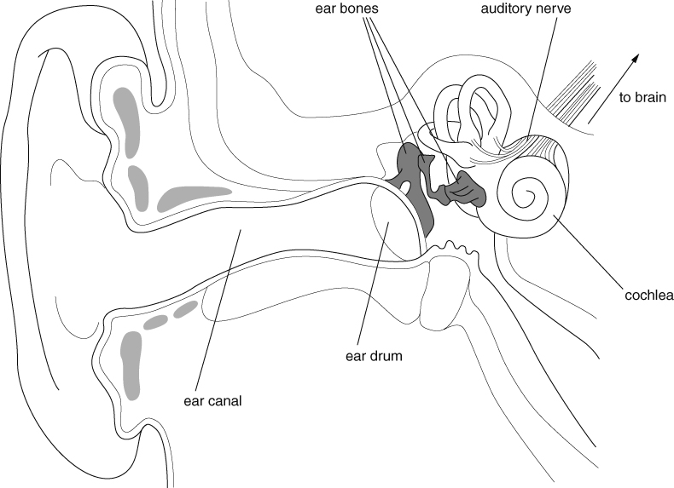
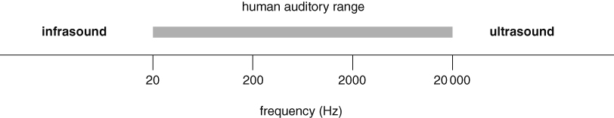
7L
HALF TERM 5
Summary Sheets
Ears and hearing
Sound is detected by ears and microphones. In a microphone, sound waves make a diaphragm
vibrate, and electronics are used to convert the vibrations into changes in an electrical current.
Ears work in a similar way. Sound waves make the eardrum vibrate. The vibrations are passed on by three small ear bones, which also amplify the vibrations (make them bigger). The vibrations pass on to the liquid inside the cochlea, where tiny hairs detect them and send impulses along the auditory nerve to the brain.
The auditory range of an animal is the range of frequencies of sound it can hear. Animals such as bats and dolphins can hear ultrasounds (sounds with frequencies greater than 20 000 Hz). Some animals can hear infrasounds (frequencies less than 20 Hz).
Uses of sound
Humans and other animals use sound for communication.
Some animals, such as bats and dolphins, use ultrasound to locate prey and avoid obstacles.
Humans use ultrasound in sonar, to find the depth of the sea or locate fish or submarines.
Humans use the energy transferred by ultrasound to clean delicate objects (such as jewellery) or in physiotherapy (to relieve pain or aid healing).

Slide 24
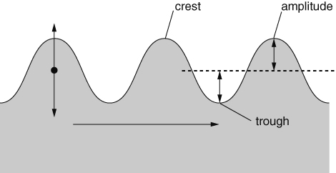
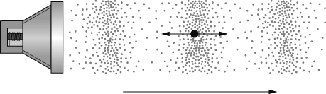
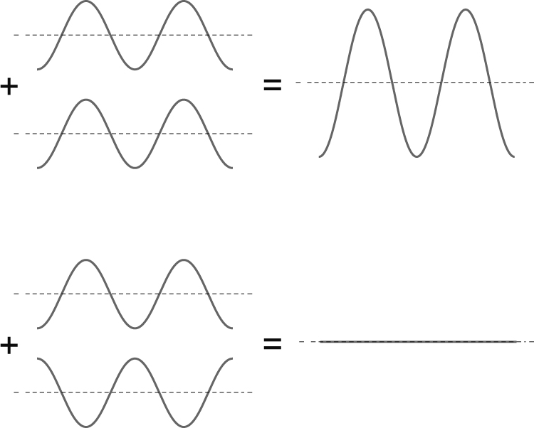
7L
HALF TERM 5
Summary Sheets
Comparing waves
Transverse waves
waves on the surface of water
particles vibrate at right angles to direction wave is travelling
Longitudinal waves
sound waves
particles vibrate in same direction as wave travels
All waves
transfer energy without transferring matter
can be reflected, transmitted and absorbed
can affect other waves by superposition, when their effects can add up or cancel out.

Slide 25


Summary Sheets
7D
HALF TERM 6
Habitats and environments
A habitat is the area where an organism lives. The conditions in a habitat are called the environment. An environment is affected by non-living factors (e.g. light, dampness, temperature), called physical environmental factors.
Physical environmental factors change from day to day (daily changes). As the conditions change, the organisms respond. For example, nocturnal animals are only active at night.
Physical environmental factors change over the year (seasonal changes). Organisms respond to these changes. For example, in autumn some birds migrate to warmer countries to feed during the winter.
To survive in a habitat, organisms need resources. An animal needs space, food, water, shelter and a mate to reproduce. Plants need space, light, water and mineral salts.
All the organisms in a habitat form a community. Within a community, the total number of one species is called a population.
Adaptations
Organisms have adaptations that allow them to survive in a habitat. For example, fish are adapted to living underwater. They have gills to take oxygen out of the water, fins to swim with and streamlined bodies to help them move easily through the water. Organisms that are better adapted to survive in an area will have a better chance of survival.
Populations
The size of a population is affected by several factors.
Jackrabbits are adapted to living in a desert habitat.
Organisms compete with each other for resources. Competition for resources may cause populations of some organisms to decrease.
Disease can kill organisms.
Poisons may kill organisms, or kill the organisms that they depend on. Some pesticides are persistent and can build up in the animals as you go along a food chain, harming the top predators.
Changes in one population affect other populations. When there are a lot of prey organisms, the number of predators increases because they have plenty of food. This decreases the number of prey, which then leads to a decrease in the number of predators.
Page 1 of 2

Slide 26




Summary Sheets
7D
Food chains and webs
Food chains show what eats what in a habitat. However, organisms depend on other organisms in other ways. For example, many birds depend on trees in which to build nests.
HALF TERM 6
Food chains are joined to form food webs. Food webs can also show omnivores (animals that eat both plants and other animals).
The populations of the organisms at each level in a food chain can be shown as a pyramid of numbers. The size of each bar represents the number of organisms. Usually there are fewer organisms as you go along a food chain because energy is lost at each level (e.g. through movement, keeping warm, in waste materials).
Variation
A species is a group of organisms that can reproduce with one another to produce offspring that will also be able to reproduce. The differences between organisms are known as variation. There is variation between different species and between members of the same species. Variation that has a continual range of values is continuous variation (e.g. height). Variation that only has certain values is discontinuous variation (e.g. blue, brown or green eyes).
Sometimes there is a relationship between two features. A relationship is normally best shown on a scatter graph. A line of best fit can be drawn through the points to show the relationship.
Relationship: people with longer arms have longer middle fingers.
Environmental variation is variation caused by the environment. In humans, sunburn and having a scar are examples of environmental variation. Plants are affected by environmental factors such as the amount of light, water, warmth or mineral salts in the soil.
The cress seedlings on the left have not had enough light. The tomato plant on the left has not had enough water.
Inherited variation is caused by features being passed from parents to their offspring during reproduction. In humans, natural eye colour and natural hair colour are both examples of inherited variation.
Page 2 of 2

Slide 27




Summary Sheets
7H
Atoms, molecules, elements and compounds
All substances are made up of tiny particles called atoms. Substances can be made of single atoms but they can also be made of atoms bonded together in small groups, called molecules. Substances can also be made of many trillions of atoms all bonded together.
Natural materials can be pure (containing one substance) or mixtures (containing two or more substances which are not joined together). A mixture is formed if elements are mixed without joining.
Elements are simple substances made up of only one kind of atom.
There are about 90 different types of atom found on Earth. Therefore there are about 90 different elements.
HALF TERM 6
Most substances are compounds, which contain more than one kind of atom (more than one element) bonded (joined) together.
The Earth’s elements
The periodic table lists all 118 known elements. Element are described by symbols of one or two letters.
The first letter is always a capital letter and the second is always lower case.
The same symbols are used in all countries.
Although there are only about 90 natural elements, there are millions of compounds.
We obtain all the elements and compounds we need for living from the Earth’s atmosphere and crust.
Our resources are limited and some may run out in the near future. We need to take care of our resources, recycle more and make less waste.
e.g. Oxygen = O Magnesium = Mg Iron = Fe
Silicon = Si

Slide 28

Summary Sheets
7H
HALF TERM 6
Metals and non-metals
Elements can be classified as metals or non-metals, depending on their properties.
The common properties of metals are: The common properties of non-metals are:
●
●
●
●
●
high melting point solids, strong and flexible, shiny (when polished),
good conductors of heat, good conductors of electricity.
low melting point (gases, liquids and solids),
brittle (when solid),
not shiny,
poor conductors of heat,
poor conductors of electricity.
e.g. copper, iron, aluminium, zinc, and tin.
Note: mercury is the only liquid metal.
e.g. sulfur, oxygen, nitrogen, carbon and iodine.
The uses of an element depend on its properties. For example, copper and aluminium are used for electrical cables as they are strong, flexible and conduct electricity very well.
Making compounds
Compounds are formed when elements are mixed and react so that the atoms join together.
Naming compounds
If there is a metal in the compound, the name of the metal goes first.
If the compound contains only two elements then one of the element’s name has its ending changed to ‘ide’.
e.g. zinc + oxygen = zinc oxide iron + bromine = iron bromide
If a compound contains two elements plus oxygen, then the name ending of one of the elements is changed to ‘ate’.
e.g. sodium + carbon + oxygen = sodium carbonate
Chemical reactions
Chemical reactions always form one or more new substances.
Many chemical reactions occur in everyday life, for example, burning, cooking, rusting, digesting food.
Typical signs of chemical reaction include:
a colour change,
a gas being given off,
a solid forming in a liquid,
an energy change.
How chemical reactions start
Some reactions start just by mixing the right substances together.
Heat is often needed to start a reaction, but once started many reactions give out heat.
Others need a continuous supply of energy to keep them going.
e.g. acid and alkalis
e.g. burning natural gas
e.g. breaking down metal ores

Slide 29


Summary Sheets
7H
Modelling chemical reactions using word equations
HALF TERM 6
reactants → products
e.g. zinc + chlorine → zinc chloride
tin carbonate → tin oxide + carbon dioxide
Thermal decomposition reactions involve breaking down a single compound using heat.
Heating copper carbonate produces copper oxide and carbon dioxide.
Thermal decomposition reactions are used in industry to extract metals.
Sorting and presenting data
The way data is sorted and presented depends on the type of variable and what you want to show.
Tables – show values and order.
Bar charts – compare differences between qualitative/discrete variables.
Line graphs – shows trends between variables.
Scatter graphs – look for relationships between quantitative variables.
Pie charts – shows proportions of a total.
Note: Qualitative data = words. Quantitative data = numbers. Discrete data = only certain number values.
Gases in air | %
nitrogen | 78
oxygen | 21
other gases | 1
Pie chart of gases in air
Page 3 of 3
18

