Slide 1
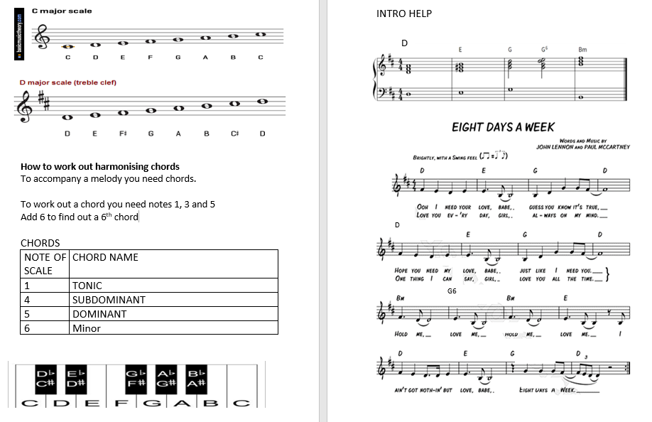
YEAR 9 – BEATLES – TOPIC ONE

Slide 2
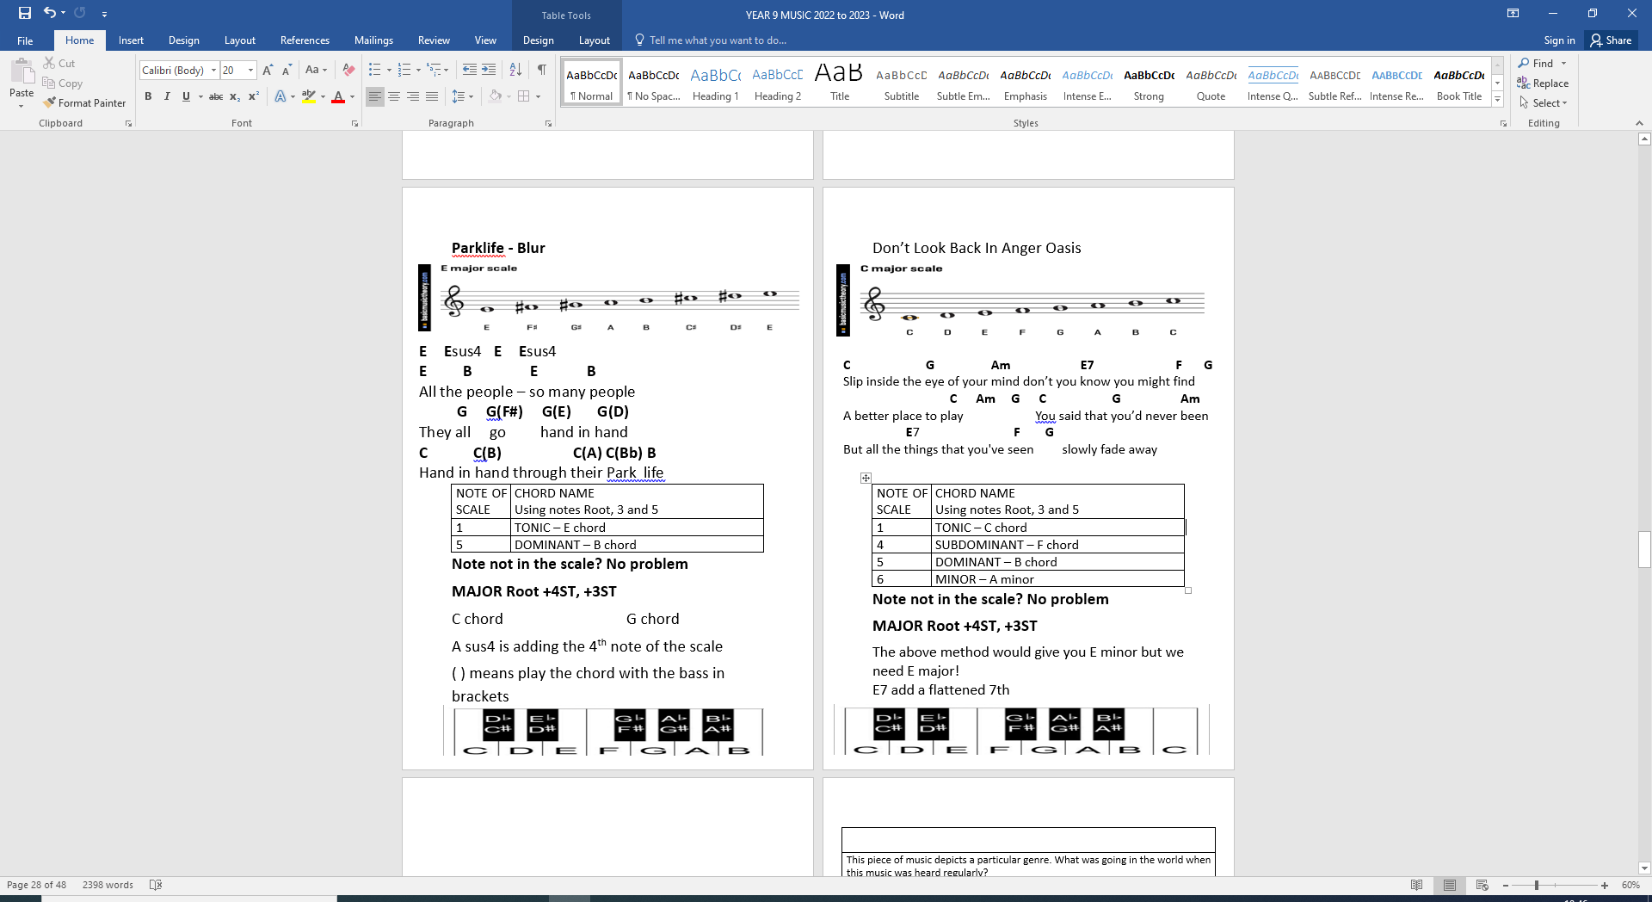
YEAR 9 – BRITPOP – TOPIC TWO

Slide 3
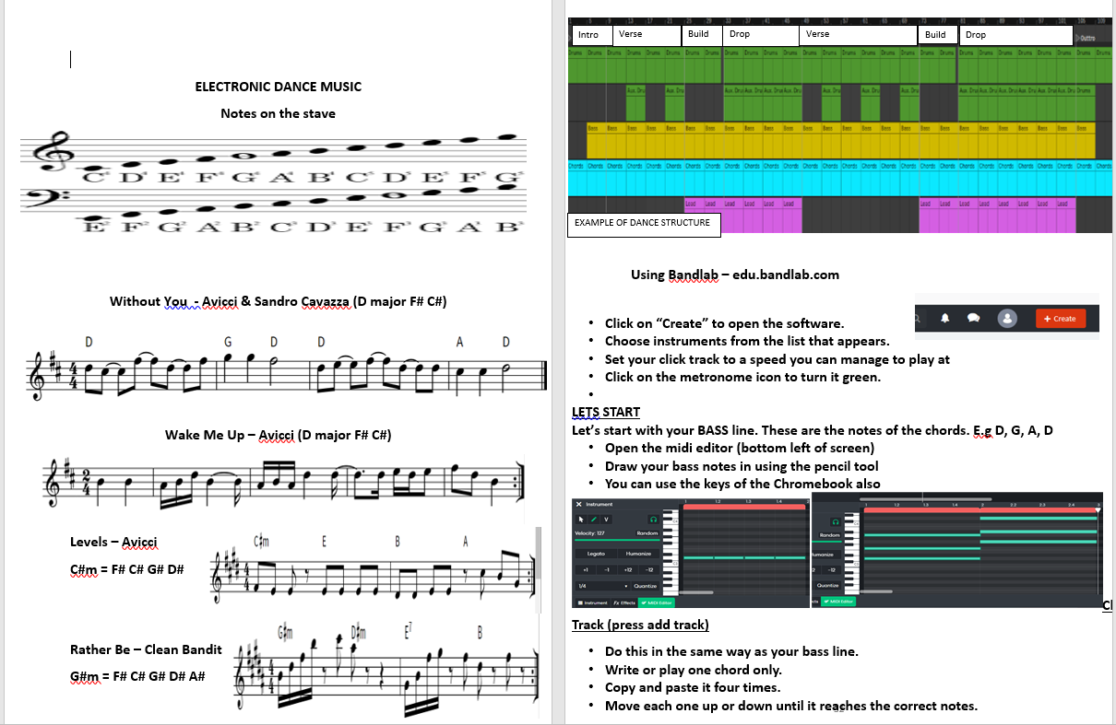
EDM Topic 3

Slide 4
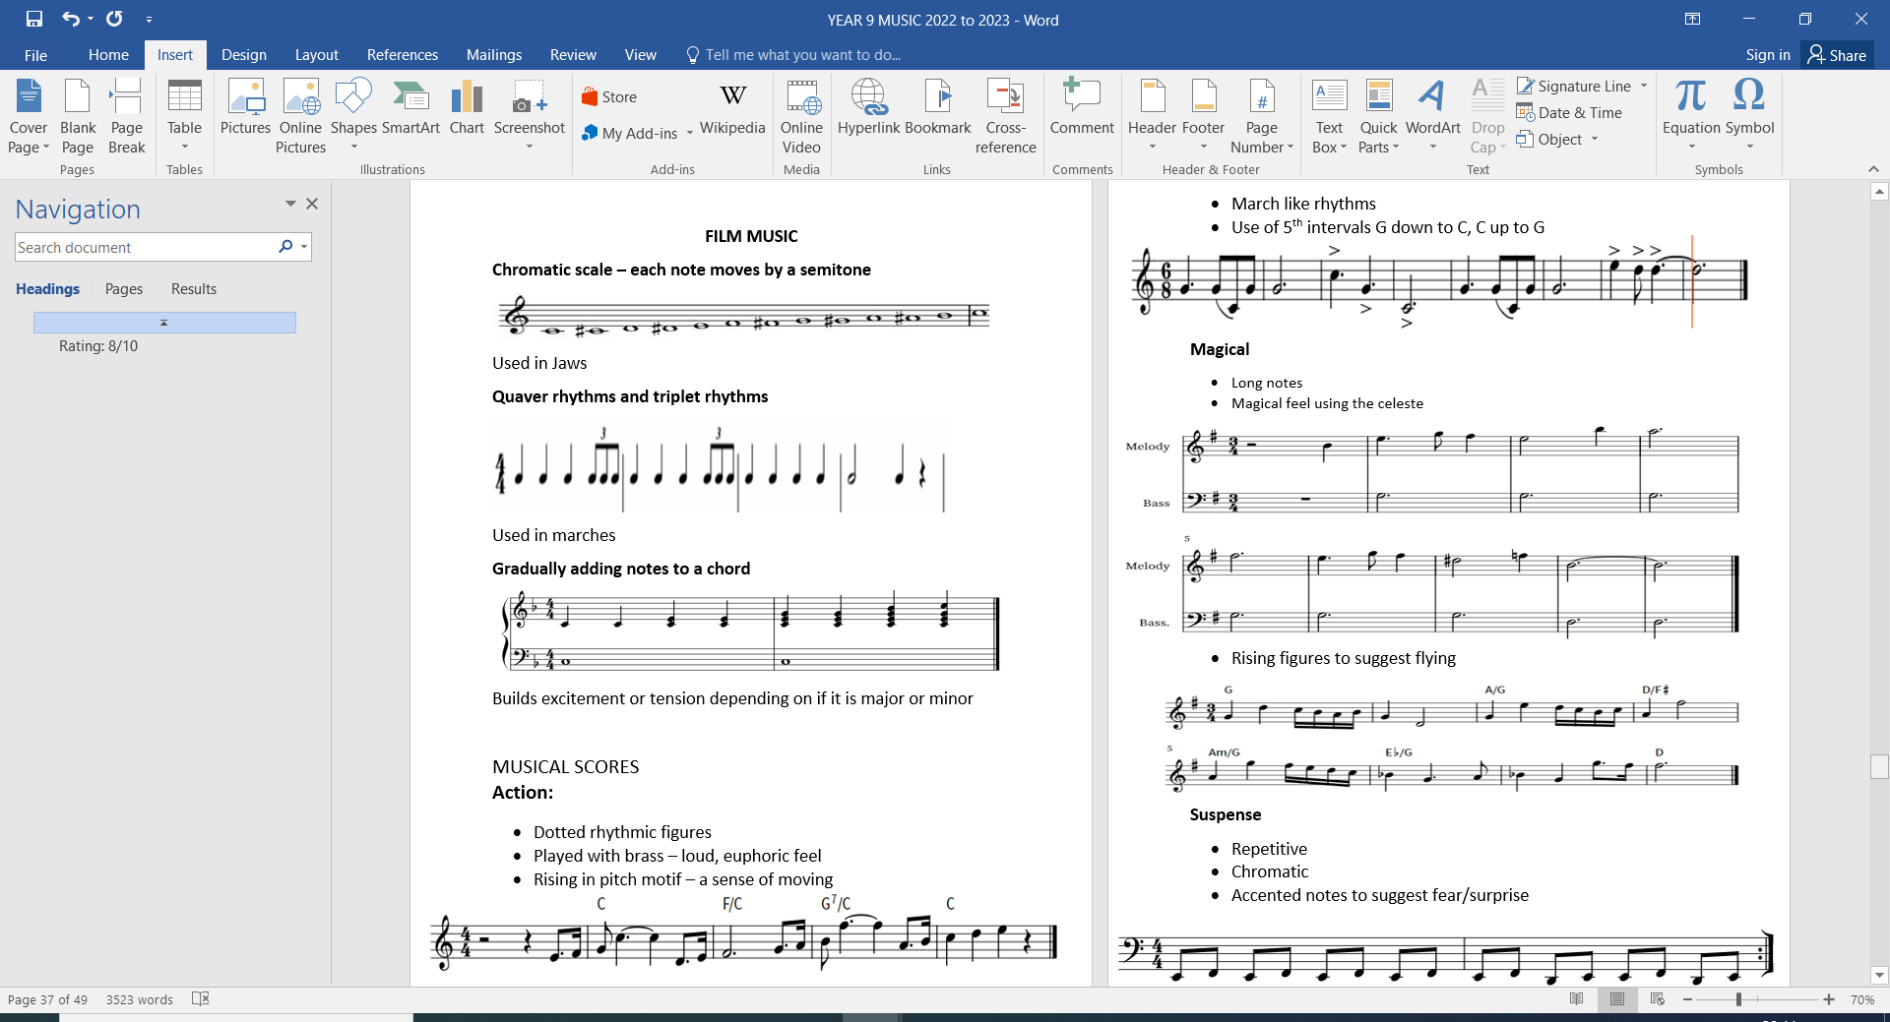
YEAR 9 – TOPIC FOUR

Slide 5
YEAR 9 – TOPIC FIVE

