Slide 1
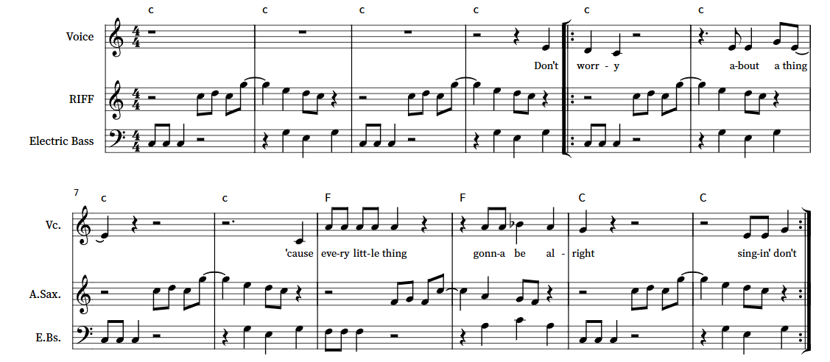

Year 8 Topic 1 Knowledge Organiser
Reggae
Three Little Birds in the Key of C
Score Reading Help
Riff based on the chord of C
C D C G - E D C
1 2 1 5 3 2 1
Chord Structure
To be played in a skank rhythm
C | C | C | C
F | F | C | C

Slide 2
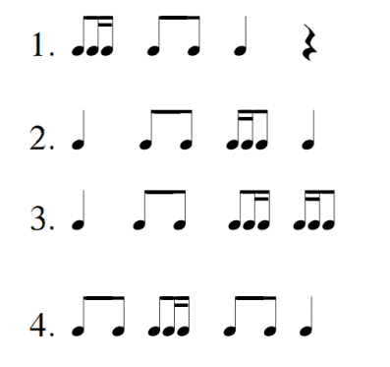
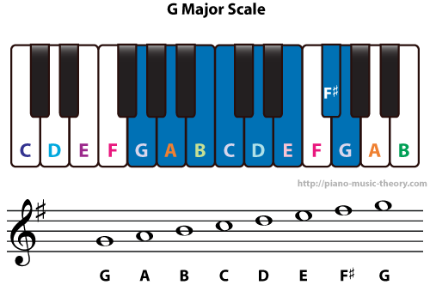
Year 8 Topic 2 Knowledge Organiser
Podcast Riff
Popular 4 Bar Chord Progressions in the Key of G
G | C | D | G
G | Am | D | G
G | Em | C | G
G | Em | Am | D
4 Rhythms which can be used when creating a riff
Vocabulary
A riff is a repetitive pattern
A riff is used to attract an audience
You can create a bass line from a chord progression

Slide 3
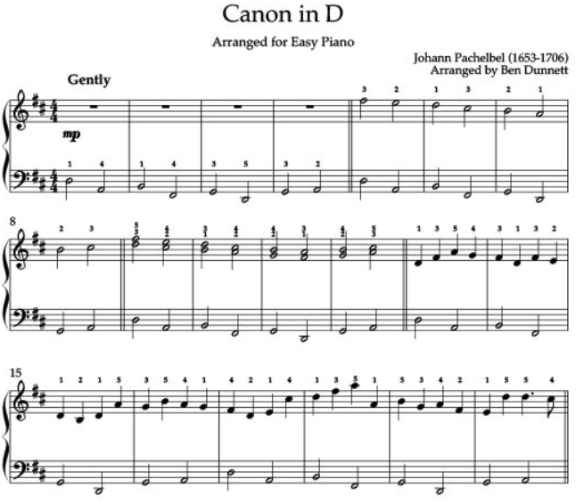
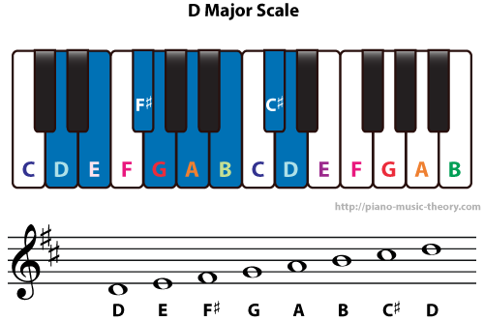
Year 8 Topic 3 Knowledge Organiser
Pachelbel's Canon
Pachelbel's Canon Chord Progression
D | A | Bm | F#m
D F# A | A C# E | B D F# | F# A C#
G | D | G | A
G B D | D F# A | G B D | A C# E

Slide 4
Year 8 Topic 4 Knowledge Organiser
Pachelbel Through The Ages
Pachelbel's Canon in D Chord Progression
D | A | Bm | F#m
D F# A | A C# E | B D F# | F# A C#
G | D | G | A
G B D | D F# A | G B D | A C# E
This is used for Scatman's World
Pachelbel's Canon in G Chord Progression
G | D | Em | Bm
GBD | D F# A | E G B | B D F#
C | G | C | D
C E G | G B D | C E G | D F# A
This is used for Black Parade

Slide 5
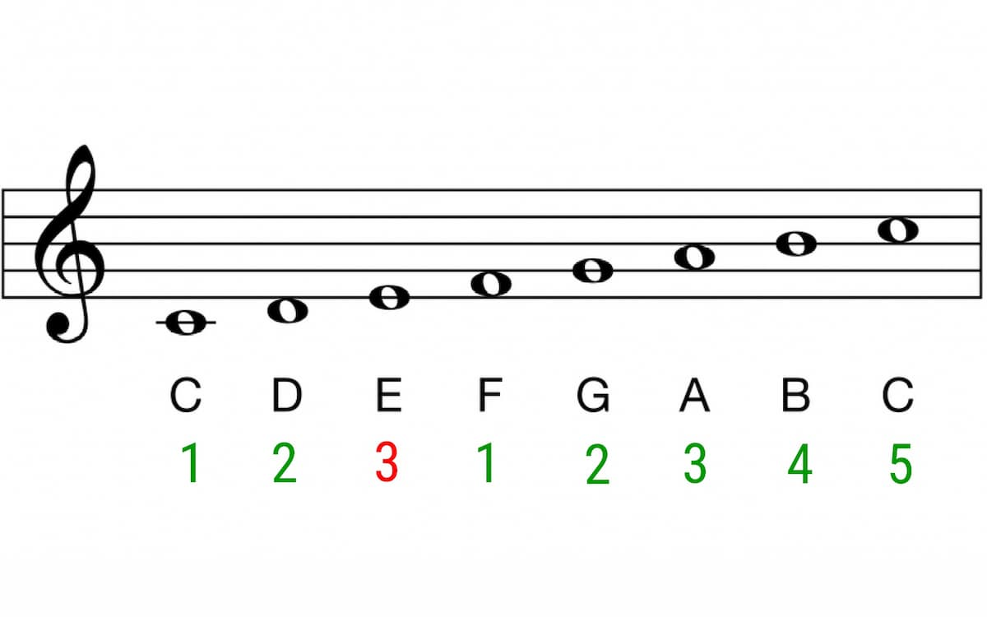
Year 8 Topic 5 Knowledge Organiser
Blues
A Typical Blues Progression in the Key of C
C | C7 | C7 | C7
F7 | F7 | C7 | C7
G | F | C7 | C
Creating a 7th Chord
Stick with the 1, 3, 5 rule and add a flattened 7th
The C7 chord:
The root is C, go to the third note
E, go to the fifth note
G, go to the flattened seventh
Bb. The notes for C7 are C E G Bb
Blues Lyrics
First line: I am feeling low so I sing the first line of a song
Repeat: I am feeling low so I sing the first line of a song
Last line: The last line is here and it sounds really wrong
Improvise with a Blues scale over the chord progression:
To find the Blues scale you do the following:
Take away the second note
Flatten the third note
Take away the sixth note
Flatten the seventh note
Scale of C
Blues scale:
C Eb F G Bb

Slide 6
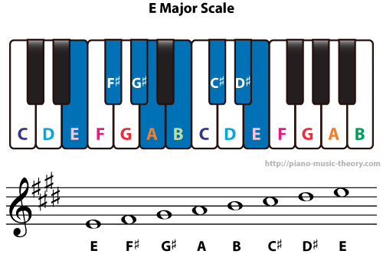
Year 8 Topic 6 Knowledge Organiser
Blues Through the Ages
A Typical Blues Progression in the Key of C
C | C7 | C7 | C7
F7 | F7 | C7 | C7
G | F | C7 | C
Used for Hound Dog by Elvis Presley
A Typical Blues Progression in the Key of E
 |  | E | E
E | E | E | E
A | A | E | E
B | A | E | E
Used for I Want To Break Free By Queen
Scale of C

