Slide 1
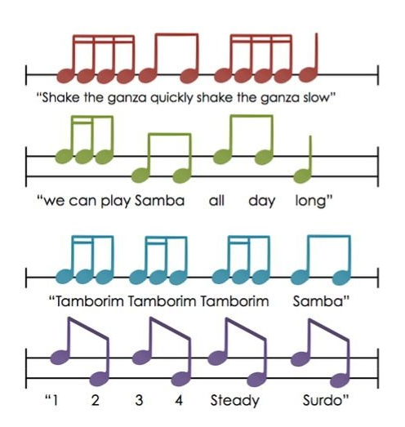
Year 7 Topic 1 Knowledge Organiser
Rhythm
Note Value | Said like this | Looks like | Duration
Semibreve | Hold - - - | 𝅝 | 4 beats
Dotted minim | Hold - - | 𝅗𝅥. | 3 beats
Minim | Hold - | 𝅗𝅥 | 2 beats
Crotchet | Beat | 𝅘𝅥 | 1 beat
Crotchet rest | Shh | 𝄽 | 1 beat
2 quavers | Quavers | ♫ | 1 beat
Rhythm has no consonants
Rhythm Has Your Two Hips Moving = Rhythm
Composer: A composer writes music
Samba Rhythms
Time signatures
2 3 ​ 4 6
4 4 4 8
2 crotchet beats 3 crotchet beats 4 crotchet beats 6 quaver beats
in a bar in a bar in a bar in a bar

Slide 2
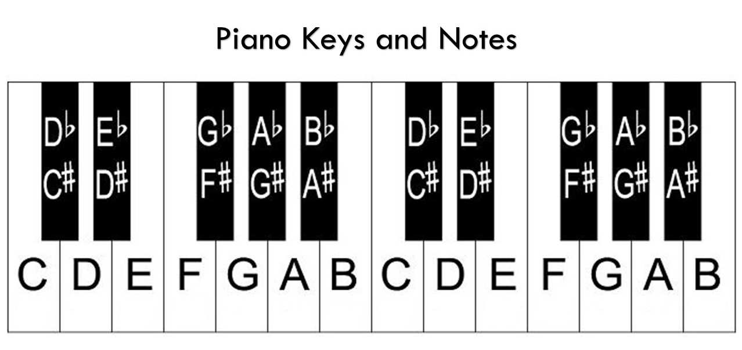
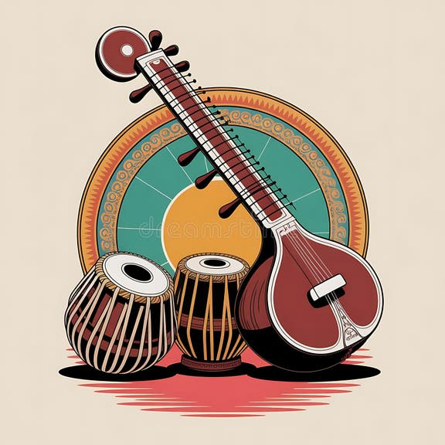
Year 7 Topic 2 Knowledge Organiser
Indian Music
Alap Irregular pulse Introduces the rag Only the drone and rag play
Jhor Tabla enters playing the tal Rag plays in time with the pulse The drone plays in time with the pulse
Jhalla Tabla plays shorter note values Rag plays shorter note values The drone plays shorter note values
The rag is made up of C D F G and B
In the rag you do not play A and E
The rag is improvised
Indian Instruments
Tabla
Sitar
Bansuri

Slide 3
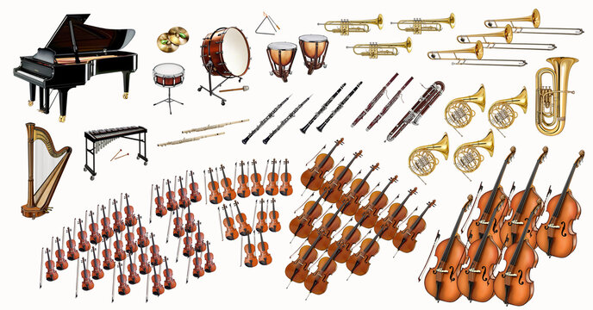
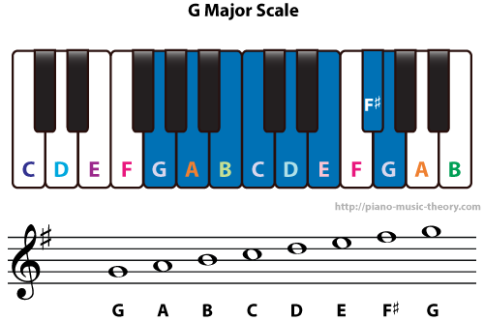
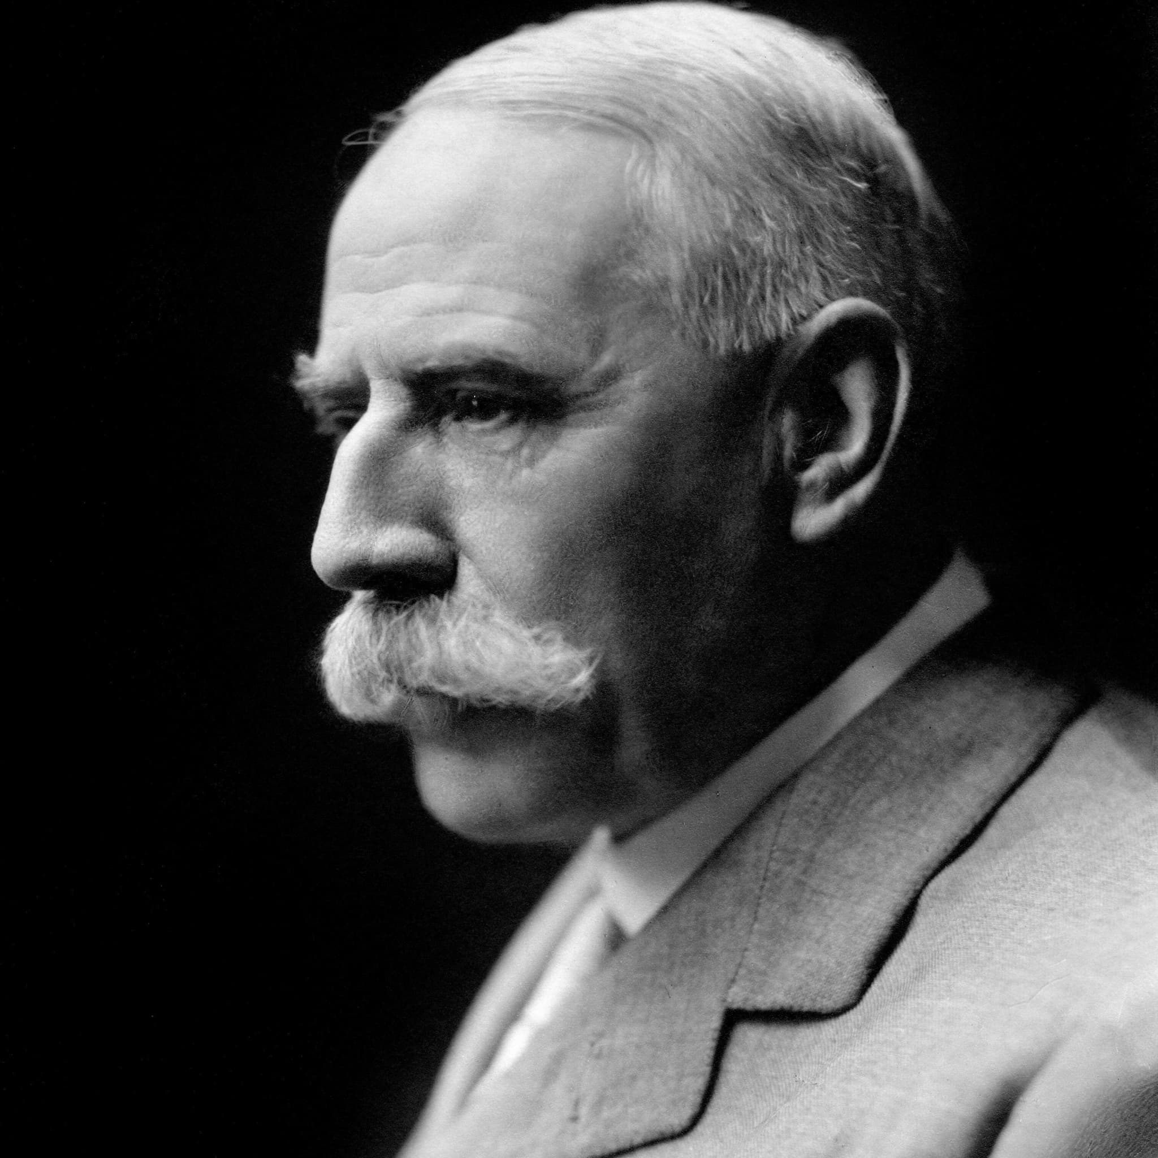
Year 7 Topic 3 Knowledge Organiser
Elgar's Pomp and Circumstance
Western Orchestra
Strings
Woodwind
Brass
Percussion
Edward Elgar
Edward Elgar composed Pomp and Cirumstance. Lyrics were added to create Land of Hope and Glory.

Slide 4
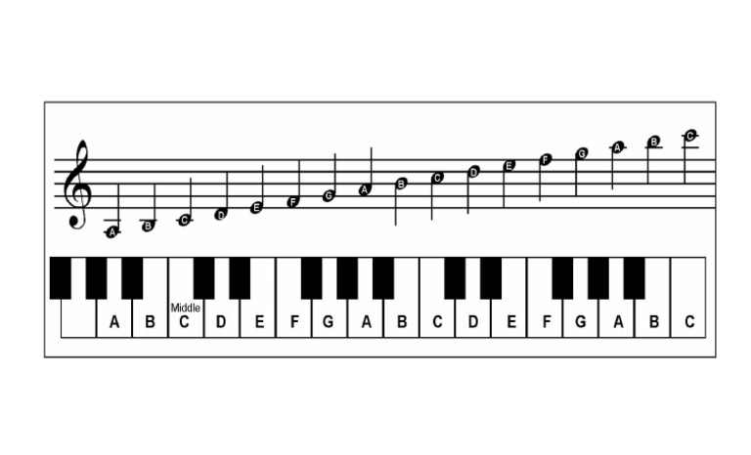
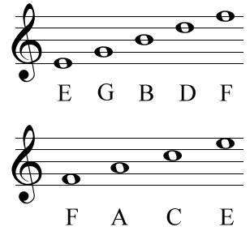
Year 7 Topic 4 Knowledge Organiser
Major and Minor Scale
Lined notes on a stave
Notes on a stave with the keyboard
Space notes on a stave
To work out a major scale:
Root, Tone, Tone, Semitone, Tone, Tone, Tone, Semitone.
To work out a minor scale and sharpen the seventh note
Root, Tone, Semitone, Tone Tone, Semitone, Tone, Tone
A tone is 2 steps
A semitone is 1 step

Slide 5
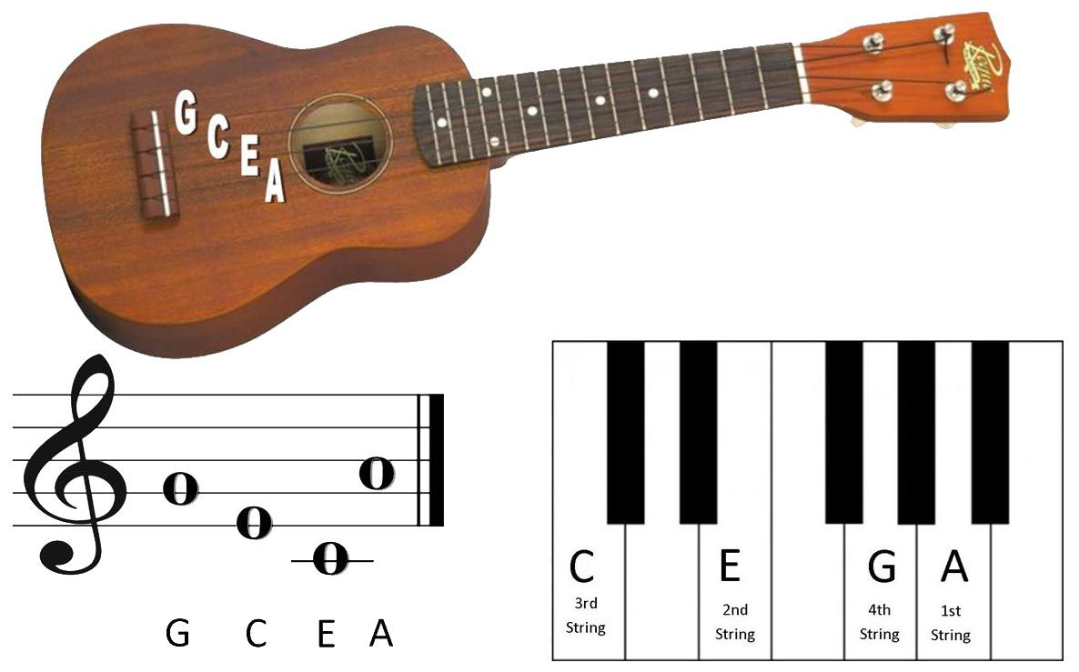
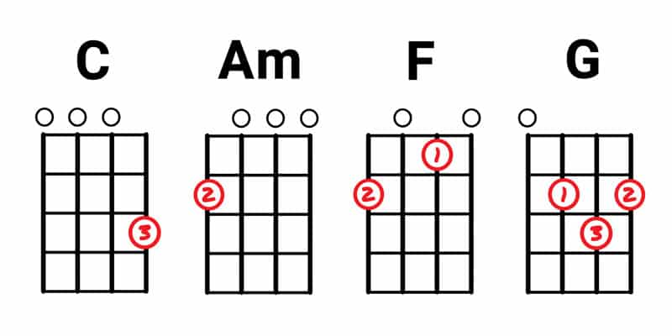
Year 7 Topic 5 Knowledge Organiser
Ukulele
Open ​strings on the ukulele
Working out scales
To work out a major scale:
Root, Tone, Tone, Semitone, Tone, Tone, Tone, Semitone.
To work out a minor scale and sharpen the seventh note
Root, Tone, Semitone, Tone Tone, Semitone, Tone, Tone
A tone is 2 steps
A semitone is 1 step
Key terms used in the topic 'Ukulele'
Fretboard Fret
Strings Resonate
Tuning Pegs Open Strings
Saddle Sound hole
Third finger third fret on the string of A = C Major
First fret E, second fret G = F Major
Second finger, second fret on the string of G = Am

Slide 6
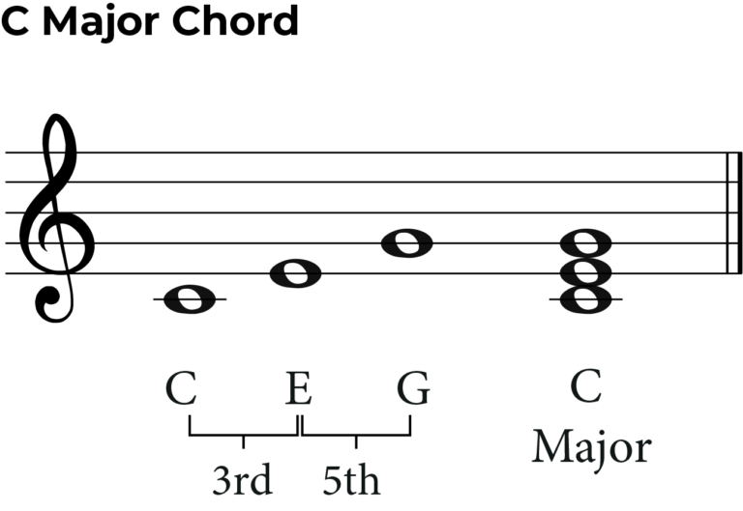
Year 7 Topic 6 Knowledge Organiser
Chords
Working out chords
Visual demonstration of the 1, 3, 5 rule
The chord of C
The 1, 3, 5 rule
Find the root note. This is 1. Count up 3, then 5. This gives you the chord you want.
In the key of C major let's work out the chord of C major.
C, count up 3
E, go up to 5
G
Now, let's work out the chord of F major
F, count up 3
A, go up to 5
C
C major | C = 1 | D | E = 3 | F | G = 5 | A | B
The chord of G
C major | C | D = 5 | E | F | G = 1 | A | B = 3
The C Chord in standard notation
Important information about chords
A chord accompanies a melody
A chord has a homophonic texture
The first chord of a scale is called the tonic
The fifth chord of a scale is called the dominant
The second and sixth are minor chords

