Slide 1
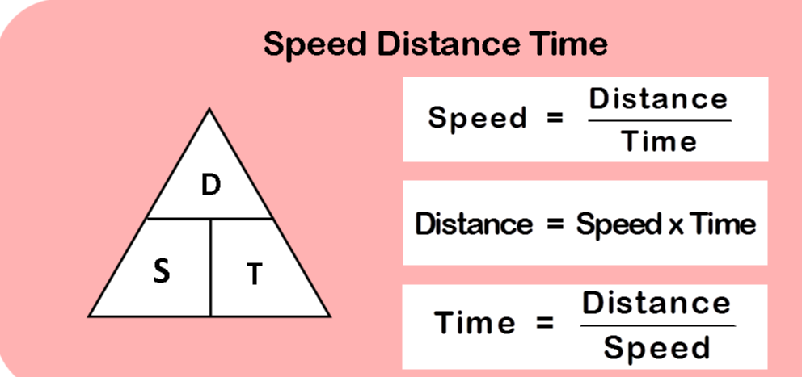
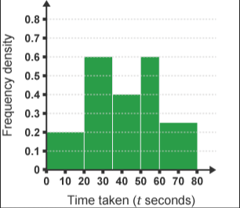

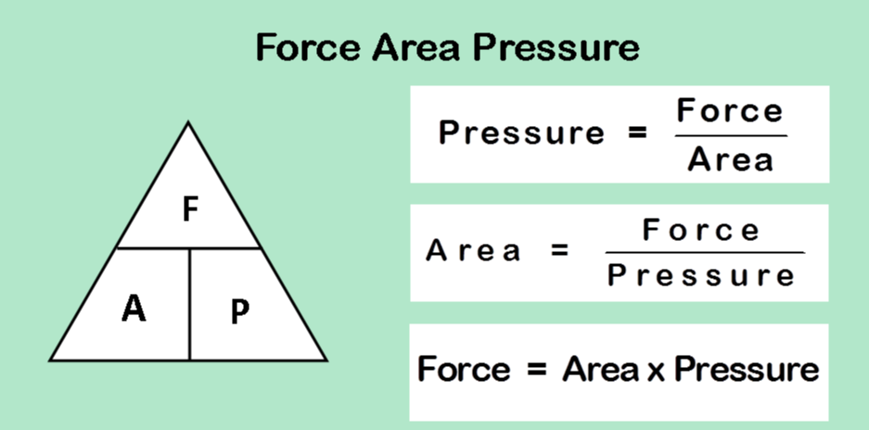

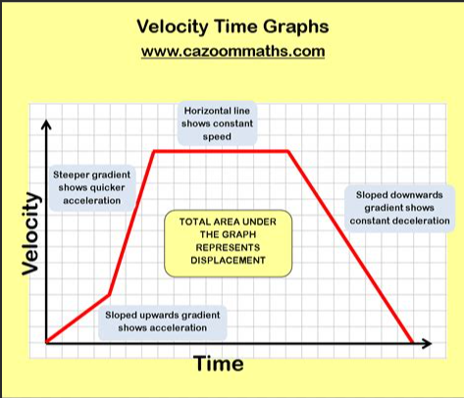
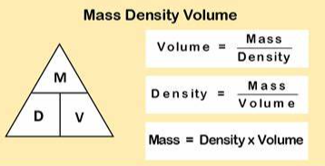
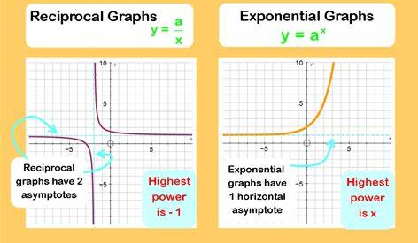
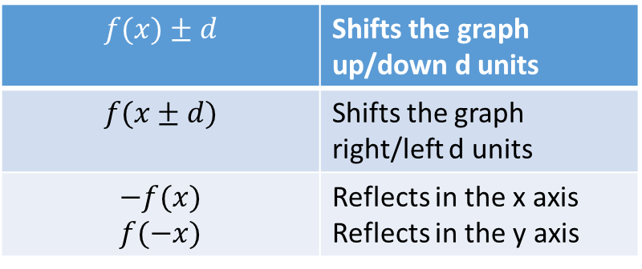
Year 11 – Higher Knowledge Organiser HT1
Histograms:
Boxplots:
Lower quartile= 25% of the data
Upper quartile = 75% of the data
Interquartile range= upper quartile- lower quartile
$$f(x)±d$$ | Shifts the graph up/down d units
$$f(x±d)$$ | Shifts the graph right/left d units
$$−f(x)$$ $$f(−x)$$ | Reflects in the x axis Reflects in the y axis

Slide 2
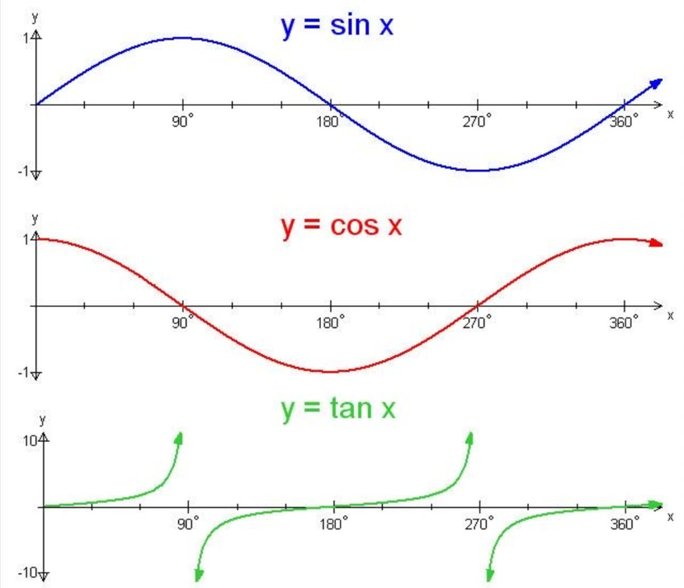
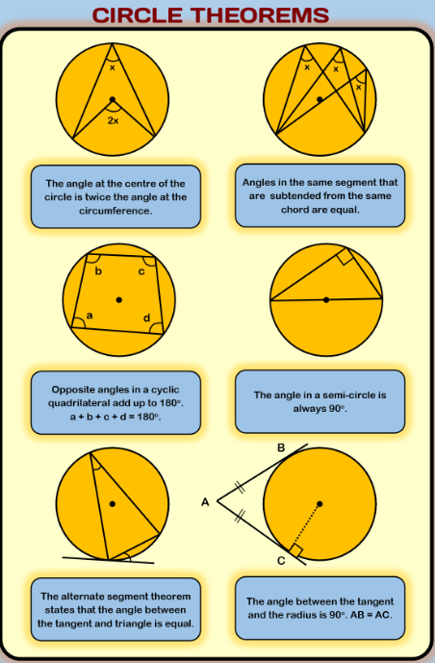
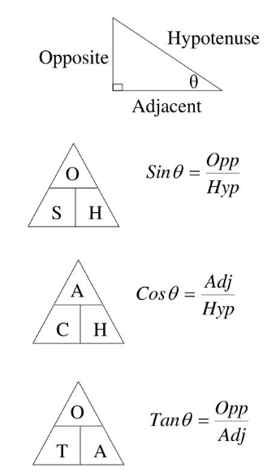
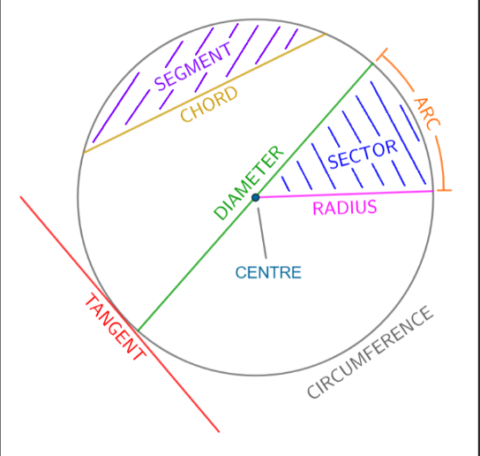
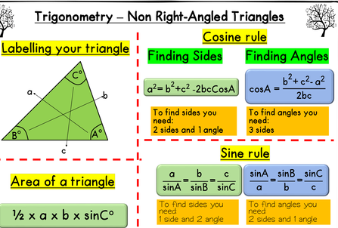
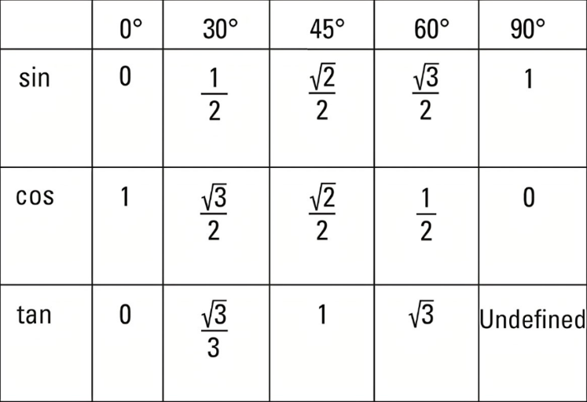
Year 11 – Higher Knowledge Organiser HT2
Trigonometry:
Circles:
Exact Trig:

Slide 3
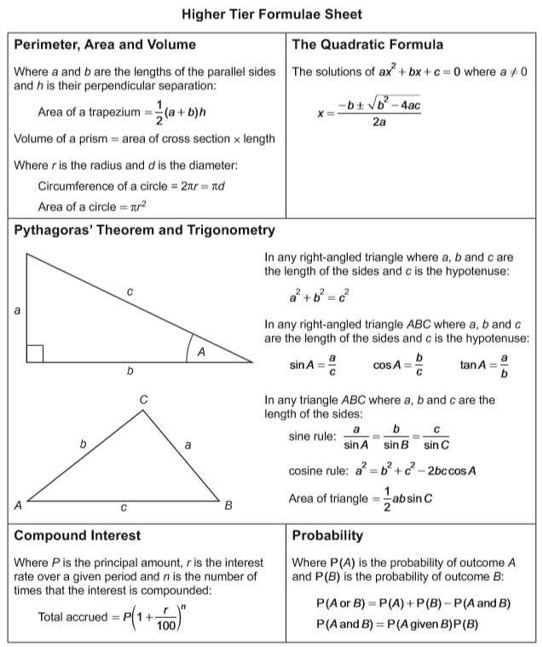





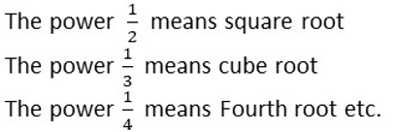


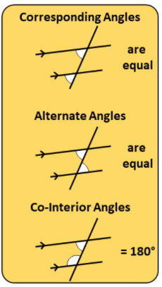



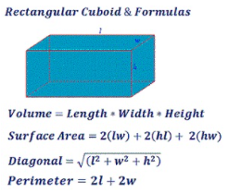

Year 11 – Higher Knowledge Organiser Formula and Facts
You need to learn these
Angle Facts
Polygons
e = exterior angle
i = interior angle
n = number of sides
e = 360 n = 360
n e
i + e = 180
sum of interior = 180(n-2)
Sectors of Circles
You are given this in the exam

Slide 4
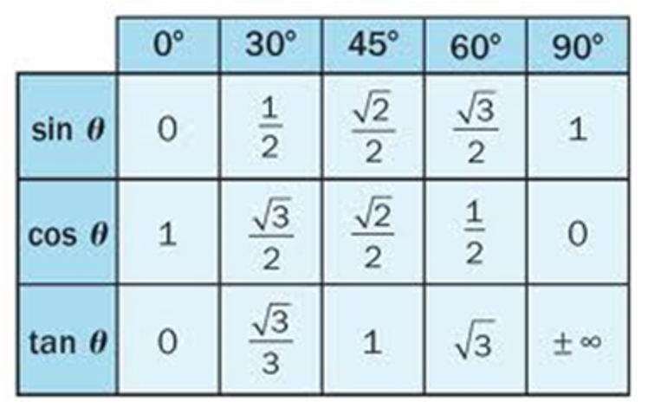
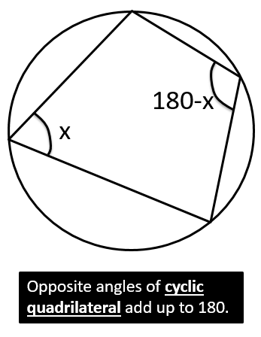
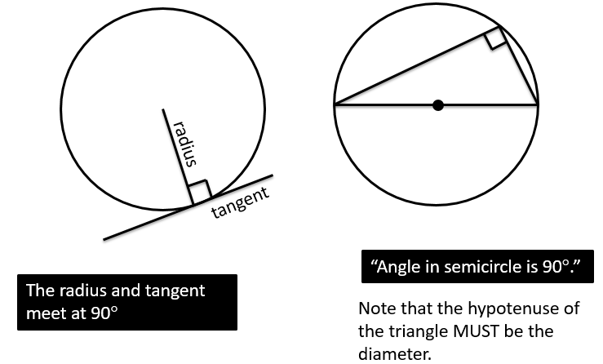
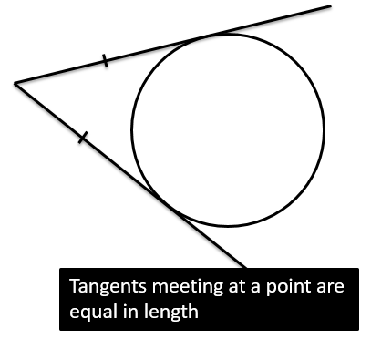
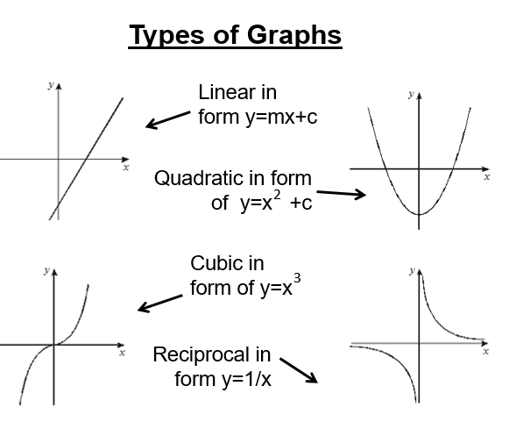
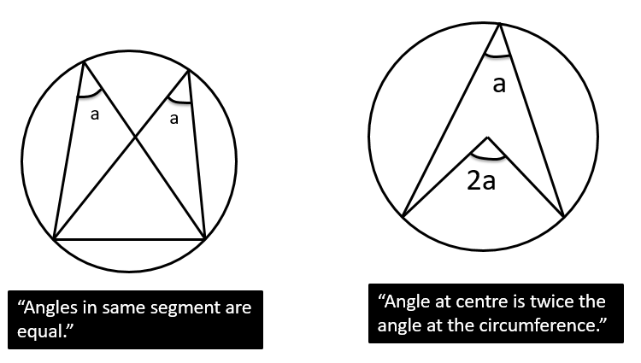
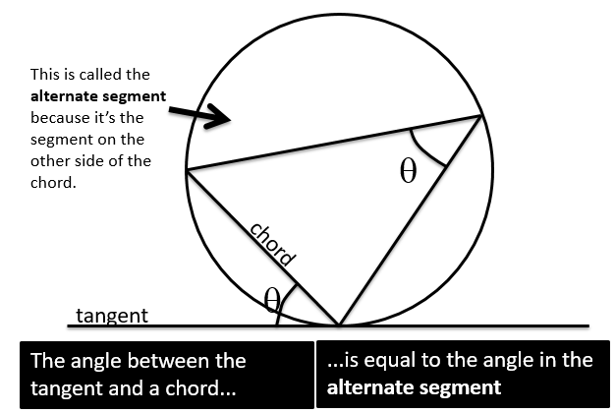


Circle Theorems
Proportionality

