Slide 1
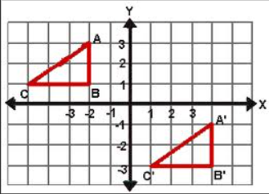
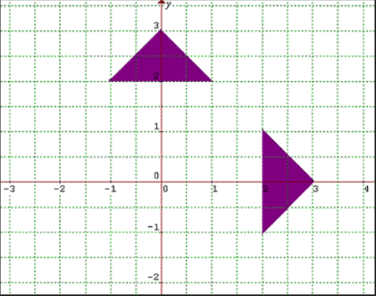
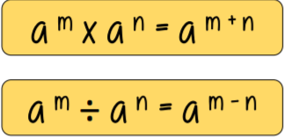
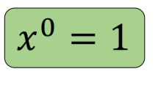
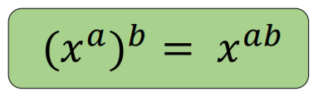
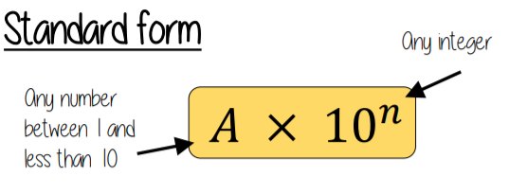
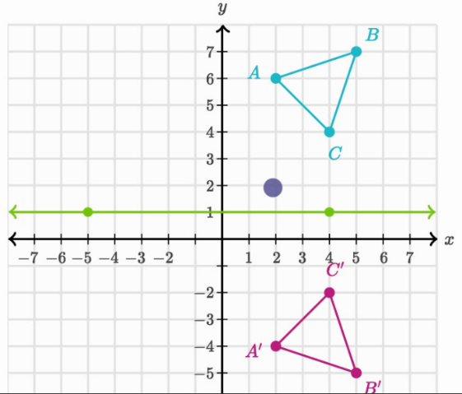
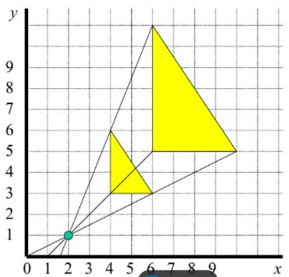
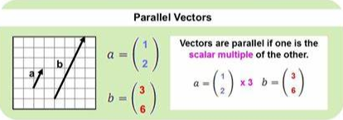



Year 11 – Foundation Knowledge Organiser HT1
To describe a rotation you need:
The angle of rotation
The direction
The coordinates of the centre
Indices:
Translations
Describe with a vector
Rotation
$$\left(\begin{matrix}3 \\ 2\end{matrix}\right)$$
Squares right/left
Squares up/down
Transformations
Reflection
Describe with a line of symmetry
Enlargement
Vectors:
$$\left({a \atop b}\right)+\left({c \atop d}\right)=\left({a+c \atop b+d}\right)$$
$$\left({a \atop b}\right)$$
a moves right/ left
b moves up/ down
Reflection in the line y=1
To describe an enlargement you need:
Scale factor
Centre of enlargement
Use tracing paper for reflection and rotation

Slide 2
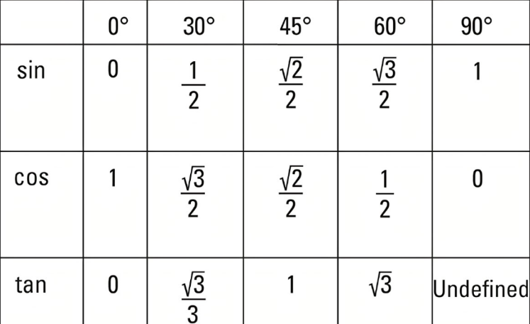
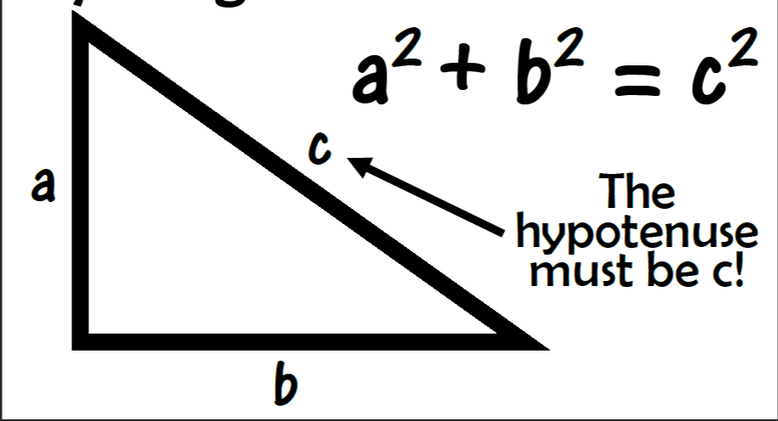
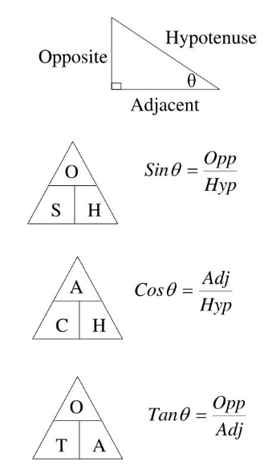
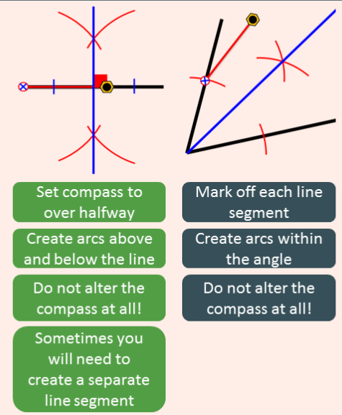
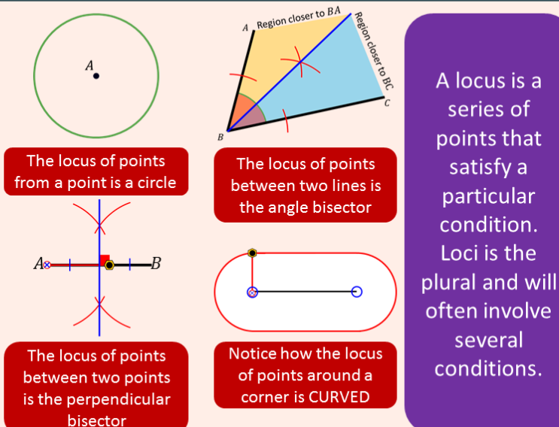
Year 11 – Foundation Knowledge Organiser HT2
Pythagoras theorem:
Trigonometry:
Exact Trig:
Construction:
Loci:

Slide 3
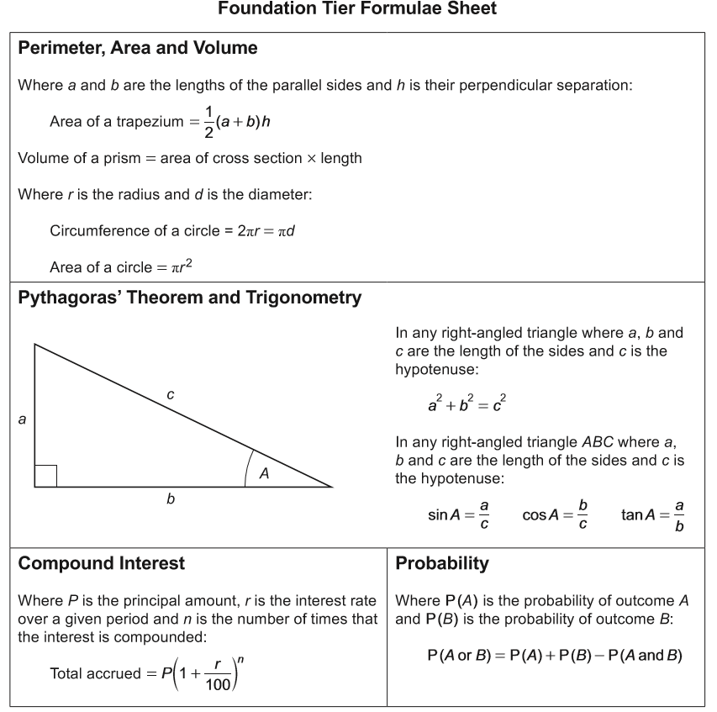


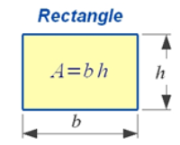
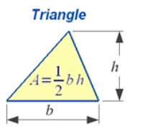
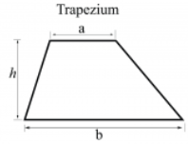
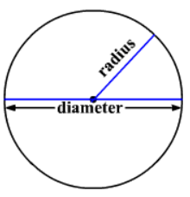
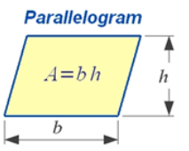
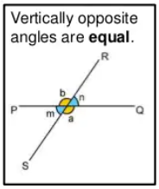
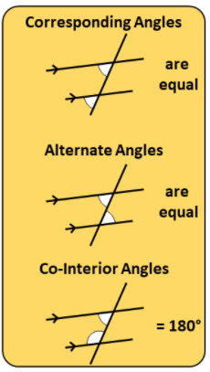
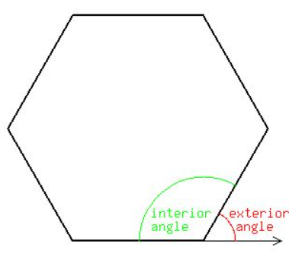
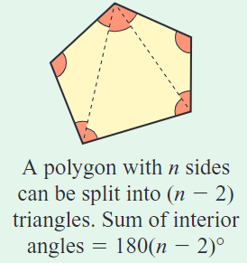
Year 11 – Foundation Knowledge Organiser Formula and Facts
You need to learn these
Diagrams not given
Angle Facts
You are given this in the exam
e = 360/n
n = 360/e
e+i = 180
e = exterior angle
i = interior angle
n = number of sides

Slide 4
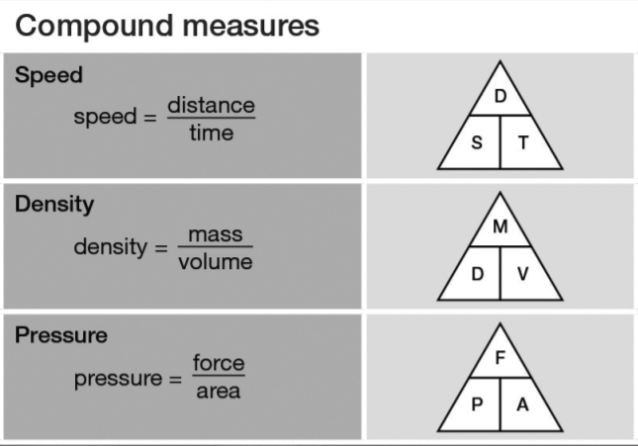
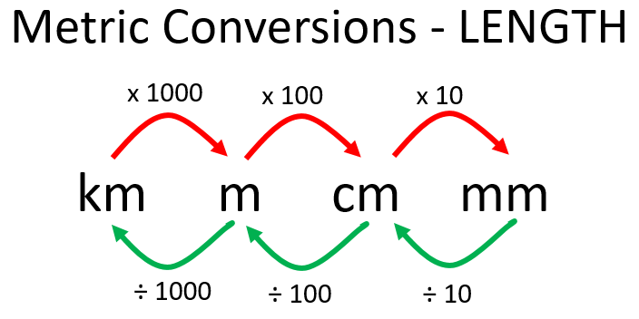
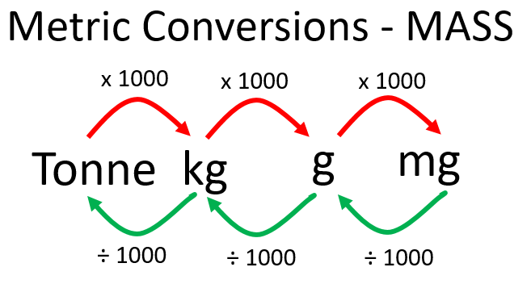
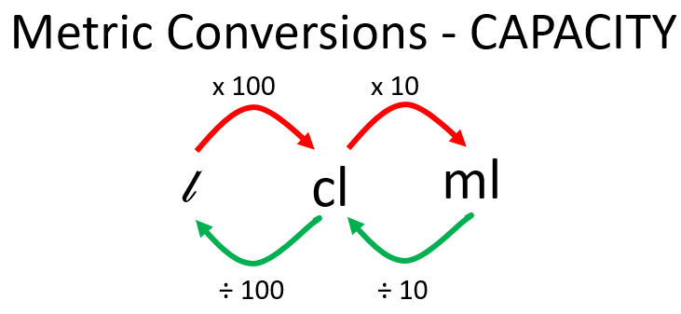
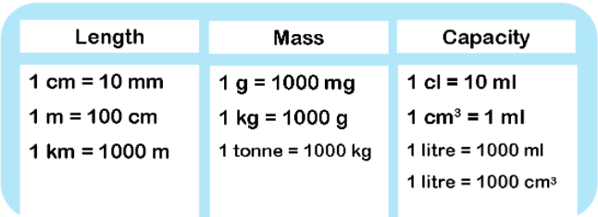
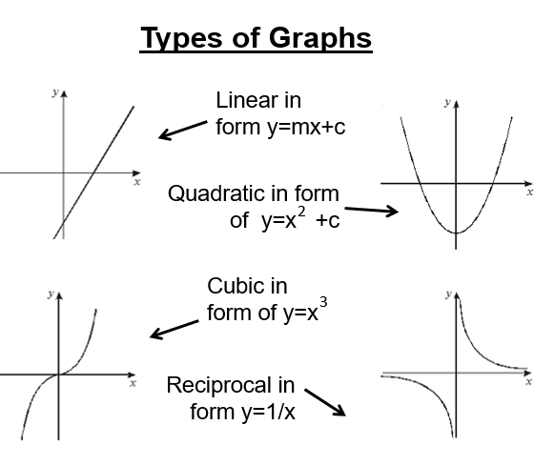
5miles = 8km
Extras

