Slide 1
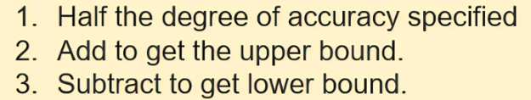
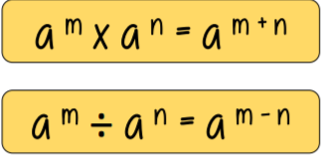
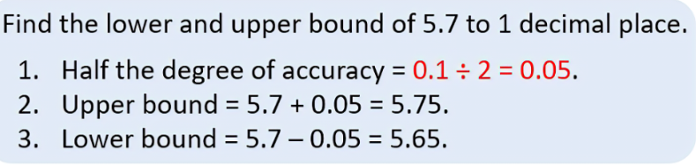
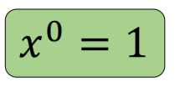
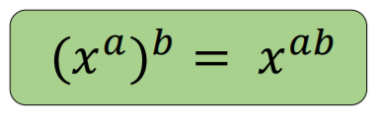
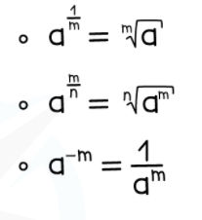
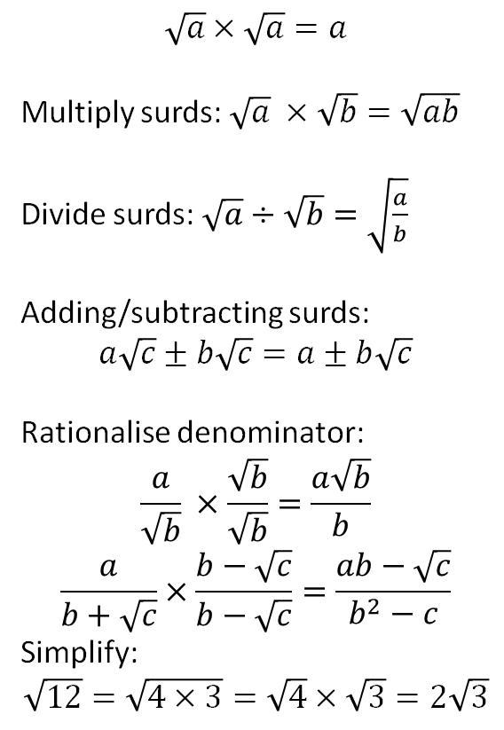
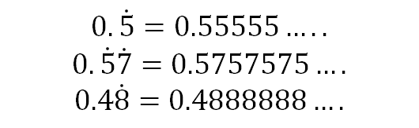
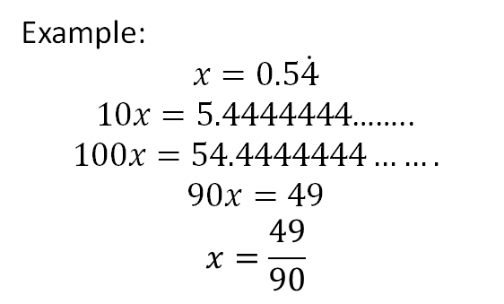
Year 10 – Higher Knowledge Organiser HT1
Bounds:
Indices:
Surds:
How to find the upper and lower bound?
$$\sqrt{a}×\sqrt{a}=a$$
Multiply surds: $\sqrt{a} ×\sqrt{b}=\sqrt{ab}$
Divide surds: $\sqrt{a}÷\sqrt{b}=\sqrt{\frac{a}{b}}$
Adding/subtracting surds:
$$a\sqrt{c}±b\sqrt{c}=a±b\sqrt{c}$$
Rationalise denominator:
$$\frac{a}{\sqrt{b}} ×\frac{\sqrt{b}}{\sqrt{b}}=\frac{a\sqrt{b}}{b}$$
$$\frac{a}{b+\sqrt{c}}×\frac{b−\sqrt{c}}{b−\sqrt{c}}=\frac{ab−\sqrt{c}}{b^{2}−c}$$
Simplify:
$$\sqrt{12}=\sqrt{4×3}=\sqrt{4}×\sqrt{3}=2\sqrt{3}$$
Recurring decimals:
$$0.\dot{5}=0.55555…..$$
$$0.\dot{5}\dot{7}=0.5757575….$$
$$0.4\dot{8}=0.4888888….$$
Example:
$$x=0.5\dot{4}$$
$10x=5.4444444$……..
$$100x=54.4444444…….$$
$$90x=49$$
$$x=\frac{49}{90}$$
Product rule for counting:
m x n
Where m is the number of ways to do one task and for each of these, there are n ways of doing another task
Find a square number that goes into it.

Slide 2
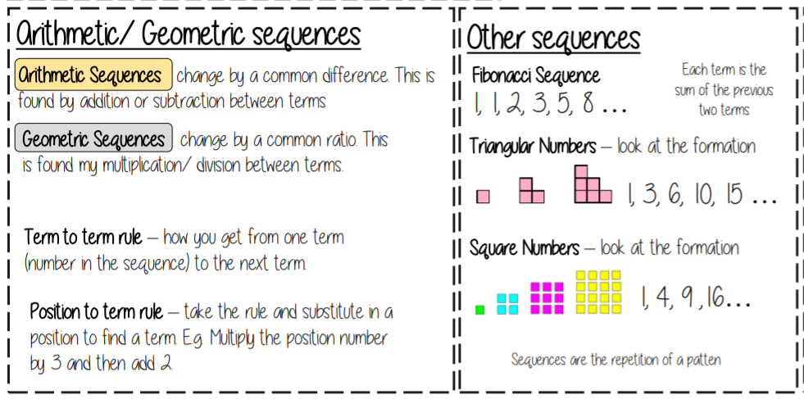
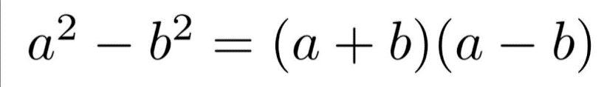
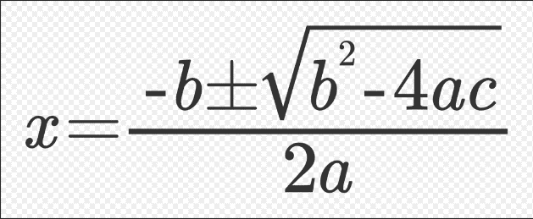
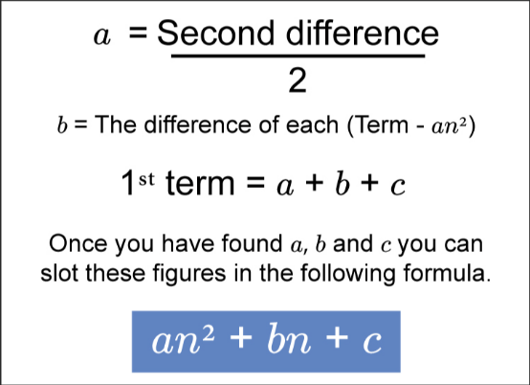
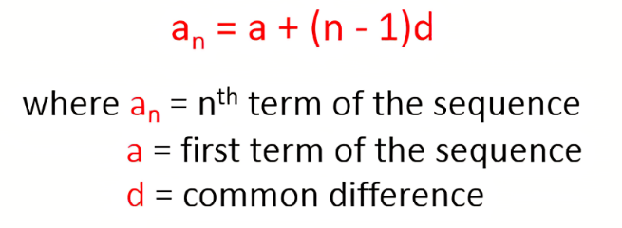
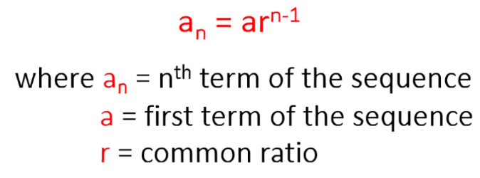
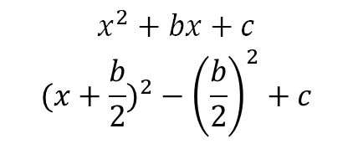

Year 10 – Higher Knowledge Organiser HT2
Factorise- put into brackets
Expand- multiply out brackets
Difference of 2 squares:
Complete the square:
$$x^{2}+bx+c$$
$$({x+\frac{b}{2})}^{2}−{\left(\frac{b}{2}\right)}^{2}+c$$
Quadratic formula:
Arithmetic nth term:
Geometric nth term:
Quadratic nth term:
For a general equation:
$$ax^{2}+bx+c=0$$

Slide 3
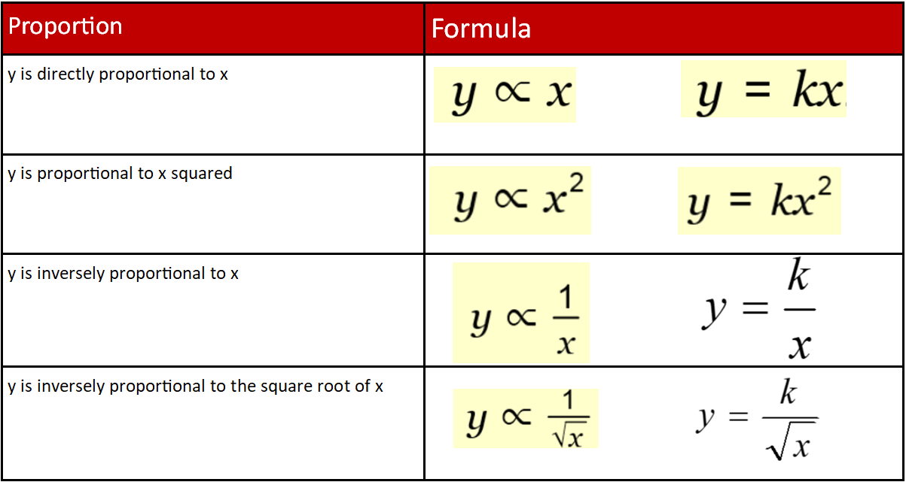
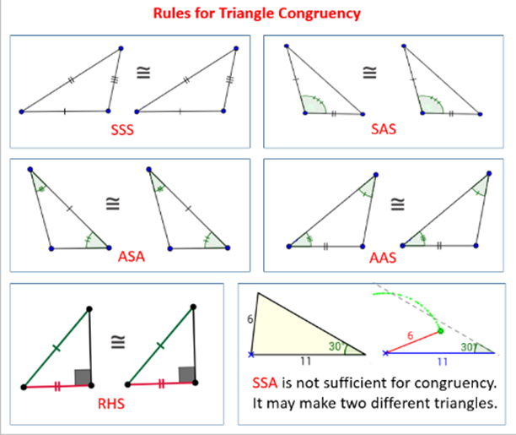
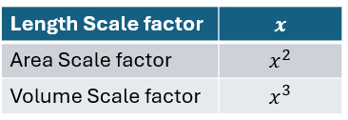
Year 10 Higher – Half Term 3 Maths Knowledge Organiser
Similar shapes: Two shapes are similar if the angles are the same size or the corresponding sides are in the same ratio.

Slide 4
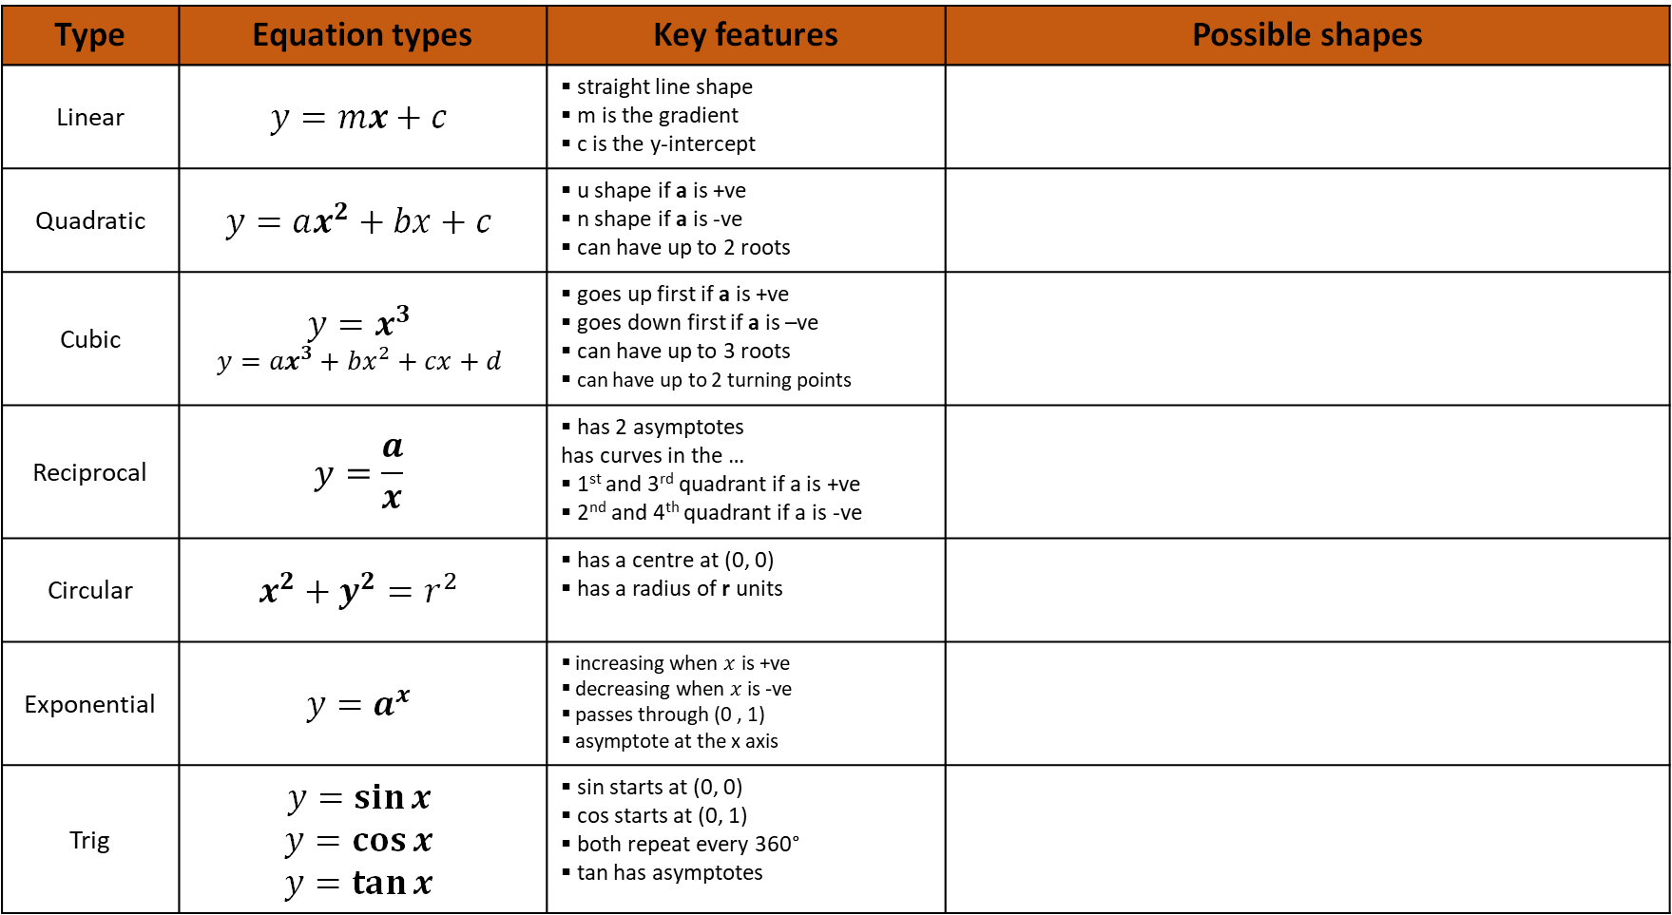
Year 10 Higher – Half Term 4 Maths
Type | Equation types | Key features | Possible shapes
Linear | $$y=mx+c$$ | straight line shape m is the gradient c is the y-intercept
Quadratic | $$y=ax^{2}+bx+c$$ | u shape if a is +ve n shape if a is -ve can have up to 2 roots
Cubic | $$y=x^{3}$$ $$y={ax}^{3}+bx^{2}+cx+d$$ | goes up first if a is +ve goes down first if a is –ve can have up to 3 roots can have up to 2 turning points
Reciprocal | $$y=\frac{a}{x}$$ | has 2 asymptotes has curves in the … 1st and 3rd quadrant if a is +ve 2nd and 4th quadrant if a is -ve
Circular | $$x^{2}+y^{2}=r^{2}$$ | has a centre at (0, 0) has a radius of r units
Exponential | $$y=a^{x}$$ | increasing when $x$ is +ve decreasing when $x$ is -ve passes through (0 , 1) asymptote at the x axis
Trig | $$y=\sin{x}$$ $$y=\cos{x}$$ $$y=\tan{x}$$ | sin starts at (0, 0) cos starts at (0, 1) both repeat every 360° tan has asymptotes

Slide 5
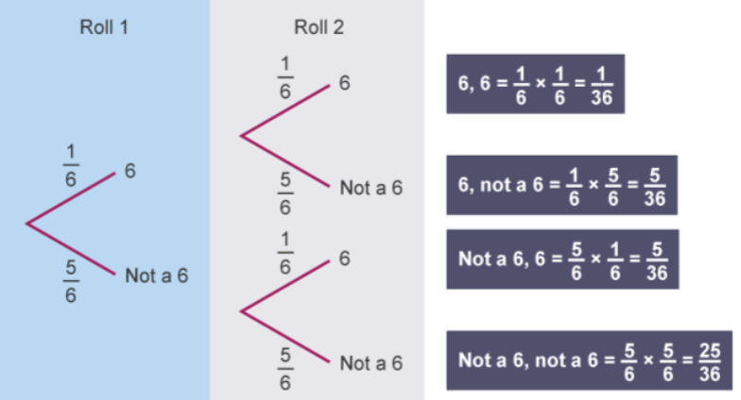
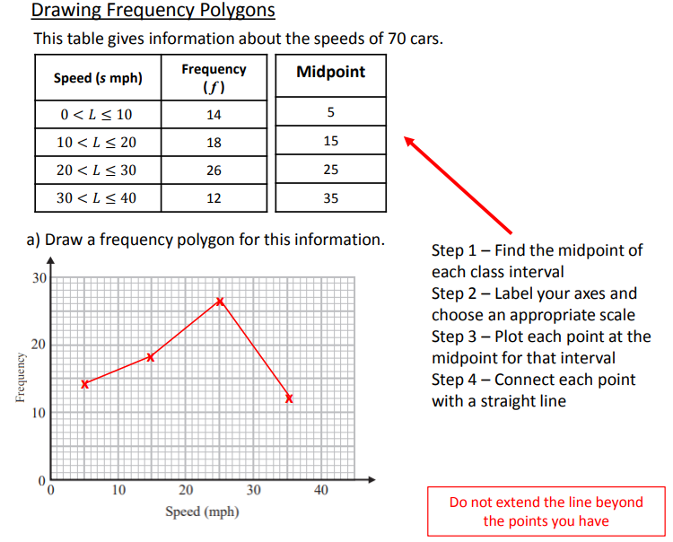
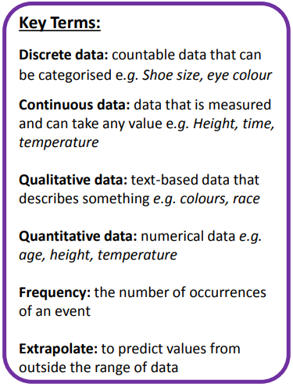
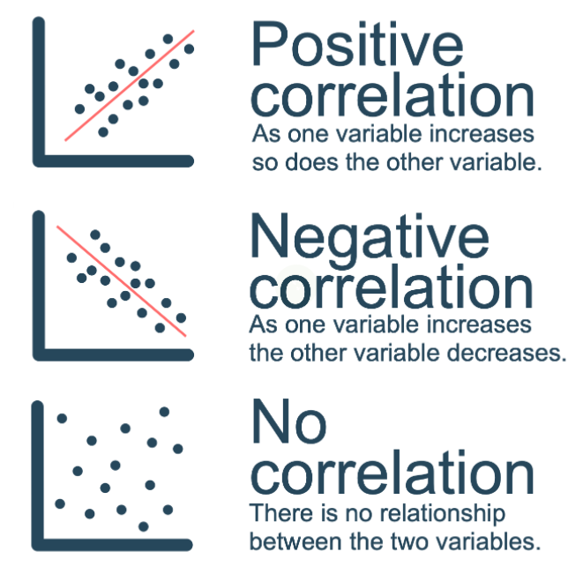
Year 10 Higher – Half Term 5 Maths
Probability Tree diagrams are a way of showing combinations of two or more events
Scatter Graphs

Slide 6
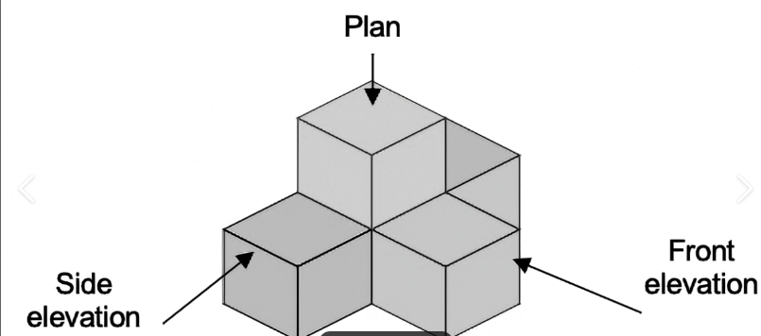
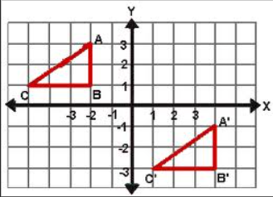
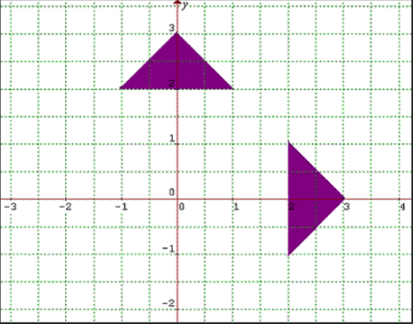
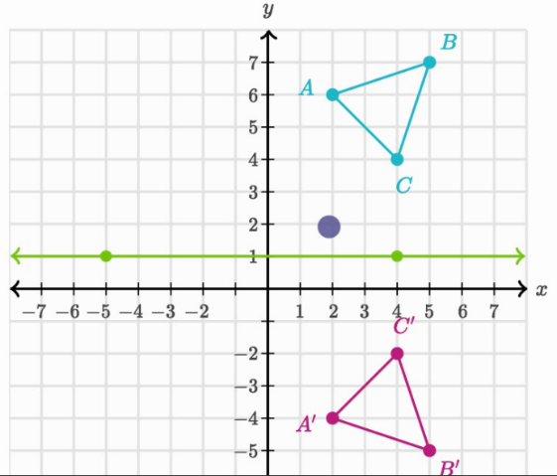
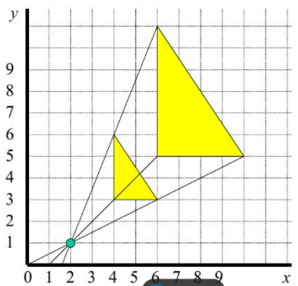
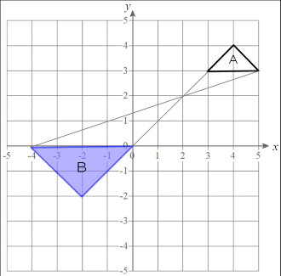
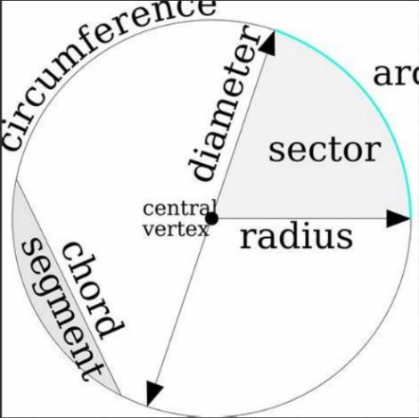
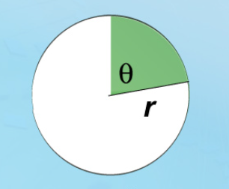

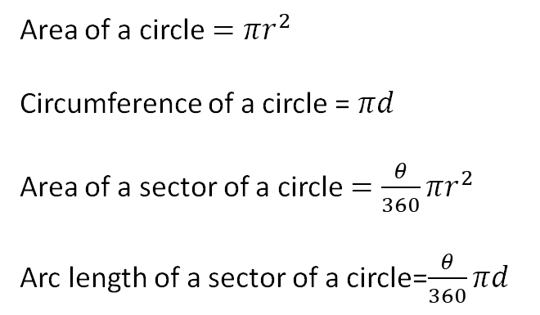
Year 10 Higher – Half Term 6 Maths KO
To describe a rotation you need:
The angle of rotation
The direction
The coordinates of the centre
Plans and elevations:
Translations
Describe with a vector
Rotation
$$\left(\begin{matrix}3 \\ 2\end{matrix}\right)$$
Squares right/left
Squares up/down
Circles:
Area of a circle $=πr^{2}$
Circumference of a circle = $πd$
Area of a sector of a circle $=\frac{θ}{360}πr^{2}$
Arc length of a sector of a circle=$\frac{θ}{360}πd$
Negative enlargement
By SF -2
Transformations
Reflection
Describe with a line of symmetry
Enlargement
Reflection in the line y=1
To describe an enlargement you need:
Scale factor
Centre of enlargement
Use tracing paper for reflection and rotation

Slide 7
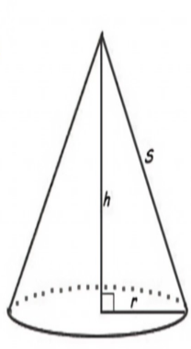
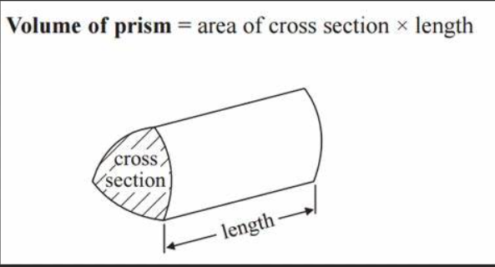
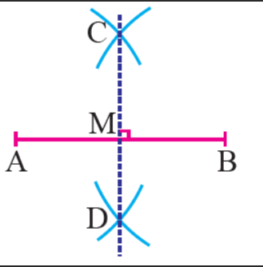
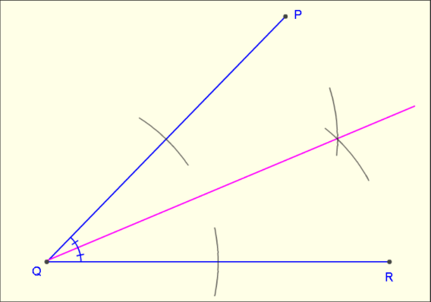
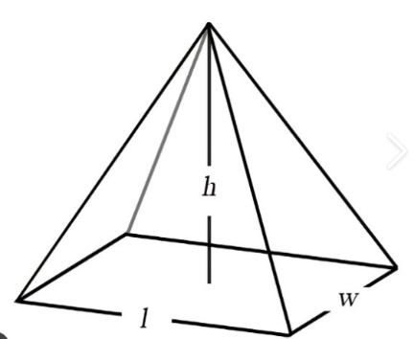
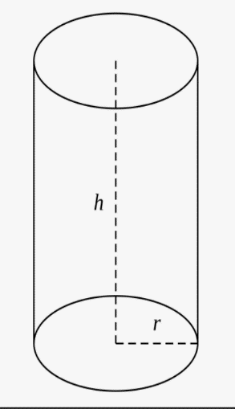
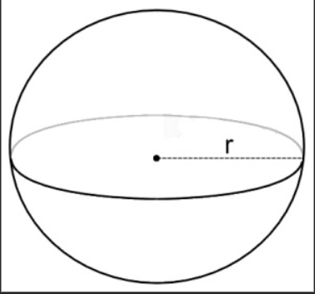
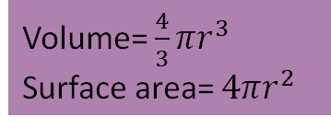






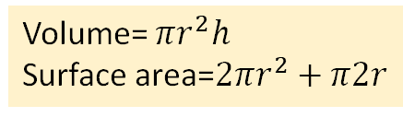

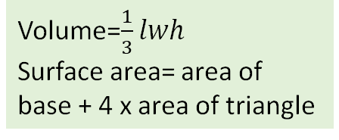

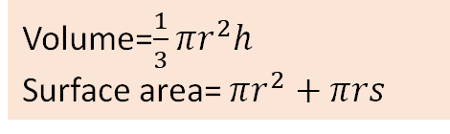


Year 10 Higher – Half Term 6 Maths KO
Surface area and volume:
Constructions:
Surface area – the total area of the surface of a three-dimensional object
Volume- shows the amount of three-dimensional space occupied by an object
Perpendicular bisector – cuts a line in half
Bisector of an angle- cuts an angle in half
Always leave construction marks
Volume=$\frac{1}{3}πr^{2}h$
Surface area= $πr^{2}+πrs$
Perpendicular bisector
Bisect an angle
Volume= $πr^{2}h$
Surface area=$2πr^{2}+π2r$
Convert between metric area:
$$÷100000$$
Volume=$\frac{1}{3}lwh$
Surface area= area of base + 4 x area of triangle
$$÷100$$
$$÷10000$$
Volume= $\frac{4}{3}πr^{3}$
Surface area= $4πr^{2}$
$$mm^{2}$$
$$cm^{2}$$
$$m^{2}$$
$$km^{2}$$
$$×100$$
$$×10000$$
$$×1000000$$

