Slide 1
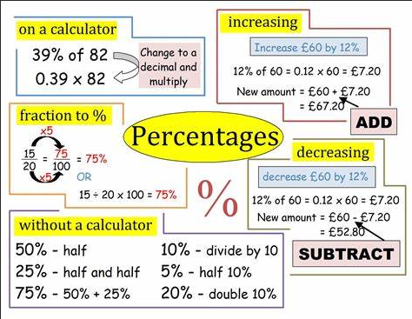
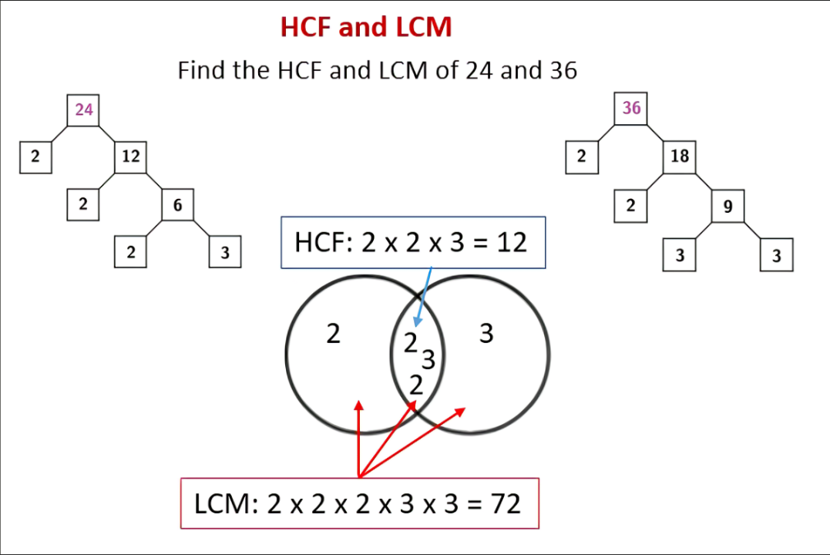

Year 10 – Foundation Knowledge Organiser HT1
Prime number: only factors 1 and its self
2,3,5,7,11,13,17……..
Factor: is a number that divides into another number exactly and without leaving a remainder
e.g factors of 8= 1, 8,2,4
Multiples: The result of multiplying a number by an integer
e.g multiplies of 10
10,20,30,40
HCF and LCM :
$$compound interest=original ×{multiplier}^{n}$$
Where n is the number of years

Slide 2
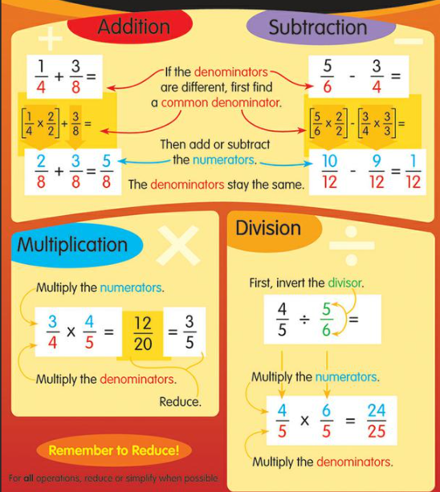
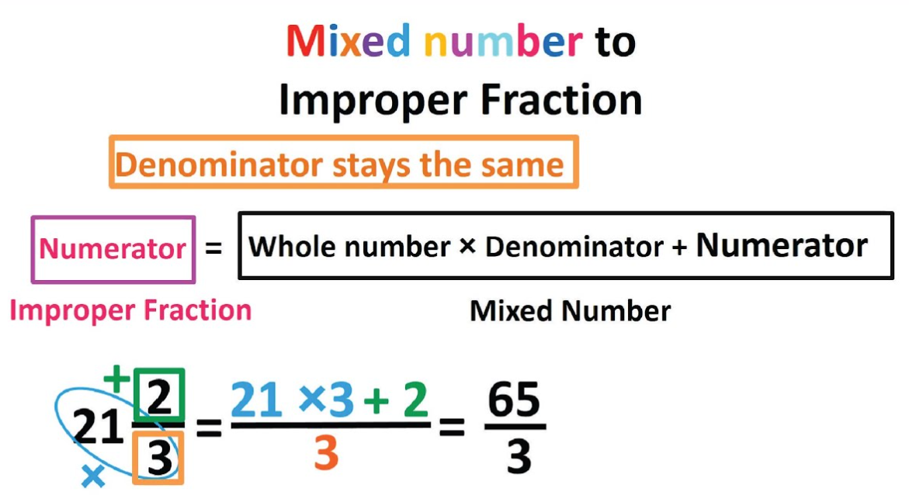
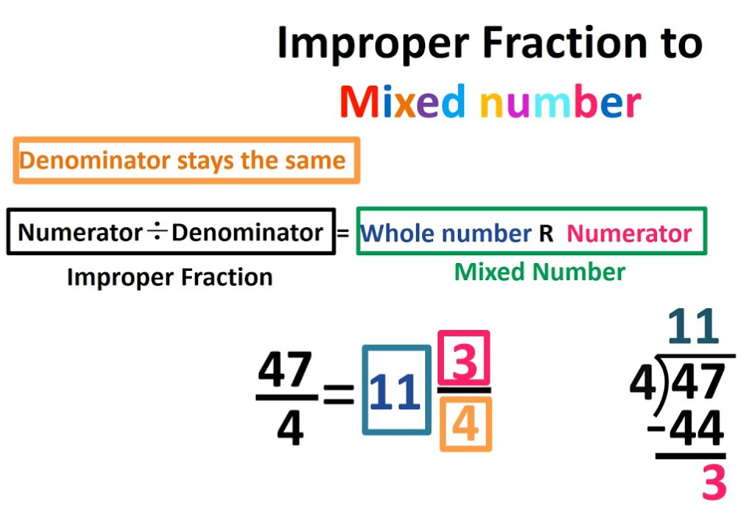
Year 10 – Foundation Knowledge Organiser HT1

Slide 3
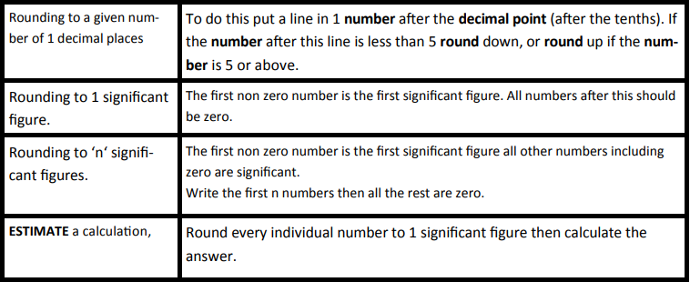
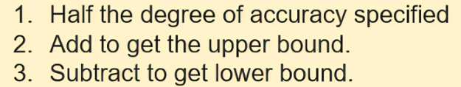
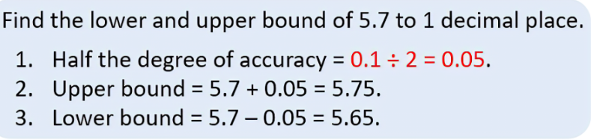
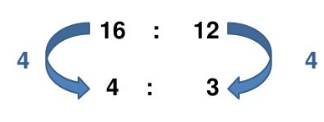
Rounding
Year 10 – Foundation Knowledge Organiser HT2
Bounds:
How to find the upper and lower bound?
Ratio- a way of comparing 2 or more quantities
Simplify ratio:
Divide by common factors.
Ratio- difference between:
Share in a ratio:
A bag contains yellow +blue blocks in the ratio 1:3 There are 8 more blue blocks than yellow blocks. How many yellow blocks are there?
James and Helen get pocket money in the ratio 3 : 5. The total amount of pocket money they are given is £24. How much money do they each get?
Ratio- finding on quantity:
3:5
3+5 = 8
The ratio of boys to girls in a school is 4 : 5 There are 220 boys in the school. How many girls?
1:3
3-1 = 2
Boys
Girls
x 4
x 3
x 4
x 3
4
5
9:15
24
x 55
x 55
4:12
8
220
275

Slide 4
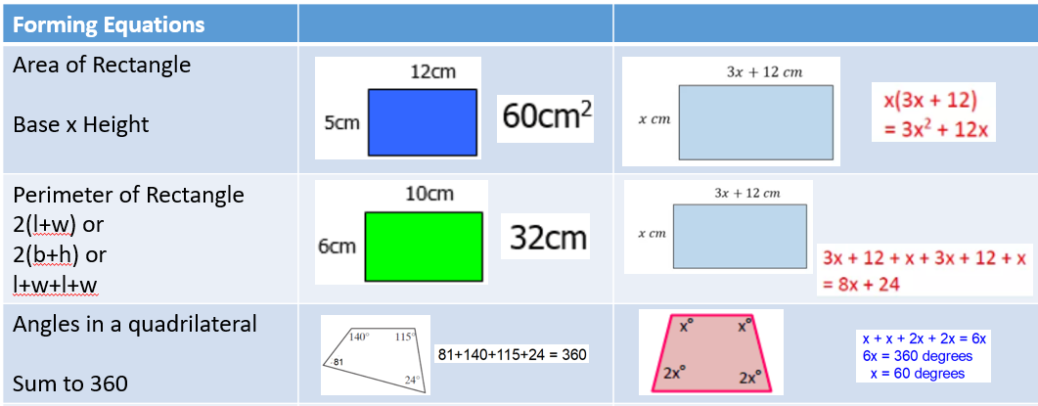
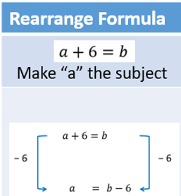
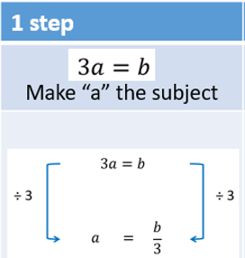
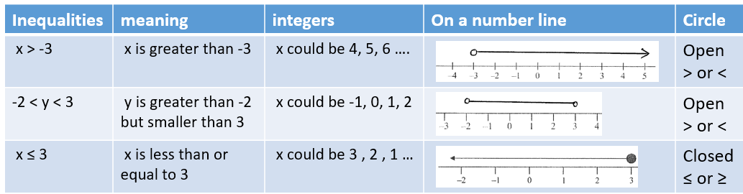
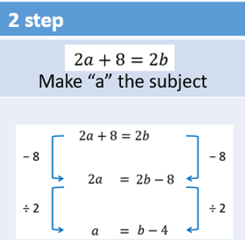
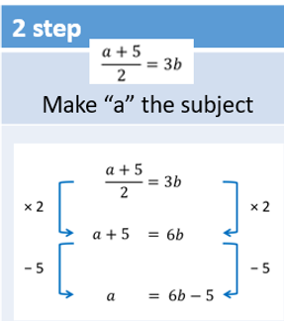
Year 10 Foundatation – Half Term 3 Maths Knowledge Organiser

Slide 5
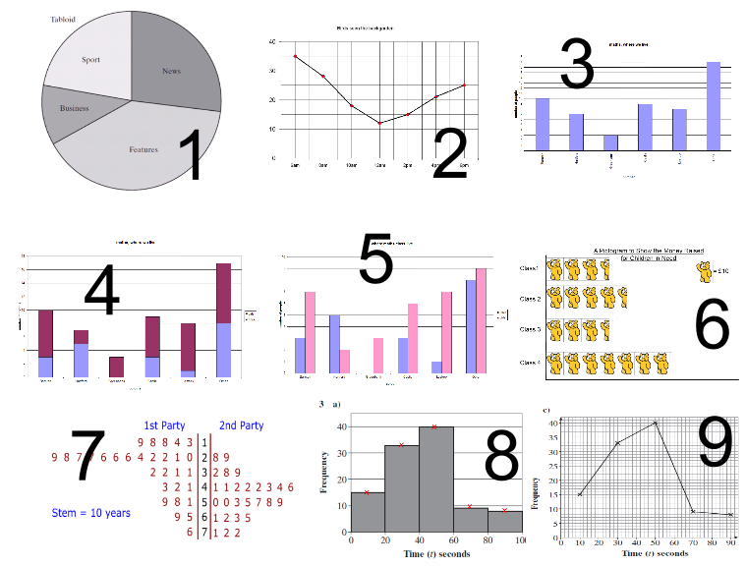
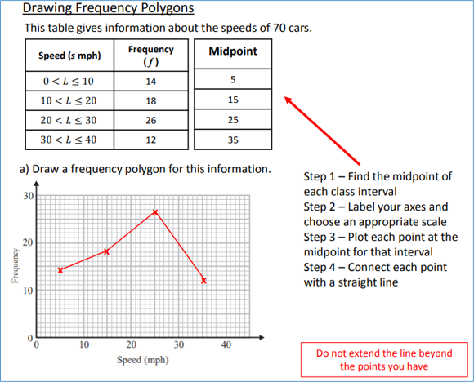
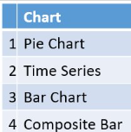
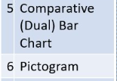
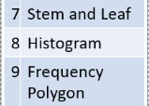
Year 10 Foundation – Half Term 4 Maths Knowledge Organiser

Slide 6
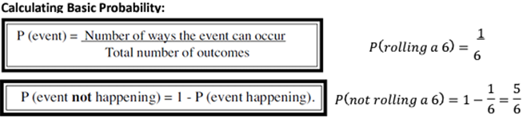
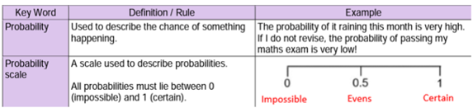
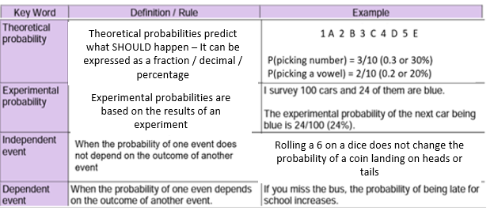
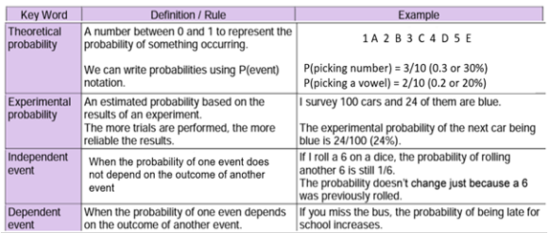
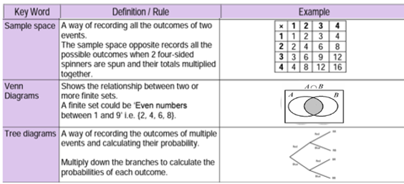
Year 10 Foundation – Half Term 4 Maths Knowledge Organiser
The probability it will rain this month is very high
All probabilities lie between 0 and 1
Theoretical probabilities predict what SHOULD happen – It can be expressed as a fraction / decimal / percentage
In the space diagram ….
P(4) = 3/16
There are three ways of getting a number 4 from a possible 16 outcomes
Experimental probabilities are based on the results of an experiment
Rolling a 6 on a dice does not change the probability of a coin landing on heads or tails
Outcomes are listed inside each circle – This venn diagram shows outcomes that fulfil set A and set B – the intersection
These help determine probabilities from INDEPENDENT events – we MULTIPLY outcomes as we move from left to right

Slide 7
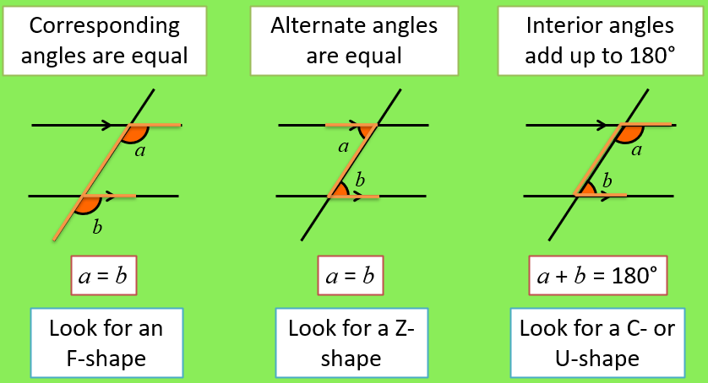
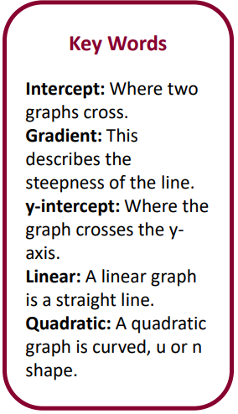
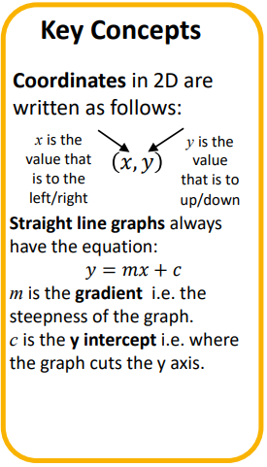
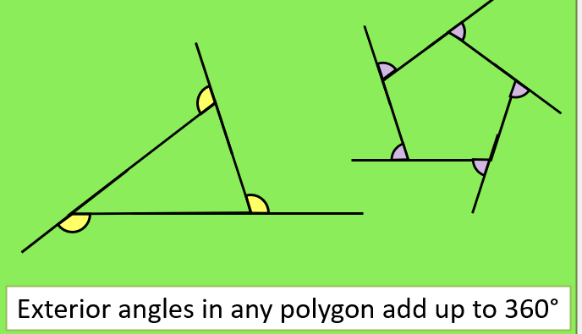
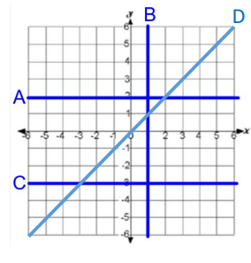
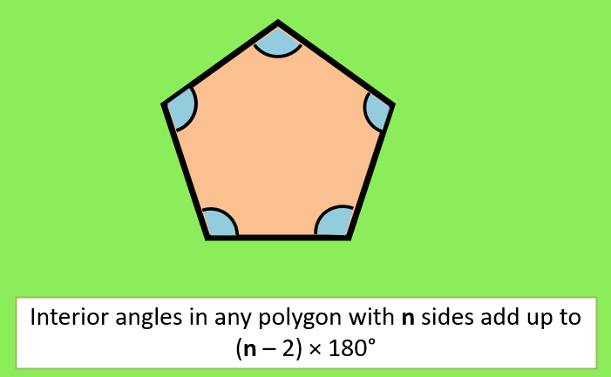

Year 10 Foundation – Half Term 5 Maths KO

Slide 8
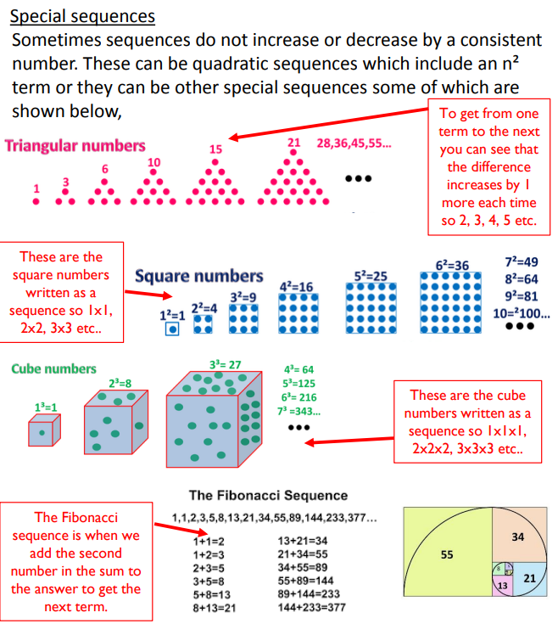
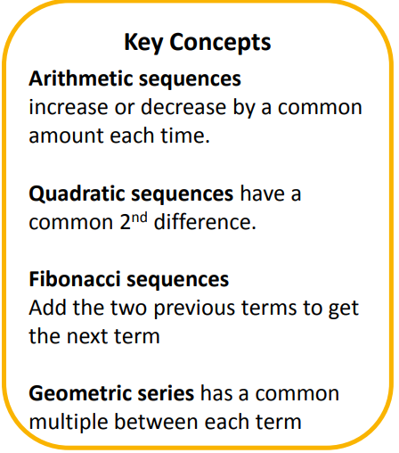

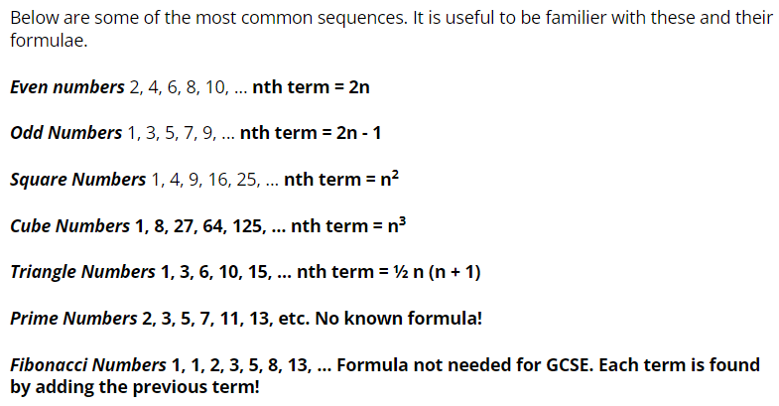
Y10 F – Half Term 5 Maths KO

Slide 9
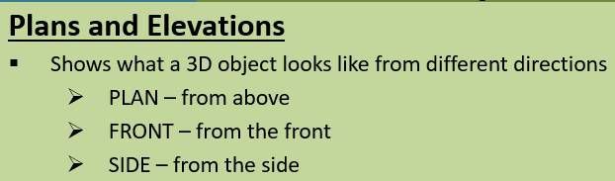
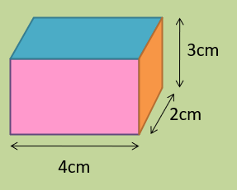
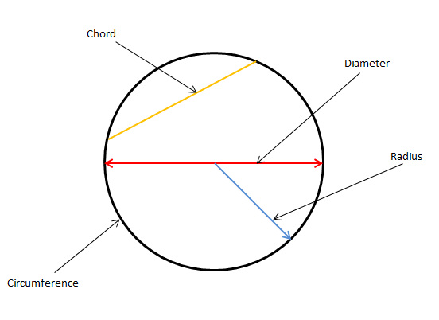
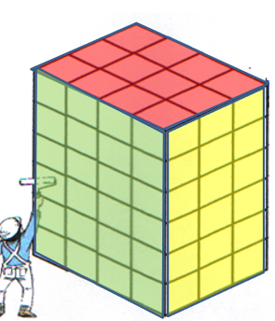
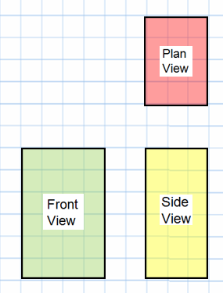
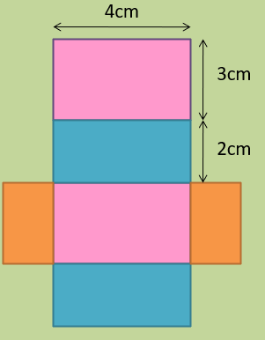
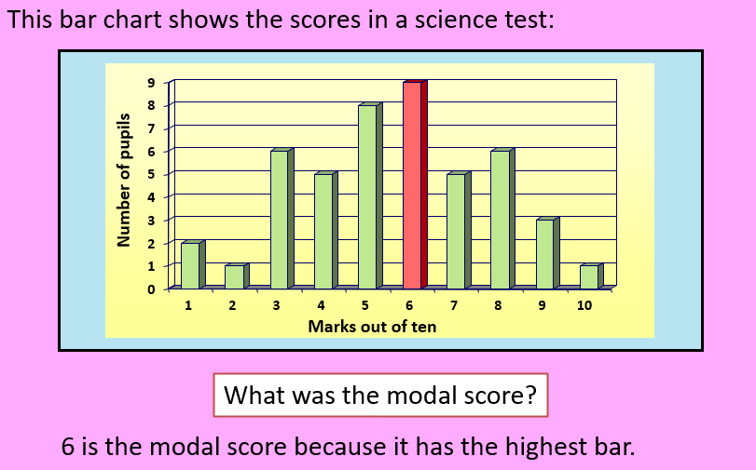
Year 10 Foundation – Half Term 6 Maths Knowledge Organiser
Parts of a circle

