Slide 1
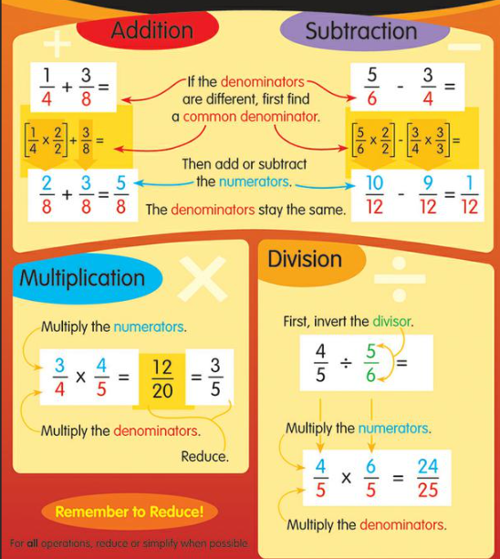
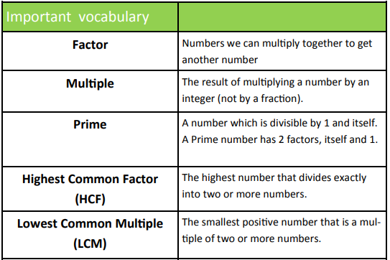
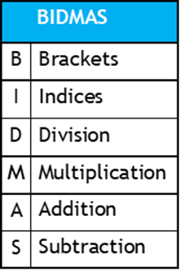
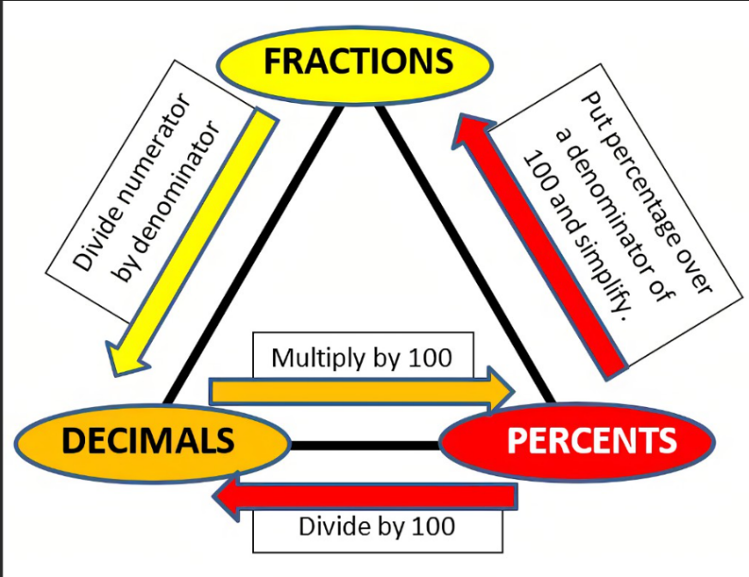
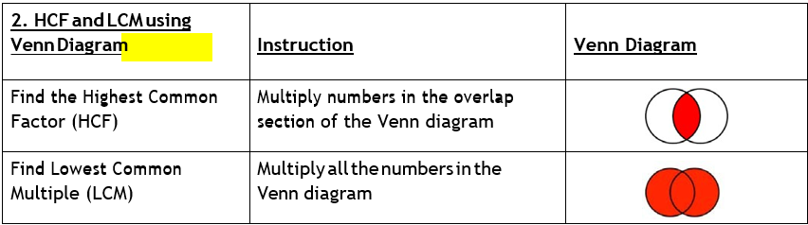






Year 8 – Half term 1 Maths Knowledge Organiser
Indices:
$$3^{a}×3^{b}=3^{a+b}$$
$$3^{a}÷3^{b}=3^{a−b}$$
$$({3^{a})}^{b}=3^{a×b}$$
$$3^{−a}=\frac{1}{3^{a}}$$
$$x^{1}=x$$
$$x^{0}=1$$
Integer- whole number
Square number- multiply an integer by itself.
Cube number- multiply an integer by itself 3 times.

Slide 2
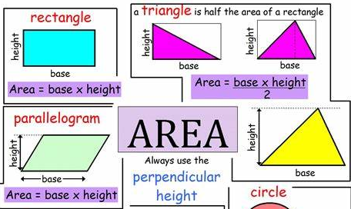
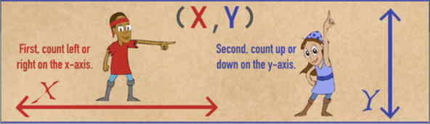
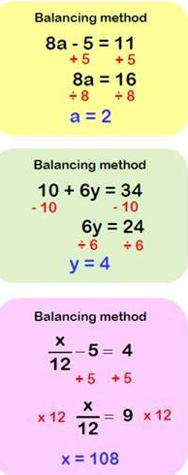
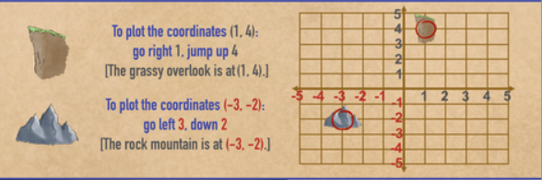
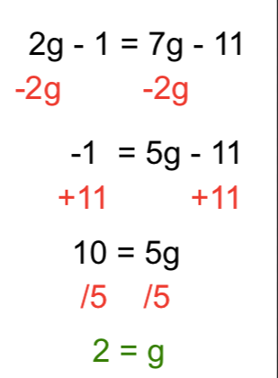
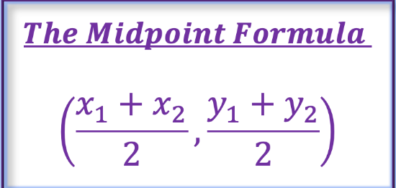
Year 8 – Half term 2 Maths Knowledge Organiser
Coordinates:
Solving equations:
Where x is on both sides:
y=a graphs are horizontal
Variable- a quantity represented by a letter
x=a graphs are vertical
Expression- a mathematical statement with an equals sign
Equation-says that two things are equal. It will have an equals sign "="

Slide 3
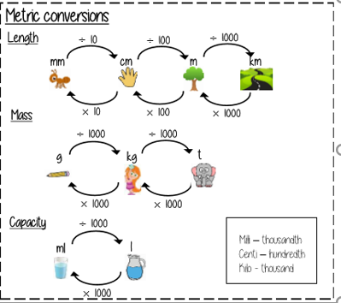
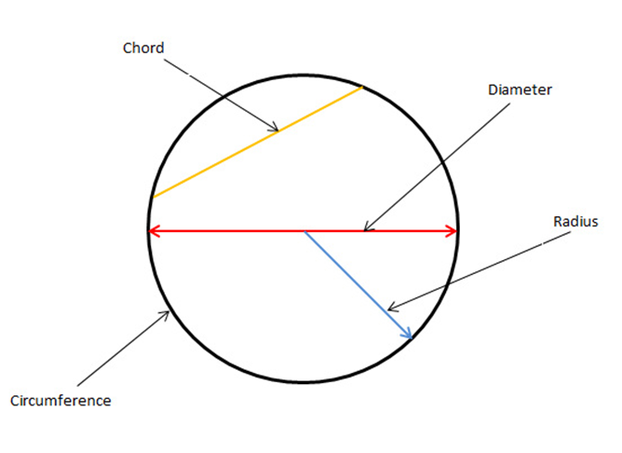
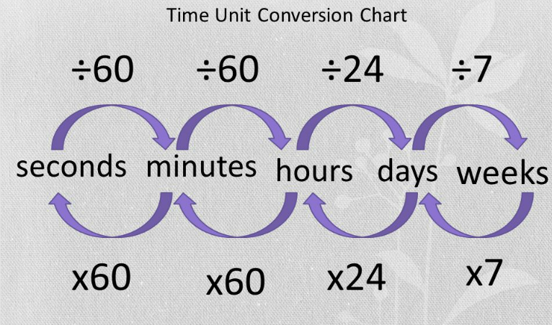
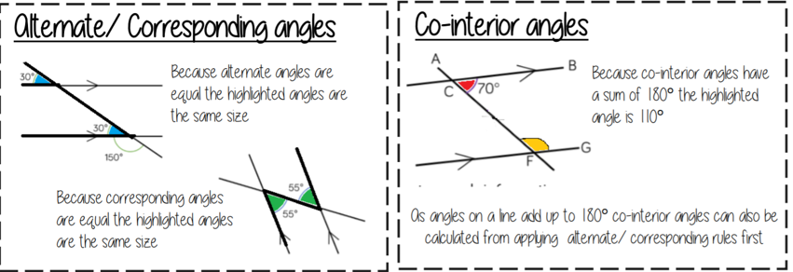
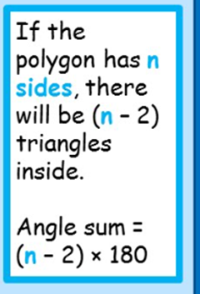
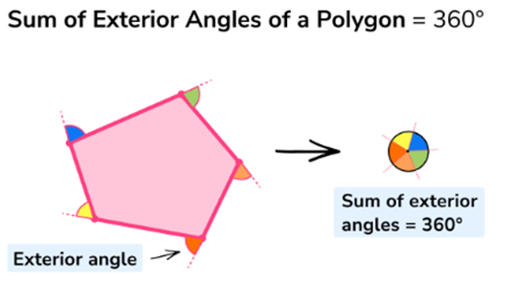
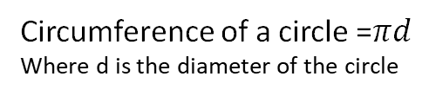
Year 8 – Half term 3 Maths Knowledge Organiser
Parts of a circle
Circumference of a circle =$πd$
Where d is the diameter of the circle
Angles in parallel lines
Angles in a polygon

Slide 4
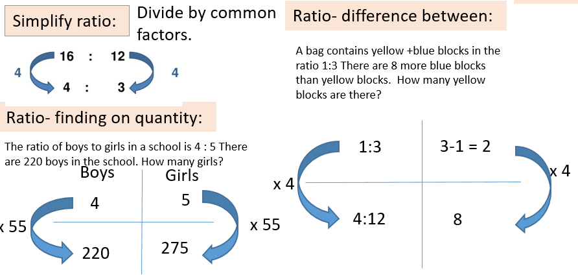
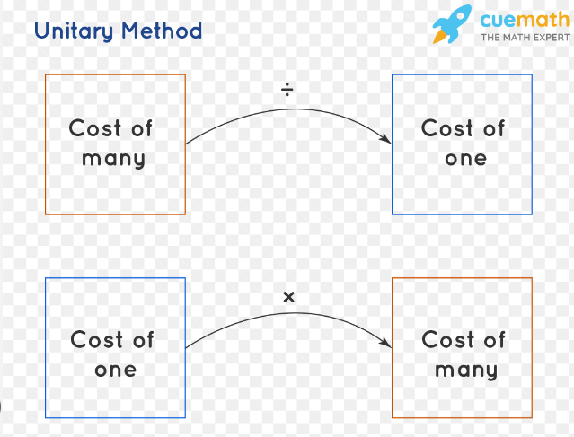
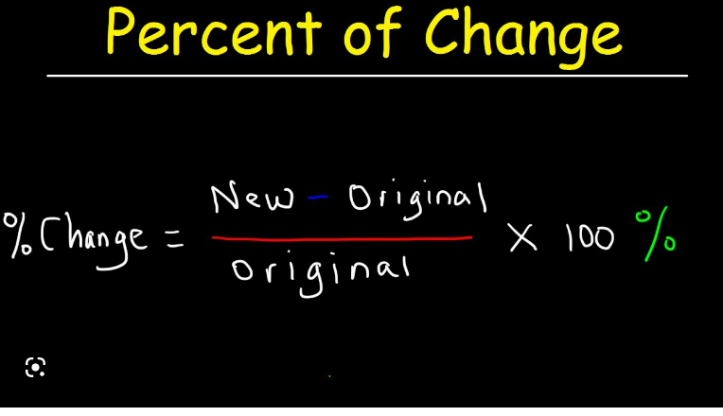
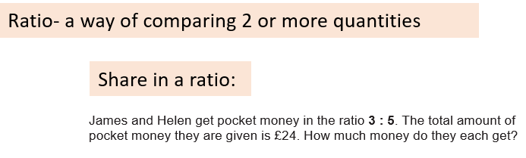
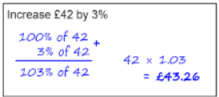
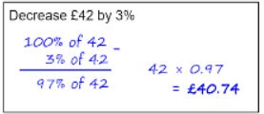
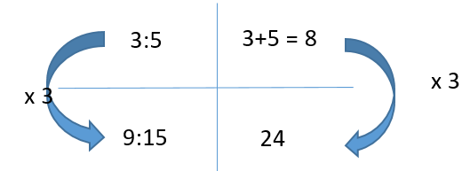
Year 8 – Half term 4 Maths Knowledge Organiser
Proportion

Slide 5
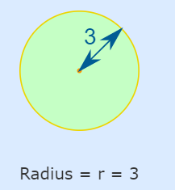
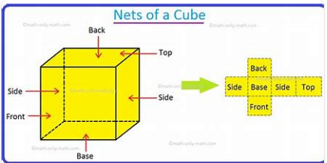
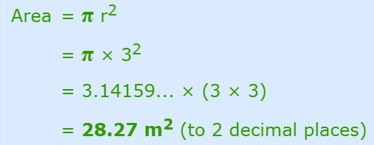
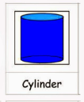

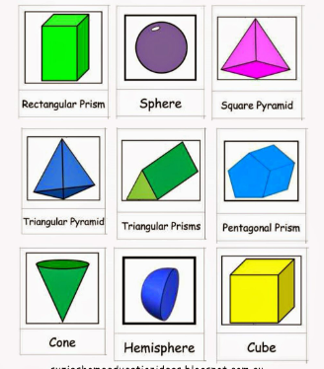
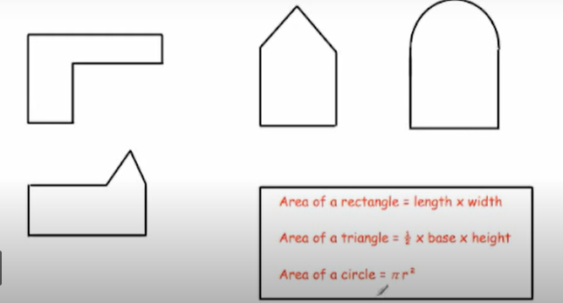
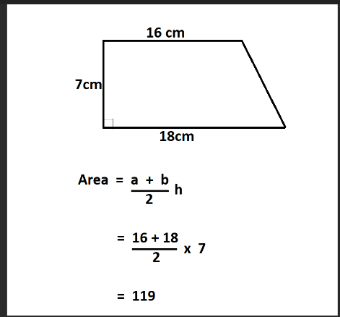
Year 8 – Half term 5 Maths Knowledge Organiser
Divide the shapes into separate shapes
then work out the areas and add them together.

Slide 6
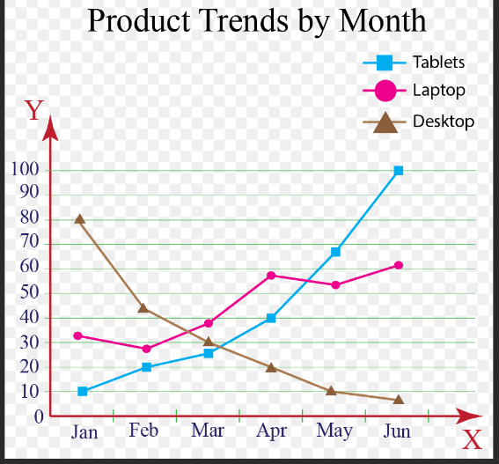
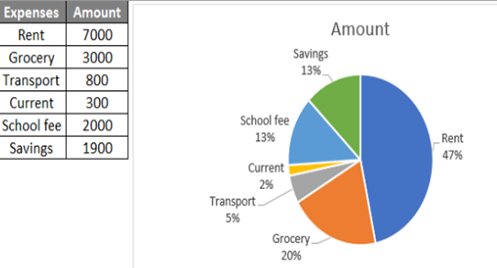
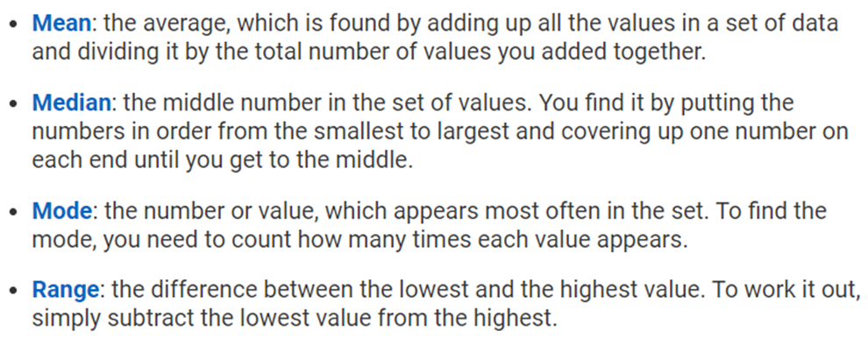
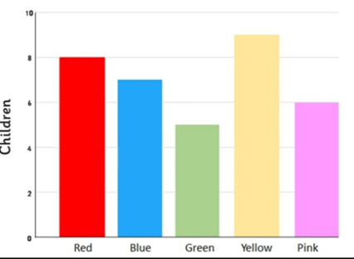
Year 8 – Half term 5 Maths Knowledge Organiser
Example of a line graph
Example of a pie chart
Averages
Example of a bar chart

Slide 7

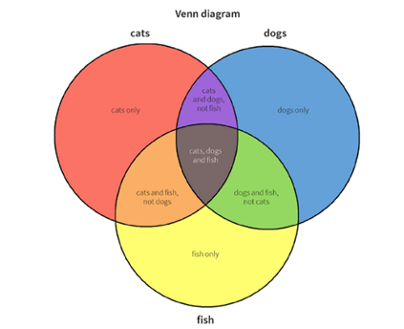

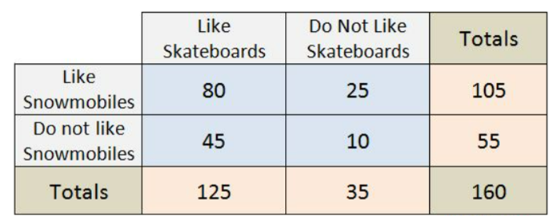
Year 8 – Half term 6 Maths Knowledge Organiser
Example of a venn diagram
Names of 3D shapes
Example of a 2 way table

Slide 8
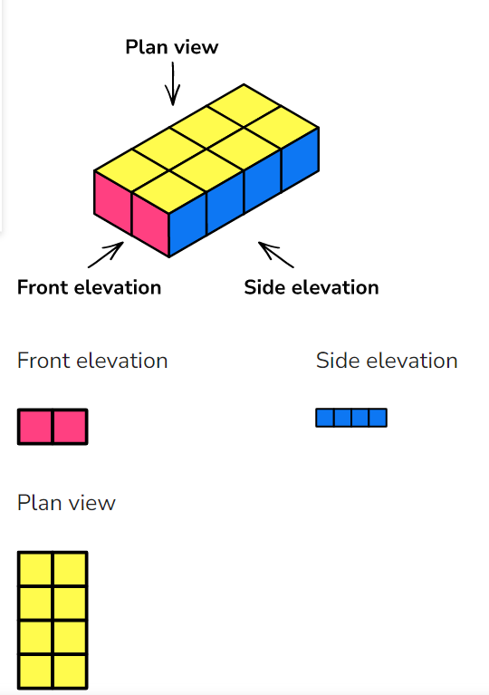
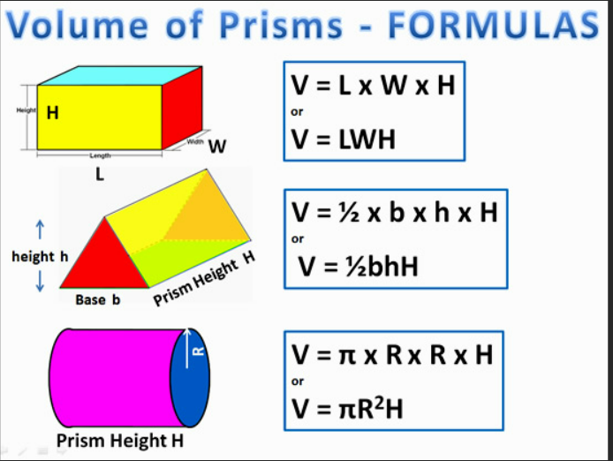
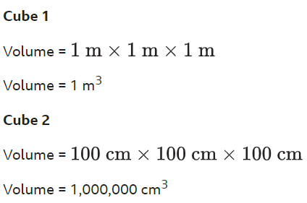
Year 8 – Half term 6 Maths Knowledge Organiser

