Slide 1
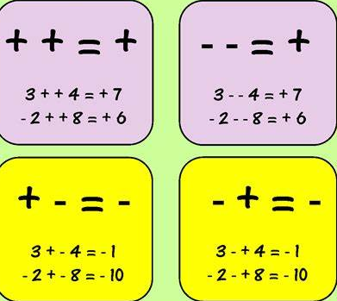
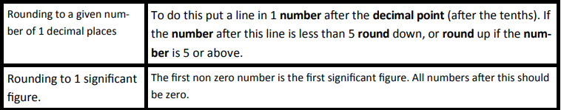
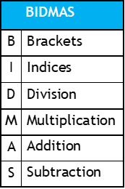
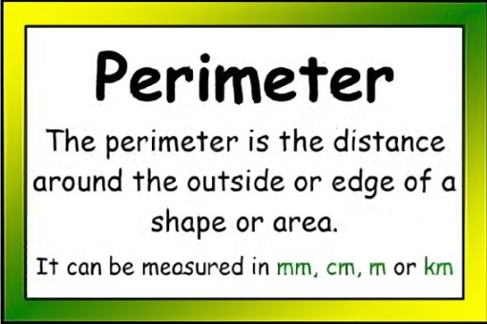
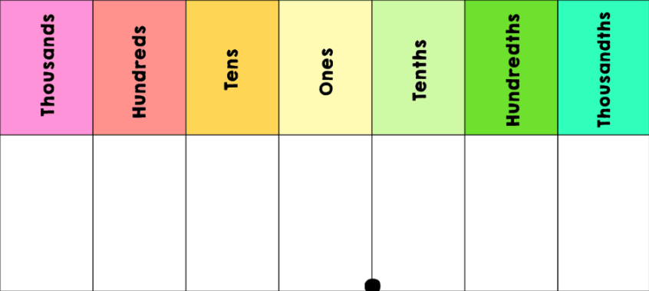
Year 7 Half Term 1 Knowledge Organiser
Rounding
Negative numbers:
Negative number- a number less than zero
Integer- whole number
Cube number- multiply an integer by itself 3 times.
Product- The answer when two or more values are multiplied together.
Square number- multiply an integer by itself.
Prime- a number with 2 factors 1 and itself.
Sum- The result of adding two or more numbers.
Place value:
Even number- divisible by 2
Odd number- not divisible by 2

Slide 2
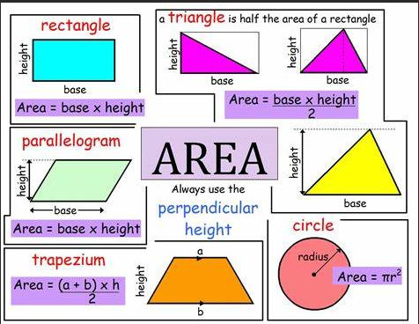
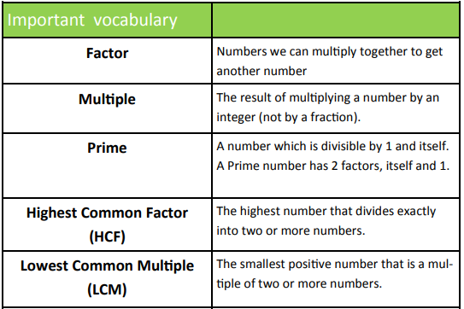
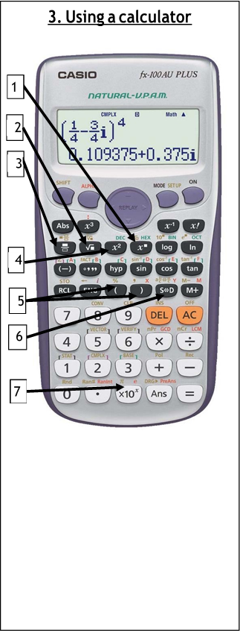
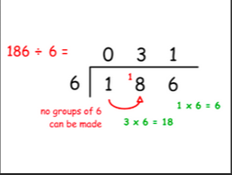
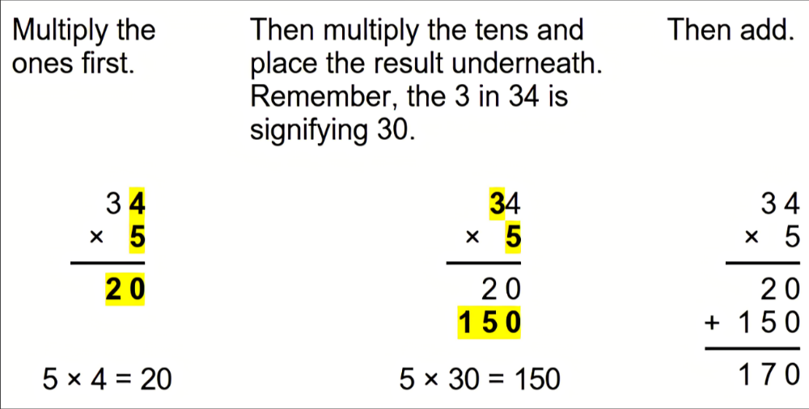
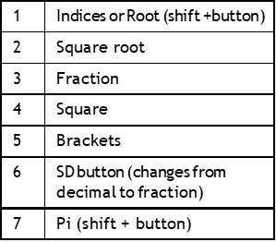
Year 7 Half Term 2 Knowledge Organiser
Multiplication-
Prime numbers:
2,3,5,7,11,13,17,19,23,29
Division-
Square numbers:
1,4,9,16,25,36,49,64,81,100,121,144,169,196,225

Slide 3
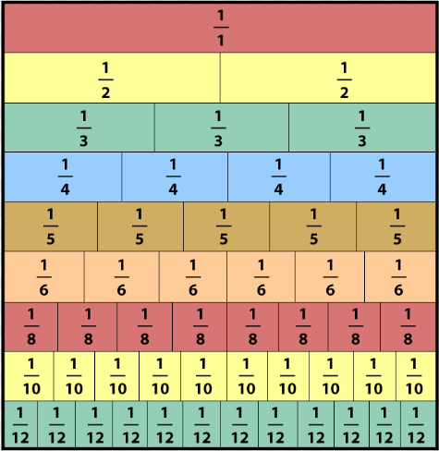
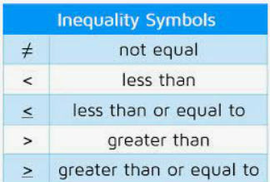
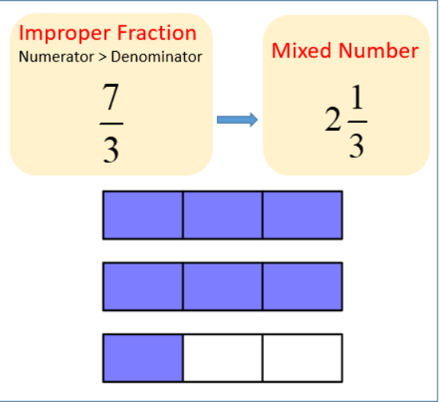
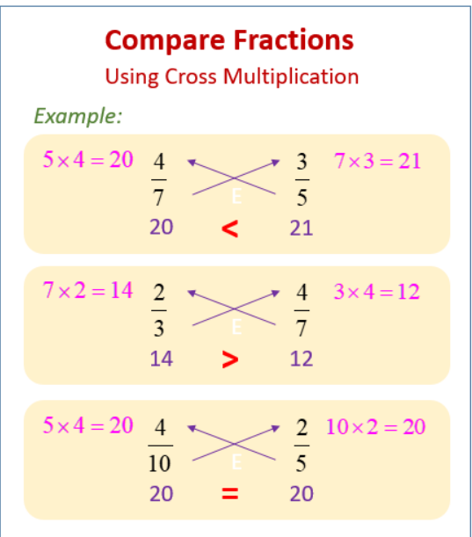
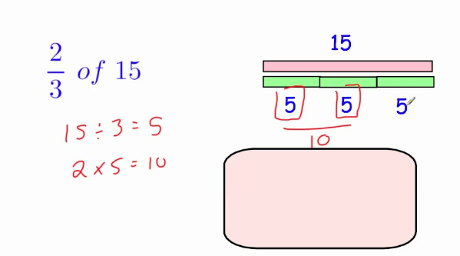
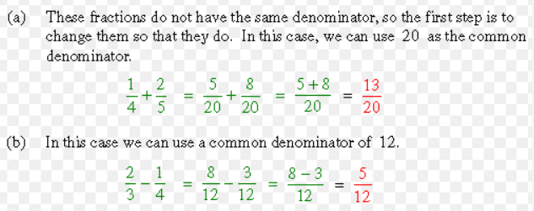
Year 7 Half Term 3 Knowledge Organiser
Fractions
Fraction wall
Adding & Subtracting fractions
Fraction of an amount

Slide 4
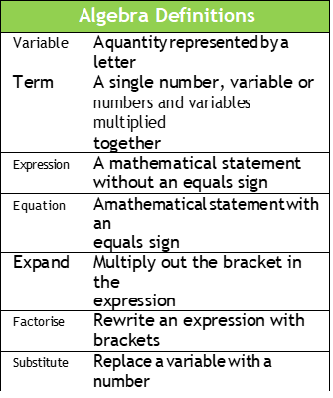
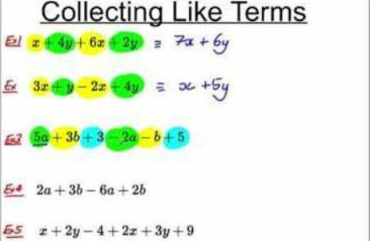

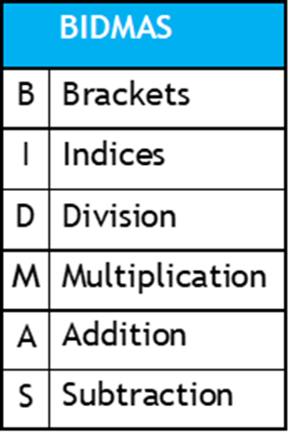
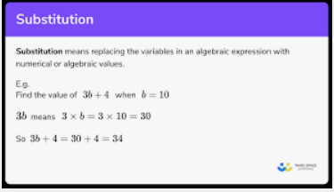
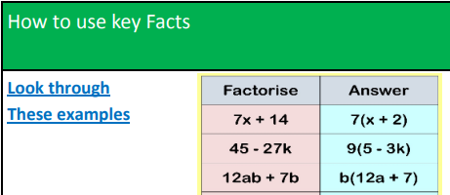
Year 7 Half Term 4 Knowledge Organiser

Slide 5

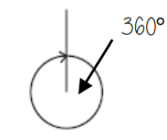
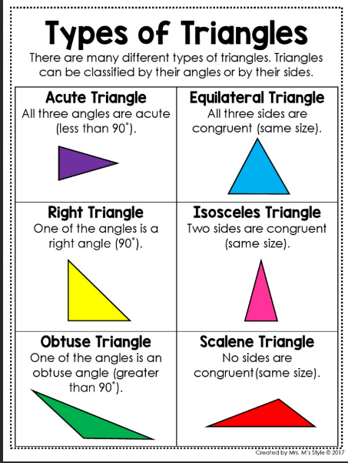
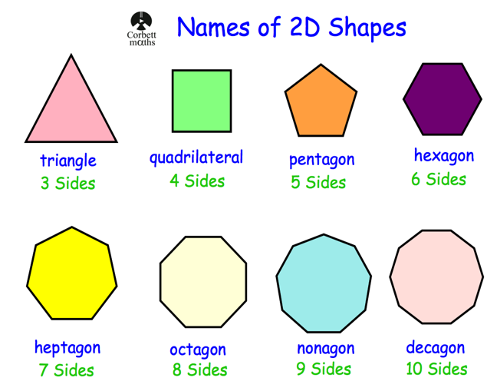






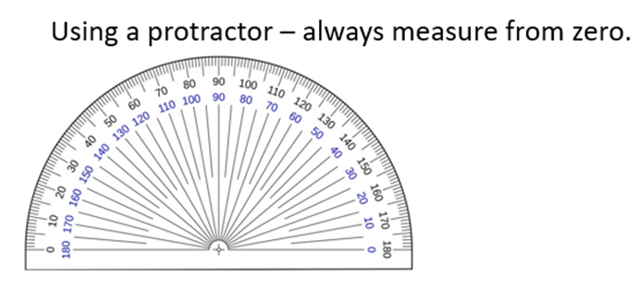


Year 7 Half Term 5 Knowledge Organiser

Slide 6
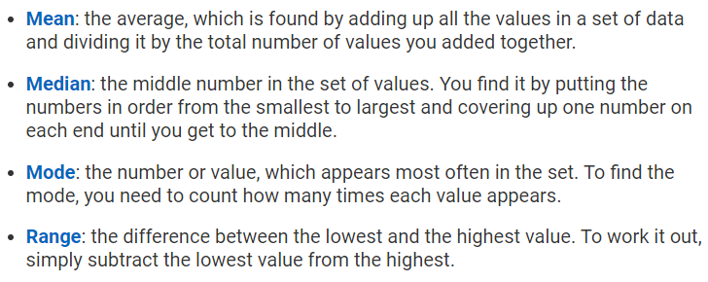
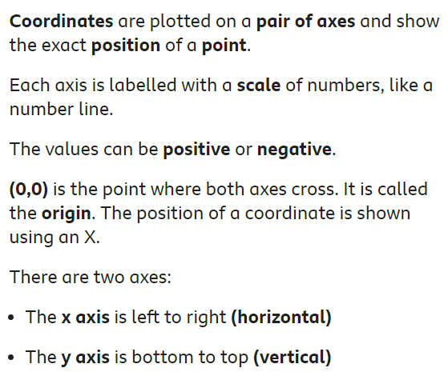
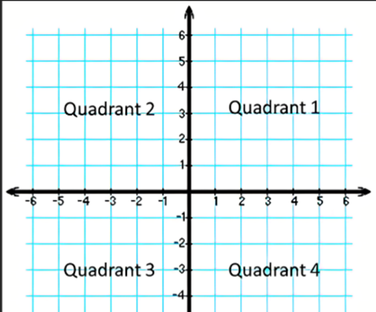
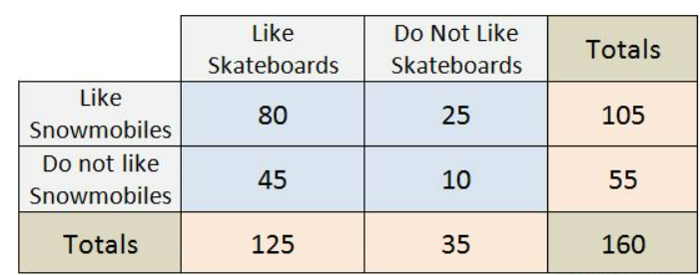
Year 7 Half Term 6 Knowledge Organiser
Averages
Sequences:
Sequence: a number pattern
Term : a number contained in a sequence
First term: the first number in a sequence
Term-to-term rule: describes how to get from one term to the next
Nth term – the rule that allows us to find any term in a sequence
Coordinates
2 way table- shows the frequency of data which satisfies two variables.

