Slide 1
Year 11 HT2

Slide 2
Power and the People, c1170-Present
The Pilgrimage of Grace was a serious threat to the rule of Henry VIII.
Most levels of society were involved – lords, knights as well as commoners – although it has to be said that many people remained loyal to the King.
It is important to remember it was no solely caused by religious changes – there were other causes too, such as poor harvests, low wages, bad government and rumours of new taxes.
For a time there were 50,000 armed men in the north of England involved.
They wanted change, mainly religious change, but they did not want to remove the King.
It was a conservative movement, seeking to reverse change and return to the old ways of religion. It was fed by rumour and uncertainty in a time of economic stress and strain for people.
Henry was able to face down the rebels and emerge at the end of the process in a stronger position.
Of all the rebellions, it is one of the least remembered.
Why did Henry VIII break with the Catholic Church?
What problems were caused by the religious changes?
Henry resented the power and wealth that the Church held in England.
He was frustrated when the Pope refused him a divorce from his first wife, Catherine of Aragon.
Henry stopped paying taxes to the Pope and made himself head of the new Church of England.
He also closed down monasteries to weaken the power of the Church and steal its wealth
Problem | Explanation
Social | Church and monasteries were the centre of people’s social lives which the King had now taken away.
Economic | Henry increased taxes even though he became rich from closing monasteries.
Religious | Many people did not like the changes to church services made by the King.
Political | Many nobles lost influence due to Henry’s divorce whilst other families gained power.
All monasteries were closed down
More changes in church services
Protestants became more confident in introducing their ideas
Story of the Pilgrimage
Significance of the Pilgrimage of Grace
The rebels took over York, Hull and Pontefract Castle in the North.
The King’s army of the north, led by the Duke of Norfolk, only numbered 5,000 whereas there were over 50,000 rebels.
When the rebels took over a town they made sure the monks and nuns were returned to their monasteries and nunneries.
The Duke of Norfolk told the King he had to negotiate.
A list of grievances was drawn up and sent to the King.
Henry agreed to some of the rebels demands in order to buy himself some more time including: a pardon for all, a Parliament in York and that no more monasteries would be closed down before Parliament was called.
After the pardon was read out at Aske’s insistence, the rebels agreed to disband and go home.
Aske was invited to spend Christmas with the King at Windsor.
When travelling home a new revolt broke out. Henry used this as an excuse to tear up the pardon attack the north.
Aske was hanged in chains in York.
216 people were executed.
Why did the Pilgrimage fail?
The rebels were too ready to accept the promises of the King.
Could have beaten the King with force, not with diplomacy.
The leaders did not trust the commons.
by disbanding their force of 50,000 people they handed over the initiative to Henry.
The rebels were easily duped by the Duke of Norfolk and his promises in Doncaster.
No more religious rebellions took place during Henry’s reign
Aske was brutally and publically executed
Ended the power of the Catholic Church in England
Made people scared to rebel against the King again
Keywords
Factor | How it affected the Pilgrimage of Grace story
Chance | Robert Aske was caught up in the revolt accidentally. He was forced to make an oath of support before he was allowed to continue on his journey to London. Without this the revolt would not have had their leader.
Religion | Henry VIII had made changes to the Church in England including the introduction of a new prayer book in 1535. The rebels wanted Henry to reverse these changes. The rebels were also led by priests and monks carrying church banners.
Economy | There were rumours of new taxes and there had been poor harvests which drove up food prices. All this made the people frustrated with the King
Role of the individual | Aske led the rebels and ordered them to disband after the King’s ‘promise’ which made it easier for Henry to deal with the rebels.
Pilgrimage:
Grievances:
Protestant:
Robert Aske:

Slide 3
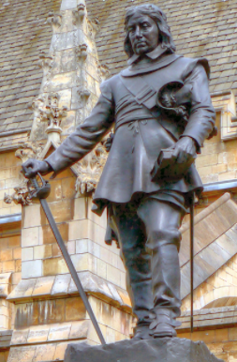
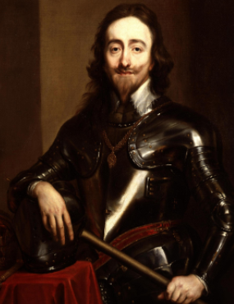
Summary
Challenging Royal Authority: The English Civil War
Rule by Parliament
Rule by the army
During this time the nation fought a civil war, executed a king, became a republic, restored the monarchy and replaced the king yet again.
People in the 1640s talked about a ‘world turned upside down’.
It was a period of strong feelings and dissent in politics, in economics and in religion.
Families were often divided. Loyalties were tested and big questions asked such as, is it right to rebel against your King?
The demands of Parliament were met, but those of the poor, and women, were not.
The reputations of key characters involved – Charles I and Cromwell – are still disputed today.
Causes of the English Civil War
Religion | Money | Power
Charles was married to a Catholic and people feared his children were being brought up as Catholics. Puritans dominated Parliament. They did not like the Catholic changes to Churches by Archbishop Laud. The Scots opposed the introduction of a new prayer book and went to war against Charles. | Charles ruled without Parliament for eleven years and raised taxes without Parliament’s permission. Charles introduced ship tax to pay for his failed war against Scotland. Charles was forced to pay compensation to the Scots but had limited funds. | Charles believed in the Divine Right of Kings – he was appointed by God. Charles preferred the advice of his favourite ministers to consulting with Parliament. Charles attempted to arrest the leading members of Parliament. After this failed he fled to Nottingham to wage war against them.
Rule by Cromwell
Between 1649-60 England tried three ways to rule without a King – but failed
It was the first time a King was not replaced by another King
Significance of the English Civil War
The New Model Army
Charles’ Execution
Swung the balance of power in Parliament’s favour.
The first fully professional army created by Oliver Cromwell.
Soldiers were veterans from other battles and held strong religious views.
The soldiers believed that God was on their side
Officers were promoted by merit and not class.
Soldiers were well paid – 8d per day.
Many members believed that all men should have the vote.
MPs were divide about how to treat the King. The army ejected 300 MPs leaving only a Rump who put the King on trial.
Charles was found guilty of treason. He refused to plea as he did not recognise the power of the court.
Charles was executed on 30th January 1649.
After his execution Parliament abolished the monarchy and the House of Lords.
England was declared a Commonwealth.
When the monarchy was restored it did not hold the same power
Parliament asked Charles II to become King
Parliament met more regularly
Not as influenced by the abilities of each king
Key events of the Civil War
Factor | How it affected the English Civil War story
War | Charles went to war with the Scots to enforce a new prayer book on them. He was defeated and was ordered to pay them compensation.
Government | Charles’ actions alienated Parliament and led to the start of the Civil War. The ‘Rump’ Parliament decided that the King should be executed,
Religion | The first argument started when Charles attempted to force a new prayer book to Scotland. The Puritan members of Parliament were defending their faith against their ‘Catholic’ King.
Ideas | Parliament believed that the power of the army and the right to end Parliament should be transferred from the King to them.
Role of the individual | Cromwell created the New Model Army which defeated the Royalists. After he was pivotal in the execution of Charles I and became the ruler of England.
Oliver Cromwell
Keywords
The mastermind behind the New Model army which was used to defeat the Royalist army and capture Charles I
1649 Cromwell crushed a rebellion in Ireland.
Groups going against the government were marginalised and their leaders were imprisoned.
1653 Cromwell, backed with the army, marched into Parliament and took power as Lord Protector.
Attempted to create a religious settlement that would appeal to all but his puritan views made him unpopular.
He closed theatres, banned Christmas and stopped women wearing make up.
After Cromwell’s death Parliament restored the monarchy but it had gained more powers than before the Civil War.
Oliver Cromwell:
Divine Right of Kings:
Ship Tax:
Rump Parliament:
New Model Army:
Lord Protector:
Puritan:

Slide 4
Summary
Challenging Royal Authority: The American War of Independence
In 1776 the thirteen colonies of North America declared their independence from Britain. Most people believed that colonies were unable to exist as a separate country.
Over the previous 150 years these colonies had been largely self-governing but it was war with France that brought to a head the tensions that led to the American Revolution.
There are echoes of Magna Carta and other revolts in the words of the Declaration of Independence, words that are still powerful today and which would have a most profound impact on events during the following 200 years.
The American Revolution and the War of Independence that followed it had important consequences for the way Britain was governed.
The slogan of the Revolution, ‘no taxation without representation’, remains a strong political rallying cry today
Causes of the American War of Independence
Taxes and War | Powerful ideas & Strong Individuals
The Seven Years war with France made Britain introduce new taxes in America. Britain sent troops to defend their 13 American colonies but wanted them to pay for their up keep. As a result they introduced new taxes on the 13 colonies including the Stamp Act of 1763. There was wide spread opposition to the new taxes as the Americans felt they as they were not represented in the British Parliament then they should not be taxed. This promoted the slogan of the War of Independence, ‘No taxation without representation’. 1773 Boston Tea Party: tipped all the tea on a boat going to Britain into the sea as a protest against British rule. The British responded by closing Boston Harbour to all shipping until compensation was paid. This angered the Americans more. | There were three groups which had different ideas: Moderates: wanted a compromise with the British. Loyalists: wanted to remain part of the British Empire. Radicals: Americans should be represented in any law that taxed them. Thomas Paine was a strong individual: Wrote a pamphlet called ‘Common Sense’ in 1776. The pamphlet urged for American Independence. Sold over 500,000 copies
Changes to the voting system
Fairer distribution of power in Britain
Freedom of the individual
Support for radical opinions grew in Britain
Re-affirmed democratic beliefs
Significance of the American War of Independence
Consequences of the American War of Independence
USA | Great Britain | France | Rest of the World
Declared independence – the declaration reflected the Magna Carta. First time a colony rejected the rule of a European country. | Trading increased with Canada and India. Led to people wanting change in the voting system and the way power was distributed in England | Supported the Americans with troops, ships & money. Erupted into their own revolution six years after. | People began questioning about the rights of having an empire. Adam Smith believed that trade was more important in generating wealth than having colonies.
Caused other revolutions against powerful leaders
The defeat made the British more determined never to experience it again
Keywords
Independence:
Revolution:
Declaration:
Representation:
Thomas Paine:
Loyalist:
Radical:
Yorktown:
Boston Tea Party:
The Seven Years War:
French Revolution 17789
Defeated the French in 1815
The British Surrender at Yorktown
Factor | How it affected the American Civil War story
War | The Seven Years war with France resulted in Britain increasing the taxes on the colonies. This forced the American colonies to declare their independence and fight against British rule.
Government | The British government decided to introduce new taxes to force the Americans to pay for British troops to defend their country, This caused the Americans to declare their independence.
Communication | All of the colonies worked together to battle against British rule. After news spread they were supported by France in their battle for independence.
Ideas | There was a widespread belief within America that they colonies should reject British rule.
Role of the individual | Thomas Paine and John Adams were key in promoting independence. Adams helped draft the American Constitution.
The American’s supported by the French surrounded the British army at Yorktown.
The British commander had no choice but to surrender as he could not bring in reinforcements.
They were forced to surrender all of their weapons including 214 artillery pieces and thousands of muskets.
On hearing the surrender the British Government passed a Bill stating that no more attempts to defeat the Americans should be taken.
Britain did not have the political will to continue the fight.
The defeat at Yorktown was a humiliating end and defeat for the ’superior’ British forces.

Slide 5

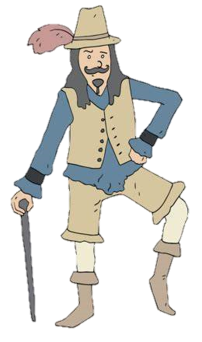

Power and the People, c1170-Present
Pilgrimage of Grace
Explain why the Pilgrimage of Grace was a threat to Henry VIII’s rule.
Who was Robert Aske and why was he significant?
Explain the importance of economic factors in causing the Pilgrimage of Grace.
How far was the Duke of Norfolk's role the main reason for the failure of the Pilgrimage of Grace?
How significant was the failure of the Pilgrimage of Grace for future rebellions?
The English Revolution
Explain the main cause of the English Civil War
Why was this revolution significant for the course of English history?
Create a profile on Oliver Cromwell including further research of his career and influence.
Explain why the new model army were a successful fighting force.
Research: Can you still see the impact of the Civil War on the relationship between the Monarchy and Parliament today?
The American War of Independence
Explain what was a more important cause of the War of Independence: Taxes or Powerful ideas?
Why were the British defeated?
Which country saw the biggest consequences of the War of Independence?
How did the British react to this defeat?
Research: How far has independence benefitted America?

Slide 6
Year 11 HT1

Slide 7
Power and the People (Medieval)
Feudal System | A hierarchy of land ownership
Barons | The king’s chief supporters who would own lots of land and grant it to knights.
Villeins | Peasants who worked the land
Charter of liberties | An agreement which bound the king to certain laws.
Magna Carta | A set of rules which the king had to abide by in ruling England
Battle of Bouvines | Victory for France which fuelled opposition to King John.
Runnymede | The place where the Magna Carta was signed
Key events
Magna Carta
The barons challenge the power of the king over his laws and rebel. They manage to get him to sign a charter with rules for governing England at Runnymede in 1215. This represented the beginnings of Parliament
Simon de Montford’s rebellion
When Simon led a rebellion against the misrule of the king and called a Parliament, it was the first Parliament to which representatives from counties and towns were summoned to give advice.
For the first time, it was not just the great barons who were being consulted, but representatives of a much wider section of the community.
constitution | The laws for governing the land
The Provisions of Oxford | A series of changes in the way England was governed where Henry III lost power over the government to council of 15
Revolt | To take violent action against something or someone
Smithfield | Where the peasants met the king and Wat Tyler was stabbed
Poll tax | A tax levied by the king to pay for his wars in France.
Work Service | Where some peasants had to work on the lords land for 2 days without pay
Peasants Revolt
Dissatisfied with their lot in life peasants from the south of England march to London to meet the king to discuss his laws in the hope of forcing a change. It failed when the leaders were arrested and killed and the demands not met.

Slide 8
Power and the People (Medieval)
Key individuals
King John Considered to be the worst king of England who was brought to account by the barons and forced to sign the magna Carta in 1215 | Henry III He faces a rebellion in Wales and discontent from English barons. The Provisions of Oxford create a Privy Council to advise the king. It also establishes that Parliament is to be held three times a year. | Simon de Montford Led a rebellion against Henry II Iand then called a new parliament to decide on a new constitution. He was later killed and mutilated at the battle of Evesham. | John Ball Leader of the peasants revolt who intended to march to the king and petition him for a fairer deal. He was later executed for his role in the rebellion. | Wat Tyler Leader of the Peasants revolt marching from Canterbury to London to oppose the poll tax. He was stabbed while riding over to speak to the king.
Research
Research what happened at the Battle of Evesham
What happened to King John’s crown jewels?
What happened during the reintroduction of a new Poll Tax in 1990?

Slide 10
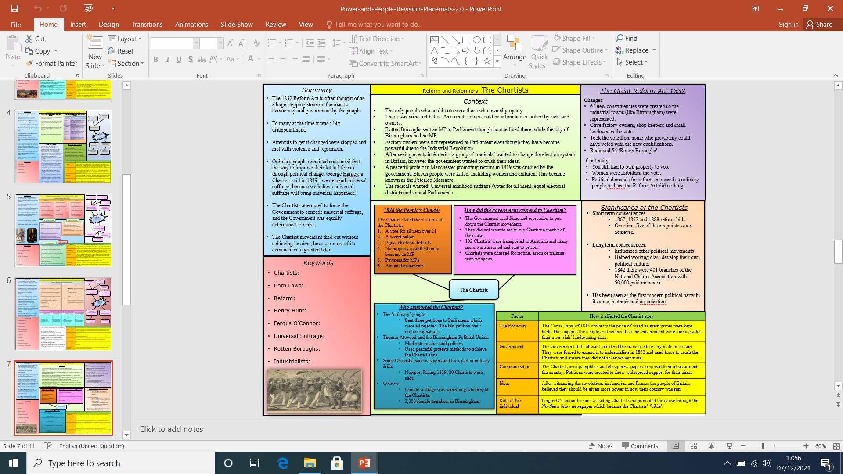
Knowledge Organiser YR11 HT3 – Power and the People

Slide 11
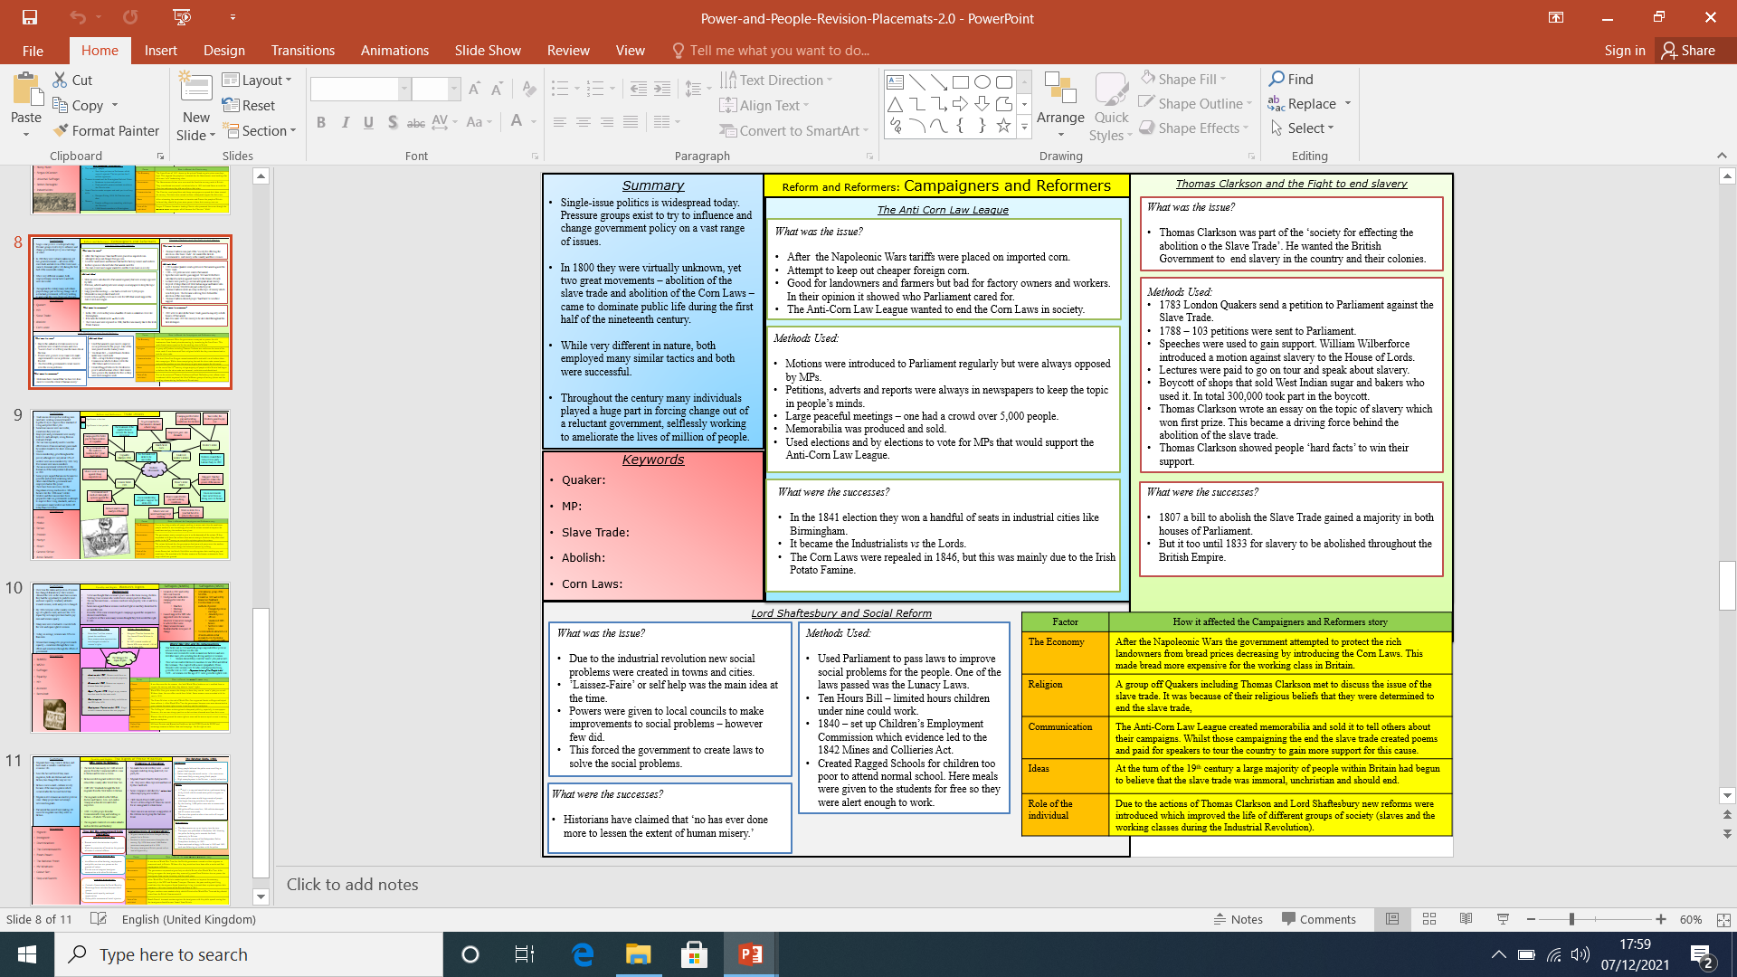
Knowledge Organiser YR11 HT3 – Power and the People

Slide 12
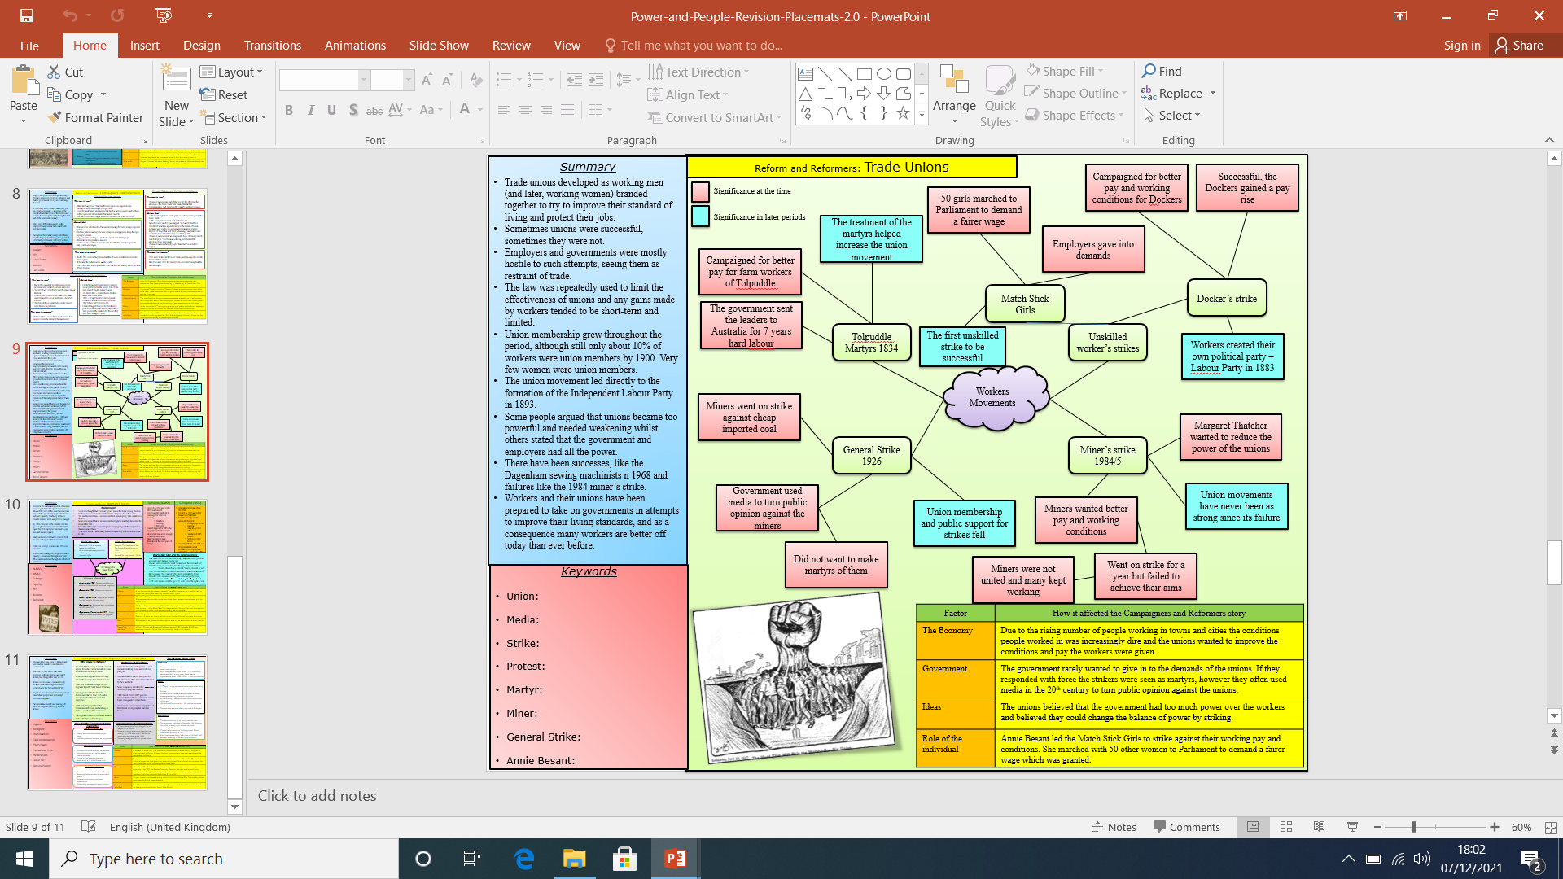
Knowledge Organiser YR11 HT3 – Power and the People

Slide 13
YR11 – HT3 and HT4

Slide 14
Germany 1890-1945: Democracy to Dictatorship YR11- HT3
Kaiser Wilhelm II
The leader of Germany in 1890 was Kaiser Wilhelm II. He was an autocrat, which meant that he was in complete charge of Germany. He did have a Chancellor, but only the Kaiser could appoint him (he could dismiss him too). There was a Reichstag or parliament, however, this had very limited to power. It had no say on policy or government actions.
However, there was a growing call for greater democracy, particularly from the Social Democrat Party, who represented the working class. Although the Kaiser had introduced a generous package of welfare laws e.g. Old age pensions and unemployment benefits, many working class people still continued to vote for the SDP who wanted a lessening of the Kaiser’s powers.
Further Problems
Germany had concentrated on building up its industry during the late 19th century, making it the strongest economy in Europe. However, this led to shortages in farming and agriculture. Germany had to import a large proportion of its food. This could be dangerous if a major war broke out.
Kaiser Wilhelm II also wanted Germany to be a great international power and develop an empire. This led to him creating a modern navy. However, this was viewed as a threat by GB and tensions rose between the two countries, culminating in war in 1914
Impact of WWI
The war cost Germany a huge amount in terms of lives and money. At the end of the war Germany was virtually bankrupt. Its people were also starving due to the Allied blockade. Nearly a million children were orphans, and on top of this a revolution took place at the end of the war, which saw the end of the Kaiser’s rule. Germany lost WWI and suffered the humiliation of having to pay reparations to the Allies. Many Germans thought that the final figure of £6.6 billion was too high. They also lost large amounts of their territory and had to reduce their army. The new Weimar Government were forced to sign the Treaty of Versailles, which led to many German people to hate this new government as they thought it had ‘stabbed the people in the back’.

Slide 15
Germany 1890-1945: Democracy to Dictatorship YR11- HT3
Causes of revolution in Germany
WWI – Germany’s failure in WWI had come as a shock to many Germans who had been convinced of success through propaganda. Defeat had shattered ideas that Germany were a global superpower.
Treaty of Versailles – German people were outraged at the terms of the ToV. They were forced to accept blame for the whole war, lost colonies and land to European nations, and fined £6.6 billion in reparations.
Social unrest – Many working class Germans who had grown to hate the Kaiser were unhappy at the upper classes and gentry who still held most of the power despite loosing the war. Those Germans would also show discontent at the failings, weakness and disorganisation of the Weimar Republic.
Economy – Having spent most of their money on total war, Germany faced an economic issue post WWI. Germany had loans to repay, reparations forced upon them, and the loss of jobs from the reduction of their army from 3 million to 100,000.
Spartacist revolt – January 1919
Communist uprising led by Karl Liebknecht and Rosa Luxemburg. Spartacists wanted to replicate the Bolshevik revolution in Russia and went on strike. Taking to the streets to protest they ended up in violent clashes with the Freikorps – a dangerous group of right wing ex-military servicemen - who eventually put them down.
Kapp Putsch – March 1920
In crushing the communists the Freikorps had saved the government, but the terms of the Treaty of Versailles meant Germany’s army had to be significantly reduced and the Freikorps had to be disbanded. During 13 - 17 March 1920, as a reaction to this, the right-wing nationalist, Dr Wolfgang Kapp led a Freikorps takeover in Berlin. The regular army refused to attack the Freikorps; Kapp was only defeated when the workers of Berlin went on strike and refused to cooperate with him.
Munich Putsch
Causes:
1923 – 55,000 Nazi members
Hyperinflation
Copying Mussolini
Weimar called off strike in Ruhr.
Events:
Hitler and SA storm Munich beer hall.
Forced politicians to agree to rebel.
Next day Hitler marched into Munich.
Politicians had called police when Hitler let them go.
Police opened fire and Hitler was arrested 2 days later
Short term failure:
Nazi party was banned
Hitler was tried for treason
Hitler sentenced to 5 years in prison.
Long term success:
Mass media coverage of Hitler
Hitler served only 8 months
Wrote Mein Kampf
Changed tactics to democratic means.
Hyperinflation -1923
Hyperinflation is when money quite literally becomes worthless. This happened in Germany 1923. It started after France and Belgian troops invaded the Ruhr after Germany failed to pay its second reparations instalment. The workers went on strike, which the Weimar Government supported, and in order to pay the striking workers the government printed off money. This caused prices to increase rapidly. The cost of 1 egg was over 6 billion marks!!!Hyperinflation left a legacy of bitterness amongst Germans, especially the Middle Class who had their life’s saving wiped out because of the crisis

Slide 16
Germany 1890-1945: Democracy to Dictatorship YR11- HT3
Stresemann Years – Golden Age of Weimar
In 1924 Gustav Stresemann became the new leader of the Weimar Republic. The first problem he tackled was the Hyperinflation crisis. In order to solve this he introduced a new currency called the Rentenmark, which helped to stabilise the currency and build confidence. He also negotiated loans from the USA in a deal known as the Dawes Plan. This was where the USA loaned $800 million to Germany. This allowed Germany to invest in its industry and in the short-term allowed Germany to recover economically. However, in the long-term it created a problem, since Germany’s wealth was based on American loans, and if the Americans recalled these loans, Germany’s economy would be in tatters.
In foreign affairs Stresemann also signed the Locarno Treaties. This allowed Germany to be part of the international community again, as Germany accepted its new western borders with France and Belgian and promised never to use war as an instrument of foreign policy. It also paved the way for Germany to join the League of Nations, which they had been forbidden to join in 1919. This also allowed Germany to normalise its relations with other countries and trade more easily.
Finally, Stresemann negotiated the Young Plan in 1929. This reduced reparations by two-thirds (£2.2 billion) and gave Germany longer to pay their debts off. However, in the same year America was hit by the Wall Street Crash which led to a Great Depression. As a consequence the USA recalled its loans from Germany, setting off an economic disaster within Germany, where unemployment rose to over 6 million and many banks and businesses became bankrupt.

Slide 17
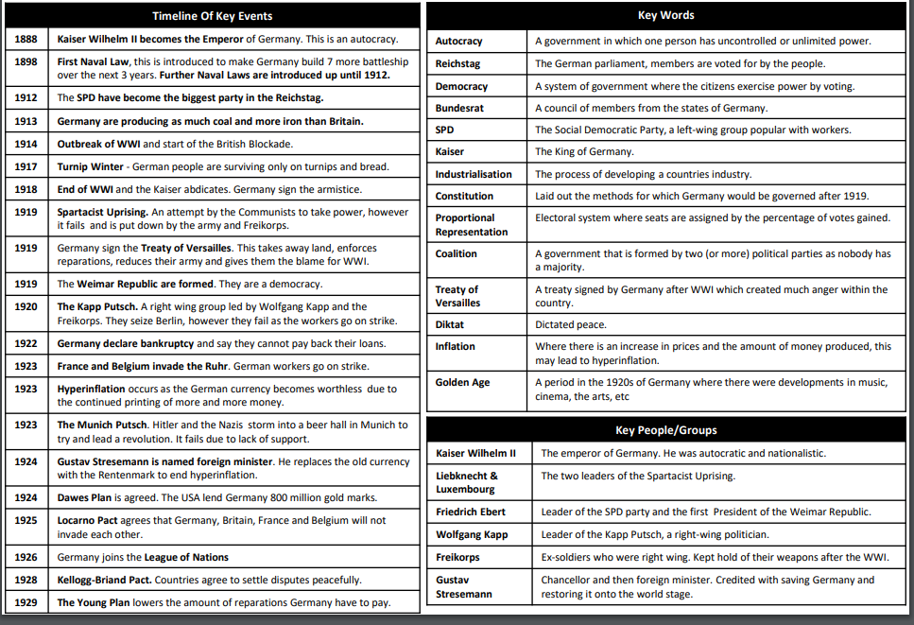
Germany 1890-1945: Democracy to Dictatorship YR11- HT3

Slide 18
YR11 – HT4

Slide 19
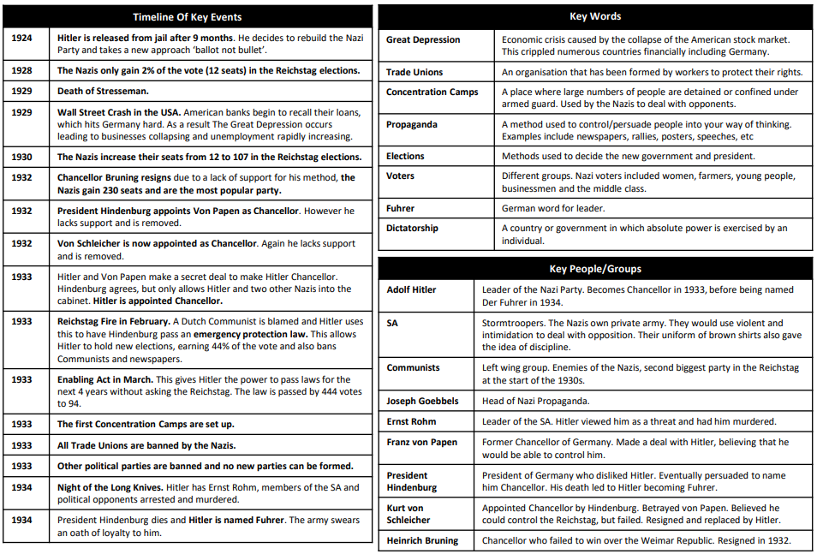
Germany 1890-1945: Democracy to Dictatorship YR11- HT3

Slide 20
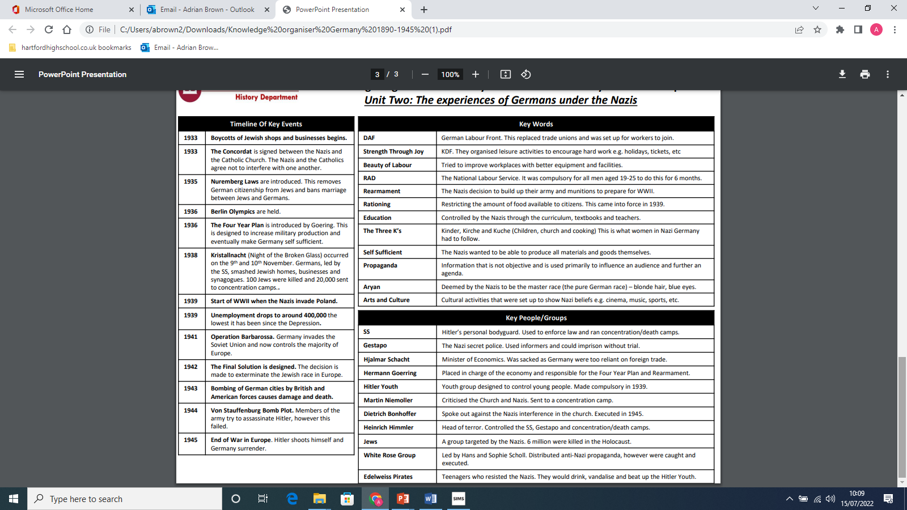
Germany 1890-1945: Democracy to Dictatorship YR11- HT3

Slide 21
YR11 – HT5

Slide 22
Germany 1890-1945: Democracy to Dictatorship YR11- HT3
Kaiser Wilhelm II
The leader of Germany in 1890 was Kaiser Wilhelm II. He was an autocrat, which meant that he was in complete charge of Germany. He did have a Chancellor, but only the Kaiser could appoint him (he could dismiss him too). There was a Reichstag or parliament, however, this had very limited to power. It had no say on policy or government actions.
However, there was a growing call for greater democracy, particularly from the Social Democrat Party, who represented the working class. Although the Kaiser had introduced a generous package of welfare laws e.g. Old age pensions and unemployment benefits, many working class people still continued to vote for the SDP who wanted a lessening of the Kaiser’s powers.
Further Problems
Germany had concentrated on building up its industry during the late 19th century, making it the strongest economy in Europe. However, this led to shortages in farming and agriculture. Germany had to import a large proportion of its food. This could be dangerous if a major war broke out.
Kaiser Wilhelm II also wanted Germany to be a great international power and develop an empire. This led to him creating a modern navy. However, this was viewed as a threat by GB and tensions rose between the two countries, culminating in war in 1914
Impact of WWI
The war cost Germany a huge amount in terms of lives and money. At the end of the war Germany was virtually bankrupt. Its people were also starving due to the Allied blockade. Nearly a million children were orphans, and on top of this a revolution took place at the end of the war, which saw the end of the Kaiser’s rule. Germany lost WWI and suffered the humiliation of having to pay reparations to the Allies. Many Germans thought that the final figure of £6.6 billion was too high. They also lost large amounts of their territory and had to reduce their army. The new Weimar Government were forced to sign the Treaty of Versailles, which led to many German people to hate this new government as they thought it had ‘stabbed the people in the back’.

Slide 23
Germany 1890-1945: Democracy to Dictatorship YR11- HT3
Causes of revolution in Germany
WWI – Germany’s failure in WWI had come as a shock to many Germans who had been convinced of success through propaganda. Defeat had shattered ideas that Germany were a global superpower.
Treaty of Versailles – German people were outraged at the terms of the ToV. They were forced to accept blame for the whole war, lost colonies and land to European nations, and fined £6.6 billion in reparations.
Social unrest – Many working class Germans who had grown to hate the Kaiser were unhappy at the upper classes and gentry who still held most of the power despite loosing the war. Those Germans would also show discontent at the failings, weakness and disorganisation of the Weimar Republic.
Economy – Having spent most of their money on total war, Germany faced an economic issue post WWI. Germany had loans to repay, reparations forced upon them, and the loss of jobs from the reduction of their army from 3 million to 100,000.
Spartacist revolt – January 1919
Communist uprising led by Karl Liebknecht and Rosa Luxemburg. Spartacists wanted to replicate the Bolshevik revolution in Russia and went on strike. Taking to the streets to protest they ended up in violent clashes with the Freikorps – a dangerous group of right wing ex-military servicemen - who eventually put them down.
Kapp Putsch – March 1920
In crushing the communists the Freikorps had saved the government, but the terms of the Treaty of Versailles meant Germany’s army had to be significantly reduced and the Freikorps had to be disbanded. During 13 - 17 March 1920, as a reaction to this, the right-wing nationalist, Dr Wolfgang Kapp led a Freikorps takeover in Berlin. The regular army refused to attack the Freikorps; Kapp was only defeated when the workers of Berlin went on strike and refused to cooperate with him.
Munich Putsch
Causes:
1923 – 55,000 Nazi members
Hyperinflation
Copying Mussolini
Weimar called off strike in Ruhr.
Events:
Hitler and SA storm Munich beer hall.
Forced politicians to agree to rebel.
Next day Hitler marched into Munich.
Politicians had called police when Hitler let them go.
Police opened fire and Hitler was arrested 2 days later
Short term failure:
Nazi party was banned
Hitler was tried for treason
Hitler sentenced to 5 years in prison.
Long term success:
Mass media coverage of Hitler
Hitler served only 8 months
Wrote Mein Kampf
Changed tactics to democratic means.
Hyperinflation -1923
Hyperinflation is when money quite literally becomes worthless. This happened in Germany 1923. It started after France and Belgian troops invaded the Ruhr after Germany failed to pay its second reparations instalment. The workers went on strike, which the Weimar Government supported, and in order to pay the striking workers the government printed off money. This caused prices to increase rapidly. The cost of 1 egg was over 6 billion marks!!!Hyperinflation left a legacy of bitterness amongst Germans, especially the Middle Class who had their life’s saving wiped out because of the crisis

Slide 24
Germany 1890-1945: Democracy to Dictatorship YR11- HT3
Stresemann Years – Golden Age of Weimar
In 1924 Gustav Stresemann became the new leader of the Weimar Republic. The first problem he tackled was the Hyperinflation crisis. In order to solve this he introduced a new currency called the Rentenmark, which helped to stabilise the currency and build confidence. He also negotiated loans from the USA in a deal known as the Dawes Plan. This was where the USA loaned $800 million to Germany. This allowed Germany to invest in its industry and in the short-term allowed Germany to recover economically. However, in the long-term it created a problem, since Germany’s wealth was based on American loans, and if the Americans recalled these loans, Germany’s economy would be in tatters.
In foreign affairs Stresemann also signed the Locarno Treaties. This allowed Germany to be part of the international community again, as Germany accepted its new western borders with France and Belgian and promised never to use war as an instrument of foreign policy. It also paved the way for Germany to join the League of Nations, which they had been forbidden to join in 1919. This also allowed Germany to normalise its relations with other countries and trade more easily.
Finally, Stresemann negotiated the Young Plan in 1929. This reduced reparations by two-thirds (£2.2 billion) and gave Germany longer to pay their debts off. However, in the same year America was hit by the Wall Street Crash which led to a Great Depression. As a consequence the USA recalled its loans from Germany, setting off an economic disaster within Germany, where unemployment rose to over 6 million and many banks and businesses became bankrupt.

Slide 25
Germany 1890-1945: Democracy to Dictatorship YR11- HT3

Slide 26
Germany 1890-1945: Democracy to Dictatorship YR11- HT3

Slide 27
Germany 1890-1945: Democracy to Dictatorship YR11- HT3

Slide 28
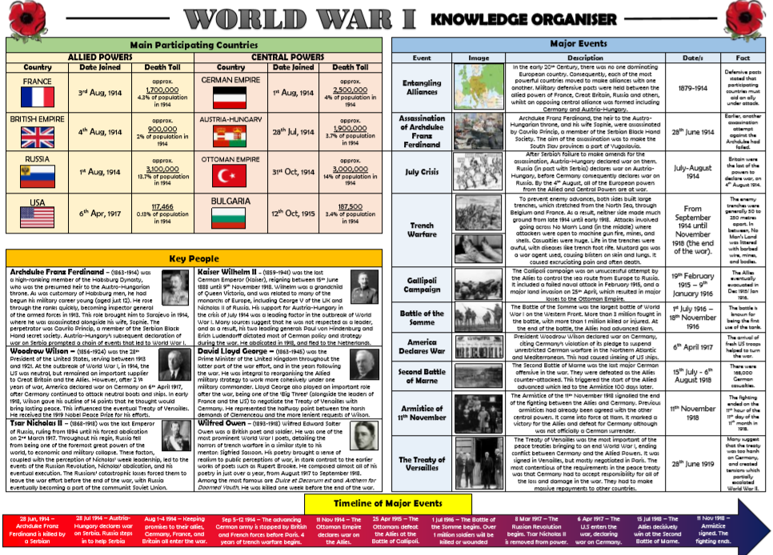
Origins of WWI

Slide 29
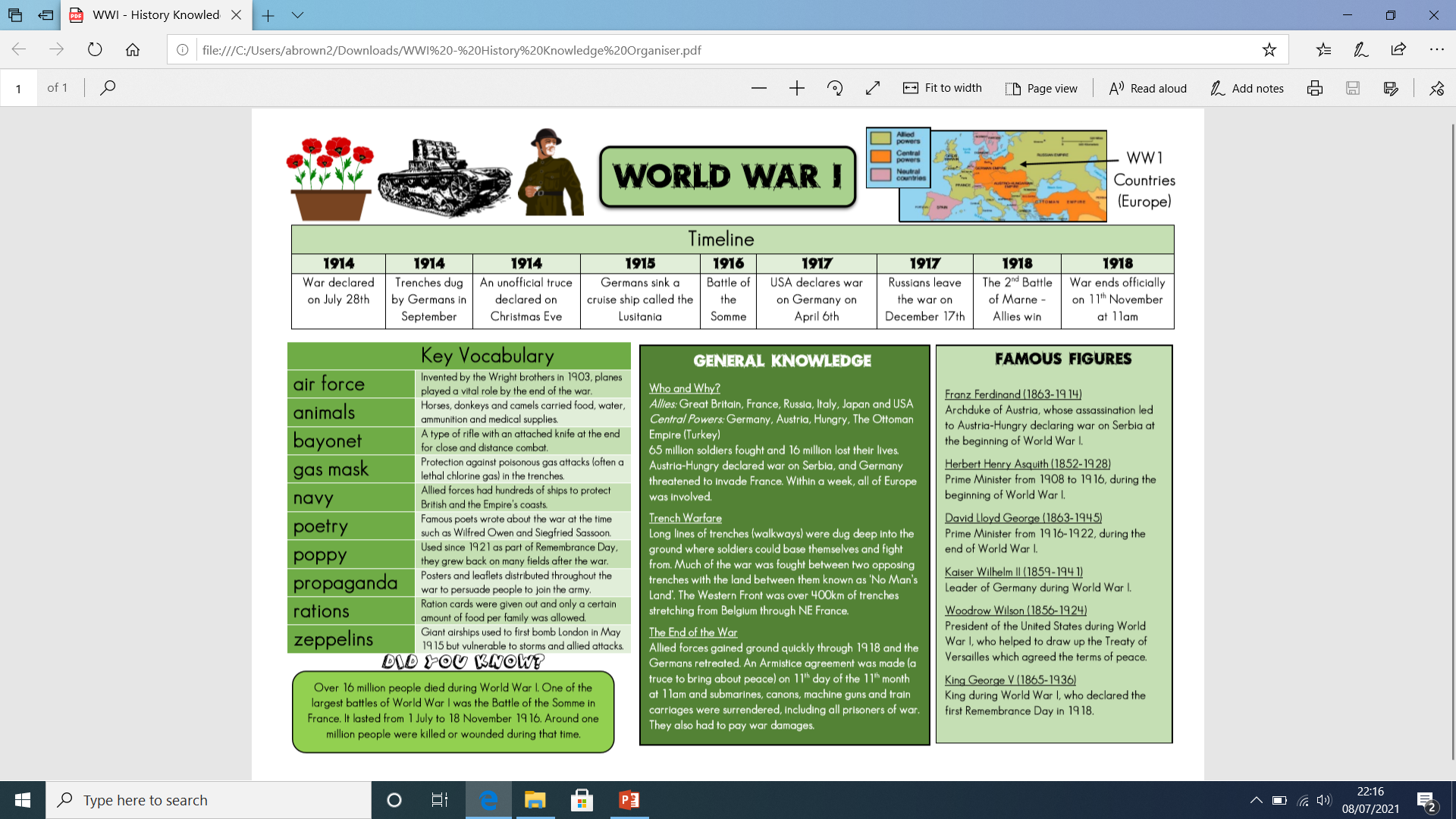
World War I

Slide 30
World War I
17 | The BEF | The British Expeditionary Force, Britain's army in 1914
18 | Conscription | Compulsory order for all men 18 to 41 to join the army
19 | Schlieffen Plan | German plan in 1914 to attack and defeat France, then attack Russia so they would not have to fight both.
20 | Stalemate | A deadlock where no side is able to make progress to win.
21 | No Mans Land | Area separating opposing armies in trench warfare.
22 | Tommy | Nickname for a British soldier.
23 | Barbed Wire | Strong wire with sharp barbs at regular intervals, used to stop people passing.
24 | Mustard Gas | Poisonous gas used by the Germans, French and British
25 | Artillery | Large guns that fire explosive shells over long distances
26 | Trench Foot | A painful condition of the feet caused by long exposure in cold water or mud, as a result some feet were amputated.
27 | Trench Fever | A disease caused by lice bites which made soldiers very ill in the trenches.
28 | Dugout | Shelter dug into the side of the Trench
29 | Bayonet | A blade attached to the end of a soldiers rifle
30 | Armistice | An agreement made by tin a war to stop fighting.
31 | War effort | How people at war and at home contribute to the war.
32 | Conscientious Objector | Someone who refuses to fight or be involved in war for religious, moral or political reasons, also called ‘Conchies’
33 | Suffragette | Women who protested, using violent methods to achieve equal rights for women, like voting.
34 | Suffrage | The right to vote in political elections.
35 | Strike | Where workers refuse to work in protest
36 | Munitions | Military weapons and ammunition
37 | David Lloyd George | Prime Minster of Britain during and after WW1

