Slide 1
Year 10 HT1

Slide 2
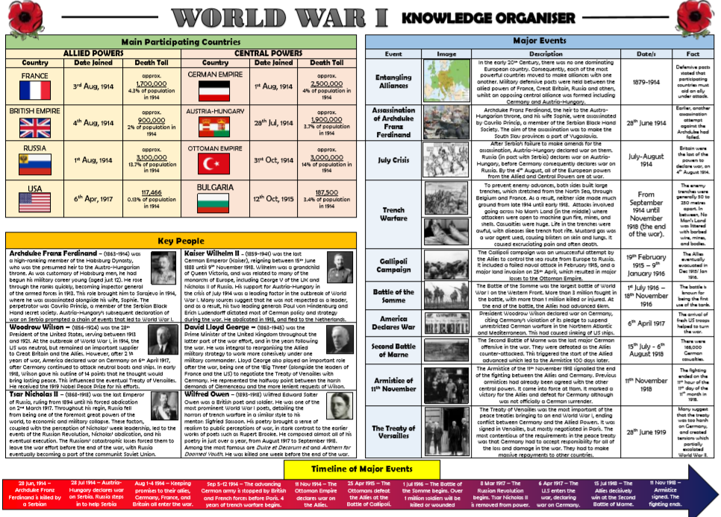
Origins of WWI

Slide 3
Year 10 – HT2

Slide 4
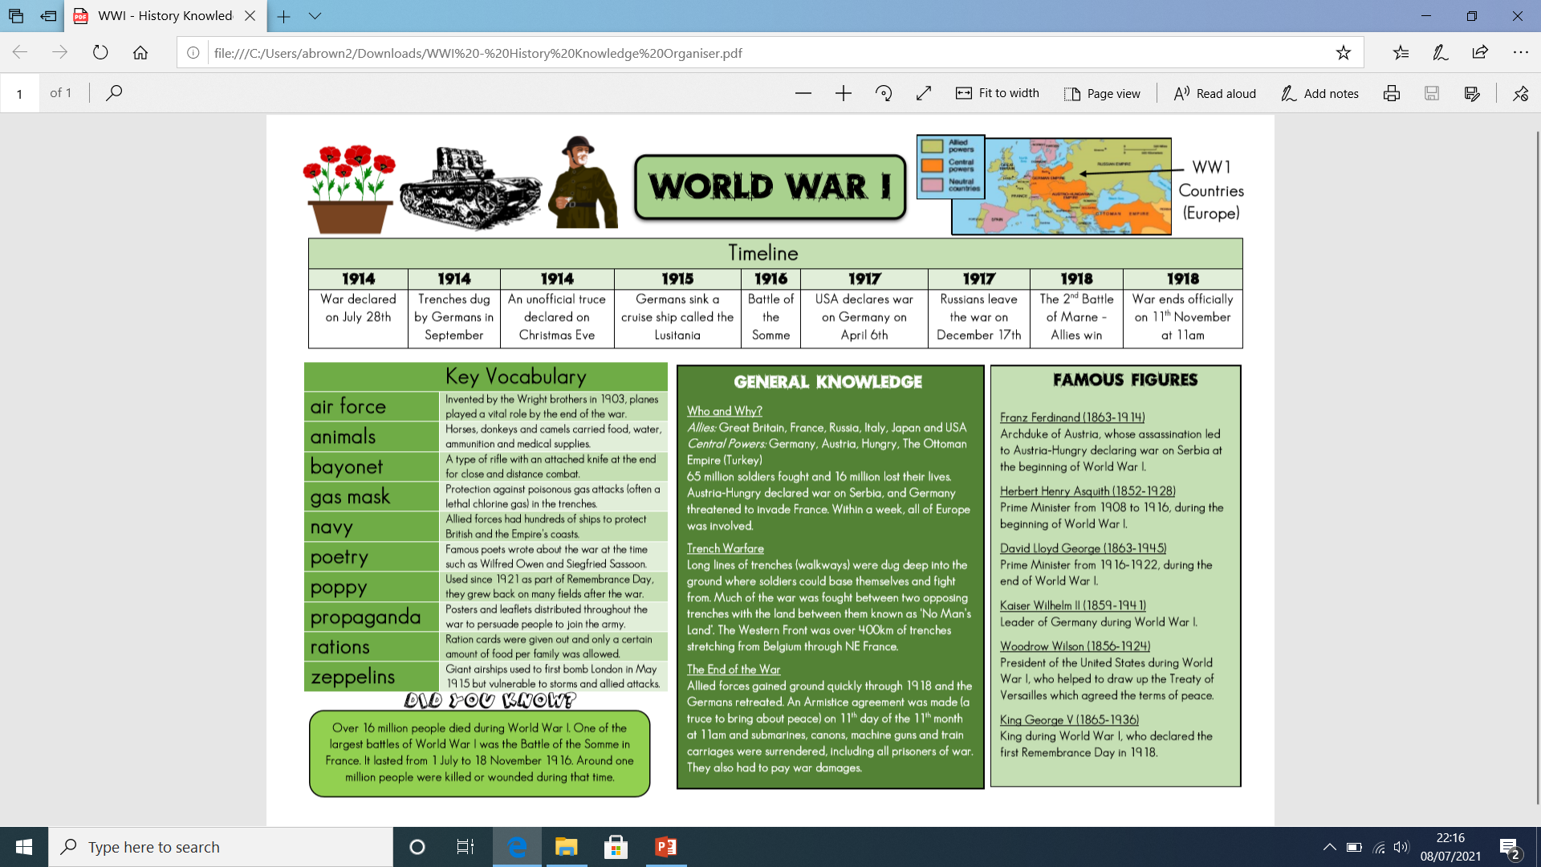
World War I

Slide 5
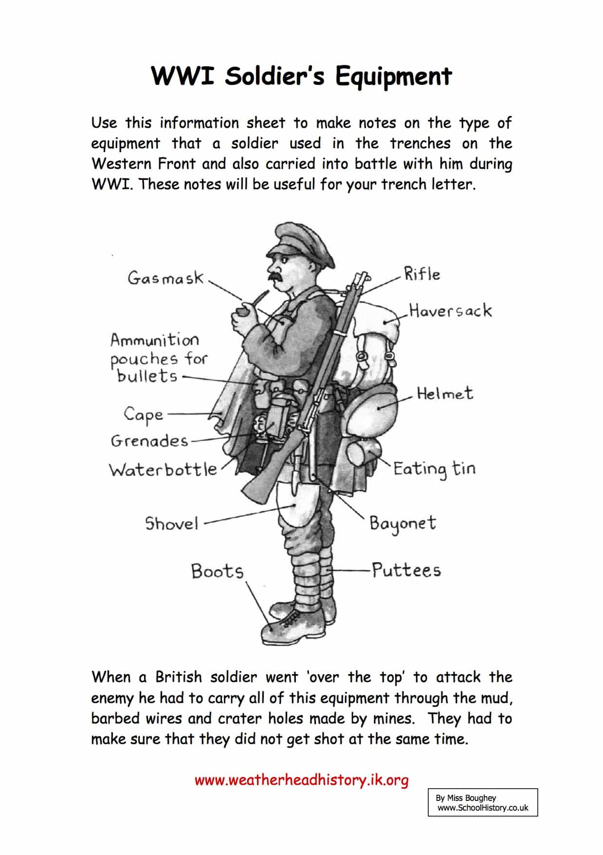
World War I
Timeline
1 | 28th June 1914 - Archduke Franz Ferdinand is assassinated in Bosnia
2 | 4th August 1914 – Britain declares war on Germany
3 | 8th August 1914 Britain passes DORA (the Defence of the Realm Act) which gives the government powers such as to ration food, control the news and use factories.
4 | September 1914 The French stop the German attack at Marne, leading to the start of Trench Warfare on the Western Front
5 | April 1915 – Poison gas is used for the first time at the Second Battle of Ypres
6 | June 1915 – The first ever ‘dog fight’ between German and British airplanes
7 | July 1916 – Battle of the Somme, the largest battle of the war.
8 | Sept 1916 – The ever first tank is used in the Battle of the Somme
9 | January 1917 – Conscription introduced in Britain
10 | February 1918 – Representation of the People Act, this gives the first time vote to men over 21 and women over 30
11 | 11th November 1918 – An armistice is signed, Germany surrenders and WW1 ends
12 | 1919 – Government passes a law forcing women to leave their war time jobs as men return from the war and factories were not needed for wartime production
Key Concepts
13 | Trench Warfare | Trench warfare is a type of fighting where both sides build deep trenches as a defence against the enemy. These trenches can stretch for many miles and make it nearly impossible for one side to advance.
14 | Western Front | The area of fighting in western Europe in the First World War. A majority of fighting was done in North–Eastern France and Belgium in trenches
15 | Alliance | An agreement between countries to protect each other in war. This was major cause of WW1, there were two main alliance in 1914. The Triple Entente (France, Britain and Russia) and the Triple Alliance (Germany, Austria-Hungary and Italy)
16 | War of Attrition | A war based on winning by wearing down the enemies armies, economy and morale. This happened in the First World War

Slide 6
World War I
17 | The BEF | The British Expeditionary Force, Britain's army in 1914
18 | Conscription | Compulsory order for all men 18 to 41 to join the army
19 | Schlieffen Plan | German plan in 1914 to attack and defeat France, then attack Russia so they would not have to fight both.
20 | Stalemate | A deadlock where no side is able to make progress to win.
21 | No Mans Land | Area separating opposing armies in trench warfare.
22 | Tommy | Nickname for a British soldier.
23 | Barbed Wire | Strong wire with sharp barbs at regular intervals, used to stop people passing.
24 | Mustard Gas | Poisonous gas used by the Germans, French and British
25 | Artillery | Large guns that fire explosive shells over long distances
26 | Trench Foot | A painful condition of the feet caused by long exposure in cold water or mud, as a result some feet were amputated.
27 | Trench Fever | A disease caused by lice bites which made soldiers very ill in the trenches.
28 | Dugout | Shelter dug into the side of the Trench
29 | Bayonet | A blade attached to the end of a soldiers rifle
30 | Armistice | An agreement made by tin a war to stop fighting.
31 | War effort | How people at war and at home contribute to the war.
32 | Conscientious Objector | Someone who refuses to fight or be involved in war for religious, moral or political reasons, also called ‘Conchies’
33 | Suffragette | Women who protested, using violent methods to achieve equal rights for women, like voting.
34 | Suffrage | The right to vote in political elections.
35 | Strike | Where workers refuse to work in protest
36 | Munitions | Military weapons and ammunition
37 | David Lloyd George | Prime Minster of Britain during and after WW1

Slide 7
YR10 HT3

Slide 8
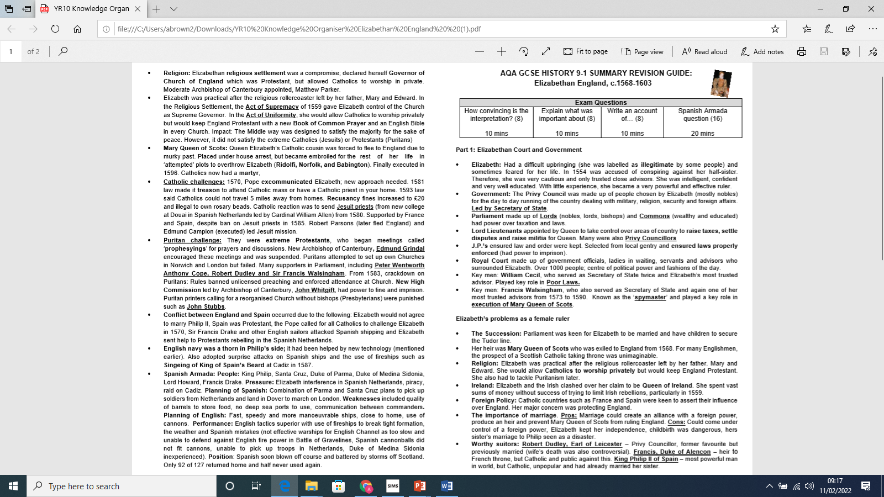
Knowledge Organiser YR 10 HT3 – Elizabethan England (Overview)

Slide 9
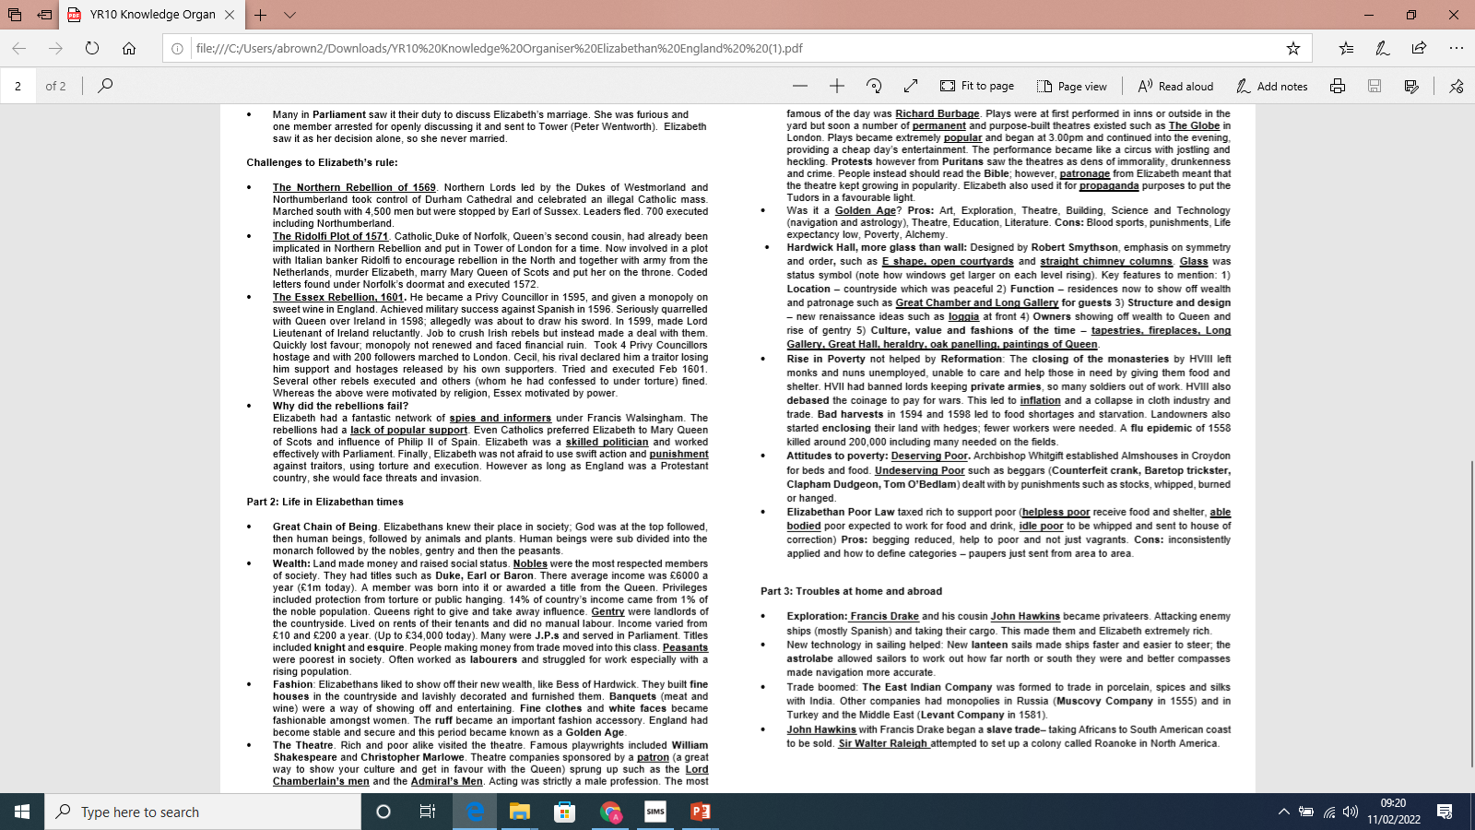

Slide 10
YR10 HT4

Slide 11
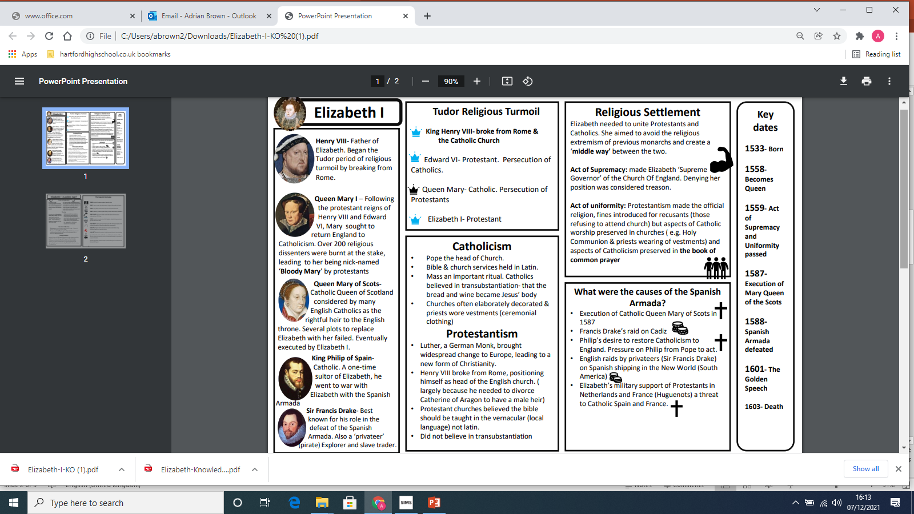
Knowledge Organiser YR10 HT3 – Elizabethan England

Slide 12
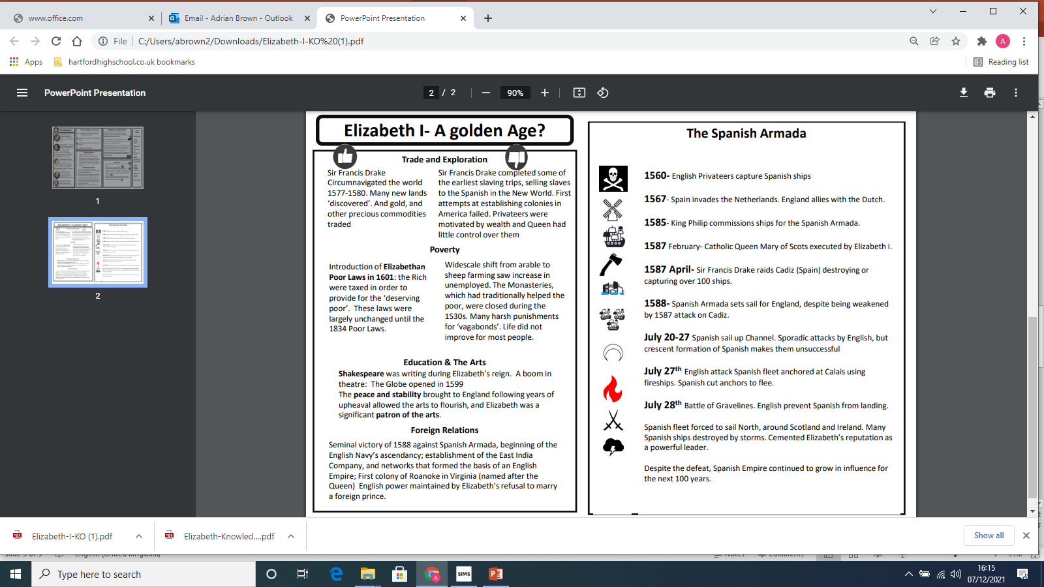
Knowledge Organiser YR10 HT3 – Elizabethan England

Slide 13
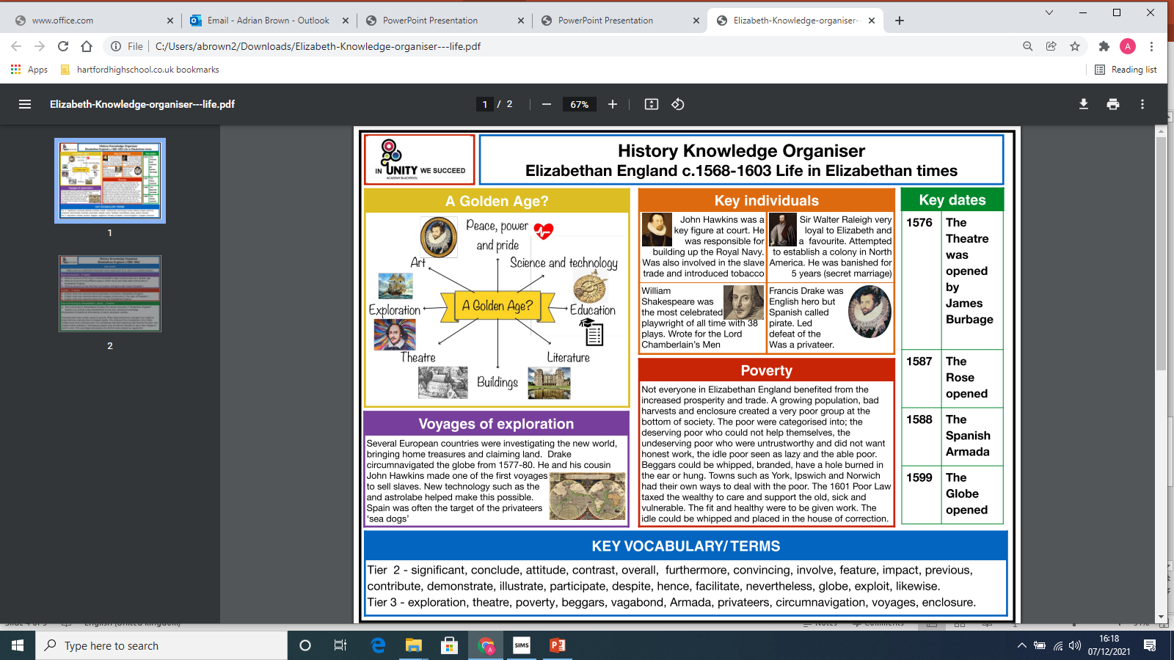
Knowledge Organiser YR10 HT3 – Elizabethan England

Slide 14
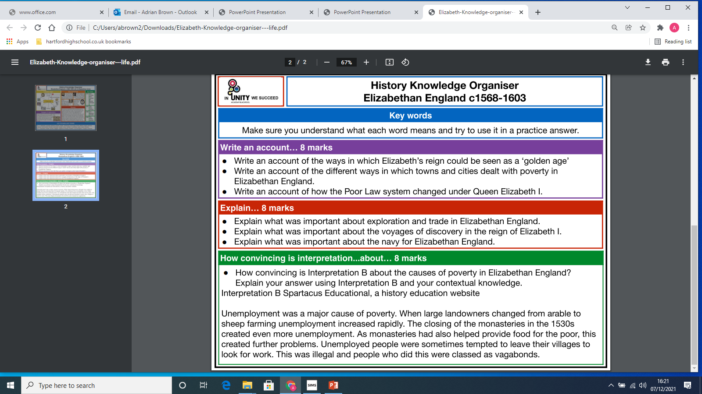

Slide 16
Poverty
Why did Poverty levels increase?
Debasement:
Debasement means mixing more of a common metal with the precious metal (usually gold or silver)
More coins could therefore be made which meant more money. However, the side effect was inflation and rising prices
This also meant an increase in poor people unable to pay for the rising cost of food
Bad Harvests:
England was hit by bad harvests between 159 and 1598 which led to food shortages and some people died of starvation.
More landowners started to enclose their land with hedges for sheep and cattle farming
This meant less land was used for arable crops which also meant fewer workers were needed.
This left people jobless and homeless.
Dissolution of the Monasteries:
Henry closed all the monasteries in England and many people who had worked for the Church lost their jobs.
Furthermore the poor had been looked after by the monks and nuns. They now had nowhere to go.
Rising Population:
The population in Elizabethan England grew from 2.8 million to 4 million. Limited places to live gave landlords more power who unfairly increased rents.
Bad harvests, inflation, less food and a terrible outbreak of flu in 1556 killed around 200,000 workers who produced food.
All of these factors create a very poor group of people at the bottom of Elizabethan society.
Types of Vagabond:
Counterfiet Crank: Bite on soap to froth at the mouth and pretend to have a fit. People
would hopefully feel sorry for him and give him money.
Baretop Trickster: A woman who would trick men into following them by removing items of clothing. The man would then be beaten and robbed by the woman’s accomplices.
Clapper Dudgeon: Cut himself and tie dirty bandages around the wound. People would feel sympathy and give him money.
Tom O’Bedlam: Pretend to be mad to get money. Bark like a dog for hours, follow people around or stick a chicken’s head in his ear.
The Poor Laws
Poverty was mostly considered to be your own fault in Elizabethan times, but attitudes started to change towards the end of Elizabeth’s reign and the government decided to take action. This was because of:
fears that the ‘social order’ might be threatened if the growing number of poor people ganged together and started a rebellion
the risk that vagabonds and beggars might turn to crime
fears that the poor might spread disease
What actions were taken?
Local level
Justices of the Peace were made responsible for poverty in their parish. They collected taxes in order to help the poor. Authorities grouped people into either the ‘impotent poor’ or the able-bodied poor’:
Impotent poor – Unable to work due to age, disability or other infirmity. Limited relief was provided by the community.
Able-bodied poor - physically able to work and were forced to, to prevent them from becoming beggar. It was thought many able-bodied poor were lazy and idle. The 1572 Vagabonds Act introduced severe action against vagrants who could now be whipped, bored through the ear and put to death if they were repeatedly caught begging.
1601 Poor Law:
Brought in a compulsory Poor Rate system.
Everyone had to contribute and those who refused would go to jail.
Begging was banned and anyone caught was whipped and sent back to their place of birth.
Alms-houses were established to look after the impotent poor.

Slide 17
Explorers
Sir Francis Drake
He grew up as a Puritan who hated Catholics and he was very anti-Spanish. His first voyage in 1566 was as a slave trader. He was attacked in 1568 by the Spanish at San Juan de Ulua in Mexico, losing four ships and over 300 men. He sought to take revenge on the Spanish after this.
Notable expeditions
Drake was the first Englishman to sail around the world, circumnavigating the globe between 1577 and 1580. He went on to play a role in the Spanish Armada by attacking Cadiz in 1587 and delaying preparations. He was also vice-admiral during the Armada.
Impact
Launched successful attacks on the Spanish empire, bringing back gold, silver and jewels, making a huge profit.
Claimed new lands for England and made valuable trading contacts with the Spice Islands.
Knighted by Elizabeth and made an admiral.
John Hawkins
He was a navigator and slave trader who was Sir Francis Drake’s cousin.
Notable expeditions
He made three voyages during the 1560s, capturing Africans and selling them into slavery in Central America to Spanish settlers.
After this he returned to England and designed and built ships for the navy. Elizabeth appointed him as a vice-admiral fighting against the Spanish Armada.
Impact
Developed a new type of fighting galleon which was faster, lighter and better able to withstand harsh weather conditions than ships in the Spanish fleet.
His innovative designs were important in helping to lead England to victory.
Walter Raleigh
The queen invested in his privateering expeditions against the Spanish. He wanted to establish colonies for Elizabeth in North America. The area was thought to have an inexhaustible supply of wine, oil, sugar and flax.
Notable expeditions
In 1584 he obtained a royal charter to establish a colony on Roanoke Island off the coast of North Carolina. He organised two expeditions to take settlers to the colony. The first group came home after a year; the second were left there but later disappeared. The reasons for their disappearance are unclear and Roanoke is sometimes given the name ‘The Lost Colony’.
Impact
Raleigh was imprisoned in the Tower of London in June 1592 for marrying one of Elizabeth’s ladies-in-waiting, He was released in August 1592 to lead a very successful naval attack against the Spanish. Following the attack, Raleigh was sent back to the Tower but was released the following year and became a Member of Parliament.
Whilst imprisoned in the Tower, Raleigh wrote many poems and even wrote a history of the world.

Slide 18
History - Year 10 HT6

Slide 19
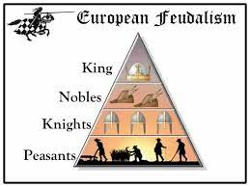
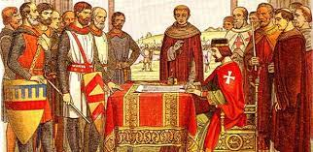
Power and the People YR10 –HT6
Medieval Society
Medieval society was built on the Feudal System. This meant that the King and the Barons were at the top. After them came the knights and finally the lowly peasants.
The king was in complete charge of running the country, although he would have advisors to help him. People believed the king had been appointed by God.
A medieval king was supposed to:
Defend the people by leading the army well
Keep the country peaceful
Successfully deal with any rebellions
Maintain good relations with the church
King John and the Magna Carta
King John fell out with his barons. The 3 main reasons were:
John’s record in fighting wars was poor. He lost land that Barons owned in France
He placed a high tax on the Barons (scutage)
He fell out with the Pope, who excommunicated John and England from the church, meaning no one could get married or buried!!!
This ultimately led to a rebellion by the Barons.

Slide 20
Power and the People YR10 –HT6
Magna Carta
To try and stop the rebellion by the Barons, John agreed to sign the Magna Carta (Great Charter). The Magna Carta promised the following for all freemen:
Unfair taxes (such as scutage) would not be allowed.
All freemen had the right to proper trial
The church will be free to make its own appointments
A group of barons will be created to monitor the king and make sure he sticks to the Magna Carta.
However, the king quickly went back on his word, leading to the First Barons’ War.
The Baron’s gained the support of the French and promised the throne to a French prince called Louis.
However, John dies of eating too many peaches!!! And the throne passes to his son, Henry, who agrees to the terms of the Magna Carta
Long-term impacts of the Magna Carta
Magna Carta introduced the concept that the King had to follow certain rules and laws
Eventually more people gained their freedom
Kings after John signed similar versions of Magna Carta
It was viewed as the first step in Britain becoming a democracy

Slide 21
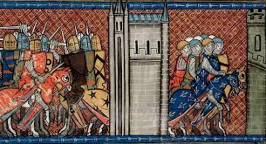
Power and the People YR10 –HT6
The Origins of Parliament
Henry III came to the throne in 1216. But he had problems just like his father. Henry’s relationship with the Pope was not good, as the Pope wanted him to fight in wars in Sicily. Along with this Henry wanted to win land back which John had lost in France. He, therefore, sent his brother-in-law, Simon de Montfort to win back the lost land. Montfort did win some of the land back, but there were reports that he had been too harsh, so Henry sent his son, Edward to keep an eye on things. Finally, Henry upset many Barons as he seemed to favour foreigners over the Barons, especially when it came to high government positions.
The Provisions of Oxford
Due to these issues the barons refused to support the king. Simon de Montfort led the barons to call a Great Council. Here, in 1258, the king had to agree to the Provisions of Oxford.
Some of the Provisions
A council of 15 barons would help the king to rule the country. They would be elected by the king and barons
Foreign members of the royal household would be banished
Castles would be held by Englishmen
Each county would have a sheriff and taxes would be decided locally.
Second Barons’ War
Henry did not like the Provisions of Oxford and asked for the Pope to cancel them, which he did. However, Henry carried on running the country just as badly as before. Therefore, the barons revolted against the King, choosing Simon de Montfort as their leader.
At the Battle of Lewes in 1264 de Montfort captured the king and imprisoned his son, Prince Edward. Simon de Montfort was now in charge.
In 1265 de Montfort summoned the first ever parliament, where barons as well as the common people were represented. This helped to develop democracy in England
However, some barons were concerned that de Montfort was becoming an autocrat so they put their support back behind the king. With the release of Prince Edward, de Montfort was defeated at the Battle of Evesham, where his body was cut to pieces. The monarchy was back in charge!!!

Slide 22
Power and the People YR10 –HT6
The Peasants Revolt
Reasons for the uprising:
The Black Death arrived in England in 1348, killing a third of the population, this meant that there were fewer workers so the peasants started to demand higher wages.
This allowed many peasants to buy their freedom from a lord. However, in 1351 the Statute of Labourers was passed which was a way to control the peasants and their rising wages.
King Richard II was also fighting a war in France and needed money. He introduced a poll tax, which many peasants thought was unfair and would ruin them.
Some churchmen e.g. John Ball, started to preach about how the church and state had been exploiting the poor, again this led to anger.
Key events
There were uprisings in Essex and Kent against bad priests and evil landowners in the spring of 1381.
Wat Tyler became the leader of the revolt and the peasants marched to London.
The peasants killed the King’s Chancellor, Simon of Sudbury.
The king agreed to speak with the rebels but there was too much violence at first. He eventually met with Wat Tyler, and agreed to his demands.
Wat Tyler was killed on 15 June 1381, possibly by one of the king’s men.
King Richard went back on his word. In the short term the revolt ended in favour of the king, but it had a lasting impact on land ownership, wages taxes and freedom

