Slide 2
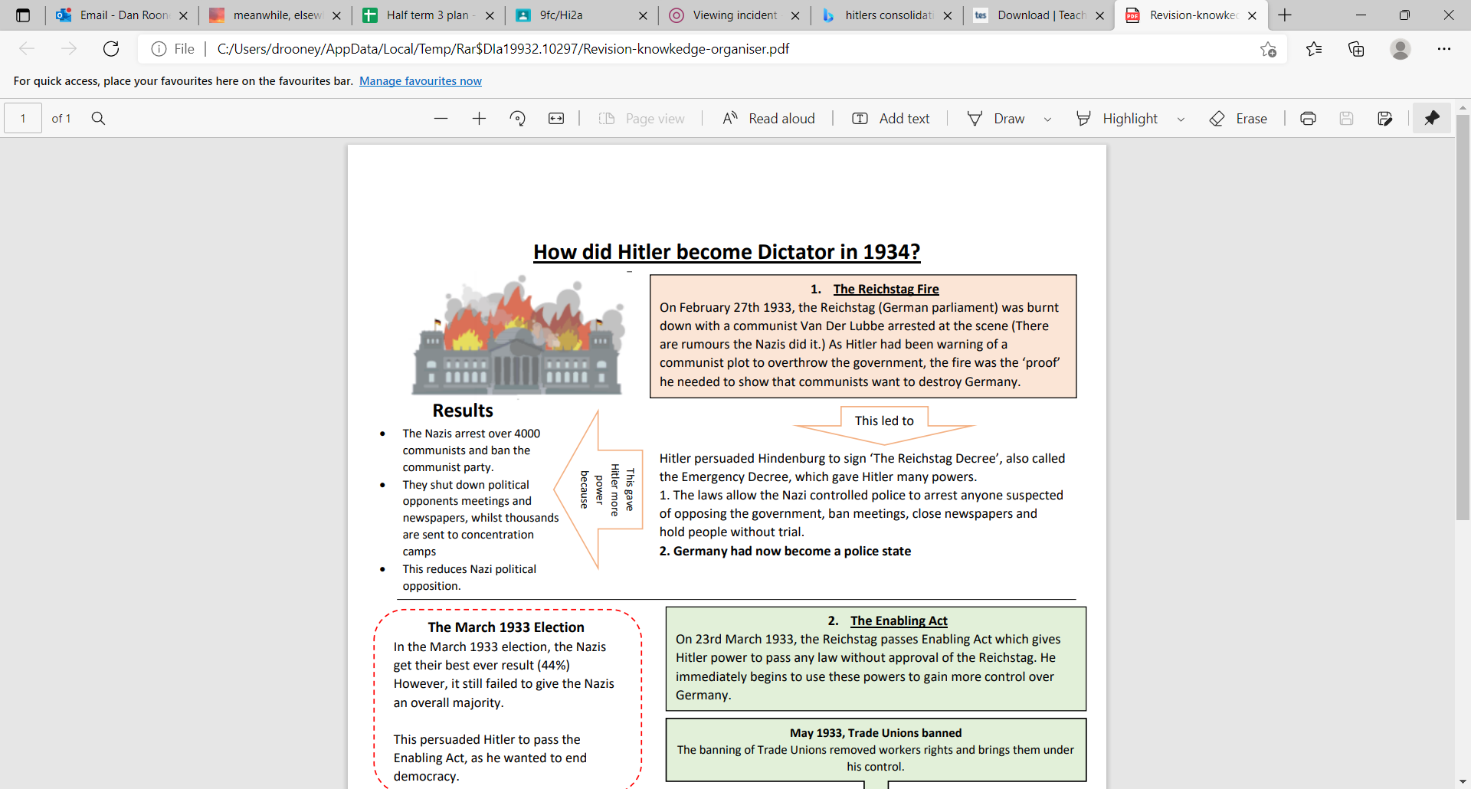
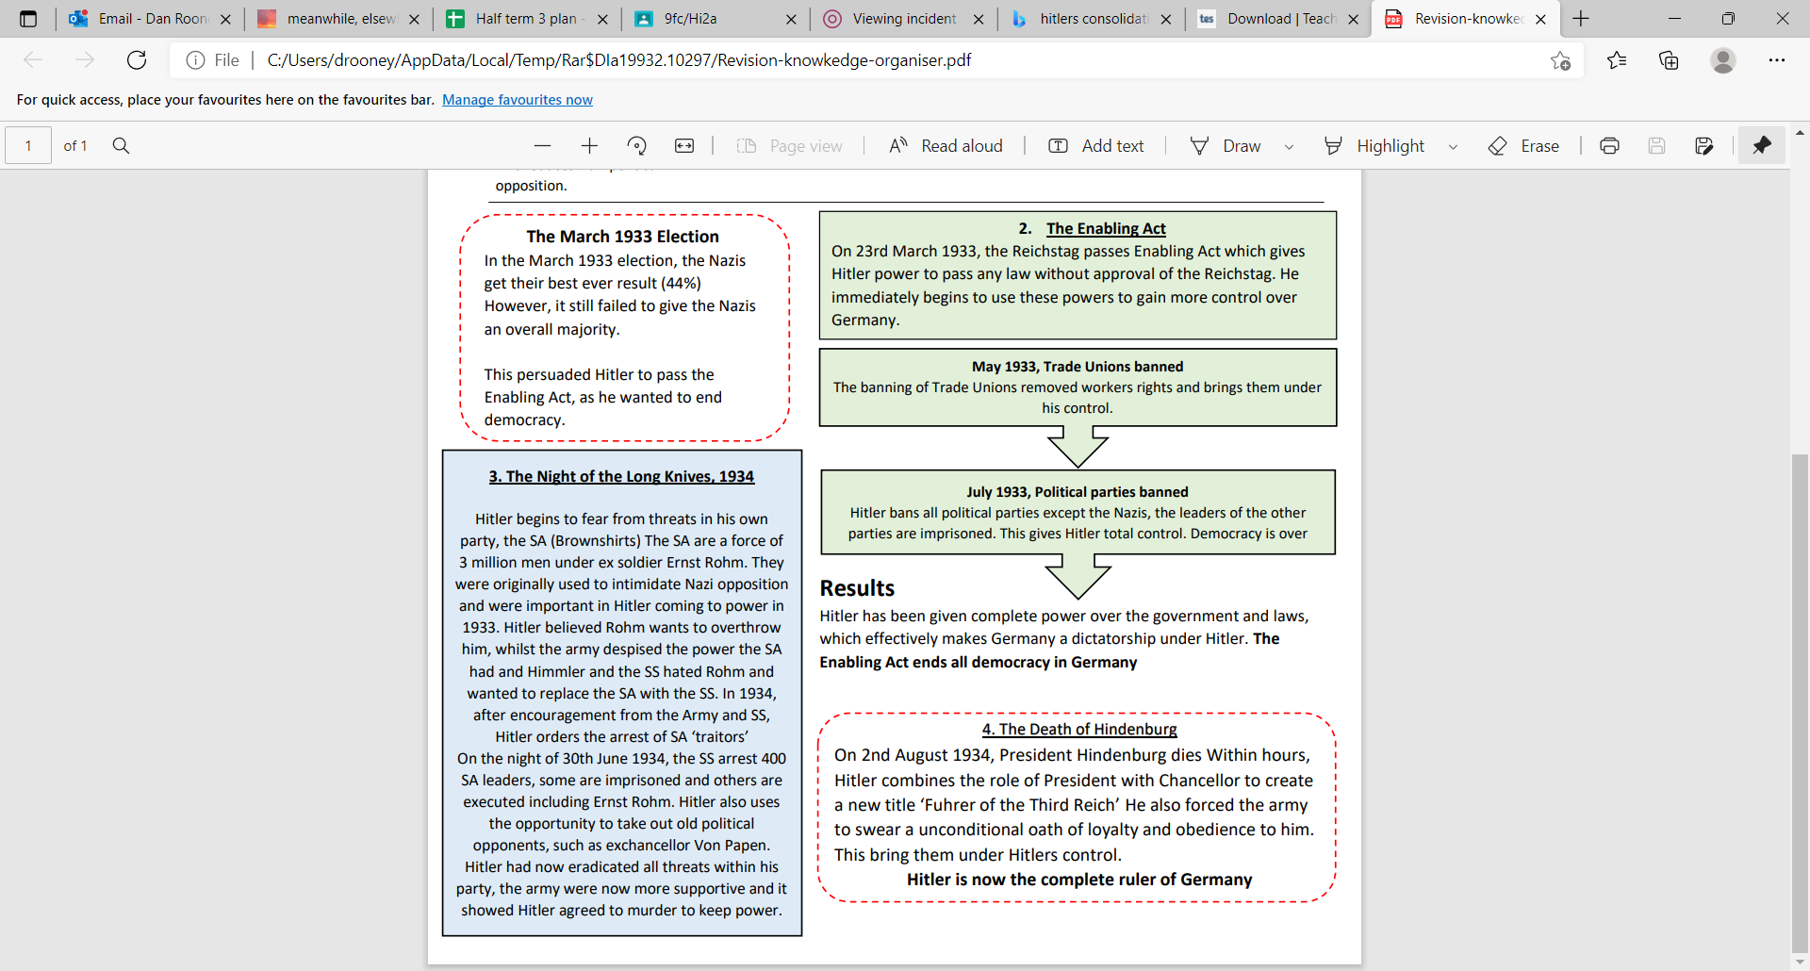
How did Hitler become the Leader of Germany?

Slide 3
Year 9 HT2

Slide 4
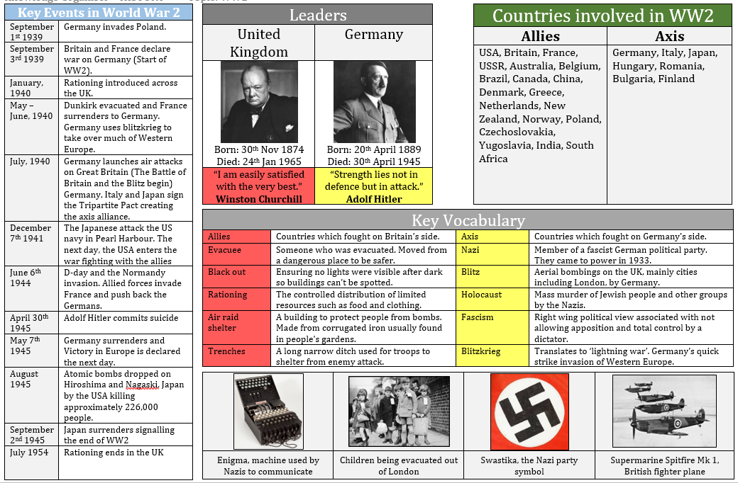
World War II

Slide 5
History - Year 9 HT3

Slide 6
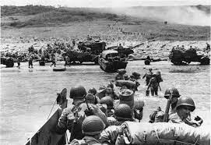
How did WWII end? YR9 – HT3
Why was D-Day important?
On 6 June 1944 – 'D-Day' – Allied forces launched the largest amphibious invasion in the history of warfare. Codenamed Operation 'Overlord', the Allied landings on the beaches of Normandy marked the start of a long and costly campaign to liberate north-west Europe from Nazi occupation.
Early on 6 June, Allied airborne forces parachuted into drop zones across northern France. Ground troops then landed across five assault beaches - Utah, Omaha, Gold, Juno and Sword. By the end of the day, the Allies had established a foothold along the coast and could begin their advance into France.
Germany tried to defend the northern coast of France with a series of fortifications known as the 'Atlantic Wall'. However, German defences were often incomplete and insufficiently manned.
Members of the French Resistance and the British Special Operations Executive (SOE) provided intelligence and helped weaken defences through sabotage. The Allied deception campaigns succeeded in convincing the Germans as late as July 1944 that the main invasion force would still land elsewhere. The threat of this larger, second invasion kept German reinforcements tied down away from Normandy.

Slide 7
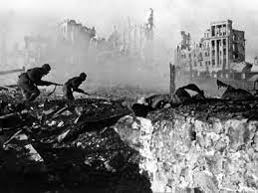
How did WWII end? YR9 – HT3
Stalingrad
On June 22, 1941, despite the terms of the Nazi-Soviet Pact of 1939, Nazi Germany launched a massive invasion against the USSR. Aided by its greatly superior air force, the German army raced across the Russian plains, inflicting terrible casualties on the Red Army and the Soviet population. With the assistance of troops from their Axis allies, the Germans conquered vast territory, and by mid-October the great Russian cities of Leningrad and Moscow were under siege. However, the Soviets held on, and the coming of winter forced a pause to the German offensive.
For the 1942 summer offensive, Adolf Hitler ordered the Sixth Army, under General Friedrich von Paulus, to take Stalingrad in the south, an industrial center and obstacle to Nazi control of the precious Caucasian oil wells. In August, the German Sixth Army made advances across the Volga River while the German Fourth Air Fleet reduced Stalingrad to a burning rubble, killing over 40,000 civilians. In early September, General Paulus ordered the first offensives into Stalingrad, estimating that it would take his army about 10 days to capture the city. Thus began one of the most horrific battles of World War II and arguably the most important because it was the turning point in the war between Germany and the USSR.
In their attempt to take Stalingrad, the German Sixth Army faced a bitter Red Army under General Vasily Zhukov employing the ruined city to their advantage, transforming destroyed buildings and rubble into natural defensive fortifications. In a method of fighting the Germans began to call the Rattenkrieg, or “Rat’s War,” the opposing forces broke into squads eight or 10 strong and fought each other for every house and yard of territory. The battle saw rapid advances in street-fighting technology, such as a German machine gun that shot around corners and a light Russian plane that glided silently over German positions at night, dropping lethal bombs without warning. However, both sides lacked necessary food, water, or medical supplies, and tens of thousands perished every week.
Soviet leader Joseph Stalin was determined to liberate the city named after him, and in November he ordered massive reinforcements to the area. On November 19, General Zhukov launched a great Soviet counteroffensive. German command underestimated the scale of the counterattack, and the Sixth Army was quickly overwhelmed by the offensive, which involved 500,000 Soviet troops, 900 tanks, and 1,400 aircraft. Within three days, the entire German force of more than 200,000 men was encircled.
Italian and Romanian troops at Stalingrad surrendered, but the Germans hung on, receiving limited supplies by air and waiting for reinforcements. Hitler ordered Von Paulus to remain in place and promoted him to field marshal, as no Nazi field marshal had ever surrendered. Starvation and the bitter Russian winter took as many lives as the merciless Soviet troops, and on January 21, 1943, the last of the airports held by the Germans fell to the Soviets, completely cutting the Germans off from supplies. On January 31, Von Paulus surrendered German forces in the southern sector, and on February 2 the remaining German troops surrendered. Only 90,000 German soldiers were still alive, and of these only 5,000 troops would survive the Soviet prisoner-of-war camps and make it back to Germany.

Slide 8
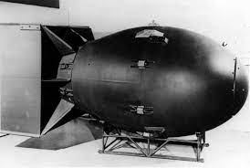
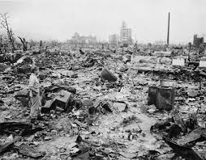
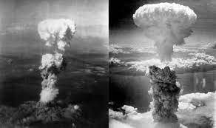
How did WWII end? YR9 – HT3
Atomic Bomb
The two atomic explosions had the effects desired by the Allies. On 10th August the Japanese government indicated its readiness to accept defeat, subject to certain conditions. On 14th August it finally accepted the demand for unconditional surrender. The following day was declared `Victory over Japan’ or VJ Day, although it was not until 2nd September that the final Japanese surrender was signed, thereby bringing the Second World War to a formal close.
Why had the Allied powers considered it necessary to inflict such unprecedented destruction on Japanese civilians in order to bring the war to an end?
At the Potsdam Conference (17th July – 2nd August 1945) the Allies formulated their terms for ending the war with Japan, which centred on that country’s acceptance of unconditional surrender, as had been the case with Nazi Germany in May. However, the Allies were also aware that whilst the Japanese Emperor Hirohito desired an end to hostilities, and would probably accept the unconditional capitulation demanded, the `hawks’ of the Japanese military and civilian leadership were totally opposed to such a humiliating condition and were ready to fight to the finish – whatever that might look like.
At 8.15 on the morning of 6th August 1945, the Japanese city of Hiroshima was devastated by the first atomic bomb to be used as a weapon of war. The bomb, nicknamed `Little Boy’, was dropped from the USAAF B29 bomber `Enola Gay’ and exploded some 1,800 feet above the city. Delivering the equivalent of around 12.5 kilotons of TNT, the bomb reduced 5 square miles of the city centre to ashes and caused the deaths of an estimated 120,000 people within the first four days following the blast. Many were instantly vaporised by the explosion, others died afterwards from the effects of burns and radiation.
Three days later, just after 11 on the morning of 9th August, a second atomic bomb nicknamed `Fat Man’ exploded above the city of Nagasaki. Although it was even more powerful than `Little Boy’, the destruction caused by this bomb was less than at Hiroshima due to the nature of the terrain (the original target had been the city of Kokura, but the B29 carrying the bomb had been diverted to Nagasaki because of heavy cloud cover). Nonetheless, over 2 square miles of the city were pulverised and some 73,000 people killed.

Slide 9
YR9 – HT4

Slide 10
Knowledge Organiser – HT4 (Holocaust)
Ghettos:
Nazi Germany invaded Poland on 1 September 1939 and as a result, the UK and France declared war. In spring 1940, the Nazis established ghettos – segregated parts of the larger towns and cities across Poland where Jews were forced to live. The largest ghetto was in Warsaw, where 400,000 Jews were crowded into 1.3 square miles of the city. Jews responded to the ghetto restrictions with a variety of resistance efforts. Hundreds of thousands of people died in the ghettos, from starvation, disease and executions carried out by the Nazis.
Nazi Ideology:
The success of Hitler and the Nazi party did not come from nowhere. The party developed and established itself in a Germany devastated by defeat in World War One and suffering an economic crisis. Antisemitism was present in societies across Europe, and there was a rise in pseudo-scientific ideas of eugenics and ‘race theory’. Right-wing extremists blamed the country’s defeat in World War One on a conspiracy between communists and Jews.
The ‘Final Solution’:
In 1941 the Nazis stepped up their persecution of the Jews through murder on an industrial scale. This began with mass shootings across eastern Europe, carried out by killing units called the Einsatzgruppen (task forces), after the Nazi invasion of the USSR in June 1941. By December 1941 over 1.5 million Jews had been killed by beatings, starvation or mass shootings. The Wannsee Conference was held in Berlin on 20 January 1942 and was attended by high-ranking Nazis. Here they planned the mass-deportation of European Jews to extermination camps in German-occupied Poland, where they would be murdered. This ‘Final Solution’ aimed to exterminate all Jews in Europe. Deportation on this scale required organisation and coordination from collaborators across Europe.
Nazi persecution of the Jews:
Once the Nazis came to power they introduced laws that denied Jews many freedoms and restricted their rights. Boycotts of Jewish doctors, lawyers and shops began in 1933 and by 1935 Jews were not allowed to join the civil service or the army. The introduction of the Nuremberg laws in September 1935 meant Jews were banned from marrying non-Jews and their citizenship was removed, including their right to vote. On 9 November 1938 the Nazis initiated attacks against the Jews. 91 Jews were murdered, 30,000 were arrested and sent to concentration camps and 267 synagogues were destroyed. This night became known as Kristallnacht – the ‘Night of Broken Glass’. These attacks sparked debate in the House of Commons which led to Britain supporting the Kindertransport – a programme that rescued 10,000 children, the majority of whom were Jewish.
The camps:
The Nazis created more than 40,000 camps throughout German-occupied countries. There, inmates were subjected to slave labour, overcrowding, poor sanitary conditions, starvation and cruel treatment, with a high death rate. After initial attempts to commit mass murder through shootings proved ‘inefficient’, the Nazis extended the camp system to include six extermination camps, including Auschwitz-Birkenau. Their purpose was to carry out genocide using gas chambers
Liberation:
As Allied troops made progress across Nazi-occupied Europe, they discovered and liberated concentration and extermination camps. The camp of Majdanek in Poland was the first to be liberated, in the summer of 1944. On 8 May 1945, following the invasion of Germany and Hitler’s suicide, Germany surrendered. Two thirds of Europe’s Jews had been murdered.
Justice:
Many senior Nazi war criminals were never sentenced for their roles during the Holocaust. After the war, the Allies brought 22 of the most senior Nazis to trial in Nuremberg, Germany between 1945 and 1946. The Nuremberg Trials were one of the most important innovations in the history of international law and helped lead to the establishment of the International Criminal Court over 50 years later, in 2002.

Slide 11
YR9 HT5

Slide 12
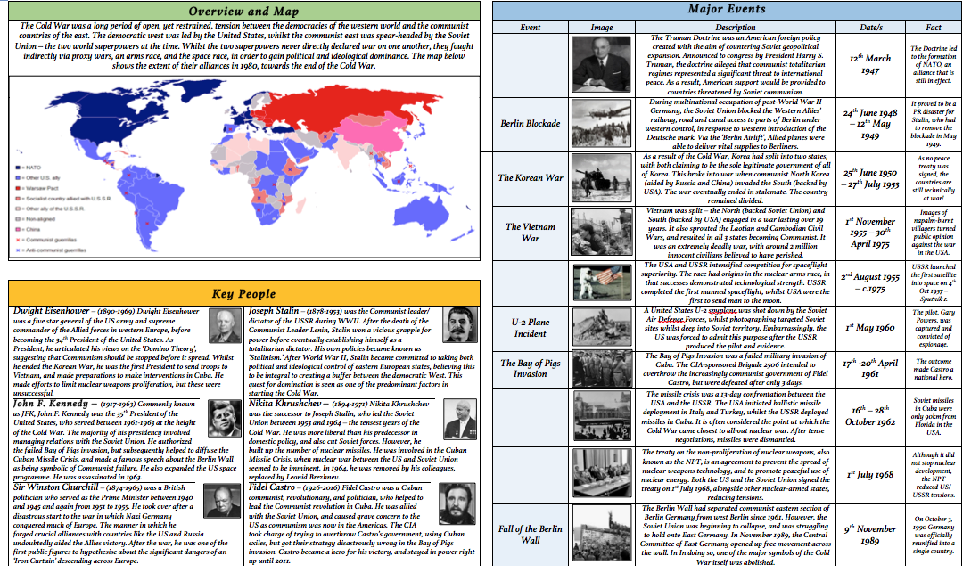
Knowledge Organiser YR9 HT5 – Cold War (Rise of the USA)
Cuban Missile Crisis

Slide 13
YR9 HT6

Slide 14
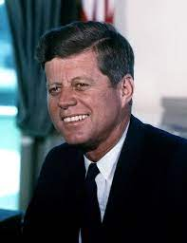
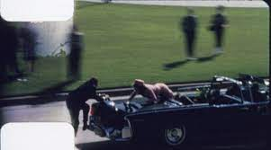
Knowledge Organiser YR9 HT6 – Post 1945
Assassination of JFK
John Fitzgerald Kennedy was the youngest President of the USA. He was 43 when he was elected. JFK had fought in WWII and narrowly defeated his presidential opponent, Richard Nixon in 1960. JFK was tough on communism and wanted to contain its influence. This led to the Cuban Missile Crisis where the world came the closest ever to a full nuclear war.
In November 1963, JFK visited Dallas, Texas, with his wife. When he was travelling along Dealy Plaza in down time Dallas, several shots rang out. One of them fatally hit JFK leading to shock and horror throughout the world. Although the assassin was quickly captured, Lee Harvey Oswald, doubt has always surrounded the assassination. With many believing that a wider conspiracy was at work and a cover up had occurred.

Slide 15
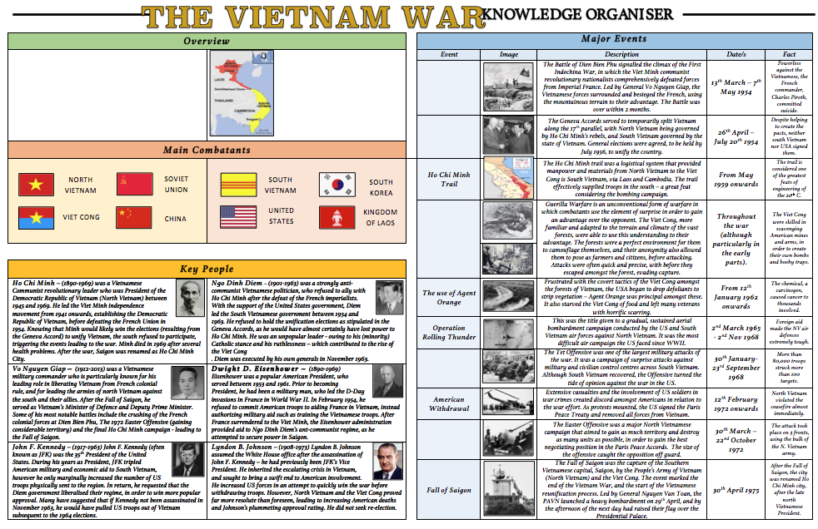
Knowledge Organiser YR9 HT6 – Post 1945

Slide 16
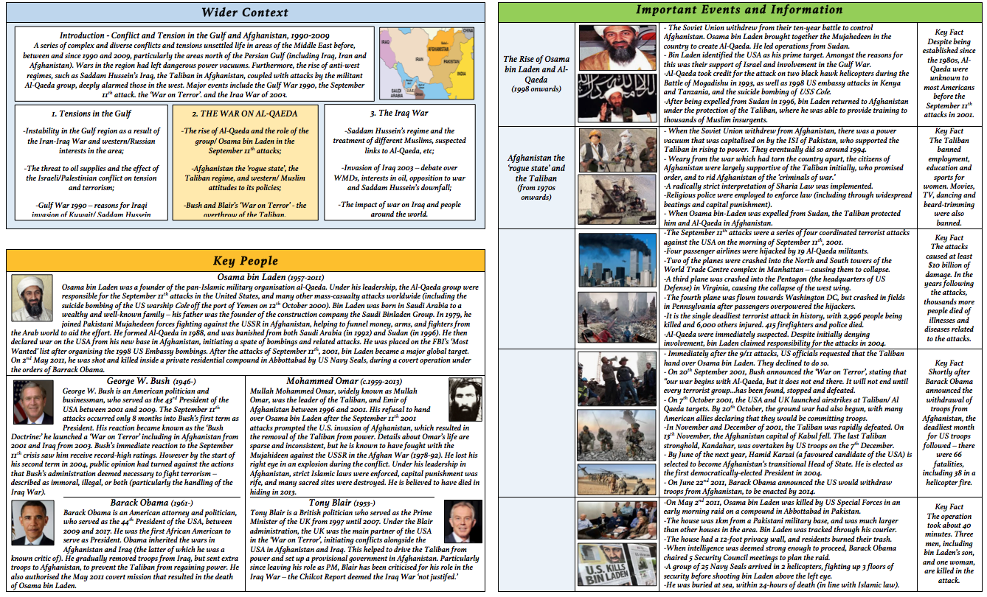
Knowledge Organiser YR9 HT6 – Post 1945
9/11

