Slide 1
Year 7 HT1

Slide 2
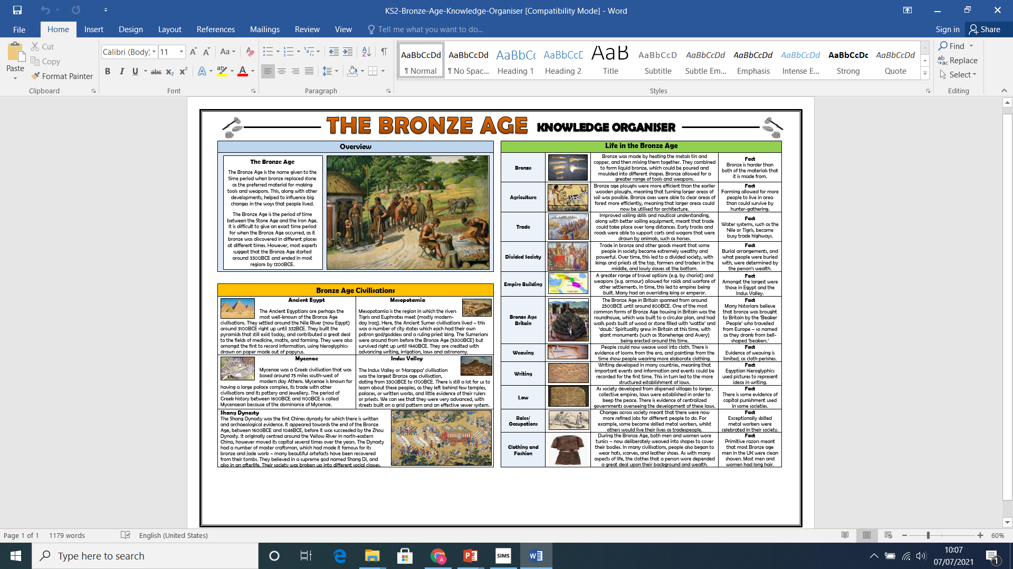
Ancient World (Including the Celts)

Slide 3
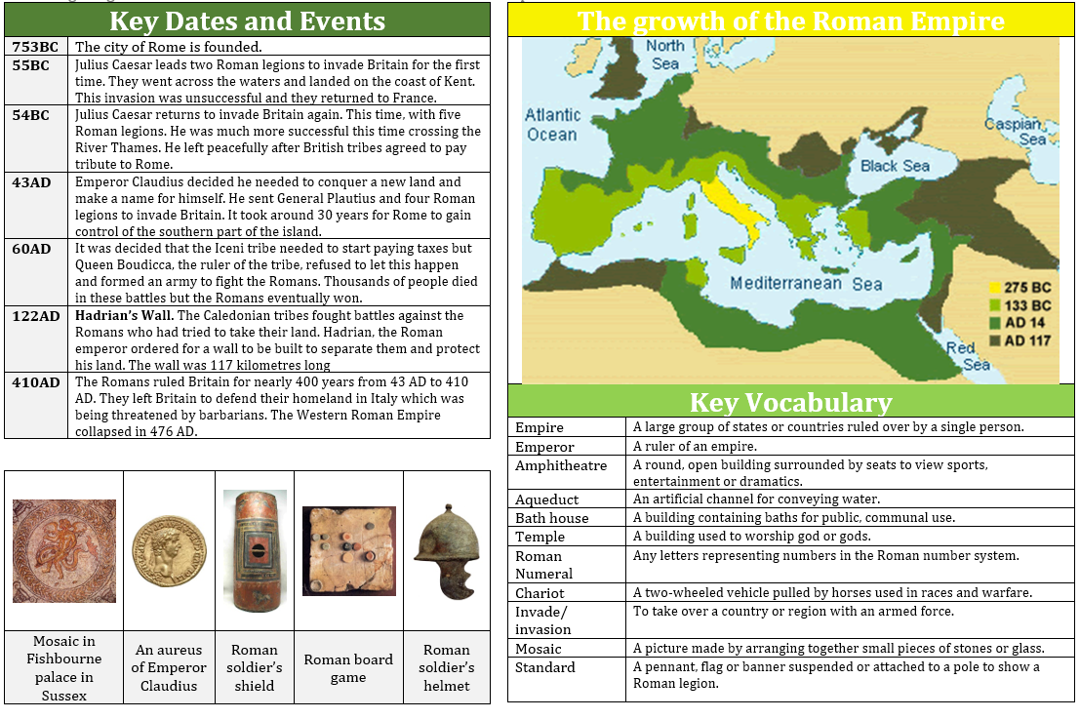
The Romans

Slide 4
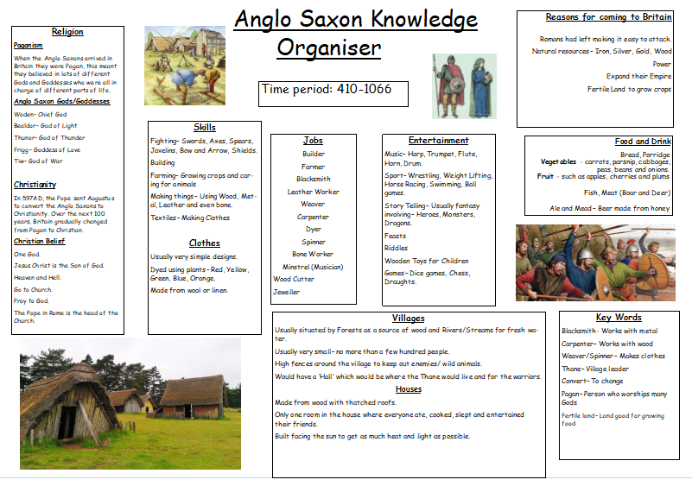
The Anglo-Saxons

Slide 5
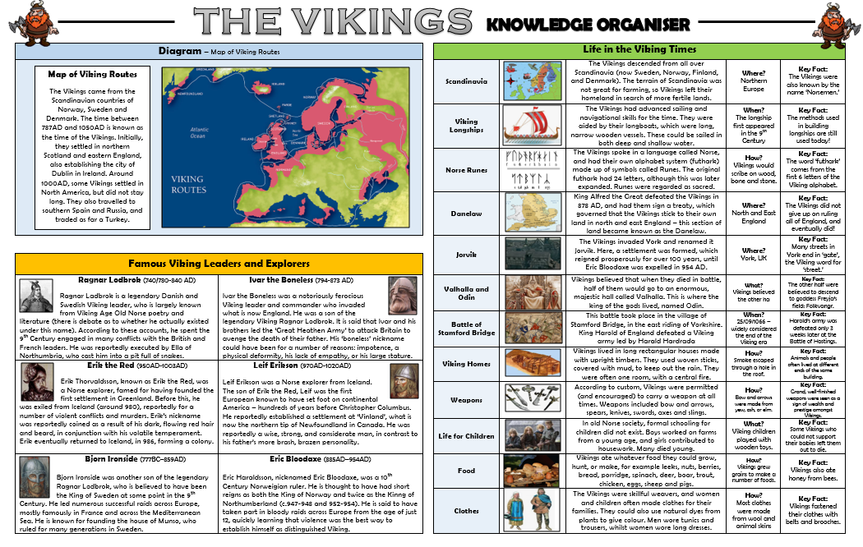
The Vikings

Slide 6
Year 7 HT2

Slide 7
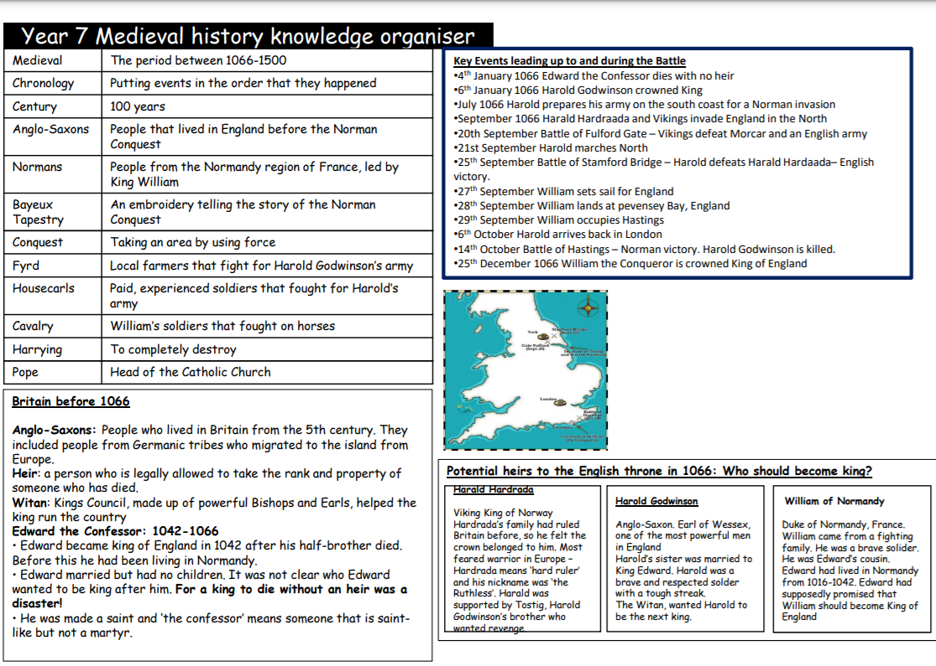
Why did William win the Battle of Hastings?

Slide 8
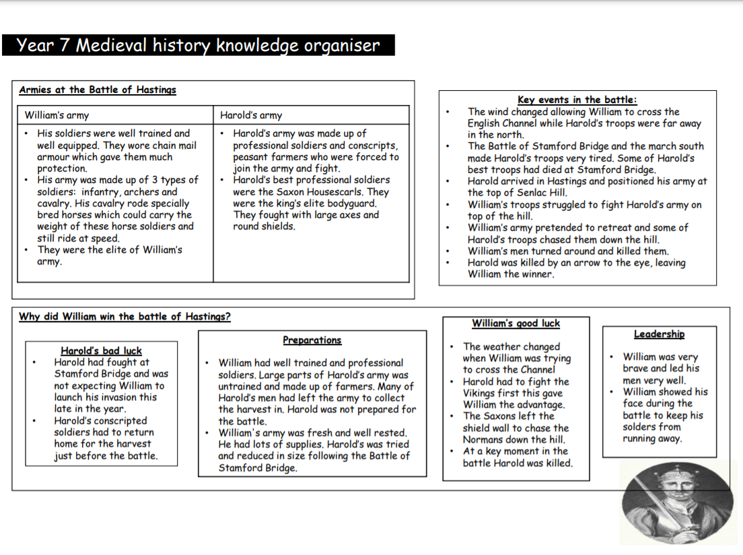
Why did William win the Battle of Hastings?

Slide 10
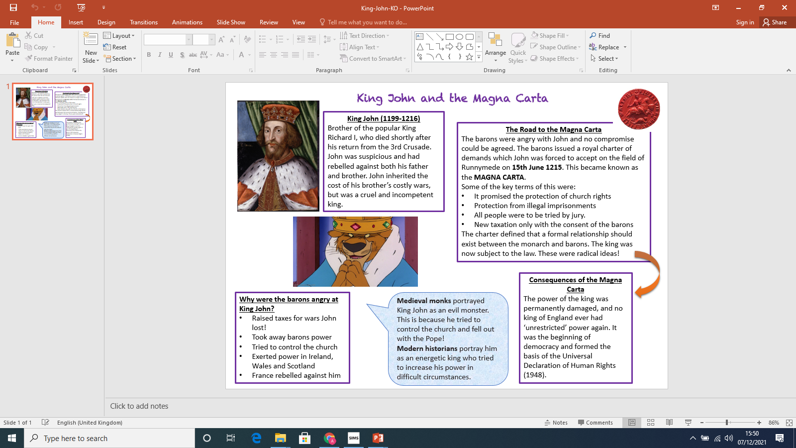
Knowledge Organiser YR7 HT3 – Medieval Realms

Slide 11
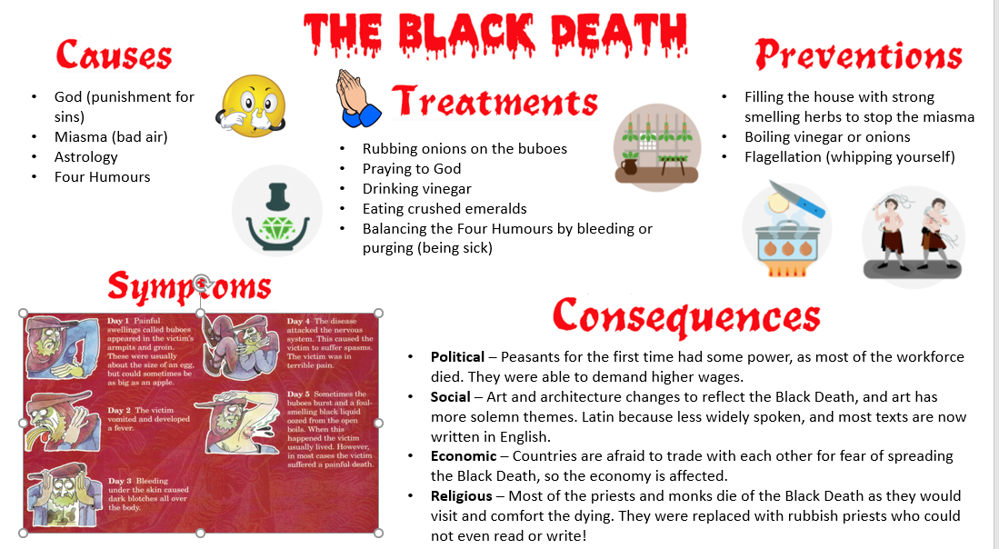
Knowledge Organiser YR7 HT3 – Medieval Realms

Slide 12
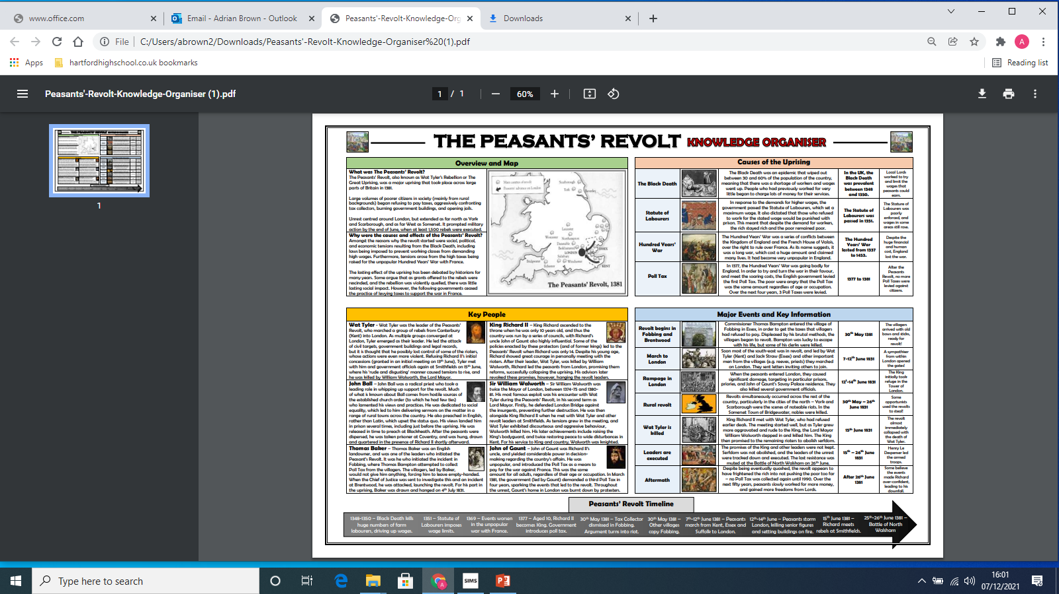
Knowledge Organiser YR7 HT3 – Medieval Realms

Slide 14
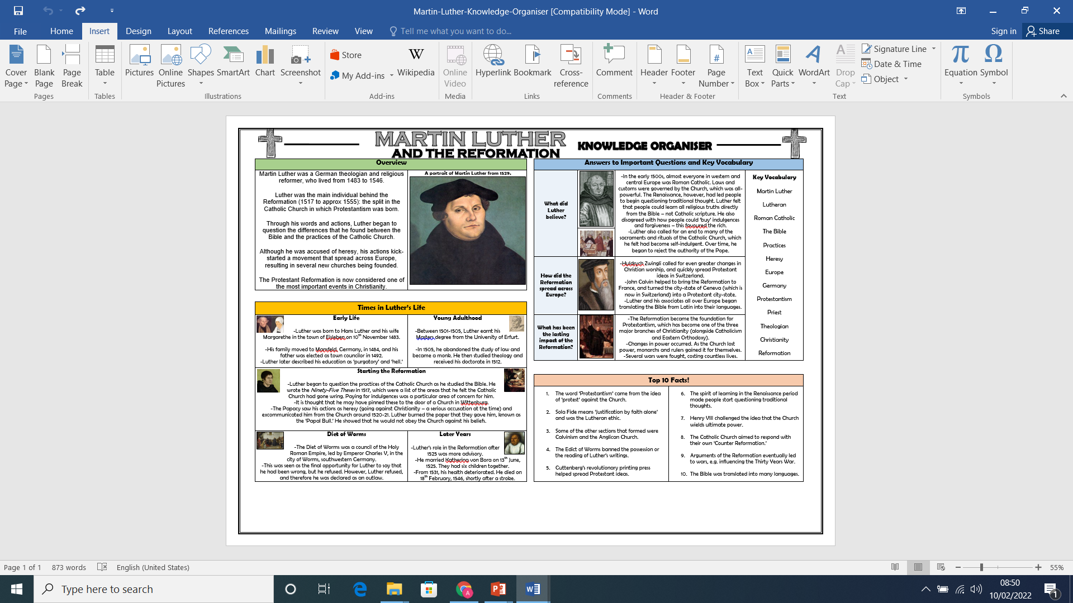
Knowledge Organiser YR7 HT4 – Tudors (Reformation)

Slide 15
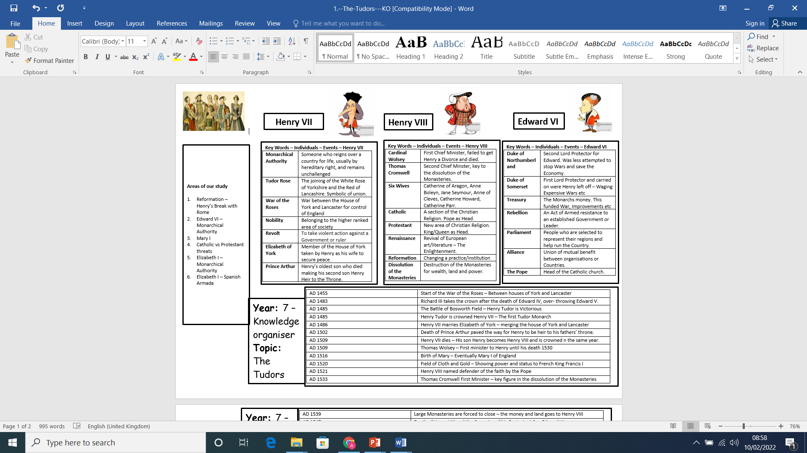

Slide 16
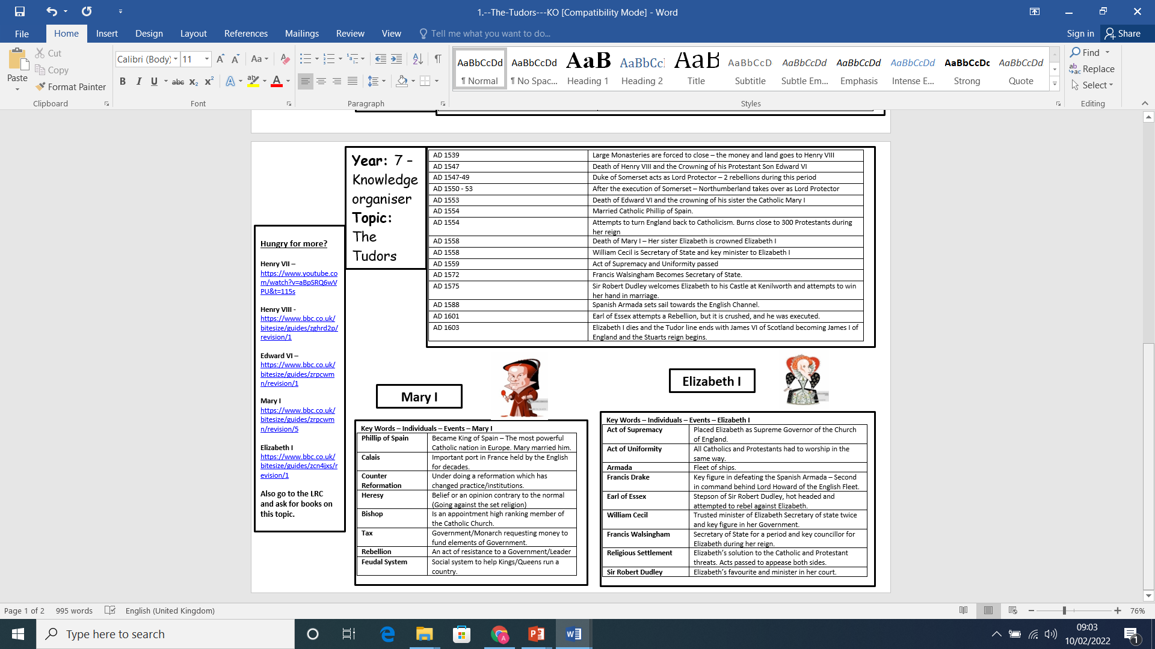

Slide 18
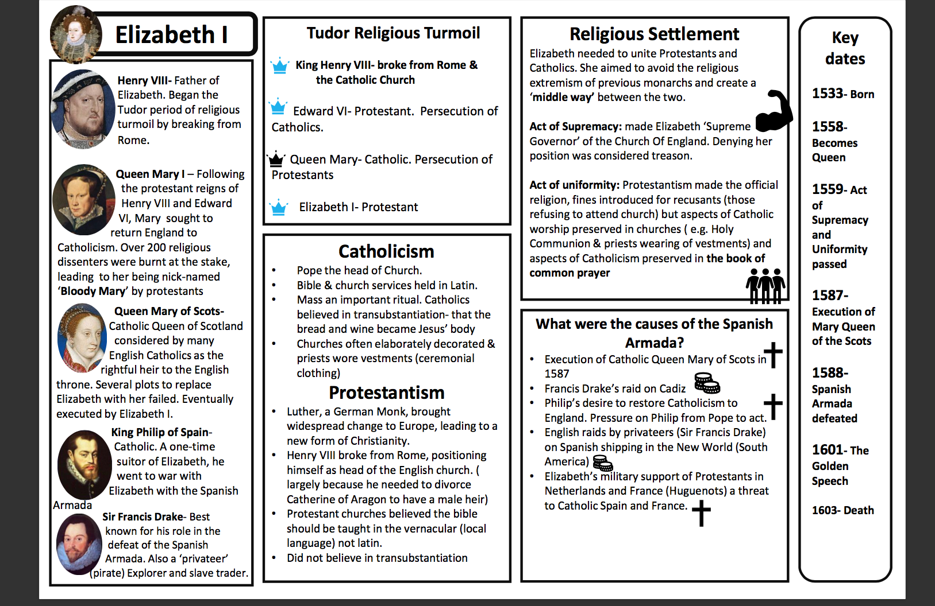
Knowledge Organiser YR7 HT5 – Elizabethan England

Slide 19
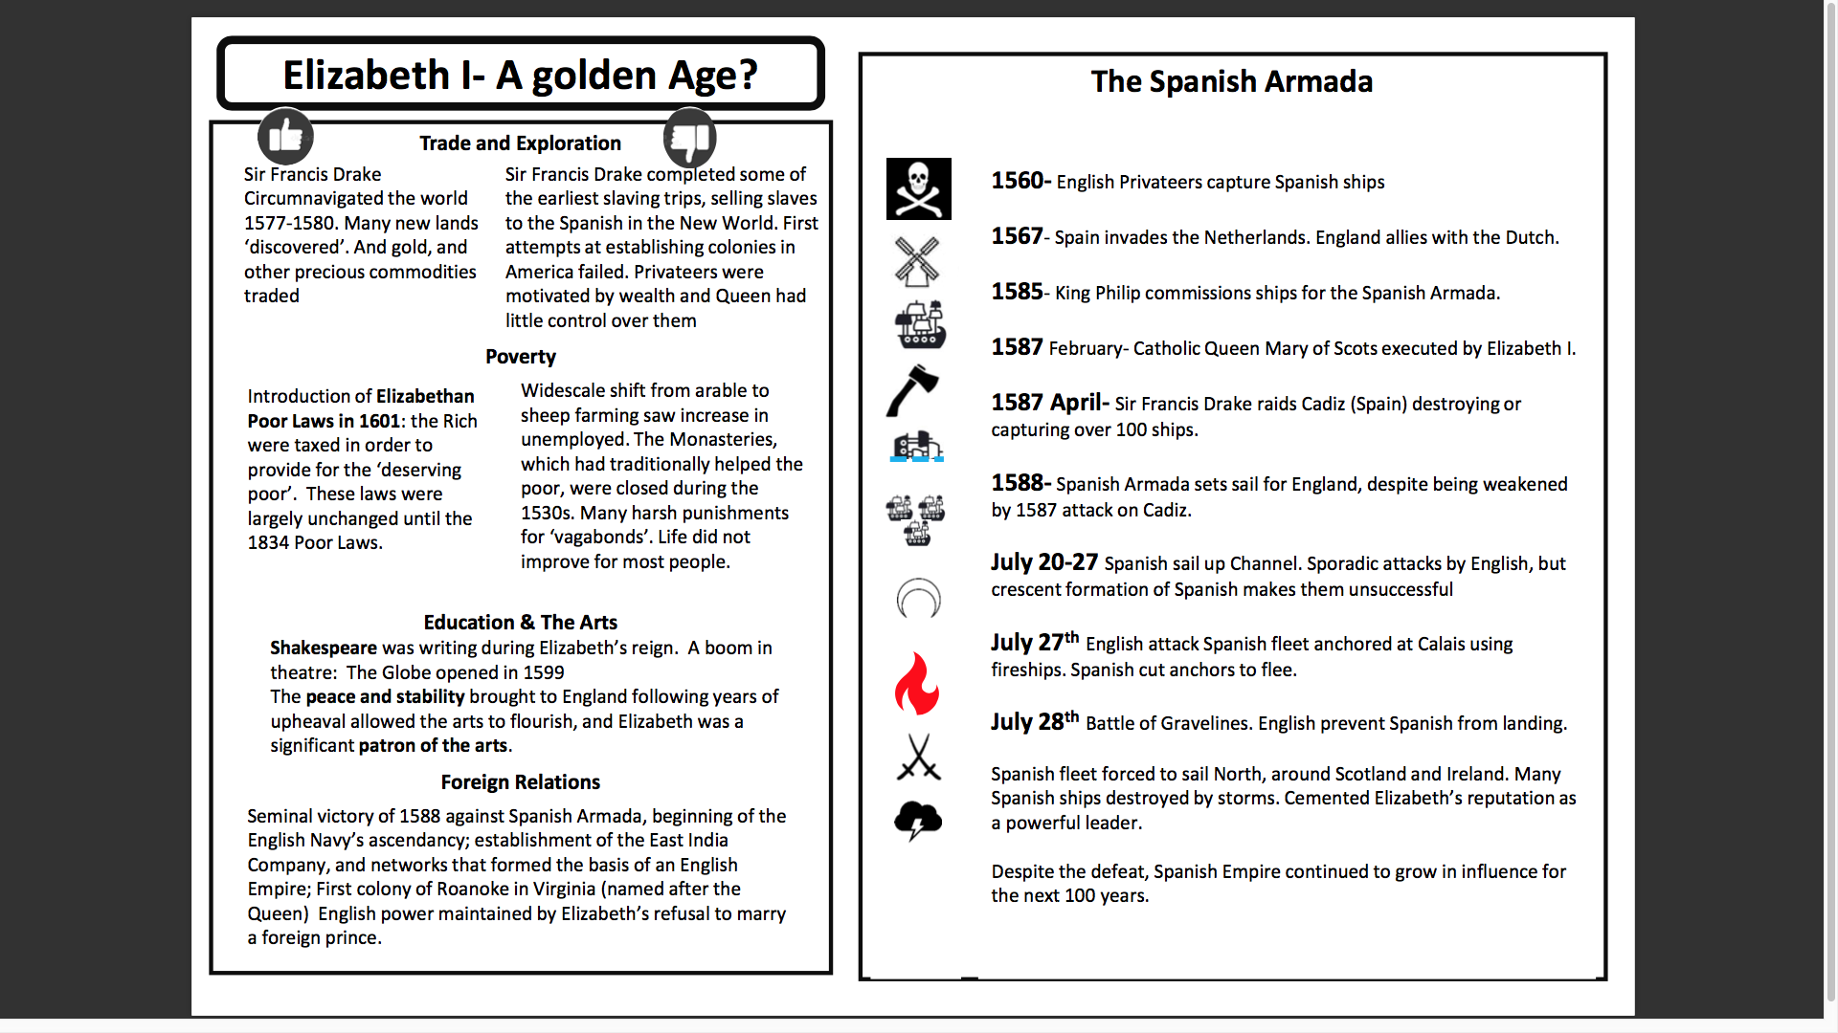
Knowledge Organiser YR7 HT5 – Elizabethan England

Slide 21
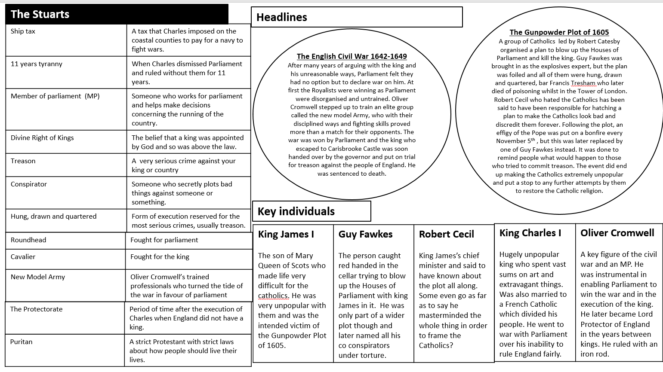
Knowledge Organiser YR7 HT6 – Stuarts

