Slide 1
Geography Knowledge Organisers
Year 11

Slide 2
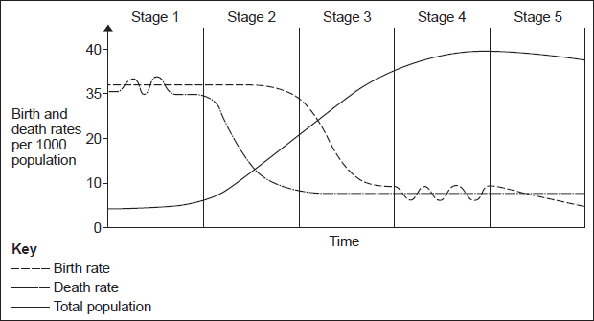
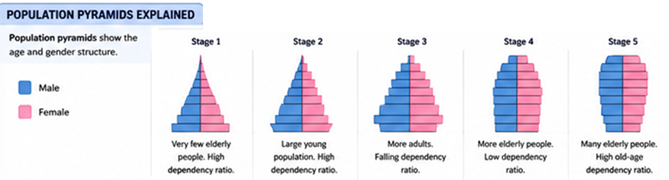
Development Gap Year 11 HT1
Global variations in development
There are global variations in economic development and quality of life. This means some countries have high incomes, good healthcare and education, while others face poverty, poor services and low life expectancy. The difference between richer and poorer countries is called the development gap.
Indicator | Description | High or low
GDP/GNI | Economic indicator. A measure of a countries wealth | High in a HIC
Birth rate | Number of births per 1000 per year | Low in a HIC
Death rate | Number of deaths per 1000 per year | Low in a HIC
Life expectancy | How many years on average a person can expect to live | High in a HIC
Access to safe water | % of the population with clean safe drinking water | High in a HIC
Adult literacy | % adults who can read and write | High in a HIC
Infant mortality | % babies that die before the age of one | Low in a HIC
Multi-Indicator
Human Development Index (HDI) – scores countries from 0 (low) to 1 (high) using:
GNI (Income / Wealth)
Years spent in education
Life expectancy (Health)
Limitations of development measures
GNI per head hides inequality within countries
Average data can hide regional differences
Data in LICs may be inaccurate or outdated
HDI does not include environmental quality or happiness
Some countries may rank differently depending on the indicator used
Classifying levels of development
Countries are grouped in different ways:
HICs (High Income Countries) – high wealth, advanced services, high quality of life (e.g. UK, USA)
NEEs (Newly Emerging Economies) – rapidly developing industrial economies (e.g. India, Brazil)
LICs (Low Income Countries) – low income, limited industry, poorer quality of life (e.g. Niger, Haiti)
Demographic Transition Model (DTM) the DTM shows population change linked to development stage:
Stage 1–2 (LICs): high birth rates, falling death rates, rapid population growth
Stage 3 (NEEs): falling birth rates, improving healthcare and education
Stage 4–5 (HICs): low birth and death rates, ageing population
As countries develop, they move through the DTM stages due to improvements in healthcare, education and income.
Causes of uneven development
🌦 Physical causes
Climate extremes (drought, floods)Natural hazards (earthquakes, hurricanes)Poor soils and limited resources
Disease (e.g. malaria in tropical regions)
💼 Economic causes
Lack of investment and infrastructure
Debt burden
Unemployment and reliance on primary industries
Unequal global trade (HICs dominate markets)
🏛 Historical causes
Colonialism and exploitation of resources
Long-term dependence on HICs
Unequal development of industry and infrastructure
Consequences of uneven development
Large wealth gaps between countries
Differences in health, education and life expectancy
Poor access to services in LICs
Increased international migration from poorer to richer countries
Brain drain (skilled workers leaving LICs/NEEs)
A population pyramid is a graph that shows the age and sex structure of a population. It displays the number or percentage of males (left) and females (right) in different age groups.

Slide 3

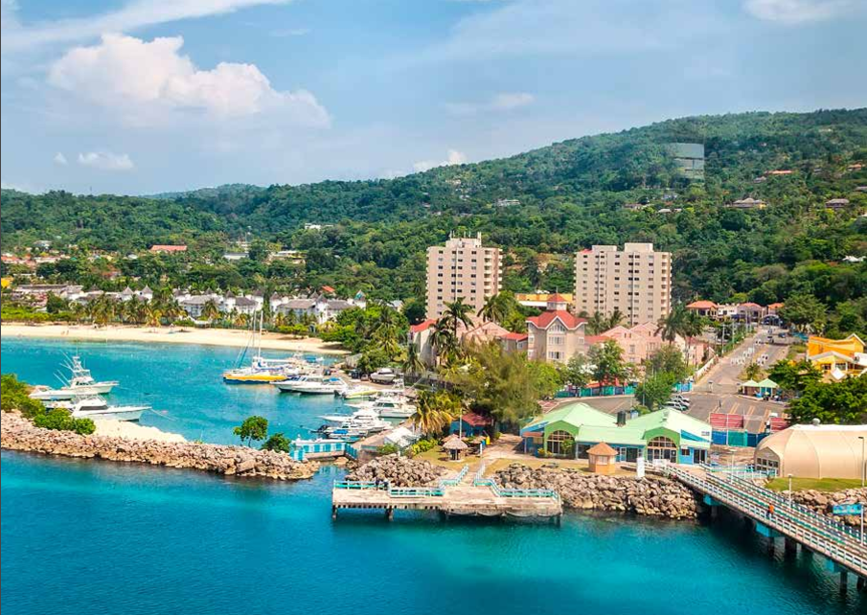

Reducing the Development Gap Year 11 HT1
Trade
What is Free trade? Free trade is when countries can trade with each other without tariffs (taxes). This has the potential to benefit the worlds poorest. However subsidies are a barrier to free trade. This is when rich countries give money to their farmers to help them produce goods cheaply.
This can steal trade from LICs.
What is a trading group? Countries can join together to get higher prices for their goods. EG the EU
Aid
Aid is when a government or non government organisation NGOs gives help to another country in the form of money, emergency supplies, food or specialist skills. It can help by enabling countries to invest in roads, health care and education. Only Aid that is long term and freely given can really help to close the development gap.
Industrial Development
Countries invest in manufacturing housing is built and hospitals roads and railways.
Population becomes better educated and healthier and industry can expand.
This is called the positive multiplier effect
Fair Trade
Fair trade is an international movement that sets standards for trade to ensure that producers in LICs get a fair deal.
Fair trade also helps to fund local community projects and all farming is done in environmentally friendly way.
Tourism
Countries with tropical beaches etc. can attract tourists.
Investment in the local area can benefit the local economy and people get jobs.
However there can be damage to the natural environment and it is vulnerable to recession
Investment
Countries and TNC’s invest money and expertise in LIC’s. China have invested in a railway in Nigeria and a power station in Zimbabwe. There are some benefits but many think it’s a type of exploitation benefitting China.
Intermediate technology.
Intermediate technology is sustainable and appropriate to the needs, knowledge and wealth of the local people. EG: Adis Nifra In Ethiopia where as small dam was created to help with irrigation
Micro finance
This involves small scale financial support.
It helps people especially women to start up small businesses e.g. making honey
The Garmeen bank is an example
Named Example: In Jamaica, tourism is one of the most important industries and a key strategy for reducing the development gap.
Tourism creates over 300,000 jobs (direct and indirect) in hotels, airports, tour companies, transport and entertainment. This reduces unemployment, especially in coastal areas such as Montego Bay and Ocho Rios, and provides income for many informal workers (e.g. taxi drivers and street vendors).
It also brings in large amounts of foreign exchange, making tourism one of Jamaica’s biggest sources of income. This money helps the government invest in infrastructure improvements, including airports, road networks, healthcare and utilities, which improves quality of life for residents.
Tourism has encouraged foreign direct investment (FDI) from international hotel chains and cruise companies, helping to build large resorts and improve facilities. It also supports local businesses, such as farming (supplying food to hotels), craft markets and small tour operators, creating a multiplier effect in the economy.
However, there are limitations:
A significant amount of money is lost through economic leakage, as foreign companies own many hotels and airlines
Many jobs are low-paid, seasonal and insecure, meaning income is not stable
Tourism can increase pressure on the environment, including coral reef damage, water use and coastal erosion
Development is often uneven, with tourist areas benefiting more than inland rural communities

Slide 4
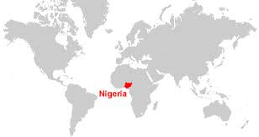
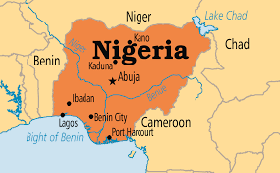
A Case study of a NEE Country – Nigeria Year 11 HT2
Location and Importance
Location
Located in West Africa on the Gulf of Guinea (Atlantic Ocean). Borders Benin, Niger, Chad and Cameroon. Capital city: Abuja. Largest city: Lagos.
Why is Nigeria important?
Population: Over 230 million (largest in Africa). Africa's largest economy by GDP. One of the world's largest oil producers. Member of OPEC (Organisation of Petroleum Exporting Countries). Fast-growing regional power influencing trade, politics and culture across Africa.
Nigeria's Economic Development
Nigeria is a Newly Emerging Economy (NEE)
Rapid economic growth since the 1990s has been driven by: Oil production, Manufacturing, Telecommunications, Financial services, Construction.
GDP has grown significantly although growth fluctuates with oil prices.
Manufacturing in Nigeria.
Today manufacturing accounts for 10% of Nigeria's economy. E.g. Volkswagen.
Regular paid work gives people an income. Industry stimulates growth in other areas of the supply chain. People pay taxes to the Government. This is an example of the positive multiplier effect
Political Links – member of African Union, ECOWAS, United Nations, OPEC
Increasing trade with: China, India, European Union
China has invested heavily in: railways, airports, roads, power stations
TNCs :Transnational corporations in Nigeria are: Unilever and Shell
Advantages: creates thousand of jobs, pays taxes to the Nigerian government, develops infrastructure – roads, electricity ports, trains local workers, increases exports, attracts foreign investment
Disadvantages - Oil spills damage farmland and rivers. Gas flaring causes air pollution. Profits often leave Nigeria. Local communities receive few benefits. Oil theft and conflict have increased. Farming and fishing have declined in polluted areas.
The effect of development on the environment:
Industrial Growth: Pollution from factories gets in to the water supply. Gases get into the atmosphere. Many forests have been cleared for Industrial development
Urban Growth: Waste from homes is a major issue. Traffic congestion pollutes the air. More deforestation when the new capital Abuja was built.
Mining and oil extraction: Tin mining leads to soil erosion. Oil spills can harm the coast and cause fires. Very bad spill Bodo 2008-9
Commercial farming: Water pollution due to the use of chemicals, Soils erosion due to forest clearance leads also to the loss of species
Wider Context
Political - Gained independence from UK in 1960.Federal democracy with elected government. Has experienced political instability and corruption, although democracy has become more stable.
Social - More than 250 ethnic groups. Largest groups: Hausa-Fulani (north)Yoruba (south-west)Igbo (south-east) Population is growing rapidly. Large differences in wealth between north and south.
Cultural - Hundreds of languages spoken. English is the official language. Home of Nollywood, the world's second-largest film industry by number of films produced. Major exporter of music, fashion and literature.
Environmental - Tropical climate. Diverse ecosystems including rainforest, savanna and mangroves. Issues: Oil pollution, Deforestation, Desertification in the north, Flooding
60% of Nigerians live in poverty
Aid in Nigeria Aid from the USA has helped to prevent the spread of AIDS. WaterAid – provides clean drinking water, improves sanitation and trains local communities increasing life expectancy and reducing spread of diseases. Nets for Life project supplying mosquito nets to reduce the spread of malaria
Problems with aid
Can create dependency.
Money can be lost through corruption
Projects may not meet local needs. Donors may have political influence on where the aid is spent.
Quality of life There have been many benefits to development: Higher disposable incomes. Improvements to infrastructure (road network). Better access to safe water and education. Better quality health care. Increased mobile phone access.
However: Around one-third of Nigerians still live in poverty. Large regional inequalities. Unemployment remains high. Rapid urbanisation has led to the growth of informal settlements. Access to healthcare varies greatly. Great dependency on oil.

Slide 5
The Changing Economy of the UK Year 11 HT3
Economic and Industrial Change in the UK
Key causes of change: De-industrialisation is the decline of traditional industries such as manufacturing. This has happened because: machines and technology have replaced many people. Other countries e.g. china can produce cheap goods because labour is less expensive. Globalisation — is the growth and spread of ideas around the world. Many people now work on global brands in the quaternary sector e.g. in IT. Increased world trade and cheaper imported products have contributed to the decline in UK manufacturing. Government policies — government decisions on investment in new infrastructure and technology and support for businesses (e.g. tax breaks) affect how well the economy grows. Membership in government groups, e.g. World Trade Organisation, make it easier for companies in the UK to operate across the world.
Moving towards a post-industrial economy:
A post-industrial economy is where manufacturing industry declines to be replaced by growth in the service sector and quaternary sector. This happened in the UK from the 1970s. By 2026, 79% of UK employment was in the tertiary sector and 10% in the quaternary sector. 9% of employment was in manufacturing compared to 55% in 1900. Development of information technology the use of IT is a key factor in the UK’s move to a post-industrial economy. Internet access allows people to work from home. Over 1.6 million work in the IT sector. And the UK is one of the world’s leading digital economies. Service industries and finance the UK service sector has grown rapidly since 1970s, today is contributes over 79% of the UK’s GDP. Finance is an important part of the service sector the UK is the world’s leading centre of financial services Some, like HSBC, have their global headquarters in the UK. The financial services sector accounts for about 10% of the UK’s GDP. Research and development (R&D) is increasing in the UK, making use of the UK’s highly skilled university graduates – research employs over 60,000 people. In 2025, nearly £50 billion was spent on R&D in the UK and it is estimated to contribute 3% of the UK’s GDP and it one of the UK’s economy’ main growth areas in the future.
Environmental impacts of Industry on the physical environment
Large-scale extraction industries such as mining and quarrying can have an impact on the environment. Quarries have been cut out of the countryside and huge waste tips piled up on the edges of mining settlements. They can destroy natural habitats, pollute water courses and scare the landscape. | Modern manufacturing industries have an effect on both the landscape and the environment. Manufacturing plants can look very dull and uninteresting and can have a negative visual effect on the landscape. Industrial processes can cause air and water pollution, as well as degrading the soil. The transport of raw materials and manufacturing products is usually by road, which increases levels of air pollution and damage to the environment when roads are widened or new ones built
UK Science and Business Parks
A science park is a group of scientific and technical knowledge-based businesses located on a single site. Most are associated with universities, enabling them to use research facilities and employ skilled graduates. Science parks may also include support services such as financial services and marketing. Science parks often have: Good transport links – close to motorways/ railway / airports. Excellent links with universities. Attractive location with green areas. A business park is an area of land occupied by a cluster of businesses. Business parks are usually located on the edges of towns because: land tends to be cheaper than in town centres and with more land, it may be possible to extend businesses. Access is also better with less congestion. Businesses can benefit by working together.

Slide 6
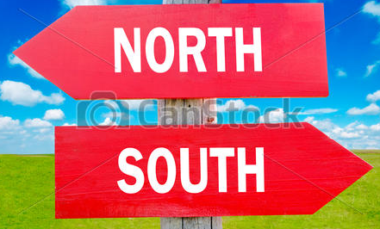
The Changing Economy of the UK Year 11 HT3
How can industrial development be more sustainable?
Today there is a much greater concern about the need for industries to be environmentally sustainable. This can be achieved in a number of ways. • Technology can be used to reduce harmful emissions from power stations and heavy industry. • Desulphurisation can remove harmful gases such as sulphur dioxide and nitrogen oxide from power station chimneys. • Stricter environmental targets put in place for industry on water quality, air pollution and landscape damage. • Heavy fines imposed when an industrial pollution incident occurs. Quarrying can be made more sustainable with: • Strict controls on blasting and removal of dust from roads and landscaping • Recycling is encouraged • Companies are expected to restore of improve a quarry after it has been used.
Named Example: Torr Quarry, Somerset
Torr Quarry is an example of how modern industry can be more environmentally sustainable. Torr Quarry is a limestone quarry in the Mendip Hills. It employs over 100 people and contributes more than £15 million towards the local economy each year. • The quarry is being restored to create wildlife lakes • 200 acres of the site have already been landscaped • Regular monitoring of noise, vibration, dust and water quality. • Rail transport of quarried rock minimises the impact om local roads.
North-South Divide
What is the north-south divide? It refers to a real of imagined cultural and economic differences between the south of England and the rest of the UK. In general the south enjoys high incomes and longer life expectancy., But the south also has higher house process and more traffic congestion.
Why is there a north-south divide?
• During the Industrial Revolution, the UK’s growth was centred on coalfields, heavy industries and engineering in northern England, Wales and Scotland. • Since 1970s, many industries have declined, reducing prosperity in those areas. • London and the South East developed rapidly due to a fast-growing service sector.
How can regional strategies address the north-south divide?
Local Enterprise Partnerships (LEPs) were partnerships between local authorities and businesses that aimed to encourage investment, improve skills and create jobs. Since 2024, most LEP responsibilities have been transferred to local and combined authorities, giving councils a greater role in supporting economic growth. Lancashire LEP will: promote new businesses and create 50,000 new jobs by 2023. Improve transport with £20 million investment. Extend superfast broadband across 97% of the region. Create 6,000 high-skilled jobs in Enterprise Zones at Samlesbury and Warton. Enterprise Zones encourage new businesses and jobs by offering incentives such as business rate discounts, simpler planning rules and high-speed broadband. They are designed to attract investment and regenerate deprived areas. The Northern Powerhouse aims to reduce the economic gap between northern England and London by improving transport, investing in science and technology, and giving more decision-making powers to regional mayors. Projects include HS2 (partly cancelled), Northern Powerhouse Rail (planned) and improvements to local rail and road networks. Investment in industry and innovation - Growth of science parks, technology hubs and research centres in northern cities (e.g. Manchester, Leeds). Government funding for high-tech and green industries to replace lost manufacturing jobs. Aim: create higher-skilled, better-paid jobs.

Slide 7


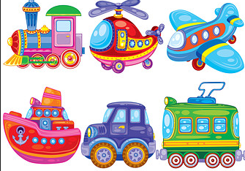
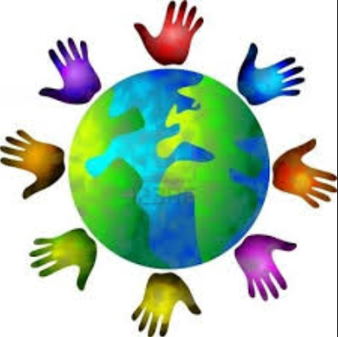
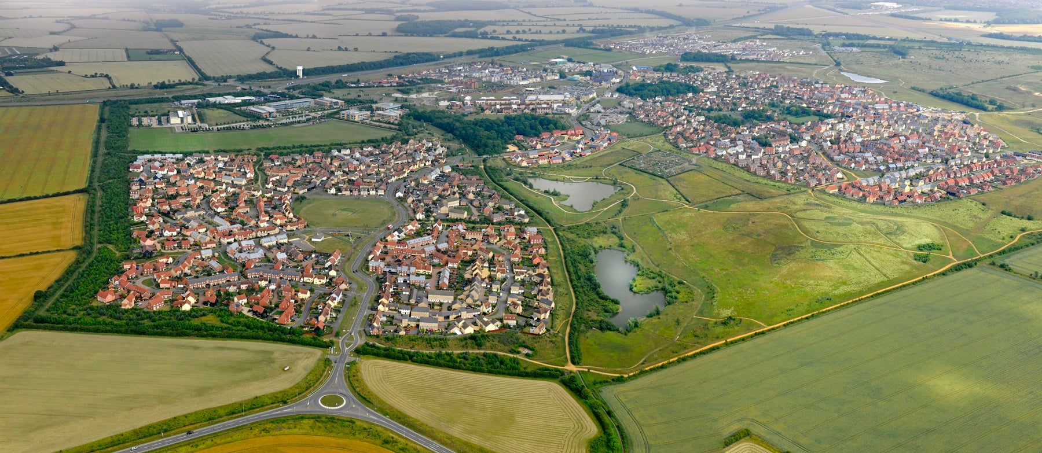
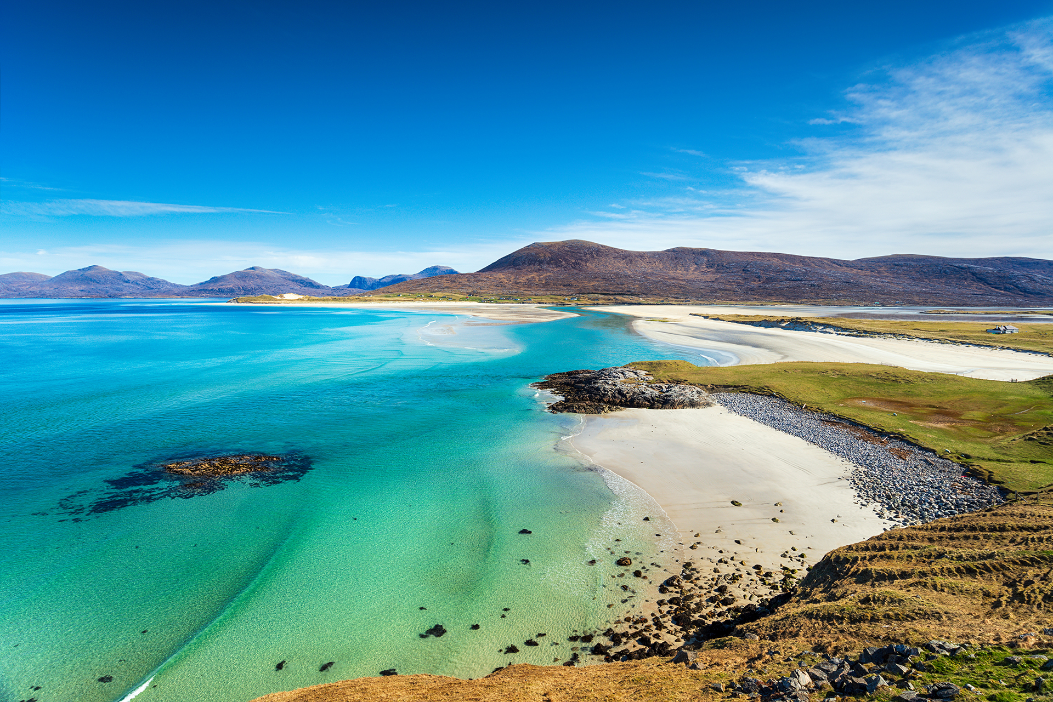
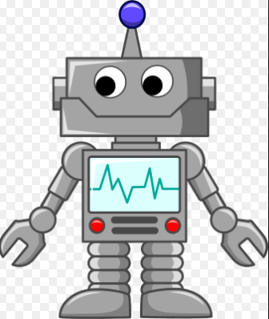
The Changing Economy of the UK Year 11 HT3
UK Global Links
Political | Commonwealth Organisation of 56 countries, most were formerly part of the British Empire. King Charles III is the Head of the Commonwealth The Commonwealth promotes trade, democracy, human rights and sustainable development. It provides the UK with important trading partners and strengthens political and cultural links around the world. European Union (EU) The UK joined the EU in 1973 and left on 31 January 2020 The EU remains the UK's largest trading partner, accounting for around 40–45% of UK exports and over 50% of UK imports. Since Brexit, the UK has introduced new trade and border arrangements with the EU while negotiating new trade agreements with countries outside Europe.
Trade | 42% of UK exports go to the EU, while 58% are exported to non-EU countries, with the USA being the UK's largest single export market. Trade with countries such as China and India is also increasing. Major exports include financial services, insurance, technology, communications and professional services, rather than manufactured goods.
Transport | The UK has over 250 airports with flights to hundreds of destinations worldwide. Around 2.5 million flights use UK airports each year, making air travel vital for trade and tourism. Heathrow is the UK’s busiest airport and 4th busiest airport in the world Eurotunnel (Channel Tunnel) links our island to Europe as well as sea ferries.
Culture | English Language has helped us set up strong links Students abroad can sit British exams UK TV productions have a global audience e.g. Doctor Who We are a culture of immigration leading to a unique and multicultural society
Technology | 97% of population has internet – very connected! We spend more online shopping than anywhere in Europe 18 million businesses run from home
UK Transport Links
Ports | Air | Roads
32 million passengers travel though UK ports. Ports employ 120,000 people. Liverpool2 project will doubled the ports capacity to over 1.5 million containers a year which create thousands of jobs and boost the regional economy. | Airports create vital global links, provide 1000s of jobs and boost economic growth. There are plans for a third runway at Heathrow Airport, to expand its capacity, however people living nearby are concerned about noise and air pollution. | Road Investment Strategy includes: 100 new road schemes, 1300 new miles added to motorways. Extra lanes added to motorways to make them smart motorways.
Changing rural landscapes in the UK
Growth; South Cambridgeshire The population is increasing due to migration – migrants from Cambridge, other parts of the UK and eastern Europe. Social Effects: 80% car ownership leads to increased traffic on narrow roads. Housing developments on the edges of villages can reduce community spirit. Economic effects: reducing in agricultural employment, lack of affordable housing, high petrol prices, pressure on services due to growing population. | Decline, Outer Hebrides The population has declined by 50% since 1901, people move away due to limited employment opportunities. Social Effects: school closures due to too few children. Ageing population has fewer young people to support them. Economic effects: services are closing, small farms can only provide work for 2 days a week, there has been an increase in tourism, but the infrastructure can support the scale of tourism needed.

Slide 8
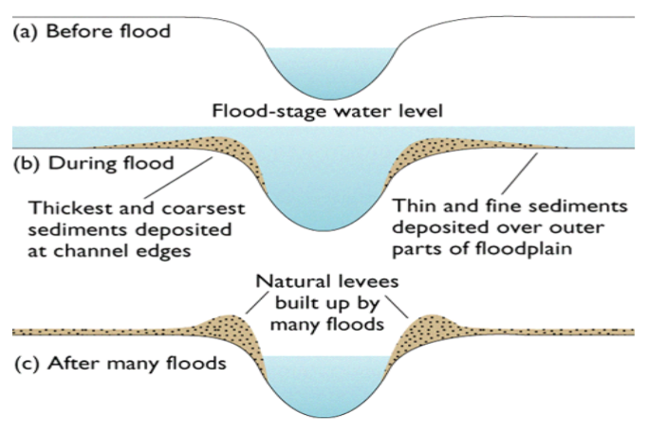
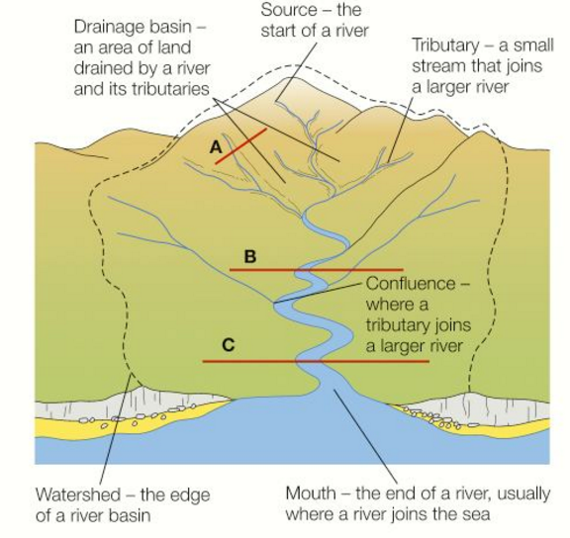
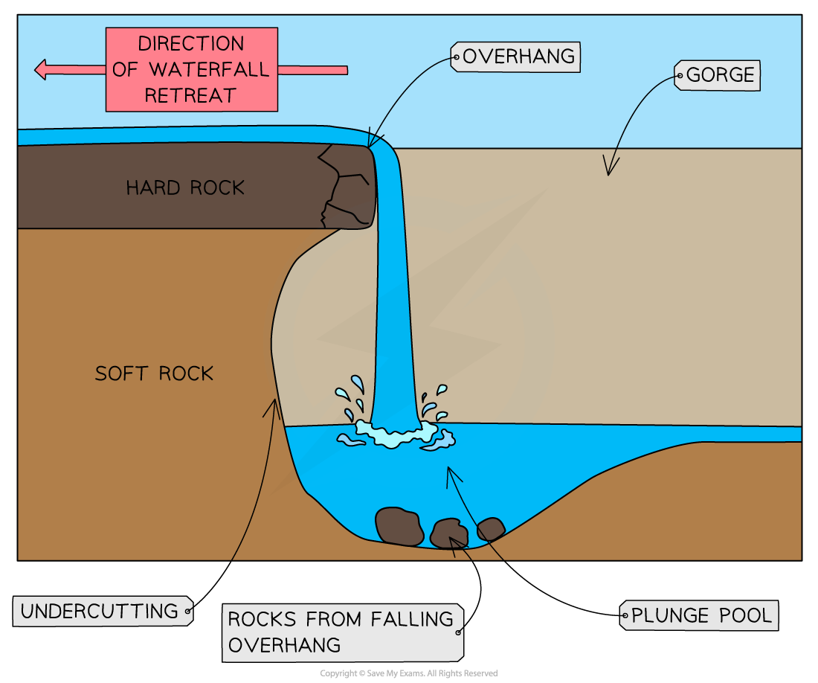
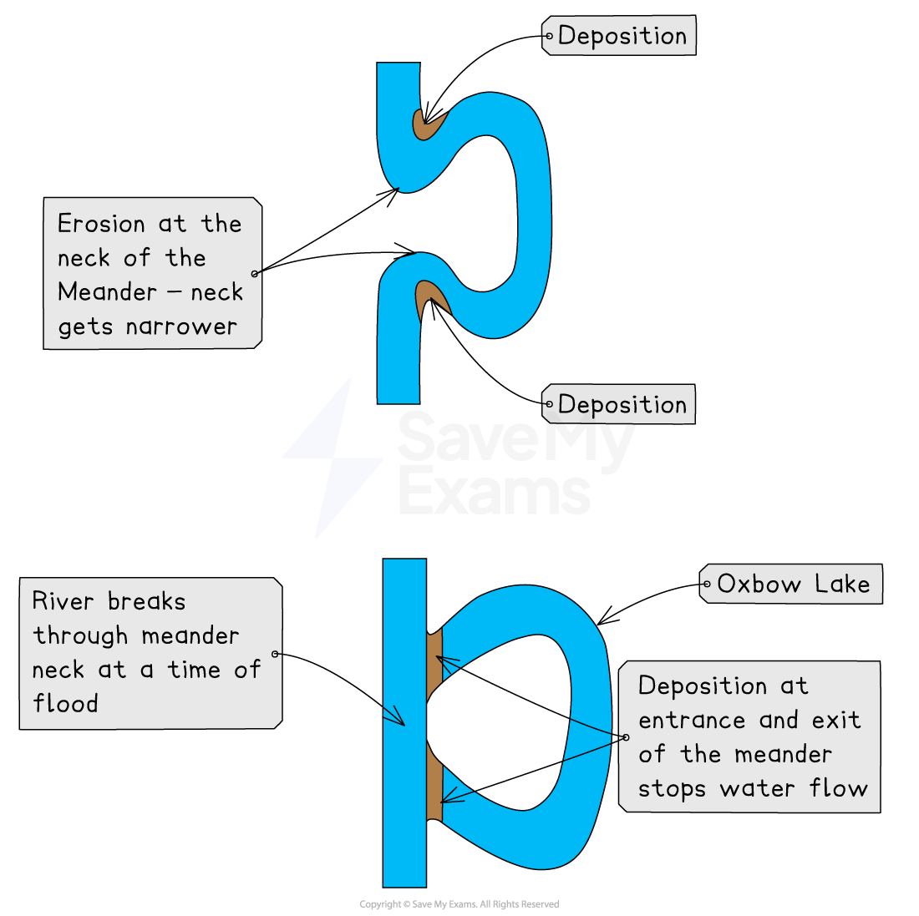
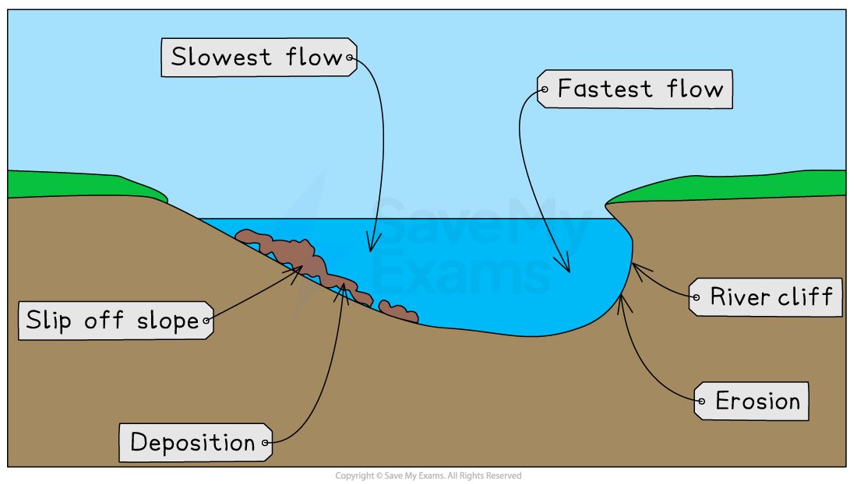
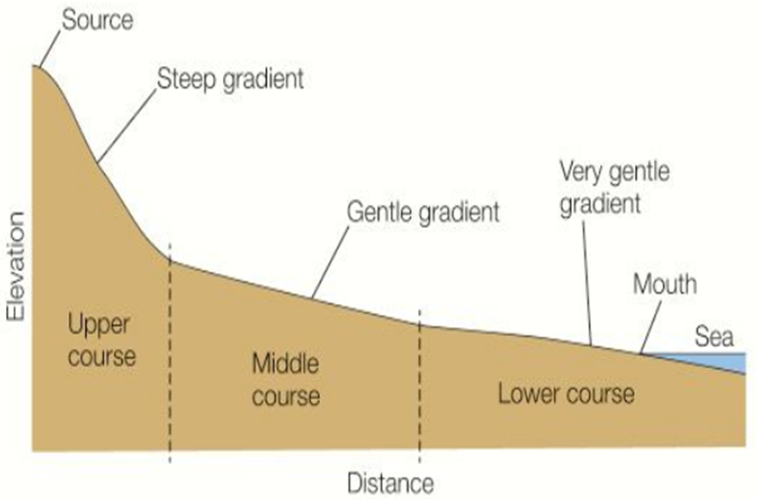
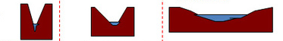

River Landscapes Year 11 HT4
Upper Course of a River
Near the source, the river flows over steep gradient from the hill/mountains. This gives the river a lot of energy, so it will erode the riverbed vertically to form narrow valleys.
Middle Course of a River
Here the gradient get gentler, so the water has less energy and moves more slowly. The river will begin to erode laterally making the river wider.
Lower Course of a River
Near the river’s mouth, the river widens further and becomes flatter. Material transported is deposited.
Formation of Ox-bow Lakes
1) Erosion of outer bank forms river cliff. Deposition inner bank forms slip off slope.
2) Further hydraulic action and abrasion of outer banks, neck gets smaller.
3) Erosion breaks through neck, so river takes the fastest route, redirecting flow
4) Evaporation and deposition cuts off main channel leaving an oxbow lake.
Formation of Floodplains and levees
When a river floods, fine silt/alluvium is deposited on the valley floor. Closer to the river’s banks, the heavier materials build up to form natural levees.
Nutrient rich soil makes it ideal for farming. Flat land for building houses.
Formation of Waterfall
1) River flows over alternative types of rocks.
2) River erodes soft rock faster creating a step.
3) Further hydraulic action and abrasion form a plunge pool beneath.
4) Hard rock above is undercut leaving cap rock which collapses providing more material for erosion.
5) Waterfall retreats leaving steep sided gorge.
Long Profile of a River
Cross Profile of a River
Upper
Course
Middle Course
Lower
Course
Key Words:
Source, Mouth, Watershed, Tributary, Confluence, Vertical and Lateral Erosion, Deposition, Sediment

Slide 9
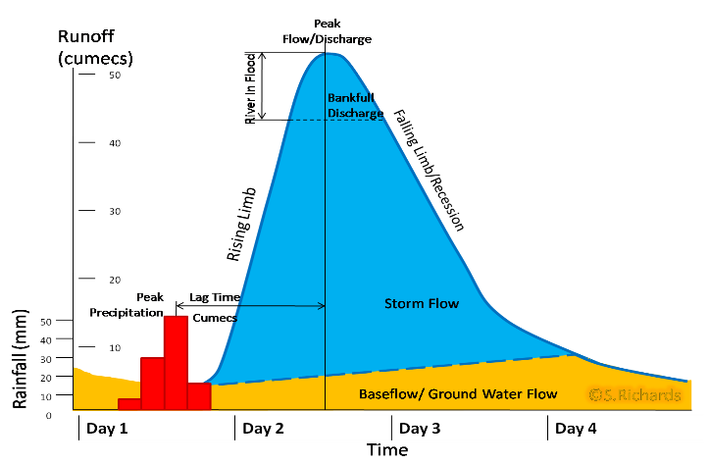
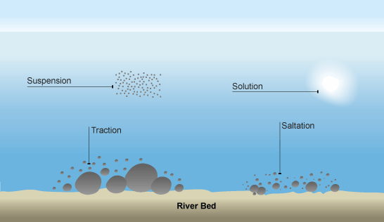
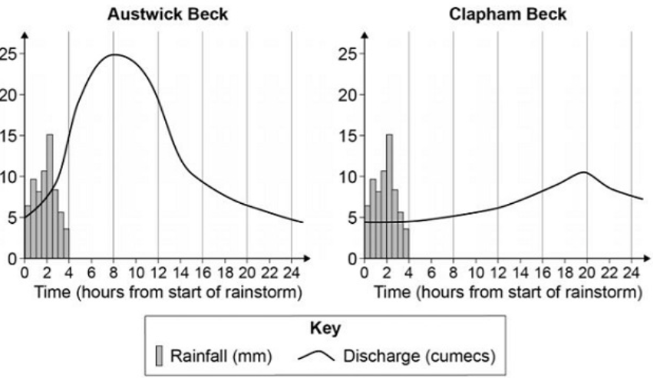
River Landscapes Year 11 HT4
Types of Erosion
The break down and transport of rocks – smooth, round and sorted.
Attrition | Rocks that bash together to become smooth/smaller.
Solution | A chemical reaction that dissolves rocks.
Abrasion | Rocks hurled at the base of a cliff to break pieces apart.
Hydraulic Action | Water enters cracks in the cliff, air compresses, causing the crack to expand.
Types of Transportation
A natural process by which eroded material is carried/transported.
Solution | Minerals dissolve in water and are carried along.
Suspension | Sediment is carried along in the flow of the water.
Saltation | Pebbles that bounce along the sea/river bed.
Traction | Boulders that roll along a river/sea bed by the force of the flowing water.
Hydrographs and River Discharge
River discharge is the volume of water that flows in a river. Hydrographs who discharge at a certain point in a river changes over time in relation to rainfall
1. Peak discharge is the discharge in a period of time.
2. Lag time is the delay between peak rainfall and peak discharge.
3. Rising limb is the increase in river discharge.
4. Falling limb is the decrease in river discharge to normal level.
What is Deposition?
When the sea or river loses energy, it drops the sand, rock particles and pebbles it has been carrying.
Factors affecting hydrographs
Flashy Hydrograph Steep Slopes Small drainage basin Impermeable surface Low levels of vegetation High levels of precipitation
Low Hydrograph Gentle slopes Large drainage basin Permeable surface High levels of vegetation Low levels of precipitation
Physical and Human Causes of Flooding
Physical: Prolong & heavy rainfall Long periods of rain causes soil to become saturated leading runoff. | Human: Deforestation when trees are removed, this will increase surface runoff as the water will not be intercepted.
Physical: Relief Steep-sided valleys channels water to flow quickly into rivers causing greater discharge. | Human: Land Use Tarmac and concrete are impermeable. This prevents infiltration & causes surface runoff.
Physical: Geology Impermeable rocks causes surface runoff to increase river discharge. | Human: Agriculture Farming of crops can often leave the soil exposed and leads to rapid surface run off.

Slide 10
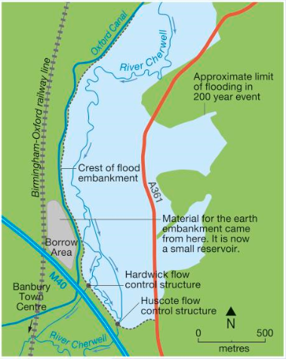
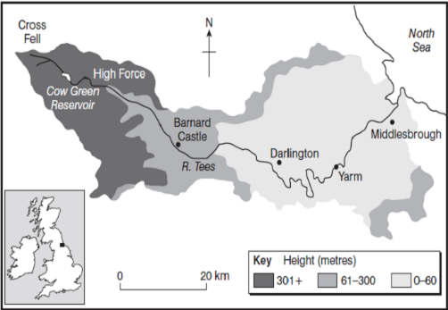
River Landscapes Year 11 HT4
River Management Schemes
Soft Engineering | Hard Engineering
Floodplain zoning-restrict land use to certain locations River restoration – return river to original course e.g. River Quaggy Demountable Flood Barriers put in place when warning raised. E.g. Bewdley Managed Flooding – naturally let areas flood, protect settlements. E.g. Banbury | Dams and reservoirs – regulate river flow eg Rutland Straightening Channel – increases velocity to remove flood water. Artificial Levees – heightens river so flood water is contained. Flood relief channel – man made channel to by-pass an urban area e.g. Jubilee River
Named Example: The River Tees
Location and Background Located in the North of England and flows 137km from the Pennines to the North Sea at Red Car.
Geomorphic Processes Upper – Features include V-Shaped valley, rapids and waterfalls. Highforce Waterfall drops 21m and is made from harder Whinstone and softer limestone rocks. Gradually a gorge has been formed. Middle – Features include meanders and ox-bow lakes. The meander near Yarm encloses the town. Lower – Greater lateral erosion creates features such as floodplains & levees. Mudflats at the river’s estuary.
Management -Towns such as Yarm and Middleborough are economically and socially important due to houses and jobs that are located there. -Dams and reservoirs in the upper course, controls river’s flow during high & low rainfall. Better flood warning systems, more flood zoning and river dredging reduces flooding.
Named Example: Managing Floods at Banbury
Why was it required? Banbury is located in the Cotswold Hills and much of the town is on a floodplain of the River Cherwell, a tributary of the Thames. Population = 45,000 . Banbury has a history of devastating floods. Flooding in 1998 – closure of railway station, roads closed and caused £12.5 million of damage.
Management Strategy - 2012 2.9km earth embankment along M40 – flood storage area Flow control structures in the embankment – controls the rate of flow downstream to Banbury. Raised A361 and improvements in road drainage. New earth embankments and floodwalls. New pumping station New Biodiversity Action Plan (BAP)
Social, Economic and Environmental Issues Social - Raised A361 will be open - Improved quality of life for locals – footpaths/ green areas - Reduced levels of anxiety Economic - Cost £18.5 million Donors – Environment Agency Cherwell District Council - Protects 441 houses 73 businesses benefits +£100m. Environmental - 100000 tonnes earth needed to build embankment. New BAP – ponds, hedgerows. Part of floodplain – allowed to flood.

