Slide 1
Geography Knowledge Organisers
Year 9

Slide 2
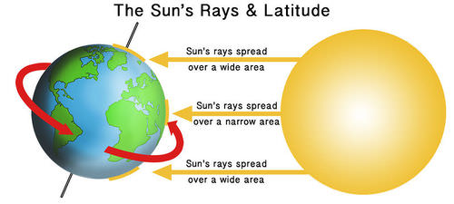
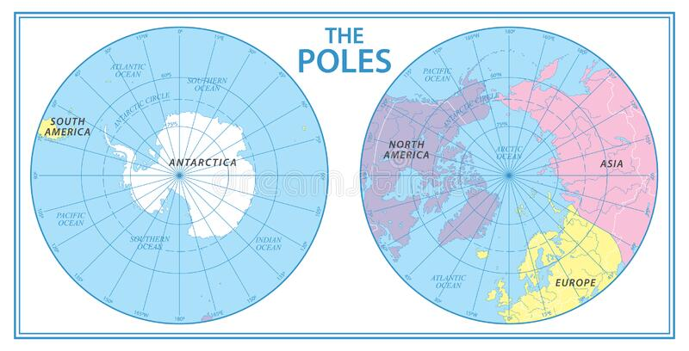
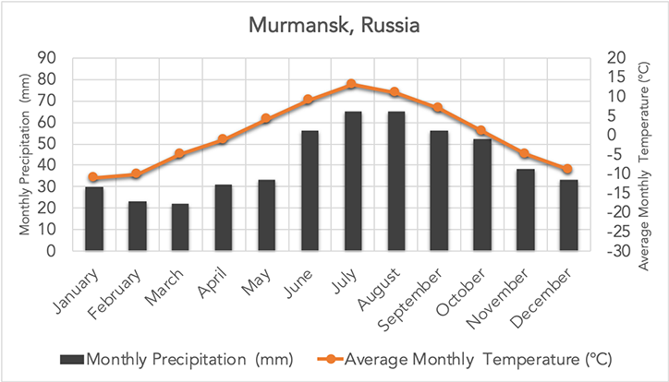
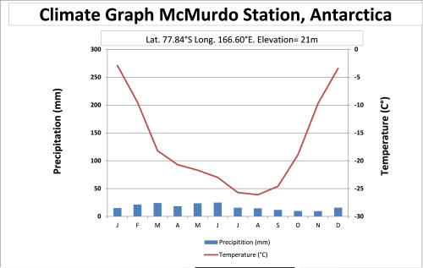


Polar Regions Year 9 HT1
Where are the polar regions?
The Arctic in the northern hemisphere is a frozen ocean surrounded by land.
Antarctica in the southern hemisphere is a frozen continent surrounded by ocean.
Countries with an Arctic coastline include Russia, USA (Alaska), Canada, Greenland, Norway, Sweden and Finland.
Antarctica has no countries, but the nearest are Australia, South Africa, Argentina and Chile
What is the climate like in polar regions?
Polar regions are cold because they are at high latitudes, so the Sun's rays are less direct.
They are dry because high-pressure systems cause air to sink, reducing rainfall and snowfall.
Who owns Antarctica? The Antarctic Treaty
No country owns Antarctica. It is protected by the Antarctic Treaty System. The treaty promotes peace, scientific research and environmental protection. Countries agree not to mine resources or use Antarctica for military purposes. Some rules are voluntary agreements between treaty members. The treaty will be reviewed in 2048, raising questions about possible future conflict over natural resources.
Impacts of tourism on Antarctica
Countries that sign the treaty agree:
To make Antarctica a natural reserve that is devoted to peace and science
To allow scientists freedom to work
To share scientific knowledge
To set aside any territorial claims
To ban nuclear explosions and the disposal of radioactive waste
To make sure all visits to Antarctica comply with the treaty
To ban all commercial mining until at least 2048.
To ensure all waste is disposed of without damaging the environment
Most people only stay on land for a few hours | Invasive species can be brought onto land as seeds stuck to the soles of shoes | Cruise ships an leak oil and damage the marine environment
Tourists can become champions of Antarctica | Tourists cant visit all year due to the harsh winter climate so this limits numbers | Fragile plants can get trampled
Nesting birds can be disturbed | Tourists and visitors get to appreciate the beauty of the last great wilderness | Erosion of paths where most tourists walk
Waste created by visitors has to be dealt with | Antarctica has no native residents so tourists can speak up for Antarctica | Small boats can disturb the resting sites of seals off shore
What are the threats to Antarctica?
Tourism is increasing, mainly through cruise ships. Cruise ships may leak oil, harming wildlife and ecosystems. Visitors can disturb wildlife and introduce non-native species, such as seeds carried on boots. Tourists can also become advocates, helping raise awareness and support conservation.
Climate change is warming Antarctica and melting ice. An ice shelf is a thick floating extension of ice attached to land. Larsen C Ice Shelf is an example of an ice shelf where a huge iceberg broke away in 2017.

Slide 3
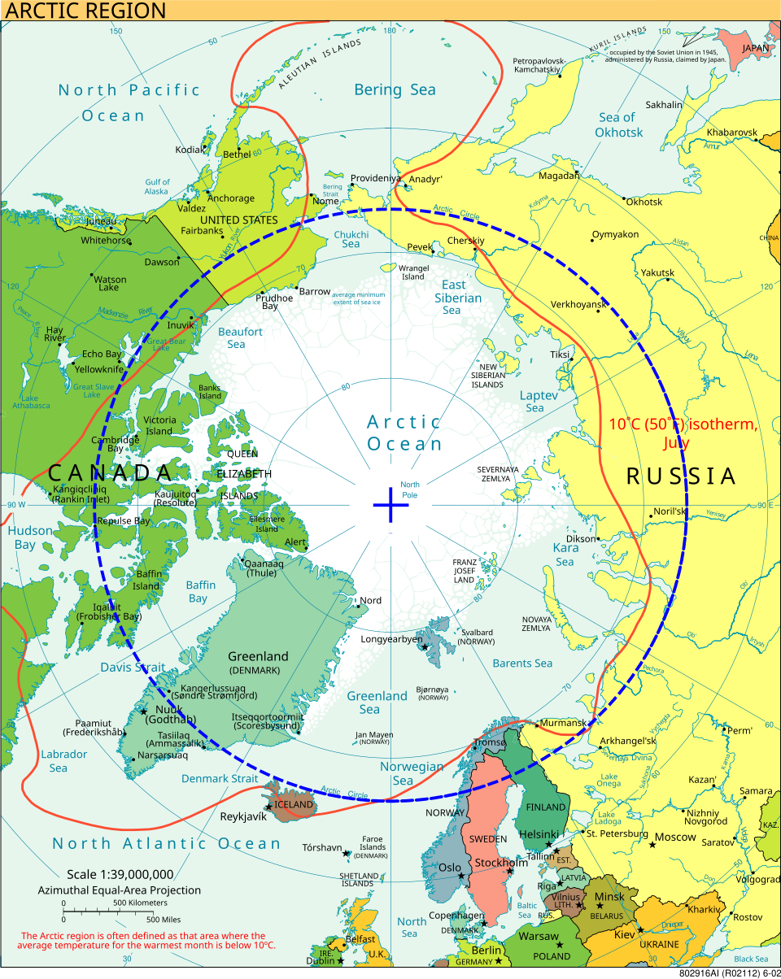
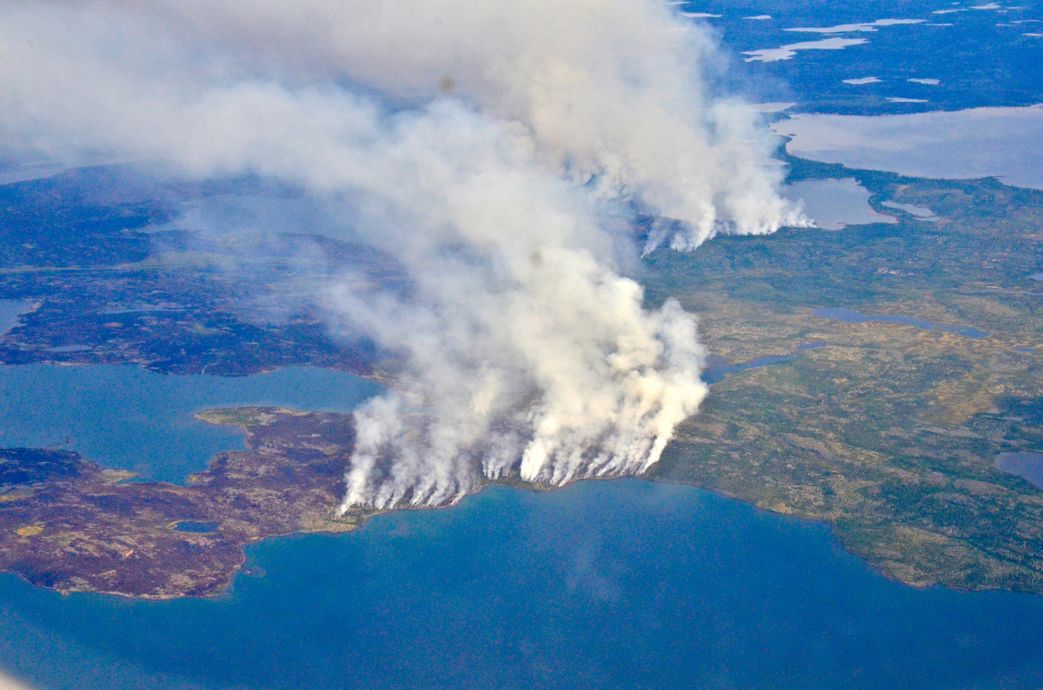
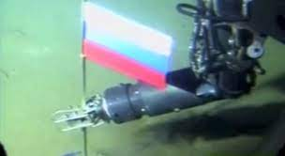
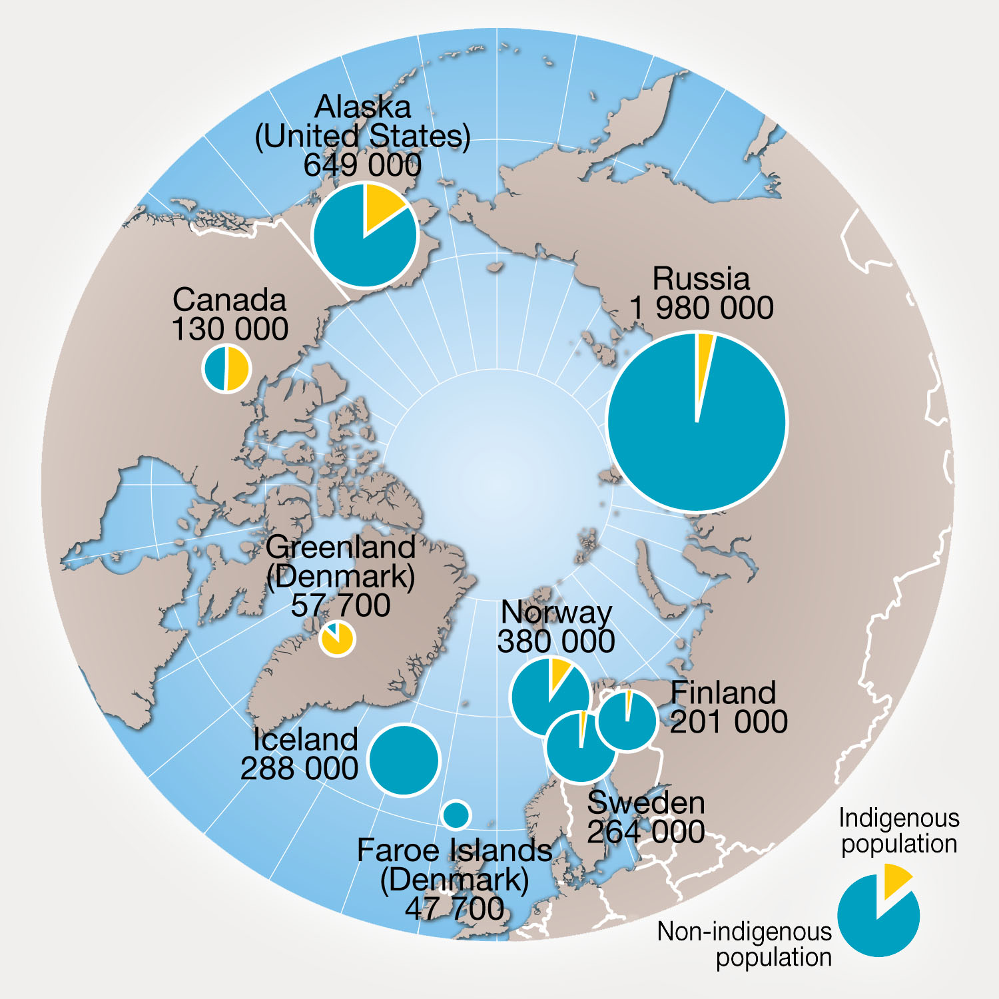
Polar Regions Year 9 HT1
The Arctic
There are 8 countries which have land and a share of Arctic: Norway, Sweden, Finland, Russia, USA (Alaska), Denmark (Greenland), Canada and Iceland.
Across these 8 countries indigenous people make up about 10% of the 4 million people that live there. Out of these 4 million inhabitants in the Arctic, 2 million are Russian
Apart from the Greenland icecap the Arctic is frozen ocean. Ocean temperatures rarely fall below -2°C which makes it on the whole warmer than Antarctica
How significant are changes in the Arctic?
Threats include climate change, melting sea ice, tourism and resource development.
Changes can be judged by:
Time scale: short-term or long-term? Scale: local, regional or global? Category: environmental, economic or social?
What is happening in the Russian Arctic?
Rising temperatures increase the risk of wildfires.
Fires and warming melt permafrost (permanently frozen ground).
Melting permafrost causes subsidence, where the ground sinks and damages buildings and roads.
Russia has the longest coastline of all the Arctic nations. As the ice melts it opens up tremendous possibilities for Russia.
Currently their major coastline is frozen for 6 months of the year so as the ice melts this reveals their coastline and potential new trade routes, shipping ports and oil exploration are possible.
Russia have already laid claim to the seabed under the ice at the North pole by planting a flag on the sea bed
Melting sea ice creates opportunities for oil and gas extraction and new shipping routes
These changes may bring economic benefits but can also increase environmental damage and international conflict.
Tiksi, a remote town in Siberia, continues to be inhabited because of jobs, culture and its strategic location.
Careers:
Antarctica Scientist/researcher
£50-80,000 per year
Engineer working in the Arctic £65,000 per year
Questions to consider:
Can the traditional life of the indigenous people survive?
Will future generations respect the Antarctic treaty?
Will Russia push ahead with plans to develop their Arctic coast?
What does the future hold for Arctic people?
Over 4 million people call the Arctic home with well over 30 different languages spoken. Three main indigenous groups are:– Sámi (northern Scandinavia)– Gwich'in (Alaska and Canada)– Inuit (Canada, Greenland and Alaska)
Traditional lifestyles include reindeer herding, fishing, hunting and travelling across ice
Climate change is reducing sea ice and changing wildlife habitats.
This affects food supplies, transport, traditions and culture.

Slide 4
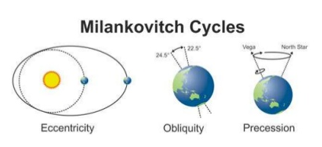
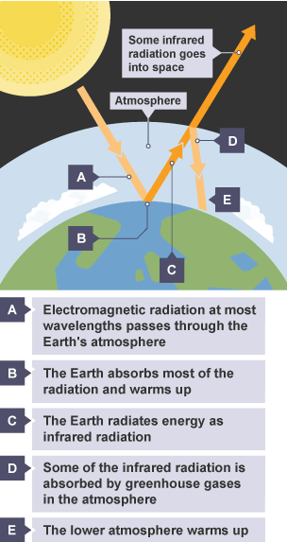
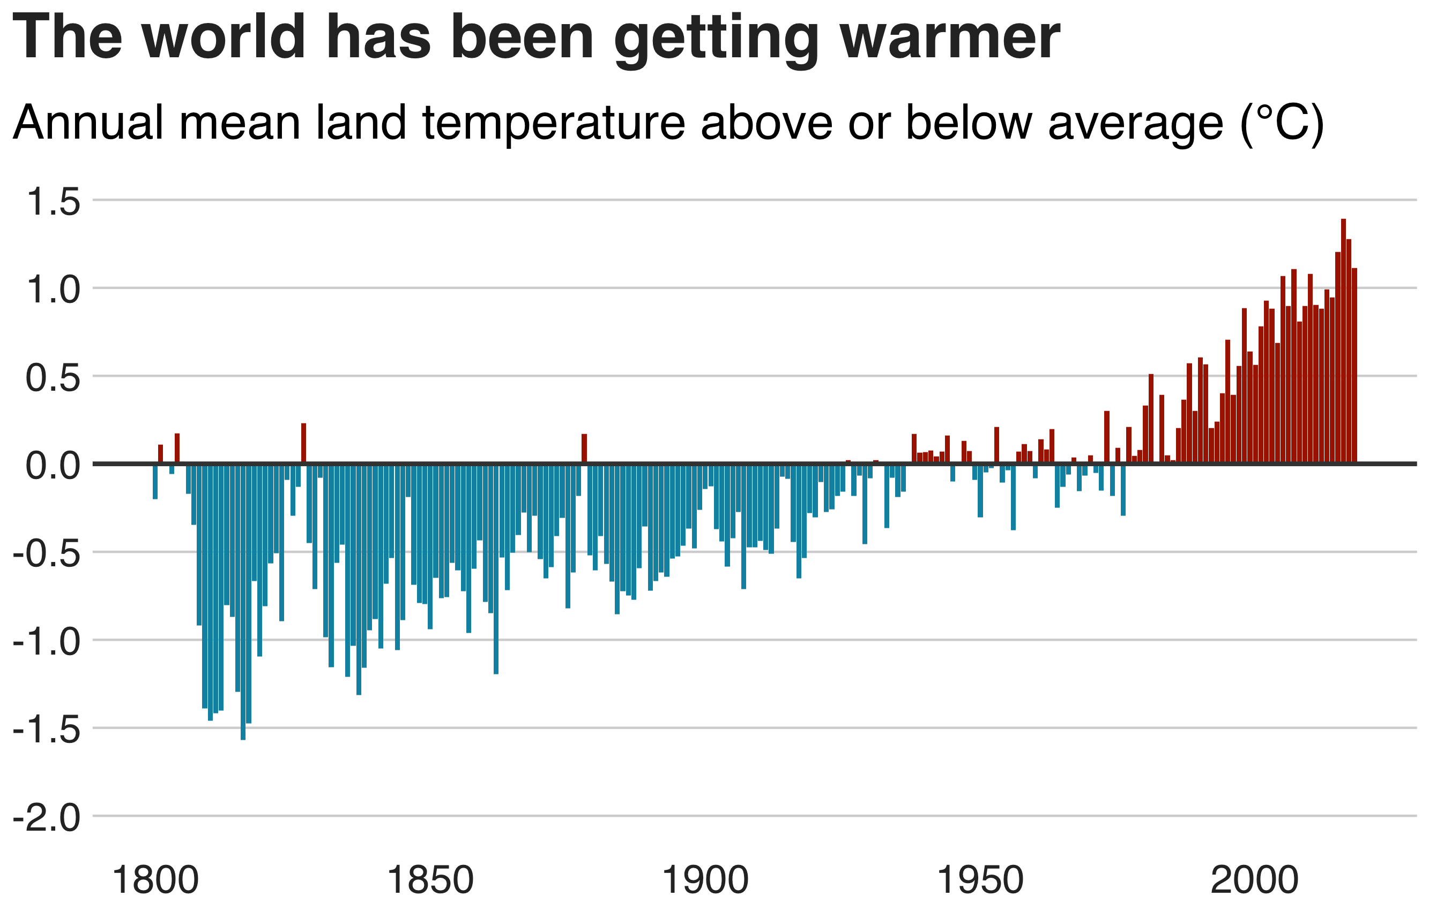
Climate Change Year 9 HT2
Evidence for Climate Change
Earth's climate has always changed over time. During the Quaternary Period (the last 2.6 million years), the climate has alternated between cold glacial periods (ice ages) and warmer interglacial periods. The most recent Ice Age ended approximately 10,000 years ago, allowing human civilisation to develop.
Ice cores contain trapped air bubbles that reveal past atmospheric conditions and greenhouse gas concentrations. Ocean sediment cores contain pollen and microscopic organisms that indicate past temperatures and vegetation. Tree rings show annual growth patterns linked to climate, while historical diaries, paintings and photographs provide evidence of changing landscapes such as shrinking glaciers.
Modern evidence shows that global temperatures have risen rapidly since the late nineteenth century. This is supported by temperature records, retreating glaciers, reductions in Arctic sea ice, rising sea levels and satellite observations using Geographic Information Systems (GIS).
Natural Causes of Climate Change
The Milankovitch Cycles explain long-term climate change over thousands of years. Changes in the shape of Earth's orbit (eccentricity) occur over around 100,000 years, altering the distance between Earth and the Sun. Changes in the tilt of Earth's axis (obliquity) occur approximately every 41,000 years, affecting the intensity of seasons. The Earth's wobble (precession) changes over around 26,000 years, altering the
Changes in solar activity, including periods of increased sunspots and solar flares, can temporarily increase the amount of solar radiation reaching Earth and contribute to short-term warming.
Large volcanic eruptions can cause temporary global cooling. Volcanic ash and dust reflect incoming solar radiation, while sulphur dioxide combines with water vapour to form tiny droplets of sulphuric acid that reflect sunlight back into space. This can lead to a volcanic winter, reducing global temperatures for several years.
Human Causes of Climate Change
The greenhouse effect is a natural process that keeps Earth's average temperature at around 15°C. Without greenhouse gases, the Earth's average temperature would be approximately −18°C, making life impossible.
Human activities have strengthened this natural greenhouse effect by increasing the concentration of greenhouse gases in the atmosphere. This is known as the enhanced greenhouse effect.
The main greenhouse gases are:
CO₂ – burning fossil fuel, car exhausts, deforestation and burning trees
CH₄ (methane) – livestock farming., rice farming, rotting waste in landfill sites
N₂O (nitrous oxide) – fertilisers and cement production, sewage treatment, car exhausts, electricity production
Short-wave solar radiation enters the atmosphere, but outgoing long-wave radiation is trapped by greenhouse gases, warming the planet. Historically, HICs have produced the most emissions, while many LICs contribute least but are most vulnerable.

Slide 5
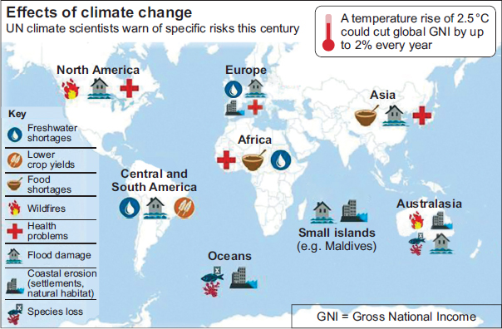
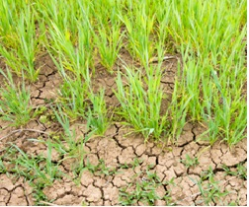
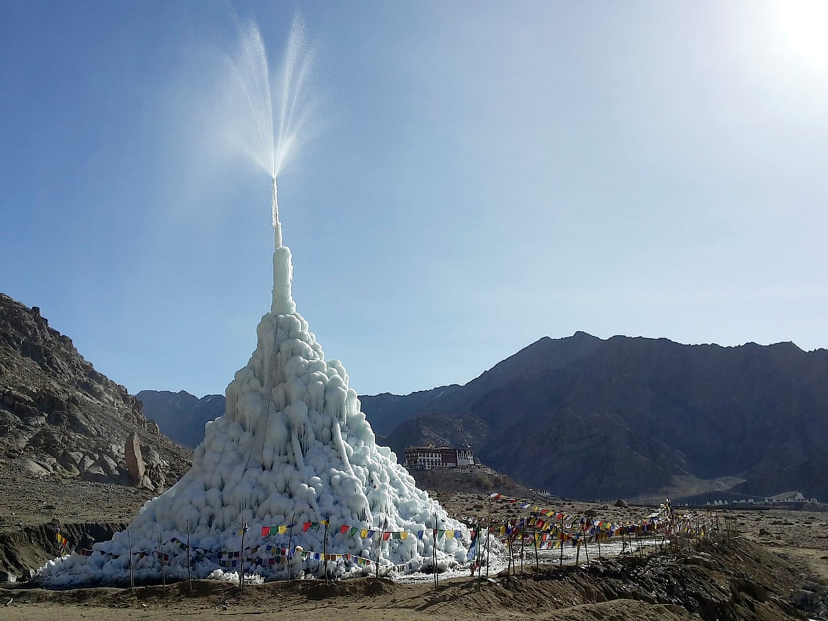
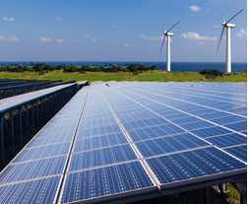
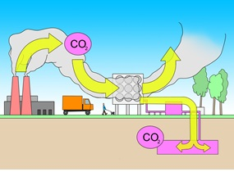
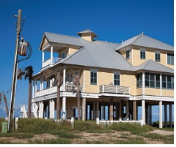
Climate Change Year 9 HT2
How can climate change be managed?
Mitigation aims to reduce the causes of climate change by lowering greenhouse gas emissions.
Using renewable energy such as solar, wind and hydroelectric power reduces reliance on fossil fuels and lowers carbon dioxide emissions. However, renewable energy is not suitable everywhere because it depends on local weather and physical geography.
Planting trees (Afforestation and reforestation) increase the number of trees, which absorb carbon dioxide through photosynthesis. However, trees store less carbon during winter when deciduous trees lose their leaves, and forests take many years to mature.
Carbon capture and storage (CCS) removes carbon dioxide from power stations and industries before it enters the atmosphere. The gas is stored underground in suitable rock formations. Although effective, CCS is expensive and can only be used where suitable geology exists.
International agreements encourage countries to reduce emissions. The Paris Agreement (2015) aims to limit global warming to well below 2°C, with efforts to keep it below 1.5°C. Annual COP (Conference of the Parties) meetings monitor progress, although agreements rely on countries meeting their commitments.
Effects of climate change on the environment and people:
Climate change is increasing global temperatures causing:
Environmental impacts include melting glaciers and ice sheets, rising sea levels, more frequent extreme weather, changing rainfall patterns, drought, wildfires and loss of biodiversity.
People are affected by flooding, food and water shortages, damage to homes and infrastructure, health risks from heatwaves, and climate migration.
The impacts are greatest in many lower-income countries (LICs), even though they contribute the least to greenhouse gas emissions.
How can climate change be managed?
Adaptation involves adjusting to the impacts of climate change.
Farmers in low-latitude regions (near the Equator) are adapting by growing drought-resistant crops, improving irrigation efficiency, water harvesting, planting trees to provide shade and changing planting dates (when seeds are planted) to match shifting rainfall patterns.
Water supplies are managed through improved irrigation systems, rainwater harvesting and the construction of artificial glaciers in the Himalayas. These artificial ice structures slowly melt during summer, providing water for farming when natural glaciers have retreated.
Low-lying coastal areas such as the Maldives face rising sea levels. Adaptation strategies include constructing sea defences, building houses on stilts and, in the long term, purchasing land in other countries, including Sri Lanka, as a possible future refuge if sea-level rise continues.
Adaptation reduces vulnerability to climate change but does not stop global warming. The effectiveness of each strategy depends on cost, local conditions and future climate change.
Examples to Know
Paris Agreement (2015) – global agreement to reduce emissions.
Artificial glaciers (Himalayas) – water supply adaptation.
Maldives – adapting to sea-level rise.
Essential Facts
Last Ice Age ended 10,000 years ago.
Greenhouse effect keeps Earth at 15°C.
CO₂, CH₄ and N₂O are the main greenhouse gases.
Mitigation = reduce causes. Adaptation = cope with impacts.

Slide 6
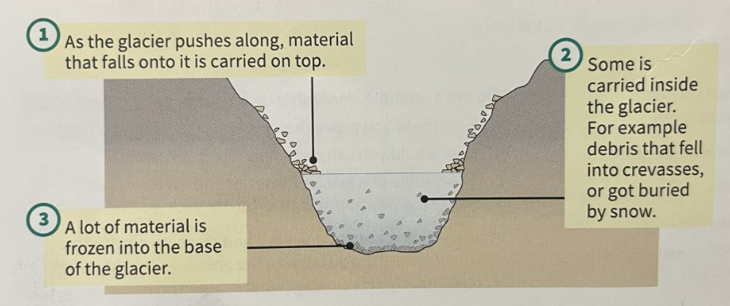
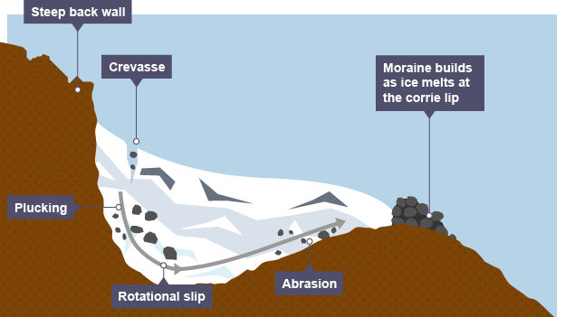
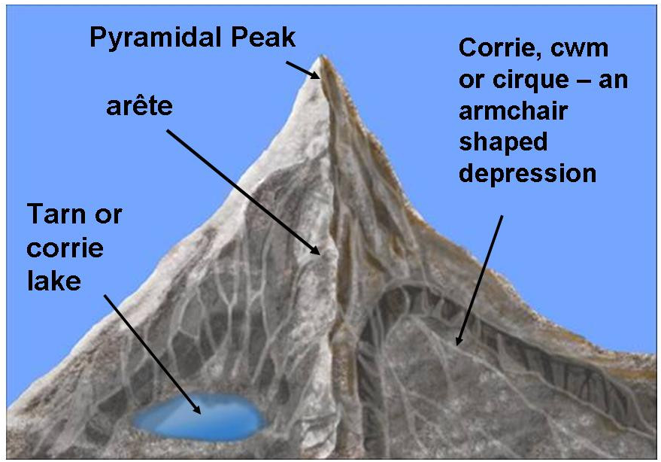
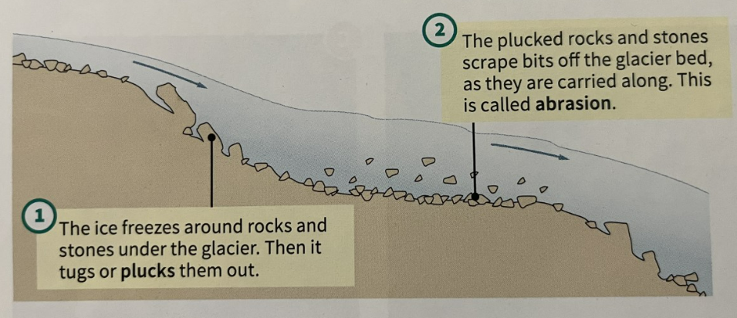
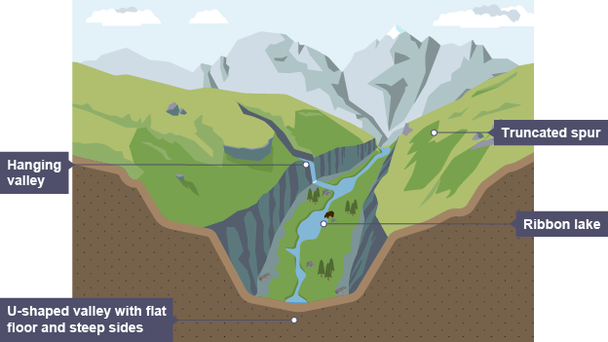
Glaciation Year 9 HT3
Subject Specific Tier 3 - Vocabulary
Ice age, tundra, glacier, glaciated, ice shelf, iceberg, crevasses, erosion, transportation, deposition, plucking, abrasion, freeze-thaw, corries, arêtes, pyramidal peaks, hanging valley, u-shaped valley, ribbon lake, till, terminal moraine, lateral moraine, ground moraine, erratics, drumlins
Ambitious Tier 2 – Vocabulary
Compacted, flow, spectacular, bulldoze, route
What and where are glaciers?
During the last ice age ice covered about a third of Earth’s land.
Glaciers are large masses of ice that flow across the land. Giant glaciers are called ice sheets.
Glaciers are found on every continent.
Antarctica and Greenland contain 99% of Earth’s ice.
Mountain or alpine glaciers are much smaller than ice sheets.
Glaciers depend on snow. They form when snow falls layer upon layer and become compacted into ice. It takes a layer of snow 10m thick to make 1m of ice. As the ice gets heavier it starts to flow.
Ice can flow inside a glacier because the ice crystals slide over each other, under pressure. The ice at the bottom of a glacier can melt due to the weight of the glacier causing the glacier to slide along on the melted water.
Mountain glaciers flow down the sides of mountains and eventually meet a place where they melt.
Ice sheets flow out to the thinnest parts. In Antarctica they flow into the oceans and form ice shelves.
How do glaciers shape the land?
As glaciers flow they scrape and shape the landscape like giant bulldozers.
Erosion Processes – abrasion and plucking
Transportation Processes
Deposition Processes
Till is the load in a glacier which has fallen to the floor. Water melting from ice is called melt water. It runs off to feed rivers and lakes.
Landforms shaped by erosion
Corries start as sheltered hollows that are deepened by abrasion and plucking. They can often have lakes in them called tarns.
Arêtes are a sharp ridge formed by two back-to-back corries.
Pyramidal Peaks are formed by three or four corries forming around a mountain top.
U-shaped valleys begin as v-shaped valleys that are bulldozed by a glacier and widened and deepened. They often contain misfit rivers.

Slide 7
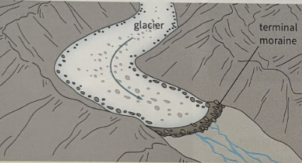
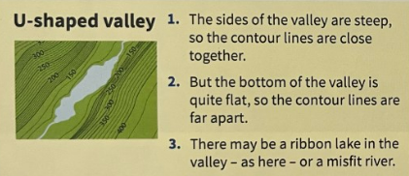
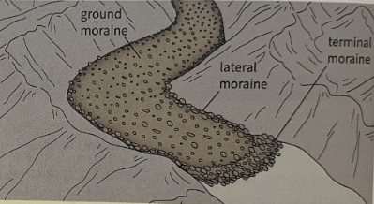
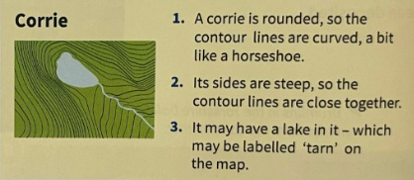
Glaciation Year 9 HT3
What was Europe like in the last ice age?
The last ice age began around 110,000 years ago. An ice sheet spread over much of northern Europe, and most of the British Isles.
The ice sheet did not cover the whole of Britain, but the areas that were not covered where tundra. The ground was deeply frozen and only the surface thawed in summer. There was limited vegetation and animal life (Woolly mammoth, bison, Arctic fox).
By 10 000 years ago, Earth had warmed up again. The ice age ended and the ice over Britain melted away.
During the ice age, water levels in the oceans were much lower than today (Up to 120m lower). This meant that Britain was connected the rest of Europe by land.
There was nobody in Britain 20 000 years ago. People had arrived there 40 000 years ago, but it became too cold. People returned to Britain
12 000 years ago.
Britain was cut off from Europe by rising sea levels 8 100 years ago.
Living in a glaciated landscape
Case study: The Lake District is in Cumbria, north west England. It is a national park.
Glaciation on OS maps:
On OS maps glaciated areas are often shown with contour lines that are very close together showing steep land. Contour lines help us to pick out landforms left behind by glaciers.
People in the Lake District earn money from the landscape through tourism, farming and forestry.
Landforms shaped by deposition
Different types of moraine:
Erratics are huge rocks that are dropped as the ice melts. They may be a long way from where they started.
Drumlins are low hills, shaped like the back of a spoon.
Careers linked to glaciated landscapes:
Glaciologist – A scientist who conducts tests to understand the movement and processes of glaciers and snow.
Ski-instructor – Someone who teaches skiing to large groups of people of similar ability or to individuals.
Mountain Rescue - teams of highly trained individuals who come to the aid of the injured, unwell, lost or missing in our mountain regions

Slide 8
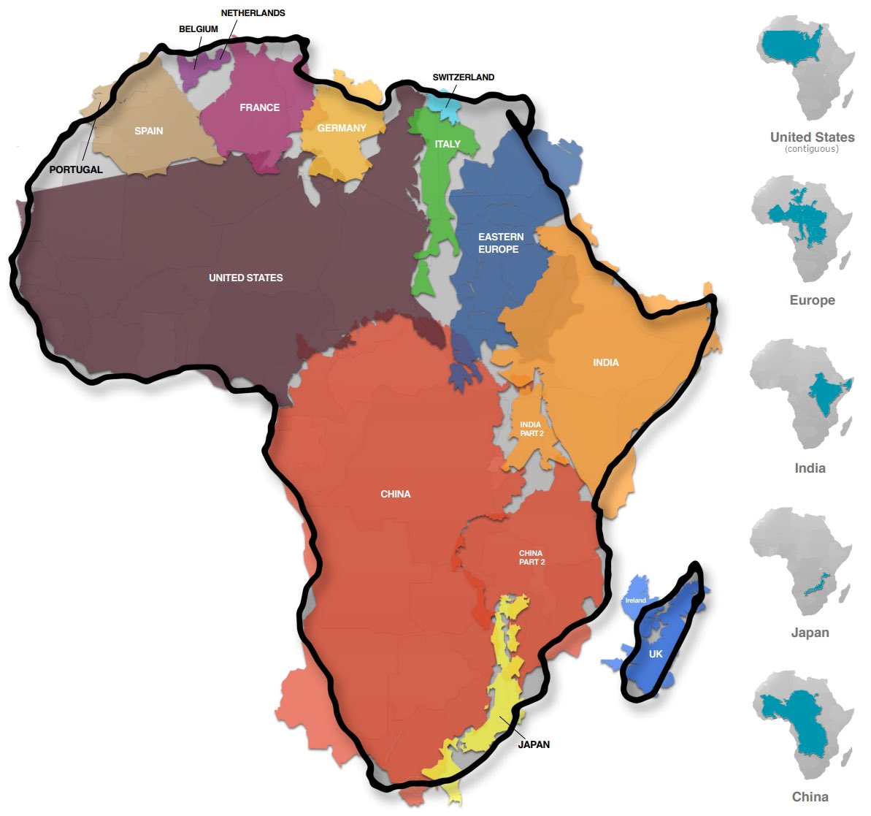
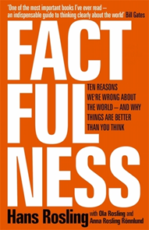
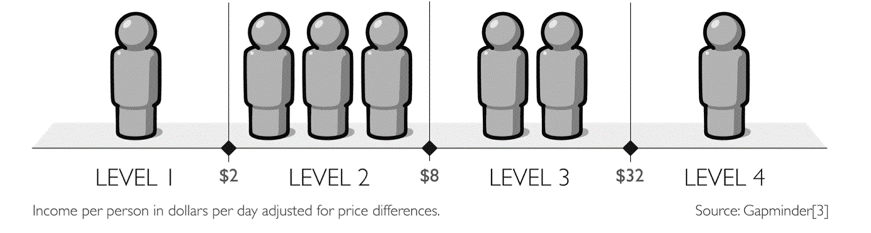
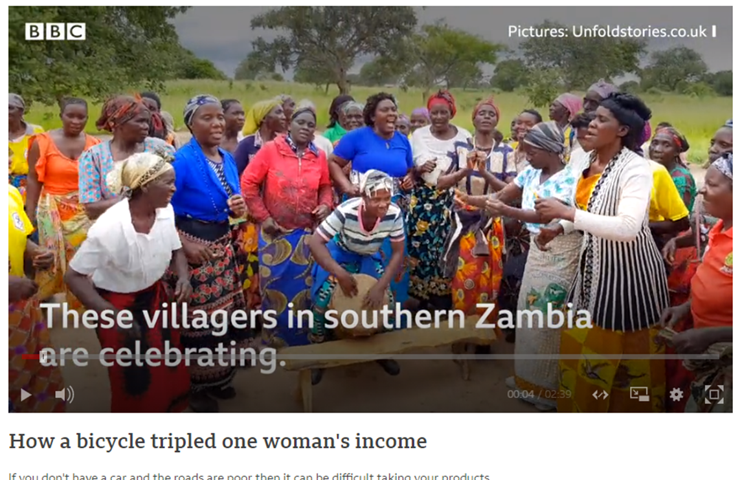
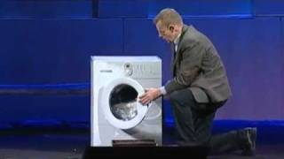
Factfulness: A view of development Year 9 HT4
How Do We See the World?
The way we view the world is influenced by the maps we use. Because the Earth is a sphere, flat maps distort the size of countries. Places near the poles appear much larger, while countries near the Equator appear smaller. This can affect our understanding of the world. For example, Africa is much larger than many people think and contains 54 countries. Our views of different places are also shaped by the media, which often focuses on particular stories and events.
How Do We Divide the World?
Describing the world as simply rich and poor does not reflect reality. A better way is to use Hans Rosling's four income levels, which show that countries develop gradually rather than fitting into two groups. One useful way of comparing countries is infant mortality (the number of babies who die before their first birthday per 1,000 live births). This indicator reflects access to healthcare, clean water, food, education and income, making it a good measure of development.
Life at Different Income Levels
People around the world have similar hopes of improving their lives. As incomes rise, families gain better access to housing, sanitation, education and healthcare. Even small improvements in income can increase life expectancy. Simple technologies, such as a bicycle, can make a big difference by helping children reach school, improving access to healthcare and allowing families to transport goods to sell.
Small Changes Can Make a Big Difference
Small increases in income can have a large impact on quality of life.
Owning a bicycle can transform peoples lives. They are able to carry more to market and get there quicker so they have more time to work on their farms. This can triple their income and allow them to move out of level
Items such as washing machines save time, allowing adults to work more and children to spend more time in education. Over time these changes improve health, education and future income. Geographers often use graphs and data to show how improvements in income lead to better living standards.
Hans Rosling in his book on Factfulness divides the world into four income levels:
Level 1: 1 billion people live on less than $1 per day. They walk bare foot and may sleep on the floor
Level 2: 3 billion people live on $2-8 per day. You will have shoes and maybe a bike. Your family sleeps on mattresses
Level 3: 2 billion people live on $8-32 per day. You may have a motorbike and your children finish school
Level 4: You spend more than $32 per day. You have a car and may be able to go on holiday once a year. You will have a high school education

Slide 9
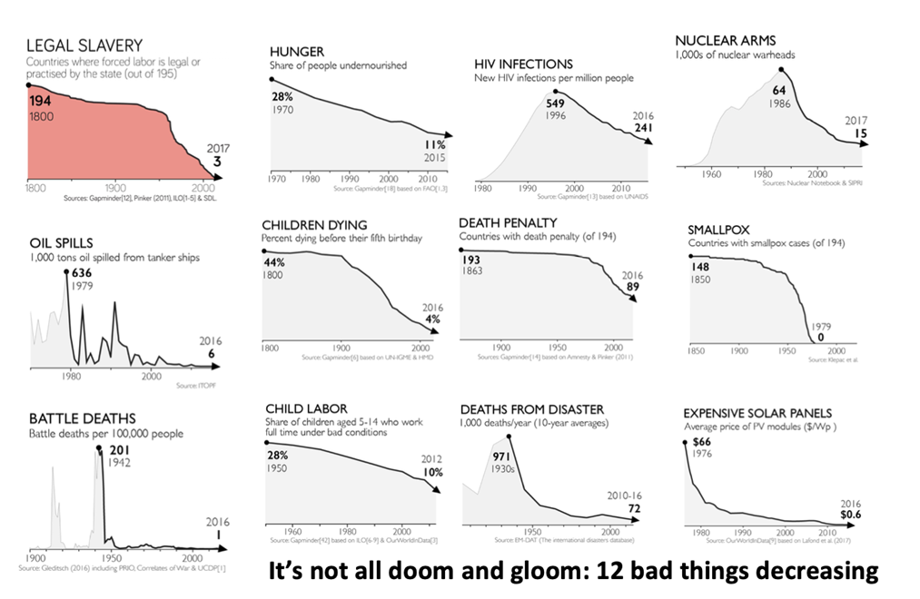
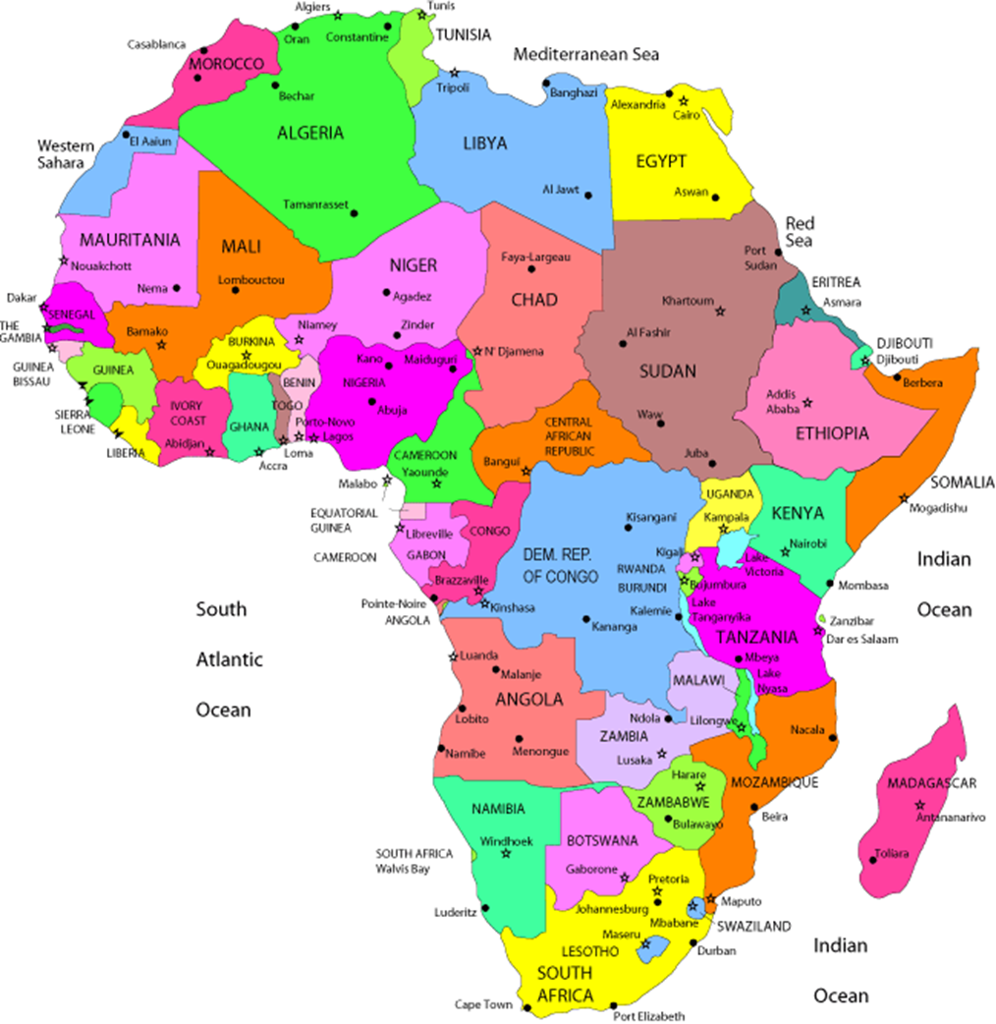
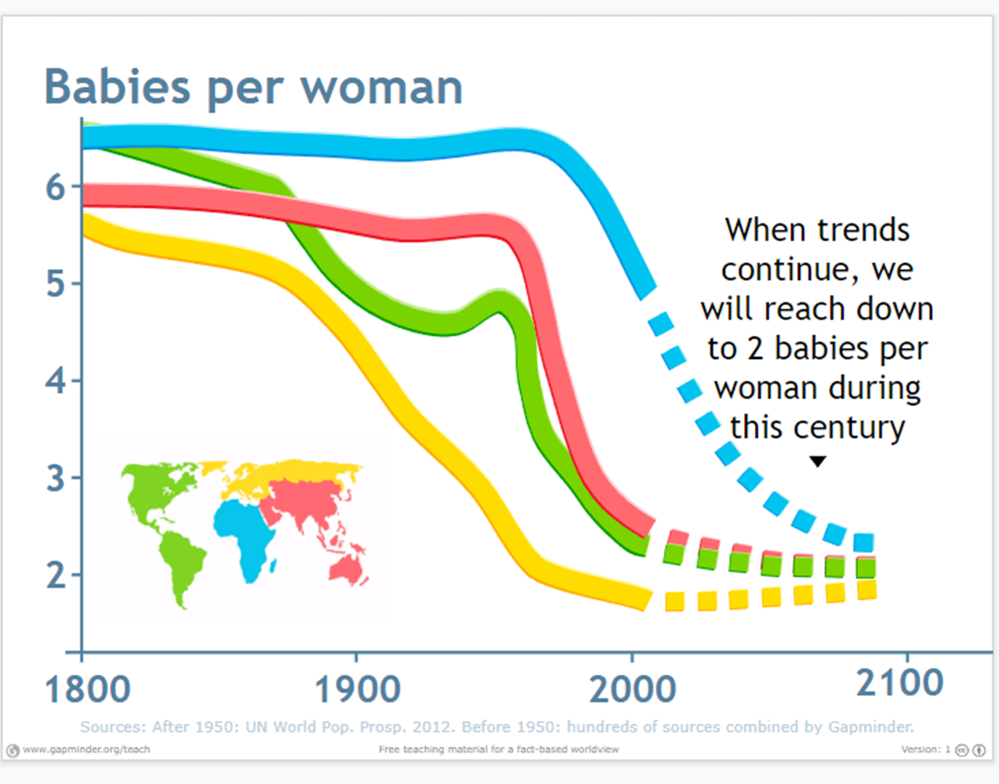

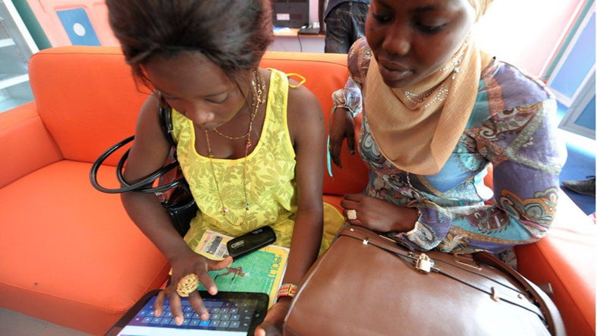
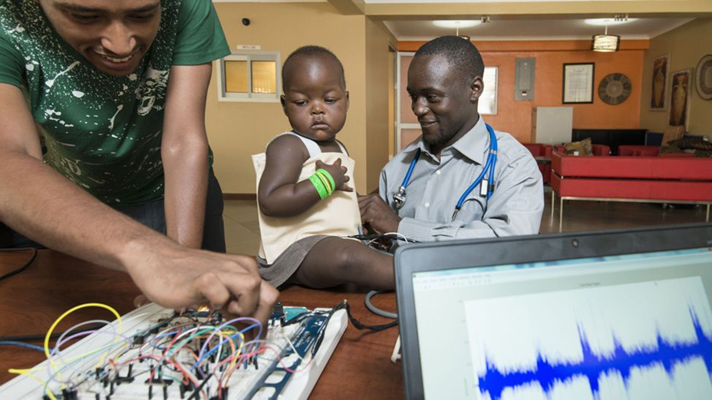
Factfulness: A view of development Year 9 HT4
The Problem with the 'Single Story’
No continent or country can be understood through one story. Africa is a diverse continent with many cultures, languages, economies and successful innovations.
However, people often only hear stories about poverty, conflict or disease. Writer Chimamanda Ngozi Adichie explains that a "single story" creates stereotypes and can lead to unfair assumptions. Geography encourages us to question these ideas by using evidence from a range of sources.
A stereotype is a widely held but fixed and oversimplified image or idea of a particular type of person or thing
It's Not All Doom and Gloom
The news often focuses on negative events, which can make the world seem worse than it really is. In reality, many global trends are improving. The cost of solar energy is falling, making clean energy more affordable.
Around the world, birth rates are decreasing as healthcare, education and living standards improve. These changes show that many countries are making progress, even though challenges still remain.
Africa is not a country.
It is the second-largest continent (covering 20% of the Earth’s land surface), with 54 countries and over 1.5 billion people (around one in every five people on Earth).
There is NO African language.
There is NO African flag
Africa is larger than the USA, China, India and most of Europe combined, but many world maps make it appear much smaller than it really is.
Africa is the most linguistically diverse continent in the world, with over 2,000 living languages. Nigeria alone has more than 500 languages, making it one of the most linguistically diverse countries on Earth.
A quote from the book to help us.
“As billions of people left extreme poverty, most of them decided to have fewer children. They no longer needed large families for child labour on the small family farm. And they no longer needed extra children as insurance against child mortality. Women and men got educated and started to want better-educated and better-fed children: and having fewer of them was the obvious solution.”
A currency that pays online workers
A jacket that detects pneumonia

Slide 10
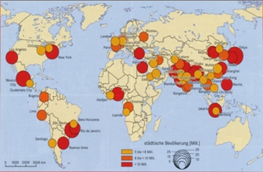
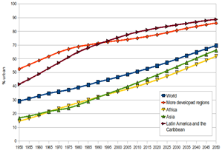
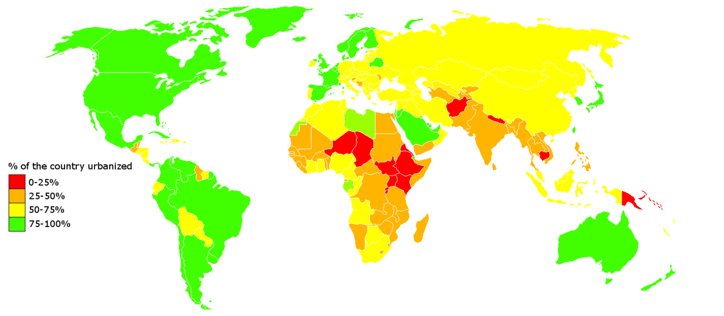
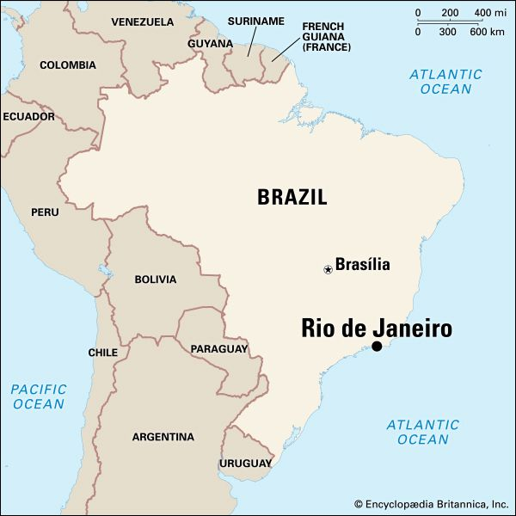
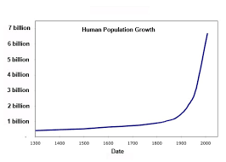
Urban World – Rio de Janeiro Year 9 HT5
What is Urbanisation?
This is the proportion of people living in urban areas such as towns or cities. In 2007, the UN announced that for the first time, more than 50 % of the world’s population live in urban areas.
Where is urbanisation happening? Urbanisation is happening all over the world but in LICs and NEEs rates are much faster than HICs. This is mostly because of the rapid economic growth they are experiencing. The worlds population is increasing. Since 1900 this growth has been exponential (doubling)
Types of Cities
Megacity | An urban area which over 10 million people living there.
 |  | More than two thirds of current megacities are located in either NEEs and LICs. Projections estimate there will be between 37 and 66 megacities globally by 2050
There are three types of megacities:
Slow Growing: No squatter settlements e.g. Tokyo (often in HIC’s)
Growing: Under 20% squatter settlements e.g. Rio de Janeiro (Often in NEE’s)
Rapid growing: Over 20% squatter settlements. e.g. Mumbai (Often in LICs and NEE)
Causes of Urbanisation
Rural - urban migration (1) | The movement of people from rural to urban areas.
Push Factors |  | Pull Factors
Natural disasters War and Conflict Mechanisation Drought Lack of employment |  | More Jobs Better education & healthcare Increased quality of life. Following family members.
Natural Increase (2) | When the birth rate exceeds the death rate.
Increase in birth rate (BR) |  | Lower death rate (DR)
High percentage of population are child-bearing age which leads to high fertility rate. Lack of contraception or education about family planning. |  | Higher life expectancy due to better living conditions and diet. Improved medical facilities helps lower infant mortality rate.
Urban population is growing more quickly in less developed regions than in the more developed.
The largest growth in urban areas will take place in China and Nigeria. These are examples of NEE’s (newly emerging economies)

Slide 11
Urban World – Rio de Janeiro Year 9 HT5
Location and Background
Rio de Janeiro is a coastal city situated in the South East region of Brazil (NEE) within the continent of South America. It is the second most populated city in the country (6.5 million) after Sao Paulo.
City’s Opportunities
Social: Standards of living are gradually improving. The Rio Carnival is an important cultural event for traditional dancing and music.
Economic: Rio has one of the highest incomes per person in the country. The city has various types of employment including oil, retail and manufacturing.
Environmental: The hosting of the major sporting events encouraged more investment in sewage works and public transport systems.
Economic Challenges and solutions
Economic opportunities have lead to the growth of the formal economy (tax paid, holiday and sick pay)
Rio provides more than 6% of Brazils employment and large companies are attracted to Rio.
Jobs in the formal economy are mainly in public services with other areas in construction and finance.
There is a large informal economy in the favelas and few people pay tax.
Challenges are:
Unemployment is high in many favelas its over 20%. The solution is the schools of tomorrow which offer training to school leavers.
Crime is another challenge with powerful drug gangs in the favelas. The solution is the Pacifying police force who have reclaimed the favelas from the gangs
Rio’s Importance
It has the second largest GDP in Brazil It is headquarters to many of Brazil’s main companies, particularly with oil and gas.
Sugar Loaf mountain is one of the seven wonders of the world.
One of the most visited places in the Southern Hemisphere.
Hosted the 2014 World Cup and 2016 Summer Olympics.
Social Challenges and Solutions
Health:
CH: Life expectancy in the favelas is 45 and 80 in the rich areas. Infant mortality is higher in the favelas.
SL: Health visitors go into homes to check for 20 diseases
Education:
CH: Only 50% of children continue education beyond 14. Shortage of teachers. Parents need children to work.
SL: Grants to poor families and new private University in Rochina.
Water Supply
CH: 12% of Rio had no running water. 37% water lost through leaks. Frequent droughts.
SL: 300km of new pipes, by 2014 only 5% with no water supply.
Energy
CH: Frequent power cuts, poor people in the Favelas tap into electricity illegally.
SL: 60km of new wires, new Nuclear power plant. $2billion spent on new HEP plant
Migration to Rio De Janeiro
The city began when Portuguese settlers with slaves arrived in 1502.
Rio is now home to various ethnic groups. More recently, millions of people have migrated from rural areas. People do this to search for a better quality of life.
This expanding population has resulted in the rapid urbanisation of Rio de Janeiro.
Environmental challenges:
Air pollution and traffic congestion There are around 5000 deaths from air pollution. Building new roads due to the steep hillsides is difficult and there is congestion . To solve this they have expanded the Metro system. Water pollution Guanabara Bay is heavily polluted. Many rivers are open sewers. The solution is 12 new sewage works. Waste Pollution many favelas are on steep slopes with no waste collection, The solution is a power plant the burns 30 tonnes of rubbish a day.
Managing the Favelas and the urban poor
As the favelas have grown there are many challenges Crime, health, services, construction and unemployment.
The Favela Barrio Project is a Site and service scheme. It is an area in the north zone. Roads were paved, improved sanitation, a cable car and the pacifying police all helped to improve quality of life for the urban poor.
A success is that quality of life and employment has improved. A problem is that residents don’t have the skills to keep on top of repairs to the cable car and their homes.

Slide 12
Sustainable Urban Living Year 9 HT6
Problems encountered in cities:
Overcrowding
Buildings competing for space
Huge electricity consumption
Demands on water and other resources
Waste disposal
Traffic congestion
Examples of sustainable urban strategies:
Providing green spaces
Recycling water to conserve supply
Reducing reliance on fossil fuels by rethinking transport options
Conserving cultural, historical and environmental sites and buildings
Minimising the use of greenfield sites by using brownfield sites instead
Involving local communities and providing a range of employment
Keeping waste within the capacity of rivers and oceans.
Key terms:
Sustainable – meeting the needs of the present without reducing the ability of future generations to meet their needs.
Brownfield site – land that has been used, abandoned and now awaits reuse.
Greenfield site – A plot of land, often in a rural area that has not been built on before.
Frieburg – An example of a city planning for urban sustainability
The German city of Freiburg set itself the goal of sustainability in 1970
Freiburg is a city in the south-west of Germany, close to the border of France and Switzerland
Freiburg’s sustainable approach considers the environment, but also the social and economic effects of sustainability on its citizens.
Social planning in Freiburg (taking into account people’s needs):
Local people are involved in urban planning at the local and city level.
Local people can invest in renewable energy resources.
In addition to financial returns investors in renewable energy receive free football season tickets.
Financial rewards are given to people who compost their green waste and use reusable nappies.
Economic planning in Freiburg (involves providing people with employment):
Jobs for local people provided by –
  Conferences on sustainability
  Research and manufacture of solar technology
Example:
Freiburg’s solar valley employs more than 1000 people. The solar training centre employs 250 people. Many solar institutions have their HQs in Freiburg. The city hosts solar conferences.
Environmental planning in Freiburg
Ensures that resources are not wasted and the environment is protected. A key strategy is reducing the amount of waste produced.
In Freiburg:
More than 1 million corks are recycled per year.
More than 88% of packaging waste is recycled.
Annual waste disposal has been reduced from 200,000 tonnes to 50,000 tonnes in jut 12 years.

Slide 13
Sustainable Urban Living Year 9 HT6
Water supply:
Sustainable water supply depends on individuals using as little water as possible. This involves collecting and recycling water rather than taking water from reservoirs.
Homes need to have roof gardens with facilities for rainwater harvesting and wastewater recycling.
Groundwater has to be protected from pollution as it is an important source of drinking water.
What are they doing in Freiburg?
Freiburg’s waste water system allows rainwater to be retained, reused or to seep back into the ground.
There are financial incentives for inhabitants to use water sparingly.
In Vauban District water conservation includes; collecting rainwater for use indoors, green roofs, pervious pavements that allow rainwater to soak through, unpaved tramways and drainage wetlands.
Water in the River Dreisam is managed using flood retention basins. These store excess water to prevent flooding. The water is then used in the cities.
Energy conservation:
Cities make great demands on energy supply. Burning fossil fuels has provided most of this energy before now. Pollution and climate change mean that finding a sustainable energy supply is increasingly important.
What are they doing in Freiburg?
Freiburg has a strict energy policy based on:
Energy saving
Efficient technology
Use of renewable energy sources
The city plans to be 100% powered by renewable energy sources by 2050. It is one of the sunniest cities in Germany, so solar power is an important form of renewable energy. There are about 400 solar panel installations in the city, including the main train station and the football stadium.
Creating green spaces:
Provision of green spaces contributes to sustainability in economic and environmental terms.
They serve as the city’s green lungs and help to keep the air clean.
Soil is protected and prevents run off of water in heavy rainfall.
Green spaces provide free recreation and habitats for wildlife.
What are they doing in Freiburg?
44,000 trees have been planted in parks and streets.
40% of the city is forested.
In the Risenfeld District only 78 hectares are built on, leaving 240 hectares of open space.
44% of wood from the cities forests is used for timber but 75% grows back within a year.
Waste recycling in Freiburg:
Each household is provided with three bins, one for paper, one for organic waste and garden waste and one for non-recyclable material. They also have a yellow sack for packaging. The biobin is collected once a week, the others every two weeks
There are three permanent recycling yards in the city. Freiburg recycles 70% of its total waste. Recycled paper is used in school exercise books and disposable drinks containers are banned.

Slide 14
Sustainable Urban Living Year 9 HT6
How can urban transport strategies reduce traffic congestion?
Why is there a need to reduce traffic congestion?
Traffic congestion can lead to air pollution. There are also negative economic effects of increased journey times, higher fuel consumption and greater risk of accidents.
Freiburg:
The city has an integrated traffic system which is updated every ten years. It is based around the tram system which provides efficient, cheap and accessible public transport.
What has Freiburg done?
Created the ITS.
Built 400km of cycle paths with 9000 parking spaces for bikes including ‘bike and ride’ facilities at railway and bus stations.
Placed restrictions on car parking spaces; in Vauban district a parking space costs £20,000.
Lowered fares on the trams allowing unlimited travel around the city.
Given free tram tickets with concert, sports and other events in the city.
What has the impact been?
Freiburg has a low car density with less than 500 cars per 1000 residents. Tram journeys have increased by 25,000 per year.
Beijing:
Beijing has an estimated 5 million cars. The city centre is often gridlocked. Congestion is predicted to get worse.
What has Beijing done?
Limited car sales – only 20% of people who apply to own a car are successful.
Restricted vehicle use – cars are banned from the city for one day a week based on a number plate system.
Increased parking fees – Congestion charge and pollution tax have been introduced.
Expansion of the public transport system – 30 new metro lines and a rapid bus transit system are to be built by 2020.
What has the impact been?
There has been a 20% drop in car use.
There has been a 12% drop in the use of car parks in the city centre.
BUT building and widening of roads has resulted in increased car use at the expense of cycling.
Singapore:
Singapore is a small island with limited space, making traffic congestion a real problem.
What has Singapore done?
Restricted entry to the city centre during rush hour.
Introduced a quote system to reduce the number of car owners.
Increased petrol prices.
Financial incentives for using cars only at the weekend.
Advanced electronic monitoring and control of traffic signals to keep traffic flowing.
Development of an overhead railway system and efficient bus network.
What has the impact been?
45% less traffic and 25% fewer accidents in the city centre.
Traffic in the city centre has reduced by 40%.
Car ownership has declined by 1%.

