Slide 1
Geography Knowledge Organisers
Year 8

Slide 2
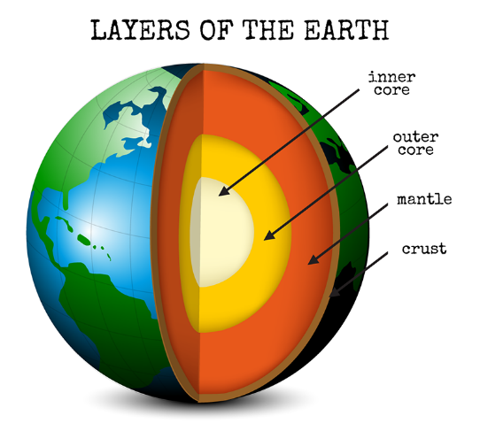
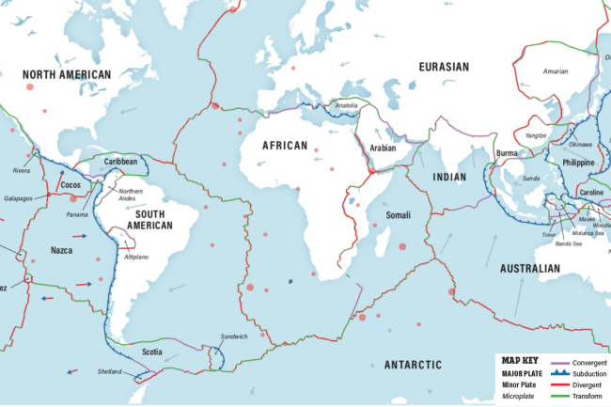
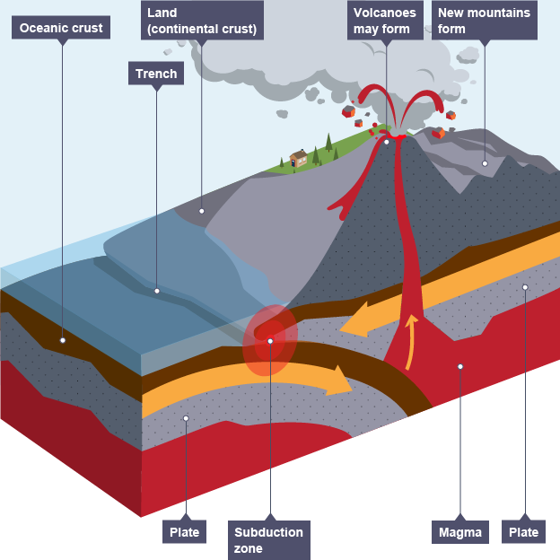
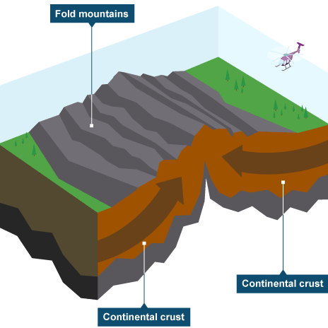
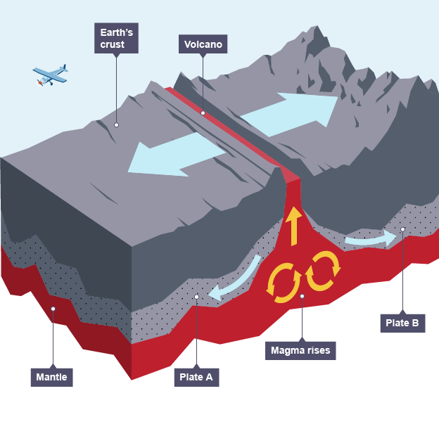
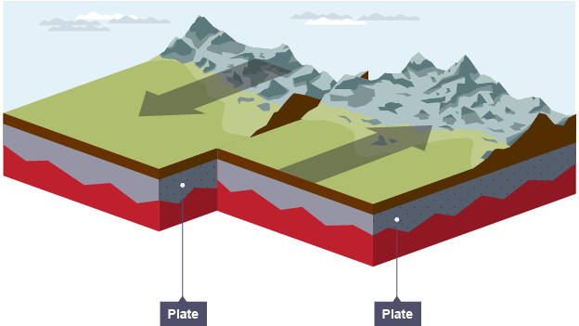
Restless Earth Year 8 HT1
Key Words:
Mantle
Inner and Outer Core
Oceanic crust
Continental crust
Pacific Ring of Fire
Earthquake
Volcano
Tsunami
Effects
Seismic
Tectonics
Constructive margin
Destructive margin
Conservative margin
Collision margin
Structure of the Earth
The inner core is extremely hot (5,500ºC) it is a very dense solid made from iron and nickel
The outer core is 2,000 km think and is a liquid
The mantle is semi-molten and about 3,000km thick, The closer the mantle is to the core, the more liquid it is.
The crust is the rocky outer later which we live. It is thin compared to other sections and made up of oceanic and continental plates
Plate Margins
The Earth’s crust is broken into different plates, which sit on the Earth’s mantle. These plates move because of convection currents. The plates move in different directions and meet at plate margins. As the plates move, parts of the curst are destroyed and in other areas new crust is created.
Oceanic plates carry the oceans. They are thinner but denser than continental plates.
Continental plates carry the land. They are thicker but less dense than oceanic plates.
Destructive
Constructive
Conservative
Destructive
Movement: The plates collide and the oceanic plate is subducted (sinks) under the continental plate.
Example: The Nazca plate is being forced under the South America plate.
Landforms and Hazards: Volcanoes, fold mountains and oceanic trenches are formed. Earthquakes
Collision (Destructive)
Movement: The two continental plates collide
Example: The Indo-Australian plate and Eurasian plate creating the Himalayas
Landforms and Hazards: Earthquakes
Constructive
Movement: The plates move apart
Example: The North American and Eurasian plate are pulling apart creating the Mid Atlantic Ridge
Landforms and Hazards: Volcanoes and Earthquakes
Conservative
Movement: The plates move alongside each other
Example: The North American and Pacific plate
Landforms and Hazards: Earthquakes

Slide 3
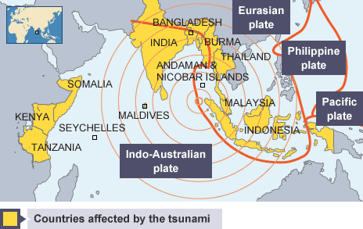
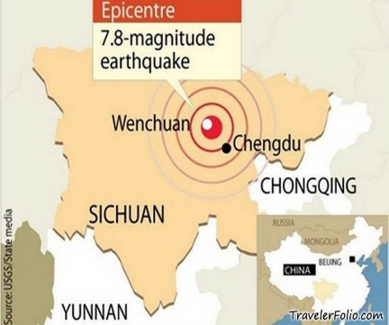
Restless Earth Year 8 HT1
Large earthquakes are usually connected with plate margins. Earthquakes happen often but most are too small for us to notice. Seismometers record earth movements.
An earthquake is a sudden shockwave caused by rocks being under stress from the movements of plates at plate margins. Eventually the stress in the rock builds up enough to deform and reach breaking point. At that point, the stored up energy is released in the form of shockwaves.
Largest Earthquakes by Magnitude
1960 Chile 9.4-9.6
1964 Alaska 9.2
2004 Indonesia 9.1-9.3
2011 Japan 9.1
1952 Russia 9.0
Measuring Earthquakes
In the past, the Richter scale was used to measure the power of earthquakes. Earthquakes are now measured using the Moment Magnitude Scale (or simply Magnitude scale). This measures the size of the seismic waves during the earthquake. Each step in the scale is ten times greater than the previous number. This is a logarithmic scale from 0-10.
The amount of damage caused by an earthquake is measured by the Mercalli Scale. This is a measure of intensity, and changes according to which area you are measuring - damage nearer the epicentre would usually be greater than further away.
Case study: Boxing Day Tsunami of 2004
Main impacts
Over 230,000 people died.
2 million people were made homeless.
People were swept away in the waters,
which arrived rapidly and with little warning.
13 countries were affected, the worst being Indonesia.
Indonesia was hit by the tsunami first. 45 minutes later the tsunami reached Thailand.
Short-term aid, such as water purification tablets, temporary housing and medical supplies were given from international countries.
In 2008 an early warning system in the Indian Ocean has been set up to detect future tsunamis.
Case Study: The Sichuan Earthquake of 2008
Main impacts:
87, 150 people killed – most trapped under rubble from collapsed buildings
370,000 people were injured
4.8 million people left homeless
5 million buildings collapsed, including schools and hospitals
Some areas were cut off by landslides
80% of buildings in Beichuan were destroyed
$137.5 billion spent on rebuilding the affected areas
Buildings have been rebuilt using stricter building codes
Effects of an Earthquake
 | Social Impacts | Economic Impacts | Environmental impacts
Short Term: | Infrastructure may be disrupted. Water supplies may be contaminated. | Shops and business may be destroyed. Looting may take place. | The landscape may be destroyed. Tsunamis may cause flooding in coastal areas
Long Term: | Disease may spread. People may have to be re-housed, sometimes in refugee camps | Rebuilding can be expensive. Income could be lost | Important natural and human landmarks may be lost.
How to reduce risk from earthquakes:
Prediction
Prediction involves using seismometers to monitor earth tremors. Experts know where earthquakes are likely to happen. However, it is very difficult to predict when they will happen.
Protection
Protection involves constructing buildings so that they are safe to live in and will not collapse.
Preparation
In earthquake-prone countries, hospitals, emergency services and residents practise for an earthquake. They have drills in all public buildings so that people know what to do in the event of an earthquake. This helps to reduce the impact and increases their chance of survival.

Slide 4
Living Off the Earth’s Resources Year 8 HT2
What are natural resources?
A natural resource is something which occurs naturally – without any help from us – and which we can make use of. Like water, soil, wind, sunlight, coal and oil.
Some resources are renewable, which means we can keep on using it and it won’t run out (for example sunlight).
Some resources are non-renewable, which means that it forms slowly, and we are using it faster than it is forming (like oil).
Resources are not shared equally across the world.
How can we tackle water scarcity?
By 2050 global water demand is projected to soar by 20% to 25%, leaving up to 5 billion people and 60% of the world's population facing severe water stress
There are solutions to this:
Using water more wisely – by watering crops only when needed, or by using less water in the bath at home.
Bring in water from other places – For example China’s water transfer schemes.
By using salt water – using desalinisation techniques, you can remove salt from water to make it save for humans to drink.
Is there enough water?
97% of the water on our planet is salty water.
3% of the water on our planet is fresh water, of which less that 1% is fresh water that we can use.
Fresh water is not equally shared across the planet. It is scarce in some places, and plentiful in others.
Some areas have physical water scarcity, where there just isn’t enough water to meet everyone’s needs. This might be because of over population or low rainfall. This often occurs in desert nations.
Some areas have economic water scarcity, where people cannot access water because of poverty. These areas can’t afford the infrastructure to bring fresh water to everyone.
What is happening to the Ogallala Aquifer?
The Ogallala is one of the world’s largest aquifers. It lies beneath the Great Plains, from Canada down the middle of the USA. It covers around eight states.
Problem: There is unreliable rainfall in the Ogallala region and so the aquifer refills slowly. Despite this, thousands of litres of water are pumped out of the aquifer per day. As a result, the water level is falling. Some places in the Ogallala region have just 20 years supply of water left at current pumping rates. Even if farmers limit the amount that they pump it will take hundreds of years for the aquifer to refill. Many parts of the Ogallala are going to run dry. Farmers will have to rely on the unreliable rainfall.
Impact: As a result, locally farming communities are going to collapse. Nationally the area is described as the breadbasket of the USA. This could result in a shortage of wheat and corn crops for the USA. Globally, the USA export large amounts of the produce from this region. This could increase the prices for these products
Key Vocabulary: Desertification, Groundwater, Aquifer, Economic water scarcity, Soil erosion, Non-renewable resources Renewable resources, Fossil fuels, Drought, Extinction, Irrigate,
Ambitious vocabulary: Desalinisation, micro dosing, mitigation, infrastructure

Slide 5
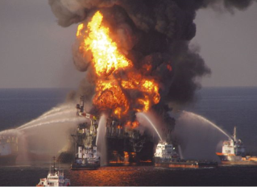
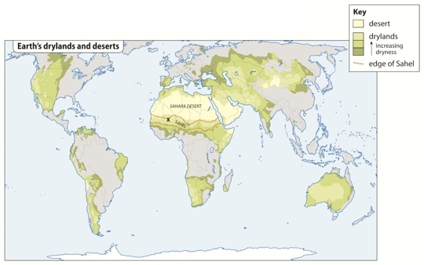
Living Off the Earth’s Resources Year 8 HT2
What is happening to the Earth’s soil?
Soil provides nutrients that plants need, it also provide them with water and oxygen.
Soil is not shared equally across the Earth’s surface. It depends upon the type of rock in a place, the climate and relief.
Earth only has a limited amount of land that is suitable for crops.
What is happening with the world’s oil?
Oil forms from tiny sea creatures which die, get buried in sediment and, after being exposed to heat and pressure, turn into oil. Humans then extract the oil from the sea bed, or from underground.
Oil is used for transport, heating, electricity and to create medicines and plastic.
Oil is harmful to the environment. When you burn it, it produces
greenhouse gases which cause global warming. It also produces
Sulphur dioxide which causes acid rain.
Oil spills harm the environment.
How do we damage our soil?
Our population is growing, but the amount of fertile soil is shrinking. Why is this?
We bury soil under concrete.
We contaminate it with dust and fumes from factories.
We cut down the trees that protect it.
We let too many animals graze on it.
We grow overgraze and use too much fertiliser on it.
Soil erosion is a product of these actions. This is when the fertile top soil is carried away by wind or water. It can lead to desertification.
Is renewable energy the future?
There are a number of types of renewable energy.
Biomass
Hydro-electric Power
Wind farms
Solar power uses solar cells to change sunlight into electrical energy. It is particularly valuable in poor countries, where access to other forms of power might be difficult.
Wave power
Tidal power
Solar farms
What are the solution to desertification?
In the Sahel, farmers have developed methods for fighting desertification.
Planting trees and bushes
Storing rainwater when it falls
Scientists are also
working to develop
new crop breeds
that will grow
more effectively on
poor soil, or in
drought.
Digging Zai Pits
Microdosing
How do we affect other species?
There are 1.7 million other known species on our planet. Scientists think at least 10 species become extinct each week. Some scientists believe humans are causing a mass extinction through deforestation, pollution, hunting, fishing and burning fossil fuels.

Slide 6
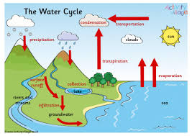
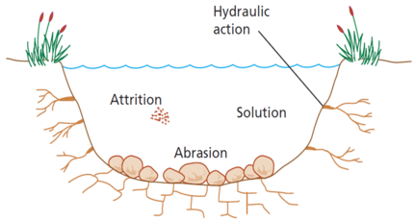
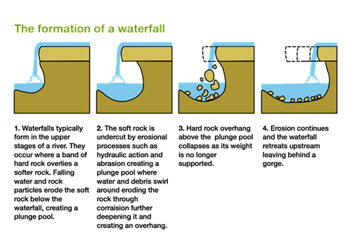
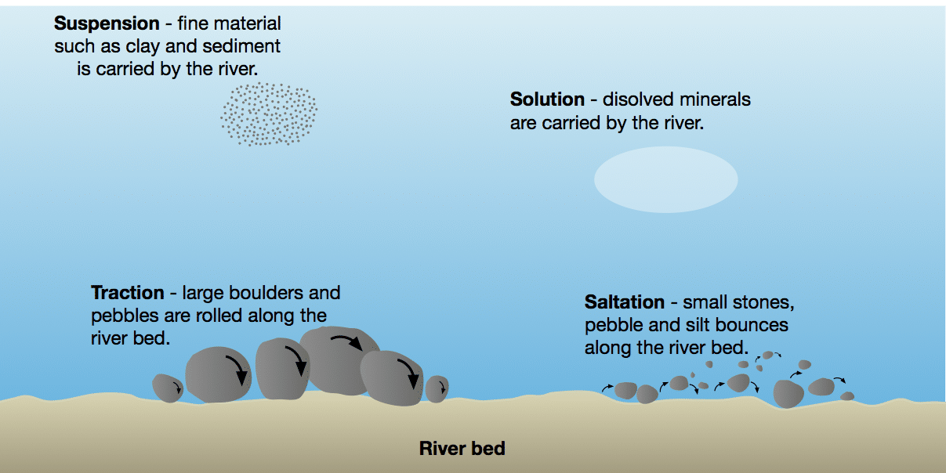
Rivers Year 8 HT3
Key Words:
Erosion
Hydraulic action
Transportation
Deposition
Waterfall
Meander
Source
Mouth
Precipitation
Upper course
Middle course
Lower course
Abrasion
Infiltration
Erosion Processes
Hydraulic Action: The force of fast-moving water crashes against the river banks and bed, breaking rock apart.
Abrasion: Rocks and pebbles carried by the river scrape and wear away the river bed and banks, like sandpaper.
Attrition: Rocks carried by the river collide with each other, breaking into smaller, smoother and rounder pieces.
Solution: Slightly acidic water dissolves soluble rocks, such as limestone, carrying them away in the water.
All the water that has ever been on our planet is still here. It moves through the land the water and the atmosphere and it can be a solid in ice, a liquid in rivers and sea and a gas as it is evaporated.
Transportation Processes
Traction: Large rocks and boulders are rolled along the seabed by powerful waves.
Saltation: Small pebbles are lifted and bounced along the riverbed by the movement of the waves.
Suspension: Fine materials, such as sand and silt, are carried within the water.
Solution: Rocks dissolve in water are carried in solution.
Deposition: Occurs when the river loses energy and drops sediment.

Slide 7
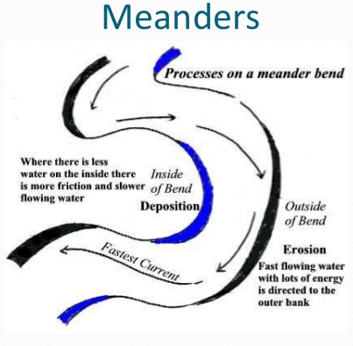
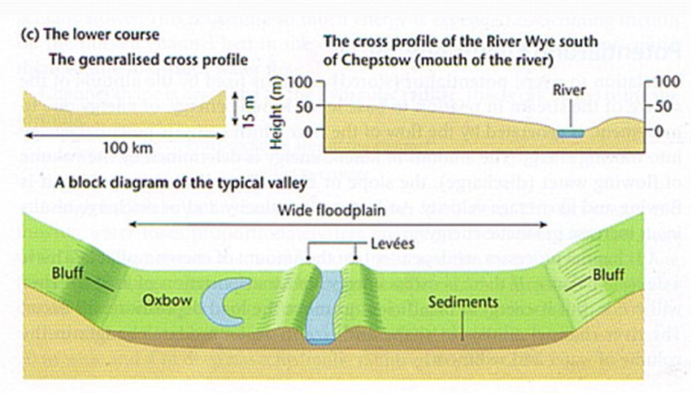
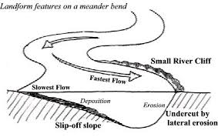
Rivers Year 8 HT3
The middle course of a river is characterised by both erosion and deposition
The lower course of the river is characterised by deposition. As the river reaches the sea the flow is slowed.
Northwich Floods (Storm Christoph, 2021)
Why did Northwich flood?
Heavy rainfall
Saturated ground
Confluence (meeting point) of the Rivers Weaver and Dane
Surface water built up
Drains couldn't empty into rivers
Pumps overwhelmed
Impacts
Roads closed, Shops flooded, Buildings damaged
People evacuated. Emergency rescue
Flood Defences: Northwich Flood Risk Management Scheme
Built: 2015–16 Cost: £7 million
Protects ≈400 homes
Defences: Raised flood walls, Embankments, Flood gates, Demountable barriers, Pumps, Monitoring systems, Glass panels
Advantages:
Protects homes, Reduces flood damage
Keeps businesses open, Saves money long term
Disadvantages
Expensive Needs maintenance
Doesn't stop surface water flooding
Can affect river habitats
A wide flood plain and natural levees are features of deposition found in the lower course of the river.
Causes of Flooding
Physical Causes
Heavy rainfall
Saturated ground (no infiltration)
Rivers meet (confluence)
Low-lying floodplain
Human Causes
Urban surfaces
Blocked drains
Overloaded drainage
Increased surface runoff
A meander is a key feature of the middle course of the river. As a meander becomes more extreme in its shape the neck becomes narrow. Over time the river breaks through the neck to form an ox-bow lake.

Slide 8
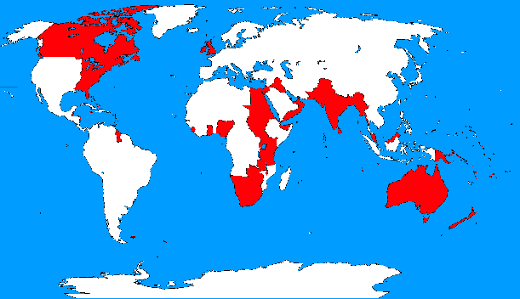
Superpowers Year 8 HT4
Definitions:
Superpower: an extremely powerful country, especially one capable of influencing international events and the acts and policies of less powerful countries. It’s power can be felt all over the world.
Uni-Polar: A world with one country with the most power
Bi-Polar: A world with two countries being the most powerful
Uni-Polar : A world with more than three powerful countries
HIC: High Income country e.g. UK, USA, Germany, Japan, Australia
LIC: Low Income country e.g. Chad, Mali, Sudan, Haiti, Malawi, Ethiopia
NEE: Newly emerging economy e.g. Indonesia, Nigeria, India, Malaysia
Factors that make a country a Superpower:
Geographic size – often linked to resources and influence over neighbours (e.g. Russia).
Population – provides workers and markets for growth (e.g. China, India).
Resources – such as oil, gas, and minerals, though some are more valuable than others.
Military strength – both in terms of numbers, but more importantly in advanced weaponry and global reach.
Economic power – control of global GDP, currencies, investment, and economic decision-making.
Cultural power (soft power) – influence through media, film, food, values and lifestyle (e.g. USA, UK).
Political power – formal influence through organisations such as the UN Security Council. Nuclear weapons and global military bases increase power projection.
What made the UK a superpower?
Industrial development and technology (steam power)
A large and successful navy
The BRIC countries (Brazil, Russia, India and China) have grown rapidly through economic development. MINT countries (Mexico, Indonesia, Nigeria and Turkey) are also developing but still face challenges before becoming superpowers.
The British Empire was known as ‘The Empire on which the un never set’
The British Empire collapsed for a number of reasons:
The Second World War weakened Britain militarily and financially, leaving it reliant on the USA and USSR, which had become new global superpowers.
Holding colonies became too costly, and nationalist movements within territories grew stronger, demanding independence.
The loss of India in 1947 was particularly significant, as it was the largest and most profitable colony, and its independence encouraged other nations to follow.
Meanwhile, opinion within Britain shifted; people wanted resources spent on domestic reforms such as the NHS and free education rather than on maintaining overseas colonies
China has become a global superpower as it:
Has influence over many neighbours
It is a large country with many resources
Benefits in China:
Lot’s of people now work in factories, which provides them with an income.
China has grown an economy responsible for bringing more people out of poverty than any other country in the world.
Although the wages of the workers in China are low, there is also a low-cost of living which makes life manageable
Many rivers and a long coastline are good for trade
A large pool of workers
A legacy of the British Empire is something that was left behind.
Positives: the Empire spread the English language, parliamentary systems, transport infrastructure, and sports such as football, cricket, and rugby.
Negatives: slavery, resource exploitation, loss of native cultures, religious conflict, and political instability in many former colonies.
Space Race in India. India has the largest population in the world and a fast-growing economy, but millions still live in poverty, including in slums such as Dharavi. India is investing heavily in space exploration, creating debate over whether money should be spent on technology or improving living conditions. Some funding also comes from international aid.

Slide 9
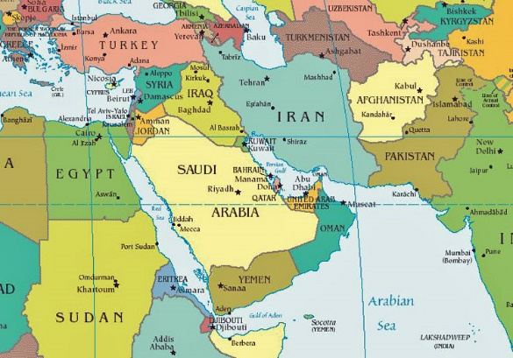
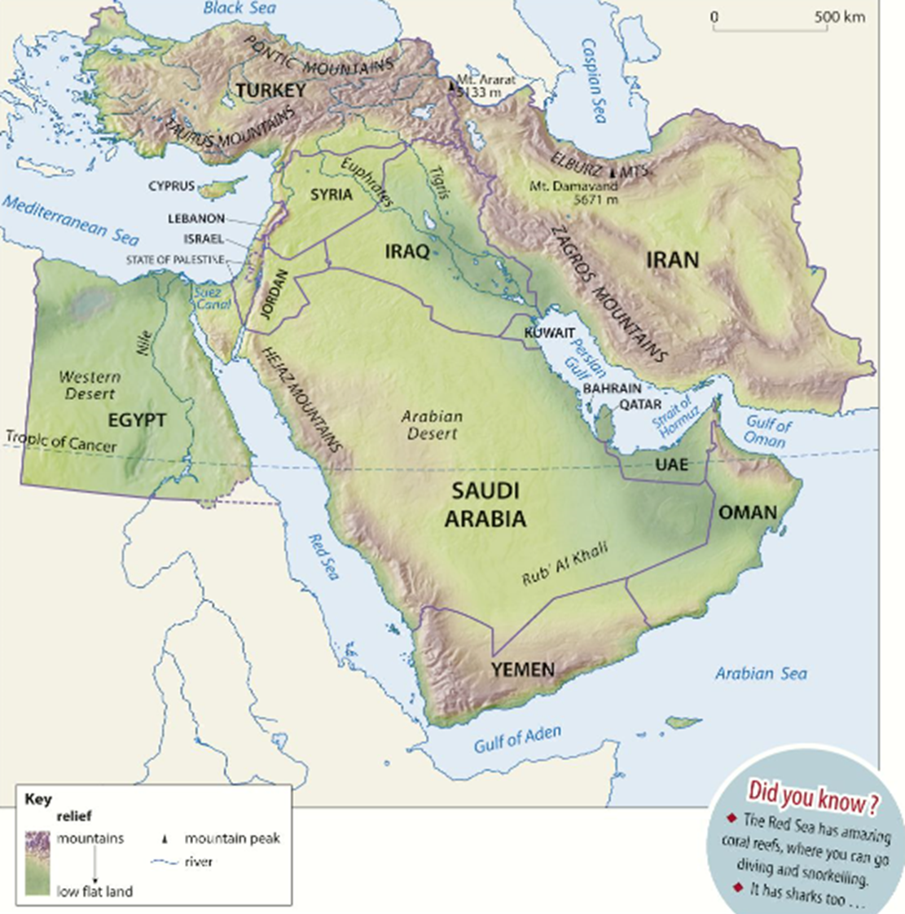
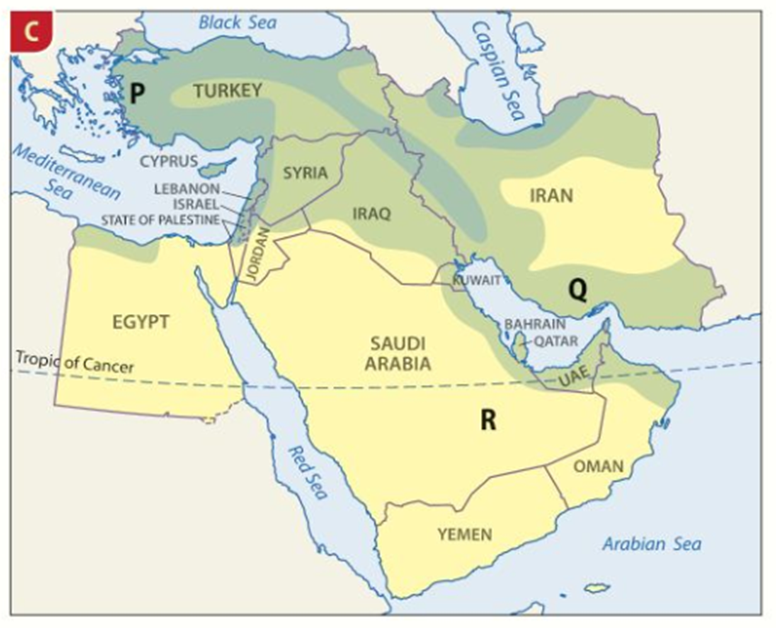
The Middle East Year 8 HT5
Key Words:
Biome
Desert
Physical Geography
Grassland
Forests
Conflict
Tourism
Region
Arabian Peninsula
Population density
GDP
The Middle East is a region made up of 16 countries: Cyprus, Turkey, Syria, Lebanon, Israel, Jordan, Egypt, Iraq, Kuwait, Saudi Arabia, Yemen, Oman, Bahrain, Qatar, the UAE and Iran. The largest country is Saudi Arabia, the second largest is Iran, and Bahrain is the smallest. Cyprus and Bahrain are islands.
The countries share a long history. Much of the region was once part of the Ottoman Empire (1299–1918), ruled from Constantinople (Istanbul). After World War One, Britain and France divided much of the region between them, creating tensions that still affect the Middle East today. All countries are now independent.
Much of the Middle East has a hot, dry climate, but temperatures and rainfall vary.
Mecca has hot temperatures all year (around 24–35°C) with very little rainfall.
Tehran has much colder winters (around 7°C) but similar summer temperatures.
Climate affects biomes.
Hot deserts dominate Egypt and the Arabian Peninsula, with plants adapted to save water and animals such as oryx, sand cats, snakes and scorpions.
Grasslands in Syria, Iraq and Iran support sheep and goat farming.
Forests and shrublands are found in northern Turkey, with animals including bears, deer and hyenas.
Most people live in areas with milder climates and reliable water supplies, while deserts have low population density. Population density is measured as the number of people per square kilometre and is often shown using a choropleth map, where darker colours represent higher densities.
The Middle East is also diverse in religion and ethnicity. Judaism, Christianity and Islam all began in the region. Today, Islam is the largest religion. Around 75% of Israel's population is Jewish, while Lebanon has a large Christian population. The largest ethnic group is Arabs, but there are also Turks, Persians and Kurds. Many Kurds live across Turkey, Iraq, Iran and Syria, with some wanting an independent country called Kurdistan. Differences in religion and ethnicity have contributed to conflicts such as the Gulf War, Israeli–Palestinian Conflict and Syrian Civil War.
Most people across the Arabian Peninsula are Arab, although millions of migrant workers also live there. All countries except Yemen are monarchies. Traditionally, Bedouin people moved around the desert herding camels, sheep and goats. The discovery of oil and natural gas transformed the region from one of the world's poorest into one of its wealthiest.
Qatar has one of the highest GDPs per person in the world, while Yemen remains one of the poorest countries because it has far fewer oil and gas resources.
This creates a large contrast in wealth across the region.
Although famous for deserts, the Middle East has a wide variety of landscapes.
Turkey and Iran are the most mountainous countries. Mount Damavand (5,671 m) in Iran is the region's highest mountain, while Mount Ararat in Turkey is linked to the story of Noah's Ark.
Over 90% of Egypt is covered by the Sahara Desert, while the Arabian Desert covers most of the Arabian Peninsula. The Rub' al Khali (Empty Quarter) is the largest continuous sand desert in the region.
Major rivers include the River Nile, Tigris and Euphrates, which support farming and settlements.
Important seas and waterways include the Mediterranean Sea, Red Sea, Black Sea, Persian Gulf, Gulf of Oman, Gulf of Aden, Suez Canal and the Strait of Hormuz, one of the world's busiest shipping routes.

Slide 10
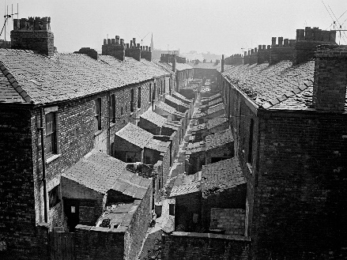
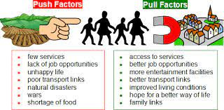
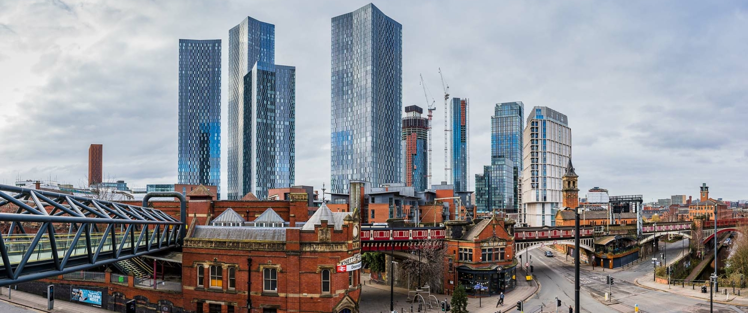
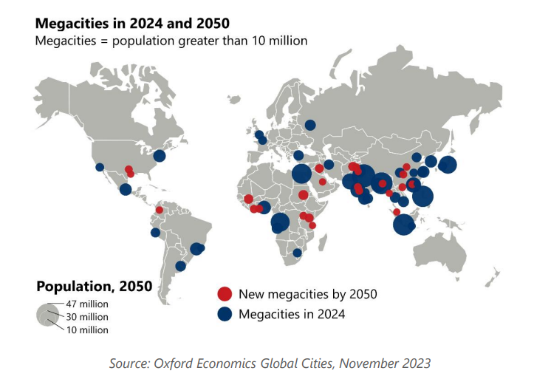
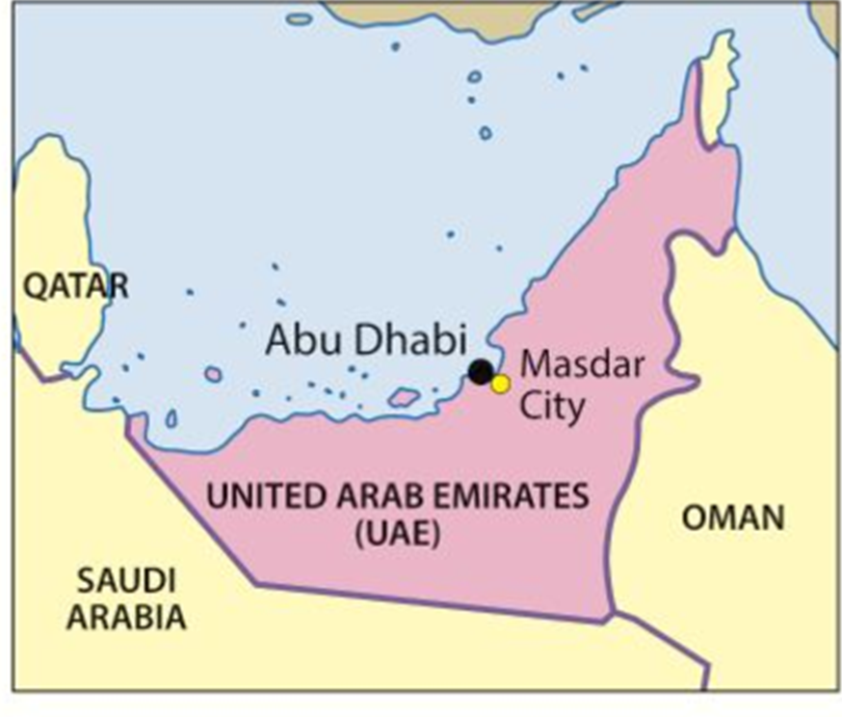
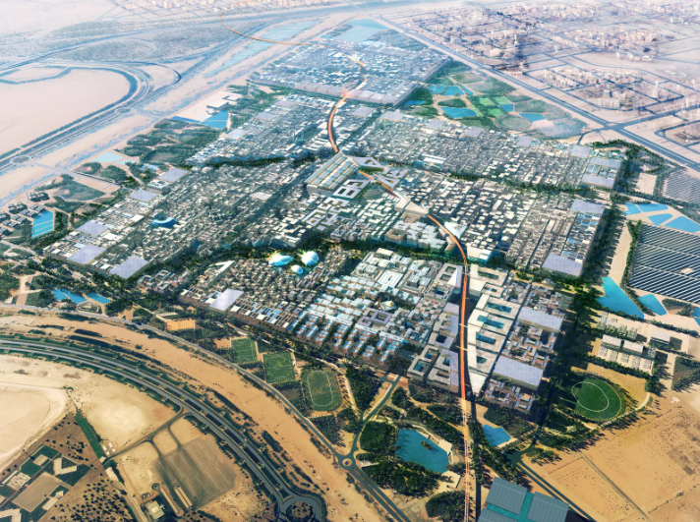
Urbanisation Year 8 HT6
What is urbanisation?
Urbanisation is the proportion of people living in towns and cities. Today, about 54% of the world's population lives in urban areas, rising to an estimated 70% by 2050. Urbanisation has led to the growth of megacities (cities with over 10 million people).
Why did Manchester grow?
Manchester began as a Roman settlement before becoming a market town. From the 1700s, cotton mills attracted thousands of workers during the Industrial Revolution. By 1853, the population had reached around 300,000. Rapid growth created overcrowded back-to-back housing, shared toilets, poor sanitation, pollution and disease. Over half of children died before the age of five. Wealthier factory owners lived in greener suburbs on the edge of the city.
How has Manchester changed over time?
Manchester's population grew from 70,000 (1801) to 766,000 (1920s) because of industry and migration. After World War Two, cotton mills closed, causing unemployment, crime and population decline. Since the 1996 IRA bombing, regeneration funded by the UK Government and the EU has transformed the city. Projects such as Spinningfields and MediaCityUK have created jobs, attracted businesses and increased the population to around 550,000.
Why do people move to cities? People migrate because of push factors (reasons to leave) and pull factors (reasons to move). In many low-income countries, rural-to-urban migration is increasing. In some high-income countries, people move back to the countryside, a process called counter-urbanisation, to enjoy more space, lower crime and a better environment.
What is life like in the slums?
A slum is an area of poorly built or informal housing.
Around 900 million people worldwide live in slums.
Rapid urban growth means housing cannot keep up with demand.
Slums often lack clean water, sanitation, electricity and waste collection.
Lagos (Nigeria) is an example.
Governments try to improve conditions by building affordable housing, upgrading homes and providing water, sewers and electricity, but rapid population growth makes this difficult.
Masdar: A city of the future
Masdar City, near Abu Dhabi (UAE), is designed to be one of the world's most sustainable cities. It aims to reduce fossil fuel use through solar power, car-free streets, driverless electric pods, walkable neighbourhoods and recycling. Narrow streets, shaded public spaces and raised buildings help keep the city up to 15°C cooler than the surrounding desert

