Slide 1
Geography Knowledge organisers
YEAR 7

Slide 2
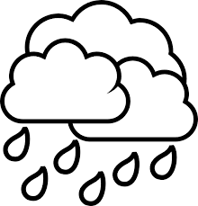
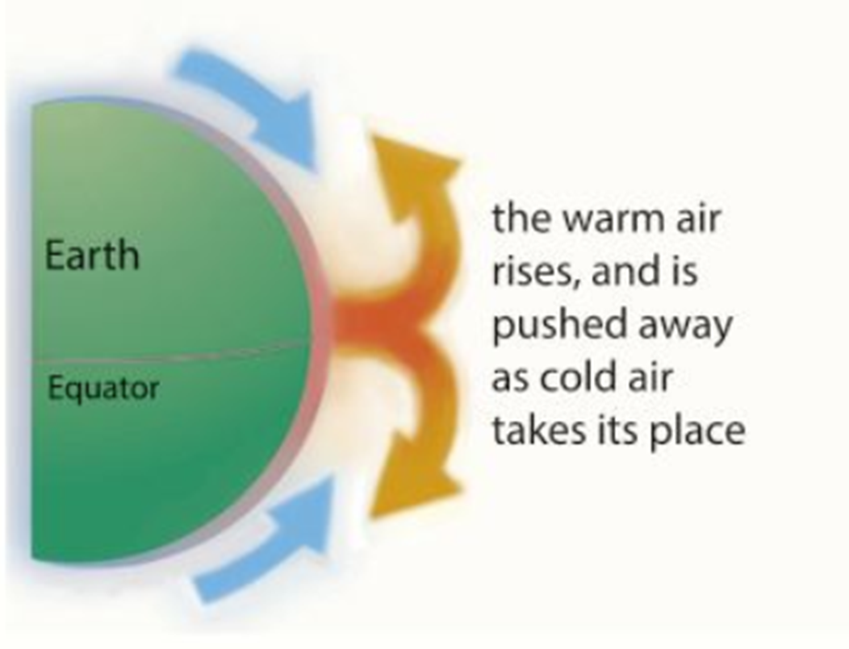
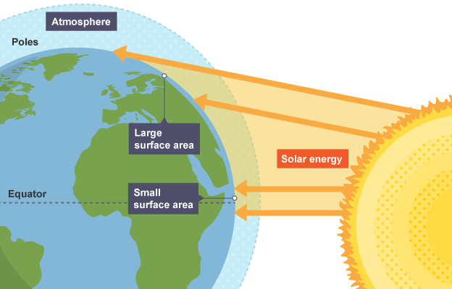
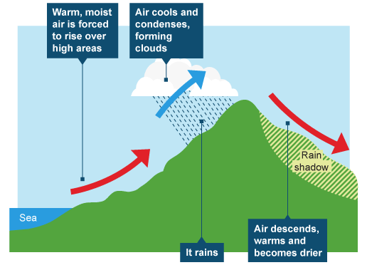
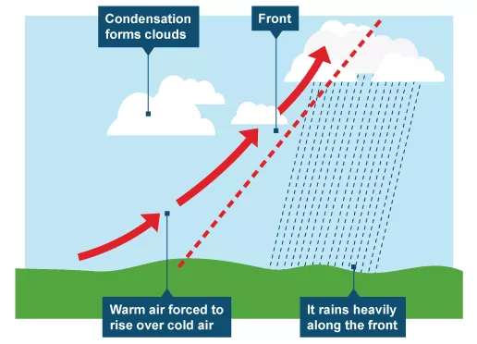
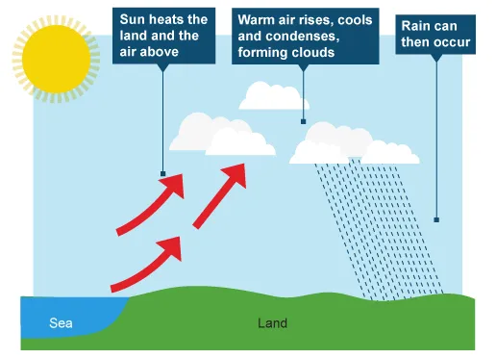

Weather and Climate Year 7 HT1
Key words:
Weather
Climate
Atmosphere
Precipitation
Celsius
Relief
Frontal
Convectional
Temperature
Thermometer
Depression
Air masses
Climate graph
Climate - the average atmospheric conditions over long time periods, weeks, months, years
Weather - what is happening in a particular place at a particular time, usually over short periods, hours or days, e.g., rain, blizzard, sunny and calm
Weather can be measured using a number of instruments.
Thermometer for temperature
Barometer for air pressure
Rain gauge for precipitation
Anemometer for wind speed
Barometer for air pressure
Sunlight hit the Earth more directly at the Equator. The curve of the Earth means that sunlight is spread over a wider area the further you move from the Equator.
Sunlight hits a smaller surface area at the Equator so heats up quickly compared to the Poles
The heat from the sun powers our weather by causing warm air to rise and cool it then returns back to Earth. This creates winds as the cold air takes the warm area space.
As air rises it cools, condenses and forms clouds. Rising air also creates low pressure. Where this happens around the globe there is rainfall – this occurs in tropical rainforest (Brazil, Malaysia, Congo etc) and temperature deciduous forests (like the UK). Where air is sinking there is no cooling, condensing and clouds so there is no rain. This is known as high pressure – this occurs in desert regions (Mali, Chad)
There are three main types of rainfall - Relief rainfall is common on the west coast of the UK. The UK is affected by frontal rain as two air masses collide (warm and cold air) and intense heat on summer days in the south east of the UK can create convectional rainfall and thunderstorms.
In each type of rainfall it is important to know what causes the air to rise and cool
Relief
Frontal
Convectional
BBC Bitesize: https://www.bbc.co.uk/bitesize/topics/zx38q6f/articles/zqnb3j6

Slide 3
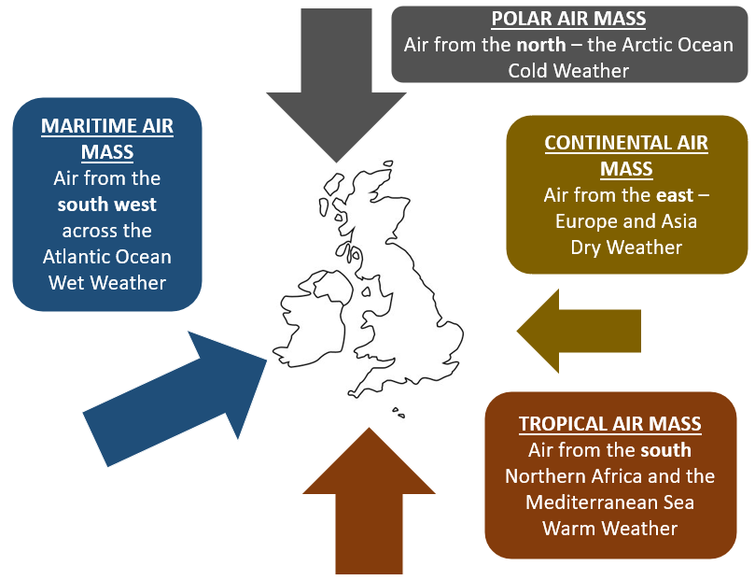
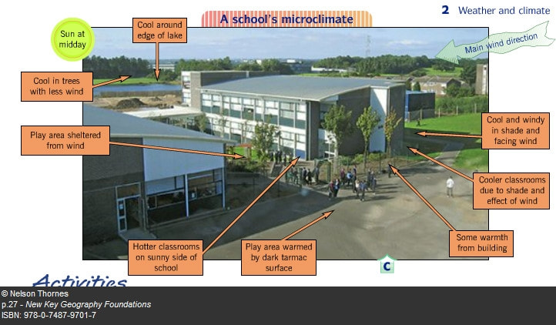
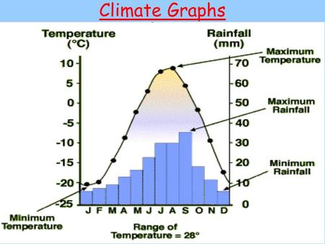
Weather and Climate Year 7 HT1
Air masses can affect the weather of the UK because we have the Atlantic Ocean to the west which brings wet weather to the UK and land to the east (Europe and Asia) which brings dry weather.
If the air blows from the south the temperature increases as they come from tropical regions like the Mediterranean if they blow from the north the temperatures will fall as the air has travelled over polar regions like the Arctic Ocean.
Microclimates
Smaller places like our school, cities and even gardens can have a microclimate.
Definition The climate of a very small or restricted area, especially when this differs from the climate of the surrounding area:
There are several factors that can affect a microclimate: shade, shelter, close to buildings, close to water, altitude.
Think: Which parts of our school site would be warmer or colder?
Which places would be windier?
One way to show climate data is on a climate graph.
This will have two vertical axis one for temperature the other for precipitation.
Months are along the horizontal axis.
It is important to read these axis carefully.
To work out the range – you need to calculate the difference between the highest and the lowest value
To work out the mean – you need to add all the data set together and divide by how many there are.
To investigate our schools microclimate we need to…..
1: Data collection: In groups we recorded the temperature and wind speed at given points around the school site.
2: Data presentation: Back in the classroom we used the data to draw bar charts to present our data.
3: Our conclusion was that ….we used our data to make a decision…does our school have microclimates?
4: Evaluating the experiment.
How could we make our results more reliable?
Collect more data over a longer period? Compare winter and summer?
What difference would l this all make to our conclusions?
Careers Link: Meteorologist. Climate scientist, Oceanographer, Research scientists, Hurricane hunter, Physicist, TV presenter, Broadcast journalist

Slide 4
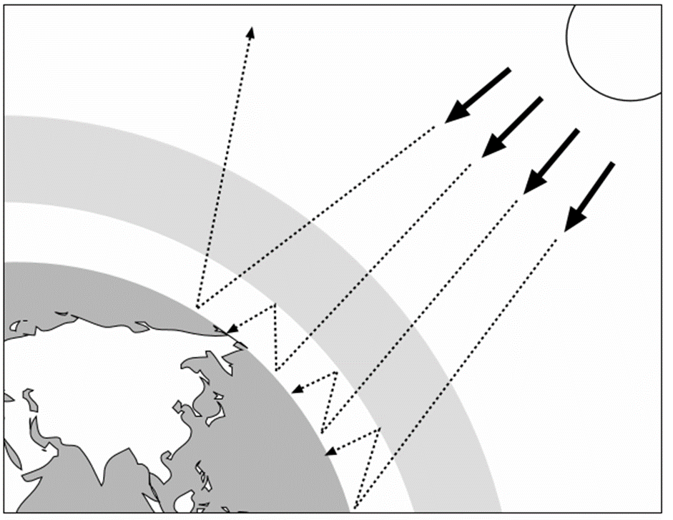
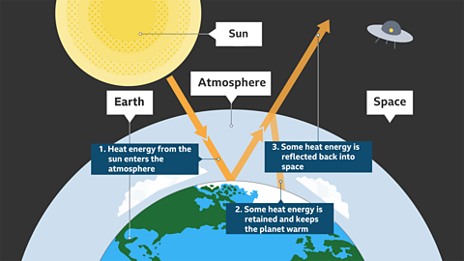
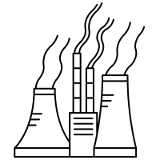


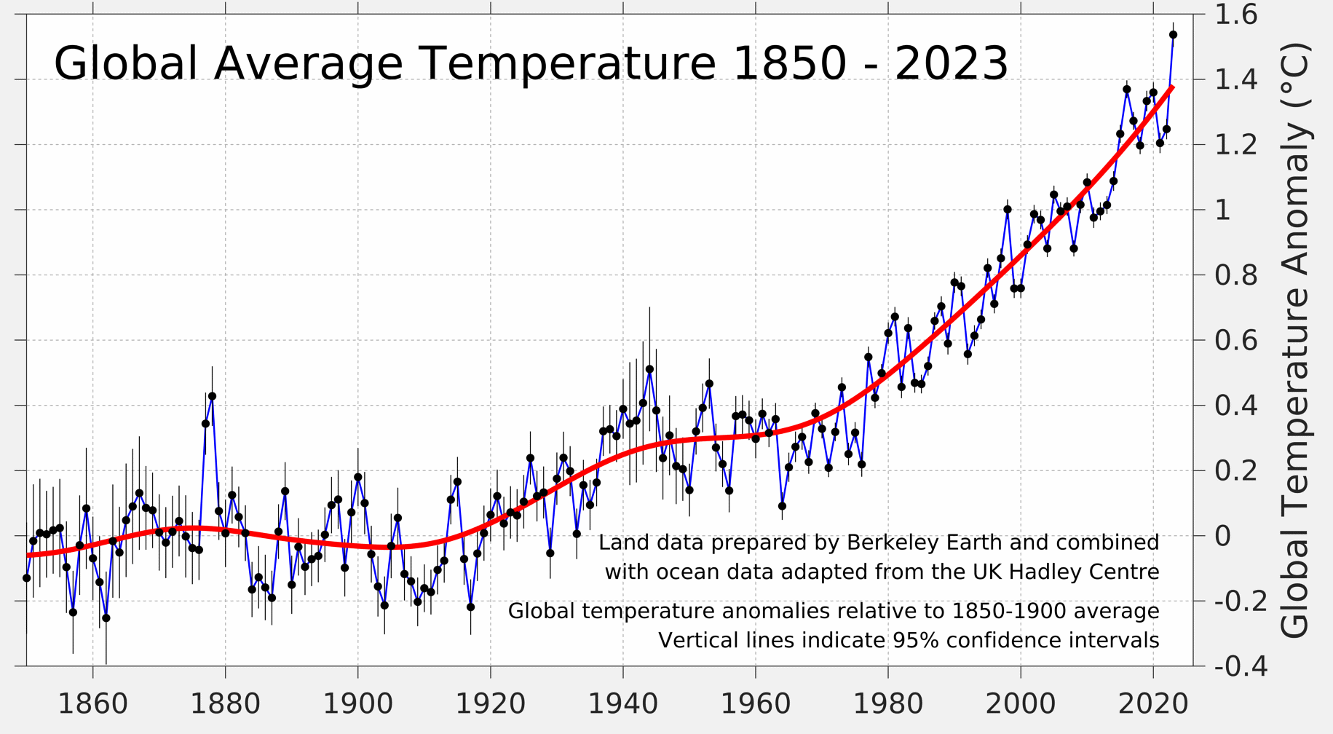
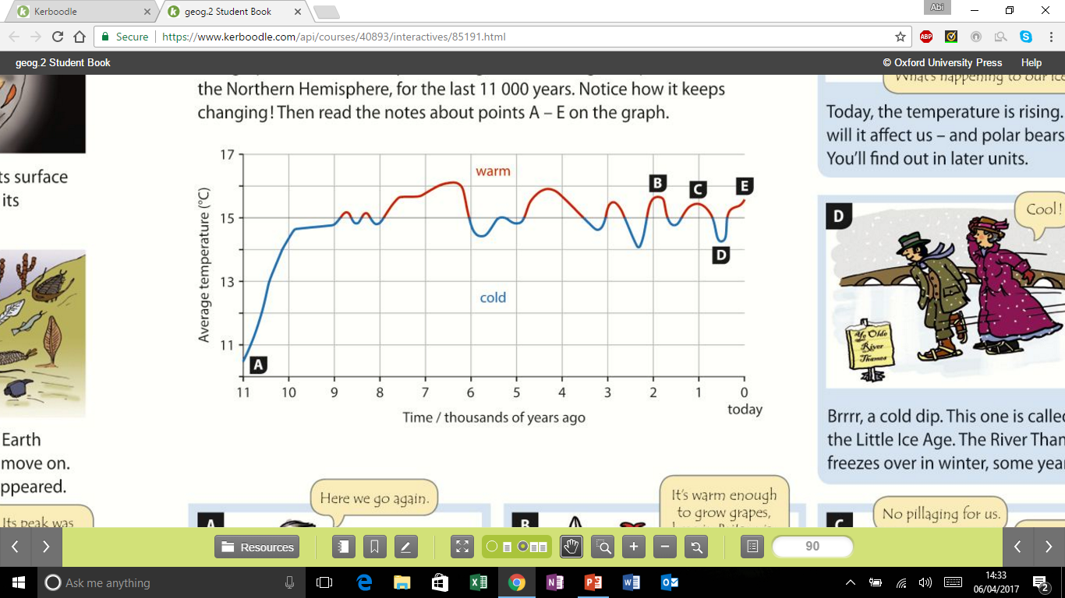
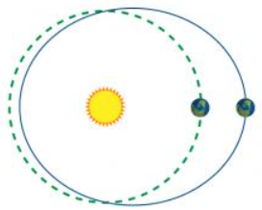
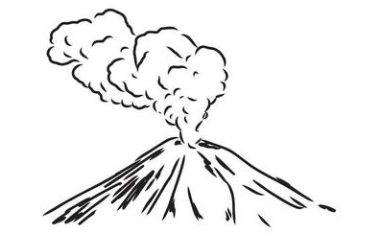
Climate Change Year 7 HT2
What is the greenhouse effect?
Climate change is causing the earth’s temperature to rise. The greenhouse effect is a natural function –without it would be too cold on planet earth to exist, but is affected by human activity.
The atmosphere allows heat from the sun to heat the earth.
The earth gives off heat.
The heat is trapped by greenhouse gases e.g. methane, carbon dioxide and nitrous oxide.
Human causes of climate change:
Burning fossil fuels, e.g. coal, gas and oil in energy production- these release carbon dioxide into the atmosphere, which traps radiation from the Sun in the atmosphere as part of the enhanced greenhouse effect
Deforestation - trees absorb carbon dioxide during photosynthesis. If they are cut down, there will be higher amounts of carbon dioxide in the atmosphere.
Dumping waste in landfill - when the waste decomposes it produces methane.
Agriculture - livestock / grazing animals (cows, sheep, goats) release methane. fertiliser lead to the release of nitrogen oxides into the atmosphere.
What has happened to the Earth’s climate?
Average temperatures in the Northern Hemisphere
Natural causes of climate change
Orbital changes - the Earth has natural warming and cooling periods caused by Milankovitch cycles or variations in the tilt and/or orbit of the Earth around the Sun (wobble, roll and stretch theory).
Volcanic activity - during a volcanic eruption carbon dioxide is released into the atmosphere.
Global average temperatures have risen by approximately 1.1°C since the pre-industrial period. The most recent decade (2012-2021) was an average of 1.0°C warmer than the 1961-1990 period in the UK. The UK has also seen the 10 warmest years on record occurring since 2003. 2022 was the UK's hottest year, with an average temperature above 10°C.
The graph shows that temperatures over the last 11 thousand years have not been consistent, 11 thousand years ago the average temperature was 10.5ºC (much colder than today). It also shows that there have been warmer periods.
Key Vocabulary: Greenhouse gases, Deforestation, Carbon dioxide(CO₂) Fossil fuels, Renewable, Solar, Drought, Effects, Global, Pollution Flooding, Sea level rise, Methane
Ambitious vocabulary: Mitigation, adaptation, long wave radiation
What is the evidence for climate change?
Ice cores—the snow traps air. The gas in the air can reveal what the temperature was like.
Rising sea levels—between 1901 and 2010 the sea rose by 0.19m.
Tree rings - the wider the ring, the warmer and more rain there was that year.
Website Links:
BBC Bitsesize: https://www.bbc.co.uk/bitesize/topics/zx38q6f/articles/z773ydm
Intergovernmental Panel on Climate Change: https://www.ipcc.ch/
NASA:
https://climate.nasa.gov/

Slide 5

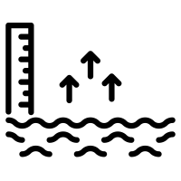








Climate Change Year 7 HT2
What are the global impacts of climate change?
Climate change is causing global temperatures to increase and average sea levels to rise.
Scientists suggest that the impacts of higher temperatures and rising sea levels could include:
A change to the location of the Earth’s climate belts, which would make it difficult for some countries to grow food causing famine
Flooding of coastal and low-lying communities – 80 million people will be affected by sea level rise.
The spread of tropical diseases, like malaria, - an additional 280 million people may be affected
There will be millions more refugees as people flee from floods, droughts or famine.
Animals and plants that can’t cope by moving or adapting will die out.
What are the impacts of climate change on the UK?
Sea levels could rise, covering low lying areas, in particular east England
Droughts and floods become more likely as extreme weather increases
Increased demand for water in hotter summers puts pressure on water supplies
Industry may be impacted, e.g. Scottish ski resorts may have to close due to lack of snow
How can climate change be managed?
Mitigation is reducing or preventing the effects of something from happening. These strategies are:
Alternative energy - solar, wind, tidal power reduces the use of fossil fuels, so less CO2 is produced
Carbon capture—storing carbon dioxide gases deep underground
Planting trees—encouraging afforestation reduces CO2 levels in the atmosphere during photosynthesis
International agreements - countries sign treaties -. the Paris Agreement in 2016, which aimed to limit global warming to below 2ºC
How can we adapt to climate change?
Adaptation strategies respond to the effects after they have happened
Agriculture (farming) must adapt as some crops can’t grow in warmer temperatures. But other crops can be grown e.g. oranges and grapes
Water supply - water can be transported
Reducing risk from sea level rise—using sea defences
How can individuals reduce their contribution to towards climate change?
Food consumption: eat less meat and more food that’s produced locally.
Fly less: if it’s the only option pick a destination close by, fly economy and choose to carbon offset.
Reduce car journeys: where possible cycle, walk or use public transport to get to school.
Get involved: find out about organisations that campaign for environmental change.
Green spaces: protect them and if possible, plant trees or introduce plants into your household.
Change your buying habits: avoid single-use items and only purchase clothes you really need.
Recycle your unwanted clothes: donate to clothing banks and charity shops or sell them on.
Use less energy: at home switch off lights and appliances when you’re not using them.
Careers
Environmental consultant Energy Efficiency Officer Recycling officer
Climate change analyst Renewable energy engineer

Slide 6
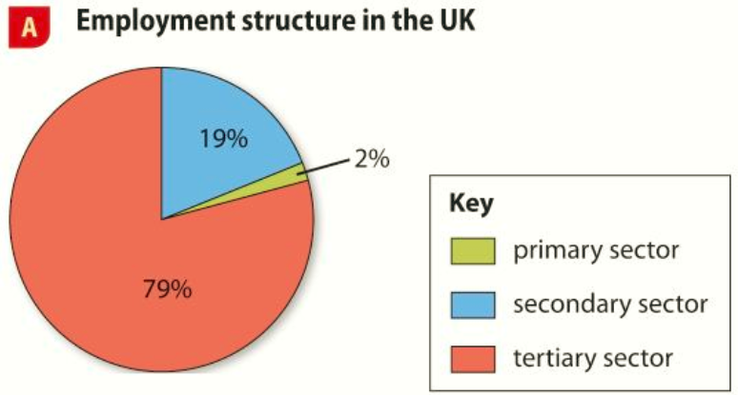
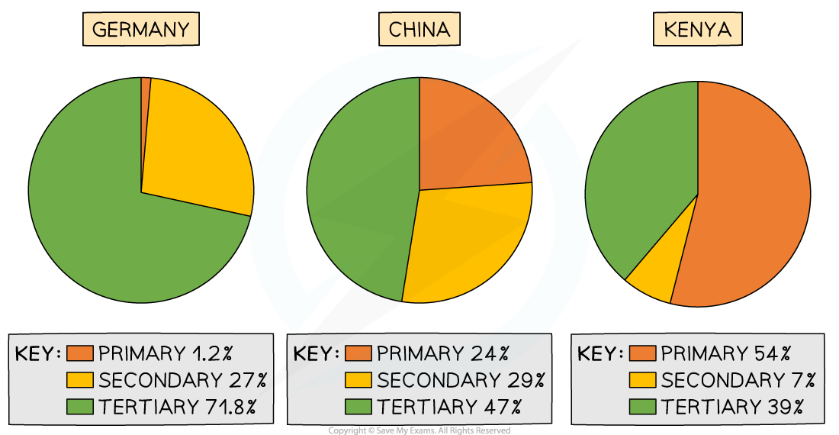
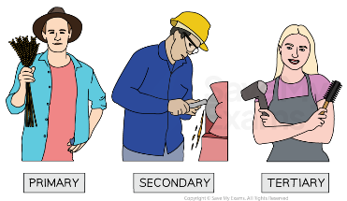
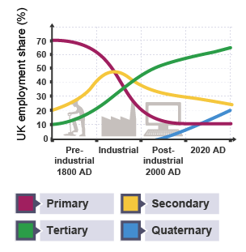
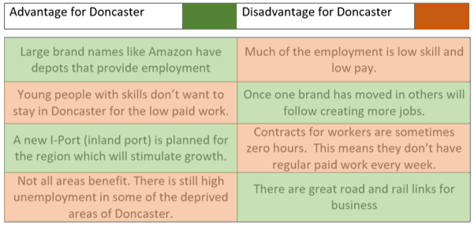

Economic Activities Year 7 HT3
Types of Industry
Industry is any economic activity which creates jobs and generates income (money).
There are four main types of industry:
Primary sector – the extraction of raw materials e.g. forestry, fishing, farming, mining
Secondary sector – taking the raw material and manufacturing them into products
Tertiary sector – providing services to people e.g. doctors, sales assistant, lawyer, chef
Quaternary sector – knowledge based industries or high-tech industries such as ICT, research and development
Around the world the employment structure vary
In low income countries primary sector dominates like in Kenya. In newly emerging economies like China there is often a more balanced employment structure while in high income countries like the UK and Germany the tertiary sector dominates.
HIC
NEE
LIC
How can changes in employment affect people’s lives?
Doncaster began as a Roman fort in 50AD. During the Industrial Revolution, train building became an important industry. The last coal mine closed in 2015 causing unemployment (when people are looking for paid work but can’t find it) – this has lead to derelict areas, high crime rates and poor health. There have been new tertiary employment opportunities in Doncaster, Amazon, Ikea and Next have warehouses and delivery centres.
These new employment opportunities have brought advantages and disadvantages:
Economic Change in the UK
In the 1600s over 70% of people worked in the primary sector, this has decreased due to the increase in the use of machinery. Jobs in the secondary sector increased during the Industrial Revolution as factories were built and urbanisation occurred, however during the 20th century there was a decrease in the number of people working in manufacturing as mechanisation (robots) replaced jobs along with increased competition from aboard. The tertiary sector increased due to the introduction of public services, the growth of financial services and an increase in leisure time and disposable income. Since the 1980s, the development of IT has meant that the quaternary sector has become increasingly important.
Key vocabulary
Primary, Secondary, Tertiary, Quaternary, Raw materials, Manufacturing, Mechanisation, Employment structure, Rural, Agriculture, Outsourcing, Multinational company, Globalisation

Slide 7
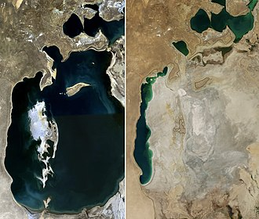




Economic Activities Year 7 HT3
Where are our clothes made today?
Companies that have factories all over the world and shops all over the world are called Multi National Companies. MNCs are an example of globalisation. This means that we trade all over the world, as products are sold all over the world.
Today many textile companies operate in Asia. This is called outsourcing. Large companies like Primark make their clothes in countries like Bangladesh because they can pay the workers less money.
Advantages for the country:
People get a regular wage and they can begin to save money and improve their lives. People develop new skills. People will pay tax that can be used by the government to build schools and improve healthcare.
Disadvantages for the country:
People often work in poor and dangerous conditions. Many people will leave the countryside leading to a decline in farming and food production.
Production of many items like our clothes involve all the sectors:
Primary involves the gathering raw materials like cotton.
Secondary involves all the manufacturing in factories all over the world.
Tertiary involves the transport of the clothes to the shops and selling them.
Quaternary involves all the research and advertising to sell more goods.
How does the fashion industry affect the environment?
Water Use
It takes 2700 litres of water to make one -t-shirt and 22,000 to make one paid of jeans. The Aral Sea in central Asia has reduced in size as the rivers that flowed into it have been diverted to grow cotton. This has lead to:
environmental issues: loss of aquatic ecosystem, loss of vegetation, windier weather causing dust storms, and a more extreme climate
economic issues: the fishing industry has gone causing unemployment and
social issues: poverty related illnesses
Application of pesticides
Pesticides are used to keep plants free from pests (insects and bugs) that could damage the crop. Farmers can loose a lot of money and end up in debt if their crop fails. Some farmers spent 60% of their wages on pesticides to try and protect their crop. The chemicals from the pesticides can harm the environment as the they are toxic and can washed out of the soil and end up in rivers as well as ending up in the food chain if animals eat the pests. Dust storms can contain pesticides which can affect people’s health. They can also harm people who often are not using protective equipment e.g. masks.
Economic change can improve people’s lives
When a country improves its exports (goods sold and exiting the country) this means they can makes more money. In addition, if people are in paid employment with a regular wage they can spend it. If a country improves its Gross Domestic Product or Gross National Income, then it has more money to spend on health, education, roads and railways.
Development Indicators:
Life expectancy – how many years on average a person lives
% with assess to clean water – percentage of the population with assess to clean water
Number of doctors – how many doctors there are per 1000 of the population
Literacy rate – what percentage of the population can read and write
% employed in agriculture - percentage of the population working in farming
Chemical waste from fabric dyeing
Many textile factories drain toxic waste straight into rivers. To clean the waste is expensive and would increase their costs. The Citarum River in Indonesia is described as the most polluted river in the world. There are 400 factories that dump waste into the river. The temperature of the waste is affecting the ecosystem for wildlife. There is no oxygen, therefore fish die which means people lose a source of income. There are heavy metals such as mercury and lead which is released into the river which is affecting locals health.

Slide 8
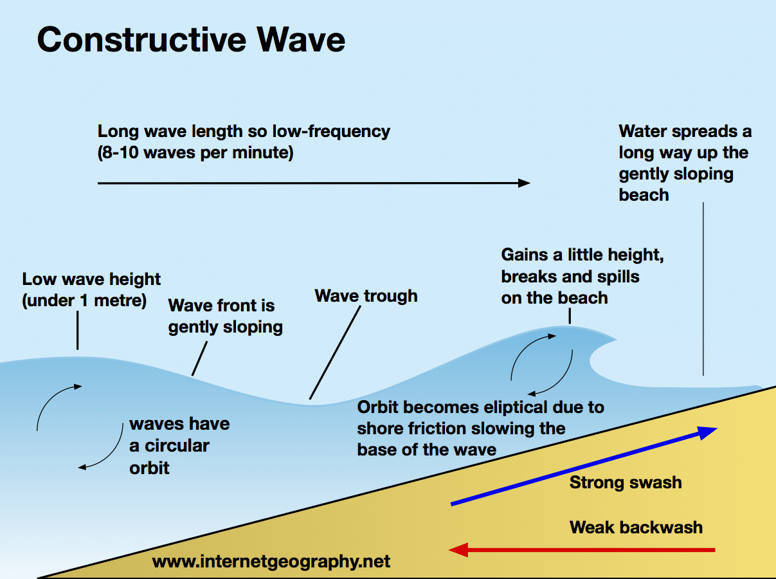
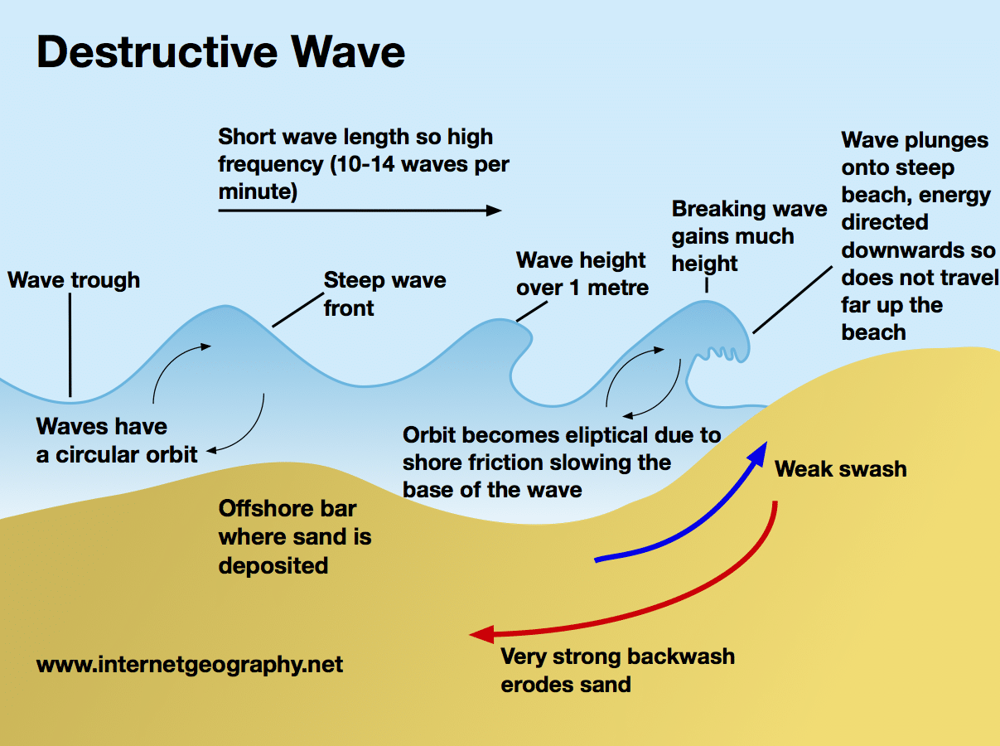
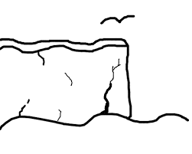

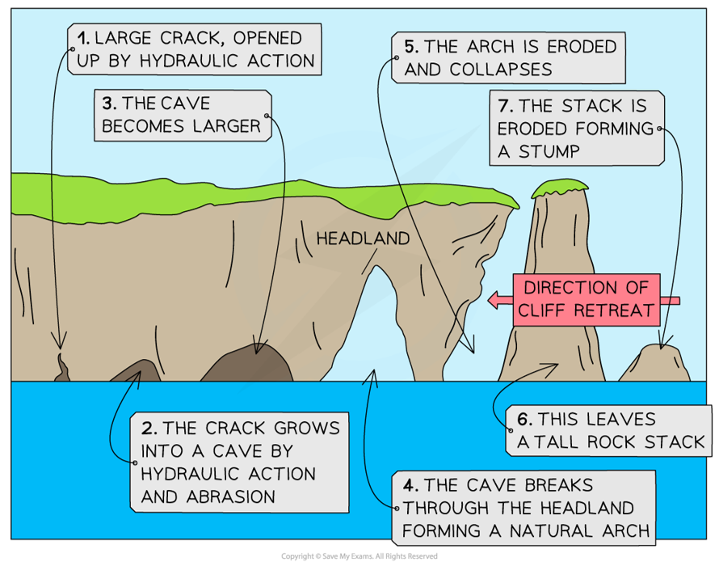
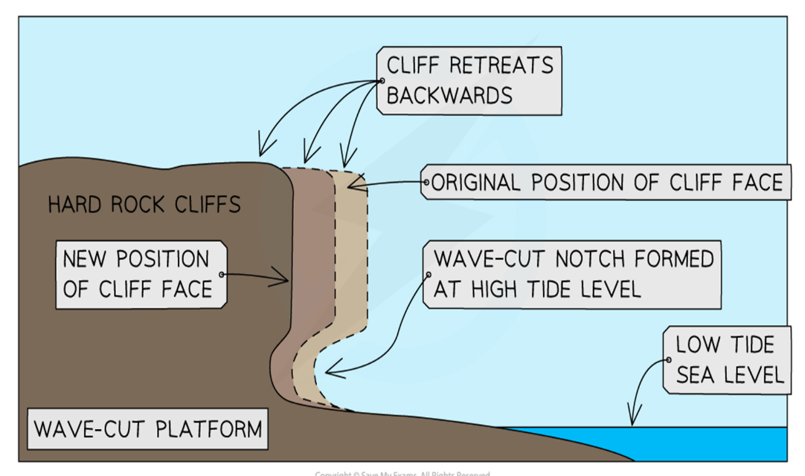
Coasts Year 7 HT4
Key words:
Erosion
Hydraulic action
Abrasion
Attrition
Headland
Transportation
Longshore drift
Fetch
Prevailing wind
Deposition
Spit
Constructive
Destructive
Waves
When a wave reaches the shore, the water that rushes up the beach is known as the swash. The water that flows back towards the sea is known as the backwash.
Destructive Waves - weak swash and strong backwash
the strong backwash removes sediment from the beach
the waves are steep and close together
Constructive Waves - strong swash and weak backwash
the strong swash brings sediments to build up the beach
the backwash is not strong enough to remove the sediment
the waves are low and further apart
Factors that affect the type of wave are: the strength of the wind, the time the wind has blown for and the distance the wave has travelled called the fetch
Coastal erosion landforms
Crack, cave, arch, stack, stump
Four types of coastal erosion
Erosion is the wearing away of rock along the coastline
Hydraulic action - this is the sheer power of the waves as they smash against the cliff. Air becomes trapped in the cracks in the rock and causes the rock to break apart.
Abrasion - this is when pebbles grind along a rock platform, much like sandpaper. Over time the rock becomes smooth.
Attrition - this is when rocks that the sea is carrying knock against each other. They break apart to become smaller and more rounded.
Solution - this is when sea water dissolves certain types of rocks. In the UK, chalk and limestone cliffs are prone to this type of erosion.
Coastal erosion landform - A wave cut platform is formed at the base of a cliff and can exist between a stack and the headland
Durdle Door in Dorset in a natural arch
Old Harry in Dorset is a sea stack
Old Harry’s wife is a stump

Slide 9
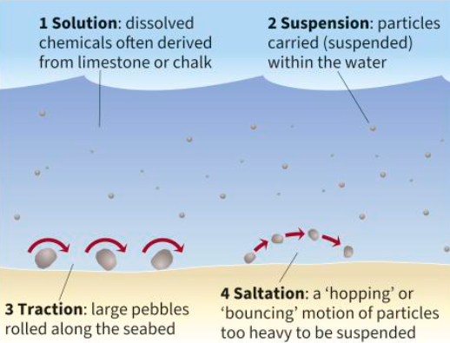
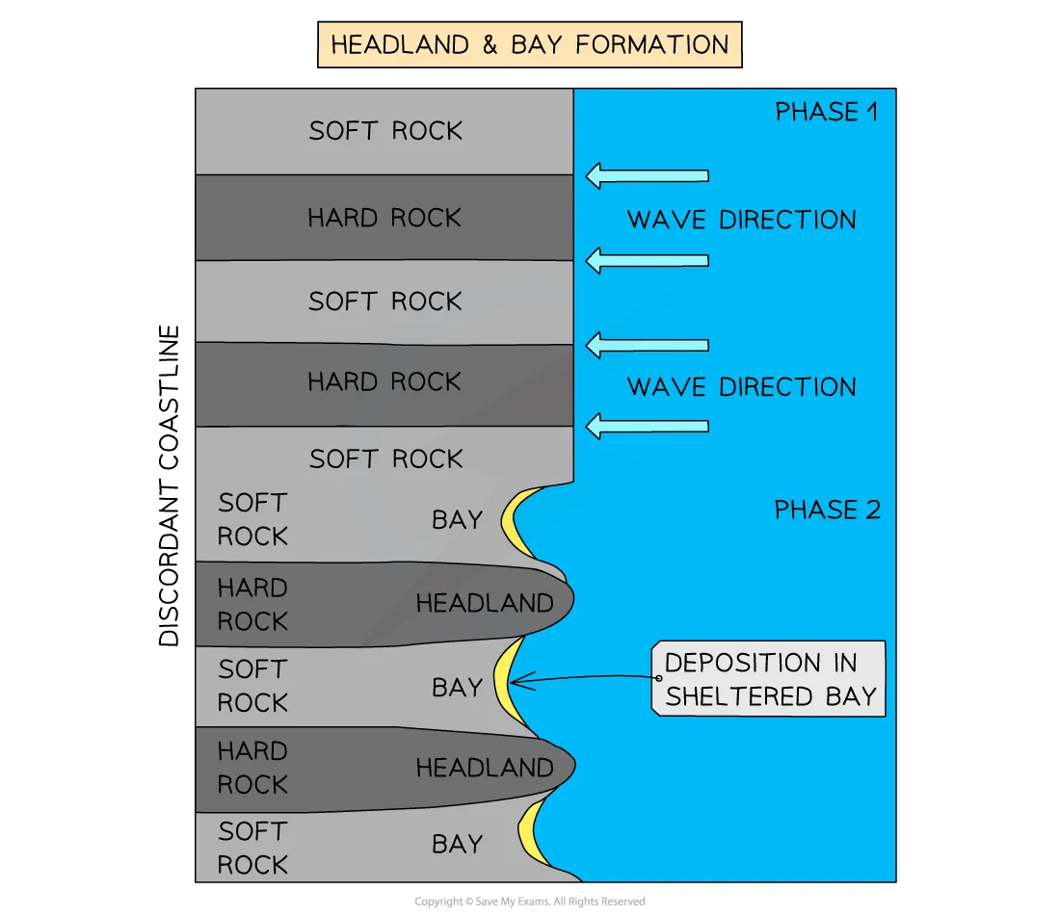
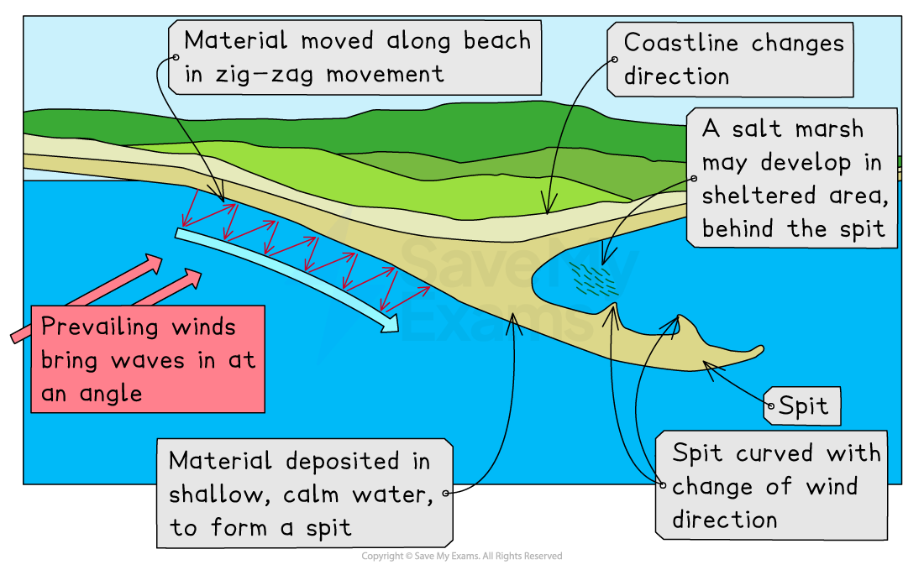
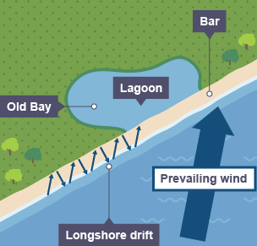
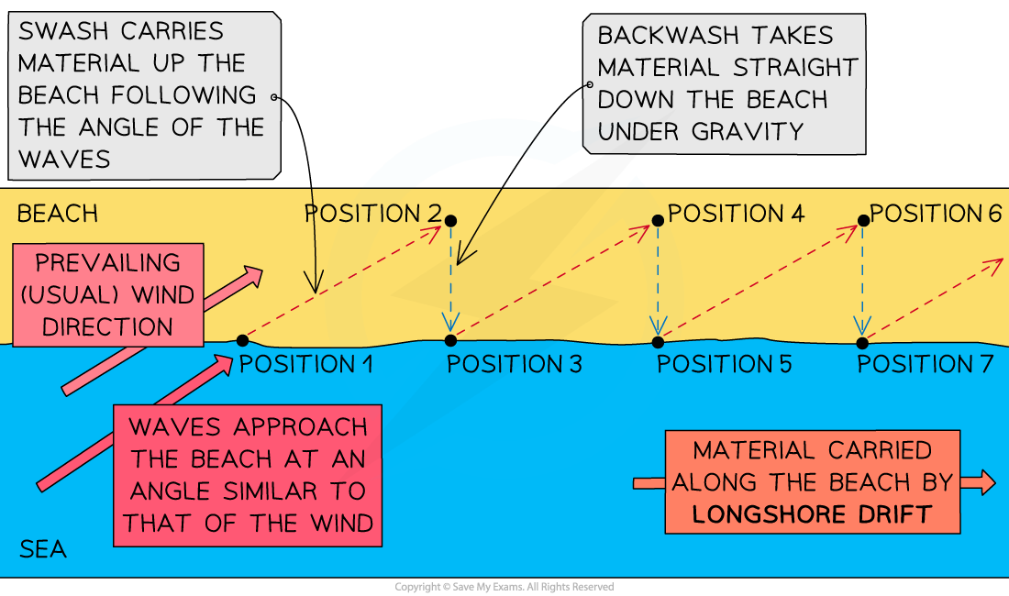
Coasts Year 7 HT4
Coastal transportation
Beach material can be moved in four different ways. These are:
Coastal erosion landforms – Headlands and Bays
Cliffs along the coastline do not erode at the same pace. When a stretch of coastline is formed from different types of rock, headlands and bays can form.
Sediment is carried by the waves along the coastline. The movement of the material is known as longshore drift. Waves approach the coast at an angle because of the direction of prevailing wind. The swash will carry the material towards the beach at an angle. The backwash then flows back to the sea, down the slope of the beach. The process repeats itself along the coast in the zigzag movement.
Coastal deposition
Deposition - when the sea loses energy, it drops the sand, rock particles and pebbles it has been carrying. Deposition happens when the swash is stronger than the backwash and is associated with constructive waves
Depositional landform - Sand spits
Depositional landform - Sand bars

Slide 10
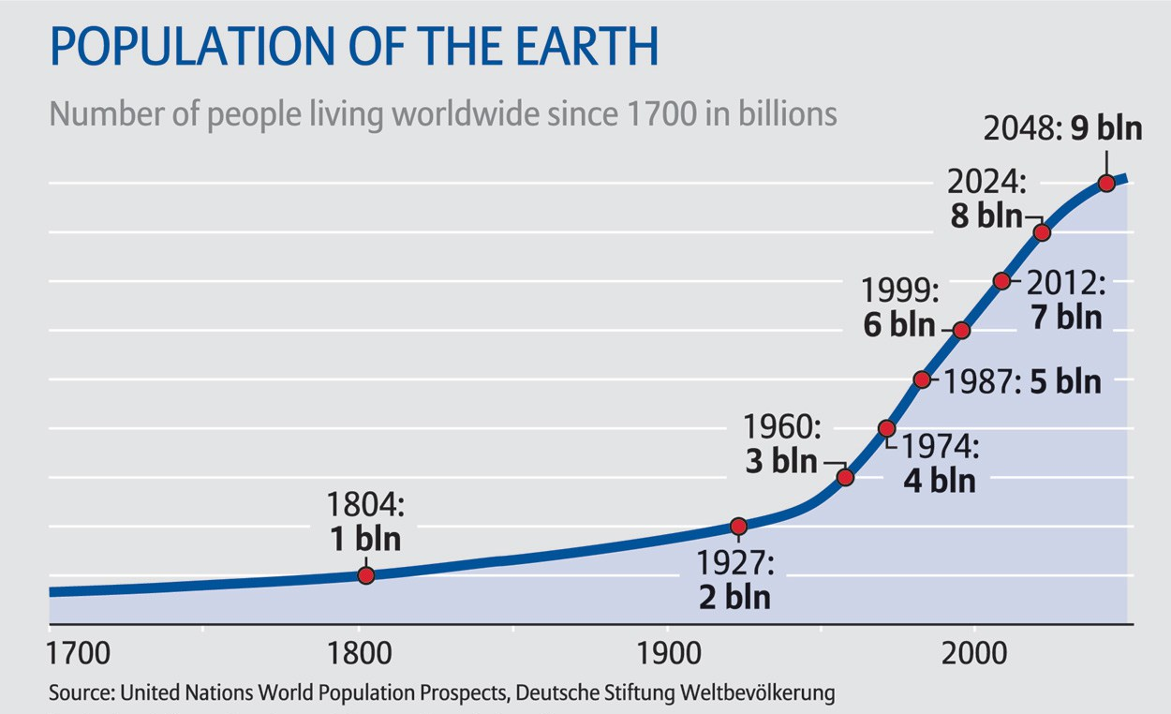
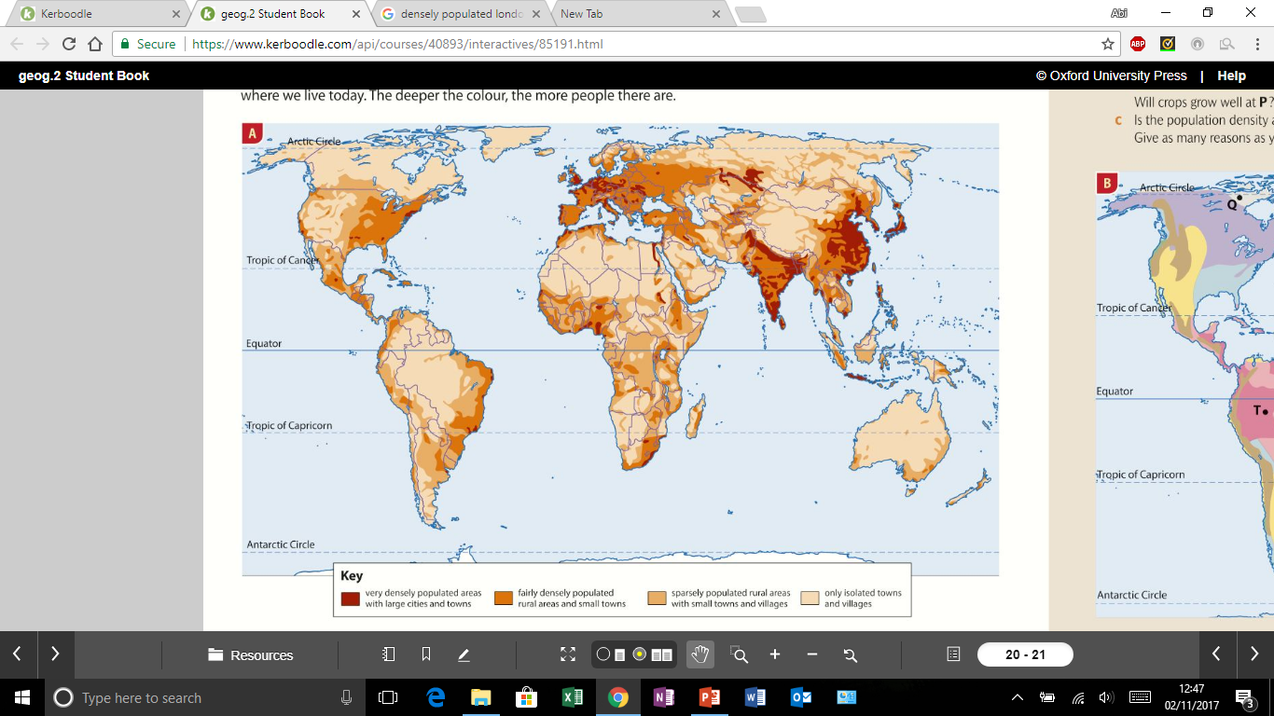

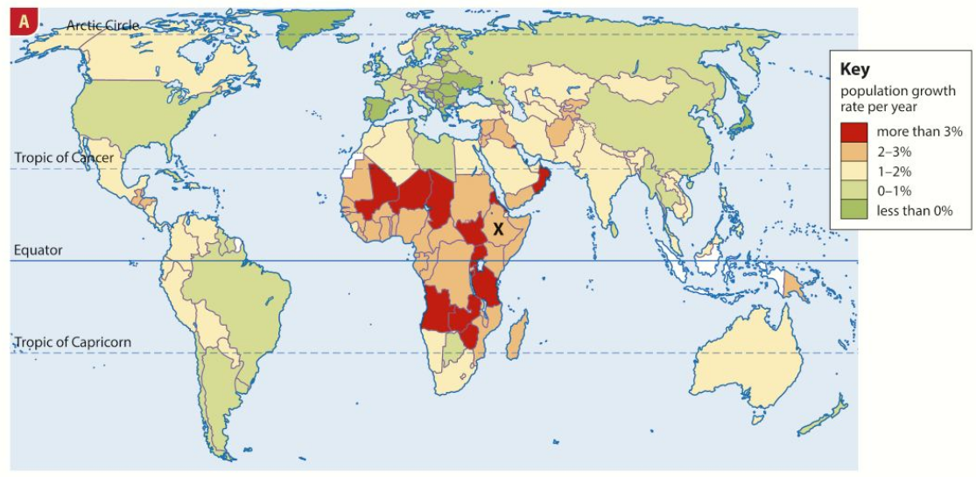
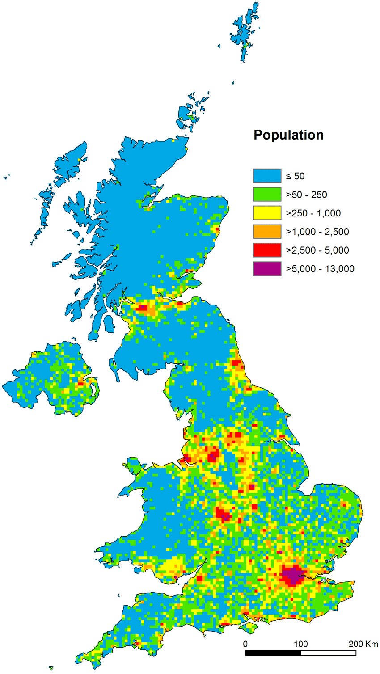
Population Year 7 HT5
Key Words
Natural increase
Birth rate
Death rate
Distribution
Density
Densely
Sparsely
Life expectancy
Youthful
Ageing
Exponential
Policy
Trends
Overpopulation
Population Growth
The world's population does not stay the same. In fact, over the last few hundred years it has been growing faster and faster.
In the entire world, there has been an explosion in population. During the 1st century AD, the world population was about 300,000 people. The current population is over 7 billion, and most of the growth has taken place within the last 100 years. In fact, in the late 1990s, the world population was 5.9 billion, which increased to over 8 billion in 2022.
World population distribution
describes how people are spread out across the globe.
The human population is not spread evenly. Few people live in locations that are sparsely populated and densely populated places have many.
What causes population to change?
births (e.g. availability of contraception and trends)
deaths (e.g. war and disease)
migration (e.g. people moving into or out of a country)
Factors affecting how densely/sparely populated an area is:
Sparse Populations: steep sloes, harsh climate, dense forest, isolated area, poor transport links, few jobs, lack of resources.
Dense Populations: flat or gently sloping land, mild climate, good soils, water, good transport links, places to work, resources e.g. coal, oil.
The population is growing at around 1.2% each year. This is roughly an extra 80 million people each year. The rate of growth is not the same everywhere, the map to the left shows that the population is rising fastest within central Africa. Generally population growth is faster is poorer, less developed countries and lower in wealthier countries.
UK population distribution
Population distribution in the UK is also uneven. Some parts of the UK are very crowded. The south east, which includes the city of London, has a much greater population than the highlands of Scotland.
Reasons for the population distribution in the UK
The south east of England benefits from: good transport links, easy access to the rest of Europe, being the seat of Government.
North West England has a high population density because many people located there because of raw materials (coal) and industry.
Scotland has a low population density because: some areas are remote, it is mountainous, making areas less accessible
Why are growth rates so high in some places?
People think of children as a form of security. They can earn money or help on the farm, but some wont survive, so a big family is welcomed.
Many women have no access to advice about spacing out their children. They may have babies one after another.
Many girls have little choice. They leave primary school after a year or two. They may be married young and husbands might control how many children they have.

Slide 11
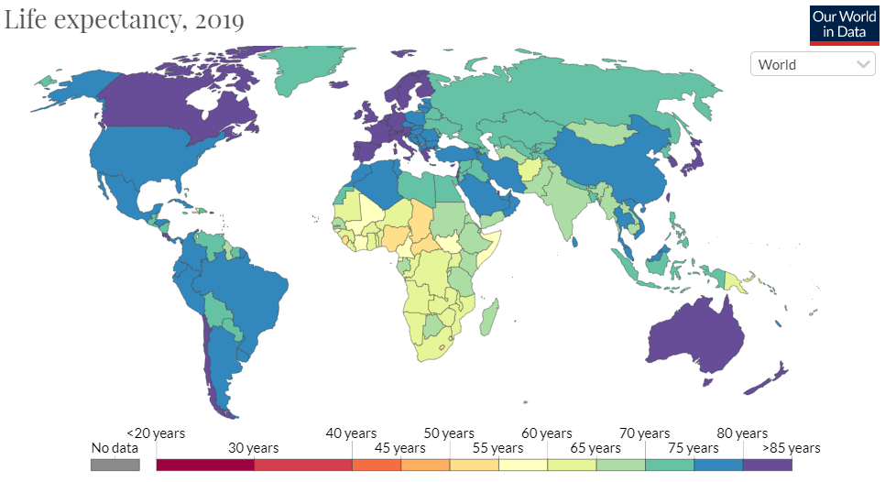
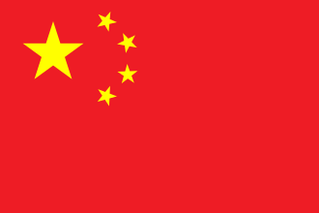
Population Year 7 HT5
Life Expectancy is how many years a person can expect to live. Average life expectancy in the UK is 82 years, where as for Nigeria it is 54 years.
Life expectancy varies due to factors such as: famine, war, disease, access to clean water, education, food and medical help.
China’s population was growing rapidly during the 1950s -1970s with so many people, there were not enough resources to go around, therefore the China One Child Policy was introduced in 1980, this was relaxed in 2015 to allow a family to have two children and was adjusted again in 2021 to become the three child policy.
Impacts of the One Child Policy
The fertility rate has dropped from 5.7 in 1960 to 1.5 in 2011. | About 400 million births may have been prevented. | In urban areas the policy was very effective.
It has led to an ageing population with a high dependency ratio. The ageing population is also increasing because of the improvements in living standards and life expectancy in the country. | The cultural preference for boys has meant that there seems to be a gender imbalance in China | There were reports of female infanticide, especially when the policy was first introduced.
Overpopulation is when there are too many people for the available resources.
Impacts of overpopulation include:
Social Impacts | Economic Impacts | Environmental Impacts
There are food shortages if the country cannot grow or import enough food. | Wages are low due to high competition for jobs | There is an increase in the amount of pollution as more people equal more greenhouse gas emissions.
Services such as healthcare and education cannot cope with the large young population so not everyone has access to them. | There becomes not enough jobs for the number of people, so unemployment is high. | There is an increase in the amount of waste and landfill sites.
Diseases spread more quickly especially is low quality housing areas. | With fewer resources, there will be an increase in living costs | The more land we take over, the less land there is for other living species e.g. pandas
An ageing population is when there are more people over 65 than under 15. This results in the working population having many elderly people to support, however as the percentage of young people is low, when they grow up, there won’t be enough of them to do all the work. Therefore immigrants from other countries might have to move to countries such as Germany to fill job shortages.
A youthful population is when there is a high percentage of people under 15 than over 65. With so many young people, many may find it hard to get work when they grow up. Countries with an youthful population have to invest in education facilities and health care services to provide for their population.

Slide 12
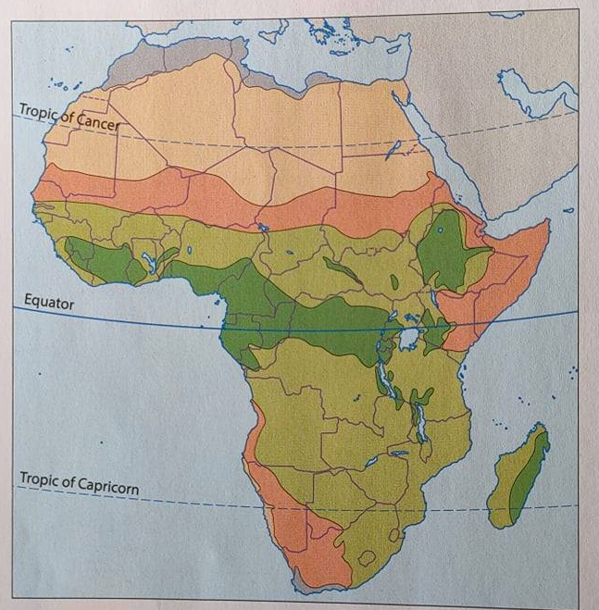
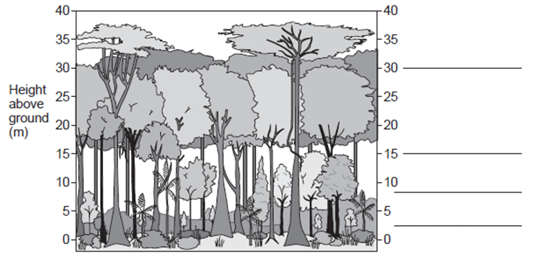
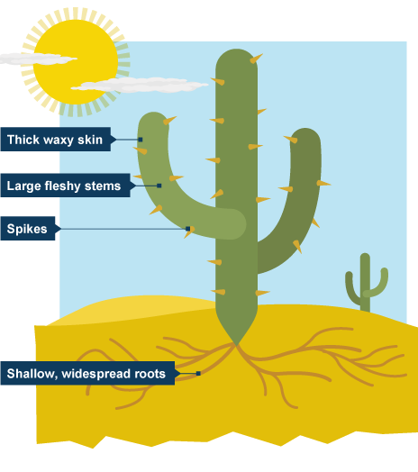
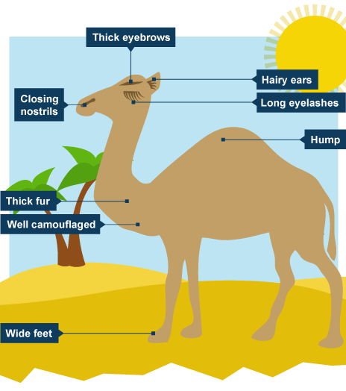
Biomes of Africa Year 7 HT6
A biome is a large region with its own distinct climate, plants and animals.
There are four main biomes in Africa as shown in the map below.
Name of biome | Climate (temperature and rainfall) | Plants and Animals | Challenges the biome faces
Hot Desert | Hot in the day – up to 50ºC. Cold at night. Very little rain – some places get almost none | Plants and animals have to adapt to the climate. Camels, gazelles, ostriches, vipers, sand rats | Extreme temperatures
Semi Desert | Always hot or warm (but cooler than the desert). There is a wet and a dry season | Wild dogs, rodents. Domestic animals – cattle, sheep, goats. Grasses, low shrubs and scattered trees | The rains often fail, so animals and crops may die.
Savannah | Warm all year, with a rainy season and little rain the rest of the year | Lions, elephants, zebras, giraffes. Rolling grasslands, acacia trees | Desertification – when deserts expand and get bigger
Rainforest | Warm and wet all year – but less than the Amazon rainforest | Chimps, gorillas, monkeys, snakes, hippos and birds. Thousands of species of plants, low shrubs, ferns and 45m tall trees | Deforestation – people cut down the trees for timber or to grow crops
Deforestation is the removal of trees.
Causes: logging, dam building, farming, mining, settlement and fuel wood, road building
Consequences: Creates jobs, soil erosion, loss of habitats, climate change
Different groups of people have different views on deforestation.
Hot desert
Semi-desert
Tourism in Kenya – in 2020 over 2 million people visited Kenya
There are both positive and negative impacts of tourism, for example, it creates jobs, however the jobs can be poorly paid. Tourists bring money to the country, however the local people may see very little of the money that tourists spend. Tourists enjoy the attractions, however can damage the landscapes.
Like deforestation, different groups of people have different views on tourism.
Savanna
Rainforest
Emergent
Plant and animal adaptations in the Sahara Desert – have to be able to cope with the climate including very little rainfall and high day time temperatures and cold night time temperatures.
Canopy
Under Canopy
Shrub Layer

