Slide 1
Year 9 HT1 Knowledge Organiser – Pigeon English by Stephen Kelman
Context The novel is set in modern day London. The novel explores the idea of a child migrating to London and demonstrates the lure of gangs and violence. It also shows how easy it is for vulnerable young people to become involved in this violent lifestyle. The novel mirrors the real life problems with knife crime in London. The novel is loosely based on Damilola Taylor. Damilola was a 10 year old young Nigerian school boy, who lost his life on the 27th November 2000 after being stabbed in the leg on the streets of Peckham. The case became one of the country’s most high-profile killings. Damilola crawled to a stairwell where builders found him and called an ambulance. Eventually, after multiple trials, two brothers were charged with manslaughter. They were 12 and 13 when they committed the crime. | Themes Gang culture: A gang is a group with a defined leadership and internal organization that claims control over territory in a community and engages, either individually or collectively, in illegal, and possibly violent, behaviour. Power: The ability to act in a certain way and influence others to act in a certain way. Innocence: Innocence is a lack of guilt, with respect to any kind of crime, or wrongdoing. It also means a lack of experience. Knife crime: Criminal offences committed with a knife. Immigration: The movement from one country to a new country to live. | Characters Harrison – The protagonist and narrator of the novel. Lydia – Harrison’s older sister Harrison’s mum – Harrison and Lydia’s mum. Auntie Sonia – Harrison and Lydia’s aunt. Julius – The rich man who dates Auntie Sonia. The DFC – A gang of boys in the local area. Miquita - Miquita is Killa’s girlfriend and a friend of Lydia and Chanelle – A friend of Lydia and Miquita. Jordan – One of Harrison’s best friends. Dean – Harrison’s best friend from school. The Pigeon – The second narrator of the novel. Poppy Morgan –A girl at Harrison’s school whom he has a crush on.
Techniques Simile: A comparison of two things using like or as – The world is like a stage. Metaphor: A direct comparison of two things which is not literal – The world is a stage. Imagery: Creating a mental picture for the reader through appealing to the senses (smell, touch, taste, see, hear) – The smell of freshly cut grass filled the air. Colloquial language: Informal language used by people in their everyday speech – Don’t chicken out! Pathetic fallacy: When nature reflects human emotion (we often see this in the weather) – The sun shone on the cloudless sky as the friends were reunited. Cyclical structure: When a text begins and ends with the same idea or event. Dual-narrative: A dual narrative is a story that is told from two different perspectives. Foreshadowing: A warning or hint of a future event. Extended metaphor: A metaphor which is repeated or extended over the course of a text. Dramatic Irony: When the reader or audience is aware of something that the character is not. | Symbols The Pigeon: The Pigeon is the second narrator of the novel. The Pigeon is the adult voice of the novel. The Pigeon acts as a guardian angel figure towards Harrison and watches over him. Some people think that the Pigeon is a father-like figure towards Harrison as his dad is in Ghana and can’t look out for him. The Pigeon is an outsider like Harrison. He talks about humans trying to keep them out. The Pigeon foreshadows the events that happen to Harrison. The fingerprint: Fingerprints and footprints seem to hold an intrinsic link to identity in the novel. They appear as a symbol throughout; Harrison collects fingerprints whilst hunting his ‘killer’; Auntie Sonia burns her fingerprints to escape ‘her old self’ and Harrison and Lydia leave their mark on the world when they leave their footprints behind. The playground: The playground could represent childhood, innocence and freedom. Kelman personifies the playground to emphasise this idea “Everybody went to watch the playground die”. Society just watches children’s lives perishing. Everybody is aware of gang violence and poverty, but no one really takes responsibility for it. Rain: Rain as a baptism – new beginning. Washing away sins. Rain washes the blood away, Harrison and Lydia tear up her costume and discard it in the rain believing that it has signified a new start. | Plot Summary Newly arrived from Ghana with his mother and older sister, eleven-year-old Harrison Opoku lives on the ninth floor of a block of flats on an inner-city housing estate. The second best runner in the whole of Year 7, Harri races through his new life in his personalised trainers – the Adidas stripes drawn on with marker pen – blissfully unaware of the very real threat all around him. With equal fascination for the local gang – the Dell Farm Crew – and the pigeon who visits his balcony, Harri absorbs the many strange elements of his new life in England: watching, listening, and learning the tricks of inner-city survival. But when a boy is knifed to death on the high street and a police appeal for witnesses draws only silence, Harri decides to start a murder investigation of his own. In doing so, he unwittingly endangers the fragile web his mother has spun around her family to try and keep them safe.

Slide 2
Year 9 - Knowledge Organiser – Speculative Fiction, Dystopia, and the Weird
Descriptive Techniques:
Simile | A comparison between two different things using "like" or "as". Example: “Her smile was as bright as the sun.”
Metaphor | A direct comparison between two unlike things without using "like" or "as". Example: “Time is a thief.”
Personification | Giving human qualities to animals, objects, or abstract ideas. Example: “The wind whispered through the trees.”
Zoomorphism | Giving animal characteristics to humans, objects, or ideas. Example: “He growled in anger.”
Chremamorphism | Giving object or machine-like qualities to humans or animals. Example: “She froze, her limbs stiff like iron rods.
Pathetic Fallacy | Attributing human emotions to nature or the environment, often to reflect a mood. Example: “The angry storm raged on.”
Imagery | Descriptive language that appeals to the senses (sight, sound, smell, touch, taste) to create vivid pictures. Example: “The scent of fresh rain lingered as the sun broke through the mist.”
Semantic Field | A group of words related to a common theme or topic. Example: (Death) The room smelt of decay. Gaping holes like tombstones were veiled by the darkness.
Oxymoron | A contradictory pair of words used together for effect. Example: “Deafening silence.”
Juxtaposition | Placing two contrasting ideas or images side by side to highlight differences or create effect. Example: “A beggar beside a Bentley.”
Repetition | The deliberate reuse of words or phrases for emphasis or rhythm. Example: “Alone, alone, all, all alone.”
Key Vocabulary:
Dystopia - A dystopia is a made-up world where society has gone wrong, often filled with suffering, control, or disaster.
Speculative- Speculative means imagining possibilities beyond the real world, asking “what if?” about the future, other worlds, or different realities.
Social Commentary- Social commentary is when a story, film, or artwork highlights problems in society, like inequality, injustice, or corruption, to make people think or change.
Android- An android is a robot designed to look and act like a human being.
Eco Narrative- An eco-narrative is a story that focuses on the environment and explores the relationship between humans and nature.
Apocalyptic- Related to or exploring the end of the world and the changing of life and society as we know it.
How to structure your writing:
Varied Sentence Starts | Could you… start with the simile, use three nouns and a colon, use a fronted adverbial?
Advanced Punctuation | Practice using ; … : Remember- ; is used to break up two linked, stand-alone clauses. … adds suspense and tension. : are used to introduce lists!
Varied Sentence Length | Vary the lengthy of your sentences. Long sentences can create a build up and often add to an overall tone of confusion and suspense as if we’re waiting…waiting for something. Short sentences have impact. They create drama.
Effective Paragraphing | Ensure you begin a new paragraph if you have a new focus. Try including dramatic one sentence paragraphs in-between your main ones!
Effective Structure | Drop your reader in. Shift the focus. Zoom on something. Link back to the start.

Slide 3
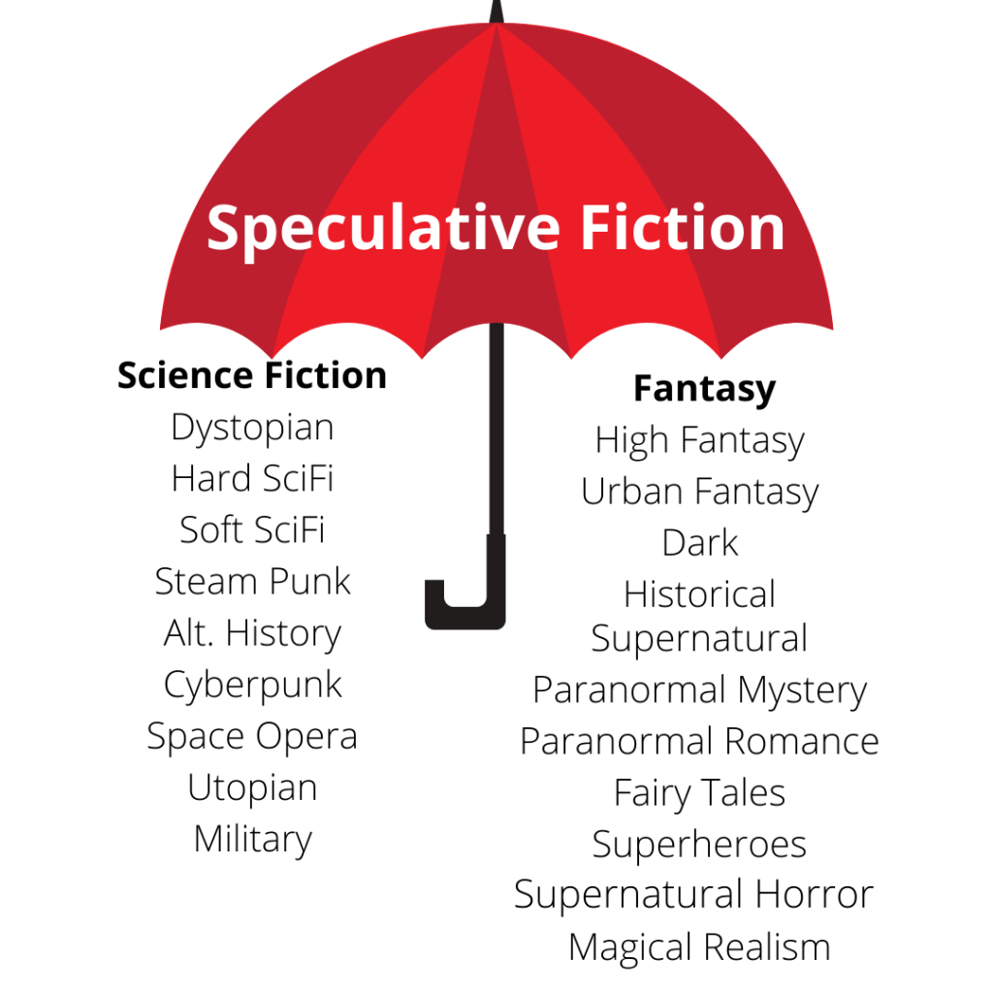
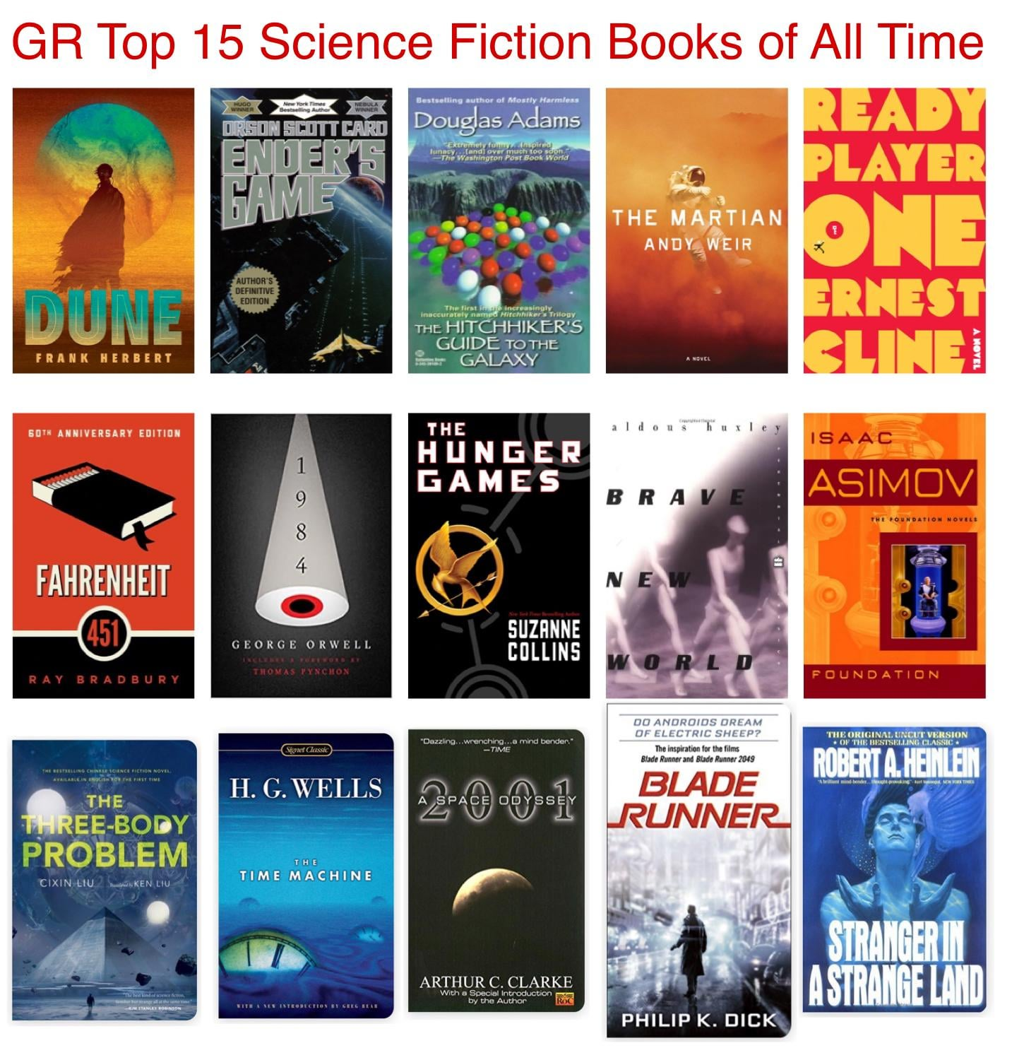
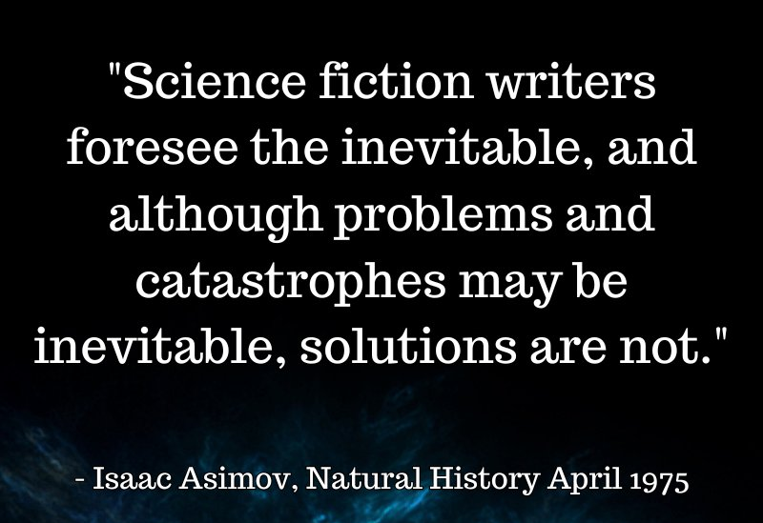
A Brief Summary… What is Speculative Fiction?
Summary of Speculative Fiction:
Speculative fiction is a broad genre of stories that imagine worlds, events, or futures that are different from our real world. It includes science fiction, fantasy, dystopia, horror, and alternate histories. These stories often ask “what if?” and explore ideas about technology, magic, society, or the future. Speculative fiction helps readers think about big questions, like how humans might change, what the future could be like, or how different choices might shape the world.
What do is it include?
Imagined Worlds – Settings that differ from our reality, such as futuristic societies, alternate histories, or fantasy realms.
What-If Scenarios – Explores hypothetical situations (e.g., "What if time travel was possible?").
Advanced Technology or Magic – Includes elements beyond current science or natural laws.
Social Commentary – Reflects or critiques real-world issues like politics, identity, or environment.
Unfamiliar Creatures or Beings – Features aliens, mythical creatures, or altered humans.
Alternative Rules or Laws – The world may have different physical, societal, or moral laws.
Exploration of the Unknown – Focus on discovery, mystery, or confronting the unfamiliar.
Extrapolation from Science or Myth – Builds on existing ideas and pushes them into the imaginative.
Heroic or Anti-Heroic Journeys – Follows characters through epic or transformative experiences.
Blurring of Genre Boundaries – Often mixes elements from sci-fi, fantasy, horror, and dystopia

Slide 4
Characters | Language Techniques | Structural Terminology
Pip Could be symbolic of the emotional, intellectual and spiritual growth that he makes throughout the novel as a pip describes a seed. Estella Means star-like. She is beautiful but is far beyond Pip’s grasp. It may also link to her lack of feeling. Ch8: ‘Her light came along the long dark passage like a star.’ Miss Havisham A compound of the verb ‘have’ and the noun ‘sham’ meaning false. Miss Havisham could have anything she wants because of her wealth but instead she lives a self-imposed impoverished life. Abel Magwitch Pip’s convict is dangerous and desperate, but Dickens used his first/forename to identify him as a victim. Cain and Abel were the sons of Adam and Eve. Cain committed the first ever murder by killing his brother. Abel was a shepherd and while Magwitch was transported to Australia he'd been living as a sheep farmer which further strengthens the analogy. | Simile: A comparison of two things using the key words like or as. The world is like a stage Metaphor: A direct comparison of two things which is not literal. The world is a stage Emotive language: Words which elicit an emotional reaction. Defeated and heartbroken, the team left the pitch Hyperbole: exaggerated statements or claims not meant to be taken literally Pathetic fallacy: When nature reflects human emotion (we often see this in the weather) The sun shone in the cloudless sky as the friends were reunited Imagery: Creating a mental picture for the reader through appealing to the senses (smell, touch, taste, see, hear). The smell of freshly cut grass filled the air Personification: the giving of human characteristics to a non-human object The rain tapped against the window Semantic field: a group of words within a sentence or paragraph which are related in meaning and theme. Corpse-like, skeleton, deathly, frail, grotesque | Motif: a repeated pattern—an image, sound, word, or symbol that comes back again and again within a particular story. Symbolism: the use of symbols/ things to represent ideas Juxtaposition: two things being seen or placed close together with contrasting effect First person narrative: a mode of storytelling in which a storyteller recounts events from their own point of view using the first person such as "I" Bildungsroman: a novel that depicts and explores the manner in which the protagonist develops morally and psychologically. A "pip" is a small seed, something that starts off tiny and then grows and develops into something new. Pip's name, then, is no accident, as Great Expectations is a bildungsroman, a story of the growth and development of its main character. Simple sentence: contains one clause with a subject and verb – the train was late. Compound sentence: contains two independent clauses that are related and joined with a conjunction – I like coffee and she likes water Complex sentence: contains one or more subordinate clause – Although I enjoy Maths, English is my favourite subject.
Year 9 HT3 Great Expectations

Slide 5
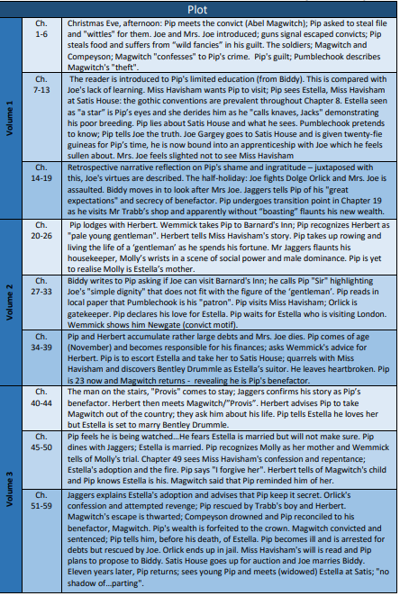
Themes and Context
Ambition and Self-Improvement Dickens presents the ambition to improve oneself that drives Pip along with many of the novel's secondary characters as a force capable of generating both positive and negative results. Pip's early ambitions focus on elevating his social class, on making himself into someone who seems worthy of Estella, but in the process he turns himself into someone who feels like a sham, is unkind to those who were kindest to him such as Joe and Provis, and ruins himself financially. Through these humbling experiences, Pip eventually comes to understand self-improvement as a more complex process involving moral and spiritual development as well. Pip's own ambitions are echoed by the self-improvement efforts of secondary characters like Joe and Ms. Havisham, who learn to write and to empathize, respectively, at Pip's encouragement.
Crime and Justice In 1800, there were about 5,000 crimes a year in Britain. This rose to 20,000 by 1840. Many people were forced to steal because they had no work or money. Dickens’ father went to debtor’s prison – he felt strongly that the justice system needed reform to help the convicted.
Social Class Dickens explores the class system of Victorian England, ranging from the most wretched criminals (Magwitch) to the poor peasants of the marsh country (Joe and Biddy) to the middle class (Pumblechook) to the very rich (Miss Havisham). The theme of social class is central to the novel’s plot and to the ultimate moral theme of the book—Pip’s realization that wealth and class are less important than affection, loyalty, and inner worth.
Education Education in the 19th century was not yet widely seen. There was no compulsory, state-provided education, so about half the population never learned to read or write because they could not afford to go to school.

Slide 6
Persuasive Technique | Definition | Example
Rhetorical question | A question asked in order to prompt further thought or to make a point rather than to get an answer. | If not me, then who? If not now, then when?
Simile | A descriptive technique that compares one thing with another, usually using 'as' or 'like‘. | He is as determinedly dishonest as a politician attempting to cover his latest immoral decision.
Emotive language | Words/ phrases deliberately used to evoke a powerful feeling from the reader i.e. sympathy, anger. | I find the notion that I am not worthy of voting for my country’s next leader because of my age, both demeaning and deeply insulting.
Statistic | A fact that is supported by numerical data. | The Trussell Trust’s foodbank network distributed 1,332,952 three day emergency food supplies to people in crisis, a 13% increase on the previous year. 484,026 of these went to children.
Flattery | Deliberately complimenting the reader. | The very fact that you are reading this article suggests that you are compassionate and understanding of the plight of your fellow man.
Hyperbole | Deliberately exaggerated language. | He was so obnoxious; I was hoping he would be arrested on the spot and given a very long prison sentence purely for not saying please or thank you.
Humour | Describing a surprising or unexpected reaction to an event/ person/ object to create amusement | My brother may look angelic but do not be fooled by his toddler aesthetic: he is a tiny-but very real-psychopath.
Listing | When the writer includes several words/ phrases/ ideas, one after the other. | Your vote is crucial – your healthcare, your children’s education, your housing, your carbon footprint, your energy bills, and your food prices are all affected by your vote.
Personification | Describing an inanimate object as having human feelings. | If we are not careful, prejudice will become our leader and it will dictate our actions and thoughts.
Eye-witness quotation/ expert quotation | Direct speech from a person who witnessed an event/ direct speech from someone who has an in-depth understanding of the topic. | The British Nursing Association said the move was “hugely concerning” and a stark example of the “extreme workforce pressure” at NHS emergency services, which are facing rising demand while recruitment and retention of nurses gets harder.
Rule of three | The use of three sentences, adjectives, nouns, questions etc. This can help to make your titles memorable, or provide examples. | Homeless people are scared, lonely, and desperate for your support.
Repetition | Using the same word or phrase in the same sentence, paragraph, or throughout your writing. You may choose a phrase to repeat between paragraphs, or a word to repeat within a sentence. | Imagine a London street without a single homeless person on it. Imagine a hospital A+E department without a queue or an 8 hour wait. Imagine schools with state-of-the-art facilities. This world is within your reach – if you vote for me.
Key Term | Definition
Capitalism | An economic and political system in which a country's trade and industry are controlled by private owners for profit, rather than by the state.
Socialism | A political and economic system which promotes social equality. Socialism promotes public services being owned and run by the government.
Right-Wing | A more traditional, conservative form of politics. Right-wing politics are generally characterised the view that certain social orders and hierarchies are natural. Right-wing politics supports stability and sticking to the status-quo.
Left-Wing | Left-wing politics is the support of social equality and rejects the idea of social hierarchy. Left-wing politics supports change and developing into a more equal society.
Democracy | A system of government decided by the entire population or a majority of eligible citizens, usually through elected representatives.
Political Party | A group of people who share political ideas and work together to achieve power at local or national level, e.g. The Conservatives or The Labour Party
Parliament | Elected representatives of the public who meet and debate to pass new laws. In the UK this is made up of The House of Commons, the House of Lords, and the Monarch.
Electorate | The people who are able to vote for and elect politicians.
Working Class | A socioeconomic group who do not earn huge amounts of money and often work in manual jobs or jobs that do not require further education, such as a university degree. The working class make up the majority of people in Britain.
Middle Class | A socioeconomic group who earn more money than the working class and usually work in jobs that require a university education, such as teachers or doctors.
Upper Class | The richest and smallest socioeconomic group in the country, made up of people who have usually inherited their wealth and hold titles, e.g. Lord, Lady. The upper class are often descended from royalty, or have married into families linked to the aristocracy.
Privatisation | The process of selling public services to private companies where they are run for profit.
Nationalisation | The process of the government taking control of services and running them from tax and national insurance money. E.g. the government paying for healthcare services.
Societal Perspective HT4

Slide 7
Socioeconomics
Definition: | The interaction between social and economic factors; what determines your social class
Key Issues: | Raising standards for the working class Ensuring people can move between social classes, e.g. through education Housing and homelessness Reducing poverty
Key Terms: | Aspiration Poverty Working/middle/upper class Social class
Environment
Definition: | The surroundings or conditions in which we live
Key Issues: | Agreeing to slow climate change Finding alternatives to oil and gas, e.g. electric, wind power, solar power Introducing more electrical vehicles Building eco-friendly homes and schools Planting more trees and forests
Key Terms: | Climate change Activists/activism Protest
Healthcare
Definition: | The provision of health services, e.g. doctors surgeries, hospitals, nurses
Key Issues: | Funding for the NHS Privatisation of the health service Better pay for nurses Recruiting nurses and doctors Overuse of the NHS Response to COVID
Key Terms: | Strike action Privatisation (selling parts of the NHS to private companies) Working conditions NHS (National Health Service)
Societal Perspective HT4
Education
Definition: | The provision of learning for including school, college and university.
Key Issues: | Grammar schools Private schools The price of going to university Student debt Education creating socioeconomic inequality The lack of diversity on the curriculum
Key Terms: | Exacerbating inequality Disadvantage gap Vocabulary gap Student loans
Introduction Techniques:
‘Imagine this…’
Rhetorical question
Quotation from an expert/somebody you know
A description of when you first became aware of the issue
Speech Structure
Introduction
Exploratory Paragraph – Anecdote
Exploratory Paragraph – Research
Exploratory Paragraph – Counter Argument
Conclusion
A Good Conclusion Should…
Leave your audience with a lasting image of the issue you are addressing.
Offer solutions to the problems you have raised.
Ask your audience to support you in tackling the issues you have raised.
Be cheesy!
An ANECDOTE PARAGRAPH should tell a story – either personal, or somebody’s real life experience.
A RESEARCH PARAGRAPH should expand on the issue by discussing facts and statistics that relate to the issue and support your anecdote.
A COUNTER ARGUMENT should suggest what people might say if they were arguing against you, then explain why they’re wrong.

Slide 8
Y9 Knowledge Organiser: Romeo and Juliet HT5 (Violence and Masculinity)
Key Themes Violence and Masculinity: Explored through family feuds, public brawls, and impulsive actions of male characters. Fate and Destiny: The characters' lives are predetermined, highlighted by the "death-mark’d love" in the prologue. Love vs. Conflict: The central love story of Romeo and Juliet is overshadowed by familial hatred and societal pressures. Patriarchal Society: Power dynamics and control, especially through Lord Capulet's treatment of Juliet. Key Characters and Symbols Romeo Montague: Protagonist; impulsive, reckless; hamartia: too impetuous. Juliet Capulet: Protagonist; mature, logical, a foil to Romeo's impulsiveness. Tybalt Capulet: Antagonist; symbolizes hatred and violence; hamartia: excessive pride and temper. Mercutio: Romeo's best friend; witty, volatile; name derived from ‘mercurial.’ Benvolio Montague: Peacekeeper; seeks harmony but is misjudged. Friar Lawrence: Wise but unreliable; a catalyst for events. The Nurse: Juliet’s confidante; mediator and advocate for peace. The Prince: Symbol of authority; enforces rules to curb violence. Lord Capulet: Patriarchal control; uses violent language towards Juliet. | Plot Summary Prologue: Introduces the story of “star-cross’d lovers” and foreshadows their deaths. Act 1: A public brawl highlights the feud between the Montagues and Capulets. Romeo and Juliet meet at the Capulet feast and fall in love. Act 2: Romeo and Juliet profess their love and secretly marry with Friar Lawrence’s help. Act 3: Tybalt kills Mercutio; Romeo kills Tybalt and is banished. Juliet is devastated but remains loyal to Romeo. Act 4: Juliet fakes her death with a potion given by Friar Lawrence to avoid marrying Paris. Act 5: Romeo, believing Juliet is dead, returns to Verona and kills himself. Juliet awakens, finds Romeo dead, and kills herself. The families reconcile after the tragedy. | Key Terminology Hamartia: Fatal flaw leading to the protagonist’s downfall. Peripeteia: Turning point or moment of no return. Dramatic Irony: When the audience knows more than the characters. Patriarchy: A system where men hold power and authority over women. Foil: A character who contrasts with another to highlight traits. Key Concepts Patriarchal Society: Juliet’s father controls her choices, highlighting societal expectations of obedience. Romeo and Juliet’s secret marriage defies these expectations. Fate and Destiny: The play revolves around the idea of inevitable fate, emphasized by the prologue and repeated references to “stars” and “fortune.” Conflict: Familial conflict (Montagues vs. Capulets) drives the tragic events. Internal conflict (Juliet’s loyalty to Romeo vs. her family) adds depth.

Slide 9
Y9 Knowledge Organiser: Romeo and Juliet (Violence and Masculinity)
Key Quotations “Do you bite your thumb at us, sir?” Explanation: This line from Act 1, Scene 1 reflects the petty provocations and simmering conflict between the Montague and Capulet servants, setting the stage for the broader family feud. “Peace? I hate the word, as I hate hell, all Montagues, and thee.” Explanation: Tybalt's declaration in Act 1, Scene 1 showcases his aggressive nature and disdain for peace, emphasizing his role as a catalyst for violence. “A plague o’ both your houses!” Explanation: Mercutio's curse in Act 3, Scene 1 after being mortally wounded symbolizes the destructive impact of the feud on innocent lives. “These violent delights have violent ends.” Explanation: Friar Lawrence’s warning in Act 2, Scene 6 foreshadows the tragic consequences of impulsive actions and intense emotions. “O brawling love, O loving hate.” Explanation: Romeo’s oxymoron in Act 1, Scene 1 illustrates the chaotic interplay of love and hate that defines the play’s central conflict. “My only love sprung from my only hate!” Explanation: Juliet’s realization in Act 1, Scene 5 highlights the painful irony of her love for Romeo, a member of her family’s enemy. “Hang thee, young baggage! Disobedient wretch!” Explanation: Lord Capulet’s harsh words in Act 3, Scene 5 showcase his authority and control over Juliet, as well as the patriarchal expectations of obedience. “Thou art a villain.” Explanation: Tybalt’s insult to Romeo in Act 3, Scene 1 escalates the tension and directly leads to the violent turning point of the play. “For never was a story of more woe than this of Juliet and her Romeo.” Explanation: The Prince’s closing lines in Act 5, Scene 3 emphasise the tragic consequences of unchecked conflict and the ultimate futility of power struggles. | Shakespeare's intentions In Romeo and Juliet, Shakespeare examines the destructive consequences of conflict and violence, delivering powerful lessons that resonated deeply with Elizabethan audiences. The play demonstrates the futility of feuds through the tragic deaths of Romeo and Juliet, whose love is crushed by the ongoing rivalry between the Montagues and Capulets. Shakespeare critiques the cyclical nature of hatred, showing how one violent act leads to another, ultimately resulting in devastating consequences for families and communities. A central theme is the impact of toxic masculinity and honor culture. Characters like Tybalt and Mercutio embody impulsive aggression, with their need to defend their honour driving much of the play’s conflict. Even Romeo’s impulsive and reckless actions contribute to the tragic events, emphasising the dangers of equating masculinity with violence. Shakespeare also critiques patriarchal control through Juliet’s struggle against her father’s insistence on marrying Paris. Her rebellion reflects the oppressive nature of rigid societal expectations, which can force individuals into desperate and dangerous decisions. Fate also plays a key role in the tragedy, as Romeo and Juliet are described as “star-crossed lovers,” yet Shakespeare intertwines this with human choices. While destiny appears inevitable, the characters’ decisions, driven by hatred and impulsiveness, escalate the tragedy. These lessons were particularly significant for Elizabethan society, which often faced family feuds, duels, and strict patriarchal norms. By portraying the devastating consequences of violence, Shakespeare encouraged his audience to embrace empathy, reconciliation, and restraint. The Prince’s failure to maintain peace serves as a reminder of the importance of strong, proactive leadership. Ultimately, Romeo and Juliet is not just a cautionary tale about love and loss but also a powerful commentary on the societal and personal costs of unchecked hatred, offering timeless insights into the need for harmony and understanding.

Slide 10
Year 9 HT6 Knowledge Organiser – Poetry from Other Cultures
Word class | Definition | Example
Verb | A verb is a word or set of words that shows action (runs, is going, has been painting); feeling (loves, envies); or state of being (am, are, is, have been, was, seem).. | ‘He plunges at me, guttering, choking, drowning.’
Adverb | An adverb labels how, when or where something happens (and they often end in ‘–ly’). | ‘Then cunningly covering his tracks’
Noun Pronoun | Nouns are names, places and things; they also signify imagined things like ‘a ghost’; and ideas or concepts, such as ‘love’, ‘guilt’ or ‘fate’. Words used instead of a noun i.e. ‘he’, ‘she’, ‘they’, ‘it’. | ‘Your words cut into me, sharp as a knife The pain that you cause always goes unseen’
Adjective | An adjective is a describing word or phrase that adds qualities to a noun. It normally comes before a noun, or after verbs like ‘am’, ‘is’, ‘was’, ‘appears’ or ‘seems’. | ‘With a deep multitude Of colourful distractions.’
Preposition | Prepositions are short words and phrases that give information about place, time and manner | ‘They dropped into the dust even before the hunter strung his bow.’
Terminology | Definition
Inference | To make an educated guess to deduce or conclude something. To form an opinion on something based on evidence.
Context | The background, environment, setting, framework, or surroundings of events or occurrences. The circumstances forming a background of an event, idea or statement, in such a way as to enable readers to understand the narrative or a literary piece.
Connotations | A meaning that is implied by a word apart from the thing which it describes explicitly. Words carry cultural and emotional associations or meanings, in addition to their literal meanings or denotations.

