Slide 1
Year 7 HT1 Knowledge Organiser My Sister Lives on the Mantelpiece – Annabel Pitcher
Context 7/7- bombings that took place on public transport in London killing 52 people and injuring 700. They were coordinated suicide bomb attacks on the London transit system on the morning of July 7th 2005. At 8:50am explosions tore through three trains on the London Underground, killing 39. An hour later 13 people were killed when a bomb detonated on the upper deck of a bus in Tavistock Square. | Themes Islamophobia – The fear, hatred and hostility towards Islam and Muslims. Prejudice – Having an opinion or judgement which is not based on experience. Grief – An experience of intense sorrow, usually after a death. Childhood – Jamie deals with extraordinary circumstances whilst he transitions through his childhood. Friendship – Jamie and Sunya navigate their friendship throughout difficult situations. Terrorism – The use of fear or acts of violence used to intimidate people or governments. Revenge – Hurting or harming someone as punishment for hurting you or someone else.
Techniques Simile – A comparison of two things using the key words like or as. ‘the moon was fat. It looked like a saucer of milk’ Imagery – Creating a mental picture for the reader through appealing to the senses (smell, touch, taste, see, hear). ‘I felt all light and fizzy, lemonade in my veins, and my thoughts popped and bubbled in my brain.’ Pathetic fallacy – When nature reflects human emotion (we often see this in the weather) ‘all the green has turned to brown and purple, as if the hills have got bruises. I like the world this way’ Emotive Language – Words which elicit an emotional reaction. ‘All the hurt turned into anger. With a shout of rage I jumped up and kicked the tyre marks’ Metaphor – A direct comparison of two things which is not literal. ‘Straight shiny hair that fell all the way down to her shoulders in a black silk curtain’ | Symbols Letters are a recurring symbol throughout the novel as it symbolises the constant hope that Jamie has in his mother returning. Angels and clouds Jamie mentions the class reward system often within the book. We can see that the rewards chart symbolises the constant memory of Rose for Jamie. Even at school, he cannot escape the memories of his sister. The Blu tack rings symbolise the relationship between Sunya and Jamie and the fact that although they may have different beliefs they are brought together in their friendship and love of superheroes. A Spiderman T-Shirt Jamie believes that the T-Shirt is a symbol of the love of his Mum and so he continues to wear it every day in the hope that his Mum will come back for him. However, by the end of the novel, the T-Shirt becomes a symbol of Jamie’s abandonment and he feels like he has outgrown it. He realises that things cannot go back to how they were. | Plot Summary Jamie, his sister Jas and their Dad move to the country from London after Jamie’s mother has an affair and leaves. Sitting on the Mantelpiece in their new home is the ashes of Rose, Jas's twin sister, who was killed on September 9 in the London Bombings, five years earlier. Jas has been deeply troubled by the death of her sister, yet it doesn't affect Jamie the same since he was too young to really know Rose. At his new school, Jamie befriends Sunya, who is a Muslim. Jamie knows his father wouldn't approve of their friendship, as he is prejudice, hates Muslims and blames Rose's death on the entire Muslim population.
 |  | Characters Jamie – He is ten years old and he is the narrator of the story. He is a typical ten year old who enjoys football and superheroes. Jas – She is Jamie’s older sister who is fifteen. She looks after Jamie like a mother. Jas is Rose’s twin. Dad – He used to work in construction but has struggled with grief and alcoholism. Sunya – A ten year old Muslim girl in Jamie’s class at school. Mum – She used to be a teacher and has now left her family to live with Nigel. Leo – He is Jas’ punk boyfriend with green hair. Nigel – Nigel is Mum’s boyfriend who she met at a support group after he had lost his wife and after Mum lost her daughter Rose.
Word Class Verb – A word which identifies a movement – run/walk Adverb – A word which describes a movement or gives more information about a verb adjective – slowly/lazily Noun – A word that identifies a person, place or thing – teacher/school Adjective – A word that describes a noun – beautiful/adorable Conjunction – A word that connects phrases or sentences – because/and/or

Slide 2
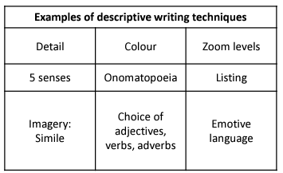
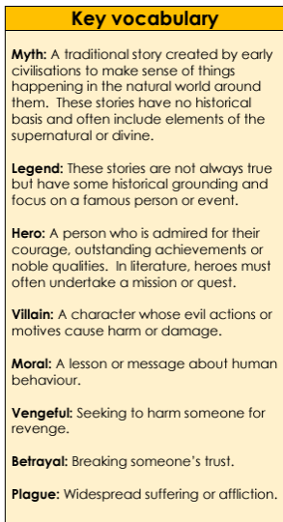
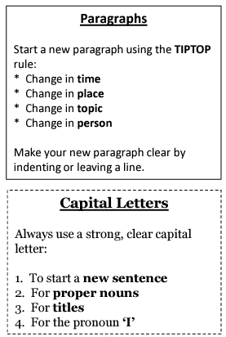
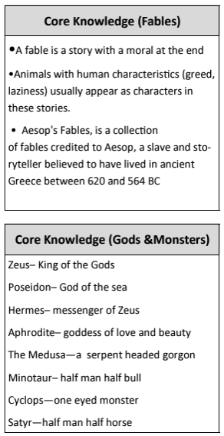
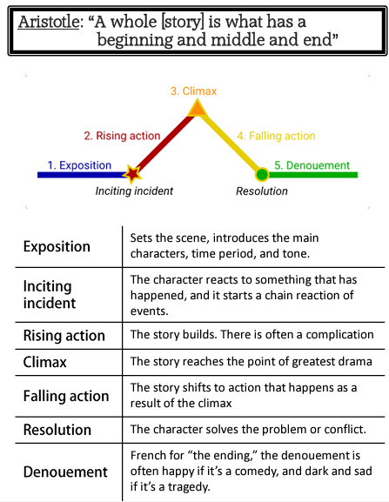
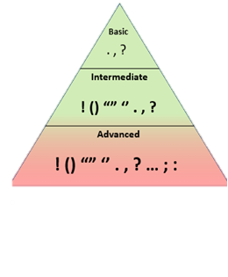
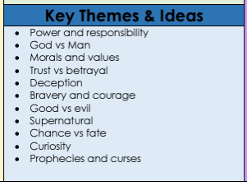
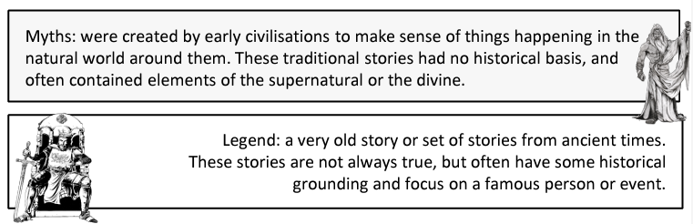
Storytelling – Myths and Legends – HT2 – Year 7

Slide 3
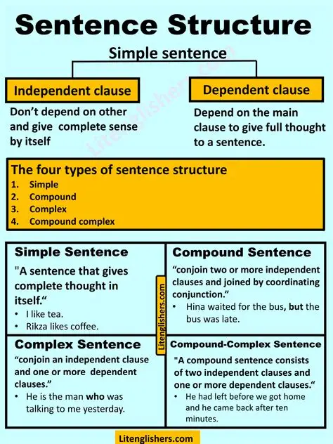
Varying Sentence Structures – Myths and Legends
The Comma Sandwich
The minotaur, half-man and half-bull, lurked in the labyrinth.
The Semi-colon to Join Two Related Clauses
Medusa glared with furious eyes; anyone who looked at her turned to stone.
The Colon to Clarify
The hero faced his greatest fear: the fire-breathing dragon.
Two Similes Sentence
The underworld was dark like a cave with no light, like a shadow swallowing the world whole.
Distance and ‘More’ sentence
The castle gates stood further than expected, more forbidding with every step towards them.
Unfortunately AND Fortunately
Fortunately, the hero found a sword of fire; unfortunately, it was guarded by a dragon.
Prepositional Start
Under the silver moonlight, the goddess whispered her ancient spell.
Adjective Openings
Silent and watchful, the sphinx guarded the temple gates.
The Dramatic Ending
The treasure chest opened slowly, revealing nothing but dust and silence.

Slide 4
Year 7 HT3 Knowledge Organiser Oliver Twist – Charles Dickens
Context Charles Dickens clearly understood the poverty in London during the 1800s, as he himself was a child worker after his father was sent to debtors’ prison. His appreciation of the hardships suffered by impoverished citizens stayed with him for the rest of his life and was evident in his writing. Dickens began writing Oliver Twist after the adoption of the Poor Law of 1834, which stopped government payments to the able-bodied poor unless they entered workhouses. Therefore, Oliver Twist became a story clearly aimed directly at the problem of poverty in 19th-century London. | Plot Summary Oliver Twist is born in a workhouse in 1830s England. He is transferred to a workhouse for adults after 9 years. After the other boys bully Oliver into asking for more gruel at the end of a meal, Mr. Bumble, the parish beadle, offers five pounds to anyone who will take the boy away from the workhouse. He is eventually apprenticed to a local undertaker, Mr. Sowerberry. Desperate, Oliver runs away at dawn and travels toward London. Outside London, Oliver meets Jack Dawkins. Jack offers him shelter in the London house of his benefactor, Fagin. It turns out that Fagin is a career criminal who trains orphan boys to pick pockets. After a few days of training, Oliver is sent on a pickpocketing mission with two other boys. When he sees them swipe a handkerchief from an elderly gentleman, Oliver is horrified and runs off. He is caught by the police. Mr Brownlow understands his innocence and tries to help Oliver, but he is kidnapped by Sikes and returns back to Fagin’s lair. Sikes’ girlfriend, Nancy, realises that Fagin wants Oliver for his inheritance (with the help of a man named Monks) and sees that she must set things right. She meets with Mr Brownlow and explains that Oliver is in danger. When word of Nancy’s disclosure reaches Sikes, he brutally murders Nancy and flees London. Pursued by his guilty conscience and an angry mob, he hangs himself while trying to escape. Mr. Brownlow confronts Monks and squeezes the truth about Oliver’s parentage from him. Monks has been pursuing Oliver all along in the hopes of ensuring that his half-brother is deprived of his share of the family inheritance. Mr. Brownlow forces Monks to sign over Oliver’s share to Oliver. Finally, Mr Brownlow adopts Oliver and he has a secure and comfortable home in the countryside.
Drama Terminology: Act/ Scene An act is a division or unit of a theatre work. Plays usually have 2-3 Acts – Shakespearean plays had around 5. A scene is a part of an act defined with the changing of characters. Characters People acting in a playscript Setting Setting is the time and place (or when and where) of the story Audience The people who watch the performance; those for whom the performance is intended. Dialogue The dialogue refers to the words that will be spoken by the actors. Colon The colon ( : ) is a punctuation mark that is put before a reveal of information. Stage Directions information for actors about how to act – usually in italics or brackets.
 | Characters Oliver He is a ‘pale, thin’ orphan who is treated badly by almost everyone he meets. He tries his best to be a good person and experiences ‘horror and alarm’ whenever he sees crimes being committed. Mr. Bumble The man who runs the workhouse and gives Oliver his name. He is ‘a fat man’ who enjoys power and doesn’t care about the people beneath him. Noah Claypole A ‘malicious and ill-conditioned’ boy who bullies Oliver at the undertakers. He eventually runs away to London and joins the same gang as Oliver. Fagin An old man who runs the gang of pickpockets. He seems kind but his ‘villainous-looking and repulsive face’ reflects his selfish nature as he gets young boys to do his dirty work for him. Jack Dawkins (The Artful Dodger) A young boy who introduces Oliver to Fagin’s gang who has ‘all the airs and manners of a man’. He’s confident and cunning. Bill Sikes A ’rough man’ who has been a criminal for many years. He beats his dog viciously and brutally kills his girlfriend, Nancy. Nancy Bill’s girlfriend who risks her life to help Oliver escape from the gang. She loves Bill even though he treats her abusively and she feels guilty about the life of crime she has led. Mr. Brownlow A wealthy older gentleman who takes Oliver in and looks after him. He believes in Oliver’s goodness even when it looks like Oliver has stolen from him and eventually finds out the truth about Oliver’s parents.
Techniques: Metaphor – saying that something is something else – ‘She’s a star’ Simile – comparing two things using ‘like’ or ‘as’ – ‘She shone like a star’ Personification – giving an item human qualities/features – ‘The stars winked at me’ Imagery – where a piece of writing creates an image in a reader’s head Foreshadowing – a warning or indication of a future event Simple Sentence: a sentence with just one independent clause Compound Sentence: a sentence with two independent clauses, that are joined by a co-ordinating conjunction Complex Sentence: a sentence with a subordinate clause and an independent clause Minor Sentence: a short sentence – usually one or two words – that doesn’t have a main verb or subject.

Slide 5
Fiction vs. Non-Fiction
Non-fiction texts are based on facts and real life, while fiction texts are made up.
HT4 – Y7 - Non-Fiction Writing
Techniques to use in your writing: | Definition | Example
Alliteration | Repeating a consonant sound to create a particular sound or tone. | “The four best bets for better business”
Opinions | Saying what you think or feel about a certain topic. | I find the whole thing completely and entirely disgusting. This should not be happening in today’s society.
Facts | Writing something that is true and can be proven. | Hartford is in the Cheshire West and Chester authority.
Rhetorical question | A question asked in order to prompt further thought or to make a point rather than to get an answer. | If not me, then who? If not now, then when?
Emotive language | Words/ phrases deliberately used to evoke a powerful feeling from the reader i.e. sympathy, anger. | With just one pound a day, you could transform the life of these poor, starving, innocent animals.
Statistics | A fact that is supported by numerical data. | Over 60% of children on the planet are suffering due to the cost of living crisis.
Eye-witness quotation/ expert quotation | Direct speech from a person who witnessed an event/ direct speech from someone who has an in-depth understanding of the topic. | “We are losing ground in the fight to end child labour” said the Unicef chief, Henrietta Fore
Rule of three | The use of three sentences, adjectives, nouns, questions etc. | This situation is disgusting, shocking and appalling.
Repetition | Using the same word or phrase in the same sentence, paragraph, or throughout your writing. You may choose a phrase to repeat between paragraphs, or a word to repeat within a sentence. | We see this happening time after time, again and again.
Types (conventions/forms) of Non-fiction Texts:
Article: Usually for a newspaper or a magazine – gives information, thoughts, facts and details on a certain topic.
Autobiography: A book that somebody writes about themselves. Usually covers their life in chronological order.
Report: Includes information about something that has happened. Usually gives facts and statistics about the topic.
Diary: Written in first person, a diary is a recollection of events that happened in someone’s life, in chronological order. Usually displays thoughts, feelings and opinions
Speech: Written to be said aloud. A text which aims to persuade, inspire, inform or motivate a group of people.
Letter: A written communication, from one person to another. Would be posted and received a day or two later.

Slide 6
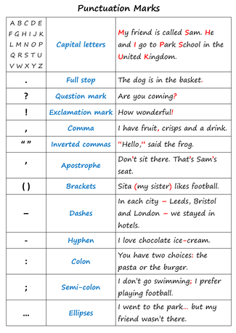
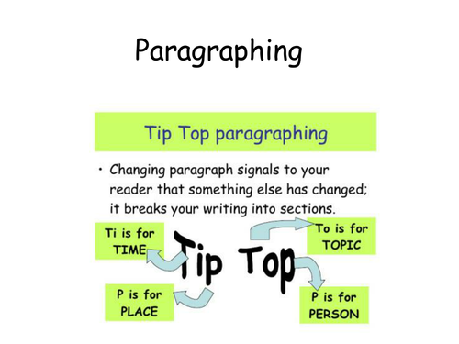
Audience
All writing has an intended audience – from emails, to text messages, ingredients on a cereal package to political speeches - even graffiti on a wall. The intended audience are the readers you expect to engage with the text.
In the case of direct messages – such as emails, texts or hand-written letters – the audience is usually the one or two people you address the message to. In this case the language and style of your writing will change according to a number of factors, including how well you know the recipient.
For example, you might use chatty language with emoticons and abbreviations in an email to a close friend. However in a job application email, you’d be expected to use formal language with full words and sentences.
Other texts, such as newspaper articles, blogs or leaflets are intended for a broader audience. In this context, you are unlikely to know your readers personally and so you need to make assumptions about them. Some writers have an ‘ideal’ reader in mind. You might consider the following things about your reader:
age
gender
culture
specialist knowledge
hobbies
political leanings
Knowing your audience allows you to choose language and a style that will appeal to them.
Tone refers to the mood or feel of your writing, e.g. should your tone be:
Friendly and chatty, or distant and polite?
Sarcastic, pleading, or dismissive?
Upbeat and positive, or calm and controlled?
Purpose
What will your writing ‘do’?
The purpose of a text is the reason for writing. There are many reasons for writing. You might be writing to:
share information
give instructions on how to do something
persuade someone that you are right
persuade a group of people to buy a product
review a film or website
explain why you’re the best person for a job
Think about your purpose before you start:
What do you want your writing to achieve?
How do you expect your reader to feel as a result of reading?
For example, if your purpose were to instruct a beginner how to fold an origami swan, your language would need to be clear and concise. Simple language and imperatives would help convey your message.
If your purpose were to persuade a group of voters to support a political campaign, your writing would need to be exciting and dynamic. Rhetorical language combined with facts and figures might help to sway your readers.
Structure refers to the way you present your writing, e.g. should you use:
Full sentences and paragraphs?
Subheadings and bullet points?
A sequence of linked paragraphs that lead to a final conclusion?
Time Periods
Texts vary when they are written in different time periods. If a text is produced in the 18th or 19th century, the sentence structures will be different and there will be some vocabulary that we are not familiar with.
Life was very different 100 years ago, and even more different 200 years ago, so there will be different ideas and information about things like:
How children were treated
How women were treated
How different races and religions were treated
What rights people did/didn’t have
When should you start a new paragraph?

Slide 7
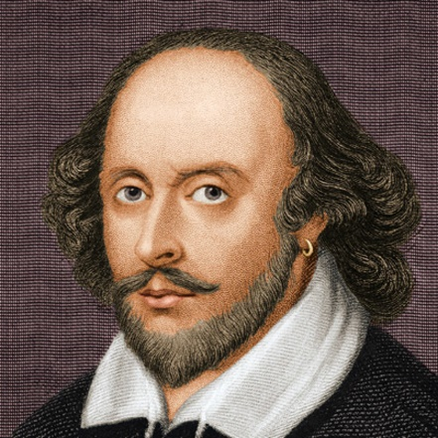
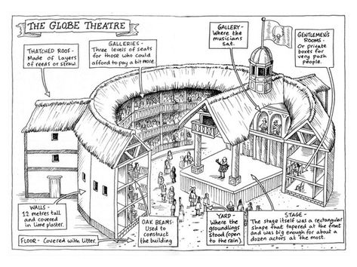
Knowledge Organiser Y7 HT5 An Introduction to Shakespeare
Context
William Shakespeare was born in 1564 in Stratford-upon-Avon, England. He grew up in a middle-class family and attended grammar school, where he would have learned Latin and Greek. At the age of 18, he married Anne Hathaway, and they had three children together.
Shakespeare moved to London in his early 20s and began working in the theatre industry. He became involved with a theatre company called the Lord Chamberlain's Men, which later became the King's Men. Shakespeare wrote numerous plays and poems during his career, becoming one of the most renowned playwrights in history.
Shakespeare's plays are known for their rich language, vivid characters, and exploration of complex themes such as love, jealousy, power, and betrayal. Some of his most famous plays include "Romeo and Juliet," "Hamlet," "Macbeth," and "A Midsummer Night's Dream."
In addition to his plays, Shakespeare wrote many sonnets, which are 14-line poems that explore themes of love, beauty, and mortality. His works have been translated into every major language and are performed and studied around the world.
Shakespeare died in 1616 at the age of 52, but his legacy lives on through his timeless works, which continue to entertain and inspire audiences of all ages.
Texts we will study this half term:
Sonnet 18 is a poem where the speaker compares someone they love to a perfect summer day. The speaker believes that the person's beauty will last forever because it's preserved in the words of the poem.
Sonnet 43 is a poem where the speaker expresses their longing and love for someone special. They begin by counting the ways in which they miss the person they love when they're apart.
The Tempest is about a magician named Prospero who uses magic to control spirits on a deserted island. He orchestrates a shipwreck to seek revenge on those who wronged him. Through forgiveness and reconciliation, he regains his rightful place as Duke of Milan.
A Midsummer Night's Dream is a comedy by William Shakespeare. It follows the intertwining plots of several characters as they find themselves in a magical forest inhabited by fairies. The story revolves around the adventures and mishaps of four young lovers, a group of amateur actors, and the king and queen of the fairies.
Richard III tells the story of a man named Richard, who is determined to become king of England. Richard is clever and manipulative, but he's also devious and ruthless. He schemes and plots to eliminate anyone who stands in his way, including his own family members.
Julius Caesar is about a powerful leader named Julius Caesar who lives in ancient Rome. Some people in Rome think Caesar has become too powerful, so they plan to assassinate him to protect their democracy.
Macbeth is a story about a Scottish warrior named Macbeth who receives a prophecy from three mysterious witches. They tell him that he will become king of Scotland. Encouraged by his ambitious wife, Lady Macbeth, Macbeth decides to take matters into his own hands and murders King Duncan to seize the throne.
The Merchant of Venice is about a merchant named Antonio who borrows money from a Jewish moneylender named Shylock to help his best friend win the heart of a very wealthy lady. Antonio agrees to a bond that if he can't repay the loan, Shylock can take a pound of his flesh.
Key terms:
Sonnet - a traditional love poem of 14 lines
Iambic pentameter – 10 syllables per line
Tragedy - a type of drama involving catastrophe and death
Comedy - a type of drama involving love, confusion and happy endings
History - A type of drama reflecting the life of a historical figure
Scene- a brief moment in a play consisting of dialogue and action.
Act- several scenes following on from each other. Each act forms the different parts of the plot.
Audience- the people watching the play.
Playwright- the writer of the play
Soliloquy/monologue- an act of speaking one's thoughts aloud when by oneself or regardless of any hearers, especially by a character in a play.
Elizabethan - describing England during the reign of Elizabeth I (1558 – 1603)
Jacobean - describing England during the reign of James I (1603 – 1625)
Shakespearian - describing England during the life of William Shakespeare ( 1564 – 1616)
The Globe Theatre
The Globe Theatre was a theatre in London associated with William Shakespeare. It was built in 1599 by Shakespeare's playing company, the Lord Chamberlain's Men, and was destroyed by fire on 29 June 1613.A second Globe Theatre was built on the same site by June 1614 and closed down in 1642.
A modern reconstruction of the Globe, named "Shakespeare's Globe", opened in 1997 approximately 750 feet (230 m) from the site
of the original theatre.

Slide 8
Year 7 Introduction to Poetry - HT6
Language Techniques | Definition | Example
Personification | Describing an inanimate object as having human feelings. | ‘Just like hopes springing high, Still I'll rise’
Metaphor | A descriptive technique that names a person, thing or action as something else. | ‘let bullets be birds, let cluster bombs burst into flocks’
Simile | A descriptive technique that compares one thing with another, usually using 'as' or 'like‘. | ‘Bent double, like old beggars under sacks’
Listing | When the writer includes several words/ phrases/ ideas, one after the other. | ‘we are families biking, recycling, reusing…’
Repetition | When a word/ phrase is noticeably repeated throughout a sentence/ paragraph/ whole text. | Mister Backlash, Mister Backlash, What do you think I got to lose?
Imagery | A technique in which the author appeals to the senses i.e. seeing, hearing, touching. | ‘Smouldering through spouts of drifting smoke that shroud The menacing scarred slope.
Word class | Definition | Example
Verb | A verb is a word or set of words that shows action (runs, is going, has been painting); feeling (loves, envies); or state of being (am, are, is, have been, was, seem).. | ‘He plunges at me, guttering, choking, drowning.’
Adverb | An adverb labels how, when or where something happens (and they often end in ‘–ly’). | ‘Then cunningly covering his tracks’
Noun Pronoun | Nouns are names, places and things; they also signify imagined things like ‘a ghost’; and ideas or concepts, such as ‘love’, ‘guilt’ or ‘fate’. Words used instead of a noun i.e. ‘he’, ‘she’, ‘they’, ‘it’. | ‘Your words cut into me, sharp as a knife The pain that you cause always goes unseen’
Adjective | An adjective is a describing word or phrase that adds qualities to a noun. It normally comes before a noun, or after verbs like ‘am’, ‘is’, ‘was’, ‘appears’ or ‘seems’. | ‘With a deep multitude Of colourful distractions.’
Preposition | Prepositions are short words and phrases that give information about place, time and manner | ‘They dropped into the dust even before the hunter strung his bow.’
Structural Features | Definition
Opening | The first mood/ image of the poem.
Stanza | A ‘paragraph’ in a poem.
Enjambment | A sentence or phrase that runs onto the next line.
Juxtaposition | Two ideas/ images placed together for contrasting effect.
Speaker | The narrator, or person in the poem.
Refrain | A phrase, line or group of lines which is repeated throughout a poem.
Terminology | Definition
Inference | To make an educated guess to deduce or conclude something. To form an opinion on something based on evidence.
Context | The background, environment, setting, framework, or surroundings of events or occurrences. The circumstances forming a background of an event, idea or statement, in such a way as to enable readers to understand the narrative or a literary piece.
Connotations | A meaning that is implied by a word apart from the thing which it describes explicitly. Words carry cultural and emotional associations or meanings, in addition to their literal meanings or denotations.

