Slide 1
YEAR 9 DRAMA KNOWLEDGE ORGANISER
HALF TERM 1 – Physical Theatre
Physical theatre shows that you don't have to use words to express ideas. It uses techniques such as movement, mime, gesture and dance and can be used to explore complex social and cultural issues.
Frantic Assembly | Frantic Assembly is a popular company known for its unique approach to physical theatre, often incorporating dance and spoken word.
DV8 | Known for their innovative and thought-provoking work, DV8 explored complex social and political themes through physical expression and stylized movement.
Kneehigh Theatre | Kneehigh Theatre is a Cornish-based company known for transforming classic fairy tales and literature into performance, using song, dance, physical theatre, puppetry, and multimedia.
Physical Theatre Techniques
Mime Gesture Status Proximity Stance Harshness and tenderness Movement Not moving Mask work Dance work Motif | This usually means stylised movement but can be comparatively realistic. A gesture may be something small but can have emotional impact or it can be a particular movement that defines a character. This may be executed by use of levels or by distance or strength of contact, or a combination of all of these with voice work. How close or far you are from your co-performers can be a source of very powerful impact. For example, the threatening gangster who speaks to his victim from a distance of perhaps a couple of inches. This is associated with strength as the body could radiate assertion and authority or weakness by stance, incorporating posture. Used here as umbrella terms to focus on the fact that in physical work the gestures and bigger movements come together to express the emotions of the piece. Every movement needs to be rehearsed with precision If the stage is full of characters moving, immobility can have a powerful effect. The impact of a mask is visual and without the facial features to show action, movement becomes an even more central performance instrument. Don’t be afraid to include dance in your work; you don’t have to be an experienced dancer. ‘Dad dancing’ can work well in a comedy for instance! This is repeated use of a movement pattern which has meaning and reminds us of the central theme of the work.

Slide 2
YEAR 9 DRAMA –Working with Text – HT 2 - KNOWLEDGE ORGANISER
Things I Know To Be True | Things I Know to Be True is a powerful contemporary play by Australian playwright Andrew Bovell, exploring themes of family, identity, love, and change. The play follows the Price family, a seemingly ordinary working-class family living in suburban Australia. Over the course of a year, each of the four adult children returns home or reaches out, revealing personal struggles that shake the family’s foundation.
Game Over | Game Over is a verbatim play written by Mark Wheeller, based on the true story of Breck Bednar, a 14-year-old boy from the UK who was groomed online and murdered in 2014. The play aims to raise awareness about the dangers of online grooming and exploitation, especially among young people. Breck was a bright and talented teenager who loved computers and online gaming. Through a gaming server, he met Lewis Daynes, an older teenager who manipulated and groomed Breck over several months. Despite his mother Lorin LaFave’s efforts to intervene and alert authorities, Breck was lured to Daynes’ flat and brutally murdered.
The Government Inspector | The Government Inspector, originally written by Nikolai Gogol, is a classic satirical comedy that exposes corruption, greed, and hypocrisy in local government. It revolves around a case of mistaken identity that throws a corrupt town into chaos. The mayor of a small town receives news that a government inspector is arriving incognito to investigate corruption. Terrified, he gathers the local officials—each as corrupt and self-serving as the next—and begins cleaning up their act in panic.
Dramatic Techniques
Marking the Moment | Marking the moment is a drama technique used to highlight a key moment in a scene or performance — a point of heightened tension, emotion, or significance that the audience should pay close attention to i.e. a spotlight can be used to direct the audience’s focus towards the key moment and a sound effect can also draw attention to it.
Objectives & Tactics | Identify what the character wants (objective) and how they try to get it (tactics).
Levels and Proxemics | Use height and space to show status, tension, or intimacy.
Blocking | Plan movement and positioning on stage to reflect relationships and power.
Pace, Pitch, Pause, Projection, Tone | Adjust voice to reflect emotion, status, and intention.
Choral Speaking / Ensemble Voice | Deliver text in unison or layered voices for impact.
Naturalism | Perform text with realistic acting and speech
Hot-Seating | Put the actor “in character” and ask questions to deepen understanding.
Role-on-the-Wall | Write character traits, relationships, and motivations inside/outside a drawn figure.
Given Circumstances | Understand the context (who, what, where, when, why).

Slide 3
Y9 Drama – HT3 – Knowledge Organiser |  | Blood Brothers Plot: Blood Brothers, a musical by Liverpudlian playwright Willy Russell, revolves around twin boys (Mickey and Edward) who are separated at birth and brought up in completely different environments in the city. The play, set in the 1960s, is divided into two acts, with songs throughout. Mickey is brought up with his seven older siblings by his struggling single mother, Mrs Johnstone. His twin brother, Edward, however is brought up as the only child of the wealthy Lyons family, who live nearby, after Mrs Lyons persuaded Mrs Johnstone to hand over one of her twins at birth. Mickey and Edward don’t meet each other until they’re seven years old, but immediately become best friends and blood brothers. The bond continues when the boys are teenagers and both live in the countryside, despite them both being in love with Mickey’s neighbour Linda. However, as they get older, the huge difference in their backgrounds pulls them apart and eventually leads to their tragic deaths. Written during a period of huge changes in society and politics, Blood Brothers draws the audience’s attention to the detrimental effect that social inequality can have on people’s lives. Blood Brothers Characters: Main characters Mickey Johnstone – The twin kept by Mrs Johnstone (Working Class) Edward Lyons – The twin given away to Mrs Lyons by Mrs Johnstone (Middle Class) Mrs Johnstone – A working class mother who struggles to provide for her family Mrs Lyons – A middle class woman who longs for a child and takes one of the twins Secondary characters Linda – A childhood friend of Mickey and then Edward. Marries Mickey but has an affair with Edward later in the play Narrator – Comments on the action in a sinister manner often referencing superstition Minor characters Sammy – An older brother of Mickey (and Edward) Always getting into trouble Mr Lyons – Mrs Lyons’ husband. He is away for the duration of Mrs Lyons’ “pregnancy” and believes Edward to be his biological son.
Constantin Stanislavski: Born: 17 January 1863, Moscow, Russia and died: 7 August 1938. He was widely recognized as an outstanding character actor and the many productions that he directed garnered him a reputation as one of the leading theatre directors of his generation. Naturalism: Naturalism is a movement in European drama and theatre that developed in the late 19th and early 20th centuries. It refers to theatre that attempts to create an illusion of reality through a range of dramatic and theatrical strategies. Naturalistic Techniques: Given circumstances – the facts about a character that cannot be changed. The magic if – an actor imagines what it would feel like to be in the situation of their character. Objective – A character’s purpose or motivation for behaving in a certain way. Subtext – The hidden meaning behind words. | Bertolt Brecht: born in Germany in 1898 and died aged 58 in 1956. He was a poet, playwright and theatre director. His most famous plays include Life of Galileo, Mother Courage and Her Children and The Caucasian Chalk Circle. Brecht's political and satirical writing made him an early enemy of the Nazi Party. Fearing persecution, Brecht left Nazi Germany in February 1933, just after Hitler took power. Epic Theatre: Epic theatre is a form of didactic drama presenting a series of loosely connected scenes that avoid illusion and often interrupt the story line to address the audience directly with analysis, argument, or documentation. Epic theatre is often highly political. Epic Theatre Techniques: Placard - a sign or additional piece of written information presented onstage. The information doesn't just comment upon the action but deepens our understanding of it. Multi-rolling - when an actor plays more than one character onstage. The differences in character are marked by changing voice, movement, gesture and body language. Gestus - a clear character gesture or movement used by the actor that captures a moment or attitude rather than delving into emotion. Alienation - the use of techniques designed to distance the audience from emotional involvement in the play

Slide 4
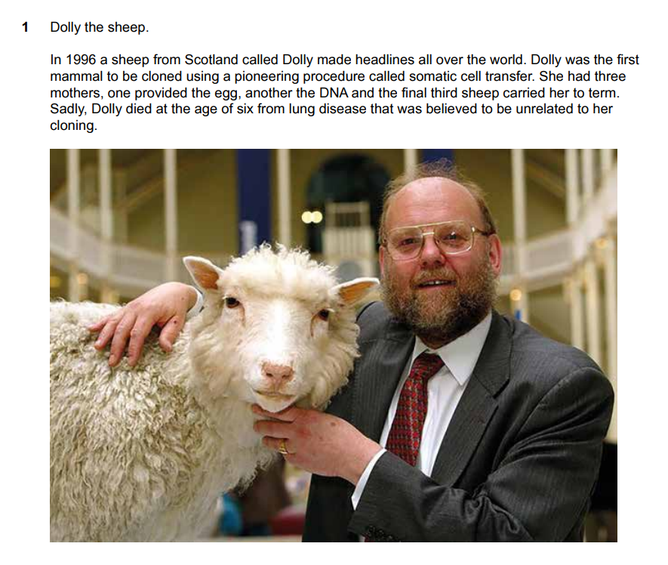
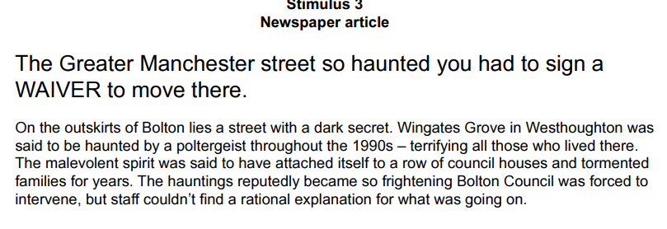
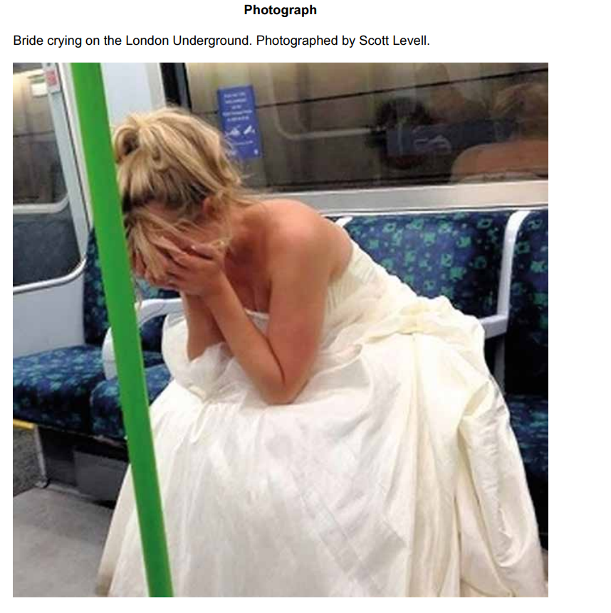
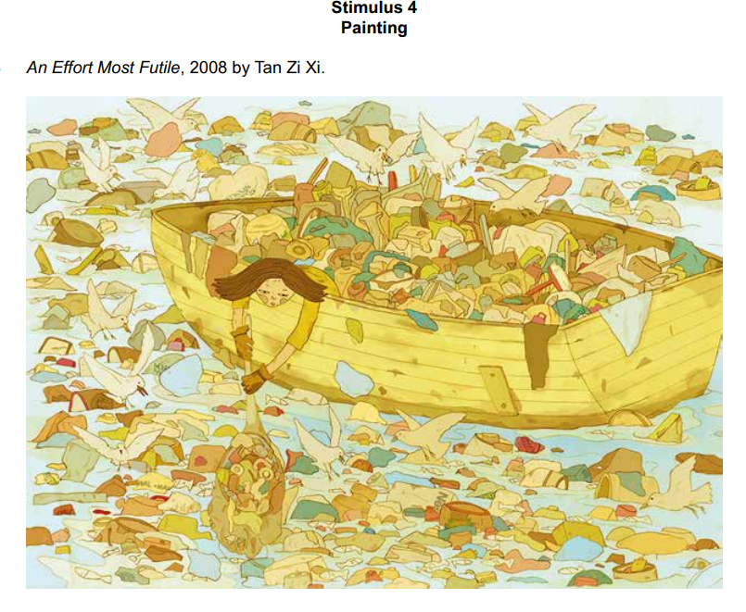
Y9 Drama – HT5 & 6 – Knowledge Organiser
Materials for Stimulus: Photographs or Artwork: Use powerful images or pieces of art to spark imagination and discussion. Students can create scenes or stories based on what they see. Short Stories or Poems: Select a short story or poem with strong themes or emotions. Students can dramatize the narrative or explore the characters' perspectives. News Articles: Current events or historical news articles can provide real-world contexts for drama. Students can re-enact events or create fictionalized accounts based on the facts. Music: Play a piece of instrumental music and ask students to create a scene that matches the mood or story they imagine from the music. Personal Experiences: Encourage students to share personal stories or experiences. These can be used as a basis for creating authentic and relatable drama pieces. Objects: Bring in a variety of objects (e.g., an old suitcase, a mysterious key, a photograph) and ask students to create a story or scene involving the object. Quotes: Use thought-provoking quotes as a starting point for discussions and scene creation. Students can explore the meaning and implications of the quote through their performances. Scripts or Play Excerpts: Provide excerpts from plays or scripts. Students can analyse the text and perform scenes, focusing on character development and interpretation. | Stimulus: Any starting point or inspiration used to generate ideas and create a piece of drama. How to Start Devising: Understand the Stimulus: Discuss its themes, emotions, and potential narratives with your team. Brainstorm ideas: Encourage creativity and avoid dismissing any ideas at this stage. Improvisation: Use improvisation exercises to explore different scenarios and characters that could emerge from the stimulus. Rehearse and Refine: Begin rehearsing the devised scenes. Encourage feedback and make adjustments as needed ASSESSMENT: Your practical assessment will ask you to create a piece of Drama based on these stimuli What ideas come to mind – find the given circumstances and go from there i.e. Why is the bride crying? Where is she? How did she get there? Who is she? When is this? What has happened? However, the unique thing about devising is that you can change anything because the stimulus is just a starting point for the drama – the spark to light the fire and guide the development of themes, characters, and storylines

Slide 5
Y9 Drama – HT5 – Knowledge Organiser |  | Macbeth Plot: Frightened, Macbeth goes to visit the witches in their cavern. There, they show him a sequence of demons and spirits who present him with further prophecies: he must beware of Macduff, a Scottish nobleman who opposed Macbeth’s accession to the throne; Macbeth is incapable of being harmed by any man born of woman; and he will be safe until Birnam Wood comes to Dunsinane Castle. Macbeth is relieved and feels secure, because he knows that all men are born of women and that forests cannot move. When he learns that Macduff has fled to England to join Malcolm, Macbeth orders that Macduff’s castle be seized and, most cruelly, that Lady Macduff and her children be murdered. When news of his family’s execution reaches Macduff in England, he is stricken with grief and vows revenge. Prince Malcolm, Duncan’s son, has succeeded in raising an army in England, and Macduff joins him as he rides to Scotland to challenge Macbeth’s forces. The invasion has the support of the Scottish nobles, who are appalled and frightened by Macbeth’s tyrannical and murderous behaviour. Lady Macbeth, meanwhile, becomes plagued with fits of sleepwalking in which she bemoans what she believes to be bloodstains on her hands. Before Macbeth’s opponents arrive, Macbeth receives news that she has killed herself, causing him to sink into a deep and pessimistic despair. Nevertheless, he awaits the English and fortifies Dunsinane, to which he seems to have withdrawn in order to defend himself, certain that the witches’ prophecies guarantee his invincibility. He is struck numb with fear, however, when he learns that the English army is advancing on Dunsinane shielded with boughs cut from Birnam Wood. Birnam Wood is indeed coming to Dunsinane, fulfilling half of the witches’ prophecy. In the battle, Macbeth hews violently, but the English forces gradually overwhelm his army and castle. On the battlefield, Macbeth encounters the vengeful Macduff, who declares that he was not “of woman born” but was instead “untimely ripped” from his mother’s womb (what we now call birth by cesarean section). Though he realizes that he is doomed, Macbeth continues to fight until Macduff kills and beheads him. Malcolm, now the King of Scotland, declares his benevolent intentions for the country and invites all to see him crowned at Scone.
Vocabulary: Neutral position: Stood up, feet shoulder width apart, arms relaxed by sides, no facial expression. Still Image: A frozen depiction of a scene. Mime: An acting technique that requires no sound or props. Physical Theatre: The use of an actor’s body to create props, set and/or objects. Improvisation (spontaneous and polished): Acting that requires no script and no or minimal planning time. Body Language: The emotions that are implied by your body’s position. Gesture: Actions that communicate feelings or instructions. E.g. nodding, waving. Facial Expression: The emotions that are implied by the movements of your facial features. Motive: The reason behind a characters actions and behaviours. Shakespeare: An Elizabethan/ Jacobean playwright. Elizabethan: The period of time in which Englad was ruled by Queen Elizabeth 1 (1558–1603) Jacobean: The period of time in which Englad was ruled by King James 1 (1603–1625) Monologue: A speech given by a character that reveals their inner thoughts – the character is giving this speech directly to the audience. Soliloquy: A speech given by a character that reveals their inner thoughts – the character is only speaking to themselves and is unaware of the audience. (Translates from Latin to ‘Solo-Talk’) | Shakespeare: Born: Generally accepted as 23 April 1564, as he was baptised 26 April 1564. Hometown: Stratford-upon-Avon, Warwickshire, England. Wife: Anne Hathaway. Children: Susanna, Hamnet & Judith Works: 37 plays (at least), 154 sonnets, many poems. Died: Shakespeare died on 23 April 1616 and was buried at Holy Trinity Church in Stratford-upon-Avon. Historical Context: Likely written in 1606, Macbeth is considered one of Shakespeare’s most topical plays for a number of reasons. As a dramatization of an episode of Scottish history, the play is clearly associated with the reigning monarch, James I. Specifically, the presence of Banquo in the play, a Scottish nobleman from whom James claimed descent serves to reinforce James’s claim to the throne. The main themes in the play: treason, the psychological and social impact of regicide (murder of a King/Queen), the precariousness of power and the demonic potential of the supernatural—are all subjects that interested King James I.

Slide 6
Y9 Drama – HT 6 – Knowledge Organiser Technical Theatre | Design Elements & Techniques Mood Board – A collage of images, colours and textures to capture the visual feel of a design. Lighting Gel – A coloured film placed over lights to change their colour. Cue Sheet – A plan for lighting or sound effects, timed to match the action of the scene. Practical Set – A set that actors can interact with (e.g., doors, stairs, furniture). Symbolic Costume – Clothing that expresses a theme or idea beyond realism. Period Accuracy – Designing to match the time and place of the play’s setting. Blocking – Planning where and how actors move on stage. Key Vocabulary Realism – Design that looks true to life. Stylised – Design that exaggerates or distorts reality for effect. Transitions – How scenes change, including lighting, set, and sound shifts. Focus – Using lighting or sound to draw the audience’s attention. Atmosphere – The mood or feeling created on stage. Assessment Focus Choose a key scene from Blood Brothers. Take on the role of a scenographer. Create a presentation showcasing your design ideas for: Set Lighting Sound Costume Hair & Make-up Justify your creative decisions using key vocabulary and knowledge from the unit.
Key Concepts This unit introduces students to the creative and technical roles in theatre, beyond acting. Students explore how the visual and audio elements of a production bring a script to life and shape the audience’s experience. In the final assessment, students choose a scene from Blood Brothers by Willy Russell, and act as the scenographer — designing all aspects of how that scene would be staged. Theatre Roles Director – Oversees the creative vision of the production; guides actors and collaborates with the design team. Stage Manager – Organises rehearsals, coordinates backstage activity, ensures everything runs smoothly. Lighting Designer – Plans how lighting is used to reflect mood, time, focus and setting. Sound Designer – Adds music, sound effects, and manages microphones/audio cues. Set Designer – Designs the physical environment of the play: furniture, structures, levels, etc. Costume Designer – Designs what each character wears to reflect status, time period, and personality. Make-up and Hair Designer – Designs characters’ hair and make-up to enhance characterisation and storytelling. Scenographer – A person who designs the overall visual world of the play: set, costume, lighting, and props.

