Slide 1
Y8 Drama – Sound in Drama - HT1 knowledge Organiser | Tips for Using Vocal Skills Always warm up your voice before performing. Practice reading lines aloud in different ways. Use a mirror or recording to monitor clarity and variety. Match your vocal choices to the character’s emotion, age, and status. Why Vocal Skills Matter in Drama Bring characters to life by changing your voice. Help the audience understand your character’s emotions and intentions. Support storytelling, especially in choral or ensemble work. Essential for performing in different genres: comedy, tragedy, realism, or stylised work.
Key Techniques Pitch – How high or low your voice sounds. Used to show emotion or status. Pace – The speed at which you speak. Can show nervousness, excitement, or calmness. Tone – The emotional quality of your voice. (e.g., angry, scared, happy, sarcastic) Pause – Used to create tension, show thought, or give the audience time to react. Projection – Making your voice loud and clear enough to be heard by the audience without shouting. Articulation – Speaking clearly so every word is understood. Emphasis – Stressing particular words to highlight meaning or emotion. Volume – How loud or quiet you speak depending on the situation or character.
Key Vocabulary Vocal Variety – Using changes in pitch, pace, tone, and volume to make your voice more interesting. Inflection – The rise and fall of the voice that can change the meaning of a sentence. Accent – The way a person sounds based on where they’re from or their background. Breath Control – Managing your breath to support projection and phrasing. Intonation – How your voice rises and falls across a sentence to show questioning, command, or emotion. Diction – The choice and clarity of words when speaking.

Slide 2
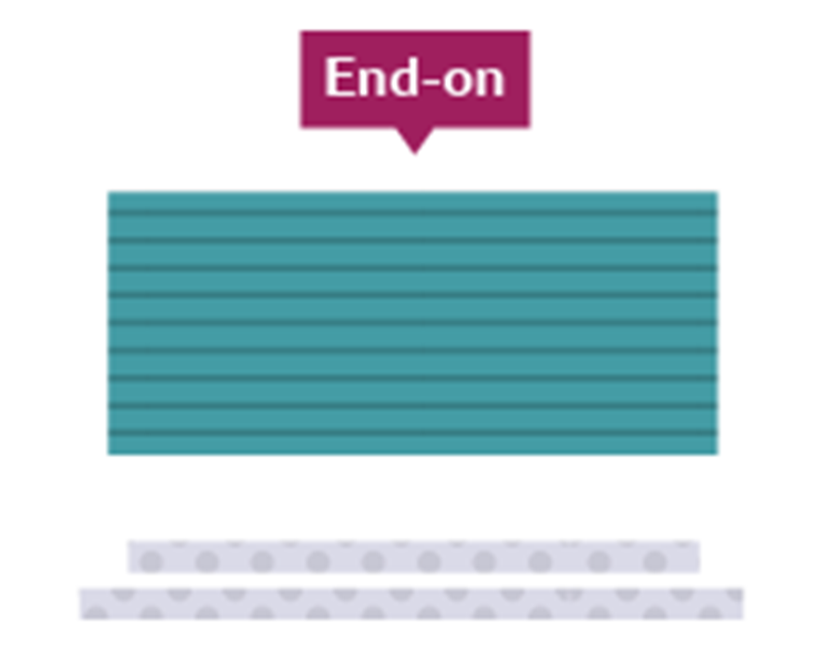
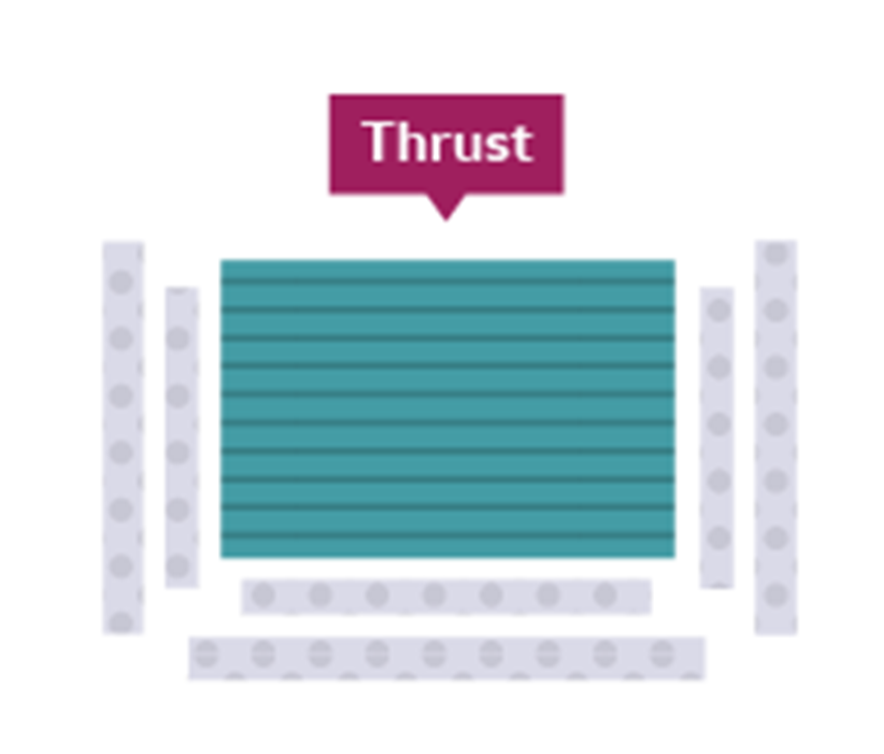


Y8 Drama – Melodrama & Soap Opera – HT2 – Knowledge Organiser |  | Stage types:
Melodrama: Melodrama is a style of theatre that was prominent in the Victorian era. It uses exaggeration and stereotyped characters to appeal to the audience’s emotions. It can be useful when working within the melodrama genre to explore stock characters, e.g. an evil villain, a wronged maiden or a noble hero. Very clear and loud vocal delivery is needed in a melodrama, facing out to the audience, combined with large gestures and exaggerated facial expressions. The plot for a melodramatic devised piece would ideally be very sensational, designed to evoke emotion within the audience, with lots of dialogue. | Soap Opera: A soap opera or soap for short is a radio or television serial dealing especially with domestic situations and frequently characterised by melodrama, ensemble casts, and sentimentality. The term "soap opera" originated from radio dramas originally being sponsored by soap manufacturers. Soap opera storylines run concurrently, intersect and lead into further developments. An individual episode of a soap opera will generally switch between several narrative threads that may at times interconnect and affect one another or may run entirely independent to each other. Episodes may feature some of the show's current storylines, but not always all of them. Soap operas rarely bring all the current storylines to a conclusion at the same time. When one storyline ends, there are several other story threads at differing stages of development. Soap opera episodes typically end on some sort of cliff-hanger.
Key Techniques / Vocabulary: Exaggeration: Exaggeration is the representation of something as more extreme or dramatic than it really is. Exaggeration is used to emphasise certain ideas by overstating it in some way. This can add drama, suspense, humour, etc. for the audience. Stereotype: A familiar character identified by an oversimplified pattern of behaviour that typically labels the character as being part of a group of people. Stock Characters: Stock characters are characters that are specific to a particular style of theatre. | Key Techniques / Vocabulary: Cliff-hanger: A cliff-hanger is a plot device in fiction which features a main character in a precarious or difficult dilemma or confronted with a shocking revelation at the end of an episode of serialised fiction. Flash Forward: A flash forward is a scene that temporarily takes the narrative forward in time from the current point of the story. Flash forwards are often used to represent events expected, projected, or imagined to occur in the future. Flashback: a short part of a film, story, or play that goes back to events in the past.
Remember:
When blocking your performances, you must be mindful never to show your back to the audience for longer than necessary.
Before you begin your rehearsal, pick and agree on where your audience will be.
Use diagonal positioning when speaking to another character on stage so that the audience can still see your facial expressions clearly.
Aim to face the audience as much as possible – this means that the audience gets the most out of your vocal projection and will be able to hear you clearly at all times.

Slide 3
Y8 Drama – HT 3 – Knowledge Organiser Given Circumstances |  | Why Are Given Circumstances Important? They help actors make clear, consistent choices. They make characters more believable and complex. They guide how actors use voice, movement, and space. They ensure all performers are working from a shared understanding of the scene. Top Tips for Applying Given Circumstances Ask questions about your character and their world. Use hot-seating or improvisation to explore background and personality. Keep referring to the script for clues and context. Work with your group to agree on the shared reality of the scene.
What Are Given Circumstances? Given circumstances are all the facts about a character and their world that influence how they behave and speak. These include the who, what, when, where, and why of a scene or character. Understanding given circumstances helps actors make believable choices and bring characters to life. Key Elements of Given Circumstances Who am I? (Name, age, job, relationships, status) Where am I? (Setting, time period, location, environment) When is this happening? (Time of day, season, historical context) What is happening? (What has just happened? What is going on in this moment?) Why am I behaving this way? (Motivation, objective, emotional state) How do I respond? (Voice, movement, reactions, inner thoughts) | Key Vocabulary Objective – What the character wants in a scene. Motivation – Why the character wants it. Subtext – The hidden meaning behind what a character says or does. Status – The level of power or control a character has in a situation. Backstory – Events from a character’s past that influence their behaviour now. Inner Monologue – A character’s thoughts, not spoken aloud. Super-Objective – The character’s main goal over the whole story.

Slide 4
Y8 Drama – Cloud Busting HT 4 knowledge Organiser | Themes & Vocabulary Themes: Bullying – Repeated harmful behaviour, often towards someone different. Friendship – Trust, support, and loyalty between people. Empathy – Understanding and sharing someone else's feelings. Identity – How someone sees themselves and how others see them. Inclusion – Making sure everyone is accepted and respected. Key Terms: Narrator – The voice that tells the story. Dialogue – What the characters say to each other. Stage Directions – Instructions for movement, voice, or action in a script. Ensemble – A group of performers working together equally. Unit Focus This scheme of work uses Cloud Busting to help students build confidence in interpreting text and using performance to explore sensitive issues like bullying, friendship, and inclusion. Students work in groups and as individuals to create meaningful performance responses and develop their skills in voice, movement, and characterisation.
Key Concepts Cloud Busting is a novel in verse by Malorie Blackman. In Drama, we use it to explore storytelling, emotion, and relationships through voice and movement. Focus on reading and interpreting script extracts. Explore characters’ thoughts, feelings, and relationships. Use performance to express key moments and explore moral questions. Reflect on the effects of bullying, difference, and empathy through character exploration.
Drama Techniques Script Reading – Reading aloud with expression and understanding of character. Still Image – Creating frozen pictures to show key moments or ideas. Thought Tracking – Speaking a character’s inner thoughts aloud during a freeze frame or scene. Role Play – Stepping into a character’s shoes to explore reactions and emotions. Hot-Seating – Asking and answering questions in character to explore motivation and backstory. Physical Theatre – Using the body to express abstract ideas or emotions (e.g., imagining "cloud busting" moments on stage).

Slide 5
Y8 Drama – Greek theatre & Antigone – HT5– Knowledge Organiser | Antigone - Plot: Two brothers, Polyneices and Eteocles are each leading opposing sides. Eteocles is fighting for the current King – King Creon, and Polyneices is fighting to overthrow King Creon. Before the play begins we learn that the brothers are both killed in battle, and so the civil war comes to an end. King Creon orders that Eteocles will be honoured and given a royal burial, but Polyneices will be disgraced. His body will be left to rot outside the battlements for the animals to pick apart and anybody who attempts to bury him will also be put to death. Antigone and Ismene are the sisters of Polyneices and Eteocles. Antigone brings Ismene out of the city walls at night for a secret meeting. Antigone is devastated and desperate to bury Polyneices’ body and wants Ismene to help her. Ismene refuses. She is too scared of the death penalty, the girls argue but Ismene is unable to talk Antigone out of her decision to bury Polyneices. The next night, Antigone sneaks out of the city walls. She waits until the guards guarding Polyneices’ body fall asleep, drags the body a short distance away and buries it. In the morning, the guards discover the body has gone missing. They are all scared and argue over who should tell King Creon. Creon is raging. He suspects Antigone and orders the guards to bring her to the throne room. Creon questions Antigone, who does not deny burying her brother. Instead, she openly argues with King Creon over the decision. Antigone argues that without burial her brother would never have been able to reach the afterlife. King Creon suspects that Antigone could not have buried her brother on her own and thinks Ismene must have helped her. He orders the guards to bring Ismene. Ismene, wanting to die alongside her sister, falsely confesses to the crime but Antigone will have none of it. The sisters argue again over who was involved in burying the body. Creon – confused over the argument, orders that both girls be put into jail for the time being. Creon’s son Haemon enters. He is engaged to Antigone and wants to convince his father to spare her life. Father and son argue, but Haemon cannot change the fact that Antigone will face the death penalty. Haemon leaves, and vows never to see or speak to his father again. Creon decides to spare Ismene and to imprison Antigone in a cave – without food or water they will brick up the mouth of the cave so that Antigone has a slow and painful death. She is brought out of the house, and she defends her actions one last time. She is taken away, with the Chorus expressing great sorrow for what is going to happen to her. Tiresias, the blind prophet, enters. He warns Creon that the Gods side with Antigone. Creon accuses Tiresias of being corrupt, and Tiresias responds that because of Creon's mistakes, he will lose one child for the crimes of leaving Polyneices unburied and putting Antigone into the earth. All of Greece will despise him, and the sacrificial offerings of Thebes will not be accepted by the gods. The Chorus, terrified, asks Creon to take their advice. He starts to waiver, and they tell him that he should bury Polyneices and free Antigone. Creon, shaken, agrees to do it. Creon leaves with his guards to help him right his previous mistakes but a Messenger enters to tell them that Haemon has killed himself. Eurydice, Creon's wife and Haemon's mother, enters and asks the Messenger to tell her everything. The Messenger reports that Haemon and Antigone have both taken their own lives. Eurydice disappears into the palace. Creon understands that his own actions have caused these events. A Second Messenger arrives to tell Creon and the Chorus that Eurydice has killed herself. With her last breath, she cursed her husband. Creon blames himself for everything that has happened, and, a broken man, he asks his servants to help him inside. The order he valued so much has been protected, and he is still the king, but he has acted against the gods and lost his child and his wife as a result. The Chorus closes by saying that although the gods punish the proud, punishment brings wisdom.
Greek Theatre: Theatre was a very big focus in Greece and started in approximately 550 BC. Theatre performances were in honour of an ancient Greek God called Dionysus. They had big festivals and theatre competitions in honour of this Greek God – Dionysus. There were three types of theatre; Comedy, Tragedy and Satire (making fun of leaders). Actors used masks and gestures to tell the story and the chorus (group of singers) told the story like narrators. Sophocles & Antigone: Antigone is a tragedy by Sophocles written in or before 441 BC. Sophocles is one of three ancient Greek tragedians whose plays have survived. The most famous tragedies of Sophocles feature Oedipus and Antigone: they are generally known as the Theban plays. Of the three Theban plays Antigone is the third in order of the events depicted in the plays, but it is the first that was written. Sophocles wrote over 120 plays, but only seven have survived. Antigone is still a popular story today with many adaptations in film, theatre and opera.
Key Techniques / Vocabulary: Exaggeration: Exaggeration is the representation of something as more extreme or dramatic than it really is. Exaggeration is used to emphasise certain ideas by overstating it in some way. This can add drama, suspense, humour, etc. for the audience. Canon: moving or speaking one after the other like a Mexican wave Unison: moving or speaking at the same time Hot Seating: Hot Seating is a Drama strategy which helps actors to develop their knowledge of their character. Questions are asked to the actor sitting in the 'hot-seat' who answers in character. Tragedy: Tragedy is a genre of drama based on human suffering and, mainly, the terrible or sorrowful events that befall a main character. Chorus: The chorus (group of singers) stood at the side of the stage and told the story like narrators. Part of the purpose of the Greek Chorus – whilst moving in unison –was to show the emotion of a play’s story with their gestures and facial expression.

Slide 6
Y8 Drama - Devising – HT6 – Knowledge Organiser |  | Poetry Stimulus: What has happened to Lulu by Charles Causley What has happened to Lulu mother? What has happened to Lu? There is nothing in her bed but an old rag doll And by its side a shoe Why is her window wide mother? The curtain flapping free. And only a dusty circle on the shelf Where her money-box used to be? Why do you turn your head mother? Why do the teardrops fall? And why do you crumple that note on the fire And say it is nothing at all. I woke to voices last night I heard an engine roar Why do you tell me the things I heard Were a dream and nothing at all.
Key Techniques: Thought-Tracking: when a character speaks their thoughts aloud to the audience (no other character on stage can hear this.) Physical Theatre: Using your body to tell a story rather than words/ Creating objects on stage using your body Hot Seating: a drama strategy in which a character or characters, played by the teacher or a child, are interviewed by the rest of the group. Improvisation: Spontaneous drama created without a script to explore ideas around a stimulus or starting point | Key Vocabulary: Sub-text: The hidden meaning behind the words a character says Stimulus: Starting point for devising (e.g. image, text, object, theme). Poem: a piece of writing in which the expression of feelings and ideas is given intensity by particular attention to diction (sometimes involving rhyme), rhythm, and imagery – good for devising. Tableaux: A still image - a group of actors or motionless figures representing a scene from a story Exploration: Investigating characters, themes, or settings through drama. Flashbacks: a scene that takes place before a story begins that takes the audience back in time to the past events in a character's life.
Poetry Stimulus: Poetry can be an excellent stimulus for Drama as it is emotive, tells a story or is open to interpretation. This poem creates a scenario that can be further explored using Drama to create original dramas around the initial stimulus. The questions within the poem give clear opportunities to explore using devised drama techniques and there is also opportunity to explore events before or after the disappearance. The exploration of the relationship between Lulu and the mother allows for creative drama responses and gives students the opportunity to relate to what has happened and therefore encourages further creativity. The reading score of the poem is simple but the content offers many avenues to explore using devised drama.
I heard somebody cry mother,
In anger and in pain,
But now I ask you why mother,
You say it was a gust of rain.
Why do you wander about
As though you don’t know what to do?
What has happened to Lulu mother?
What has happened to Lu?
Questions:
What has happened to Lulu?
What caused her to leave?
Who cried? Why do you think? How did Lulu leave the house? What did she take with her? How does the mother feel? Who is the narrator of the poem? What does the Mother tell him/her? Why?

