Slide 1
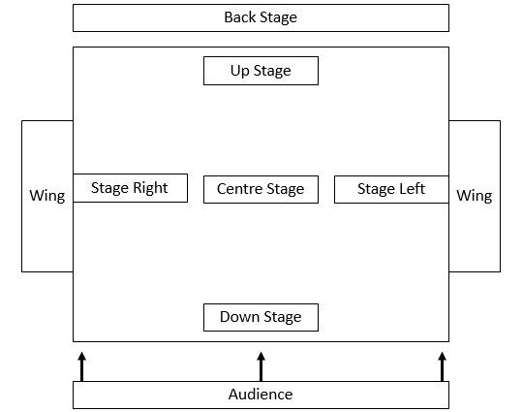
YEAR 7 DRAMA KNOWLEDGE ORGANISER
HT1 - Basic Skills
Actor | A performer who assumes the role of a character in a play, film, or television show.
Audience | The people who watch the performance; those for whom the performance is intended.
Backs to the Audience | Something an actor must try to avoid unless intentional.
Blocking | Decisions about where actors enter, exit and stand on the stage is called blocking. Blocking needs to be carefully considered so that the space is used well and everybody can see.
Body Language | Body language is communication coming from the movement or position of an actor.
Character | A person portrayed in a drama, novel, or other artistic piece.
Characterisation | How an actor uses their body and voice to develop and portray a character.
Corpsing | Where an actor breaks character. This is considered very unprofessional.
Facial Expression | The look on an actors face that portrays the feelings and emotions of their character.
Gesture | A defined movement that clearly communicates meaning, eg shaking a fist communicates anger. Gestures are usually made with the arms and hands, but not always.
Mime | Mime is the art of demonstrating an action with an object that doesn't exist.
Neutral Position | A stance that actors use to focus. Actors stand with feet shoulder width apart, hands by their side, knees are relaxed, Face is neutral and actors are silent. This stance is often used between activities or before creating characters.
Polished Improvisation | Polished improvisation in theatre is the playing of dramatic scenes without written dialogue but with some planning and rehearsal beforehand.
Spontaneous Improvisation | Spontaneous improvisation in theatre is the playing of dramatic scenes without written dialogue and with no rehearsal beforehand.
Still image | This is a frozen picture which communicates meaning. It's sometimes called a freeze frame or tableau. It can provide insight into character relationships with a clear focus upon use of space, levels, body language and facial expression. The rules of a still image are: You must remain silent You must not move at all
End On Stage | Many Drama Studios are set up with end-on staging, meaning that the stage space is on one side of the room and the audience sit on the opposite side.

Slide 2
YEAR 7 DRAMA KNOWLEDGE ORGANISER
HT2 – Pantomime
The origins of Theatre: | Key Conventions: | Definition:
The History of Pantomime: Pantomime is often believed to something quintessentially British but it actually originates from Italy! Commedia dell’arte is a style of Italian street theatre that originated in the 16th Century. This style was famous for its use of stock characters, comedy and use of exaggeration as was a significant influence on the pantomimes that we know and love today. Pantomimes are mostly performed at Christmas time and are usually based on fairy tales and nursery stories. | Exaggeration | Exaggeration means making an action or gesture even bigger than it is in real life.
 | Comedy | Comedy is a genre of Drama consisting of verbal jokes and sometimes physical slapstick comedy intended to make the audience laugh.
 | Singing and Dancing | Familiar songs that the audience will recognise are often used to encourage them to sing along.
 | Direct Address | This is where the characters speak to the audience.
 | Audience Participation | The actors encourage the audience to participate in the performance often by booing, cheering or repeating lines back to them. For example, ‘It’s behind you!’.
Stock Characters: Stock characters are characters that are specific to a particular style of theatre. In Pantomime these include; the Evil Villain, the Damsel in Distress, the Hero, the Principle Boy (a male character played by a female. This is often the Prince or the Protagonist (main character) -for example, Aladdin is often played by a female actor), and the Pantomime Dame (a female character played by a male. This is often a mother, Evil stepmother, stepsister or fairy). | Special Effects | For example, confetti, smoke, crashes and flashes of light.
 | Costume | Lavish costumes in bright colours
 | A simple or familiar plot | These often involve a Princess or Damsel in Distress having to be rescued from an Evil Queen or Villain.
 | Specific entrances and exits | For example, the evil characters will always use stage left because left is traditionally associated with the devil.
 | Projection | The strength of speaking or singing whereby the voice is used powerfully and clearly.

Slide 3
Y7 Drama – Frankenstein HT3 – Knowledge Organiser | Frankenstein – Stage Adaptation by Philip Pullman - PLOT: Act 1 Victor Frankenstein is busy working in his laboratory in Ingolstadt. He is joined by his friend Clerval. Frankenstein explains his work around animals and electricity to Clerval. Clerval is astonished by Frankenstein’s findings and how electricity and can affect body parts. Elizabeth arrives. She is concerned that Frankenstein has not been in contact with the family for months. His father is very ill. It is clear that Frankenstein has become obsessed with his work and attempts to create life. Frankenstein wishes to be left alone. However, Clerval comes back into the room – he is shocked by the Monster as he now comes to life. The Monster runs away. Act 2 Agathe and Felix live a simple life in a cottage in the forest. Felix has to leave Agathe – he is concerned for her safety. Agathe is blind and they have heard of recent trouble in the nearby town. Felix leaves. The Monster has been collecting wood for the family. Agathe is unaware of the Monster’s presence. However, the Monster picks up a mirror and is shocked to see his own appearance for the first time. Agathe, blind, talks to the Monster. She touches his face and believes that he has been disfigured. They share a conversation. Suddenly, Felix enters. He believes the Monster is attacking Agathe – he seizes his musket. Agathe defends the Monster, but Felix believes him to be evil. Consequently, the Monster leaves, exclaiming his need for revenge. Act 3 Frankenstein is in his study in Geneva. Elizabeth enters. William is missing. A priest arrives, carrying William’s body. The Monster arrives. He has strangled William in an act of revenge. The Monster explains that he feels betrayed and is lonely. The Monster informs Frankenstein that he has two years to create him a wife. Act 4 Elizabeth and Clerval are concerned about Frankenstein’s latest activities. They enter his laboratory, and here they discover that Frankenstein has created another life. Clerval explains to Elizabeth how Frankenstein created the Monster. Clerval vows to destroy the new creation, with Elizabeth exiting. The Monster arrives. Clerval tries to prevent the Monster’s Bride from awaking, but the Monster kills him before he is able to. Elizabeth re-enters with servants. They try to shoot the Monster. Desperately, the Monster tries to awaken his bride, but Frankenstein prevents this from happening. In response, the Monster strangles Elizabeth. Frankenstein vows to destroy the Monster, following him to the ends of the earth.
Key Vocabulary: Monologue A long, uninterrupted speech by one character in a play. Duologue A conversation/ interaction between two characters in a play. Hot Seating A technique in which you interview an actor who answers in role in order to discover more about that character and/or their situation. Tone This suggests the mood and intention towards the listener – e.g. happy or aggressive are ways to describe the mood of someone’s voice. Entrances Stage direction indicating the act of entering the play area during a performance. Exits Stage direction; to leave the stage. Genre ‘Genre’ refers to a specific style that involves a particular set of characteristics. Climax The point of greatest intensity in a series or progression of events in a play, often forming the turning point of the plot and leading to some kind of resolution. Resolution How the problem or conflict in a drama is solved or concluded.
Frankenstein – Historical Context Frankenstein is a novel written by Mary Shelley in 1818. It is about a scientist called Victor Frankenstein, who tries to create a new life using the body parts of corpses. Frankenstein is part of the Gothic Genre The elements of Gothic Genre include: Horror settings (haunted castles) Supernatural forces (ghosts) Rebellious anti-heroes Family curses Fear Gloomy and mysterious atmosphere Struggle between good and evil A contrast between reason and faith Gothic literature emerged in late 18th century Europe during a time when science and medicine was advancing, and some people began to question their religious beliefs. Parts of Europe were far more religious than the present day. Events that could not be explained were viewed as an act of God or from a supernatural force. However, science was beginning to break down these barriers. Consequently, some people thought that this, and science, was dangerous. Scientists, such as Luigi Galvani, were pushing boundaries. Galvani found that frogs’ legs twitched as if alive when struck by electricity.

Slide 4
Y7 Drama – Beowulf – HT4 – Knowledge Organiser |  | Beowulf Plot: Beowulf, the narrator of his own story, goes back to a time long ago, before he was king, when he set out on a journey to the Northlands to help a people he had heard were in grave trouble. He and his band of warriors arrive in the land of the Danes, ruled over by King Hrothgar. First met with suspicion, they are finally welcomed into Heorot; a great hall which has been built, according to tradition, to house the treasures from the Danes’ victories and celebrate the heroism of Hrothgar’s warriors. However, for twelve years Heorot has been under siege from a terrifying monster, Grendel. Each night Grendel steals into the great hall and takes someone while they sleep. When Beowulf and his warriors arrive to offer their services to the Danes, they find Hrothgar a shell of a king. Beowulf pledges to help them overcome the despair and fear they feel, and to fight for them to defeat the monster. One of the Danes, Unferth, casts doubt on whether Beowulf can do it. She has heard the tales of his heroism, but doesn’t believe he will save them. She questions why would he succeed, when their finest warriors have failed? Beowulf listens to what Unferth has to say and asks for one night to prove himself. When night comes, Grendel arrives at the great hall. Beowulf is terrified as he witnesses the full horror of the monster devouring two sleeping warriors. Drawing on all his strength, Beowulf attacks Grendel and they become locked in battle. The monster has him in a terrifying grip and Beowulf feels himself coming close to death when Unferth comes to his aide, and Grendel, turning attention onto her, loosens its hold on Beowulf. Taking his chance, Beowulf rips the monster’s arm out of its socket and Grendel runs from Heorot in agony, towards the swamp that is its home, carrying Unferth with it. Beowulf follows in pursuit. Arriving at the side of a lake, Beowulf finds Unferth dying. Unferth gives Beowulf the dagger she dreamt would kill Grendel. He takes it and dives into the lake to find the monster. At the bottom of the lake, Beowulf finds Grendel. The monster is in a cave filled with the armour and remains of the Danes it has dragged there. Grendel is still alive, but badly wounded. Beowulf takes out the dagger and plunges it into the monster’s heart. At this moment, a figure appears; it is Grendel’s mother. The monster’s mother speaks to Beowulf, offering a pact that would end the violence. In that moment Beowulf has a choice to make: to finish the cycle of violence with Grendel’s death and make peace, or to carry through and destroy the monster’s mother as well. Beowulf acts decisively, as a warrior hero, and kills the monster’s mother with one blow. Beowulf returns to the great hall victorious and is honoured with gold by the Danes. When he returns home to Geatland he is eventually made king. Fifty years pass and then a dragon comes. This is the dragon that will kill Beowulf. In his last moments, as he faces the dragon, Beowulf thinks about the choice that Grendel’s mother gave him and what kind of king he was.
Key Techniques: Story telling: the social and cultural activity of sharing stories, sometimes with improvisation, theatrics or embellishment. Crucial elements of stories and storytelling include plot, characters and narrative point of view Thought-Tracking: when a character speaks their thoughts aloud to the audience (no other character on stage can hear this.) Choral Speaking: ensemble speaking by a group often using various voice combinations and contrasts to bring out the meaning or tonal beauty of a passage of poetry or prose. | Key Vocabulary: Physical Theatre: Using your body to tell a story rather than words/ Creating objects on stage using your body Vocal Projection: the volume of your voice Vocal Tone: The ‘colour’ or emotion of your voice Blocking: The decisions made by actors/ directors about where actors should stand on stage and how they should move/ act. Levels: Heights used by actors on stage to create interest for the audience. Symbolism Themes: big ideas that are presented within a story/ play Non-naturalism: techniques used in Drama that are unrealistic. E.g. still image/ mime/ thought-tracking Fable: a short tale to teach a moral lesson, often with animals or legendary creatures Allegory: a story, poem, or picture that can be interpreted to reveal a hidden meaning, typically a moral or political one. Narration: a spoken commentary to the audience about the play Sustain Character: the ability to stay in character (no corpsing)
Beowulf Characters: Hrothgar: is the King of the Danes. Heorot: not a person but the place at the heart of the story. It is the great wooden mead hall that King Hrothgar has had built and where the whole settlement gathers to feast and celebrate. Grendel: a creature who lives in the marshland. He creeps into Heorot like ‘a loathsome shadow’ and brings terror to Hrothgar and his people. Beowulf: a warrior who arrives at Heorot with his band of warriors. He has been sent by his king, King Hygelac to help Hrothgar and his people defeat Grendel. The Warriors: King Hrothgar’s Warriors who are loyal, fearless and brave. They have sworn allegiance to Hrothgar, to each other and to all their kith and kin.

Slide 5
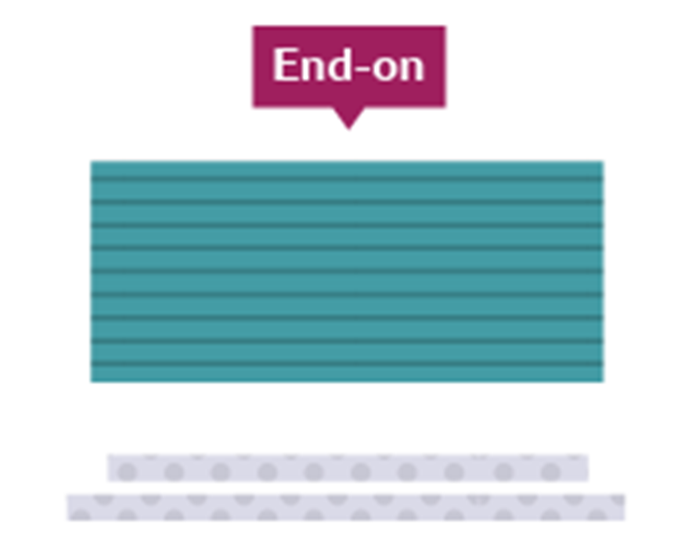
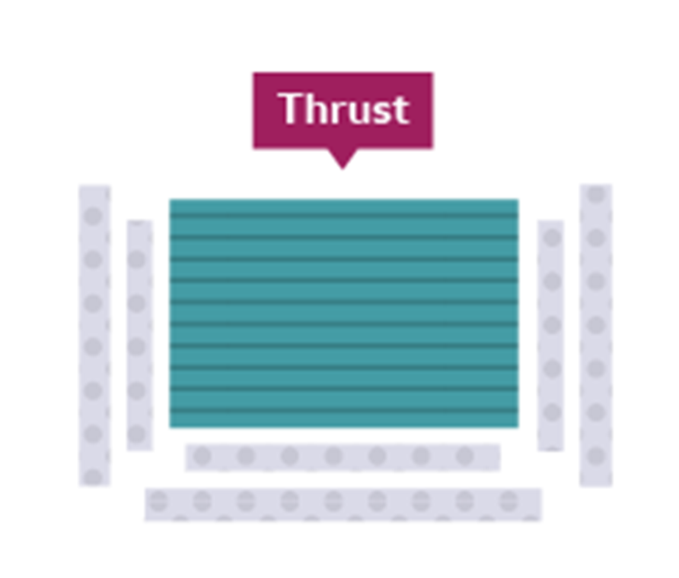
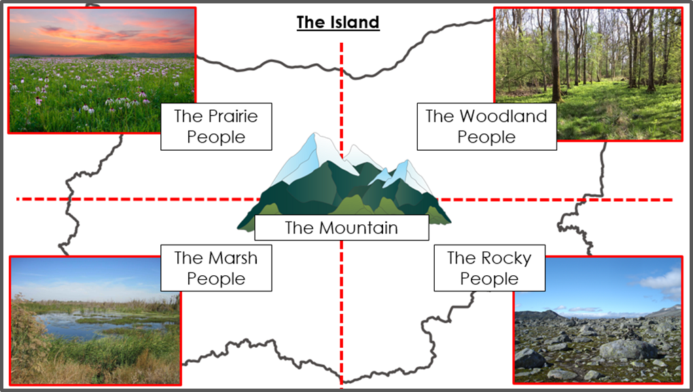
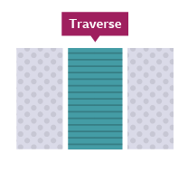

Y7 Drama – The Island – HT5 – Knowledge Organiser |  | Stage types:
Key Techniques: Improvisation: Improvisation is the activity of making or doing something not planned beforehand. Spontaneous Improvisation: When an actor(s) performs ‘on the spot’ with no script or prior rehearsal. Polished Improvisation: When an actor(s) performs a piece of drama with no script and a very short amount of time to rehearse beforehand. Role Play: When an actor takes on the role of a character, and uses spontaneous improvisation to mimic the actions/ behaviours of that character. Whole Class Role Play: Where the whole class or a large group, work together using spontaneous improvisation to create a piece of drama. This may include negotiation, problem solving and leadership skills from one or more pupils. | Key Vocabulary: Vocal Projection: the volume of your voice Vocal Tone: The ‘colour’ or emotion of your voice Blocking: The decisions made by actors/ directors about where actors should stand on stage and how they should move/ act. Levels: Heights used by actors on stage to create interest for the audience. Symbolism Themes: big ideas that are presented within a story/ play Non-naturalism: techniques used in Drama that are unrealistic. E.g. still image/ mime/ thought-tracking Narration: a spoken commentary to the audience about the play Sustain Character: the ability to stay in character (no corpsing) Unison: Speaking or moving at exactly the same time as one or more actors. Physical Theatre: Using your body to tell a story rather than words/ Creating objects on stage using your body
Remember:
When blocking your performances, you must be mindful never to show your back to the audience for longer than necessary.
Before you begin your rehearsal, pick and agree on where your audience will be.
Use diagonal positioning when speaking to another character on stage so that the audience can still see your facial expressions clearly.
Aim to face the audience as much as possible – this means that the audience gets the most out of your vocal projection and will be able to hear you clearly at all times.

Slide 6
Y7 Drama - Introduction to Shakespeare -HT6 - Knowledge Organiser |  | Plot Summary Much Ado About Nothing Two pairs of lovers, Beatrice and Benedick, and Hero and Claudio, face misunderstandings and trickery. Through gossip and disguise, love is tested—but in the end, the truth wins out and love prevails. A Comedy of Errors Two sets of identical twins separated at birth cause chaos when they unknowingly arrive in the same town. Mistaken identities, slapstick misunderstandings, and wild confusion lead to a joyful reunion. Romeo and Juliet Two young lovers from feuding families fall in love and secretly marry. Miscommunication and fate lead to a tragic end, highlighting the destructive nature of hatred and impulsive decisions. Richard II A king loses the loyalty of his people through poor leadership. His cousin, Bolingbroke, overthrows him, marking the fall of Richard and a shift in power. A historical play about authority, betrayal, and downfall. Scheme Of Work Structure of the Unit Lessons 1–4: Exploring key scenes and characters from: Much Ado About Nothing (comedy and wit) A Comedy of Errors (slapstick and farce) Romeo and Juliet (tragedy and language) Richard II (context and power dynamics) Lessons 5–8: Creating and rehearsing the final scene of A Comedy of Errors Ensemble performance Use of slapstick and comedic timing Practicing Shakespearean speech Collaborative devising and rehearsal process
Key Techniques: Context: Understanding the historical and social background of Shakespeare’s time, including Elizabethan society, theatre conventions, and gender roles. Slapstick Comedy: A style of physical comedy characterized by exaggerated movements, mistakes, and humorous violence (e.g., falls, chases, and confusion). Shakespearian Language: Exploring the rhythm (iambic pentameter), poetic devices (metaphor, pun), and unfamiliar vocabulary found in Shakespeare’s plays | Key Vocabulary Comedy: A type of play designed to make the audience laugh, often ending happily. Tragedy: A serious play with themes of conflict and downfall, often ending in death or separation. Prose and Verse: The two forms of speech in Shakespeare's writing—prose is ordinary language, verse is structured and rhythmic. Iambic Pentameter: A poetic rhythm with five beats per line, often used by noble characters. Pun: A play on words, often used for humorous or witty effect. Dramatic Irony: When the audience knows more than the characters on stage. Blocking: The precise staging of actors in a performance. Status: The relative social or power position between characters.

