Slide 1
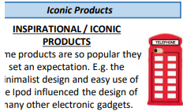
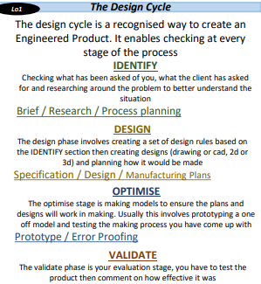
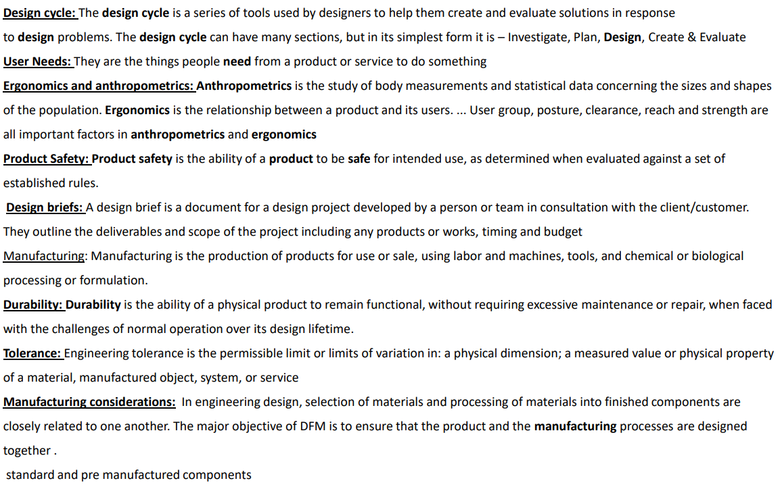
OCR Cambridge Nationals in Engineering Design
Knowledge Organiser- Skills Builder

Slide 2
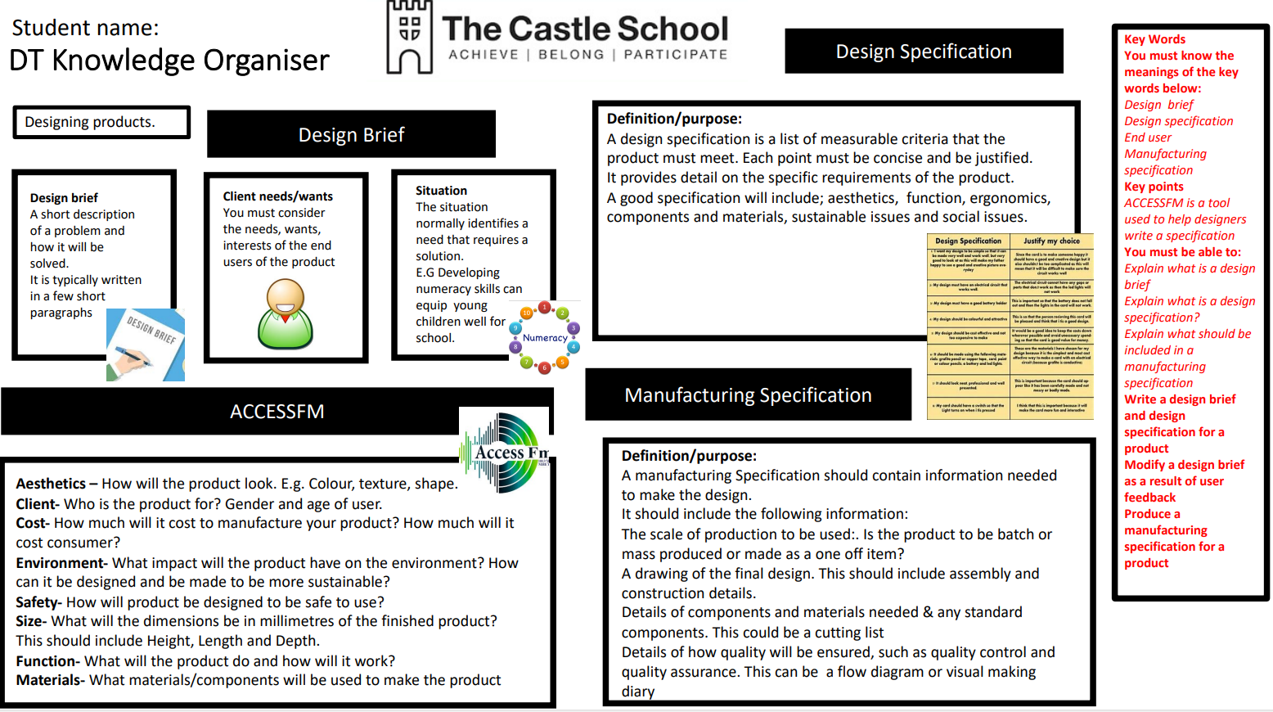
OCR Cambridge Nationals in Engineering Design
Knowledge Organiser- Skills Builder

Slide 3
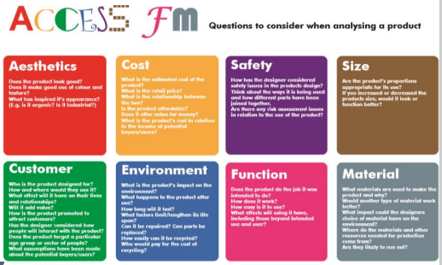
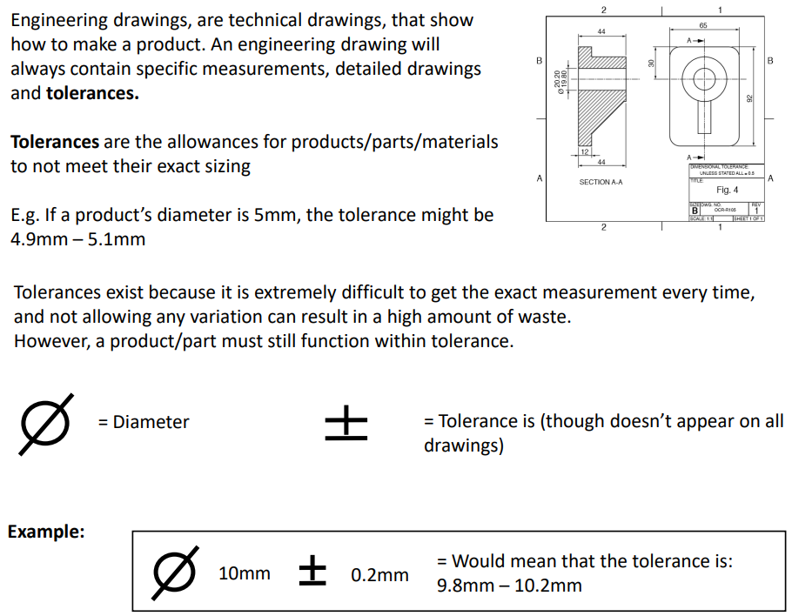
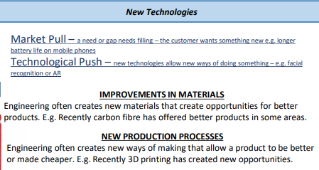
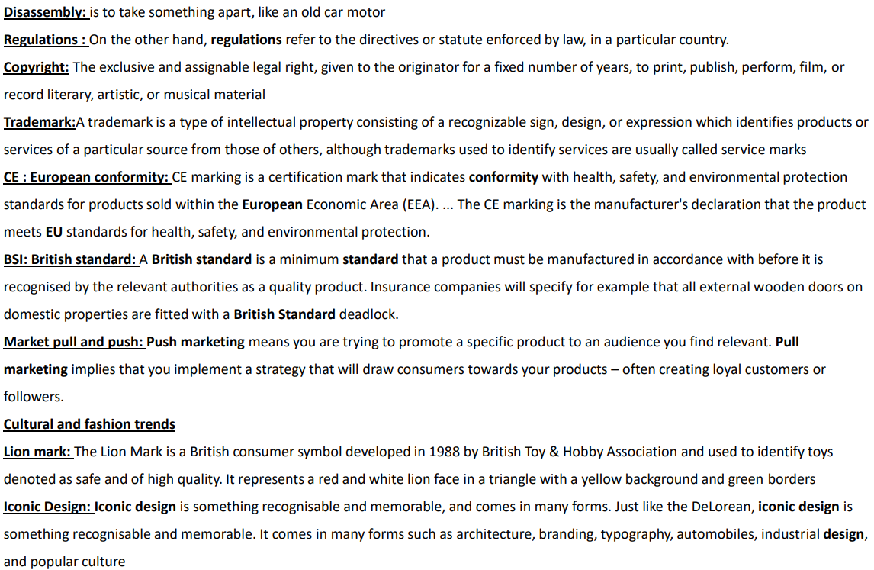
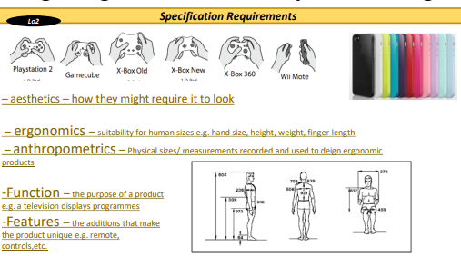
OCR Cambridge Nationals in Engineering Design
Knowledge Organiser- R039
Communicating Design Ideas

Slide 4
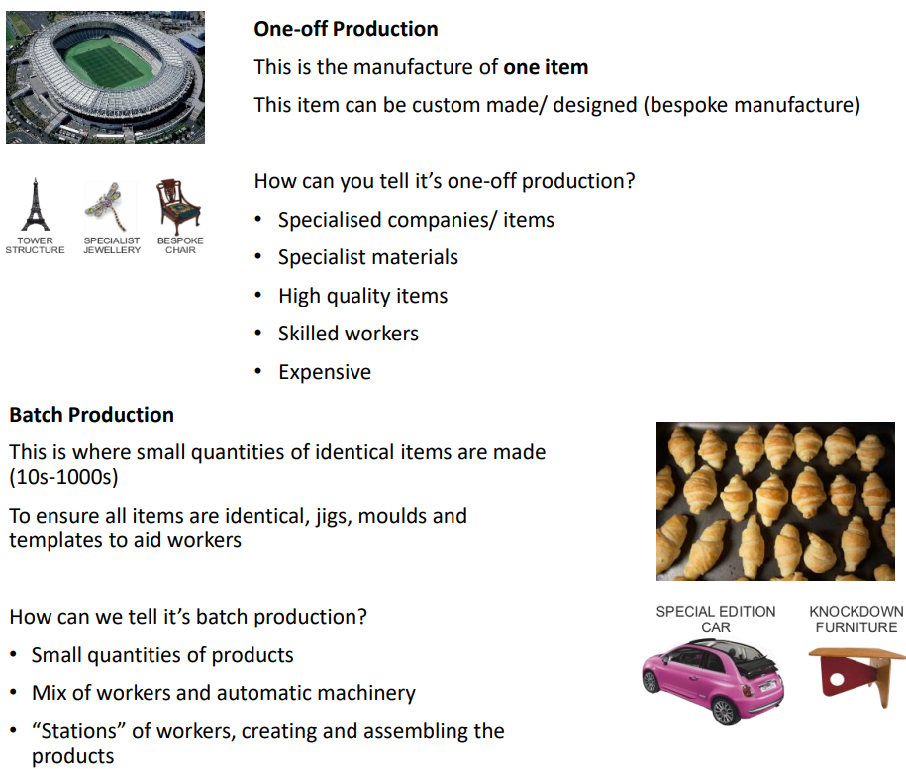
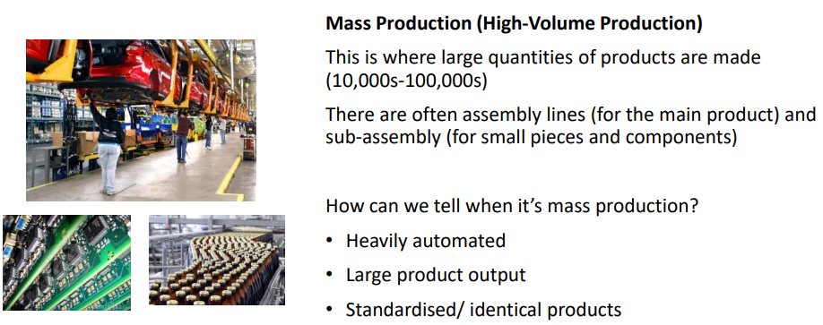

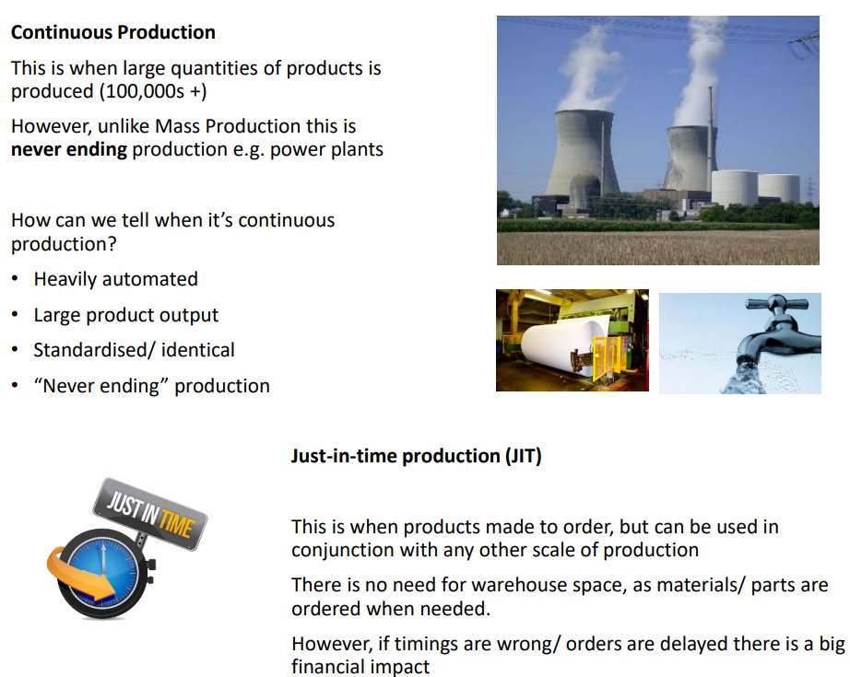
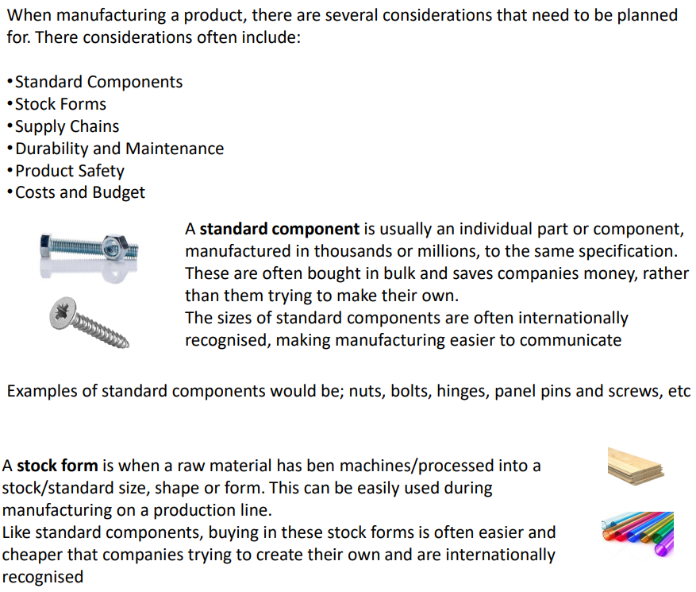
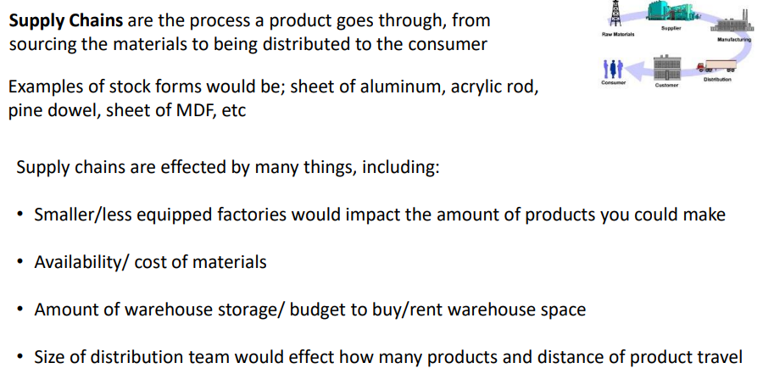
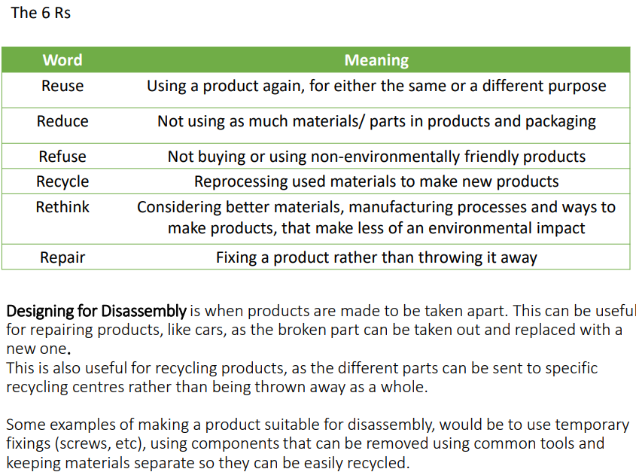

OCR Cambridge Nationals in Engineering Design
Knowledge Organiser- R040
Design Evaluation Modelling

Slide 5
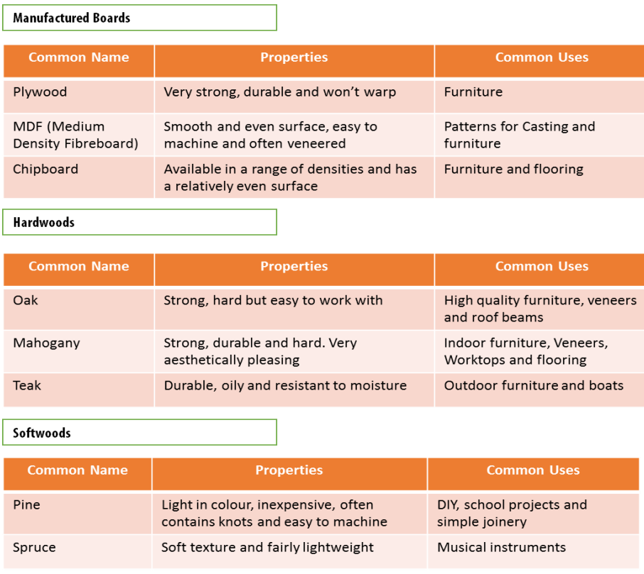
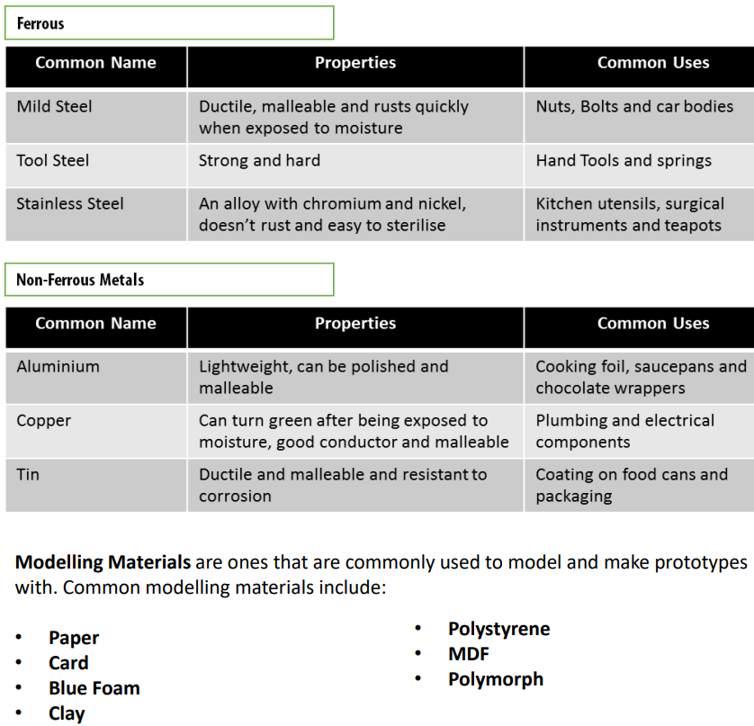
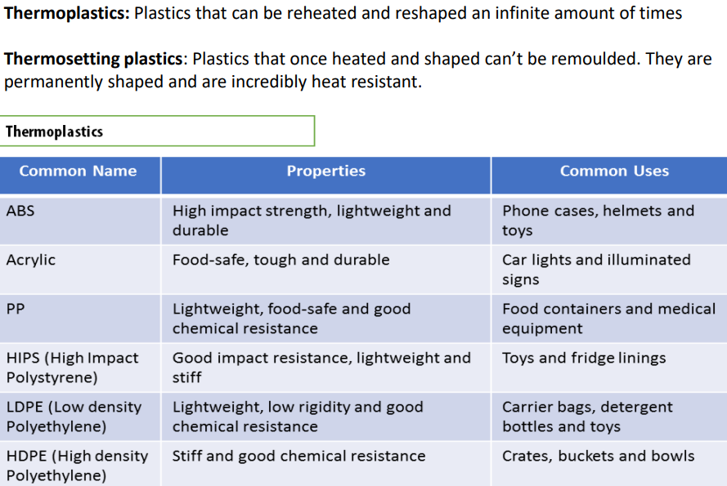
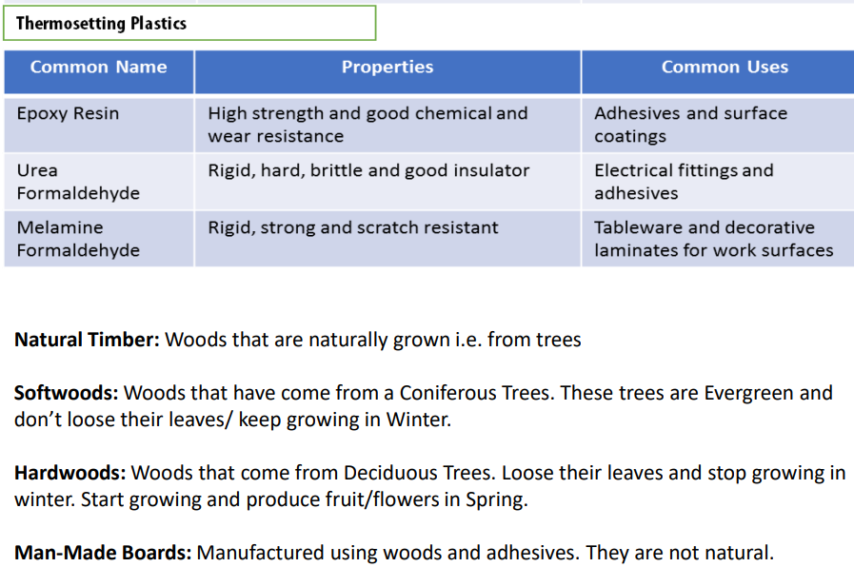
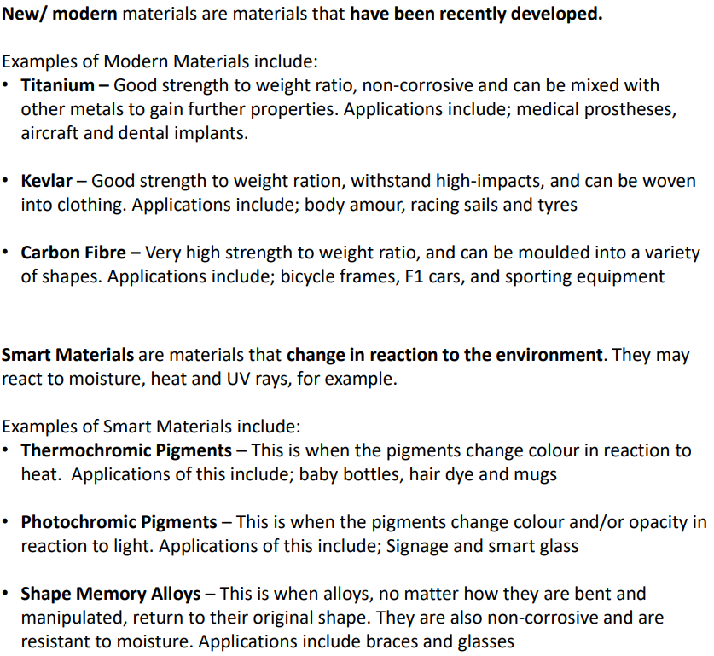
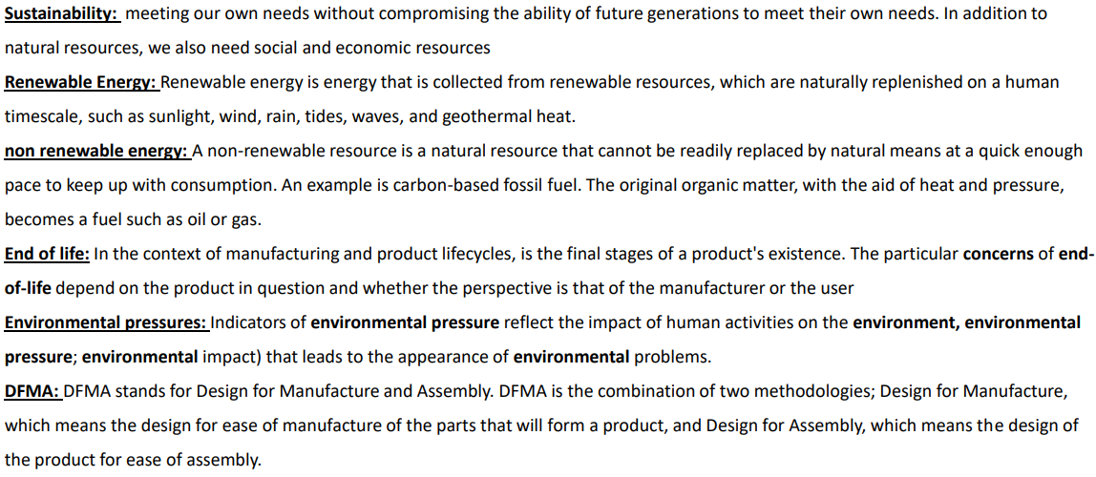
OCR Cambridge Nationals in Engineering Design
Knowledge Organiser- R040
Design Evaluation Modelling

Slide 6
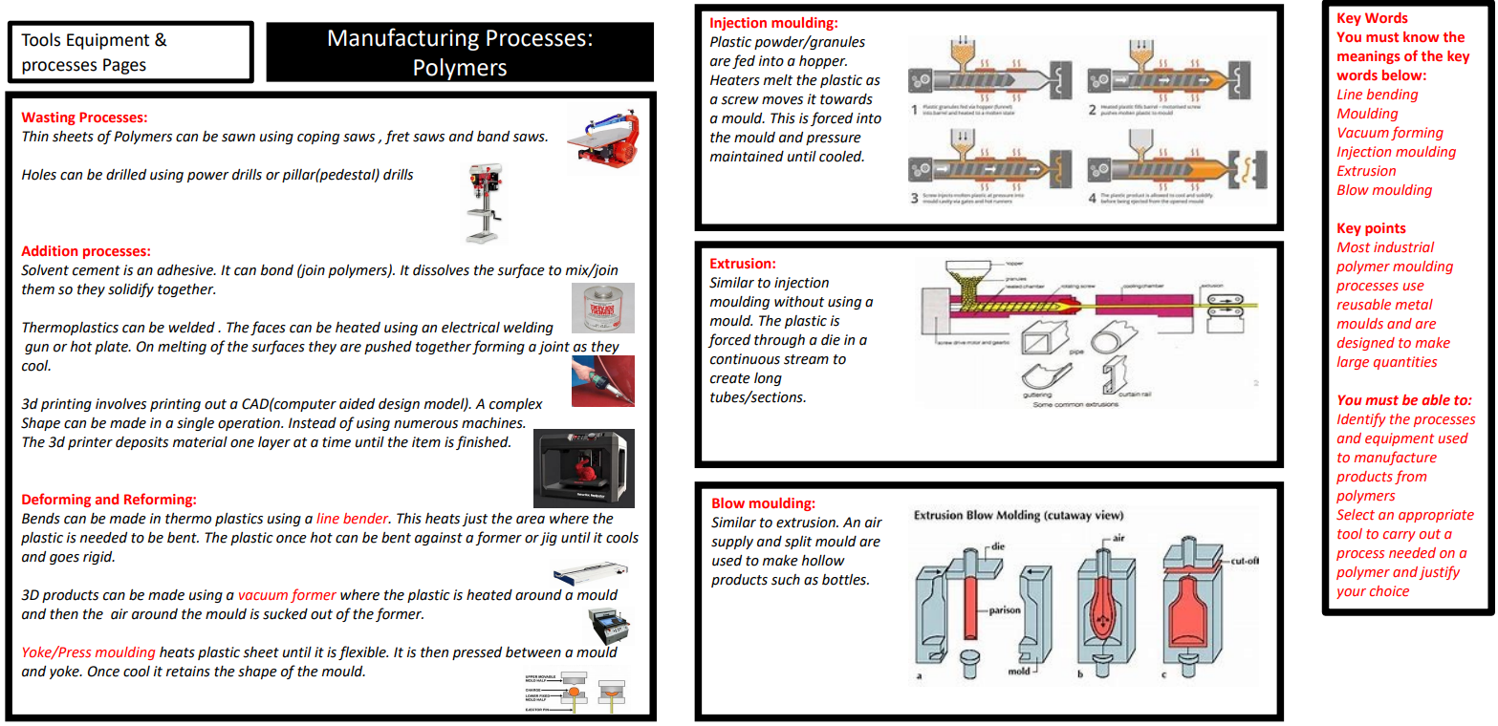
OCR Cambridge Nationals in Engineering Design
Knowledge Organiser- R040
Design Evaluation Modelling

Slide 7
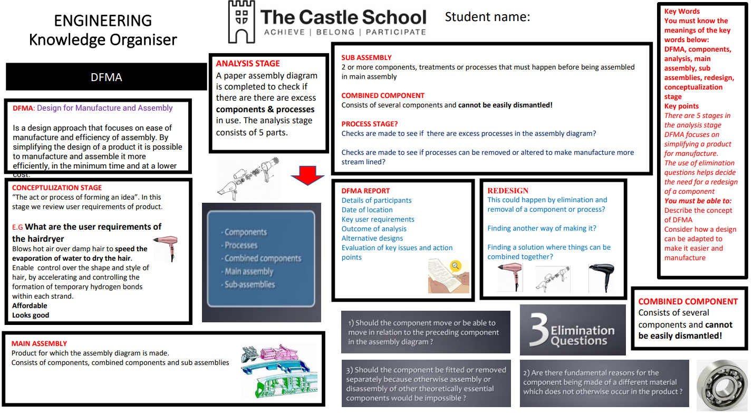
OCR Cambridge Nationals in Engineering Design
Knowledge Organiser- R040
Design Evaluation Modelling

Slide 8
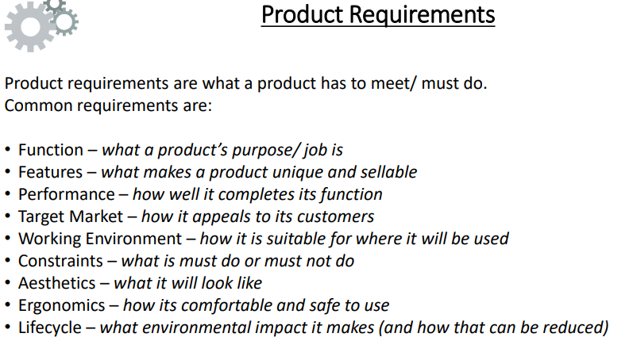
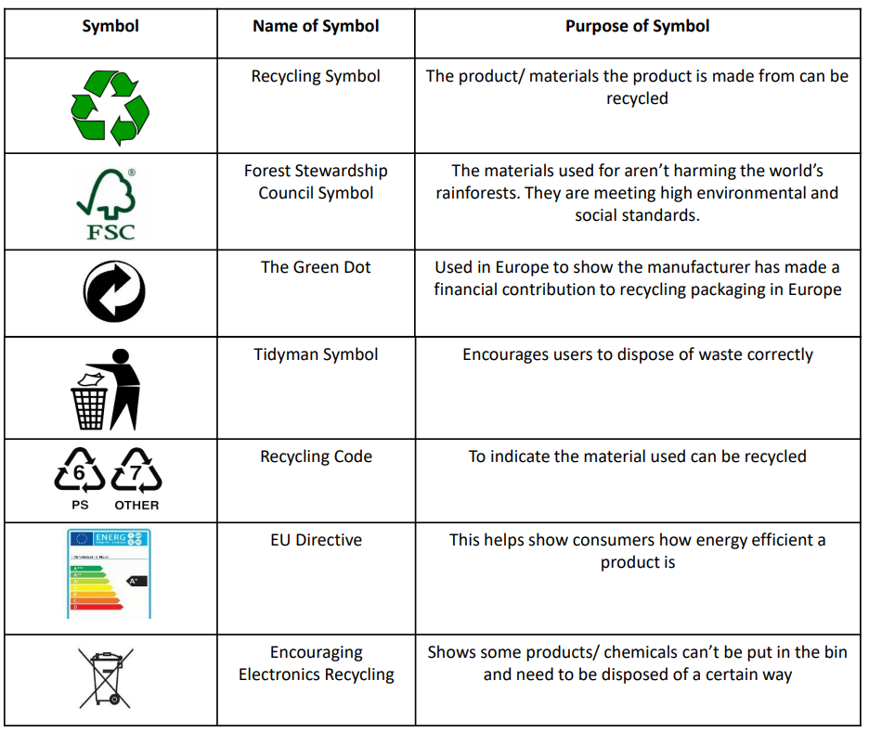
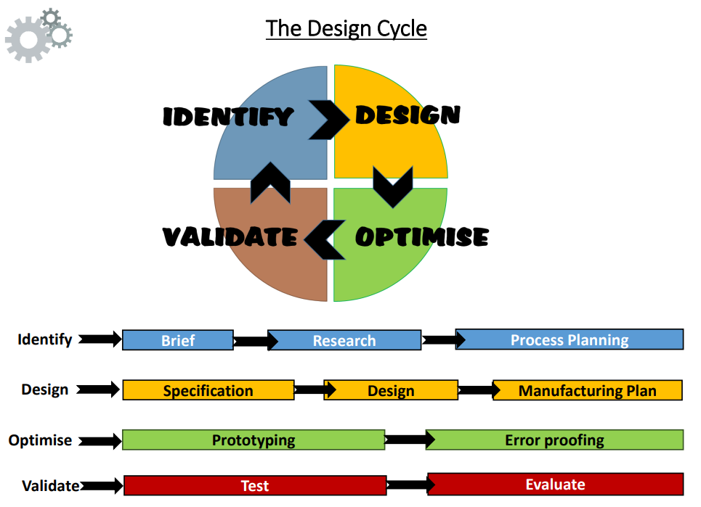

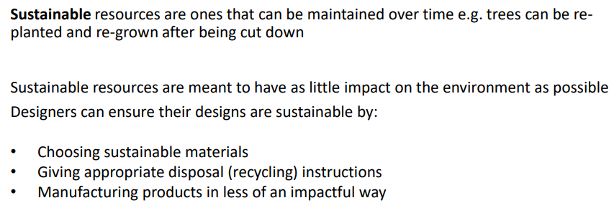
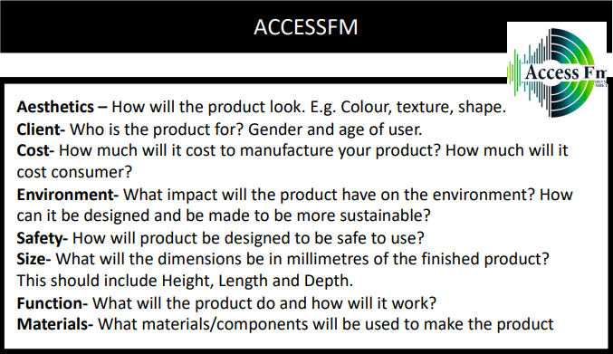
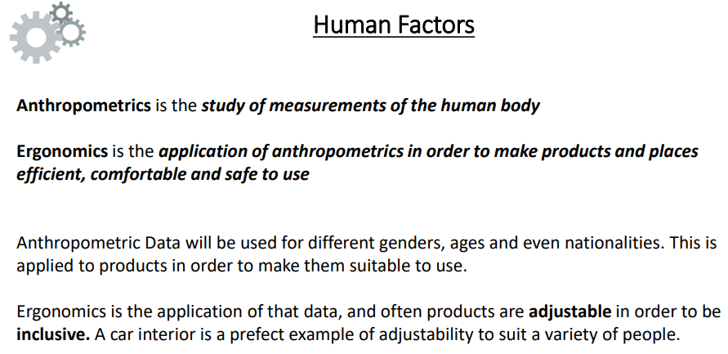
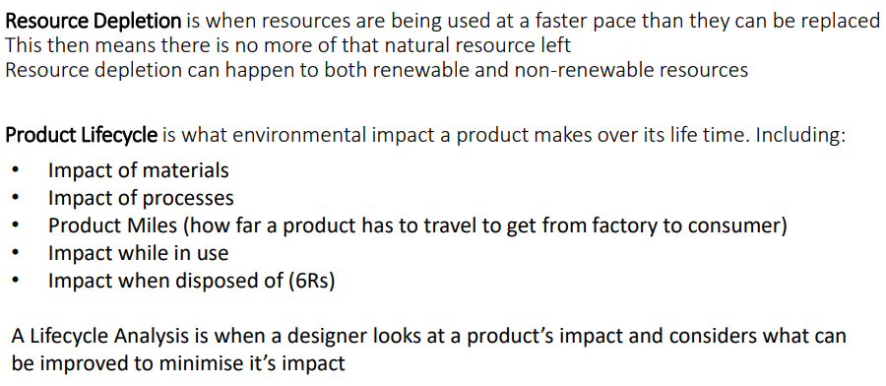
OCR Cambridge Nationals in Engineering Design
Knowledge Organiser- R038
Examination Unit

Slide 9

OCR Cambridge Nationals in Engineering Design
Knowledge Organiser- R038
Examination Unit

Slide 10
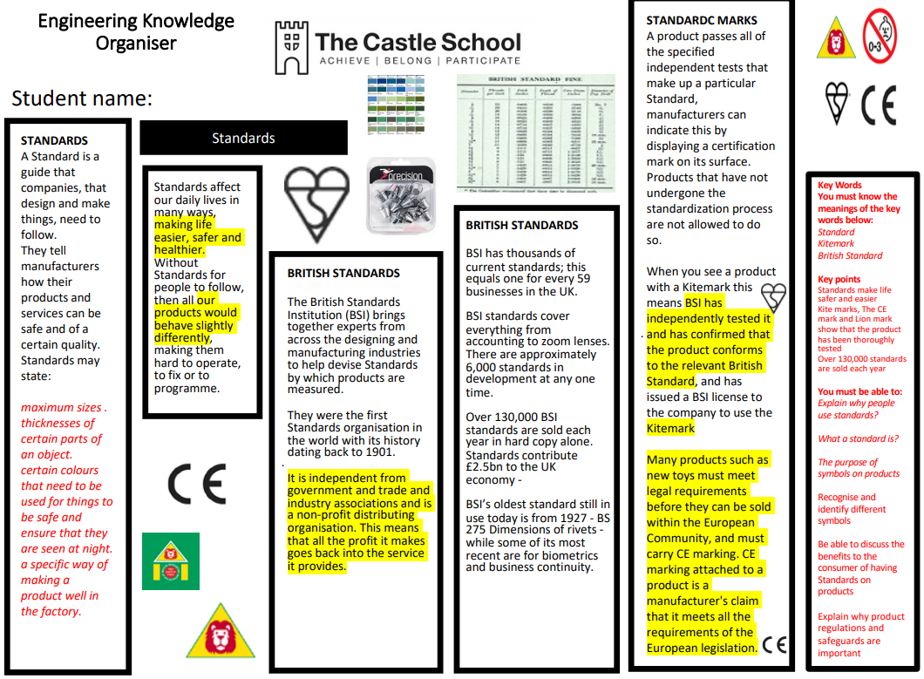
OCR Cambridge Nationals in Engineering Design
Knowledge Organiser- R038
Examination Unit

