Slide 1
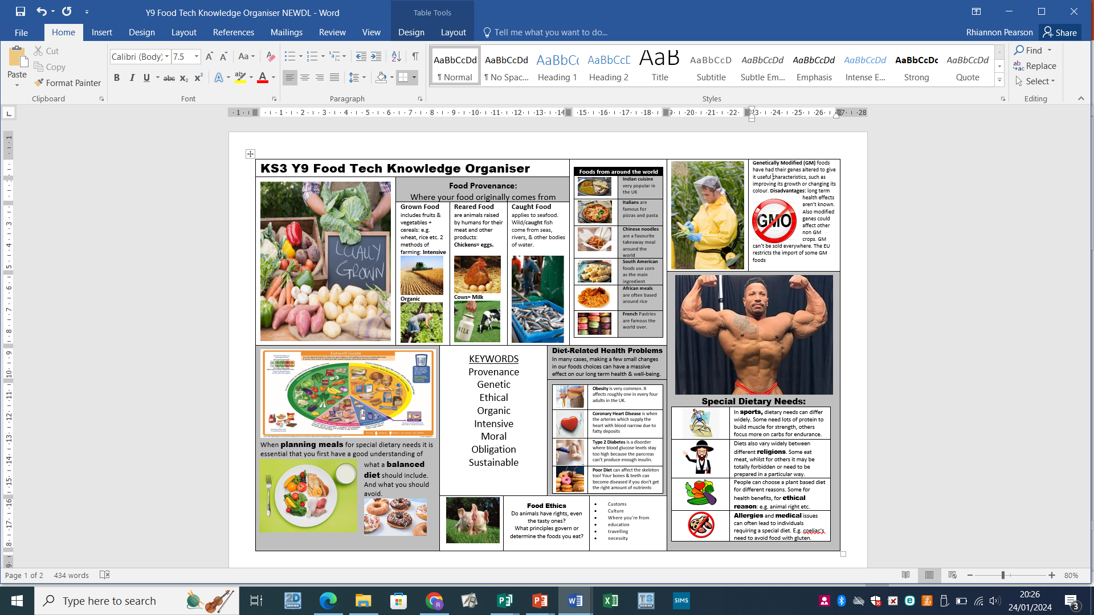
Design and Technology Knowledge organiser
Year 9 Food: Food provenance, food choice & diet related disease

Slide 2
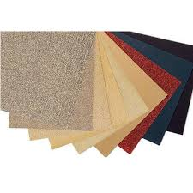
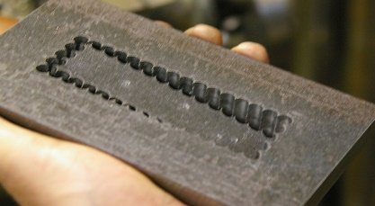
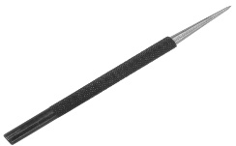
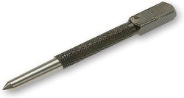
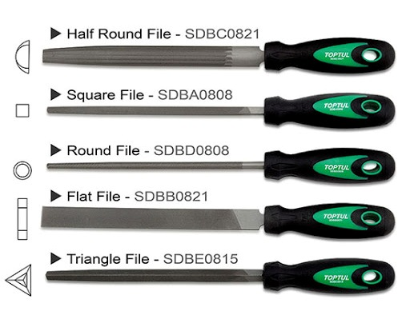
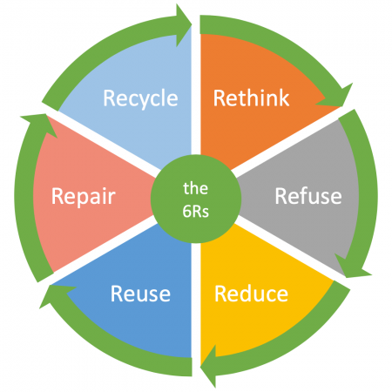
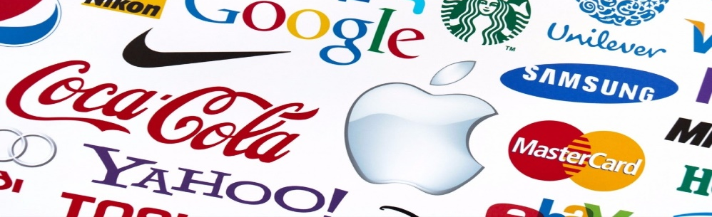
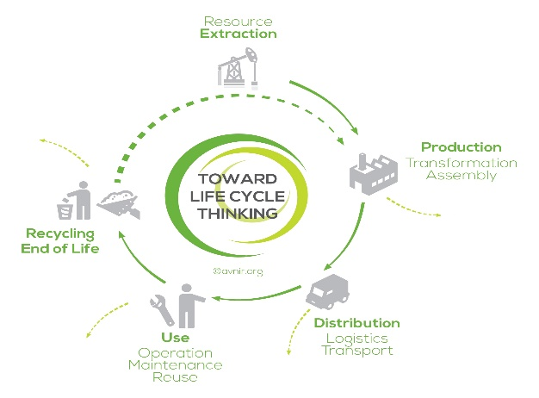




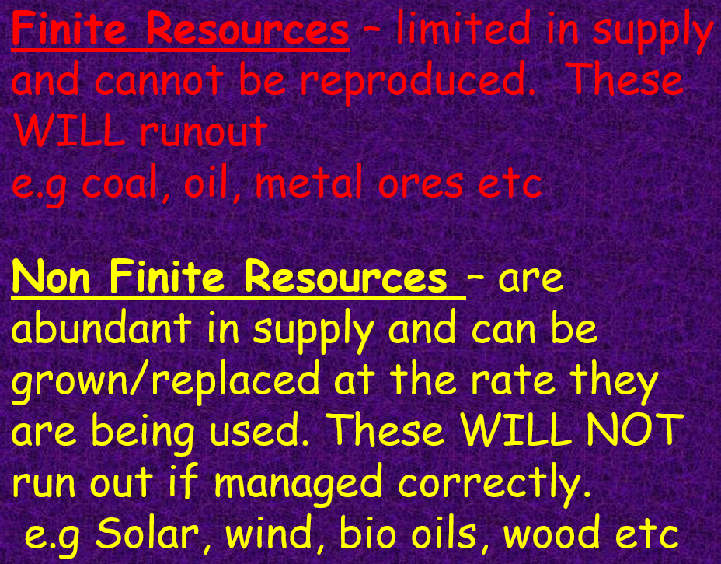

Design and Technology Knowledge organiser
Year 9 Design: Sustainability & polymers
Design & Technology Knowledge Organiser
Y9 Product Development
Chain drilling
Abrasive papers
Glass paper
Wet and Dry
Paper
Emery cloth
Scribe
80
Centre punch
Modelling—Key Terms:
Mock Up—put together quickly and simply to test a design idea
Model—an accurate copy of a product, sometimes on a smaller scale
Prototype—a real size, working model of a product made to demonstrate a design
Modelling materials might include: card, foam board, corrugated board, plywood, MDF, dowel, clay, Plasticine, polymorph, Styrofoam, Lego, K’nex, etc.
240
4000
A logo is a graphic mark, emblem, or symbol used to aid and promote public identification and recognition. It may be of an abstract or figurative design or to include the text of the name that it represents as in a wordmark
Thermoplastics are flexible when heated, can be re-shaped, ‘magic memory, good for recycling:
High Density Polyethylene—HDPE
Low Density polyethylene—LDPE
Polypropylene—PP
High Impact Polystyrene—HIPS
Thermoset Plastics are rigid, more heat resistant, once set in shape they cannot be reformed (like concrete):
Epoxy Resin—ER
Melamine Formaldehyde—MF
Urea Formaldehyde—UF
Phenol Formaldehyde—PF

Slide 3
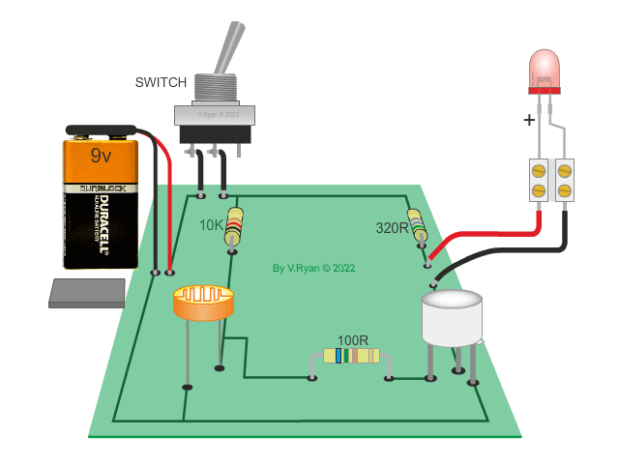
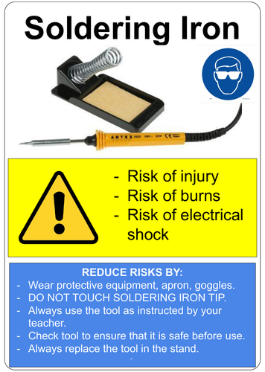
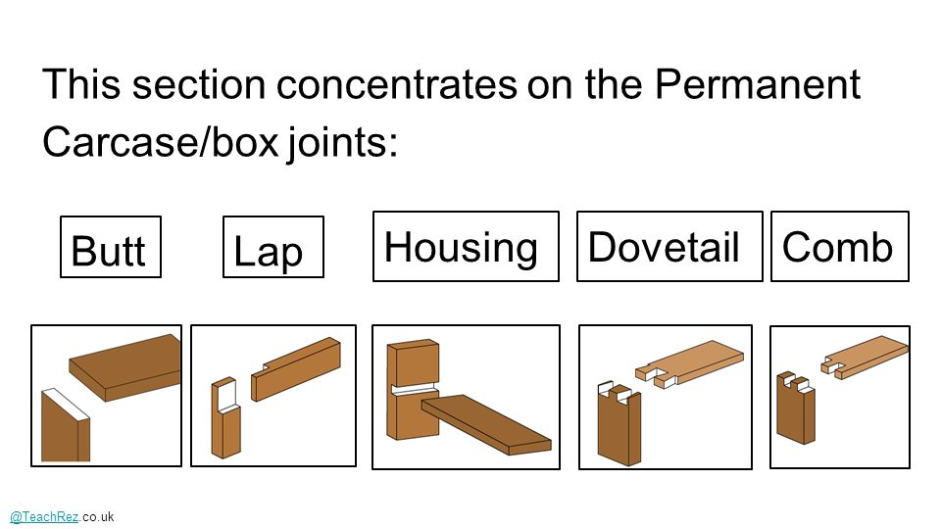
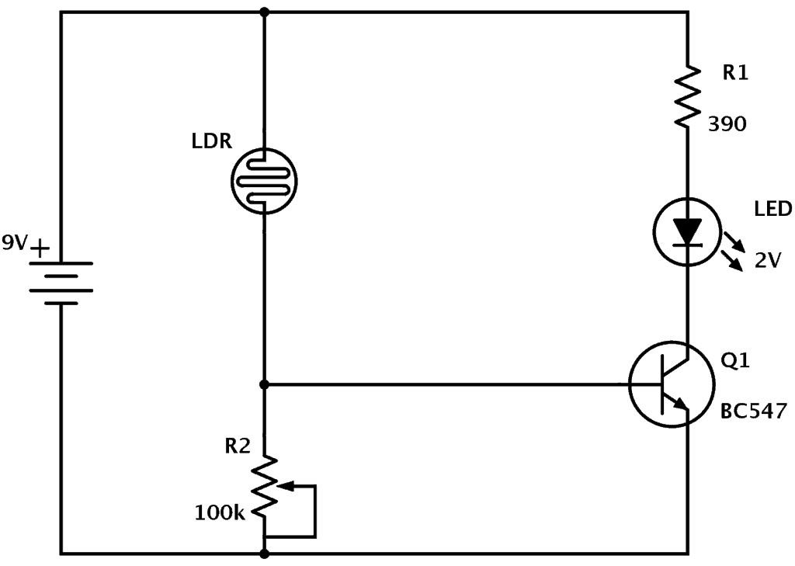
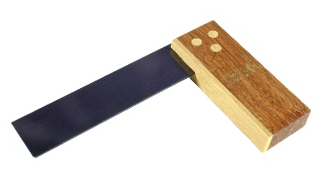
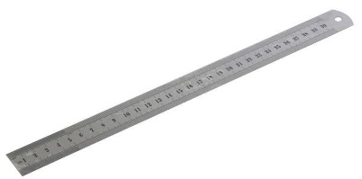
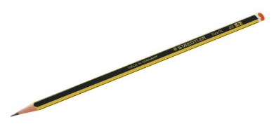
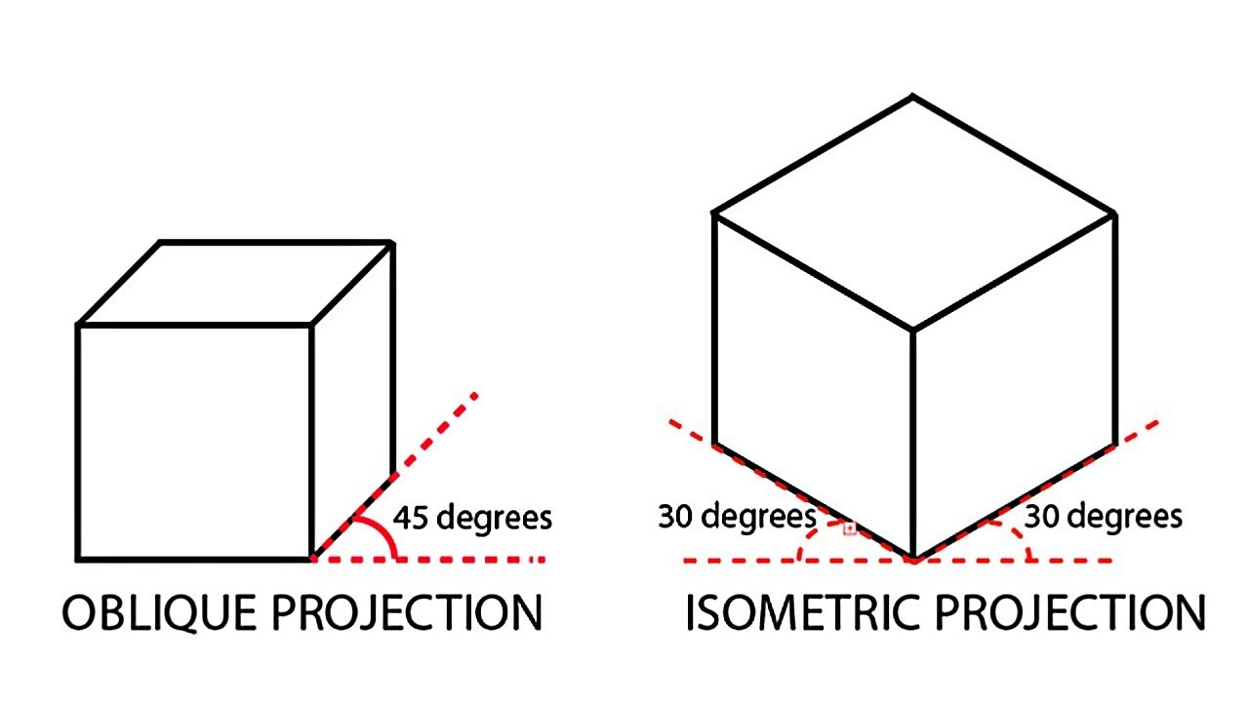
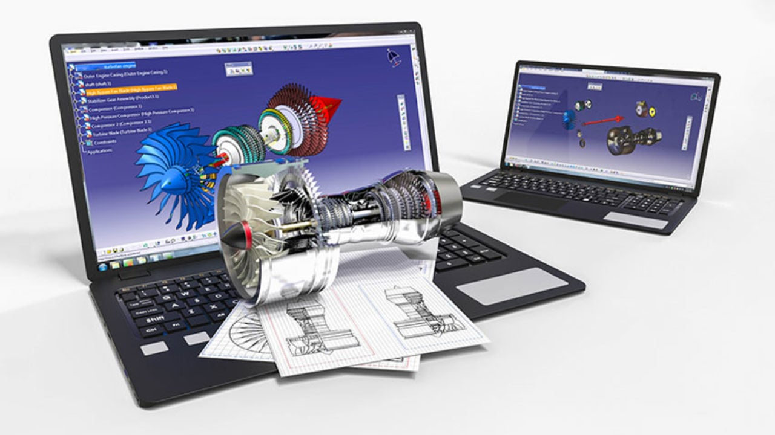

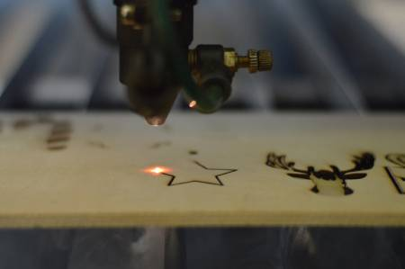
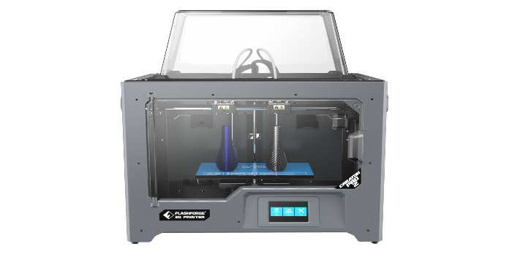

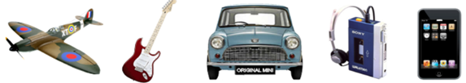
Design and Technology Knowledge organiser
Year 9 Technology: CAD & Study of design eras page 1
Wood joints
Light sensitive LED circuit
Try square
Steel rule
Sharp pencil
An iconic design is usually a design that is ‘ground breaking’ and one that sets new standards in its field.
It is a design that other designers and manufacturers follow, as it becomes a bench mark for other similar products.
3D printer
Laser cutter

Slide 4
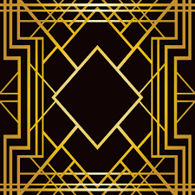
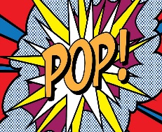
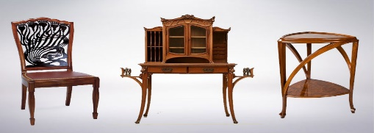
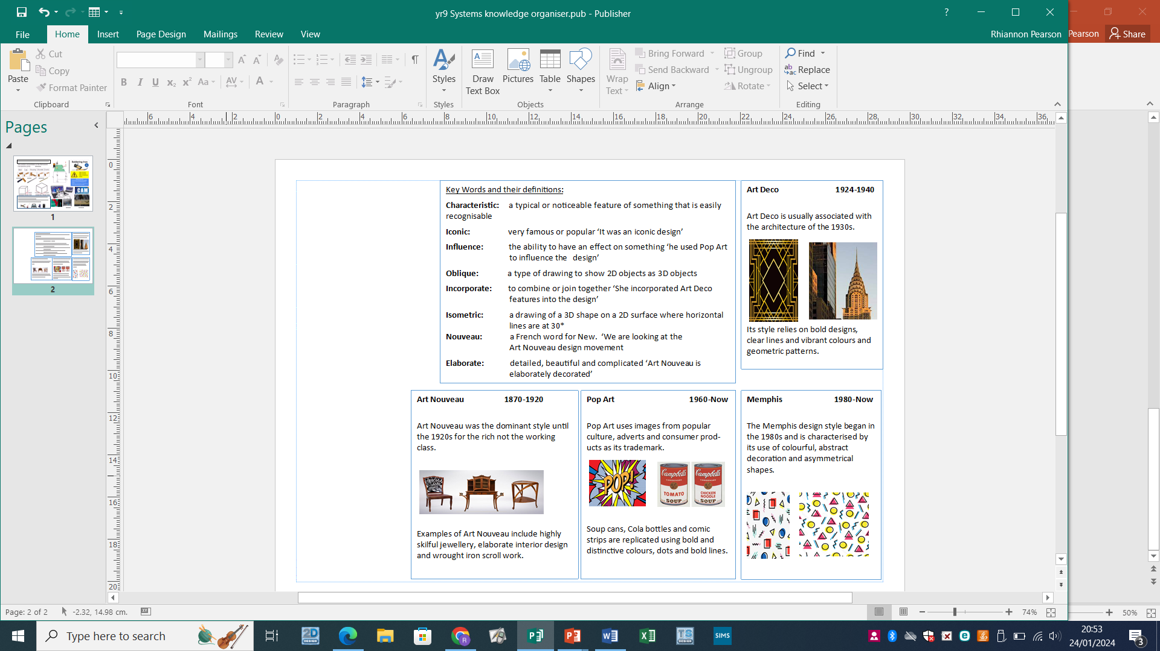
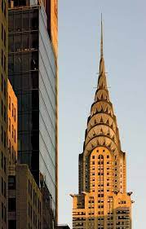
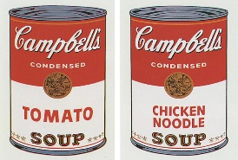
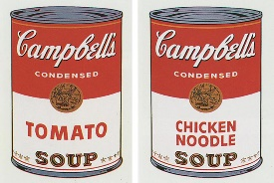

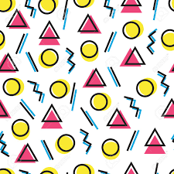
Design and Technology Knowledge organiser
Year 9 Technology: CAD & Study of design eras page 2
Key Words and their definitions:
Characteristic: a typical or noticeable feature of something that is easily recognisable
Iconic: very famous or popular ‘It was an iconic design’
Influence: the ability to have an effect on something ‘he used Pop Art to influence the design’
Oblique: a type of drawing to show 2D objects as 3D objects
Incorporate: to combine or join together ‘She incorporated Art Deco
features into the design’
Isometric: a drawing of a 3D shape on a 2D surface where horizontal lines are at 30*
Nouveau: a French word for New. ‘We are looking at the
Art Nouveau design movement
Elaborate: detailed, beautiful and complicated ‘Art Nouveau is
elaborately decorated’
Art Deco 1924-1940
Art Deco is usually associated with the architecture of the 1930s.
￼
Its style relies on bold designs, clear lines and vibrant colours and geometric patterns.
Art Deco 1924-1940
Art Deco is usually associated with the architecture of the 1930s.
￼
Its style relies on bold designs, clear lines and vibrant colours and geometric patterns.
Key Words and their definitions:
Characteristic: a typical or noticeable feature of something that is easily recognisable
Iconic: very famous or popular ‘It was an iconic design’
Influence: the ability to have an effect on something ‘he used Pop Art to influence the design’
Oblique: a type of drawing to show 2D objects as 3D objects
Incorporate: to combine or join together ‘She incorporated Art Deco
features into the design’
Isometric: a drawing of a 3D shape on a 2D surface where horizontal lines are at 30*
Nouveau: a French word for New. ‘We are looking at the
Art Nouveau design movement
Elaborate: detailed, beautiful and complicated ‘Art Nouveau is
elaborately decorated’
Art Deco 1924-1940
Art Deco is usually associated with the architecture of the 1930s.
￼
Its style relies on bold designs, clear lines and vibrant colours and geometric patterns.
Key Words and their definitions:
Characteristic: a typical or noticeable feature of something that is easily recognisable
Iconic: very famous or popular ‘It was an iconic design’
Influence: the ability to have an effect on something ‘he used Pop Art to influence the design’
Oblique: a type of drawing to show 2D objects as 3D objects
Incorporate: to combine or join together ‘She incorporated Art Deco
features into the design’
Isometric: a drawing of a 3D shape on a 2D surface where horizontal lines are at 30*
Nouveau: a French word for New. ‘We are looking at the
Art Nouveau design movement
Elaborate: detailed, beautiful and complicated ‘Art Nouveau is
elaborately decorated’
Art Deco 1924-1940
Art Deco is usually associated with the architecture of the 1930s.
￼
Its style relies on bold designs, clear lines and vibrant colours and geometric patterns.
Key Words and their definitions:
Characteristic: a typical or noticeable feature of something that is easily recognisable
Iconic: very famous or popular ‘It was an iconic design’
Influence: the ability to have an effect on something ‘he used Pop Art to influence the design’
Oblique: a type of drawing to show 2D objects as 3D objects
Incorporate: to combine or join together ‘She incorporated Art Deco
features into the design’
Isometric: a drawing of a 3D shape on a 2D surface where horizontal lines are at 30*
Nouveau: a French word for New. ‘We are looking at the
Art Nouveau design movement
Elaborate: detailed, beautiful and complicated ‘Art Nouveau is
elaborately decorated’
Art Deco 1924-1940
Art Deco is usually associated with the architecture of the 1930s.
￼
Its style relies on bold designs, clear lines and vibrant colours and geometric patterns.
Key Words and their definitions:
Characteristic: a typical or noticeable feature of something that is easily recognisable
Iconic: very famous or popular ‘It was an iconic design’
Influence: the ability to have an effect on something ‘he used Pop Art to influence the design’
Oblique: a type of drawing to show 2D objects as 3D objects
Incorporate: to combine or join together ‘She incorporated Art Deco
features into the design’
Isometric: a drawing of a 3D shape on a 2D surface where horizontal lines are at 30*
Nouveau: a French word for New. ‘We are looking at the
Art Nouveau design movement
Elaborate: detailed, beautiful and complicated ‘Art Nouveau is
elaborately decorated’
Art Deco 1924-1940
Art Deco is usually associated with the architecture of the 1930s.
￼
Its style relies on bold designs, clear lines and vibrant colours and geometric patterns.
Art Nouveau 1870-1920
Art Nouveau was the dominant style until the 1920s for the rich not the working class.
￼
Examples of Art Nouveau include highly skilful jewellery, elaborate interior design and wrought iron scroll work.
Pop Art 1960-Now
Pop Art uses images from popular
culture, adverts and consumer products as its trademark.
￼
Soup cans, Cola bottles and comic strips are replicated using bold and
distinctive colours, dots and bold lines.
Memphis 1980-Now
The Memphis design style began in the 1980s and is characterised by its use of colourful, abstract
decoration and asymmetrical shapes.
Art Nouveau 1870-1920
Art Nouveau was the dominant style until the 1920s for the rich not the working class.
￼
Examples of Art Nouveau include highly skilful jewellery, elaborate interior design and wrought iron scroll work.
Pop Art 1960-Now
Pop Art uses images from popular
culture, adverts and consumer products as its trademark.
￼
Soup cans, Cola bottles and comic strips are replicated using bold and
distinctive colours, dots and bold lines.
Memphis 1980-Now
The Memphis design style began in the 1980s and is characterised by its use of colourful, abstract
decoration and asymmetrical shapes.
Art Nouveau 1870-1920
Art Nouveau was the dominant style until the 1920s for the rich not the working class.
￼
Examples of Art Nouveau include highly skilful jewellery, elaborate interior design and wrought iron scroll work.
Pop Art 1960-Now
Pop Art uses images from popular
culture, adverts and consumer products as its trademark.
￼
Soup cans, Cola bottles and comic strips are replicated using bold and
distinctive colours, dots and bold lines.
Memphis 1980-Now
The Memphis design style began in the 1980s and is characterised by its use of colourful, abstract
decoration and asymmetrical shapes.
Art Nouveau 1870-1920
Art Nouveau was the dominant style until the 1920s for the rich not the working class.
￼
Examples of Art Nouveau include highly skilful jewellery, elaborate interior design and wrought iron scroll work.
Pop Art 1960-Now
Pop Art uses images from popular
culture, adverts and consumer products as its trademark.
￼
Soup cans, Cola bottles and comic strips are replicated using bold and
distinctive colours, dots and bold lines.
Memphis 1980-Now
The Memphis design style began in the 1980s and is characterised by its use of colourful, abstract
decoration and asymmetrical shapes.
Art Nouveau 1870-1920
Art Nouveau was the dominant style until the 1920s for the rich not the working class.
￼
Examples of Art Nouveau include highly skilful jewellery, elaborate interior design and wrought iron scroll work.
Pop Art 1960-Now
Pop Art uses images from popular
culture, adverts and consumer products as its trademark.
￼
Soup cans, Cola bottles and comic strips are replicated using bold and
distinctive colours, dots and bold lines.
Memphis 1980-Now
The Memphis design style began in the 1980s and is characterised by its use of colourful, abstract
decoration and asymmetrical shapes.

