Slide 1
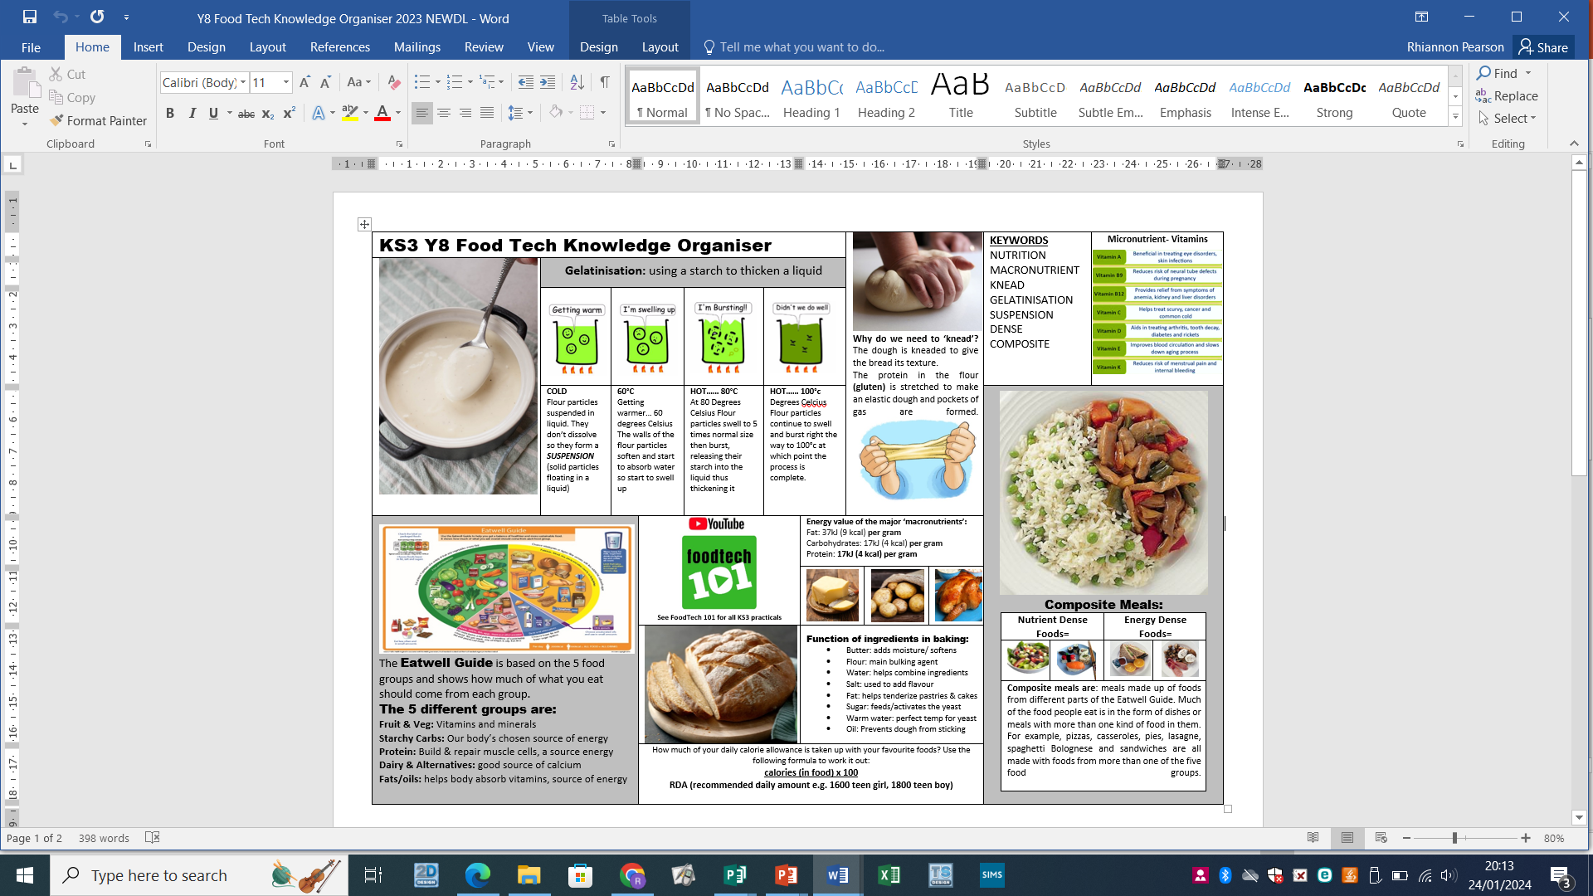
Design and Technology Knowledge organiser
Year 8 Food: Nutrients, origin & function of ingredients

Slide 2
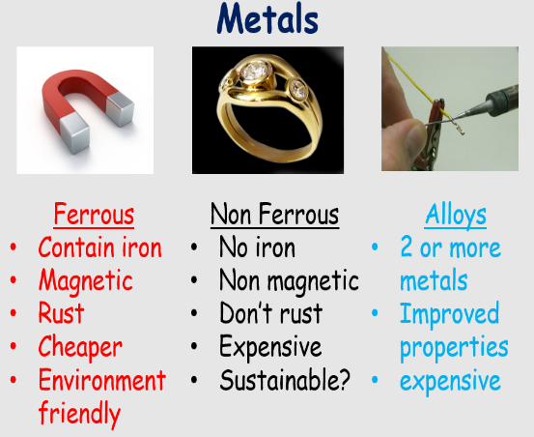
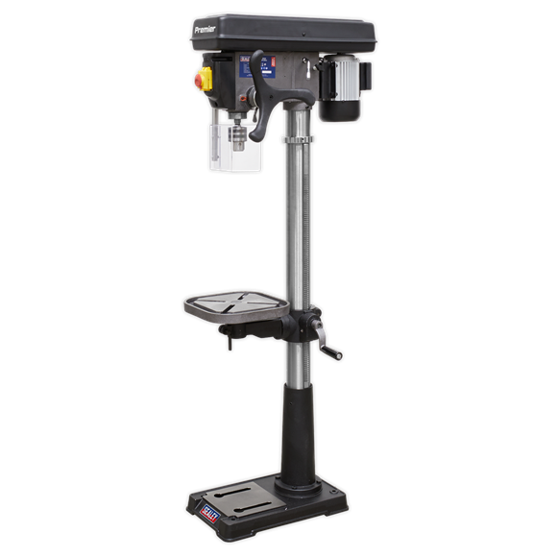
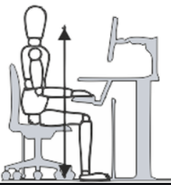
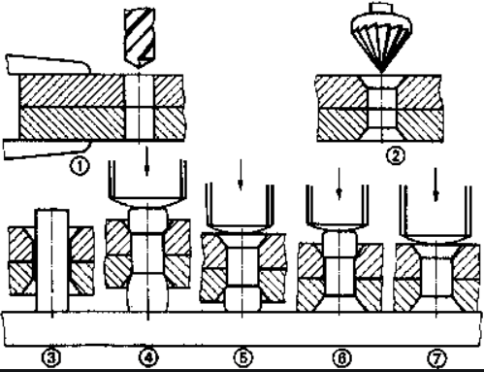
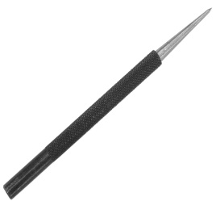
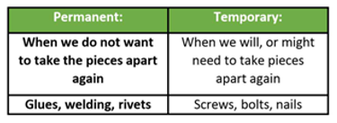
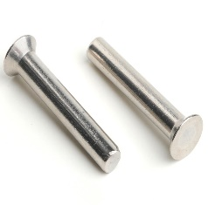
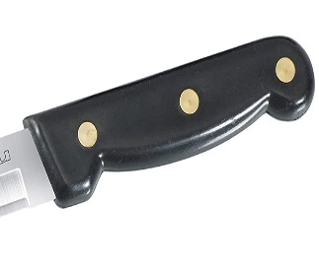
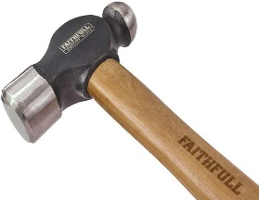
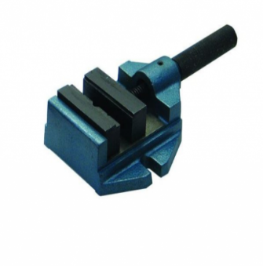
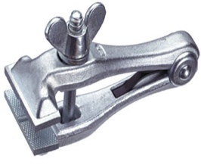
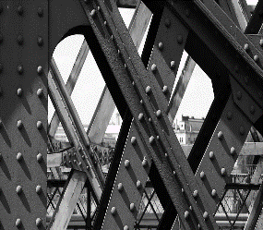
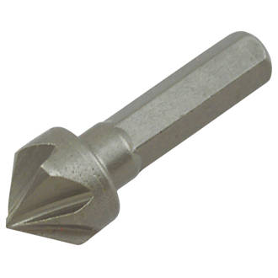
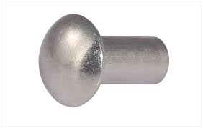
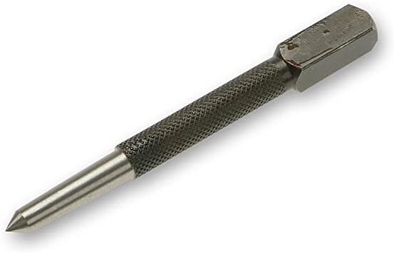
Ergonomics: human factors that affect the design of products or places
Anthropometrics: is the study of average human measurements
Pillar Drill
Countersink Head Riveting
Scribe
Design and Technology Knowledge organiser
Year 8 Design: Metals & Ergonomics
Round Head Rivets
Hand Vice
Ball Pein Hammer
Machine Vice
Centre Punch
Countersink Bit
Material PHYSICAL properties
Absorbency
An ability to take on/attract another element such as water, heat or light
Density
The mass of a material per unit of volume/how compact it is
Fusibility
The ability of a material to combine with another material when heated into a liquid, and then cooling as one
Electrical Conductivity
The ability to conduct electricity
Thermal Conductivity
The ability of a material to conduct heat
Material WORKING properties
Strength
The ability to withstand force without breaking
Elasticity
The ability to stretch and return to their original shape
Ductility
The ability to be drawn or stretched out onto a thin strand without snapping
Malleability
The ability to be deformed and to remain in that shape
Hardness
The ability to withstand scratching or denting
Toughness
The ability to withstand breaking or snapping

Slide 3
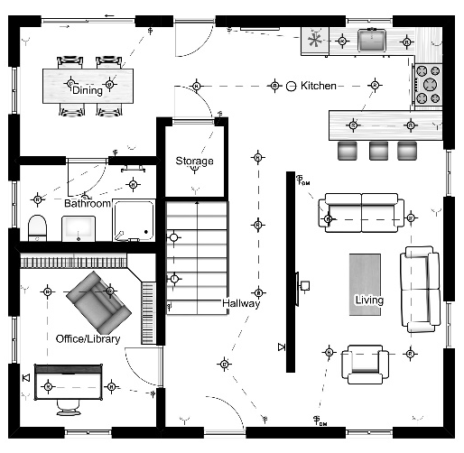
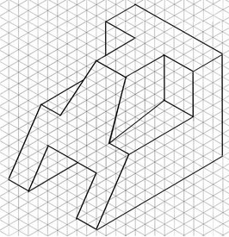
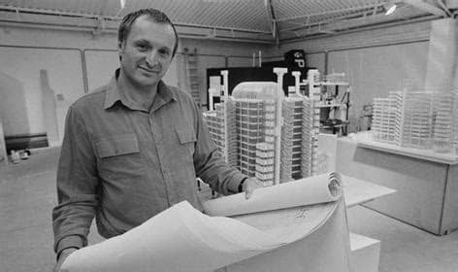
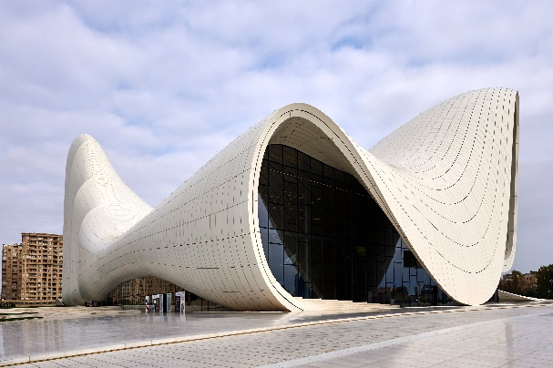
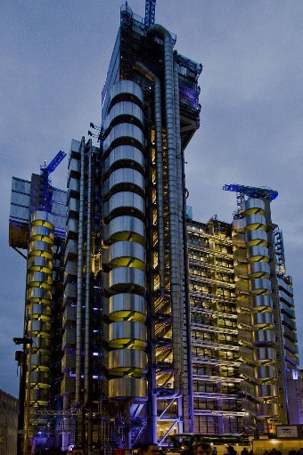
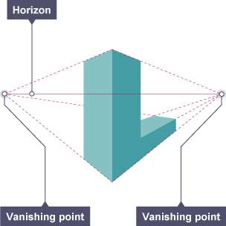

Design and Technology Knowledge organiser
Year 8 Technology: Architecture & mechanisms
A floor plan is like a map in pictures of a floor in a building. It helps architects and designers understand how the space inside a house or office looks and how everything is arranged and flows. It is a to-scale drawing of a single room, one floor, or an entire building. Each wall, ceiling, and hallway is measured and then drawn to scale.
Deign Brief / Engineering Brief
A is the statement a gives to a designer outlining what they want their product to be like, eg 'Design a drinks bottle holder for use while riding a bicycle'. The designer could also produce a brief on behalf of the client, as the client might have a problem but not know how to proceed.
Design Specification
A is a list of criteria a product needs to address. Using the brief as a starting point for research, a specification can be written when more facts are known. Information needs to be found through research to help produce early design solutions and improvements.
If the criteria are measurable, it makes it easier to later measure how effective the design ideas are, eg 'How much will the design cost to produce?‘
Inspirational Architects:
Isometric drawing, method of graphic representation of three-dimensional objects, used by engineers, technical illustrators, and architects. The technique uses a drawing grid with lines at angles of 30, 60 and 90 degrees. It is a technical drawing that required pencil and ruler and is a technique that creates drawings that can be enlarged and reduced accurately.
Zara
Hadid
Perspective drawing is a way of communicating design ideas in three-dimension – this technique requires a pencil and ruler and is classified as technical drawing. The drawing technique also needs 2 vanishing points and shows the object being drawn getting smaller as it goes into the distance. This is a popular drawing technique however the objects being drawn cannot be accurately enlarged or reduced.
Richard Rogers

