Slide 1
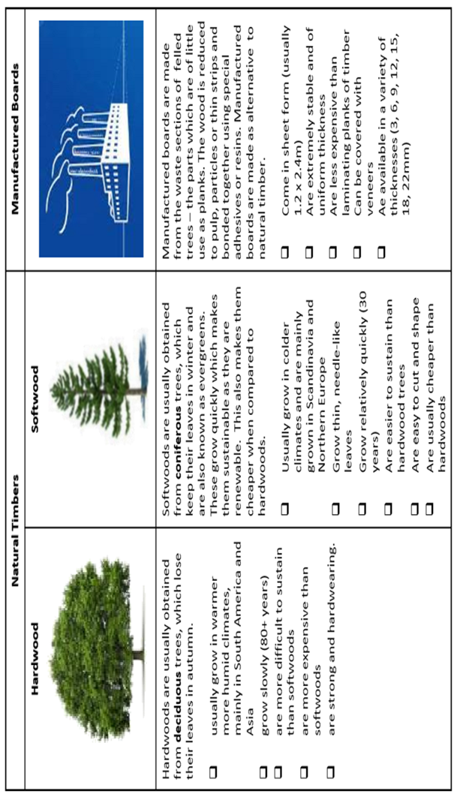
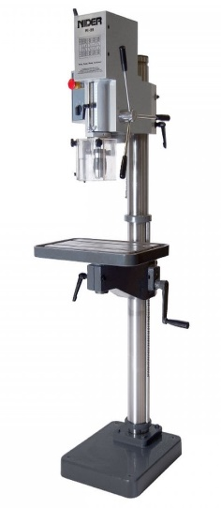
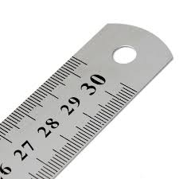
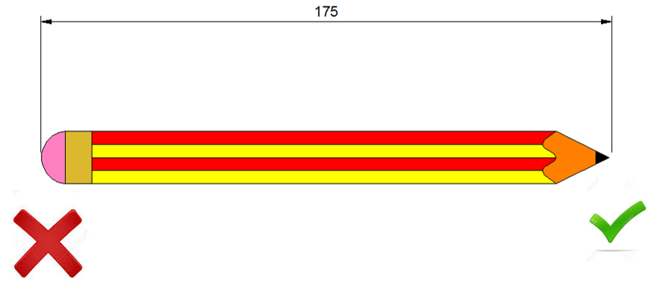
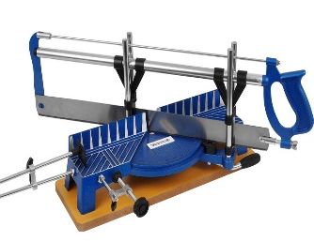
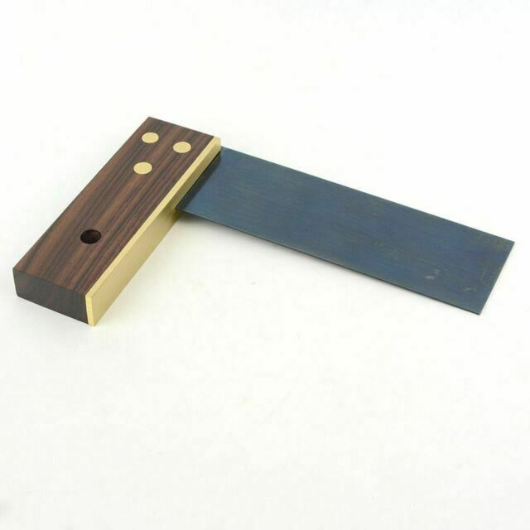
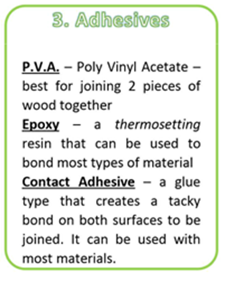
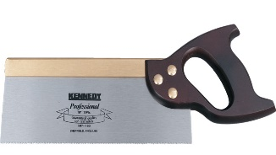
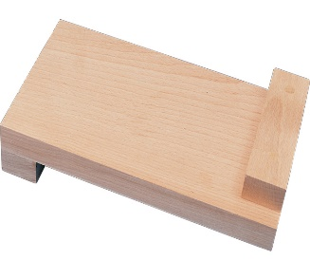
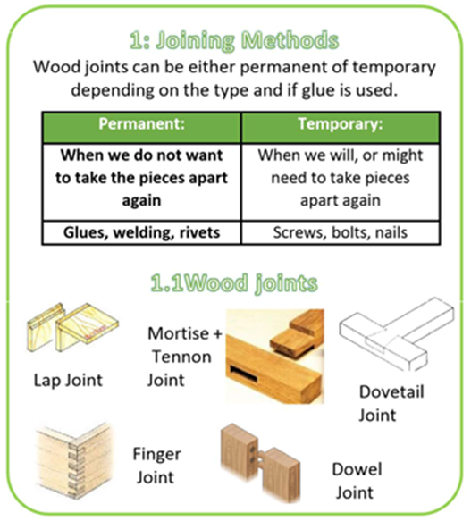
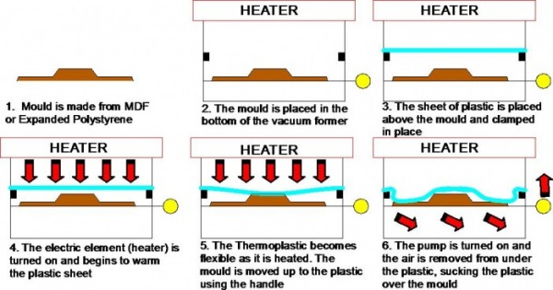
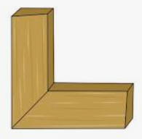
Design & Technology Knowledge Organiser
Year 7 Design: Timbers & Measuring
Woods—Key Words:
Manufactured
Deciduous
Coniferous
Felling
Seasoning
Converting
Grain
Knots
Heartwood
We always measure in millimetres!
1cm = 10mm
Adding Dimensions
Steel Rule
Pillar Drill
Mitre Saw
Tri Square
Bench Hook
Tenon Saw
Vacuum Forming
Mitre
Joint

Slide 2
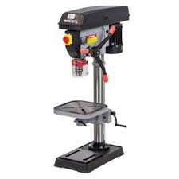
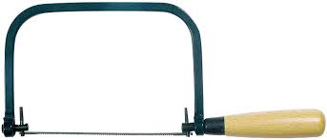
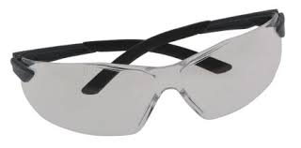
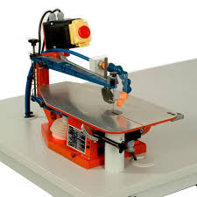
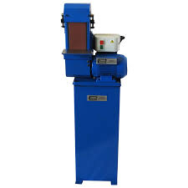
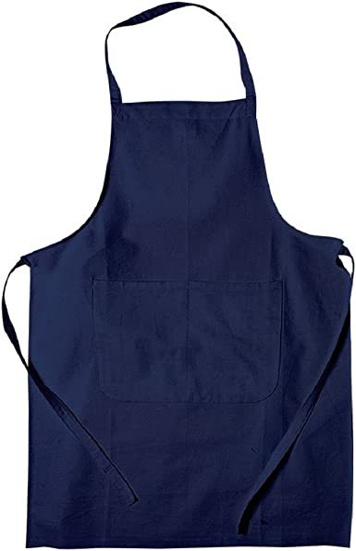
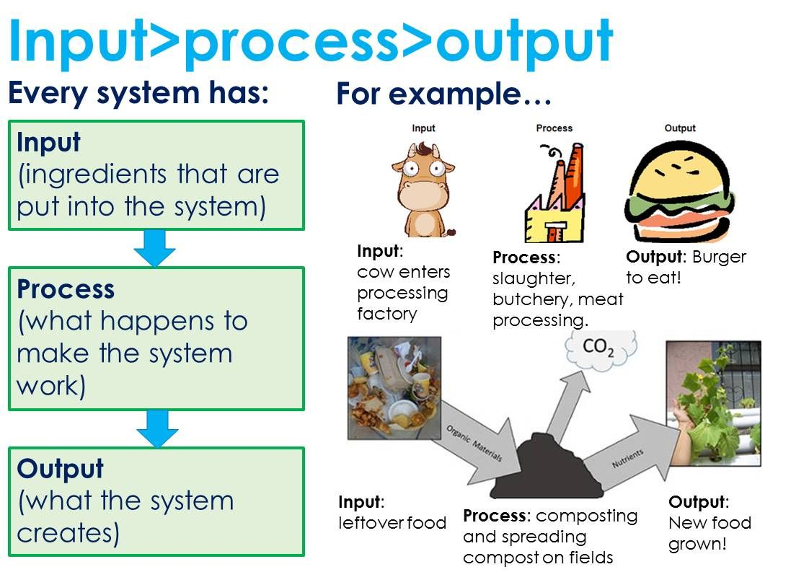
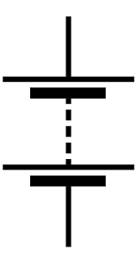
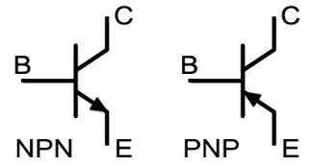
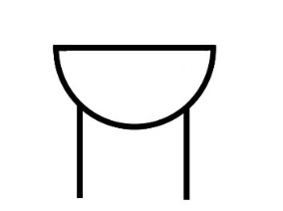
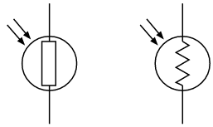
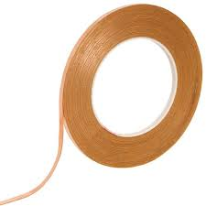
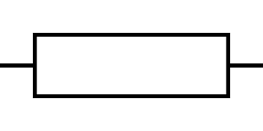
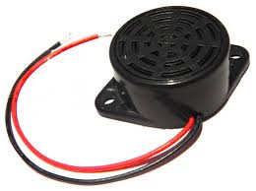
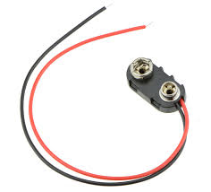
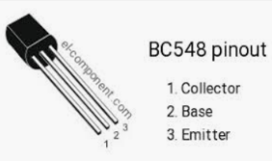
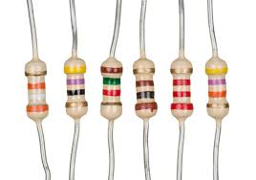
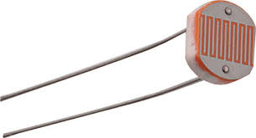
Design and Technology Knowledge organiser
Year 7 Technology: Electronics sensors and systems
Pillar Drill
Coping Saw
KEY WORDS AND THEIR DEFINITIONS
Component: a part that combines with other parts to make
something bigger (your circuit)
Target market: the group of people for which your product is
Aimed at. Who is likely to buy or use it.
Sensor: a device that detects and responds to a type
Of input (light/heat/motion/pressure etc)
Transistor a component that regulates the voltage flow
through your circuit
Resistor a component that limits the flow of electricity
in your circuit
Machines, tools and safety wear
Belt sander
Fret Saw
Safety Glasses
DT APRON
COMPONENTS & SYMBOLS
Resistor
Transistor
Buzzer
LDR
Battery

Slide 3
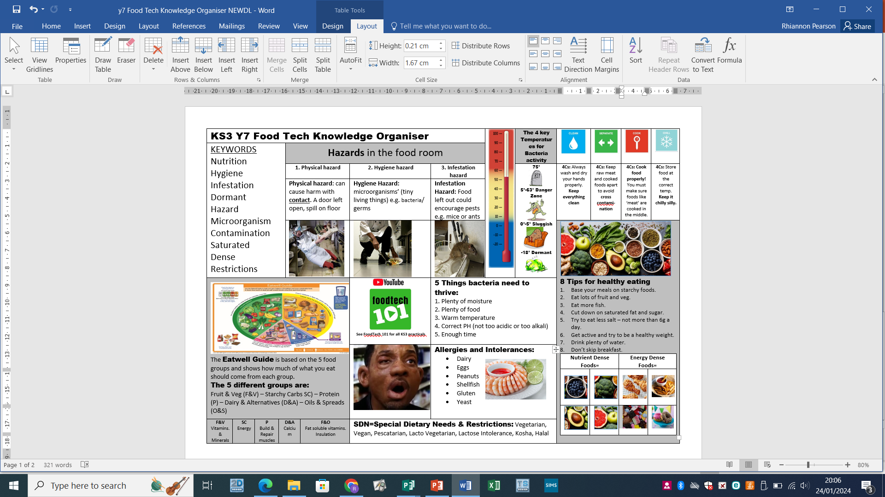
Design and Technology Knowledge organiser
Year 7 Food: Hazards & hygiene, Eatwell guide

