Slide 2
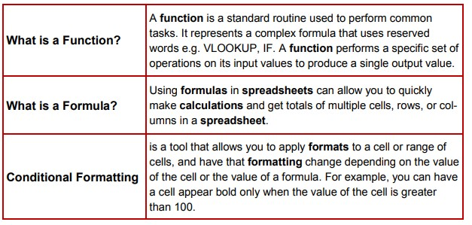
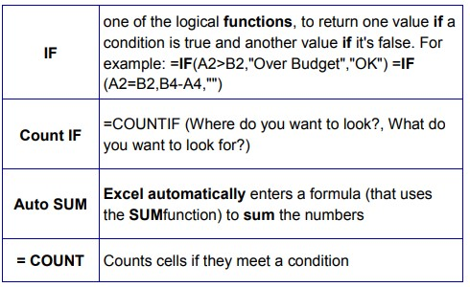
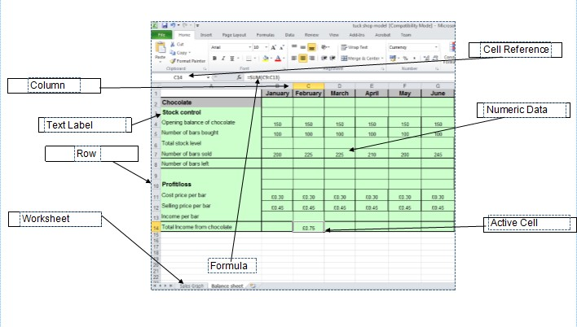
Year 8 Computing Half Term 1
Spreadsheets
Functions
Key terms
Term | Definition
Cell reference | How you refer to a single “box” on a spreadsheet.
Row | All cells in a horizontal line.
Column | All cells in a vertical line.
= SUM | Adds a range of cells together
= AVERAGE | Finds an average for a range of cells.
= MIN | Returns the smallest value in a range.
= MAX | Returns the highest value in a range.
= COUNT | Counts cells if they meet a condition.
Common Functions
Spreadsheet Layout

Slide 3
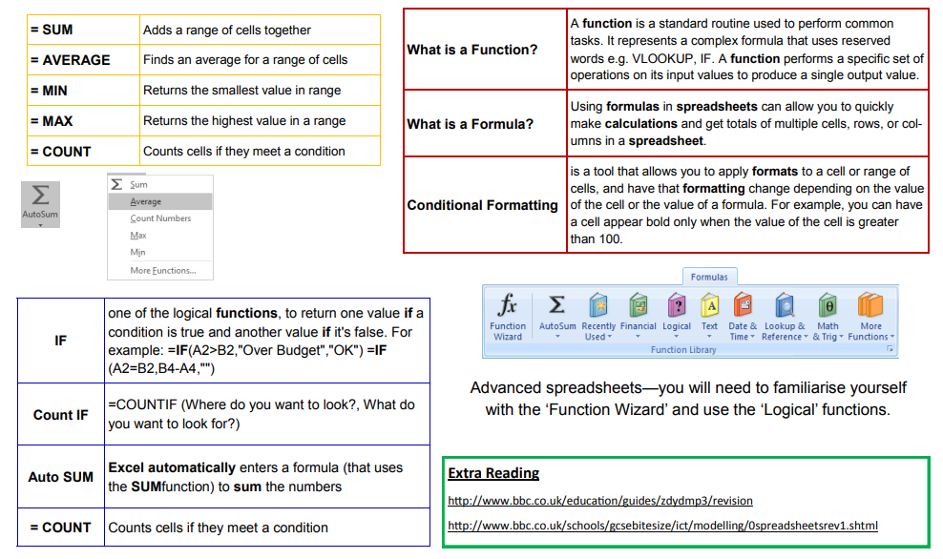
Year 8 Computing Half Term 2
Spreadsheets

Slide 4
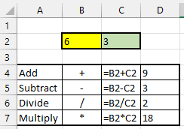
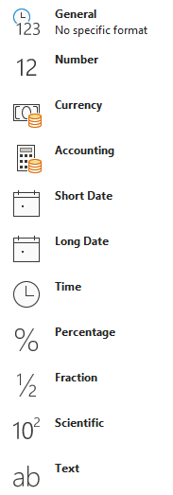
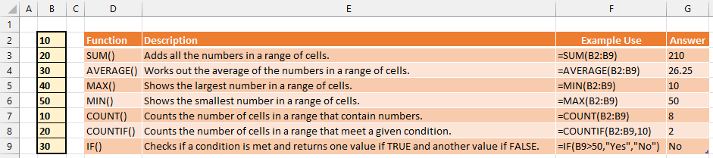
Year 8 Computing Half Term 2
Spreadsheets
Key Vocabulary
Active Cell | The cell you have selected and are currently on.
Cell | A rectangular box in a worksheet that can contain data.
Cell Range | A collection of selected cells. For example (B2:D2).
Cell Reference | A name given to each cell made up of the column letter and row number of that cell.
Chart | A graph ‐ used to show data in a visual way.
Column | A vertical collection of cells. Each column has a letter to represent it.
Data Type | The type of value being stored in a cell.
Formatting Tools | A set of tools that allow the style of a cell to be changed.
Formula | A set of instructions to be carried out.
Function | A named formula built into a spreadsheet to perform a task.
Row | A horizontal collection of cells. Each row has a number to represent it.
CALCULATIONS USING BASIC FORMULAE
EXCEL DATA TYPES
EXAMPLE FUNCTIONS IN EXCEL

Slide 5
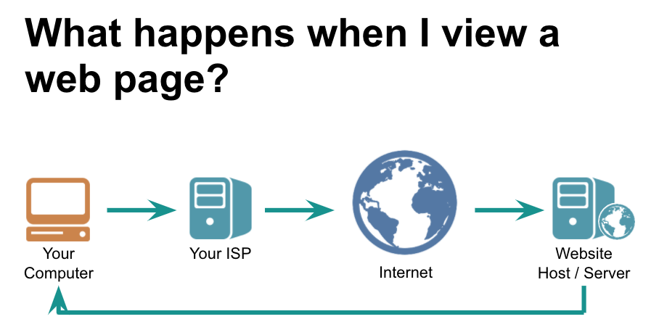
Year 8 Computing Half Term 3
Website Design
World Wide Web
Key terms
The World Wide Web is a huge collection of websites that we can access using the Internet
Each website contains web pages which are navigated to via hyperlinks
Web pages contain different types of information including images, text and multimedia
Term | Definition
WWW | Stands for World Wide Web and is the collection of all the web sites we can access.
HTML | Stands for Hypertext Markup Language and describe the content of a web page using tags.
CSS | Stands for Cascading Style Sheets and is how the style of a webpage can be changed.
Tag | An individual element that makes up part of a web page. For example <H1> This is a heading </H1>.
Hyperlink | A way of moving from one web page to another – these are used to navigate around a website.
JavaScript | The programming language commonly used alongside HTML to make a website interactive.
HTML and CSS
Common Tags
HyperText Markup Language is the language of the web
It describes the content in web pages
Cascading Style Sheets define the style and layout of web pages
Changing the Style means changing colours, layout, font style and font size.
Tag | Use | Example
<H1> | One of a few tags that can be used to create a heading – this is the largest heading you can make. | <H1> This is a heading </H1>
<p> | The tag which is used to create a paragraph of text. | <p> This is a paragraph of text </p>
<img src> | The tag which is used to add an image to a web page. | <img src = "img_girl.jpg" alt = "Girl in a jacket" width="500" height="600
<a href> | The tag which is used to create a hyperlink in a webpage. | <a href="https://www.w3schools.com"> Visit W3Schools.com!</a>
<div> | The tag which is used to segment a web page in to different sections to allow more sections to have different CSS added individually. | <div> <H1> This is a heading </> </div>
<head> | The tag which goes at the top of the page and usually only contains meta data, the webpage title and style tags. | <head> <title> This is the page name </> </head>
<body> | The tag which contains all the contents of an HTML document, such as headings, paragraphs, images, hyperlinks, tables, lists, etc. | <body> <h1>This is a heading</h1> <p>This is a paragraph.</p> </body>

Slide 6
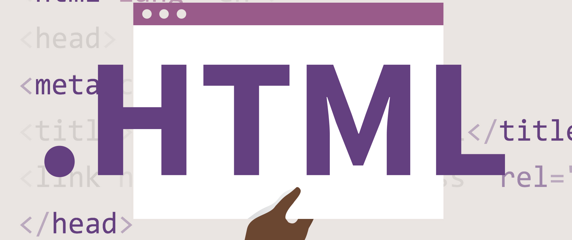
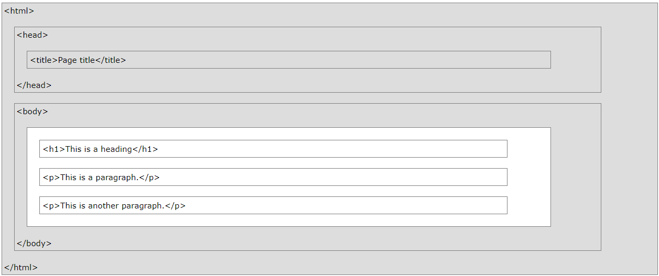
Year 8 Computing Half Term 4
HTML
What is HTML?
Hypertext Markup Language is the standard markup language for documents designed to be displayed in a web browser.
Tags
HTML uses tags in order to structure web pages. These are created using the < and > symbols. Each tag has a specific job for example
<p> </p> creates a paragraph and <h1> </h1> creates a heading.
What is CSS?
Cascading Style Sheets is a style sheet language used for describing the presentation of a document written in a markup language such as HTML.
For example:
Body {
background-color:
lightblue;
}
Key words
HTML
TAG
CSS
<P>
HTML Document Structure
<H1>
<BODY>
<HEAD>
<HTML>
<IMG SRC>
<TITLE>
<A REF>

Slide 7

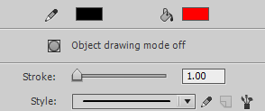
Year 8 Computing Half Term 5
Animation
What is animation?
When we show a series of images, each slightly different from the previous one, the brain is fooled into thinking the image is moving
What can animate do?
Animate, or Flash as it was formerly known, is used to create animations
These can be anything from simple web banners to cartoons – The Mr Men TV series is drawn completely in Animate, for example.
Frame
Each image in the series of images that creates the animation.
Key frame
Each key frame defines a change on the stage
and when the movie is played.
Timeline
Where you can add, remove and reorder the frames.
Onion Skinning
Allows you to view the image on multiple frames at once.
Frame rate
How quickly the animation plays through the frames, FPS means frames per second.
Tweening
Stands for inbetweening and is when the computer adds in extra frames between your key frames to make the animation smooth.
Actionscript
A programming language used to make an animation interactive.
Vector Graphics
When you draw in Animate, you create vector art.
You can combine and subtract shapes from one and other.
Drawing Tools
These tools can be used to create shapes and edit
their properties.
Motion Tweening
Moving a graphic from one position to another
Must use graphics converted to symbols
Adding a motion tween lets you design a path for the symbol to travel on
Shape Tweening
You can “morph” from one shape to another
Shape tweening can be used to gradually alter the form of any editable shape
You can change the shape, colour and position of the shape

Slide 8
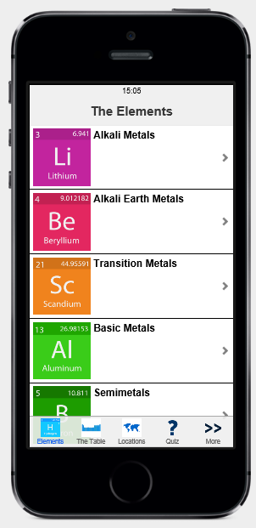
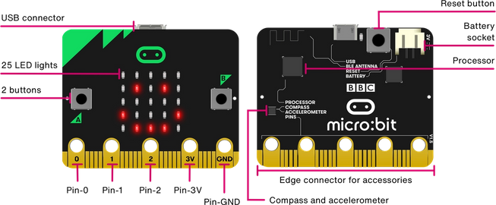
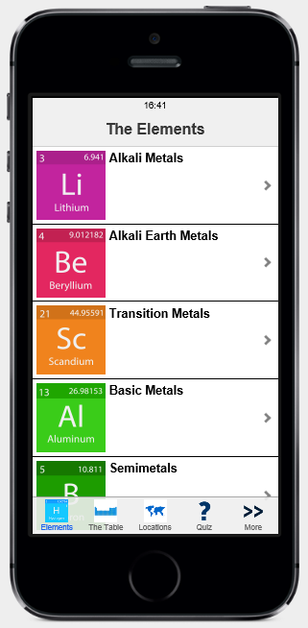
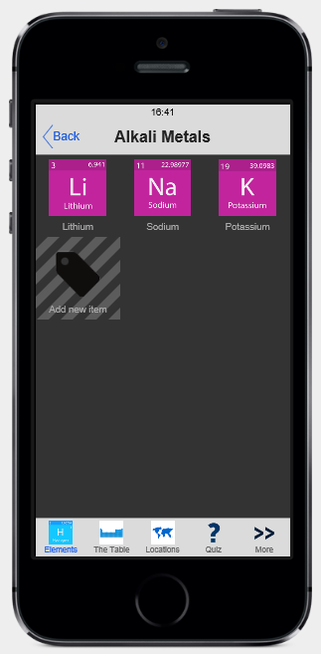
Year 8 Computing Half Term 6
AppShed & Micro:bit
What is an app?
An application is software that a user can interact with, they come in lots of different formats – like Snapchat and BBC News!
What can Appshed do?
In Appshed you can design an app that informs the user about an area of interest using links, image galleries and mapping features
The Home Screen
What is the micro:bit?
The BBC micro:bit is a pocket-sized computer that introduces you to how software and hardware work together. It has an LED light display, buttons, sensors and many input/output features that, when programmed, let it interact with you and your world.
This is the first place users will arrive after they have opened the app and is the most important screen
Types of menu screen
The basic screen layouts can be either a Standard Screen with a list or an Icons Screen

