Slide 1
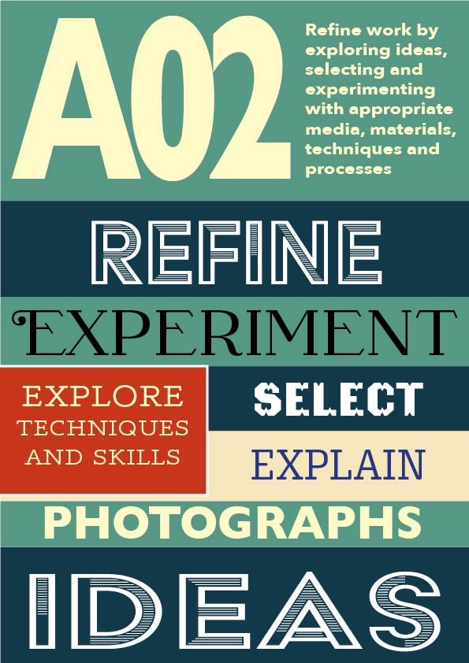
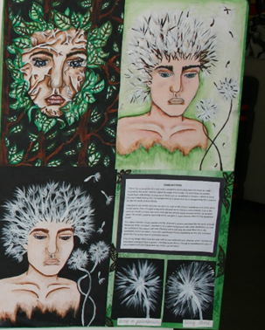
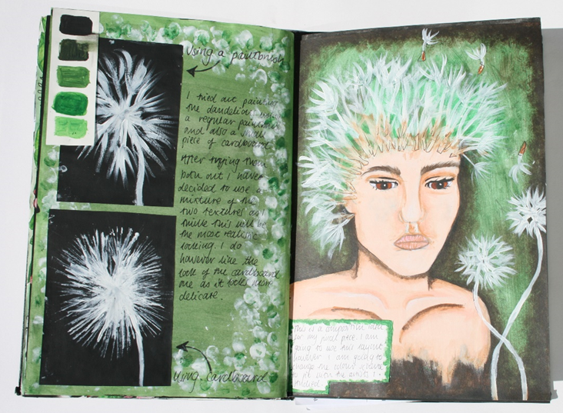
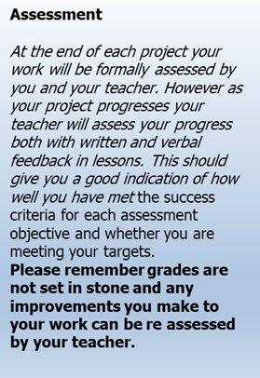
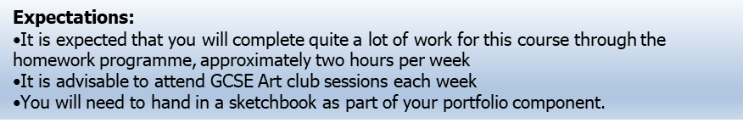
GCSE Fine art
Design and Media
You need to develop and explore ideas using media, processes and resources, reviewing, modifying and refining work as it progresses.
This assessment objective allows you to demonstrate to the examiner how creative and versatile you are. You need to start with an idea or theme and develop it, exploring lots of possible solutions using different materials and techniques and processes.
For every project/theme
Try out different materials and techniques.
Explore and experiment
Refine ideas and compositions
Review
Select
Organise
Explore
Experiment
Refine
Notes:
ART Knowledge Organisers - Year 11 – HT1

Slide 2
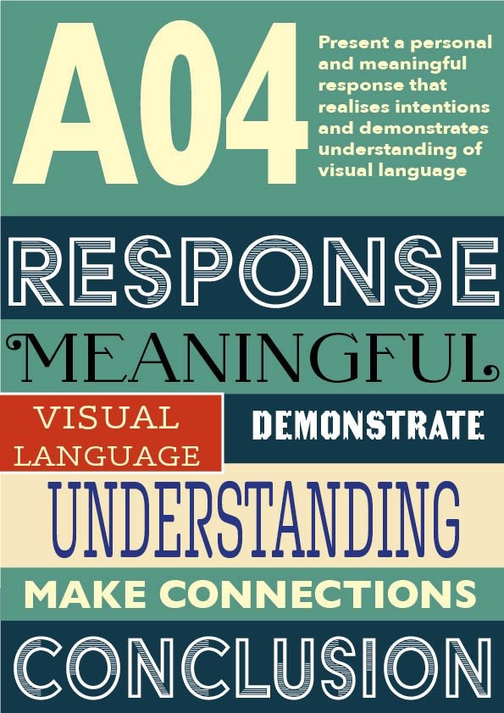
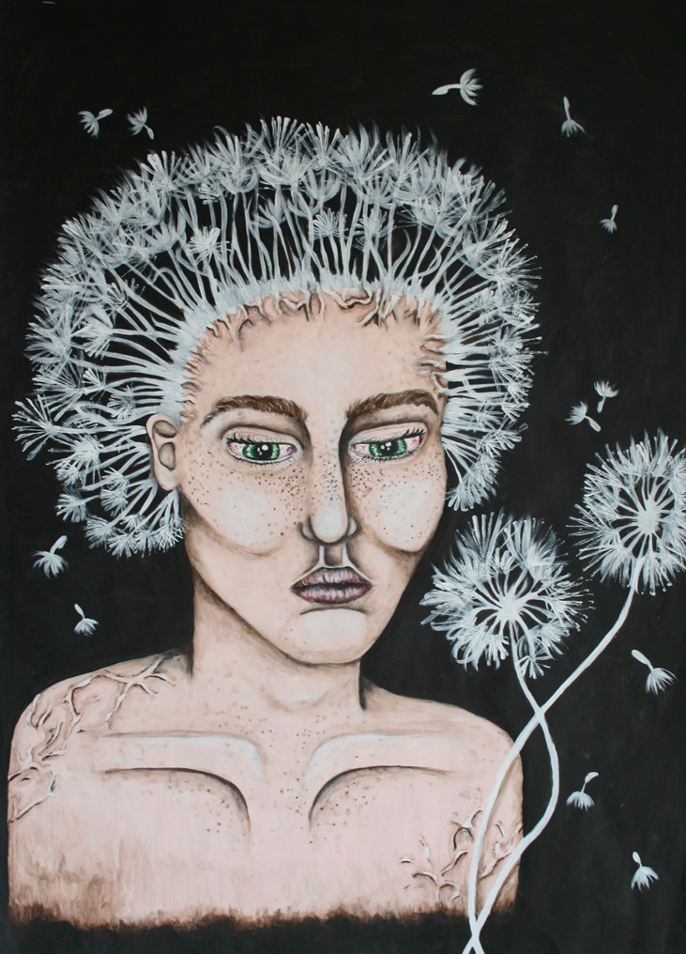
GCSE Fine art
Final piece
You need to be able to present a personal response, realising intentions and making informed connections with the work of others.
This final objective looks at all your work as a complete package; the examiner will view all of your preparatory work together with the final piece as an entire unit. They will be looking to see if you have successfully achieved what you set out to do. The examiner should be able to see connections between your own work and the work of the artists you have studied. Whatever you learned through artist research should be put to good practical use and clearly reflected in your own work.
Demonstrate skill
Communicate
Mastery
Respond
Link
Final pieces can be in any Fine art media
Painting and drawing
Sculpture
Printmaking
Textiles/Fashion
Expectations:
It is expected that you will complete quite a lot of work for this course through the homework programme, approximately two hours per week
It is advisable to attend GCSE Art club sessions each week
You will need to hand in a sketchbook as part of your portfolio component.
Notes:
ART Knowledge Organisers - Year 11 – HT2

Slide 3
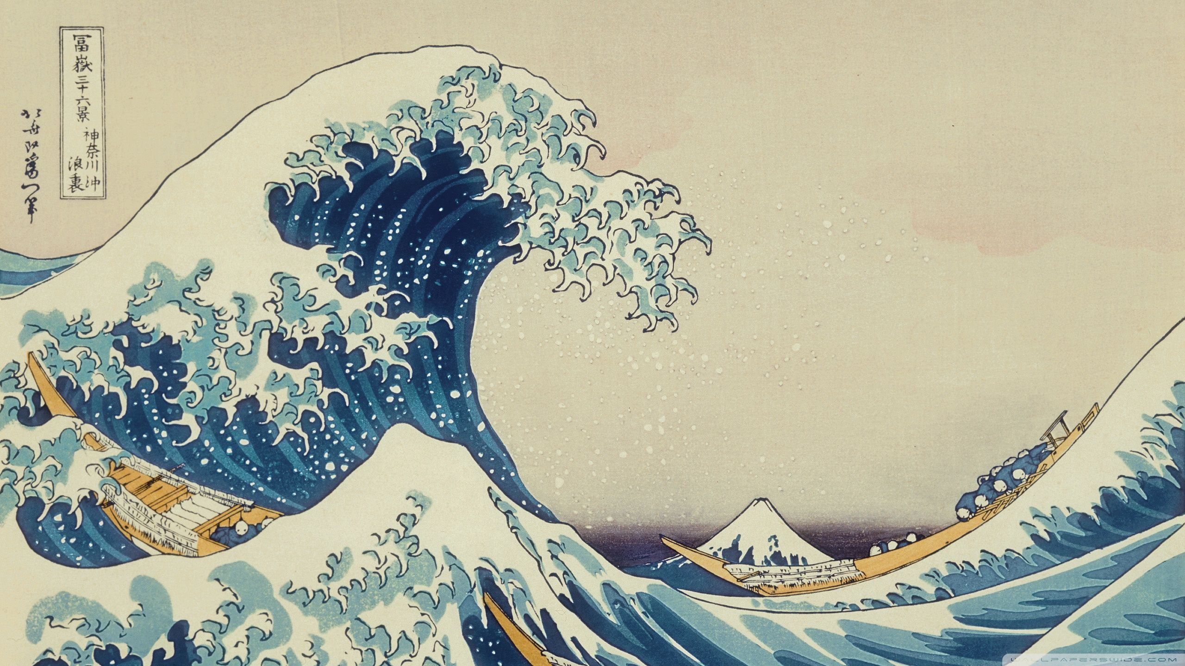
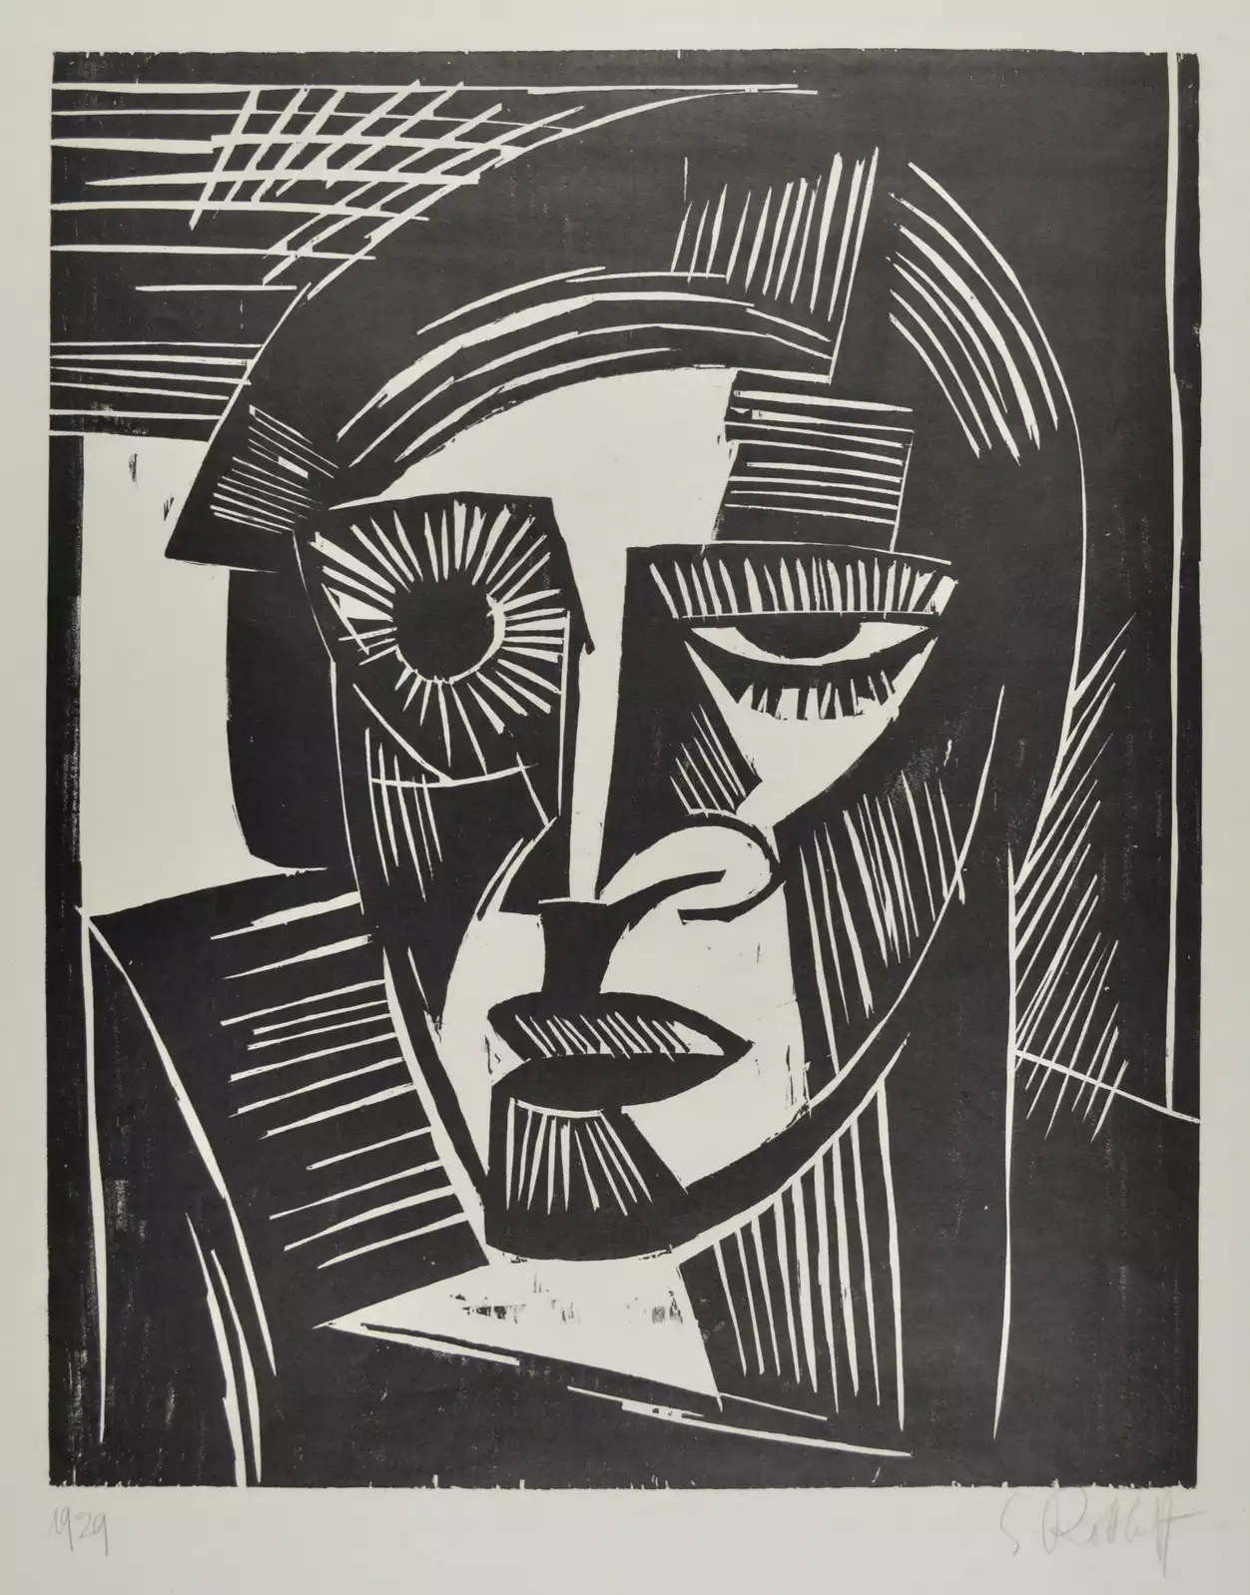
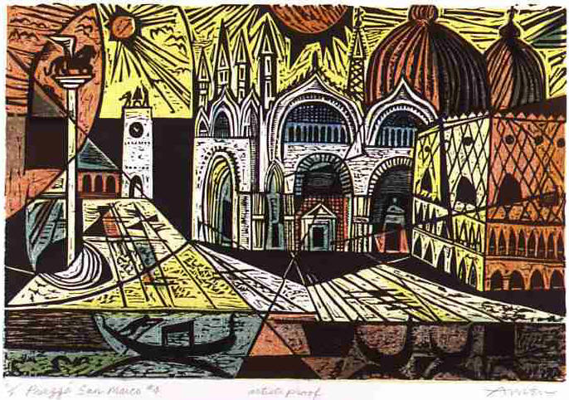
Year 11 HT3
Printmaking
During Half term 3 you will be extending your knowledge of media through the development of a final print.
Printmaking is the process of creating artworks by printing, normally on paper, but also on fabric, wood, metal, and other surfaces. "Traditional printmaking" normally covers only the process of creating prints using a hand processed technique.
Design and Media AO2
You will plan and prepare a reduction print sample to understand the process. You will then plan your own 3-4 colour reduction print based on your personal project.
Key vocabulary
Reduction, Register, Burnish, Layering, Overlap, Scratch, indent, Drypoint, Engrave, Etch, process, press.
Key Question:
How have printmaking techniques evolved in Art? Compare Scmidt Rottluff with the work of Andy Warhol and more modern digital processes.
Artist Research AO1
Explore the work of artists who have produced printmaking. Creatively present your research and annotations in your sketchbook.
Artists to consider
Karl Scmidt Rottluff
Picasso
Angie Lewin
Hokusai
Kathe Kollwitz
Irving Amen
Janice Earley
Art styles to consider
German Expressionism
Traditional Japanese Art
Pop Art
Notes:
ART Knowledge Organisers - Year 11 – HT3

Slide 4
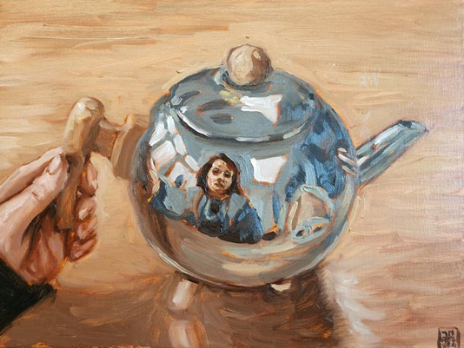
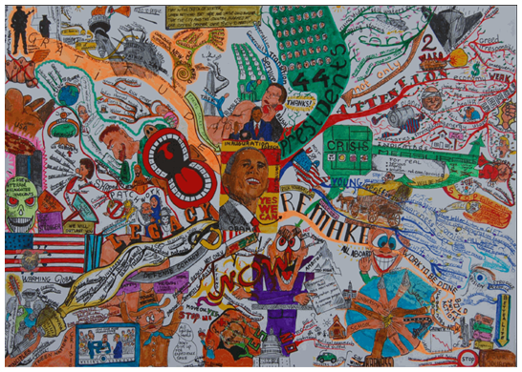
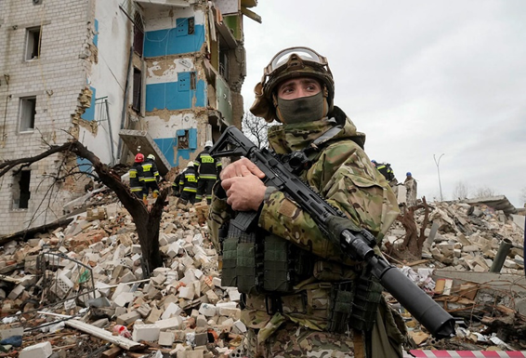
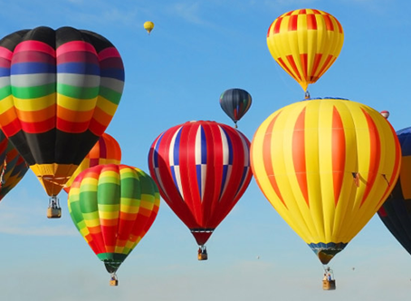
Year 11 Exam Prep HT 3/4
Exam Prep
Your exam is 40% of your overall GCSE grade.
Drawing research and record
Deliberate Practice – Produce a range of drawings in your sketchbook. Make some drawings from first hand observation and some from your photographs.
Consider Tone, Form, Texture, Line, shape.
Themes 2023
Objects
Reflection
Flight
Our World
Aged
Photography
Photography is a form of Recording and should be used whenever possible to explore visual elements. Tone, Texture, Shape, Form, Viewpoints.
Techniques – crop, filter, enlarge, zoom.
Deliberate Practice – Take a series of photos of items which could link to your theme.
Artist Research
Explore the work of artists who link to your theme.
Make copies of the artists work.
Consider how the artist has used
Deliberate Practice
Produce a google slide on 2 of your favourite artists. You can choose from the list above or find your own.
Create a mood board or mind map in your sketchbook
Plan your final piece. Compose
Try Out Arrange
Key vocabulary
Make your keywords stand out. Use a stencil.
Annotate your thoughts and ideas
Notes:
ART Knowledge Organisers - Year 11 – HT4

