Slide 1
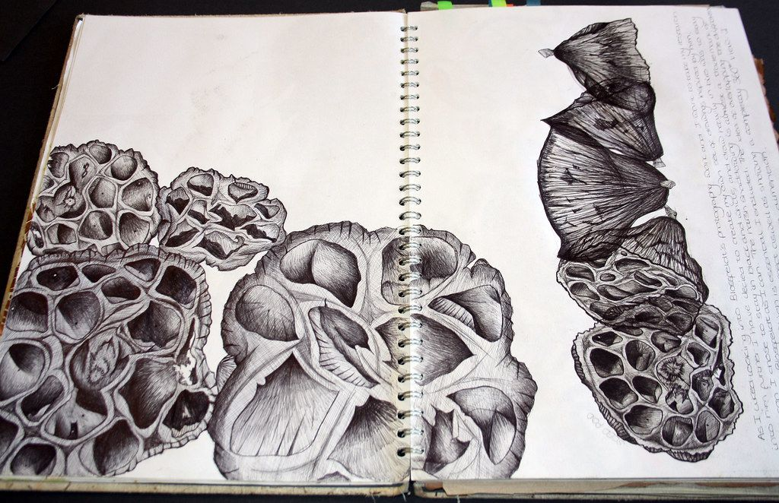
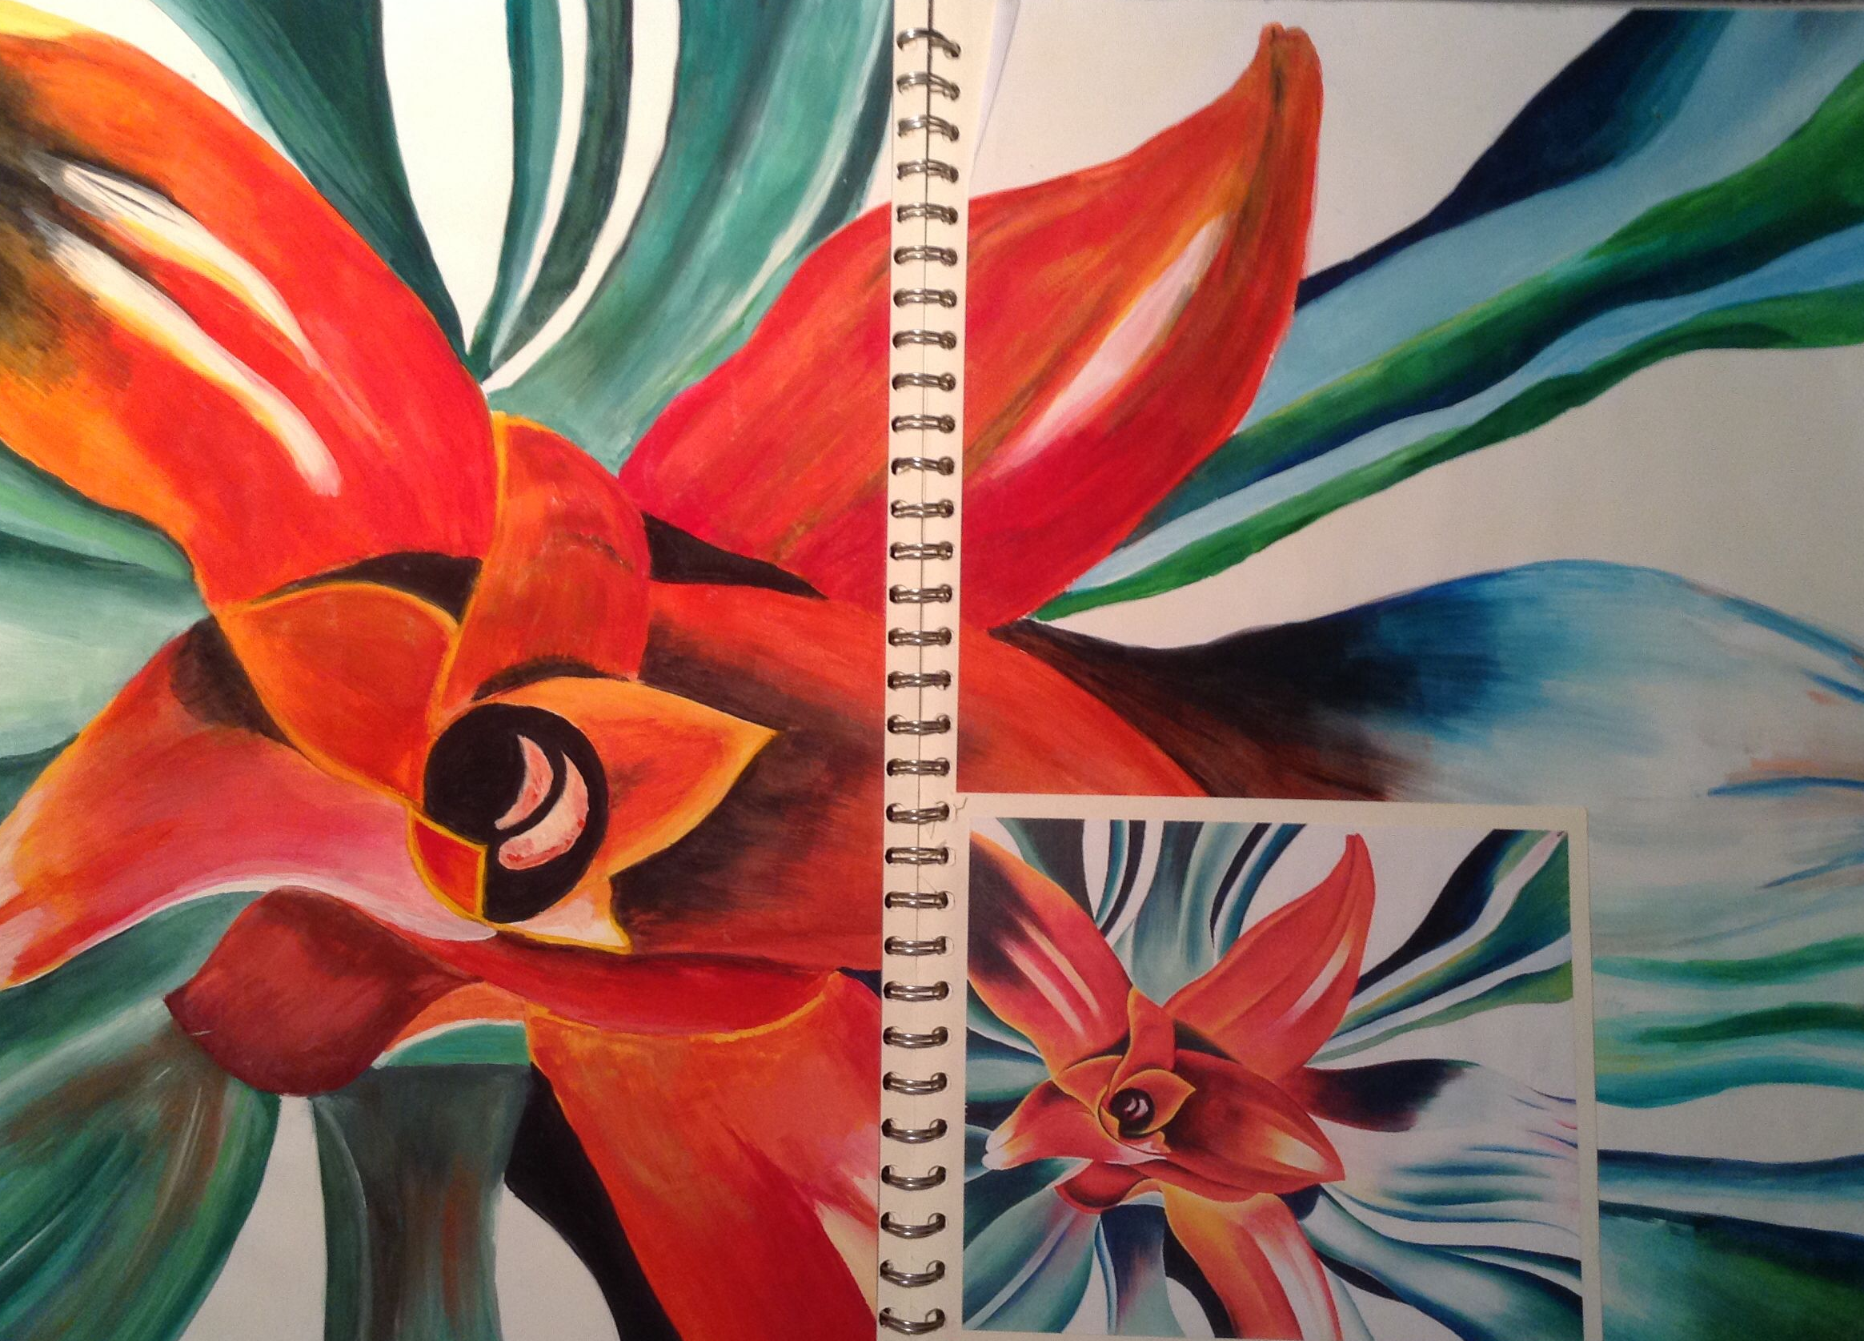
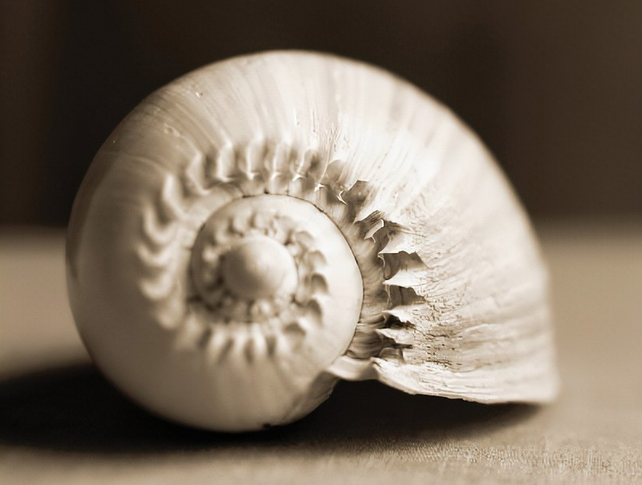
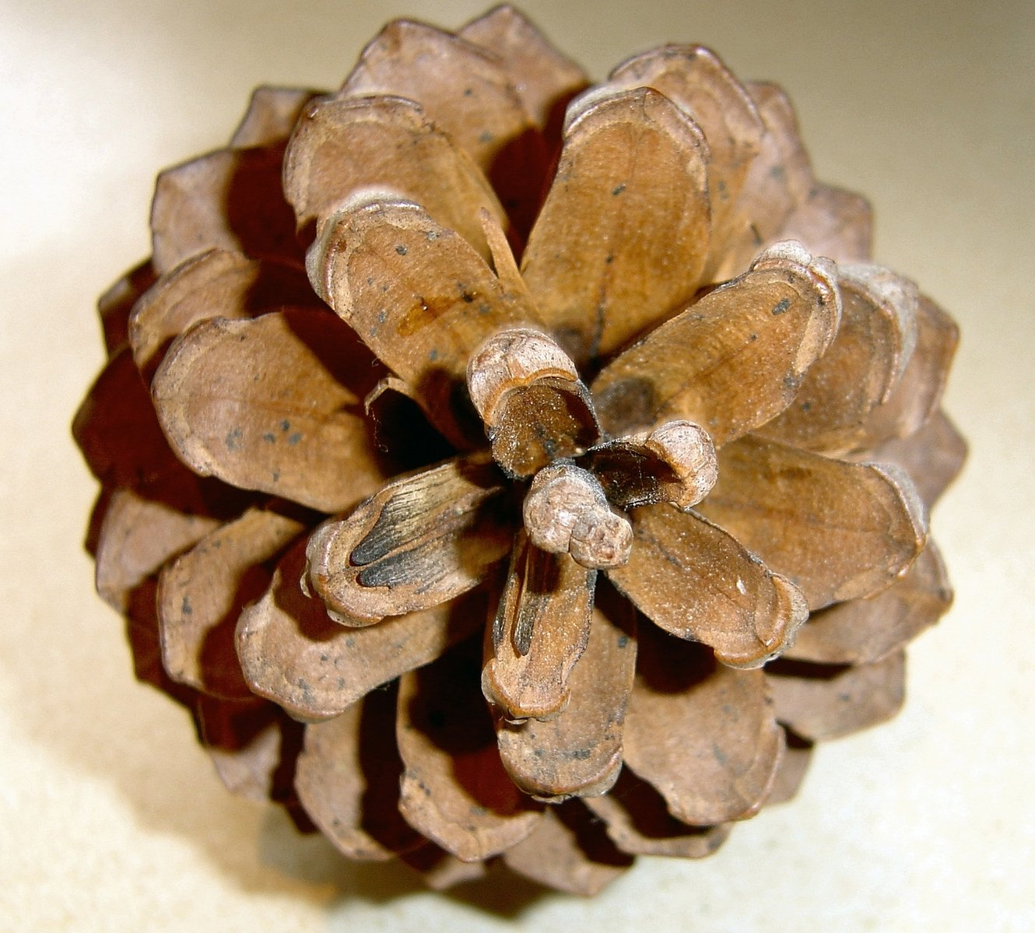
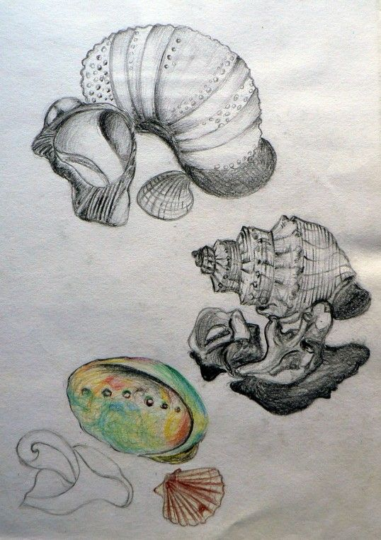
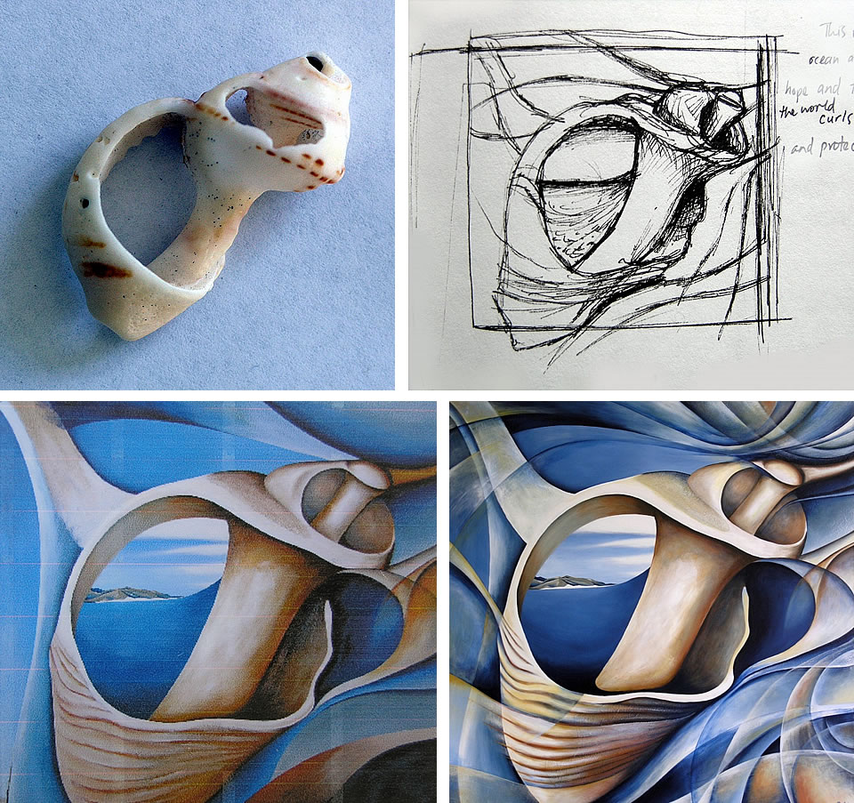
Year 10 HT1 and 2
Nature
During Half term 1 and 2 you will be exploring the theme of Nature. You need to show an understanding of the GCSE assessment objectives.
Drawing to research and record
Deliberate Practice – Produce a range of drawings in your sketchbook. Make some drawings from first hand observation and some from your photographs.
Consider Tone, Form, Texture, Line, shape.
Photography
Photography is a form of Recording and should be used whenever possible to explore visual elements. Tone, Texture, Shape, Form, Viewpoints.
Techniques – crop, filter, enlarge, zoom.
Deliberate Practice – Take a series of photos of food, consider how you can apply the techniques above.
Key vocabulary
Organic, spiky, rough, texture, representational, flowing, irregular, shadow, recording, observed.
Artist Research
Explore the work of artists who have used Nature and Natural forms as a source of inspiration. Creatively present your research in your sketchbook.
Artists to consider
Karl Blossfeldt
Amira Gale
Georgia O Keefe
Marcia Baldwin
Martin La Spina
Ernst Haeckel
Art styles to consider
Art Nouveau
Surrealism
Deliberate Practice
Produce a google slide on 2 of your favourite artists. You can choose from the list above or find your own.
Notes:
ART Knowledge Organisers - Year 10 – HT1 & HT2

Slide 2

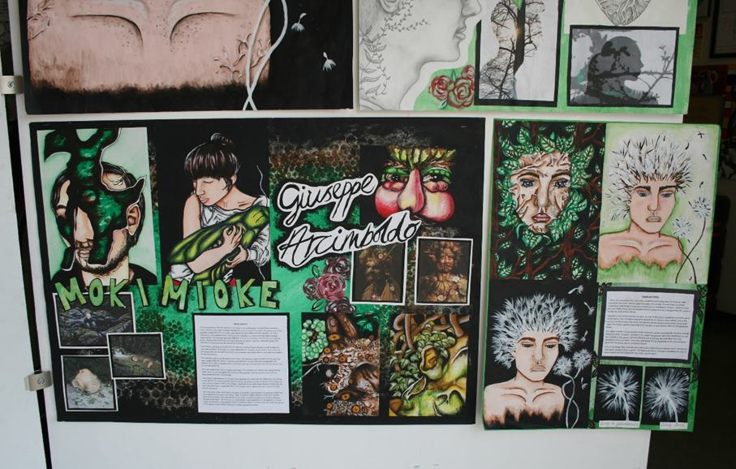
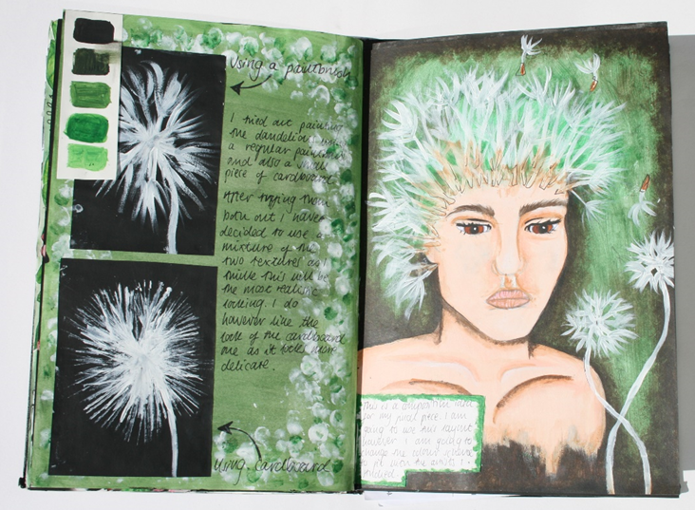
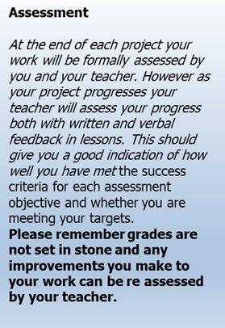
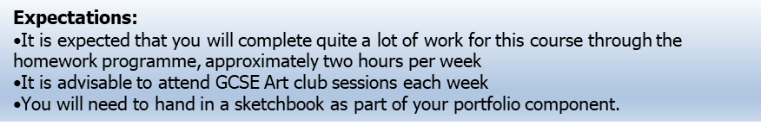
GCSE Fine art – HT3
Design and Media
You need to develop and explore ideas using media, processes and resources, reviewing, modifying and refining work as it progresses.
This assessment objective allows you to demonstrate to the examiner how creative and versatile you are. You need to start with an idea or theme and develop it, exploring lots of possible solutions using different materials and techniques and processes.
For every project/theme
Try out different materials and techniques.
Explore and experiment
Refine ideas and compositions
Review
Select
Organise
Explore
Experiment
Refine
Notes:
ART Knowledge Organisers - Year 10 – HT3

Slide 3
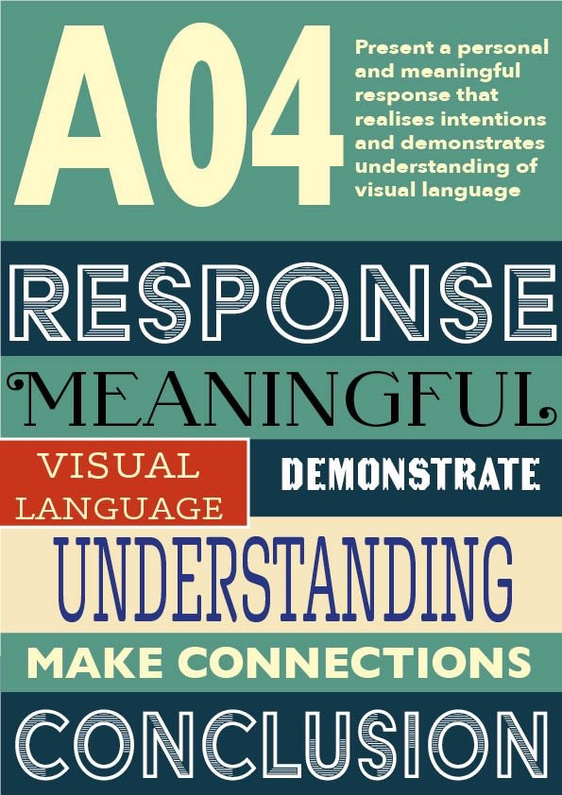
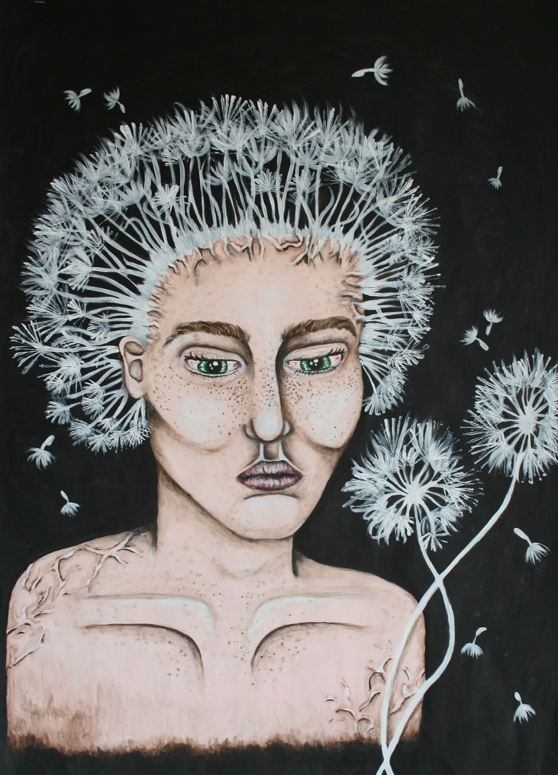
GCSE Fine art – HT4
Final piece
You need to be able to present a personal response, realising intentions and making informed connections with the work of others.
This final objective looks at all your work as a complete package; the examiner will view all of your preparatory work together with the final piece as an entire unit. They will be looking to see if you have successfully achieved what you set out to do. The examiner should be able to see connections between your own work and the work of the artists you have studied. Whatever you learned through artist research should be put to good practical use and clearly reflected in your own work.
Demonstrate skill
Communicate
Mastery
Respond
Link
Final pieces can be in any Fine art media
Painting and drawing
Sculpture
Printmaking
Textiles/Fashion
Expectations:
It is expected that you will complete quite a lot of work for this course through the homework programme, approximately two hours per week
It is advisable to attend GCSE Art club sessions each week
You will need to hand in a sketchbook as part of your portfolio component.
Notes:
ART Knowledge Organisers - Year 10 – HT4

Slide 4

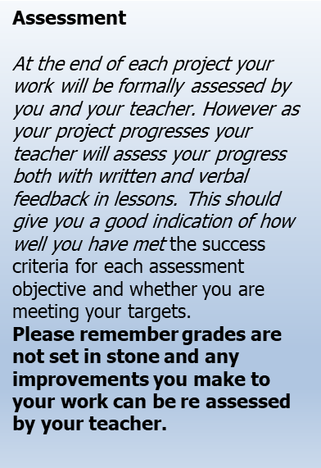
GCSE Fine Art – HT5
Artist research
You need to be able to analyse and evaluate images, objects and artefacts showing understanding of context.
To fulfil this objective you need to be able to look at work, by both past and contemporary artists and assess it critically, with reference to the time and culture in which it was produced. To do this you will need to research the background of the piece and gain a good understanding of why and how the artists produced it. You could look at what his/her motives and influences were, whether the piece is exemplary of a particular movement or style, how the piece might have been received at the time etc.
The examiner will also be looking to see whether you can understand and use the specialist vocabulary used in Art and Design.
Introduce
Analyse
Annotate
Evaluate
Give opinions
Make Links
Describe
For every theme/project you will explore
More than one relevant artist
Copy the artist work
Research why and how the work was made
Give your own opinions through written annotations
Notes:
ART Knowledge Organisers - Year 10 – HT5

Slide 5
GCSE Fine art – HT6
Design and Media
You need to develop and explore ideas using media, processes and resources, reviewing, modifying and refining work as it progresses.
This assessment objective allows you to demonstrate to the examiner how creative and versatile you are. You need to start with an idea or theme and develop it, exploring lots of possible solutions using different materials and techniques and processes.
For every project/theme
Try out different materials and techniques.
Explore and experiment
Refine ideas and compositions
Review
Select
Organise
Explore
Experiment
Refine
Notes:
ART Knowledge Organisers - Year 10 – HT6

