Slide 1
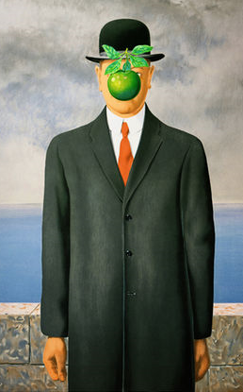
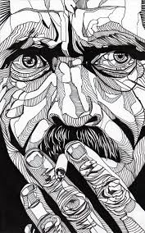
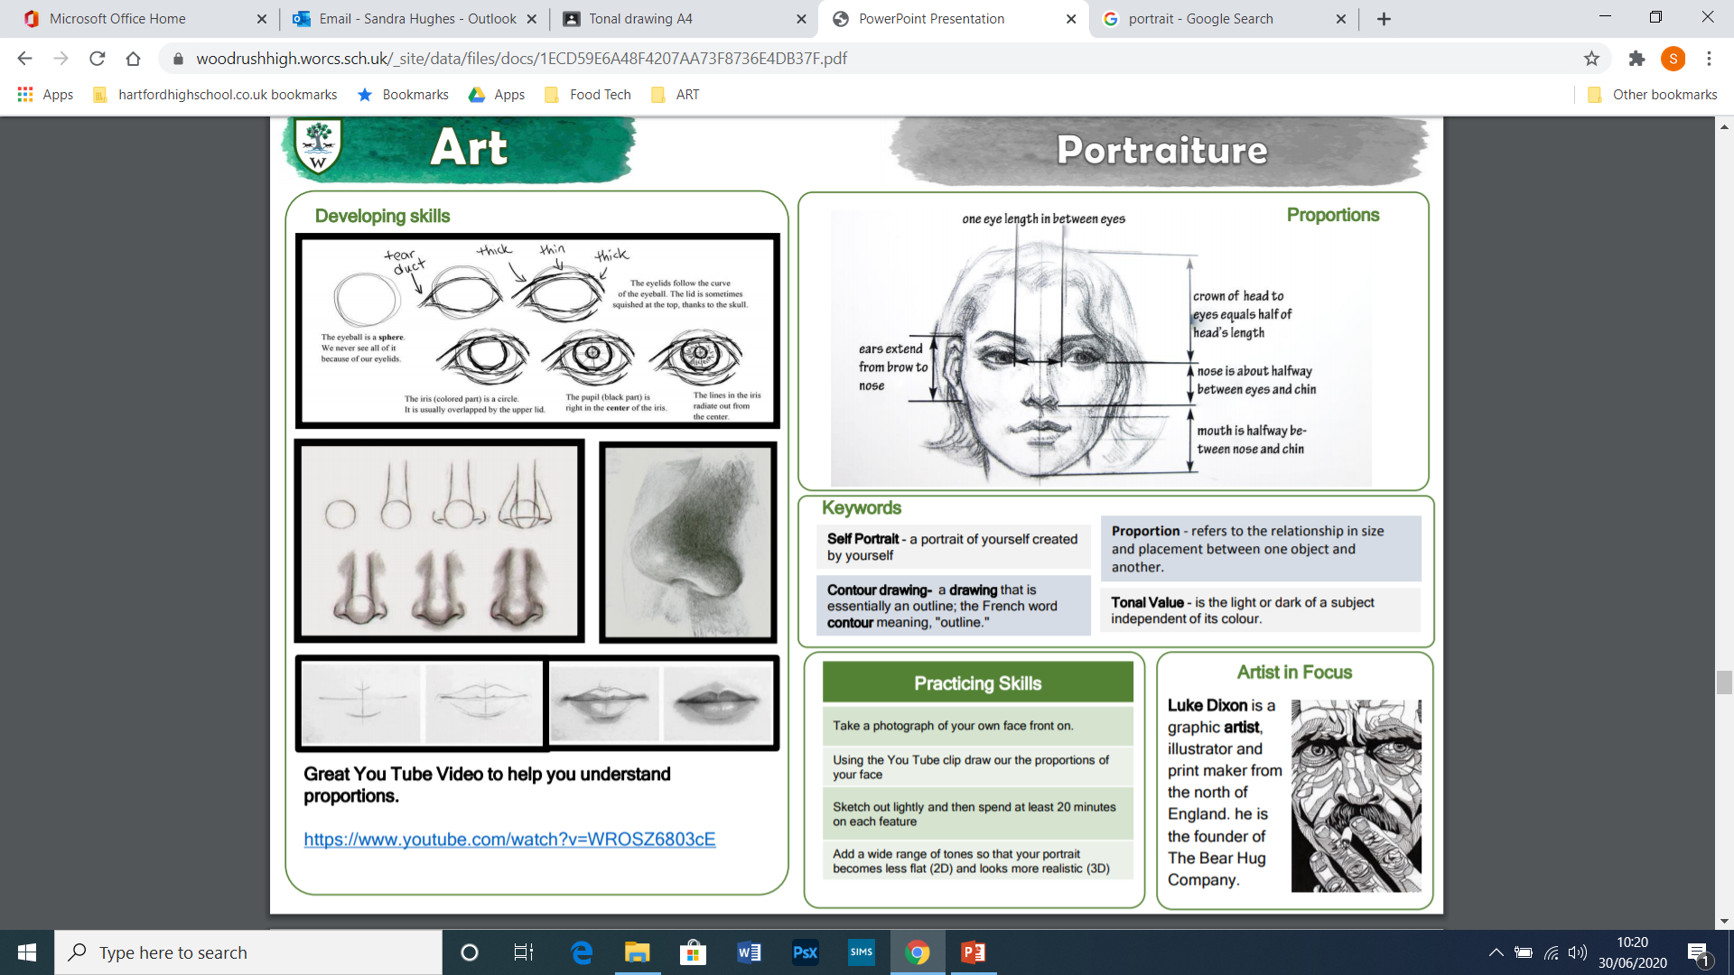
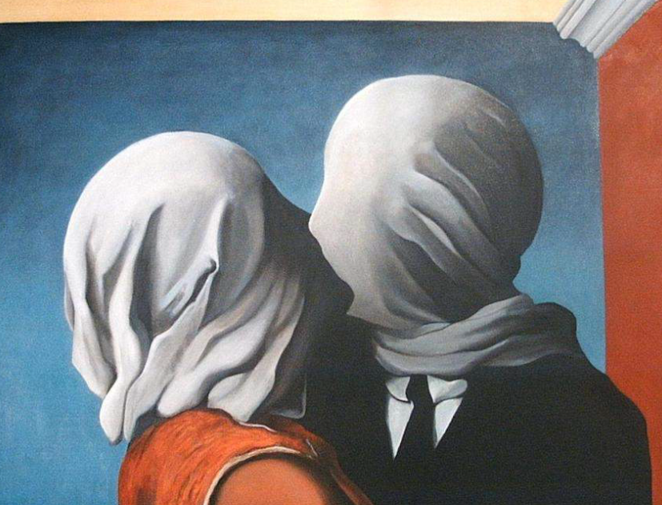
Year 9 Art half term 1 and 2
Portrait
Deliberate Practice
Artist research – produce a google slide on an artist of your choice. Consider the style of the works, the techniques used and the way that the portrait is depicted.
Select your preferred style and produce research page on this artist.
Portrait - a painting, drawing, photograph,
or engraving of a person, especially one depicting only the face or head and shoulders.
Key Vocabulary
Self portrait, Proportion, Iris, Symmetry, Profile, Character Expression ,Tone, Form
Proportion
Deliberate Practice- Drawing
Practice drawing features of the face with accuracy Add tone through blending.
Draw an eye
Draw a nose
Draw lips
Notes:
ART Knowledge Organisers - Year 9 – HT1 & HT2

Slide 2
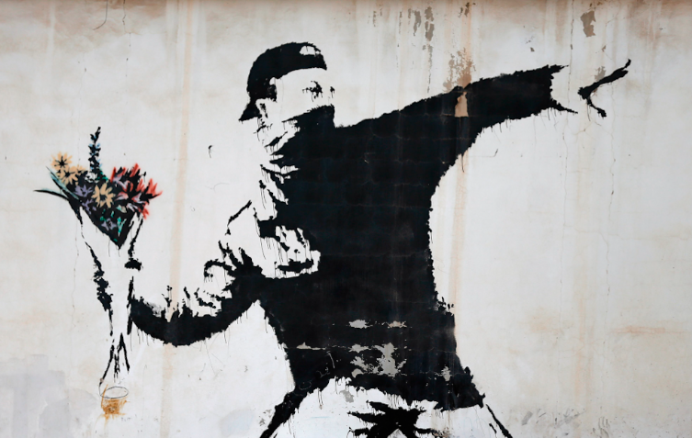
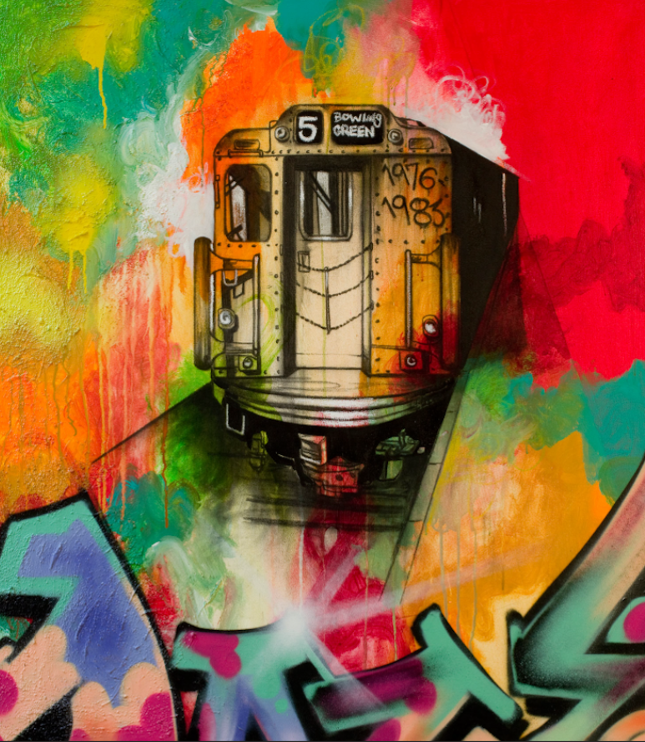
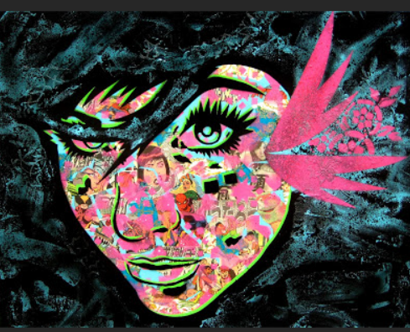
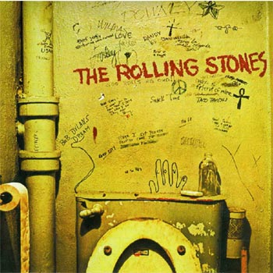
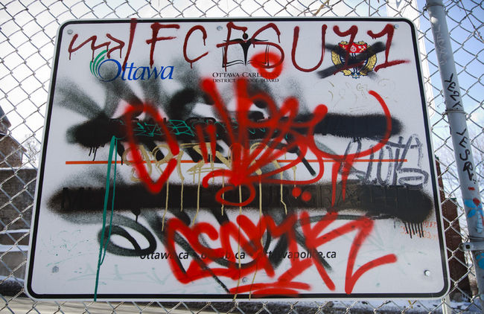
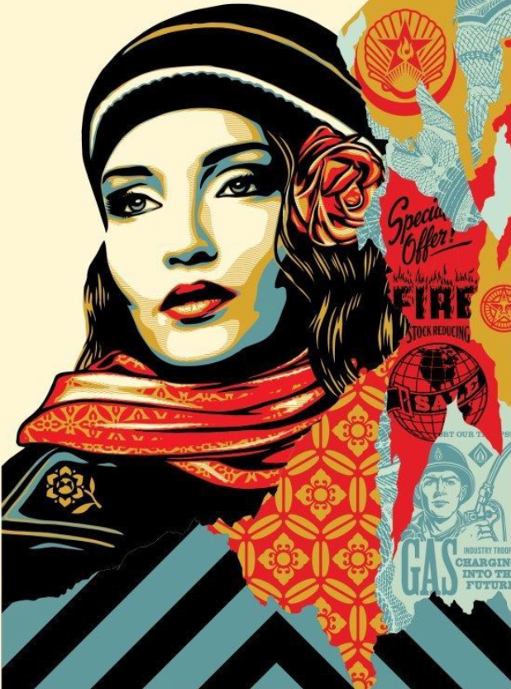
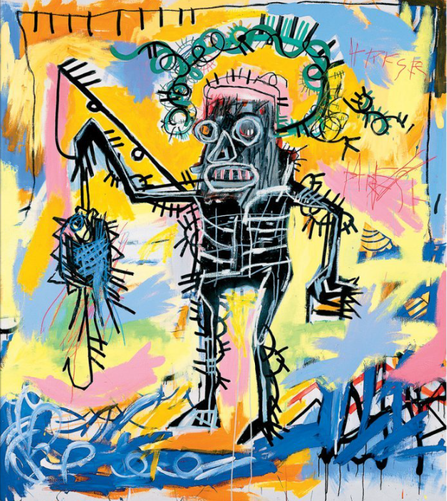
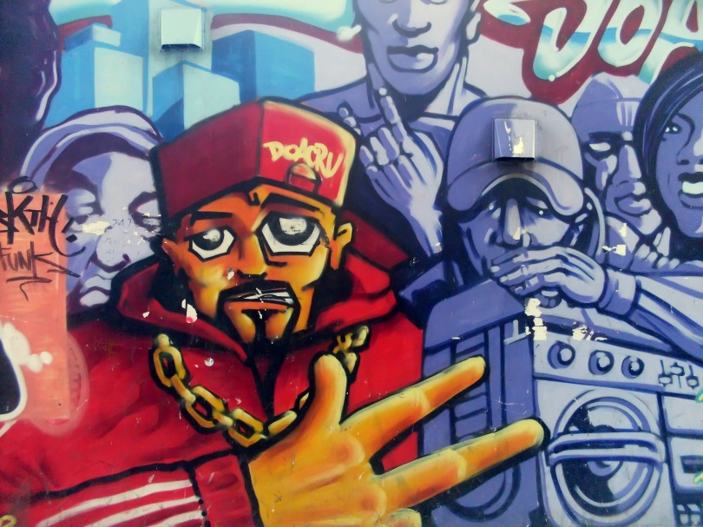
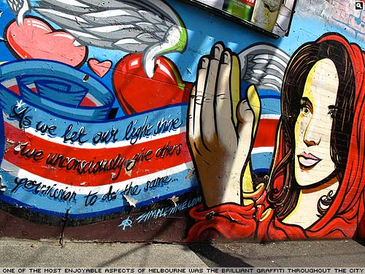
Year 9 Art HT 3 and 4
Graffiti Art
Graffiti is a form of visual communication involving writing or drawing on a wall or other surface, often without permission and within public view. Graffiti ranges from simple written words to elaborate wall paintings, and has existed since ancient times, with examples dating back to ancient Egypt, ancient Greece, and the Roman Empire.
Deliberate Practice –
Graffiti alphabet – produce a graffiti alphabet using different graffiti fonts.
Graffiti doodle spray can. Select appropriate graffiti images to create a graffiti doodle. Examples on Google classroom.
Graffiti research task
Select a graffiti artist to complete a research page on. You can select an artist from the list below or research your own artist.
Graffiti artists
Blek Le Rat
Banksy
Chris Daze
Lee Quinnones (Fab 5)
Shepherd Fairey
Zane Lewis
Freddy (Fab 5)
Keith Haring
Design your own graffiti trainer/hi top.
Graffiti introduction - https://youtu.be/4Ul4mhho03M
Graffiti, Art or Vandalism
https://m.youtube.com/watch?feature=youtu.be&v=azolNnTCnMI
Art or Vandalism – Watch the video and consider this argument.
Key words
Tag Hip-Hop Expression Wildstyle
Stencil Font Flow Dynamic
Notes:
ART Knowledge Organisers - Year 9 – HT3 & HT4

Slide 3
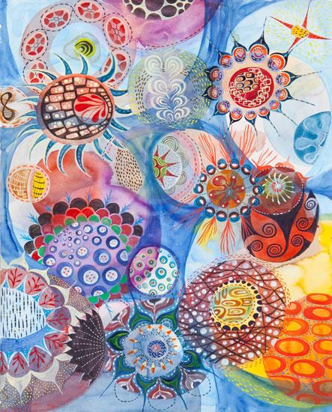
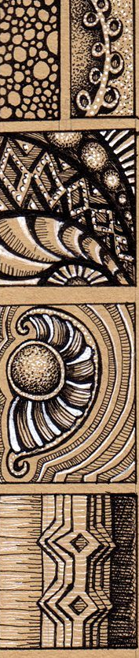
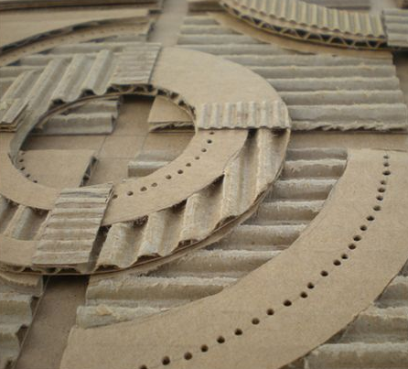
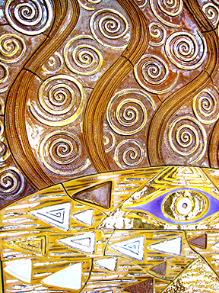

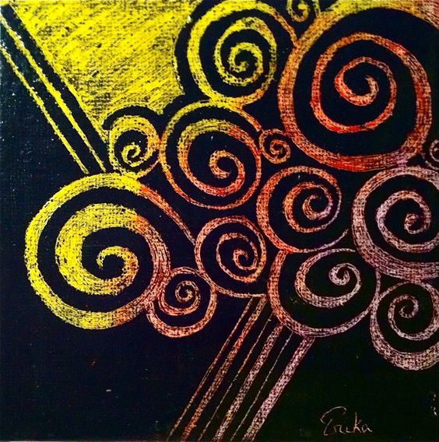
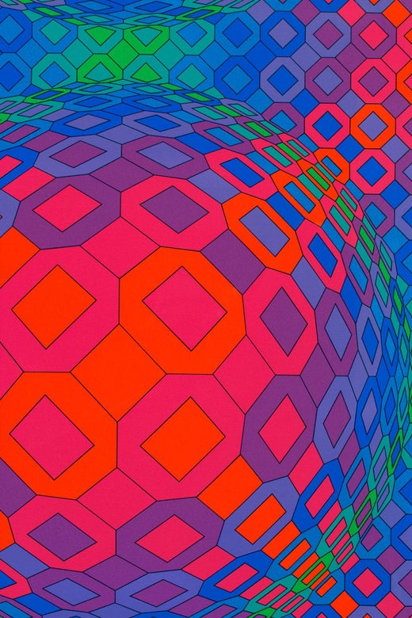
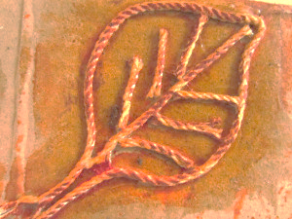
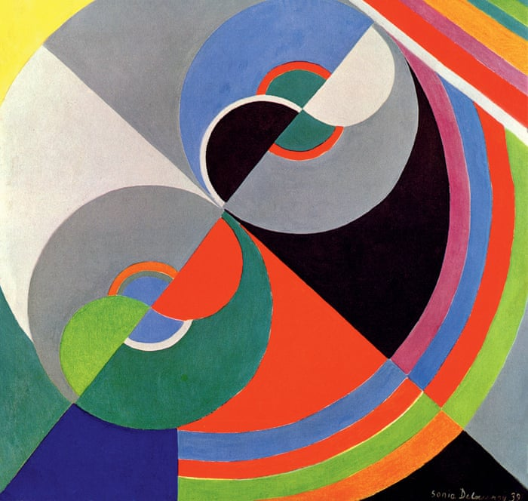
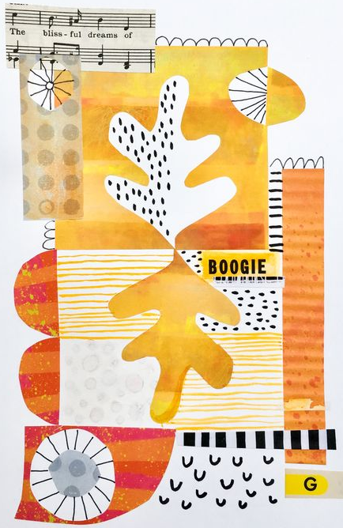
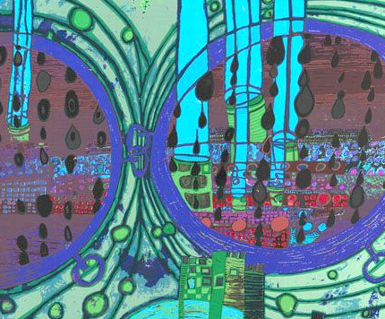
Year 9 Art term 5/6
Fashion
Explore and interpret
art elements in a range
of media.
Ethical Fashion is an umbrella term to describe ethical fashion design, production, retail, and purchasing. It covers a range of issues such as working conditions, exploitation, fair trade, sustainable production, the environment, and animal welfare.
What is the ethos of Fashion designer Stella McCartney?
Deliberate Practice task
Artist Research Task
Select an Artist or Art style where there is an emphasis on pattern, line, texture and mark. You can select from the list below or research your own. Produce a google slide.
Artists
Melinda Hackett
Gustav Klimt
Piet Mondrian
Victor Vasarely
Sonia Delaunay
Friedrich Hundertwasser
Task – Complete a visual study of your artist/Art style. This should focus on the lines, Pattern, shape, Marks and Textures in the Artworks. Present your study on an A3 piece of paper.
Design and Make a simple Fashion Item such as a Tie, Bag, T-Shirt. This to be inspired by your chosen Artist.
Pen
Card Relief
Sgraffito
https://youtu.be/ZoiU8sprXpQ
TASK - Watch the short video above and consider ways in which the fashion industry contributes to the damage to our environment. What is sustainable fashion and what practices could you adopt to support it?
String
Collage
Where do Fashion designers find inspiration?
https://www.fashiongonerogue.com/content/fashion-designers-inspiration/
Key words
Colour Pattern Accent Shape Mark Line Construct Collage Layer Combine Papier Mache Relief Interpret Design
Notes:
ART Knowledge Organisers - Year 9 – HT5 & HT6

