Slide 1
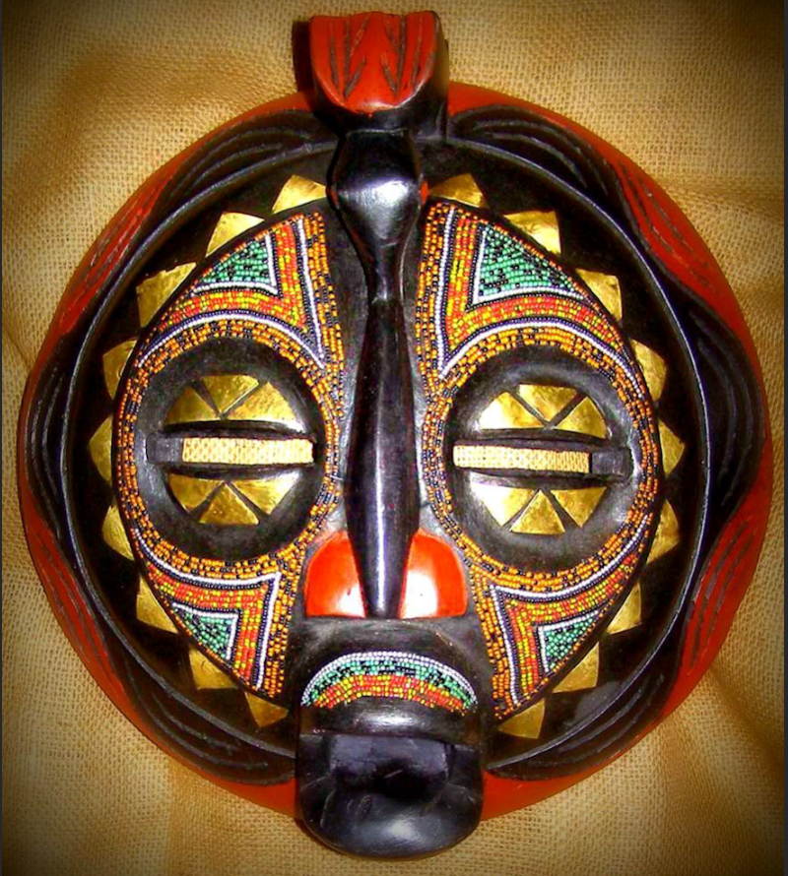
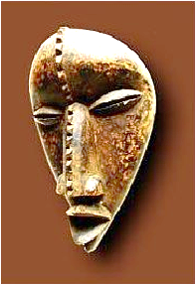
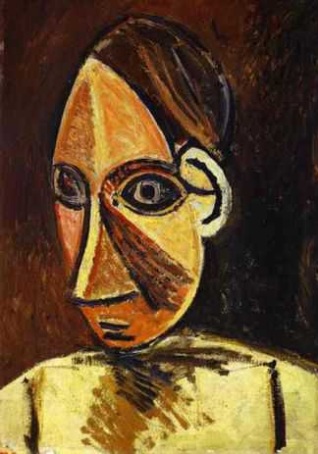
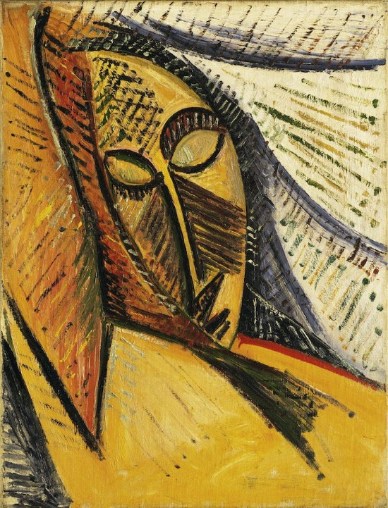
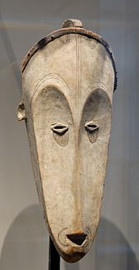
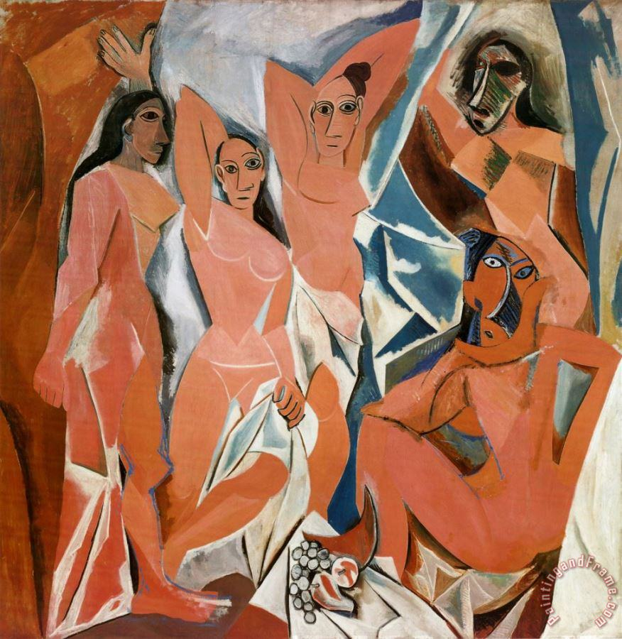
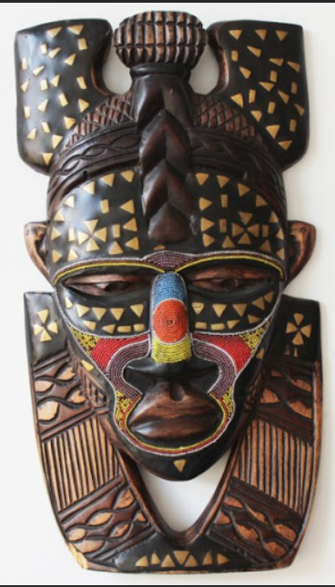
Year 8 ART HT1/HT2
African Art /Cubism
Cubism was invented in around 1907–08 by Pablo Picasso and Georges Braque. They brought different views of subjects together in the same picture, resulting in paintings that appear fragmented and abstracted
Picasso was a Spanish artist born in 1881. He had an enormous influence on 20th century art
Deliberate Practice –
Produce an Artist research page about Picasso use the Artist research page in your Knowledge organiser to help you.
Look at examples of African Masks and the portrait paintings of Picasso and compare. How are the faces similar? Look at the shape of the face, individual features, expression and marks. Use 3 of the key Vocabulary word in your written work.
African masks are a part of ceremonial costume. They are used in religious and social events to represent the spirits of ancestors or to control the good and evil forces in the community. Some combine human and animal features to unite man with his natural environment.
“Les Demoiselles D’Avignon” – How much did the painting sell for?
Picasso's African Period, which lasted from 1906 to 1909, was the period when Pablo Picasso painted in a style which was strongly influenced by African sculpture and particularly traditional African masks.
Deliberate Practice
Drawing practice – Draw an African mask of your choice. Add tone and mark-making.
Learn the definitions of the key vocabulary.
Careers Link: Sculptor
Can you think of any famous sculptures in the UK and where they are situated?
Key Vocabulary
Proportion ,Form, Symmetry, Cubism, Shape , Pattern, Ceremony, Splintered, Style, Influenced, Traditional, Impact, Layering, Fragmented, Abstract
Notes:
ART Knowledge Organisers - Year 8 – HT1 & HT2

Slide 2
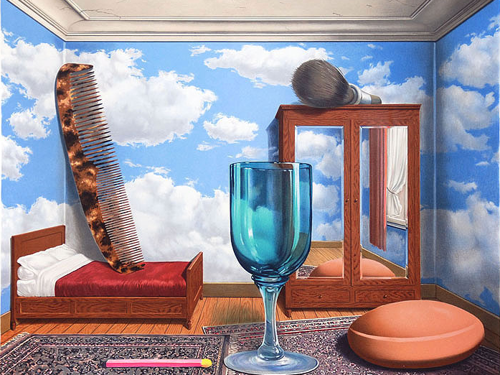
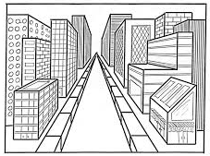
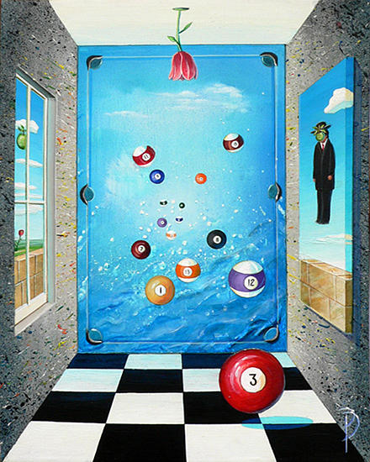
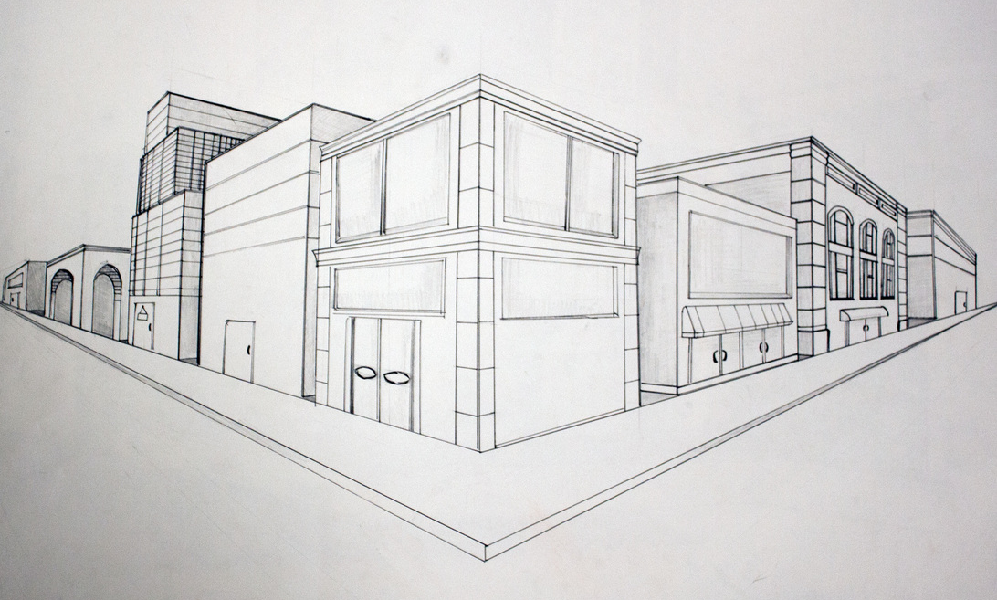
Year 8 ART HT3/HT4
Perspective
During this half term you will be learning about perspective. One point perspective is a drawing method that shows how things appear to get smaller as they get further away, converging towards a single 'vanishing point' on the horizon line. It is a way of drawing objects upon a flat piece of paper (or other drawing surface) so that they look three-dimensional and realistic.
https://youtu.be/oRYhzrZ8G_Y
Deliberate Practice
Research how perspective has been used by artists. Complete the sheet in your skills booklet
Above you can see the painting “Personal Values” by Rene Magritte (who was a Surrealist artist). You can see the scale of the objects seems wrong for the size of the room.
Deliberate Practice - Find out what Surrealism is and what makes a picture Surreal?
Careers Link: Architect
Which other subject areas might you need to be an architect?
Example of a surreal room
Two point perspective is where there is one horizon line and 2 vanishing points.
Deliberate Practice challenge draw a street using 2 point perspective.
Deliberate Practice
Produce an artist research page on Surrealism use your artist research page in your KO to help.
Using one point perspective create a Surreal room. You can include anything in your room the stranger the better. However you must stick to the rules of perspective.
Keywords
Space, Distance, Converging, Parallel, Horizontal, Vertical, Vanishing point, Horizon line, Linear, Receding, Birds eye view Worms eye view.
Notes:
ART Knowledge Organisers - Year 8 – HT3 & HT4

Slide 3
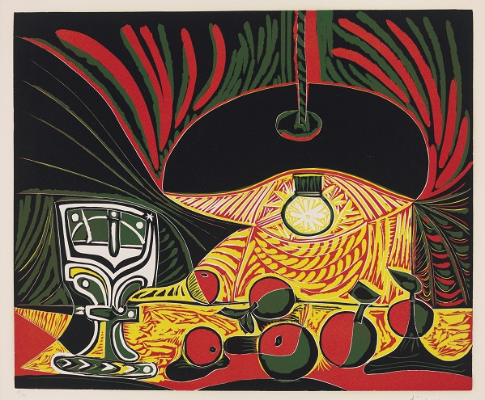
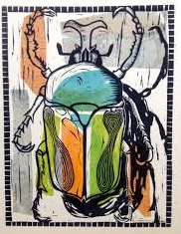
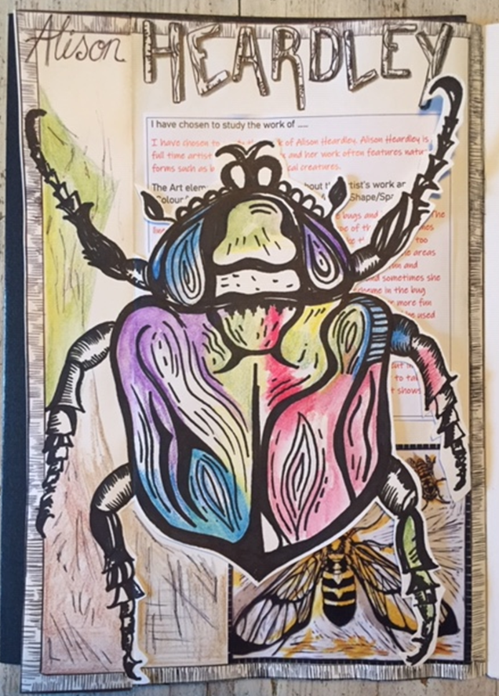
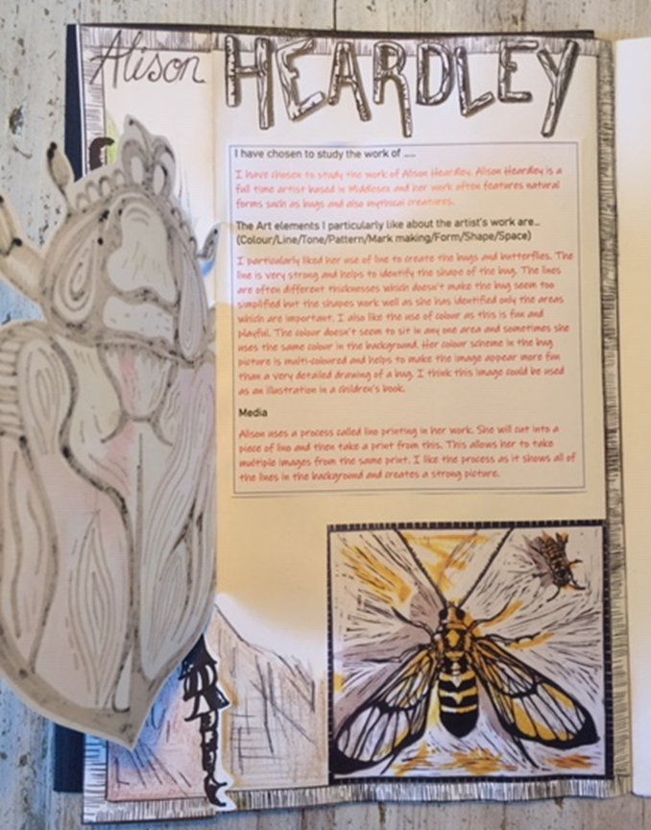

Year 8 ART HT 5/HT 6
Nature/Printing
During this term you will be learning how to make a reduction print. Printing is a process which allows artists to produce many copies of the same image. You will be focusing on the topic Bugs and will be introduced to lots of artists who have used bugs as their inspiration.
Deliberate Practice
Develop your understanding of bugs through DRAWING. Produce 3 drawing s of different bugs.
A tonal drawing - pencil
A drawing using pattern - pen
A drawing using colour – pencil crayon
Use your artist research page in your KO to present a page on the artist Alison Heardley.
A reduction print is made when an artist creates a multi-colored, layered print using a single print block. The block could be foam, linoleum or even wood. The artist repeats the process of carving and printing over and over until the final look is achieved. Above is an example of a print by Picasso.
Deliberate Practice
Produce a guide to printing, include examples of printing techniques, images of artists work and present it creatively in a booklet format or on and A4 page.
Keywords
Carving Burnish Process Engraving Intaglio Reduction Proof Register Relief Print Overlay Plate
Notes:
ART Knowledge Organisers - Year 8 – HT5 & HT6

