Slide 1
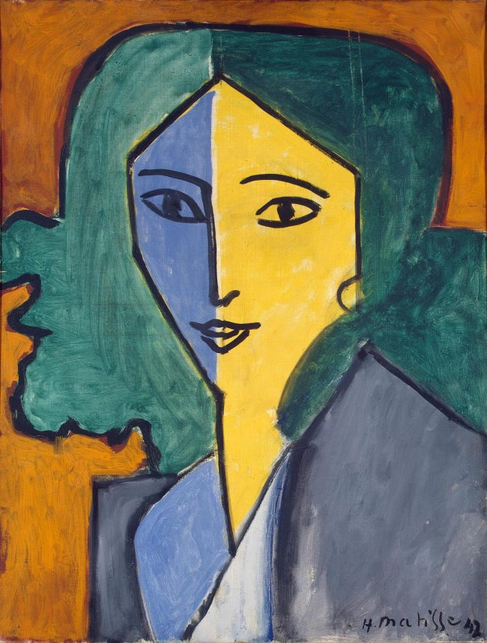
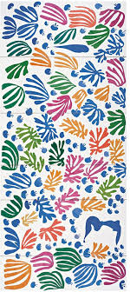
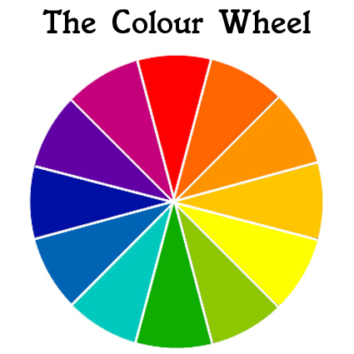

Year 7 Art HT1
Colour Theory
In Art this term you will learn how to mix colours using paint. How to recognise colour relationships and see how artists have used and applied colour in their work.
Primary colours
Red
Blue
Yellow
Secondary colours
Orange (red +yellow)
Purple (blue + red)
Green (yellow + blue)
Tertiary colours are made by mixing a primary colour and a secondary colour together. For example green and blue would make blue green.
Deliberate Practice –
Apply different colour schemes to Matisse inspired artist research using pencil crayon.
Create a colour collage colour wheel. Use different papers and magazines. How many different shades/hues of the colour can you collect?
Complete the colour section of your skills booklet.
We will be looking at the work of Henri Matisse. He was a member of the Fauvist group of artists who were very influenced by colour in their work.
Deliberate Practice –
Find out about “Fauvism” where/when did it start? Who else was involved? What characteristics can you see in the work?
Monochromatic, Secondary, Harmonising, Hue, Primary, Tertiary, Complementary, Tint, Shade, Pigment, Warm, Cold, Hot, Cool.
Notes:
ART Knowledge Organisers - Year 7 – HT1

Slide 2
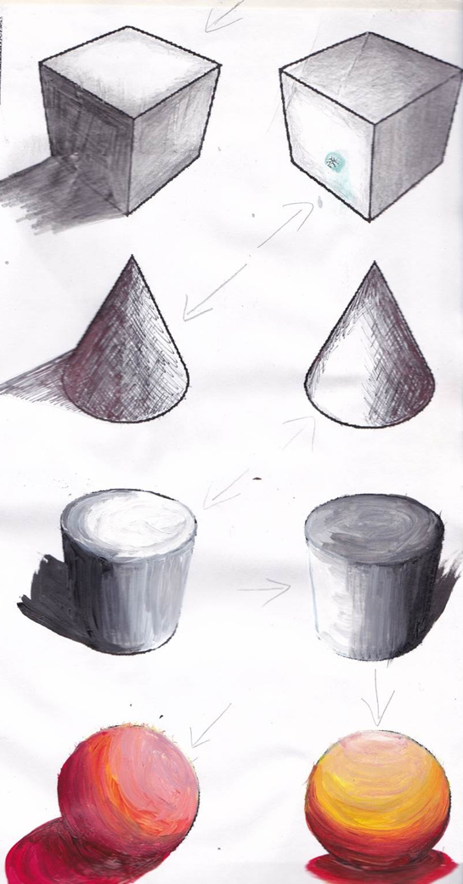
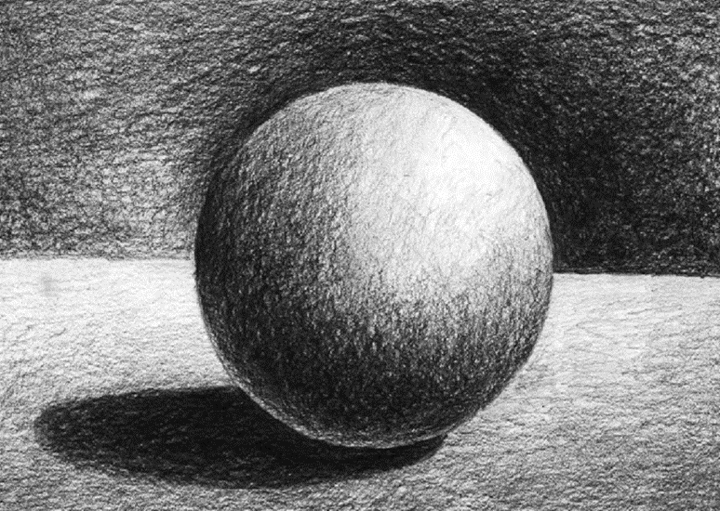

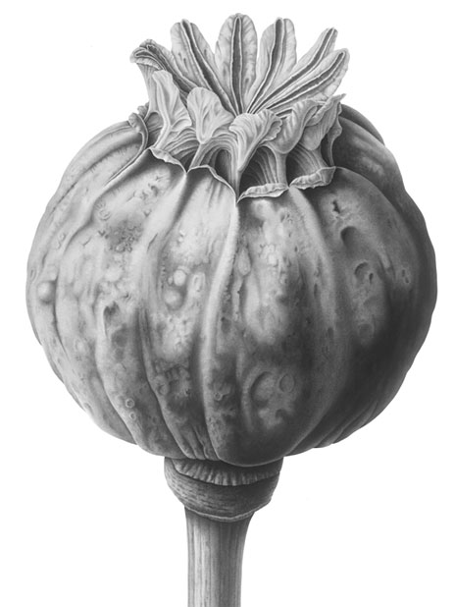
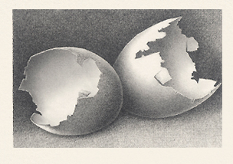
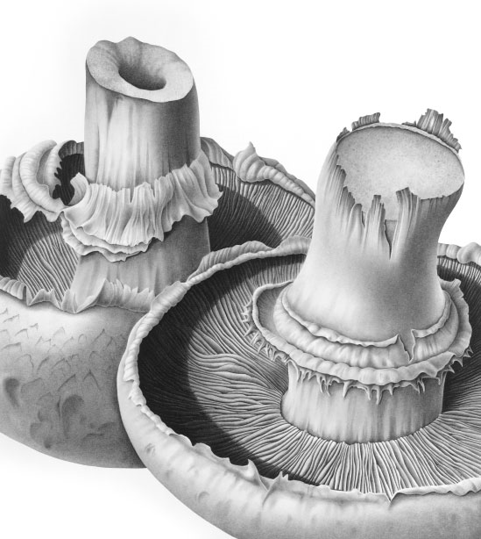
Year 7 Art HT1/2
Tone /Form
Tone refers to the lightness or darkness of something. This could be a shade or how dark or light a colour appears.
Tones are created by the way light falls on a 3D object. The parts of the object on which the light is strongest are called highlights and the darker areas are called shadows. There will a range of tones in between the highlights and shadows.
Deliberate Practice-
Watch the video from the link below have a go at shading your own shapes. Practising your drawing skills regularly will improve your hand eye coordination.
Form in drawing painting and sculpture refers to the 3-Dimensional quality of an object. You will be learning how to make flat shapes appear more rounded and curved.
https://youtu.be/vMr6eimcolc
Susannah Blaxhill is a botanical artist who specialises in pencil, watercolour and charcoal
Deliberate Practice
Select a piece of fruit or a vegetable to draw in detail, you could cut it in half to make a more interesting drawing.
Complete the Tone section of your key skills booklet.
Keywords
Tone Value Gradient Highlight Shadow Light Dark Range
Form Shape Space 3-Dimensional Rounded Curved Illusion
Notes:
ART Knowledge Organisers - Year 7 – HT2

Slide 3
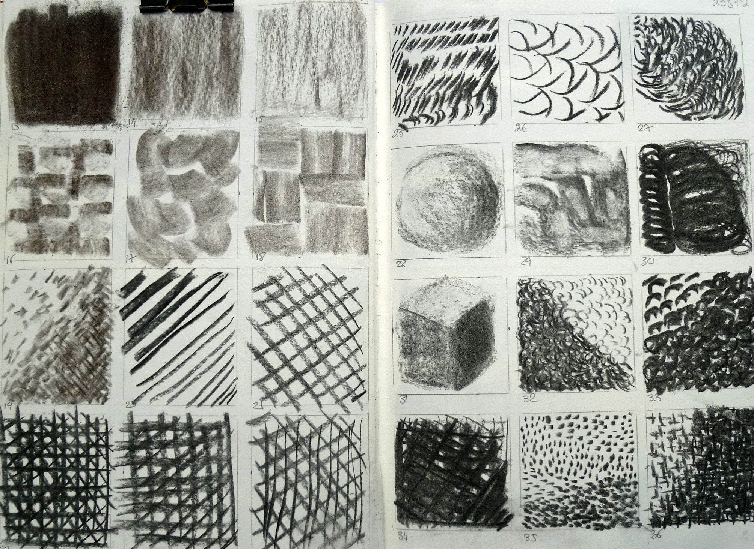
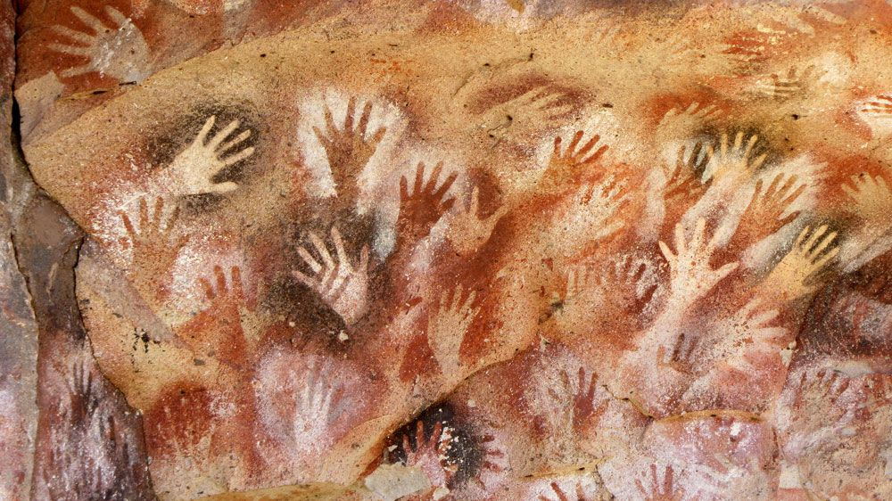
Year 7 HT3
Line Mark making/Cave Art
Mark making describes the different lines, dots, marks, patterns, and textures we create in an artwork. It can be loose and gestural or controlled and neat.
Careers Link:
What is Graphic design and what does a Graphic designer do?
Cave Art:
Watch the video link below
https://youtu.be/ZjejoT1gFOc
Answer the question sheet about cave art.
What is a stencil?
How can you make a stencil?
Deliberate Practise
Create your own dictionary of marks using a wide variety of materials and techniques.
Van Gogh uses a technique called Impasto, what is this?
A line in art is defined as a point moving in space, and it’s one of the seven elements of art (line, color, shape, form, texture, value, space). It is one of the most crucial elements, as everything begins with just a simple dot in space, that transforms into lines and then drawings.
Key Vocabulary
Dots, Dashes, Line, Communication, Tribe Narrative, curve, gestural, Impasto
Notes:
ART Knowledge Organisers - Year 7 – HT3

Slide 4
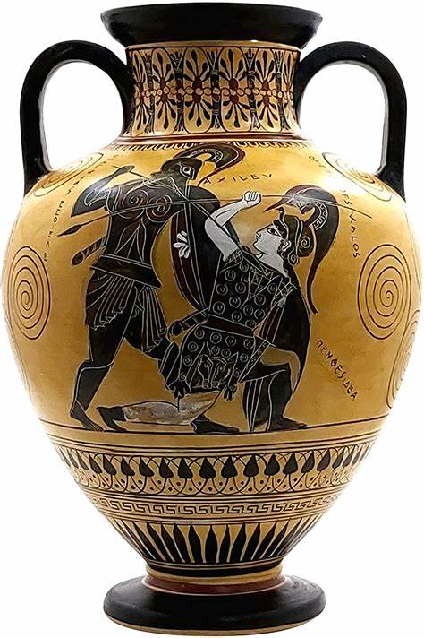
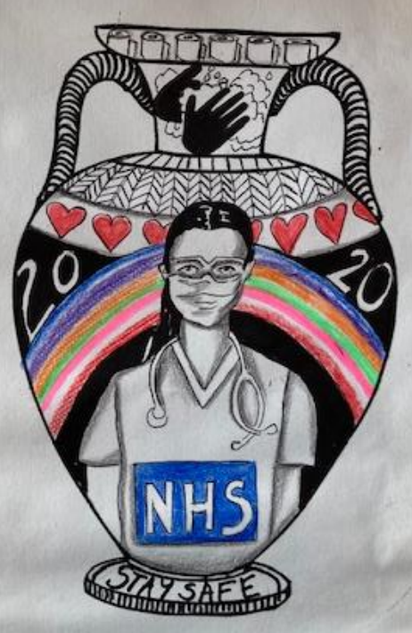
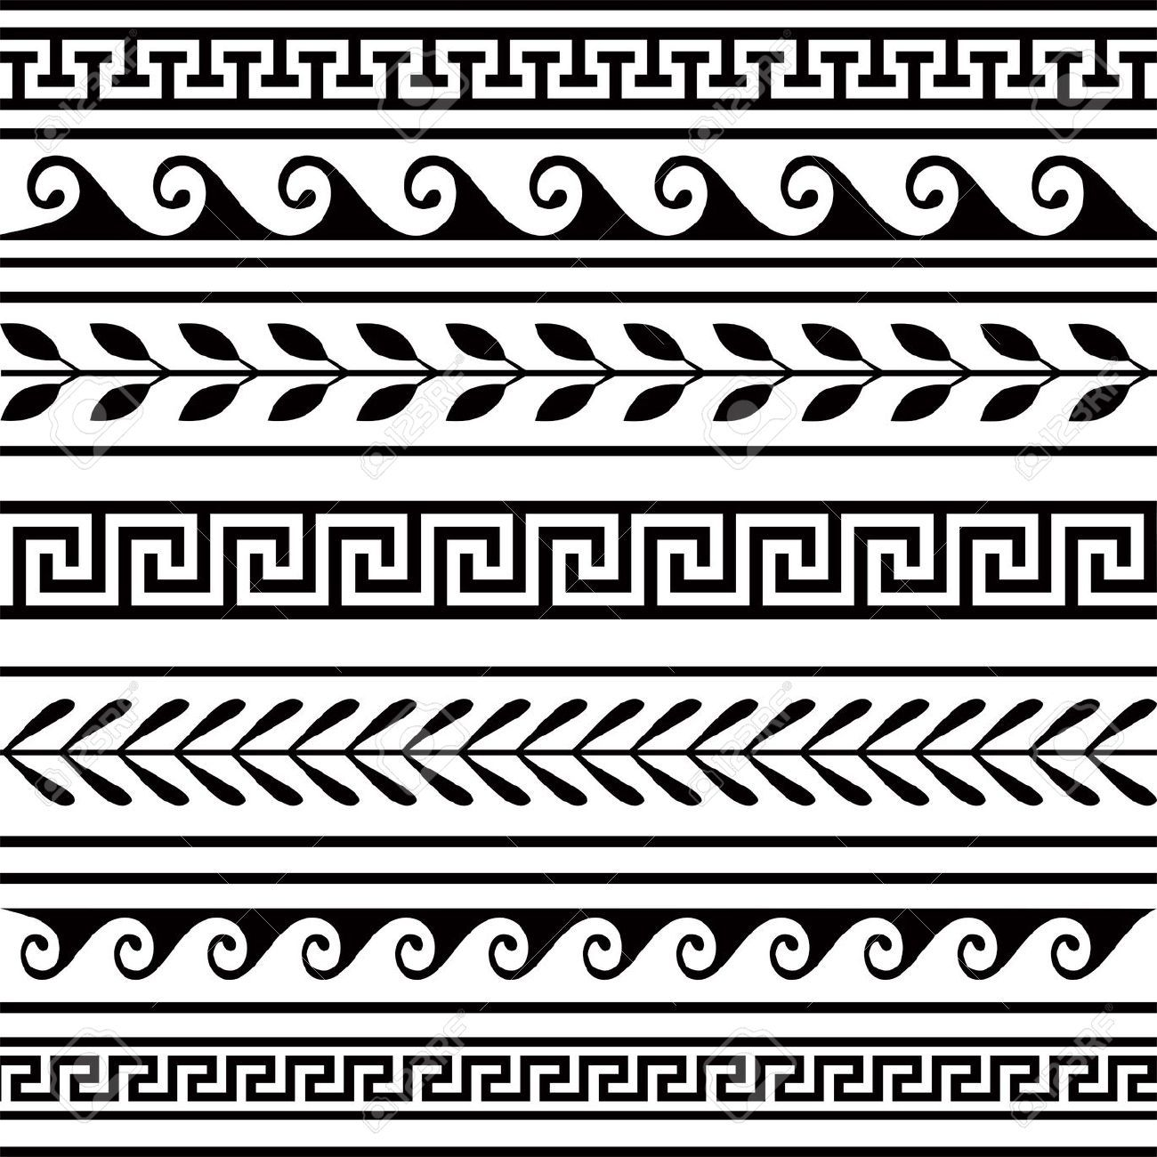
Year 7 HT 4
Greek Pots
Deliberate Practice:
Research the history of Greek Pots
Find out what the technique sgraffito is.
Design your own Greek pot based on modern day events. Your design should include pattern and images and should use colours inspired by Greek pots.
Careers Link: Ceramiscist
What objects do Ceramicists make?
Which area of the UK is famed for its pottery?
Look at the work of Grayson Perry. Can you see similarities in his work and that of the Ancient Greeks?
Key Vocabulary
Narrative, Sgraffito, Communication, Scratch, Clay, Design, Pattern, Ancient, Modern, Geometric, decoration, frieze.
Notes:
ART Knowledge Organisers - Year 7 – HT4

Slide 5
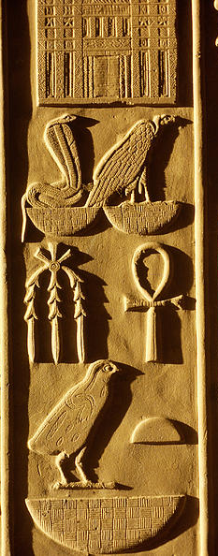
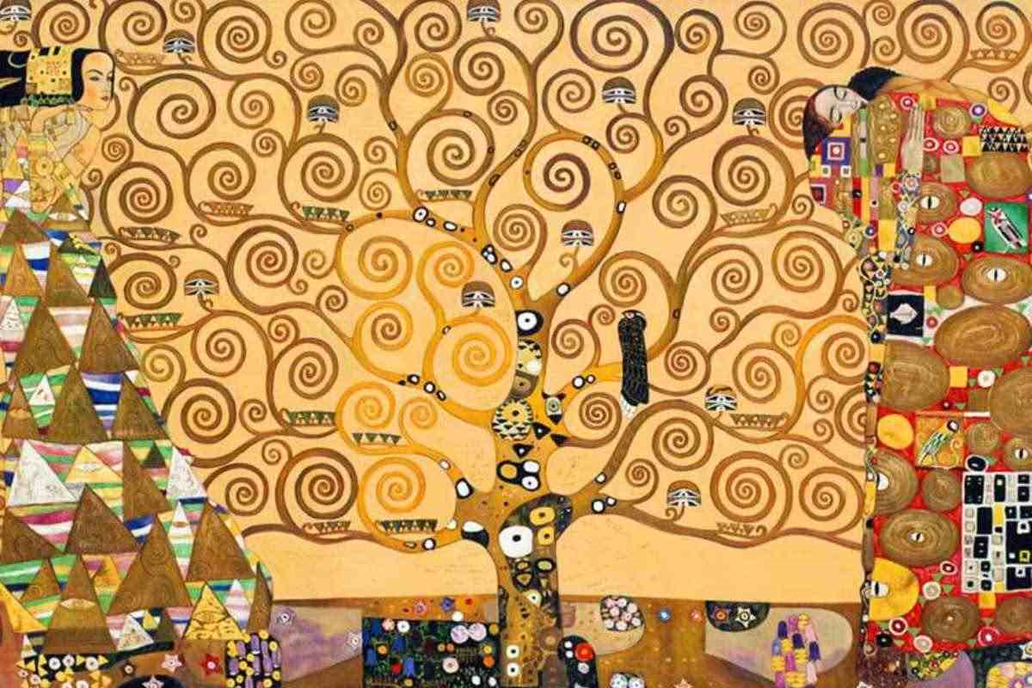
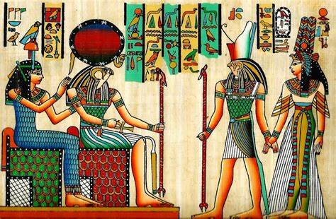
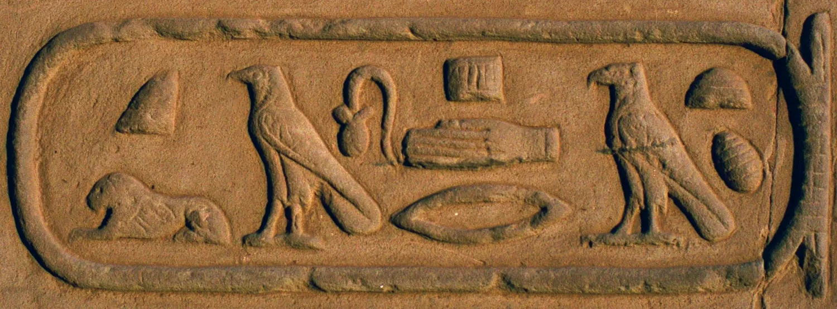
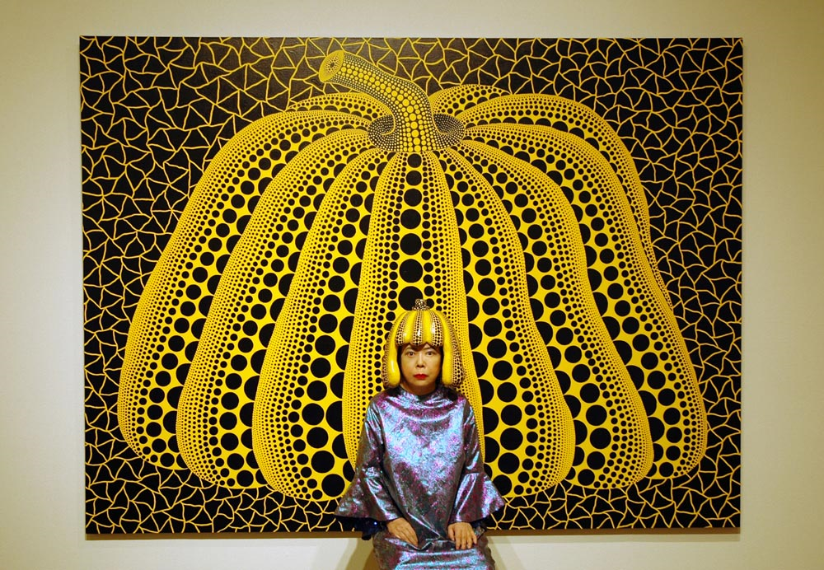
Year 7 HT5 HT6
Egyptian Art/Pattern
A pattern is a design in which lines, shapes, forms or colours are repeated. The part that is repeated is called a motif. Patterns can be regular or irregular.
The Ancient Egyptians:
“Horrible histories” Watch the video about The Egyptians from the link below.
https://youtu.be/T7WhIybg_Qo
Deliberate Practice tasks on Google classroom:
Egyptian Colour theory
Canopic Jar
Scarab beetle
Yayoi Kusama is a Japanese contemporary artist who works primarily in sculpture and installation, but is also active in painting, performance, film, fashion, poetry, fiction, and other arts.
Deliberate Practice
Have a look at the work of Kusama. Draw an everyday object and add Kusama style pattern work to it.
The painting above is by Gustav Klimt. The patterns used are more organic and based on nature.
Deliberate Practice
Create your own organic pattern design based on the work of Gustav Klimt.
Deliberate Practice
Find out the definitions for the keywords
Keywords
Repeat Symmetry Rotate Regular Irregular Organic Geometric Man-made Positive Negative Tessellation
Notes:
ART Knowledge Organisers - Year 7 – HT5 & HT6

